Slide 1
William Stallings
Computer Organization and Architecture
6th Edition
Chapter 2
Computer Evolution and Performance

Slide 2
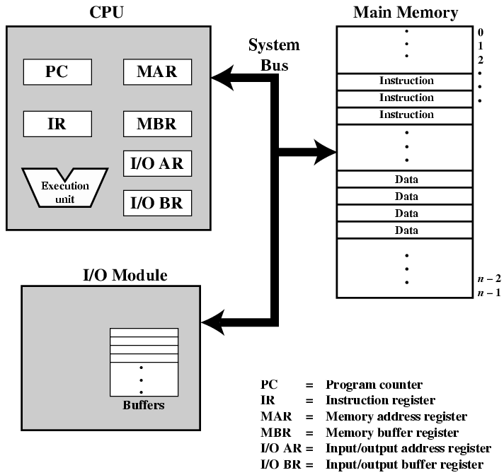
Last week: Computer:Top Level View

Slide 3
What is Computer Architecture?
Application
Gap too large to bridge in one step
Physics
In its broadest definition, computer architecture is the design of the abstraction layers that allow us to implement information processing applications efficiently using available manufacturing technologies.

Slide 4
Abstraction Layers in Modern Systems
Application
Algorithm
Programming Language
Operating System/Virtual Machines
Instruction Set Architecture (ISA)
Comp Arch
Microarchitecture
Gates/Register-Transfer Level (RTL)
Circuits
Devices
Physics

Slide 5
Architecture continually changing
Applications suggest how to improve technology, provide revenue to fund development
Improved technologies make new applications possible
Applications
Technology
Cost of software development makes compatibility a major force in market
Compatibility

Slide 6

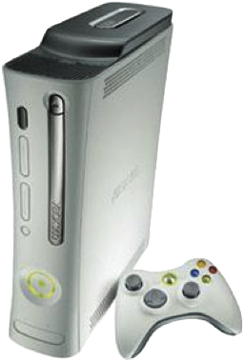
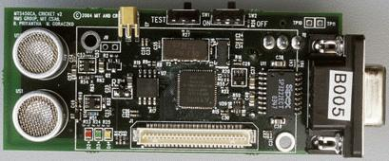
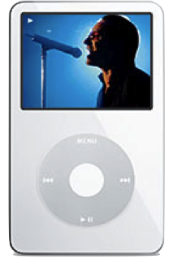
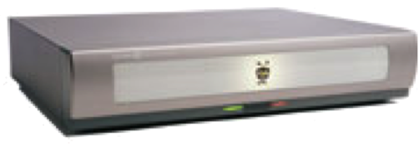
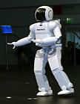
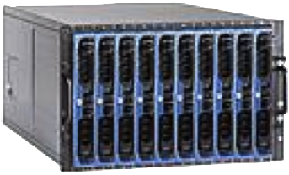
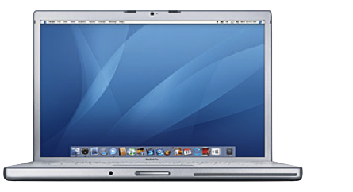
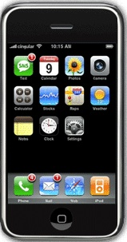
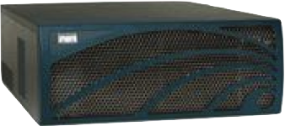
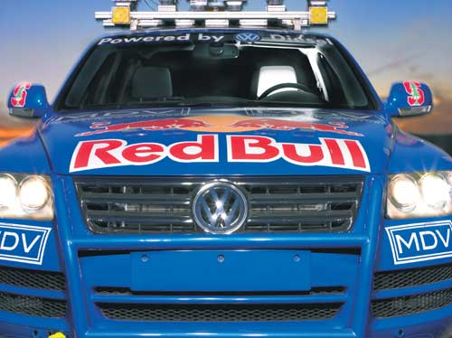
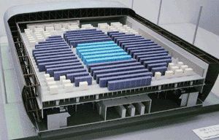
Computing Devices Now
Sensor Nets
Cameras
Games
Set-top boxes
Media Players
Laptops
Servers
Routers
Robots
Smart phones
Automobiles
Supercomputers

Slide 7
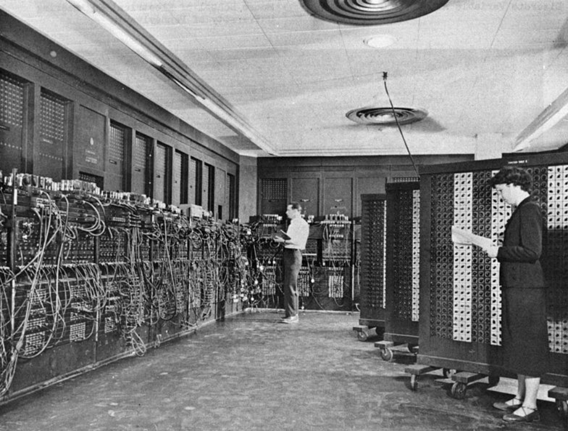
ENIAC

Slide 8
ENIAC – background -- 1G
Electronic Numerical Integrator And Computer
Eckert and Mauchly designed and built ENIAC (1943-45) at the University of Pennsylvania
The first, completely electronic, operational, general-purpose analytical calculator!
  30 tons, 72 square meters, 200KW
Performance
  Read in 120 cards per minute
  Addition took 200 μs, Division 6 ms
Not very reliable!
Trajectory tables for weapons
Started 1943, Finished 1945; Used until 1955
  Too late for war effort

Slide 9
Computer Architecture: A Little History
Sometimes we’ll use a historical event to help understand why certain ideas arose
Why worry about old ideas?
Helps to illustrate the design process, and explains why certain decisions were taken
Because future technologies might be as constrained as older ones
Those who ignore history are doomed to repeat it
  Every mistake made in mainframe design was also made in minicomputers, then microcomputers, where next?

Slide 10
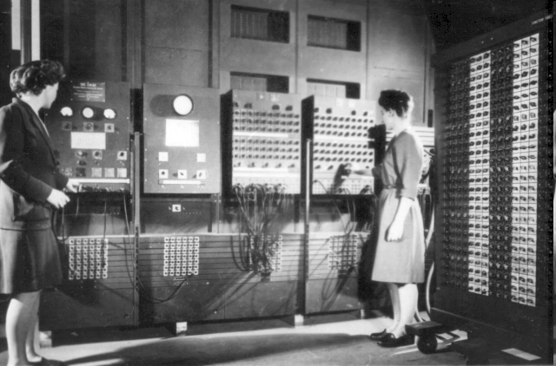
Programming in those days

Slide 11

Electronic Numerical Integrator and Computer (ENIAC)
WW-2 Effort
Application: Ballistic calculations
angle = f (location, tail wind, cross wind,
air density, temperature, weight of shell,
propellant charge, ... )
Notes:
Designers were obliged to install a ventilation shaft and a cooling system in the room. Machine had 18,000 vacuum tubes.
The slogan was: The ENIAC is able to calculate the trajectory of a large-caliber naval shell in less time than the shell takes to reach its target!
To change a program, it was necessary to change the instructions, the connector panels, and the positions of the switches all at the same time.
The inventors of ENIAC themselves admitted that, after taking into account human error, the machine only got the correct result 20 times out of 100!

Slide 12
ENIAC - details
Decimal (not binary)
20 accumulators of 10 digits
  Each accumulator had 100 vacuum tubes
  One decimal digit was represented by a ring of 10 tubes; only one “on” at a time
Programmed manually by switches
  Plug / unplug cables
18,000 vacuum tubes
30 tons
15,000 square feet
140 kW power consumption
5,000 additions per second

Slide 13
programming
Too time consuming
ENIAC’s programming system was external
  Sequences of instructions were executed independently of the results of the calculation
  Human intervention required to take instructions “out of order”
Eckert, Mauchly, John von Neumann and others designed to solve this problem
  Solution was the stored program computer
  ⇒ “program can be manipulated as data”
  both program and data were in memory
  Gets instruction from memory to execute
  Change program by setting portion of memory

Slide 14
Stored Program Computer
Program = A sequence of instructions
How to control instruction sequencing?
manual control calculators
automatic control
  internal
    plug board ENIAC 1946
    read-only memory ENIAC 1948
    read-write memory EDVAC 1947 (concept )
      The same storage can be used to store program and data

Slide 15
von Neumann/Turing
Stored Program concept
Features
  Both data and instructions (programs) are stored in a single read/write memory
  Memory contents are addressable by location, regardless of the content itself
  Sequential execution
  ALU operating on binary data
  Control unit interpreting instructions from memory and executing
  Input and output equipment operated by control unit
Princeton Institute for Advanced Studies
  IAS computer
Completed 1952

Slide 16
Paraphrased from von Neumann’s paper:
1. Since the device is primarily a computer it will have to perform the elementary operations of arithmetic most frequently. Therefore, it should contain specialized organs for just these operations, i.e., addition, subtraction, multiplication, and division.
2. The logical control of the device (i.e., proper sequencing of its operations) can best be carried out by a central control organ.
3. A device which is to carry out long and complicated sequences of operation must have a considerable memory capacity.

Slide 17
Von Neumann (cont’d)
4. The device must have organs to transfer information from the outside recording medium of the device into the central arithmetic part and central control part, and the memory. These organs form its input.
5. The device must have organs to transfer information from the central arithmetic part and central control part, and the memory into the outside recording medium. These organs form its output.

Slide 18
IAS Machine
This architecture (just described) came to be known as the “von Neumann” architecture and has been the basis for virtually every machine designed since then

Slide 19

Structure of von Neumann machine

Slide 20
IAS - details
1000 x 40 bit words
  Binary number
  2 x 20 bit instructions
Set of registers (storage in CPU)
  Memory Buffer Register
  Memory Address Register
  Instruction Register
  Instruction Buffer Register
  Program Counter
  Accumulator
  Multiplier Quotient

Slide 21

Structure of IAS – detail

Slide 22
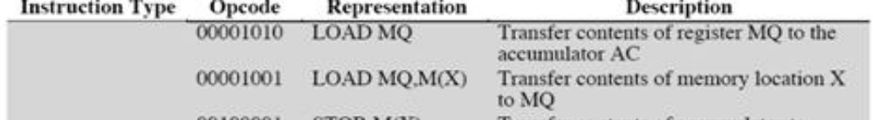
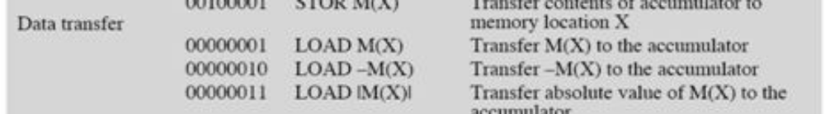
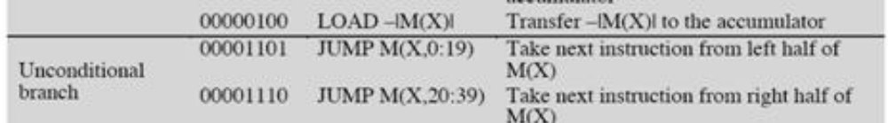
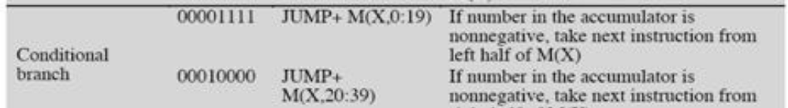
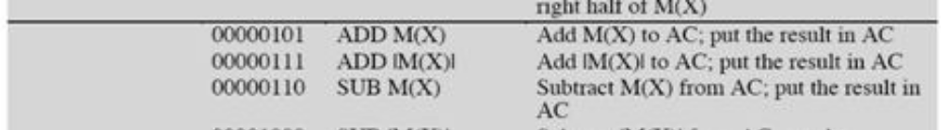
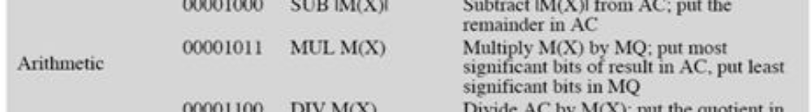
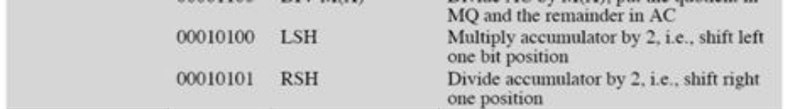
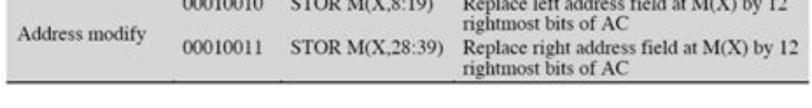
IAS Instruction Set

Slide 23
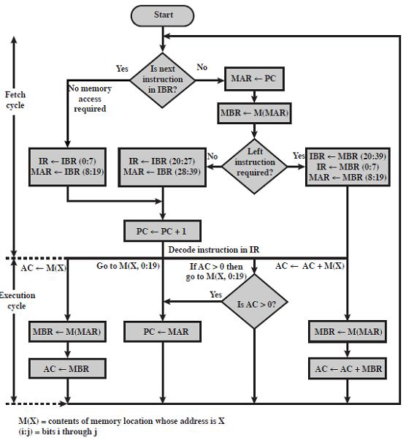
IAS Operation

Slide 24
Commercial Computers
1947 - Eckert-Mauchly Computer Corporation
UNIVAC I (Universal Automatic Computer)
  Commisioned by US Bureau of Census 1950 calculations
  First successful commercial computer
Became part of Sperry-Rand Corporation
Late 1950s - UNIVAC II
  Faster
  More memory
  Backward compatible
Developed 1100 series for scientific computation
Scientific/text processing split

Slide 25
IBM
Major manufacturer of Punched-card processing equipment
1953 - the 701
  IBM’s first stored program computer
  Scientific calculations
1955 - the 702
  Business applications
Lead to 700/7000 series
Established IBM dominance

Slide 26
Transistors -- 2G
Replaced vacuum tubes
Smaller, Cheaper, Less heat dissipation
Solid State device, Made from Silicon (Sand)
Invented 1947 at Bell Labs by William Shockley et al.
Used in computers in the late 1950’s
Defined the “second generation” of computers

Slide 27
Transistor Based Computers
Second generation machines
NCR & RCA produced small transistor machines
IBM 7000
DEC - 1957
  Produced PDP-1
  First in series of PDP machines that marked a radical shift in philosophy of computer design: focus interaction with user rather than efficient use of computer cycles

Slide 28
Hacker culture
“Hacker” used to mean someone who loved to play with computers
DEC PDP computers led to the development of hacker cultures at MIT, BBN and elsewhere
Developed music programs and the first computer game Spacewar!
The hacker culture lives on in the open source movement
See http://www.computerhistory.org/pdp-1/index.php

Slide 29
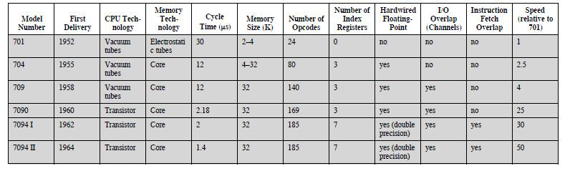
The IBM 7094
• Last of the 7000 series
• Illustrates evolution of a computer family

Slide 30
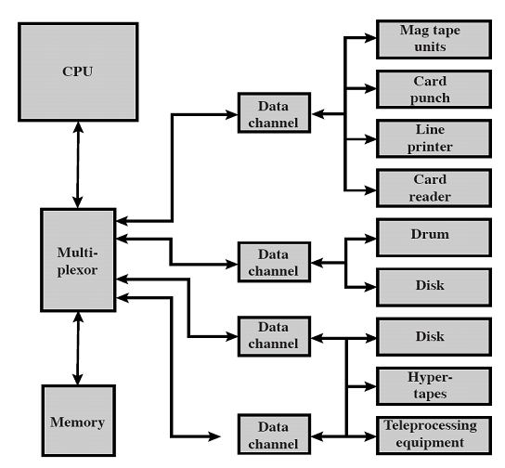
An IBM 7094 Configuration

Slide 31
Integrated Circuits; 3rd Generation
Transistors are “discrete components”
Manufactured in own container; soldered to circuit board
Early 2nd generation: 10,000 discrete transistors
Later computers several hundred thousand
1958: Integrated circuits (ICs)
  Many transistors on piece of silicon
— Defines 3rd generation of computers
Two most important 3rd generation computers were the IBM System 360 and the DEC PDP-8

Slide 32
How many transistors on one chip?
Intel: see
http://www.intel.com/pressroom/kits/quickreffam.htm
8086: 29,000
80386: 275,000
Original Pentium: 3.1 million
Pentium IV: up to 169 million
Itanium: up to 1.72 billion

Slide 33
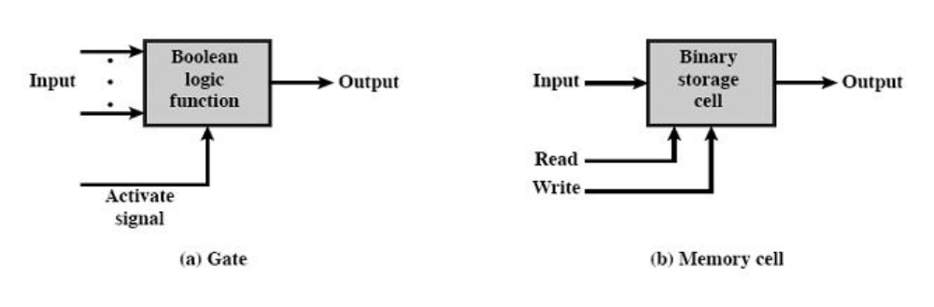
Computer Components
Only two basic components are needed to create a computer: gates and memory cells
Each component is composed of multiple transistors

Slide 34
Four basic functions
Data Storage: memory cells
Data Processing: gates
Data Movement: connections (paths) between gates and memory cells
Control: control signals activate gates and memory and determine whether memory access is read or write
Gates, memory cells and interconnections can be etched into a single piece of silicon

Slide 35
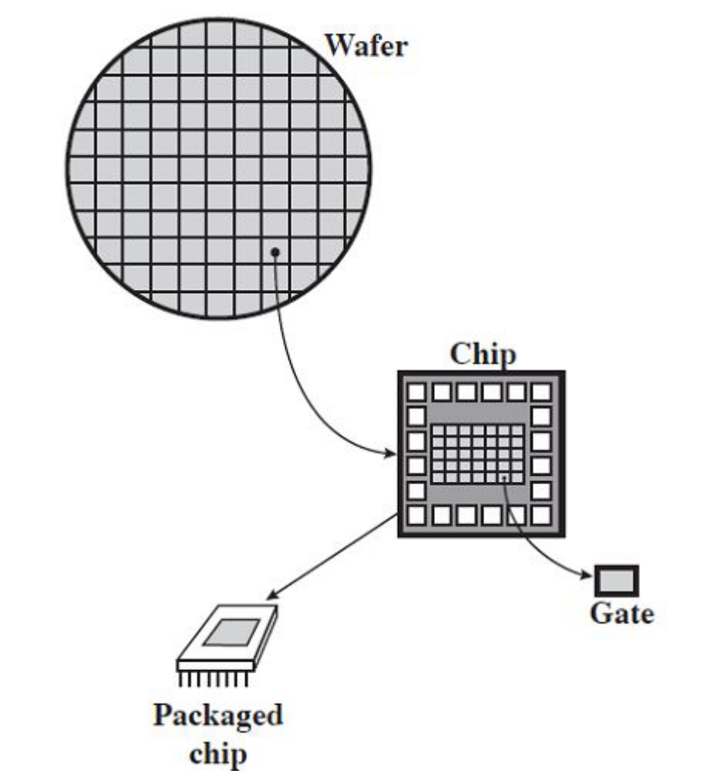
Chip manufacturing

