Slide 1
Chapter 2
Computer Evolution and Performance (cont’d)

Slide 2
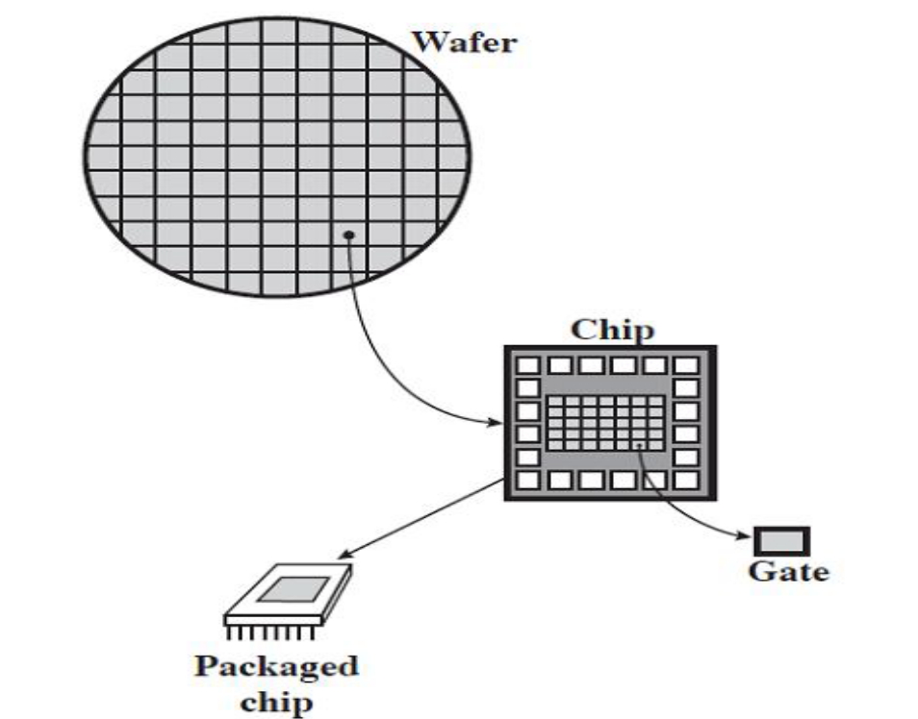
Microelectronics
Literally - “small electronics”
A computer is made up of gates, memory cells and interconnections
These can be manufactured on a semiconductor e.g. silicon wafer

Slide 3
Moore’s Law
Gordon Moore – co-founder of Intel
Predicted that the number of transistors on a chip will double every year
Since 1970’s development has slowed a little
  Number of transistors doubles every 18 months
Cost of a chip has remained almost unchanged
Higher packing density means shorter electrical paths, giving higher performance
Smaller size gives increased flexibility
Reduced power and cooling requirements
Fewer interconnections increases reliability

Slide 4
Generations of Computer
Vacuum tube - 1946-1957
Transistor - 1958-1964
Small scale integration - 1965 on
  Up to 100 devices on a chip
Medium scale integration - to 1971
  100-3,000 devices on a chip
Large scale integration - 1971-1977
  3,000 - 100,000 devices on a chip
Very large scale integration - 1978 to date
  100,000 - 100,000,000 devices on a chip
Ultra large scale integration
  Over 100,000,000 devices on a chip

Slide 5
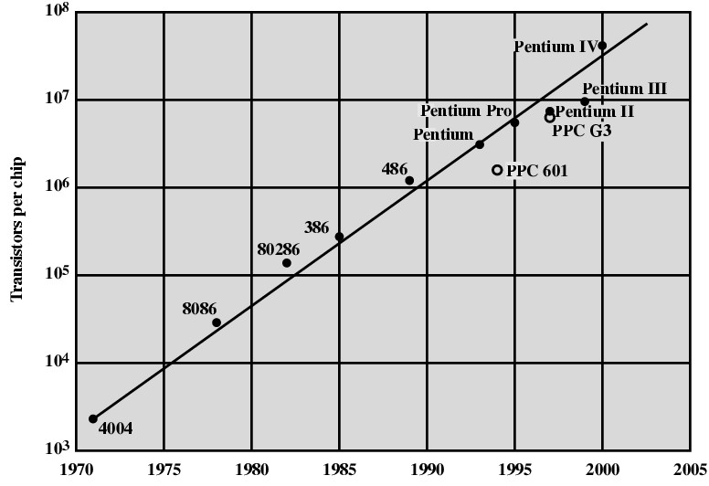
Growth in CPU Transistor Count

Slide 6
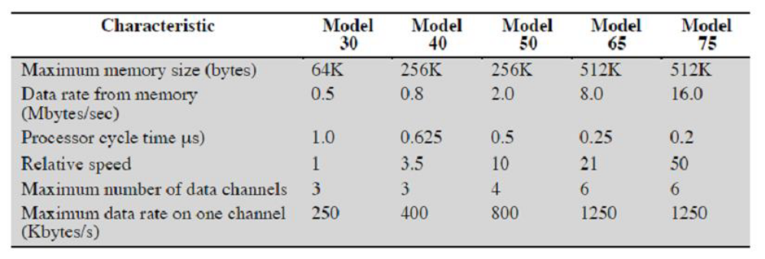
IBM 360 series (1964)
Replaced (&not compatible with) 7000series;1st planned family of computers
  Similar or identical instruction sets
  Similar or identical O/S
  Increasing speed
  Increasing number of I/O ports (i.e. more terminals)
  Increased memory size;
  Increased cost

Slide 7
System 360
Differences were:
  Complexity of ALU circuitry allowing parallel execution
  Increased bus width allowing faster data transfer
The 360 family gave IBM a huge market share
Architecture still used for IBM mainframes

Slide 8
DEC PDP-8 (1964)
First minicomputer
Did not need air conditioned room
Small enough to sit on a lab bench
$16,000
  vs. $100k+ for IBM 360
Embedded applications & OEM
Introduced BUS STRUCTURE (vs. central-switched IBM architecture)

Slide 9
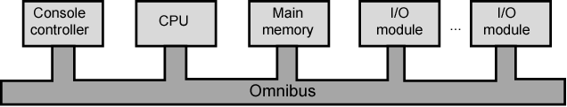
DEC - PDP-8 Bus Structure
96 separate signal paths carry address, data and control signals
Easy to plug new modules into bus
Bus is controlled by CPU
Now virtually universal in microcomputers

Slide 10
Beyond 3rd Generation
Classification by generation became less meaningful after the early 1970’s due to rapid pace of technological development
Two main developments are still being worked out:
  Semiconductor memory
  Microprocessors

Slide 11
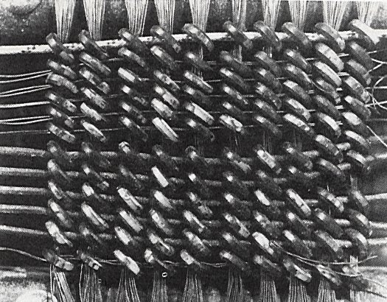
Magnetic Core Memory
Mostly assembled by hand;
Each bit stored in a small iron ring(core, about 1/16” diameter); magnetized one way:1, other way:0
Reads are destructive; restore needed
See http://www.columbia.edu/acis/history/core.html

Slide 12
Semiconductor Memory
First developed in 1970 by Fairchild
Chip size = size of a single core (i.e. 1 bit of magnetic core storage)
Holds 256 bits
Non-destructive read
Much faster than core
1974, cheaper than core memory (price per bit)
Capacity (density of elements) approximately doubles each year
Gens:1K,4K,16K,64K,256K,1M, 4M, 16M, 64M, 256M
GBs chips now available

Slide 13
Intel Microprocessors
1971 - 4004
  First microprocessor
  All CPU components on a single chip
  4 bit; add, multiply=repeated add
Followed in 1972 by 8008
  8 bit
  Both designed for specific applications
1974 - 8080
  Intel’s first general purpose microprocessor
  8-bit
  Richer instruction set
  Large addressing capability

Slide 14
16 and 32 bit processors
16-bit processors (8086) were introduced in the late 1970’s
First 32-processors were introduced in 1981 (Bell Labs and Hewlett-Packard)
Intel’s 32-bit processor did not arrive until 1985 (80386)
64-bit processor: Pentium Pro (1995), ...

Slide 15
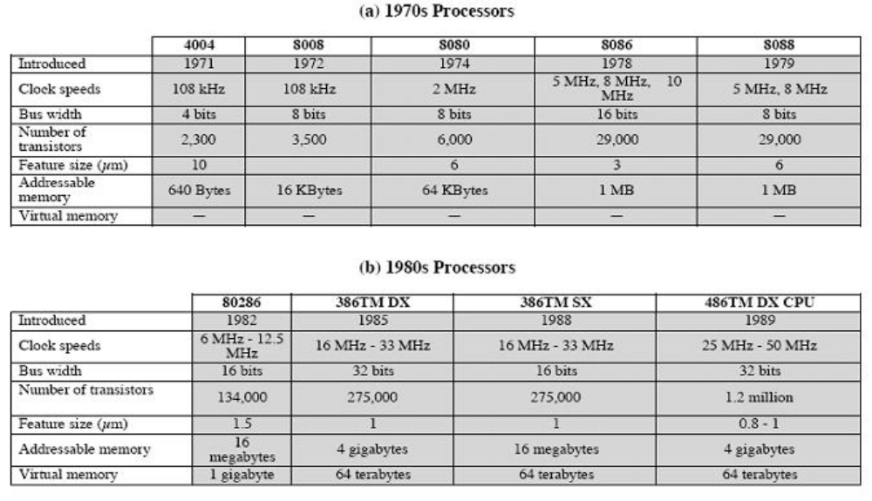
Intel x86 Processors 1971 - 1989

Slide 16
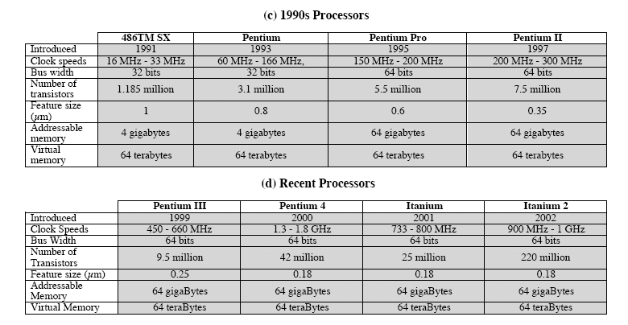
Intel x86 Processors 1990 - 2002

Slide 17
Processing Power
Today’s $400 personal computer has more computing power than a 1990 mainframe
Much of this is gobbled up by bloated operating systems (e.g., Windows)
But many PC applications are only possible with great processing capability:
  Image processing
  Video Editing
  Speech recognition
  Simulation modeling
  Multimedia authoring
  Servers for database and transaction processing

Slide 18
Design for Performance: Speeding it up
Some techniques for performance increase
Pipelining
On board cache
On board L1 & L2 cache
Branch prediction
Data flow analysis
Speculative execution

Slide 19
Pipelining: Idea
Increases the Throughput of the Processor
Don’t focus on trying to speedup individual instructions
Instead focus on throughput i.e. number of instructions executed per unit time
Like an assembly line
Instruction execution is divided into stages
When one stage has completed, that circuitry is free to operate on the “next” instruction
At any moment, multiple instructions get processed, each instruction on a different stage.

Slide 20





Pipelining Example
Consider a sandwich shop with a five step process
  Take order
  Bread
  Cheese
  Meat
  Veggies
One employee can do the job
Now imagine 5 employees making sandwiches

Slide 21
Pipeline Math
If it takes one person 5 minutes to make a sandwich
And we pipeline the process using 5 people each taking a minute
And we start making sandwiches constantly (i.e. ignore startup pipeline filling)
How long does it actually take to make a single sandwich (Real elapsed time)
What is the effective time to produce a sandwich? (i.e. a sandwich exits from the pipeline every how many minutes?)

Slide 22
Towards an instruction processing assembly line
Macro State Functional Units in Use_______________
FETCH IR ALU PC MEM
DECODE IR
EXECUTE (ADD) IR ALU Reg-file
Without Pipeline With Pipeline
instructions
instructions
I₄
F
D
E
I₄
F
D
E
I₃
F
D
E
I₃
F
D
E
I₂
F
D
E
I₂
F
D
E
I₁
F
D
E
I₁
F
D
E
time
time

Slide 23
Cache Memory
Reality…
Processors have cycle times of ~1 ns
Fast DRAM has a cycle time of ~100 ns
We have to bridge this gap to be effective!
Idea: Very fast memory stores copies of data in slow main memory
Can be onboard (same chip as processor) or in separate chips

Slide 24
The Concept of a Cache
Feasible to have small amount of fast memory and/or large amount of slow memory.
Increasing speed as we get closer to the processor
Increasing size as we get farther away from the processor
CPU looks in cache for data it seeks from main memory.
If data not there it retrieves it from main memory.
If the cache is able to service "most" CPU requests then effectively we will get speed advantage of cache.
All addresses in cache are also in memory
CPU
Cache
Main memory

Slide 25
Branch Prediction
Processor looks ahead in instruction stream and attempts to predict which branch will be taken by conditional code
Execute predicted branch and hope it’s right
Wrong guess leads to pipeline stall

Slide 26
Data Flow Analysis
Processor examines code to determine which instructions are dependent on results of instructions in pipeline
Reorders instructions in code so that independent instructions can be executed in parallel pipelines

Slide 27
Speculative Execution
With branch prediction and data flow analysis processor can execute some instructions before they appear in the execution stream
Results stored in temporary locations

Slide 28
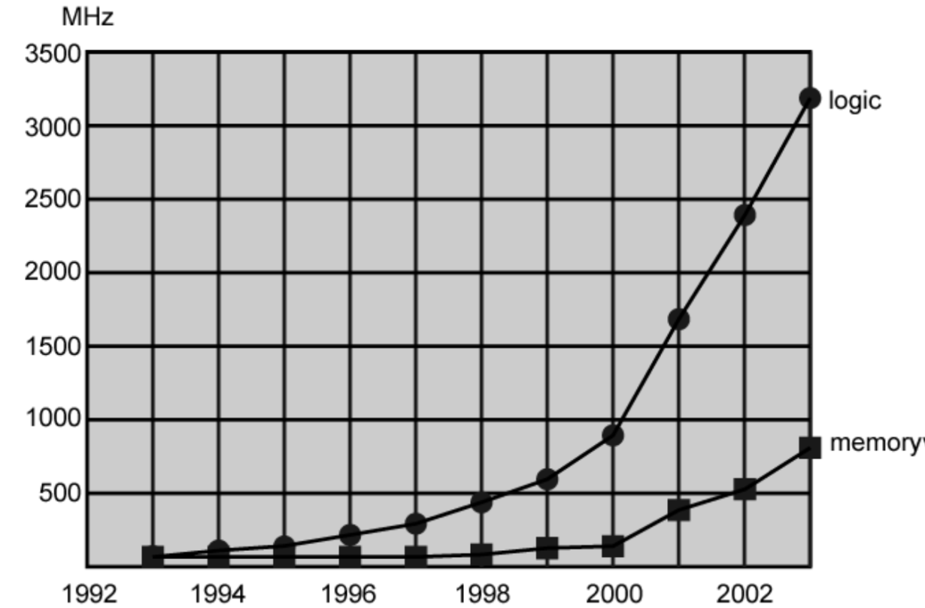
Performance Mismatch
Processor speed increased
Memory capacity increased
BUT: Memory speed lags behind processor speed

Slide 29
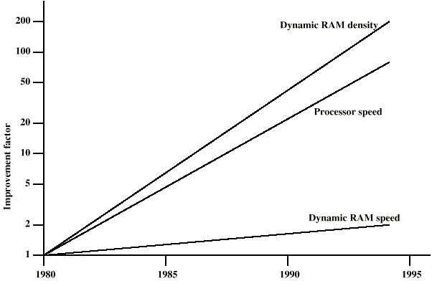
DRAM and Processor Characteristics

Slide 30
Solution
Increase number of bits retrieved at one time
  Make DRAM “wider” rather than “deeper”
  DDR(double data rate), DDR2, DDR3, DDR4
Change DRAM interface
  Cache
Reduce frequency of memory access
  More complex cache and cache on chip
Increase interconnection bandwidth
  High speed buses
  Hierarchy of buses

Slide 31
I/O Devices
Peripherals with intensive I/O demands
Large data throughput demands
Processors can handle this
But there are problems moving data between processor and peripheral
Solutions:
  Caching
  Buffering
  Higher-speed interconnection buses
  More elaborate bus structures
  Multiple-processor configurations

Slide 32
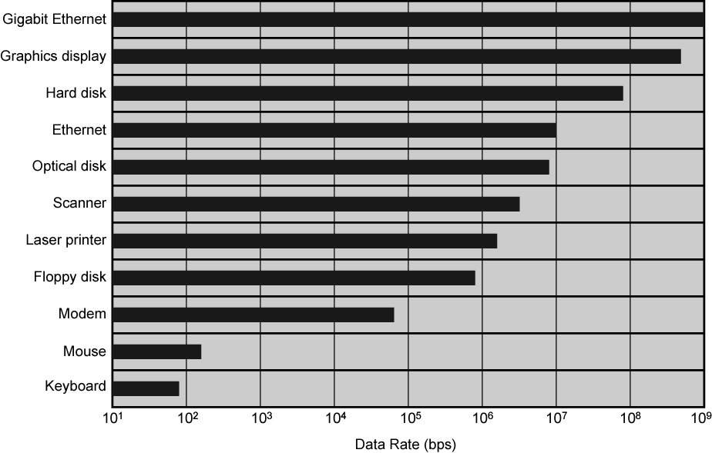
Typical I/O Device Data Rates

Slide 33
Key is Balance
Processor components
Main memory
I/O devices
Interconnection structures

Slide 34
Increased Cache Capacity
Typically two or three levels of cache between processor and main memory
Chip density increased
  More cache memory on chip
  Faster cache access
Pentium chip devoted about 10% of chip area to cache
Pentium 4 devotes about 50%

Slide 35
More Complex Execution Logic
Enable parallel execution of instructions
Pipeline works like assembly line
  Different stages of execution of different instructions at same time along pipeline
Superscalar processing allows multiple pipelines within single processor
  Instructions that do not depend on one another can be executed in parallel

Slide 36
Diminishing Returns
Internal organization of processors complex
  Can get a great deal of parallelism
  Further significant increases likely to be relatively modest
Benefits from cache are reaching limit
Increasing clock rate runs into power dissipation problem
  Some fundamental physical limits are being reached

Slide 37
New Approach – Multiple Cores
Multiple processors on single chip
  Large shared cache
Within a processor, increase in performance proportional to square root of increase in complexity
If software can use multiple processors, doubling number of processors almost doubles performance
So, use two simpler processors on the chip rather than one more complex processor
With two processors, larger caches are justified
  Power consumption of memory logic less than processing logic
Example: IBM POWER4
  Two cores based on PowerPC

Slide 38
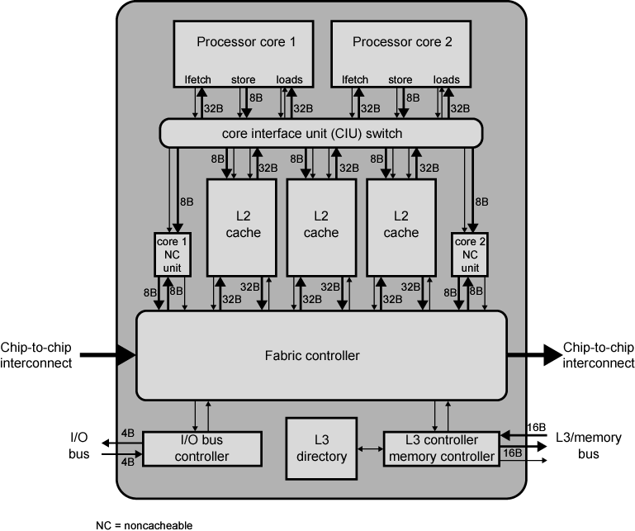

POWER4 Chip Organization

Slide 39
Pentium Evolution (1)
8080
  first general purpose microprocessor
  8 bit data path
  Used in first personal computer – Altair
8086
  much more powerful
  16 bit
  instruction cache, prefetch few instructions
  8088 (8 bit external bus) used in first IBM PC
80286
  16 Mbyte memory addressable
  up from 1Mb
80386
  32 bit
  Support for multitasking

Slide 40
Pentium Evolution (2)
80486
  sophisticated powerful cache and instruction pipelining
  built in maths co-processor
Pentium
  Superscalar
  Multiple instructions executed in parallel
Pentium Pro
  Increased superscalar organization
  Aggressive register renaming
  branch prediction
  data flow analysis
  speculative execution

Slide 41
Pentium Evolution (3)
Pentium II
  MMX technology
  graphics, video & audio processing
Pentium III
  Additional floating point instructions for 3D graphics
Pentium 4
  Note Arabic rather than Roman numerals
  Further floating point and multimedia enhancements
Itanium
  64 bit
  see chapter 15
See Intel web pages for detailed information on processors

Slide 42
Internet Resources
http://www.intel.com/
  Search for the Intel Museum
http://www.ibm.com
http://www.dec.com
Charles Babbage Institute
PowerPC
Intel Developer Home

