Slide 1
William Stallings
Computer Organization and Architecture
6th Edition
Chapter 3
Computer Function and Buses

Slide 2
Program Concept
Hardwired systems are inflexible
General purpose hardware can do different tasks, given correct control signals
Instead of re-wiring, supply a new set of control signals

Slide 3
What is a program?
A sequence of steps
For each step, an arithmetic or logical operation is done
For each operation, a different set of control signals is needed

Slide 4
Function of Control Unit
For each operation a unique code is provided
  e.g. ADD, MOVE
  that generates coorect control signals
A hardware segment(control unit) accepts the code and issues the control signals
Typical outputs from control unit
  Drive signals: DrPC, DrALU, DrREG, DrMEM
  Load signals: LdPC, LdMAR, LdIR
  Write Memory signal: WrMEM
  Write Registers signal: WrREG
  ALU function selector: func
  Register selector: regno
We have a computer!

Slide 5
Components
The Control Unit and the Arithmetic and Logic Unit constitute the Central Processing Unit(CPU)
Data and instructions need to get into the system and results out
  Input/output
Temporary storage of code and results is needed
  Main memory

Slide 6
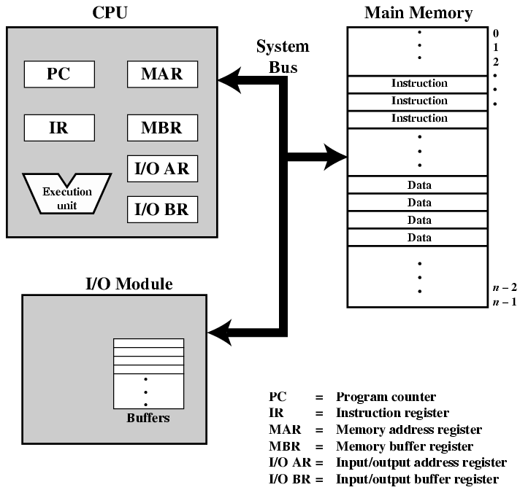
Computer Components:
Top Level View

Slide 7

CPU Instruction Cycle
Two steps:
  Fetch
  Execute

Slide 8
Fetch Cycle
Program Counter (PC) holds address of next instruction to fetch
Processor fetches instruction from memory location pointed to by PC
Increment PC
  Unless told otherwise
Instruction loaded into Instruction Register (IR)

Slide 9
FETCH macro state
Need to do
  We need to send PC to the memory
  Read the memory contents
  Bring the memory contents read into the IR
  Increment the PC
Microstates to accomplish
  ifetch1
    PC → MAR
  ifetch2
    MEM[MAR] → IR
  ifetch3
    PC → A
  ifetch4
    A+1 → PC

Slide 10
FETCH macro state (Simplifying)
ifetch1
  PC → MAR
  PC → A
ifetch2
  MEM[MAR] → IR
ifetch3
  A+1 → PC

Slide 11
Execute Cycle
Processor interprets instruction (decode) and performs required actions
Actions:
  Processor-memory
    data transfer between CPU and main memory
  Processor-I/O
    Data transfer between CPU and I/O module
  Data processing
    Some arithmetic or logical operation on data
  Control
    Alteration of sequence of operations
    e.g. jump
  Combination of above

Slide 12
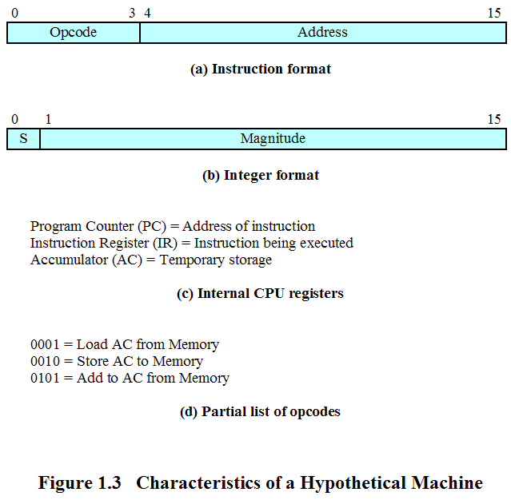
Varsayımsal Bir Makina (Hypothetical Machine)

Slide 13
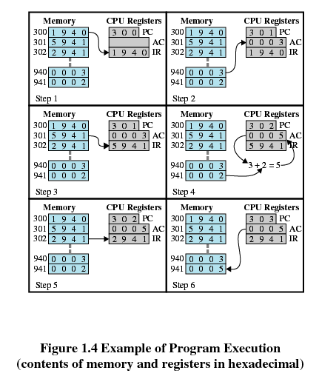
Program Çalışma Örneği

Slide 14
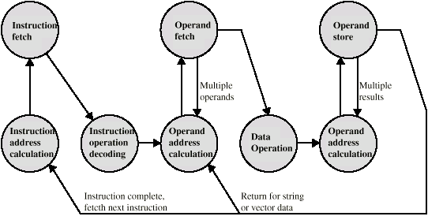
Instruction Cycle -
State Diagram

Slide 15
Interrupts
Interrupts, traps and exceptions are discontinuities in program flow
Students asking a teacher questions in a classroom is a good analogy to the handling of discontinuities in program flow
Mechanism by which other modules (e.g. I/O) may interrupt normal sequence of processing
Program
  e.g. overflow, division by zero
Timer
  Generated by internal processor timer
  Used in pre-emptive multi-tasking
I/O
  from I/O controller
Hardware failure
  e.g. memory parity error

Slide 16
Discontinuities in program execution
We must first understand
  Synchronous events: Occur at well defined points aligned with activity of the system
    Making a phone call
    Opening a file
  Asynchronous events: Occur unexpectedly with respect to ongoing activity of the system
    Receiving a phone call
    A user presses a key on a keyboard

Slide 17
Discontinuities in program execution
There is no universally accepted set of definitions for interrupts, traps and exceptions so we will use these
  Interrupts: Asynchronous events usually produced by I/O devices which must be handled by the processor by interrupting execution of the currently running process
  Traps: Synchronous events produced by special instructions typically used to allow secure entry into operating system code
  Exceptions: Synchronous events usually associated with software requesting something the hardware can’t perform i.e. illegal addressing, illegal op code, etc.

Slide 18
Dealing with...
Can happen anywhere even in the middle of an instruction execution.
Unplanned for and forced by the hardware. Hardware has to save the program counter since we are jumping to the handler.
Address of the handler is unknown. Therefore, hardware must manufacture address.
Since hardware saved PC, handler has to discover where to return upon completion.

Slide 19
Architectural enhancements
When should the processor handle an interrupt?
How does the processor know there is an interrupt?
How do we save the return address?
How do we manufacture the handler address?
How do we handle multiple cascaded interrupts?
How do we return from the interrupt

Slide 20
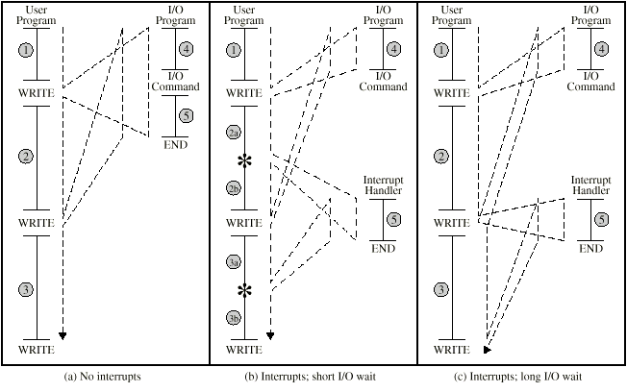
Program Flow Control

Slide 21
Interrupt Cycle
Added to instruction cycle
Processor checks for interrupt
  Indicated by an interrupt signal
If no interrupt, fetch next instruction
If interrupt pending:
  Suspend execution of current program
  Save context
  Set PC to start address of interrupt handler routine
  Process interrupt
  Restore context and continue interrupted program

Slide 22
A simple interrupt handler
Handler:
save processor registers;
execute device code;
restore processor registers;
return to original program;

Slide 23

Transfer of Control via Interrupts

Slide 24

Instruction Cycle with Interrupts

Slide 25
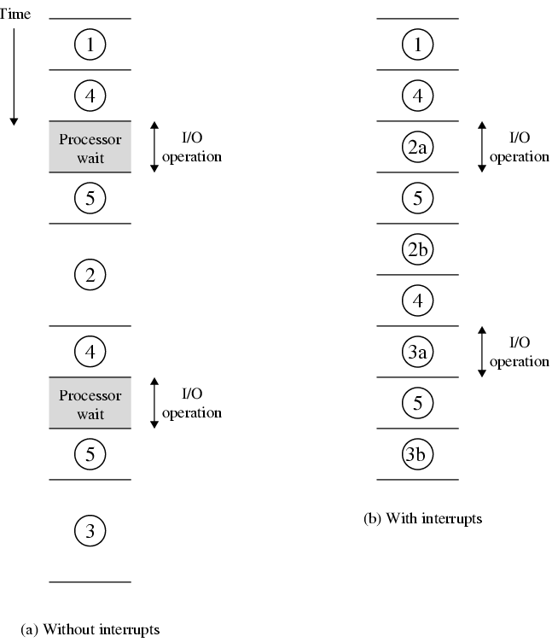
Program Timing
Short I/O Wait

Slide 26
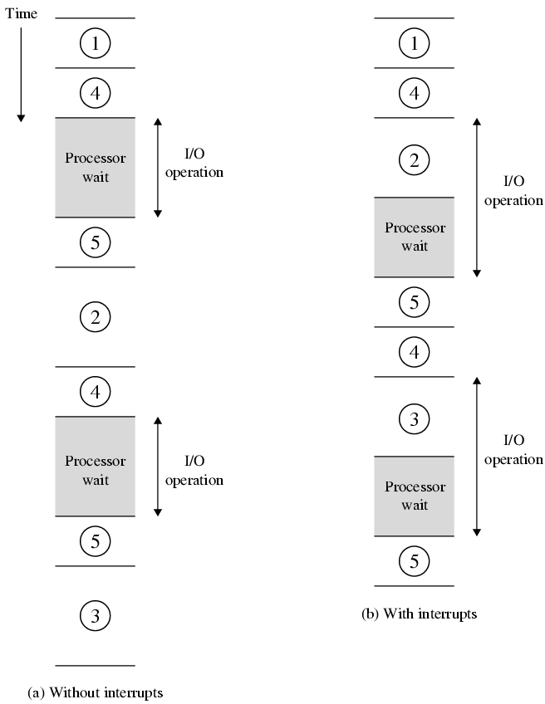
Program Timing
Long I/O Wait

Slide 27
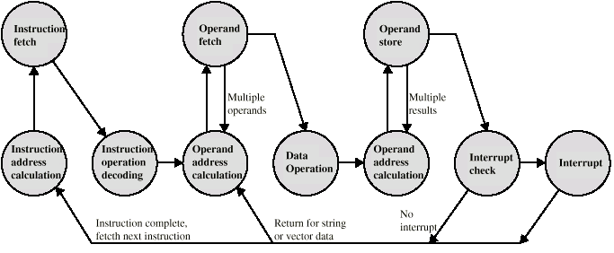
Instruction Cycle (with Interrupts) - State Diagram

Slide 28
Multiple Interrupts
Disable interrupts
  Processor will ignore further interrupts whilst processing one interrupt
  Interrupts remain pending and are checked after first interrupt has been processed
  Interrupts handled in sequence as they occur
Define priorities
  Low priority interrupts can be interrupted by higher priority interrupts
  When higher priority interrupt has been processed, processor returns to previous interrupt

Slide 29

Multiple Interrupts - Sequential

Slide 30
A simple interrupt handler
Handler:
save processor registers;
execute device code;
restore processor registers;
enable ints
return to original program;

Slide 31
Multiple Interrupts – Nested

Slide 32

Time Sequence of Multiple Interrupts

