Slide 1
William Stallings
Computer Organization and Architecture
6th Edition
Chapter 3
Computer Function and Buses (cont’d)

Slide 2
I/O Function and Direct Memory Access (DMA)
An I/O device (e.g., disk controller) can exchange data directly with the processor
Just as the processor can read data from memory and write data to memory, it can also read data from I/O devices and write data to I/O devices
In some cases it may be desirable to allow I/O devices to exchange data directly with memory
The processor will “grant permission” for this exchange to take place
Processor can then proceed to other work (provided that it does not use the bus granted to the I/O device)
This operation is called Direct Memory Access (DMA)

Slide 3
Interconnection Structures
All the components of a computer must be connected
Think of a computer as a network of memory, I/O and CPU devices
Different type of connection needed for each type of unit
  Memory
  Input/Output
  CPU

Slide 4
Memory and Memory Connection
Memory consists of n words of equal length numbered from 0 to n-1
A word of data can be read or written
Control signals specify R/W operation at location specified by address
Needs three sets of signal lines:
  Data (to receive and send data)
  Address (to receive addresses of locations)
  Control (R/W and timing, to receive control signals)

Slide 5
I/O Module and I/O Connection
I/O is functionally similar to memory, but usually much slower
Like memory, can read and write, but a single I/O module may handle more than one device
Each interface of an I/O device is referred to as a port and given a unique address
I/O devices also have external connections
Ports numbered 0 to M-1 for M ports. Think of port as an address in I/O space
I/O devices can also generate interrupts
Output:
  Receive data from computer and send data to peripheral
Input
  Receive data from peripheral and send data to computer

Slide 6
I/O Module and I/O Connection
Receive control signals from computer
Send control signals to peripherals
  e.g. spin disk
Receive addresses from computer
  e.g. port number to identify peripheral
Send interrupt signals (control)

Slide 7
Processor
Reads in instructions and data from memory
Writes out data after processing
Uses control signals to control overall operation
Receives interrupt signals (and can generate them also, e.g., divide by 0) and acts on it

Slide 8

Computer Modules

Slide 9
Types of data transfers
Memory to Processor
Processor to Memory
I/O to processor
Processor to I/O
I/O to memory
I/O from memory

Slide 10
Buses
There are a number of possible interconnection systems. Single/multiple bus structures:most common
A bus is a shared communications pathway between devices
e.g.Control/Address/Data bus, Unibus (DEC-PDP)
Because a bus is shared:
  Only one device can transmit at a time
  Signals can be received by multiple devices
  A bus is therefore a broadcast device
A bus contains multiple signal lines
  Each can handle one bit of data
  To transmit one byte of data in parallel, 8 data lines are needed

Slide 11
System Bus
Computers normally contain several buses
The bus that interconnects major components (processor, memory, I/O module) is called the system bus
A system bus typically contains from 50 to several hundred lines
Lines are grouped
  Major groupings are data, address and control signals
  Power lines may not be shown in bus diagrams

Slide 12
Bus Components (Functionally)
Functionally, bus has following components:
  Address lines
  Data lines
  Command (control) lines
  Interrupt lines
  Interrupt acknowledge lines
  Bus arbitration lines

Slide 13

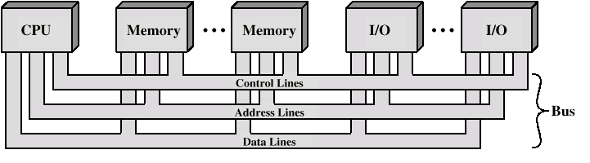
Bus Interconnection Scheme

Slide 14
Data Bus
Carries data
  Remember that there is no difference between “data” and “instruction” at this level
Width (genişlik) is a key determinant of performance
  8, 16, 32, 64, 128 bits
Determines amount of data sent to processor in one bus cycle
  8088 16-bit processor, 8-bit bus
  Pentium 32-bit processor, 64-bit bus
  Some internal processor buses have 256 bits

Slide 15
Address bus
Identify the source or destination of data
e.g. CPU needs to read an instruction (data) from a given location in memory
Bus width determines maximum memory capacity of system
  e.g. 8080 has 16 bit address bus giving 64k address space
  n bus lines can address 2^{n} words (usually bytes) of memory

Slide 16
Control Bus
Transmits control and timing information
  Memory read/write signal
  Interrupt request
  Clock signals
Timing signals indicate when bus lines are valid
Control signals specify operations to be performed

Slide 17
Typical Control Signals
Memory write signal
  Data on the bus to be written into addressed location
Memory read signal
  Data from addressed location to be placed on bus
I/O read/write signals
Bus request/grant: a module needs to gain control of the bus, / control is granted
Transfer ACK (acknowledgement)
  Indicates that data have been accepted from/placed on bus
Interrupt Request/ACK
Clock signals synchronize operations
Reset: initializes all modules

Slide 18
Basic Bus Operation
Module that wishes to send data must
  Obtain use of the bus
  Then transfer data
Module that requests data from another module must
  Obtain use of the bus
  Transfer request to other module over bus
  Wait for data to be written to the bus

Slide 19
Big and Yellow?
What do buses look like?
  Parallel lines on circuit boards
  Ribbon cables
  Strip connectors on mother boards
    e.g. PCI
  Sets of wires
With VLSI, many components (such as L1 cache) are on the same chip as the processor
An on-chip bus connects these components

Slide 20
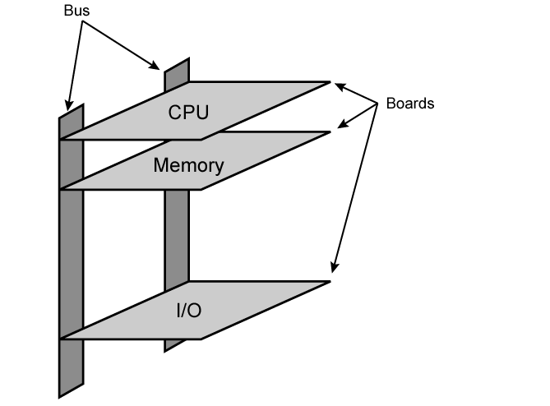
Physical Realization of Classic PC bus

Slide 21
Peripheral Devices
Device | Input/output | Human in the loop | Data rate (circa 2008) | PIO | DMA
Keyboard | Input | Yes | 5-10 bytes/sec | X
Mouse | Input | Yes | 80-200 bytes/sec | X
Graphics display | Output | No | 200-350 MB/sec |  | X
Disk (hard drive) | Input/Output | No | 100-200 MB/sec |  | X
Network (LAN) | Input/Output | No | 1 Gbit/sec |  | X
Modem | Input/Output | No | 1-8 Mbit/sec |  | X
Inkjet printer | Output | No | 20-40 KB/sec | X | X
Laser printer | Output | No | 200-400 KB/sec |  | X
Voice (microphone/speaker) | Input/Output | Yes | 10 bytes/sec | X
Audio (music) | Output | No | 4-500 KB/sec |  | X
Flash memory | Input/Output | No | 10-50 MB/sec |  | X
CD-RW | Input/Output | No | 10-20 MB/sec |  | X
DVD-R | Input | No | 10-20 MB/sec |  | X

Slide 22
Single Bus Problems
Lots of devices on one bus: performance problem
  Propagation delays: Long data paths (bus length) mean that co-ordination of bus use can adversely affect performance
  Bottlenecks when aggregate data transfer approaches bus capacity, i.e., Video and graphics controllers, Network interfaces (1GB ethernet),High speed storage devices
Use multiple buses to overcome these problems
  Hierarchical structure
  High-speed limited access buses close to the processor
  Slower-speed general access buses farther away from the processor

Slide 23

Traditional (ISA) Bus (with cache)
Local bus: connects CPU to cache memory, few local devices
System bus:Main Mem, cache controller connects to it as well. I/O controllers possibly connect to it or use 1+ expansion bus.
Interface buffers data transfers b/w system bus and IO controller on expansion bus.

Slide 24
High Speed (Performance) Bus
Local bus: connects CPU to cache controller, that is connected to system bus w/ Main memory.
High speed bus: high speed LANs, video and graphic controllers, local pheripherial buses (SCSI)
Expansion bus:Lower-speed devices on it;interface to hi-speed bus

Slide 25
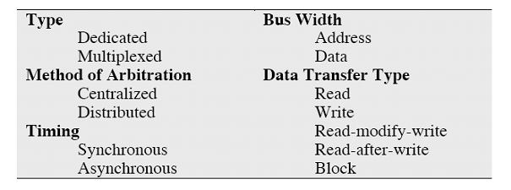
Basic Elements of Bus Design
These key elements serve to classify and differentiate buses

Slide 26
Bus Types
Dedicated (functional)
  Separate data & address lines
Multiplexed (Time multiplexing)
  Shared lines
  Address valid or data valid control line
  Advantage - fewer lines
  Disadvantages
    More complex control
    Performance– cannot have address and data simultaneously on bus

Slide 27
Bus Arbitration
More than one module controlling the bus
e.g. CPU and DMA controller
Only one module may control bus at one time
Arbitration may be centralized or distributed

Slide 28
Centralized or Distributed Arbitration
Centralized
  Single hardware device controlling bus access
    Bus Controller or Arbiter
  May be part of CPU or separate device
Distributed
  Each module may claim the bus
  Control logic on all modules
  Module currently controlling bus is the master
  Master initiates data transfer with slave device

Slide 29
Timing
Co-ordination of events on bus
Synchronous
  Events determined by clock signals
  Control Bus includes clock line
  A single 1-0 is a bus cycle
  All devices can read clock line
  Usually sync on leading edge
  Usually a single cycle for an event

Slide 30
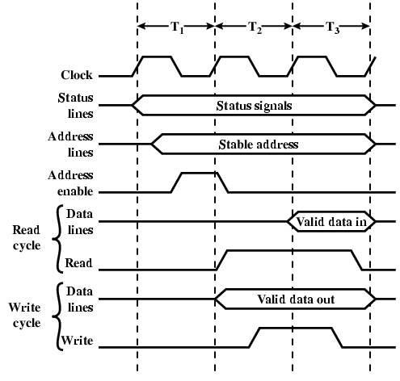
Synchronous Timing Diagram

Slide 31
Asynchronous Timing
Occurrence of one event on bus follows and depends on a previous event
  ACK signals are used to signal end of event
Synchronous timing easier to implement and test
  But all devices are limited to fixed clock rate
  Cannot take advantage of newer, faster devices
Asynchronous timing allows mixture of slow and fast devices to share bus comfortably

Slide 32
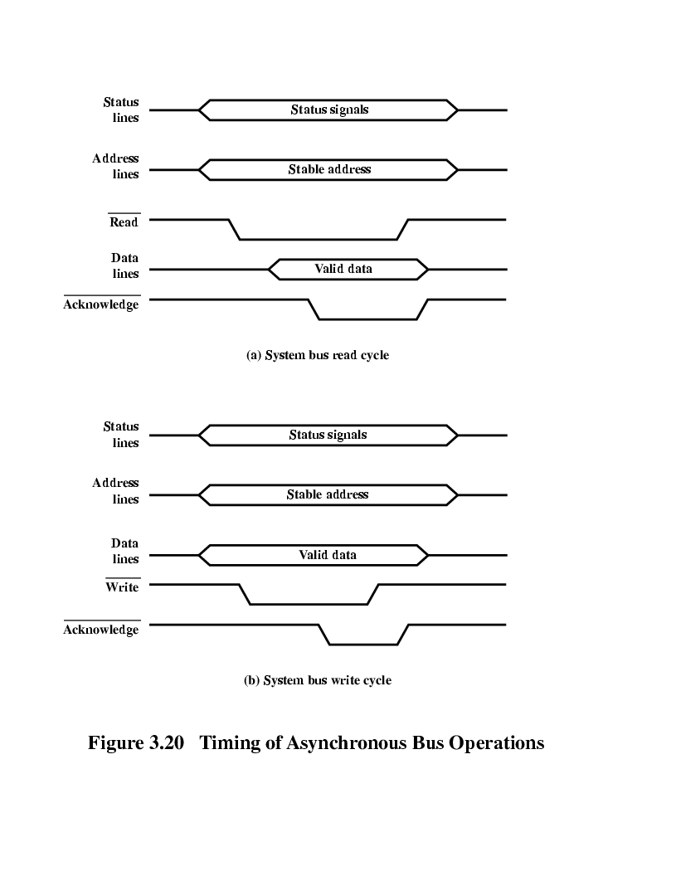
Asynchronous Timing – Read Diagram

Slide 33
Asynchronous Timing – Write Diagram

Slide 34
Bus Width
Discussed previously
Data width affects system performance
Address width determines size of addressable memory

Slide 35
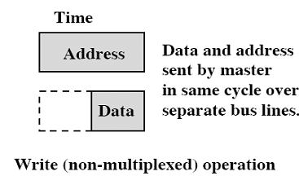
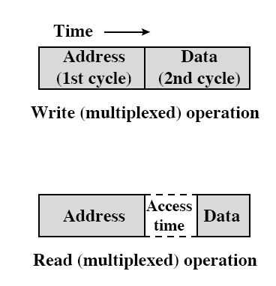
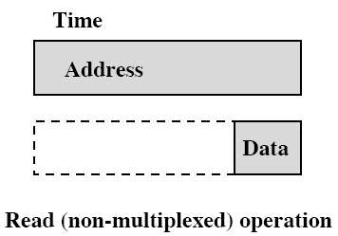
Data Transfer Types
Read and Write

Slide 36
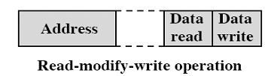
Combination Operations
Read-modify-write
  Read immediately followed by write to same location. Address put on bus once only
  Indivisible operation – no access by other elements until write completes
  Used to protect shared memory resources in a multiprogramming system

Slide 37
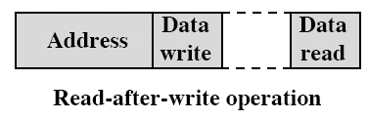

Combination Operations
Read after write
  Also indivisible; allows verification of write
Block Data Transfer
  One address transfer followed by n data transfers to/from sequential addresses

Slide 38
Case Study: PCI Bus (for Reading)
Peripheral Component Interconnection
Intel developed in 1990
Released patents to public domain
32 or 64 bit data bus
49 mandatory signal lines; 51 optional signal lines

Slide 39
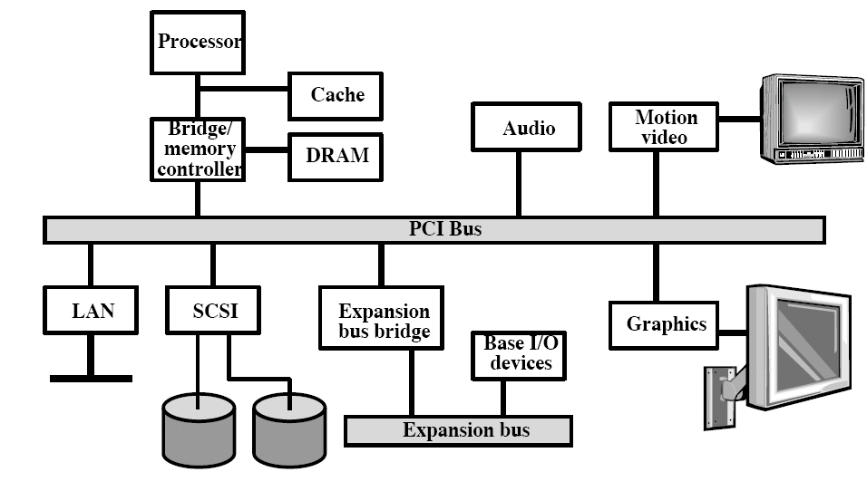
Typical Desktop PCI Configuration

Slide 40
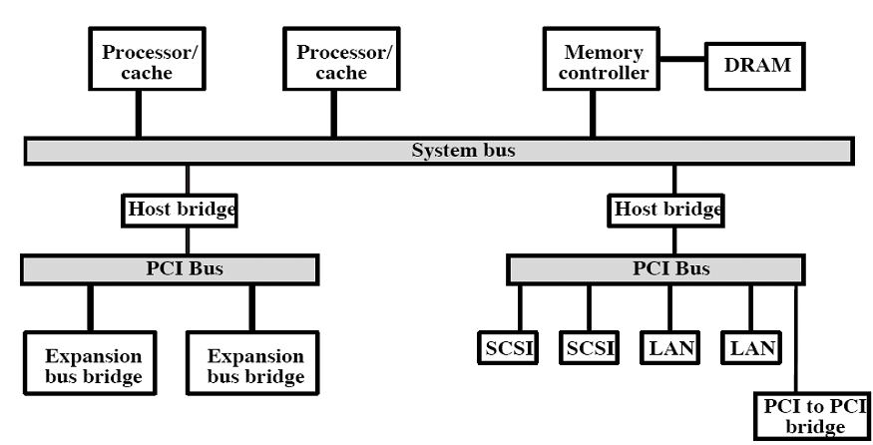
Typical Server PCI Configuration

Slide 41
PCI Bus Lines: Functional Grouping (required)
Systems lines
  Including clock and reset
Address & Data
  32 time mux lines for address/data
  Other lines interpret & validate signal lines that carry addresses and data
Interface Control
Arbitration
  Not shared
  Direct connection to PCI bus arbiter
Error lines

Slide 42
PCI Bus Lines (Optional)
Interrupt lines
  Not shared;each PCI device or interrupt controller has dedicated line
Cache support
  Snoopy cache controls (see Ch. 18)
64-bit Bus Extension
  Additional 32 lines to form 64-bit bus
  Time multiplexed
  2 lines to enable devices to agree to use 64-bit transfer
JTAG/Boundary Scan
  For testing procedures

Slide 43
PCI Commands
Bus activity takes place as transaction between initiator (master) and target
Master claims bus and determine type of transaction
  e.g. I/O read/write
  Note memory r/w specify burst transfer
  Suggest reviewing this material again after reading Ch. 4
A transaction has an address phase followed by one or more data phases

Slide 44
PCI Commands
Types of PCI commands are
  Interrupt ACK
    For interrupt controller
  Special Cycle
    For broadcast messages
  I/O Read and I/O Write
    Transfer data to/from I/O device. I/O Address given on address lines

Slide 45
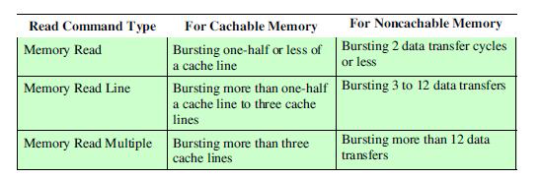
PCI Commands
Memory Read, Memory Read Line and Memory Read Multiple
  Interpretation depends on memory controller

Slide 46
PCI Commands
Memory Write and Memory Write and Invalidate
  Write data to memory. Write and Invalidate ensures that one or more cache lines are written back to main memory
Configuration Read and Write
  Enables bus master to read and write configuration data for a device (up to 256 registers per device)
Dual Address Cycle
  Used to transfer 64 bit addresses on 32 address lines

Slide 47
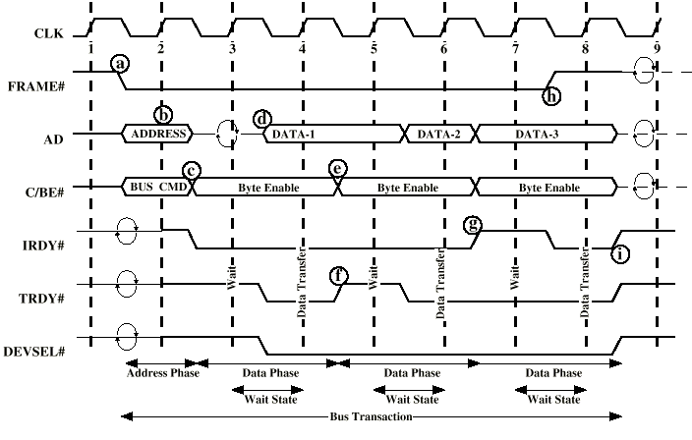
PCI Read Timing Diagram

Slide 48
PCI Bus Read Example
Events:synch’ed in the middle of clock cycle on the falling edge of signal
a)
  Bus Master gains control, asserts FRAME (begin transaction) signal.
  FRAME remains asserted until initiator ready to complete last data phase
  Put start address on AD bus
  Put read command on C/BE lines
b) Start of clock 2. Target recognize its own address on AD
c)
  Initiator stops driving AD bus. A turnaround cycle is required on all signal lines that may be driven by > 1 device
  Drop of AD prepares bus for use by target
  Initiator designates 1-4 bytes for transfer with C/BE lines
  Initiator asserts IRDY

Slide 49
PCI Bus Read Example
d)
  Selected target DEVSEL to indicate address recognized and device ready
  Places data on AD lines
  Asserts TRDY to indicate valid data on bus
e)
  Initiator reads data at beginning of clock 4
  Change Byte Enable in prep for next read
f)
  Example assumes slow target – needs time to prepare 2nd block of data
  => deassert TRDY to indicate that data will NOT be ready
  => initiator does NOT read data and BE remains unchanged
  Block of data is read at start of clock 6

Slide 50
PCI Bus Read Example
g) During clock 6, target places item 3 on bus, but initiator has buffer full
  => deassert IRDY
  => Target maintains data on bus for extra clock
h) Initiator knows third transfer is last
  => Deassert FRAME and assert IRDY to complete transfer
i) Initiator deasserts IRDY; bus -> idle state, target deasserts TRDY and DEVSEL

Slide 51
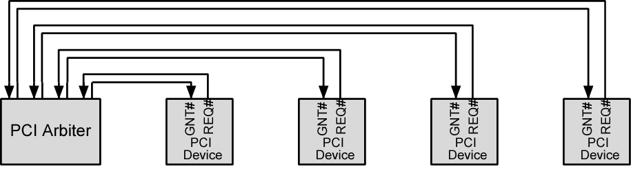
PCI Bus Arbiter
Centralized, synchronous scheme
Each master has REQ and GNT signal lines attached to central arbiter (similar to interrupt lines for devices)
REQ / GNT handshake used to grant access
PCI Spec does not dictate algorithm
  First-come, first-served; round robin; prioritized, etc.
Arbitration is used for each transaction by a bus master

Slide 52
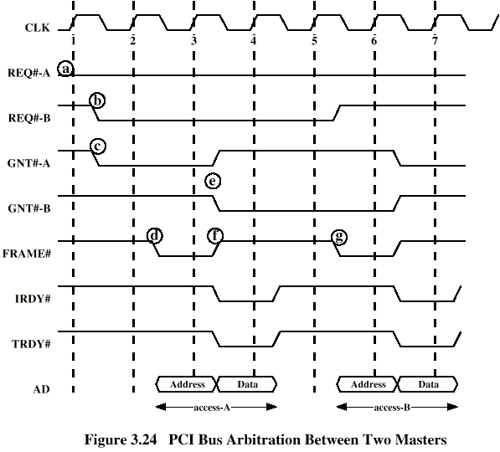
PCI Bus Arbitration

Slide 53
Additional Reading
See www.pcguide.com/ref/mbsys/buses/
In fact, read the whole site!
www.pcguide.com/

