Slide 1
William Stallings
Computer Organization and Architecture, 6th Ed.
Chap. 6 : External Memory
Types of External Memory
  Magnetic Disk*
  Optical
    CD-ROM
    CD-Recordable (CD-R)
    CD-R/W
    DVD
  Magnetic Tape

Slide 2
Magnetic Disk
Disk: circular platter of nonmagnetic material (substrate) coated with magnetizable material (iron)
Substrate used to be aluminium
Now glass or ceramic
  Improved surface uniformity
    Increases reliability
  Reduction in surface defects
    Reduced read/write errors
  Lower flight heights
  Better stiffness
  Better shock/damage resistance

Slide 3
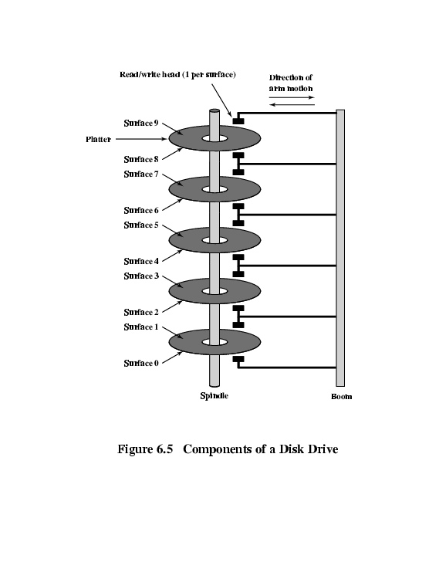
Multiple Platters

Slide 4
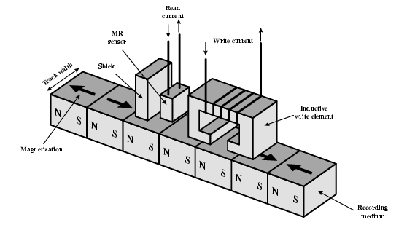
Inductive Write Read Head

Slide 5
Read and Write Mechanisms
Recording and retrieval via conductive coil called a head
May be single read/write head or separate ones
During read/write, head is stationary, platter rotates
Write
  Current through coil produces magnetic field
  Pulses sent to head
  Magnetic pattern recorded on surface below
Read (traditional)
  Magnetic field moving relative to coil produces current
  Coil is the same for read and write
Read (contemporary)
  Separate read head, close to write head
  Partially shielded magneto resistive (MR) sensor
  Electrical resistance depends on direction of magnetic field
  High frequency operation
    Higher storage density and speed

Slide 6
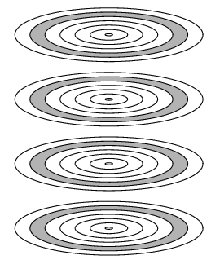
Cylinders

Slide 7
Disk Storage
Each circle represents
two tracks: one for top surface
and one for bottom surface
Cylinder X: Track X
from all 12 surfaces
(2 per platter)

Slide 8
Disk Storage
Head
Track
Spindle
Shaft
Sector
Arm
Head Assembly
All heads move
together
Platter
Top and bottom
Surfaces

Slide 9
Data Organization and Formatting
Concentric rings or tracks
  Gaps between tracks (inter-track gaps)
  Reduce gap to increase capacity
  Same number of bits per track (variable packing density)
  Constant angular velocity
Tracks divided into sectors
  Gaps between sectors (inter-sector gaps or intra-track gaps )
Min block size is one sector(data transfer unit)
Sector size 512 bytes (almost always)
May have more than one sector per block

Slide 10
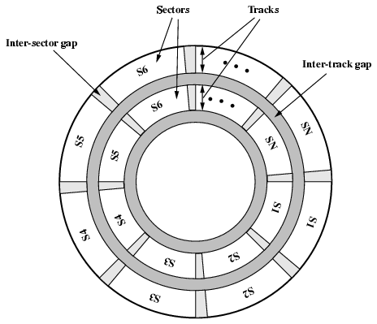
Disk Data Layout

Slide 11
Example
Given a disk drive with the characteristics:
  Number of surfaces = 200
  Number of tracks per surface = 100
  Number of sectors per track = 50
  Bytes per sector = 256
What is the total disk capacity?
Total disk capacity=number of surfaces * tracks per surface * sectors per track *bytes per sector
= 200*100*50*256 bytes
= 256000000 bytes
=256 MillionBytes (≠256 MB, MegaBytes=2²⁰ bytes)

Slide 12
Disk Velocity
Bit near centre of rotating disk passes fixed point slower than bit on outside of disk
Increase spacing between bits in different tracks
Rotate disk at constant angular velocity (CAV)
  Gives pie shaped sectors and concentric tracks
  Individual tracks and sectors addressable
  Move head to given track and wait for given sector
  Waste of space on outer tracks (Lower data density)
Can use zones to increase capacity
  Surface is divided into zones (grouping adjacent tracks)
  Each zone has fixed bits per track
  Zones farther from the center has more bits(sectors) than zones closer to the center
  More complex circuitry

Slide 13
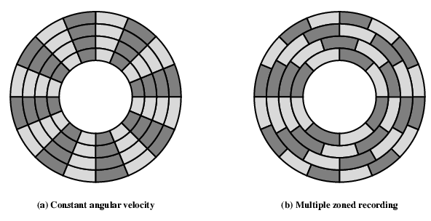
Disk Layout Methods Diagram
Each zone: just a single track wide

Slide 14
Finding Sectors
Must be able to identify
  start of track, and
  start and end of each sector
  By way of control data recorded on the disk(via format)
Format disk
  Additional information: used by disk drive and not available to user
    marks tracks and sectors

Slide 15
ST506 format (track)
Gap1
Id
Gap2
Data
Gap3
Gap1
Id
Gap2
Data
Gap3
Sync
Byte
Track
Sync
Byte
Head
Sector
CRC
Data
CRC
Each track has 30 fixed length sectors of 600 bytes each
Each sector has 512 bytes of data + control info(88 bytes)
Id: unique address to locate a particular sector
Synch:beginning of a field
Track: identifies a track on a surface, head: fixed/movable
CRC: error detecting code in ID and data fields

Slide 16
Disc Characteristics
Fixed (rare) or movable head
  Fixed:One read write head per track, heads mounted on fixed arm
  Movable:One read write head per side, mounted on a movable arm
Removable (R) or Fixed (F) Disk
  R: can be removed from drive and replaced with another disk. Provides unlimited storage capacity. Easy data transfer b/w systems
  F: Permanently mounted in the drive
Single or double (usually) sided
Single platter or multiple platter(reduces head movement, increases speed - transfer rate)
Head mechanism
  Contact (Floppy)
  Fixed gap
  Flying (Winchester)

Slide 17
Winchester Hard Disk
Developed by IBM in Winchester (Virginia, USA)
Sealed unit, one or more platters (disks)
Heads fly on boundary layer of air as disk spins, rest on disk when power off
Very small head to disk gap
Getting more robust
  Automatic error corrections, remapping of bad sectors
Universal
Cheap
Fastest external storage
Getting larger all the time
  Multiple Gigabyte now usual

Slide 18
Disk Performance
Mechanizm for a disk drive to read data:3 steps
The head assembly has to move to the specific cylinder.
The disk must spin to bring the required sector under the head.
The data from the selected surface is read and transferred to the controller as the sector moves under the head
disk is continuously spinning and the head is reading the bits off the surface as they pass under the head
Mechanizm for a disk drive to write data?

Slide 19
Speed
Seek time
  Time to move head to correct track
  Typically < 10 ms today
(Rotational) latency
  Waiting time until start of data sector to rotate under head
(Disk) access time = Seek + Latency
  The time it takes to get into position to read or write
  Once head is in position, read/write op is performed (data sector moves under the head)
Transfer time
  The time required for the read/write of data (transfer)

Slide 20
Transfer Time and Rates
Transfer time T = b / (Rn), b = bytes to transfer, r = revolutions/sec, N = number of bytes/track
Average (data) access time (in disk) T_{a}
T_{a} = T_{s} + 1/(2r) + b/(rN),
where T_{s} is average seek time, 1/(2r) average latency, and b/(rN) transfer time
Given the specifications for a disk drive:
  256 bytes per sector
  2000 sectors per track
  1000 tracks per surface
  2 platters
  Rotational speed 7500 RPM
What is the transfer rate of the disk?
  Each track has 2000 x 256 bytes = 512,000 bytes/track
  At 7500 rpm 1 rotation takes 7,500 rev/60 sec = 125 rev/sec or 0.008sec/rev
  Thus, we can transfer 512,000 bytes/0.008 sec=64,000,000 bytes/sec

Slide 21
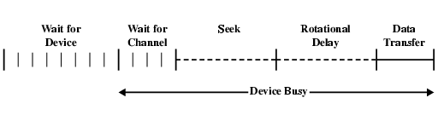
Timing of Disk I/O Transfer

Slide 22
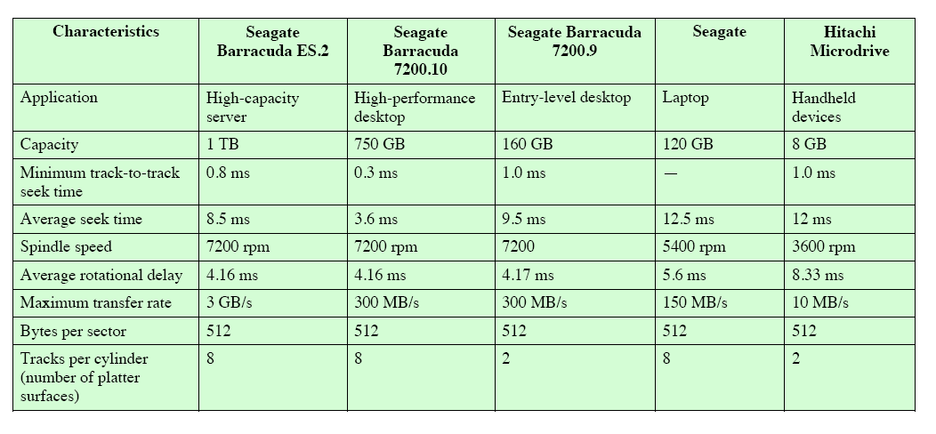
Typical Specs for a disk

Slide 23
Design Choices in implementing a File System on a Disk Subsystem
Some design constraints
  Files are of arbitrary size
  Files may be accesses sequentially or randomly
  Files need to be allocated initially
  Files need to be able to grow
  Space should be used efficiently

Slide 24
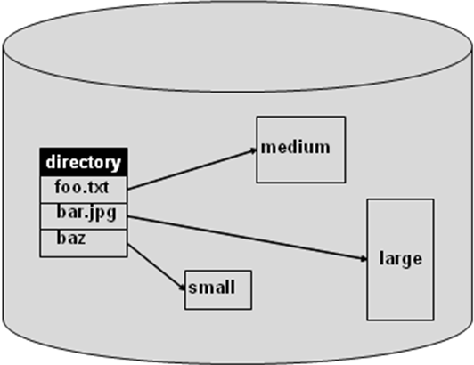
Contiguous Allocation
At file creation time a set amount of space is allocated (may depend on file type)
File cannot grow beyond that size
Fragmentation a problem

Slide 25
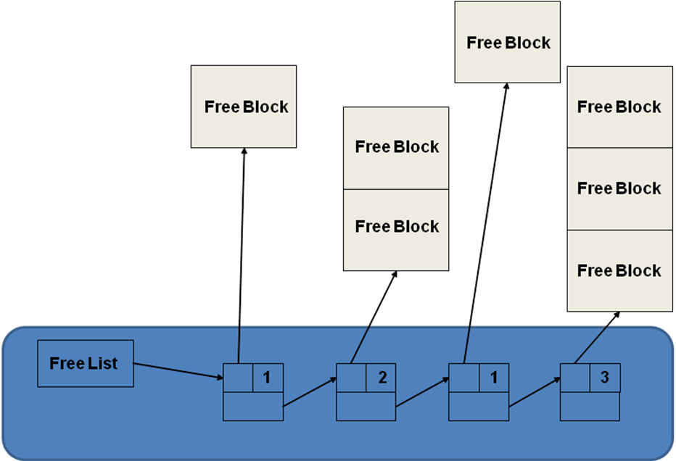
Contiguous Allocation
Free list
  Allocation may be by first or best fit
  Requires periodic compaction

Slide 26
Contiguous Allocation with Overflow Area
Modification of previous scheme to allow files to expand into a designated overflow area
Random access suffers due to overflow area
Despite limitations has been used extensively due to fast file access times

Slide 27
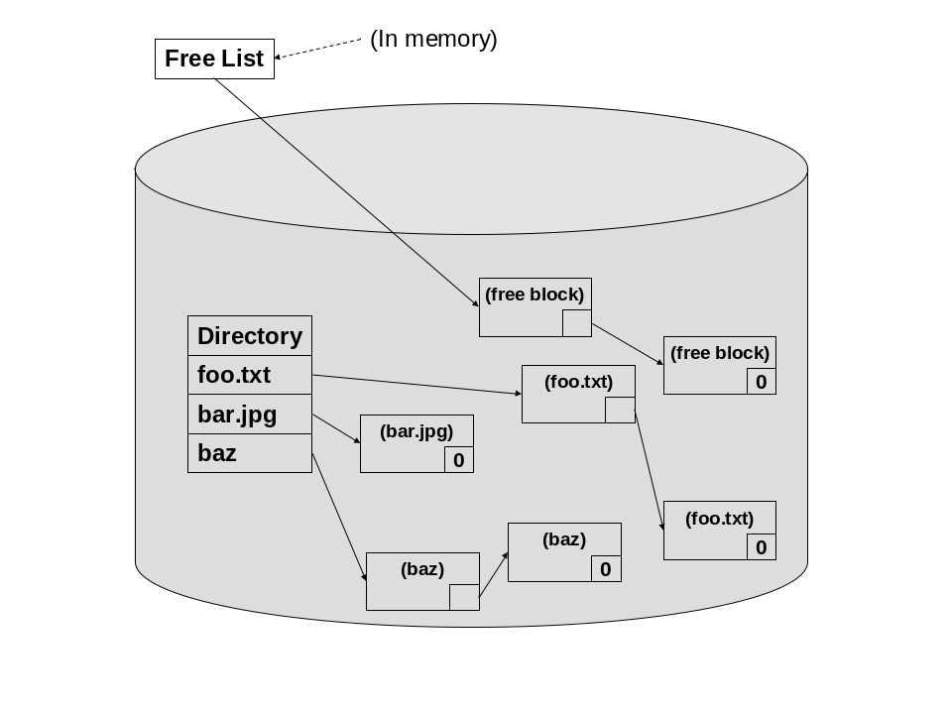
Linked Allocation
Files not stored contiguously
No compaction required
Sequential and random access poor
Susceptible to errors

Slide 28
File Allocation Table (FAT)
Directory
FAT
0
0
0
File name start index
30
1
70
0
/foo 30
.
.
50
1
-1
/bar 50
0
.
.
70
1
-1
Free/busy next

Slide 29
File Allocation Table (FAT)
Divide disk into partitions
Each partition has a FAT
The directory just has a pointer into the starting sector entry in the FAT for each file.
Less chance for errors than linked allocation
FAT becomes big so clustering and partitioning may be necessary leading to other problems

Slide 30
Indexed Allocation
Essentially breaks up FAT into one data structure per file
Allocate an index disk block for each file called an i-node
Directory entries now point to the i-node for that file
Maintain free list as bit vector

