Slide 1
William Stallings
Computer Organization and Architecture, 6th Ed.
Chap. 7: I/O
I/O Modules and Devices
I/O Techniques

Slide 2
Input/Output Problems
I/O architecture is the interface to the outside world
Computers have a wide variety of peripherals
  Delivering different amounts of data, at different speeds, in different formats
Many are not connected directly to system or expansion bus
Most peripherals are slower than CPU and RAM; a few are faster
Word length for peripherals may vary from the CPU
Data format may vary (one word might include parity bits)
Need I/O modules

Slide 3
Input/Output Module (I/O Controller)
Peripheral communications are handled with I/O modules
Two major functions
  Interface to processor or memory via system bus
  Interface to one or more peripherals via tailored data links

Slide 4
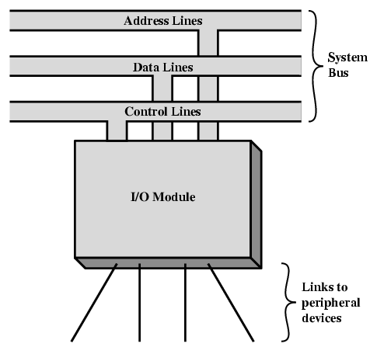
Generic Model of I/O Module

Slide 5
Communication between the CPU and the I/O devices
Computer
Device Controller
Input/Output Device

Slide 6
External Devices (peripherals)
Human readable (human interface)
  Monitor Screen, printer, keyboard, mouse
Machine readable
  Disks, tapes
    Functional view of disks as part of memory hierarchy
    Structurally part of I/O system
  Sensors, actuators
  Monitoring and control
Communications
  Modem
  Network Interface Card (NIC)
  Wireless Interface card

Slide 7
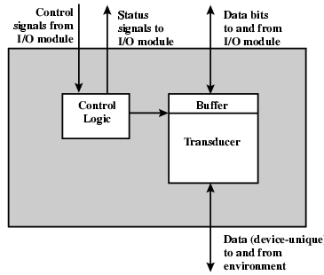
External Device Block Diagram

Slide 8
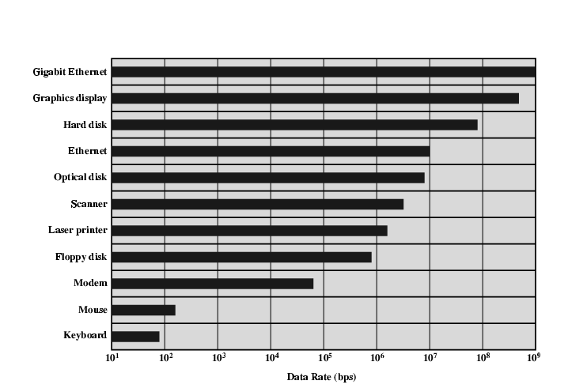
Typical I/O Data Rates

Slide 9
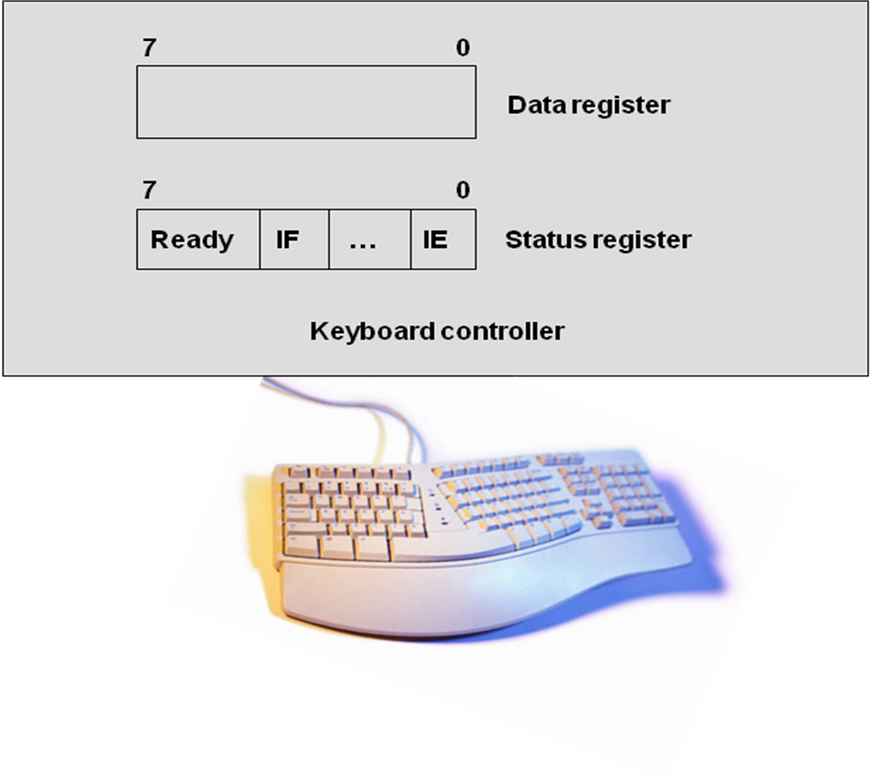
I/O Module Function and Steps
Major functions of an I/O module:
  Control & Timing
  CPU Communication
  Device Communication
  Data Buffering
  Error Detection
  (out of paper, paper jam, bad disk sector,
  data comm errors typically detected with parity bits)
I/O Steps for a read transaction:
  Processor interrogates status of I/O module
  I/O Module returns device status
  Device indicates ready to transmit;
  Processor requests data transfer by means of a command to the module
  I/O module obtains a byte of data from the device
  Data are transferred to the processor

Slide 10
Processor Communication
Command decoding
  Commands sent as signals on control bus with parameters on data bus
  E.g. disk: Read Sector, Write Sector, Seek track no, …
Data exchange with processor over the data bus
Status reporting
  Peripherals are very slow compared to processor
  May take some time after a READ command before data is ready
  Typical signals: BUSY, READY
Address decoding
  Module recognizes unique address for each device it controls

Slide 11
Device Communication
On the other side the I/O module has to communicate with the device
  Commands
  Status information
  Data
Buffering is often essential
  Handles the speed mismatch between memory and the device
  Low speed devices need to have data from memory buffered
  High speed devices need to have data going to memory buffered
  With any interrupt-driven device, data may be buffered pending interrupt handler servicing

Slide 12
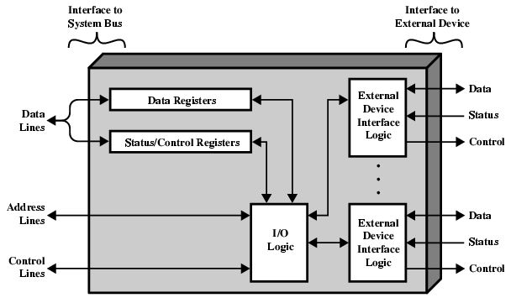
I/O Module Diagram

Slide 13
I/O Module Decisions
Hide or reveal device properties to CPU
  Disks: LBA (logical block addressing)-physical address (CHS, cylinder-head-sector) is hidden from CPU
  But older disks expose CHS addressing
Support multiple or single device
  Most disk controllers handle 2 devices
Control device functions or leave for CPU
  Ex: Video adapters with Direct Draw interface
  But tape drives expose direct control to cpu
Also O/S decisions
  e.g. Unix treats everything it can as a file

Slide 14
Terminology
Device or I/O Controller
  Relatively simple, detailed control left to CPU
I/O Processor or I/O Channel
  Presents high-level interface to CPU
  Often controls multiple devices
  Has processing capability

Slide 15
Input Output Techniques
Programmed IO
  CPU controls the entire process
  Can waste CPU time
Interrupt driven IO
  Processor issues command
  Device proceeds and leaves processor free
Direct Memory Access (DMA)
  Device exchanges data directly with memory

Slide 16
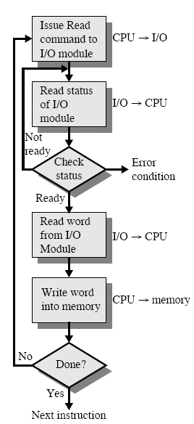
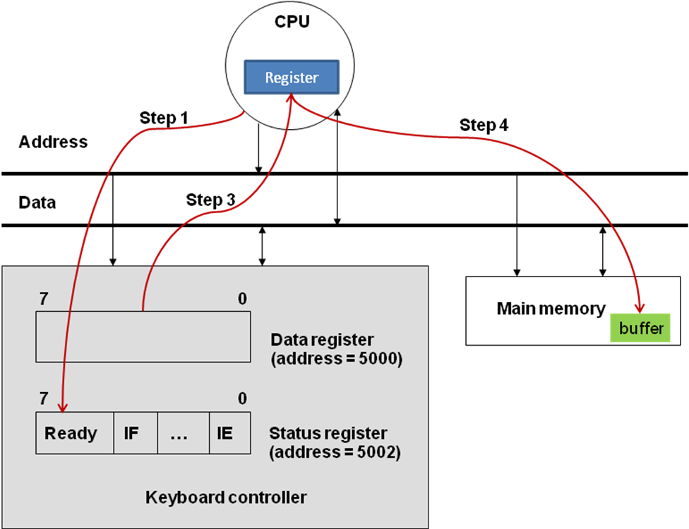
Programmed I/O
CPU has direct control over I/O
  Sensing status
  Read/write commands
  Transferring data
CPU waits I/O module to complete operation
Wastes CPU time

Slide 17
Programmed I/O - detail
CPU requests I/O operation
I/O module performs operation
I/O module sets status bits
CPU checks status bits periodically
I/O module does not inform CPU directly
I/O module does not interrupt CPU
CPU may wait or come back later

Slide 18
I/O Commands
CPU issues address
  Identifies module (& device if >1 per module)
CPU issues command
  Control - telling module what to do
    e.g. spin up disk
  Test - check status
    e.g. power? Error?
  Read/Write
    Module transfers data via buffer from/to device

Slide 19
Addressing I/O Devices
Under programmed I/O data transfer is very like memory access (CPU viewpoint)
Each device is given unique identifier
CPU commands contain identifier (address)
Memory mapped I/O
  Devices and memory share an address space
  I/O looks just like memory read/write
  No special commands for I/O. Large selection of memory access commands available
Isolated I/O
  Separate address spaces for memory and I/O adresses
  Need I/O or memory select lines
  Special commands for I/O: Limited set

Slide 20
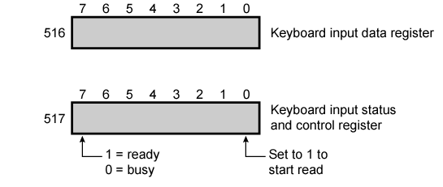
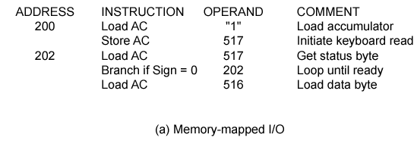
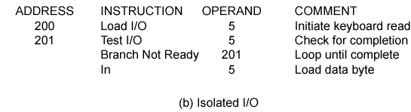
Memory mapped I/O and Isolated I/O

Slide 21
Interrupt Driven I/O
Overcomes CPU waiting
No repeated CPU checking (polling) of device status
I/O module interrupts when ready
Basic Operation
  CPU issues read command
  I/O module gets data from peripheral while CPU does other work
  I/O module interrupts CPU
  CPU requests data
  I/O module transfers data

Slide 22
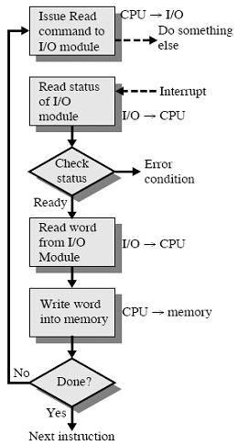
Interrupt Driven I/O Flowchart

Slide 23
CPU Viewpoint
Issue read command
Do other work
Check for interrupt at end of each instruction cycle
If interrupted:-
  Save context (registers)
  Process interrupt
    Fetch data & store
See Operating Systems notes

Slide 24
Design Issues
How do you identify the module issuing the interrupt?
  Different line for each module
    Require dedication of many bus lines / pins to interrupt lines
    Limits number of devices
  Software poll
    CPU asks each module in turn; Slow (time consuming)
  Daisy Chain or Hardware poll
    All IO modules share a common interrupt request line
    Interrupt Acknowledge sent down a chain of IO modules
    Module responsible places vector (its address) on data bus
    CPU uses vector to identify interrupt handler routine
  Bus Master
    Module must claim the bus before it can raise interrupt
    e.g. PCI & SCSI
How do you deal with multiple interrupts? (i.e. an interrupt handler being interrupted)

Slide 25
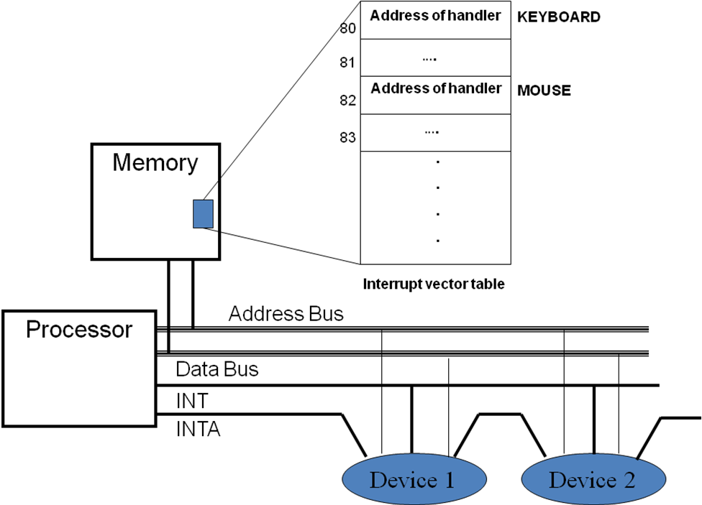
Details of receiving the address of the handler

Slide 26
Multiple Interrupts
Each interrupt line has a priority
Higher priority lines can interrupt lower priority lines
If bus mastering only current master can interrupt
Example - PC Bus
80x86 has one interrupt line INTR & one interrupt acknowledge INTA
  8086 based systems use one 8259A interrupt controller
  8259A has 8 interrupt lines
  Sequence of Events
    8259A accepts interrupts
    8259A determines priority
    8259A signals 8086 (raises INTR line)
    CPU Acknowledges
    8259A puts correct vector on data bus
    CPU processes interrupt

Slide 27
ISA Bus Interrupt System
Current x86 processors typically use 2 8259A’s (master and slave)
  This provides 15 IRQs because the slave is attached to one of the master’s IRQ pins
Up to 8 controllers can be linked to a master controller

Slide 28
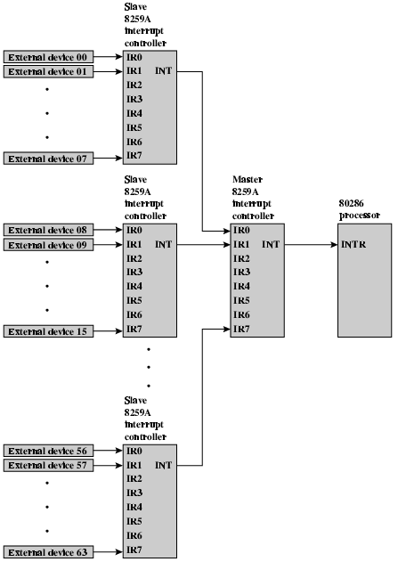
82C59A Interrupt
Controller

Slide 29
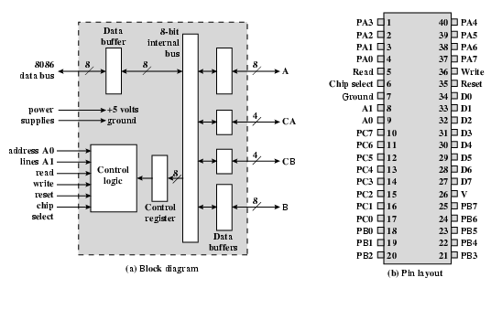
Intel 82C55A
Programmable Peripheral Interface

Slide 30
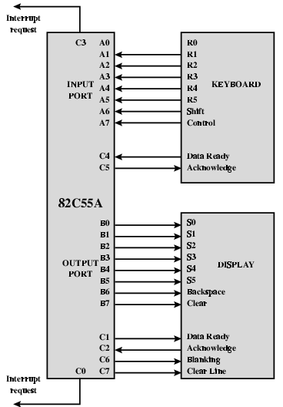
Using 82C55A To Control Keyboard/Display

Slide 31
Direct Memory Access
Both interrupt driven and programmed I/O require active CPU intervention. Problem?
  Processor must transfer data
    Read from device or memory
    Write to memory or device
  Transfer rate is limited due to device speed
  CPU is tied up managing IO transfer
DMA is the answer: DMA allows devices to communicate directly with memory without passing data through the CPU
CPU
Memory bus
DMA controller
Status
Command
Go
Memory
Device address
Memory buffer address
Count
256 bytes
Buffer

Slide 32
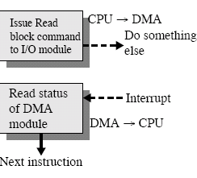
DMA Function
Additional Module (hardware) on bus
DMA controller takes over from CPU for I/O
DMA Operation
  CPU tells DMA controller:-
    Read/Write
    Device address
    Starting address of memory block for data
    Amount of data to be transferred
  CPU carries on with other work
  DMA controller deals with transfer
  DMA controller sends interrupt when finished
Additional Module (hardware) on bus
DMA controller takes over from CPU for I/O
DMA Operation
  CPU tells DMA controller:-
    Read/Write
    Device address
    Starting address of memory block for data
    Amount of data to be transferred
  CPU carries on with other work
  DMA controller deals with transfer
  DMA controller sends interrupt when finished

Slide 33
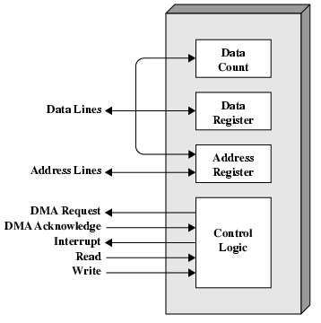
DMA Module Diagram

Slide 34
DMA and System Bus
What effect does caching memory have on DMA?
In order to access memory the DMA module must pass data over the bus
DMA and the CPU cannot share the bus at the same time
  But cpu may have cached instructions/data
  DMA can suspend processor operations temporarily (cycle stealing)
On-board level 2 cache may keep the CPU busy without accessing the system bus
  But cache coherency can be a problem

Slide 35
DMA Transfer
Cycle Stealing
DMA controller takes over bus for a cycle
Transfer of one word of data
Not an interrupt
  CPU does not switch context
CPU suspended just before it accesses bus
  i.e. before an operand or data fetch or a data write
Slows down CPU but not as much as CPU doing transfer

Slide 36
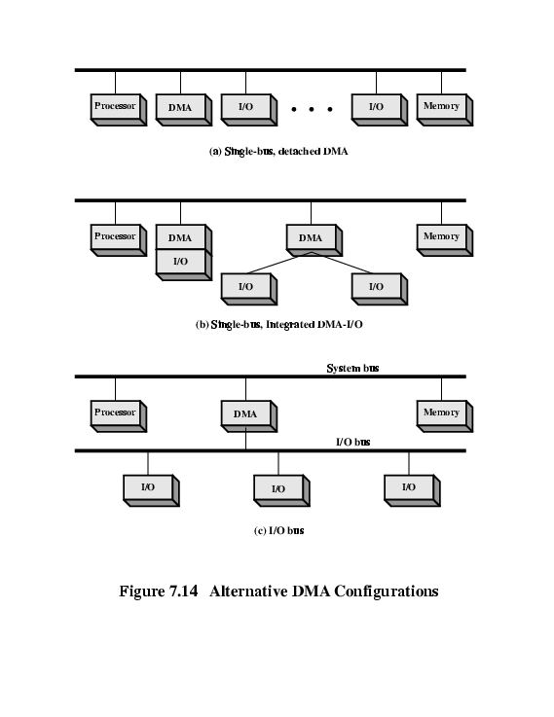
DMA Configurations (1)
Single Bus, Detached DMA controller
Each transfer uses bus twice
  I/O to DMA then DMA to memory
CPU is suspended twice

Slide 37
DMA Configurations (2)
Single Bus, Integrated DMA controller
Controller may support >1 device
Each transfer uses bus once
  DMA to memory
CPU is suspended once

Slide 38
DMA Configurations (3)
Separate I/O Bus
Bus supports all DMA enabled devices
Each transfer uses bus once
  DMA to memory
CPU is suspended once

Slide 39
The Evolution of the I/O Function
CPU directly controls device
Controller or I/O module; simple programmed transfer by CPU. Device details transparent to CPU
Same as above with interrupts; more efficient
I/O module accesses memory through DMA
I/O module becomes processor
  Executes stored program
  CPU directs module to program in memory
  I/O processor executes program and generates interrupt on completion
I/O module has local memory

Slide 40
I/O Channels and Processors
Steps 5 and 6 (processing capability, local memory) we talk about an I/O channel or I/O processor instead of I/O module
  e.g. mainframe terminal controllers, 3D graphics cards, USB hubs
CPU instructs I/O controller to do transfer or execute stored program
  Improves speed
  Takes load off CPU
  Dedicated processor is faster

Slide 41
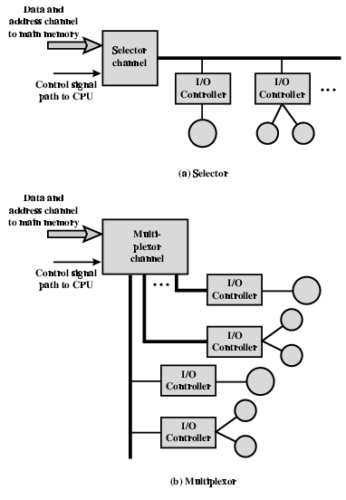
I/O Channel Architecture
Selector Channel
Controls multiple high-speed devices
Dedicated to one device at a time
Multiplexor Channel
Used with low or high speed devices
Low speed: byte multiplexor
High speed:block multiplexor

Slide 42
Interfacing
Connecting devices together
Serial and Parallel
  Traditional usage parallel for high speed, serial for low speed
  Recent development in high-speed serial interfaces have given serial devices the advantage
    USB
    Gigabit ethernet
    SATA drives
  Serial cables are smaller and easier to manage electrically
  Interference between lines limits speed of parallel interfaces
  Synchronization of lines poses a problem at high speed and limits cable length
  Cables are bulky and require lots of shielding

Slide 43
IEEE 1394 FireWire
High performance serial bus
Fast, Low cost, Easy to implement
Also being used in digital cameras, VCRs and TV
Daisy chain
Up to 63 devices on single port
Automatic configuration
No bus terminators
May be tree structure
Up to 1022 buses can be connected with bridges

Slide 44
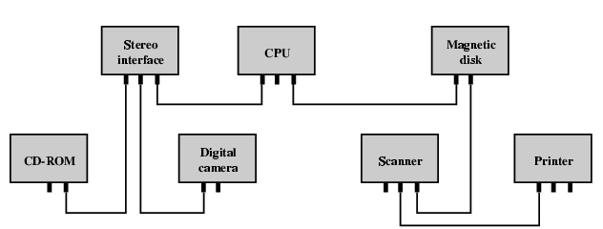
Simple FireWire Configuration

Slide 45
InfiniBand
I/O specification aimed at high end servers
  Merger of Future I/O (Cisco, HP, Compaq, IBM) and Next Generation I/O (Intel)
Version 1 released early 2001
Architecture and spec. for data flow between processor and intelligent I/O devices
Intended to replace PCI in servers
Increased capacity, expandability, flexibility
Remote storage, networking and connection between servers
Attach servers, remote storage, network devices to central fabric of switches and links
Greater server density
Scalable data centre
Independent nodes added as required
Up to 30Gbps

Slide 46
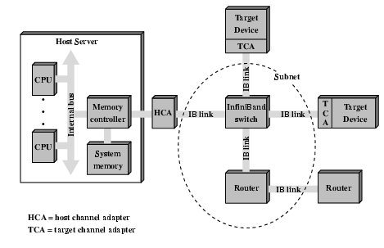
InfiniBand Switch Fabric

Slide 47
InfiniBand Operation
16 logical channels (virtual lanes) per physical link
One lane for management, rest for data
Data in stream of packets
Virtual lane dedicated temporarily to end to end transfer
Switch maps traffic from incoming to outgoing lane

Slide 48
Reading
Check out Universal Serial Bus (USB)
Compare with other communication standards e.g. Ethernet

