Slide 1
Distributed Systems
Assoc. Prof. Veli Hakkoymaz

Slide 2
Teaching Staff
Lecturer: Assoc. Prof. Veli Hakkoymaz
  Email: vhakkoymaz@gmail.com
  Web: YTU CE web site
    (http://www.ce.yildiz.edu.tr/personel/vhakkoymaz)
  Phone: x-5780
  Office: D Blok, D-220
    Office hours: Mondays 14:00-16:00
Teaching Assistant:
  Mecit Yüzkat D-026, x-5756
  muhmecit65@gmail.com

Slide 3
Course Schedule
Course Web Site:
  YTU CE web site: Dosyalar/DistSys
Lectures:
  Time: Fridays 9:00-11:45 (D-109)
  In two blocks;
    Block1: 9:00-10:15
    Block2: 10:30-11:45

Slide 4
Course Assessment
Attendance:
  for those above-threshold 0%
Quiz, Homework and lab assignments ???
  During semester worth 10%
Written examination:
  Mid1:25
  Mid2:25
  Final: 40

Slide 5
Attendance
Yoklama
  Her ders bloğu için,
%70 devam (threshold)
  Alınan yoklamalarda %70 devam etmiş olmak
  Rapor, izin, mazaret, devamsızlık vs. hepsi en fazla %30

Slide 6
Books and References
Main Text Book:
  Andrew S. Tanenbaum and Maarten Van Steen, Distributed Systems: Principles and Paradigms, Prentice Hall, Pearson Education, http://www.prenhall.com/tanenbaum/
Reference / Alternate Text Book:
  Couloris, G, Dollimore, J. and Kinberg, T, Distributed Systems - Concepts and Design, 4th Edition, Addison-Wesley, Pearson Education, http://www.cdk4.net
Research Articles:

Slide 7
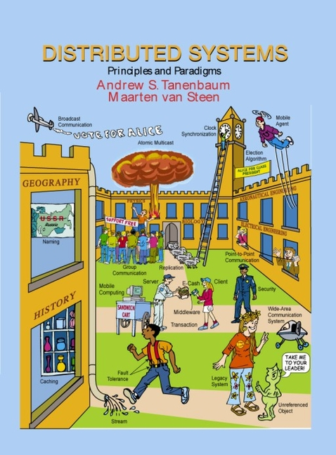
Text Book

Slide 8
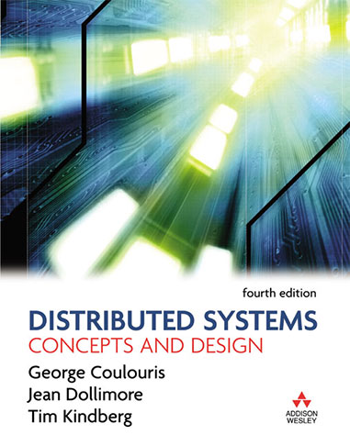
Reference Book – Alternate Text Book
4th edition published in June 2005.

Slide 9
Presentation Slides
Mostly derived from the text book.
Good ideas / figures from alternative text book may also be used.

Slide 10
Why study distributed computing?
This course aims to convey insight into, and knowledge of the principles and practice underlying the design of distributed systems.
The depth covered in this course will enable you to evaluate existing systems or design new ones.

Slide 11
Course Coverage in General
Part I: Foundations – approx. 4 weeks
  Introduction,
  System Models,
  Threads,
Part II: Principles – 4 weeks
  Inter-process Communication
  Socket Programming
  Operating System support services,
  RPC/RMI,
Paradigms/Platforms - 5 weeks:
  Distributed File Systems,
  Naming Services
  Distributed DB and Transactions
  Security in DS
Depth of some parts may be reduced due to time limits

