Slide 1
Security in Distributed Systems
Outline:
1 Motivation
2 Failure Model
3 Styles of Attacks
4 Authentication
5 The Byzantine Generals Problem
6 Summary

Slide 2
1 Motivation
More vital/secret data handled by distributed components.
Security: protecting data stored in and transferred between distributed components from unauthorized access.
Security is a non-functional requirement that cannot be added as a component but has to be built into all components.
It is the protection of data stored in and passed between distributed components from unauthorized access
Notes:
An increasing number of systems handles vital and private data that ought to be kept secret. At the same time an increasing number of systems is constructed in a distributed fashion. Just a few examples:
An electronic commerce system that enables people to book flights over the Internet demands credit card numbers and expiry dates to be entered via web pages. Knowledge of this information would enable intruders to abuse the credit card details.Several sessions may pass before the owner recognises that somebody has stolen the data and serious damage might have occurred
Companies working on complex designs, such as a new model of a car, in a distributed fashion might use a distributed CAD system that utilises a network. Final design artefacts exchanged through these networks will be very valuable and have to be secured against unauthorised access by competitive companies.
Hence security can be seen as the protection of data stored in and passed between distributed components from unauthorised access.
It is worthwhile to note that security is a typical NFR. Similar to many other NFRs, it cannot be added as an additional component to make an unsafe system safe, but it rather has to be build into each component to make that component secure.

Slide 3
Failure Model: Güvenli Ortam ve Hatalar
Güvenli ortam, güvenen ve güvenilen bileşenler topluluğu
DS, doğası gereği, her bileşenin güvenilmediği, diğer bir yönüyle de güvenilen bir bileşenin her an kaçınılmaz olarak «hatalı» olarak karşımıza çıkabileceği bir ortam.
Hata: İletişim ortamı veya Process kaynaklı
Specific errors
  Communication link may lose messages
  Link may duplicate messages
  Link may reorder messages
  Process may die and be restarted

Slide 4
Doğru ve Hatalı Process
A process that behaves according to its I/O specification throughout its execution is called correct
A process that deviates from its specification is faulty
Two types of failures:
Fail-Stop failures
A faulty process halts
execution prematurely.
Byzantine failures
No assumption about
behavior of a faulty process.

Slide 5
Fail-Stop failure
A failure results in the process, p, stopping
  Also referred to as crash failure
  p works correctly until the point of failure
p does not send any more messages
p does not perform actions when messages are sent to it
Other processes can detect that p has failed

Slide 6
Byzantine failure
Process p fails in an arbitrary manner.
p is modeled as a malevolent entity
  Can send the messages and perform the actions that will have the worst impact on other processes
  Can collaborate with other “failed” processes
Common constraints on Byzantine assumption
  Incomplete knowledge of global state
  Limited ability to coordinate with other Byzantine processes
  Restricted to polynomial computation (i.e., assume P≠NP…)
CSC469

Slide 7
Types of Threats
We attempt to protect the services and data against security threats:
  Interception : Situation where an unauthorized party has gained access to a service or data. Ex. Illegal copying of one’s files
  Interruption: Situation where services or data become unavailable. Ex. A file is corrupted or lost
  Modification: unauthorized changing of data or tampering with a service so that it no longer adheres to its original specifications
  Fabrication: Additional data or activity are generated that normally would not exist. Add an entry to pswd file or DB

Slide 8
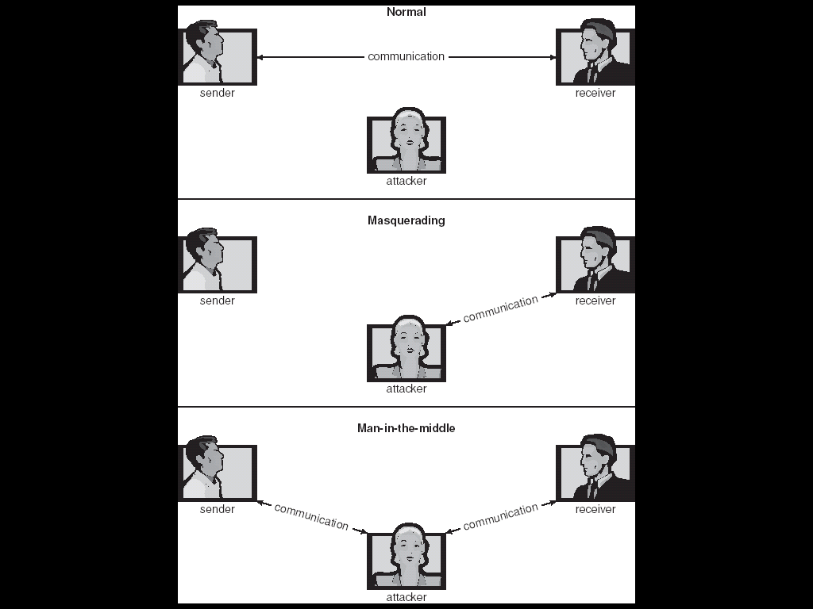
Scenario:
Typical Security Attacks
15: Security

Slide 9
Classification of Security Mechanisms in Distributed Systems
Auditing
Non-Repudiation
High Level
Authentication
Authorization or
Access Control
ENCRYPTION
Low Level

Slide 10
Cryptographic Terminology
Plain text: the message before encryption.
Cipher text: the message after encryption.
Key: information needed to convert from plain text to cipher text (or vice-versa).
Function: the encryption or decryption algorithm used, in conjunction with key, to encrypt or decrypt message.
Key distribution: How to distribute keys between senders and receivers
Notes:
Let us now introduce some terminology from the area of cryptography that we will later use
Plain text denotes a message before it is encoded (or that is encoded in a commonly accessible scheme, such as ASCII or ECBDIC).
Cipher text denotes the message after it has been encoded. The encoded message can be represented as binary or as ASCII text, whatever is more appropriate to the means of transportation.
A key is the information needed to convert the text from plain text into cipher text or vice versa.
A function is the algorithm used for encryption or description. It usually takes the key and the plain text as input and produces the cipher text and vice versa.
The key distribution service denotes a trustworthy service that hands out keys. If keys must not be publicly known (typically secret keys) the key distribution service is often not computerised.
When I was doing my (compulsory) service in the army, I worked in a signal battalion where we also had to encrypt and decrypt telex messages. Although we had a radio data network in place, key distribution was done by motorbike messengers in order to make sure that keys were not obtained by the forces on the other side of the German wall.

Slide 11
3 Attack Types:
Why are Distributed Systems insecure?
Distributed component rely on messages sent and received from network.
Is network (especially WAN networks) secure?
  Packets can be intercepted and modified at network layer!
Is client component secure?
Is client component who it claims to be? (authentication)
Are users of components really who they claim to be?
Notes:
Let us now look for the reason why distributed systems are inherently insecure.
One major reason is that distributed systems have to rely on networks that connect the different servers running the system's component. Now many networks are inherently insecure. The network layer in the Internet, for instance, routes packages containing data through the wires and every subject may listen to the network receive these packets, copy them and even modify them.
The next question that arises is how trustworthy and secure is a client that a server is communicating with. Can we be sure that the client will not pass any secure information on to components that are not authorised to gain access to the data?
How do we actually know that the client is who it claims to be? If we pass classified information to a component we want to make sure that the client is actually the client that we think it is. This is problem is known as authentication.
Another authentication problem is whether the users of components are physically those persons who ought to be using the component. A bank wants to make sure that the person using a credit card to withdraw cash from an ATM is actually the person to whom the bank issued the card. The usual approach to deal with that are passwords that are issued to the users. In fact, the PIN that you enter during a cash withdrawal is a kind of password.

Slide 12
Effects of Insecurity
Confidential Data may be stolen, e.g.:
  corporate plans.
  new product designs.
  medical/financial records (e.g. Access bills....).
Data may be altered, e.g.:
  finances made to seem better than they are.
  results of tests, e.g. on drugs, altered.
  examination results amended (up or down).
Notes:
This slide displays some potential effects of insecurity. Unauthorised access may lead to situations where confidential data is stolen. This may disclose corporate plans, new product designs, medical records, financial records and the like.
Even worse are situations where data is altered in an unauthorised fashion. Consider a customer of a bank that changes the balance of his or her bank account or students that modify the marking of an exam paper so that their marks are better than what their paper deserves.

Slide 13
Need for Security
Loss of confidence: above effects may reduce confidence in computerized systems.
Claims for damages: legal developments may allow someone to sue if data on computer has not been guarded according to best practice.
Loss of privacy: data legally stored on a computer may well be private to the person concerned (e.g. medical/personnel) record.
Notes:
The obvious concern for security in a distributed system is to make sure that the system does not reveal information to unauthorised subjects. A concern that seems less obvious in the first place is to make sure that users of the distributed system still believe in its trustworthiness and do not loose confidence in a particular distributed system or in computerised systems in general. If users loose confidence this might be much more damaging than the concrete damage that occurred due to a security attack that succeeded.
If such an attack succeeds and secret data is disclosed to unauthorised subjects the operator of the distributed system might be faced with legal action by the owner of the data and the operator may or may not sue the developers of that system itself.
As computer scientists and software engineers we also have ethical obligations to make sure that privacy is retained in computer based systems. Although there might not be measurable damage if, for instance, medical records of a person are disclosed to unauthorised people this loss of privacy must by all means be prevented.
In order to look at how they can be prevented, we have to investigate the nature of these attack in the first place in order to learn how a system can be shielded against them.

Slide 14
Tehditler ve Amaçları
Categorization of attacks (and goals of attacks) that may be made on system.
  leakage: information leaving system. disclosure of information to unauthorised subjects.
  tampering: unauthorized information altering.
  resource stealing: illegal use of resources.
  vandalism: disturbing correct system operation.
  denial of service: disrupting legitimate system use.
Used to specify what the system is secure against.
Notes:
In order to be able to protect a distributed system against security attacks that might lead to classified information leaving the system to unauthorised subjects we first have to understand the different types of security attacks we have to shield the system against. The goals of these attacks are outlined below.
Leakage denotes the disclosure of information to unauthorised subjects. A leakage attack would be if say, Whitney and Pratt hacked into a CAD System of Rollce Royce in order to obtain the latest design RR's jet engines. Although fatal in this case, leakage is probably the category that causes the least damage of the above.
Tampering denotes the aunauthorised modification of data. We would have a case of tampering, if you hacked into the School's database in order to alter the marks of your Distributed System courseworks (which you cannot because it is for security reasons not connected to the network!)
Resource stealing identifies the illegal use of resources. A case of resource stealing has occurred when hackers hacked into computers of telephone companies and managed to have the their phone calls charged to other customer's accounts.
Vandalism denotes the disturbance of correct system operation. I have seem a case of vandalism myself while I was on a research meeting in Milan. The security of CS Dept. in Milan was broken and super user privileges were acquired and then the system's hard disks were formatted. This caused serious damage to the departmental operations for a session.
This categories can now be used to identify security of systems.

Slide 15
Threats
Leakage denotes the disclosure of information to unauthorised subjects.
  hacking into a CAD System of Rolls Royce in order to obtain the latest design RR's jet engines.
  Although fatal in this case, leakage is probably the category that causes the least damage of the above.
Tampering denotes the unauthorized modification of data.
  We would have a case of tampering, if you hacked into the School's database in order to alter the marks of your Distributed System courseworks.
Notes:
In order to be able to protect a distributed system against security attacks that might lead to classified information leaving the system to unauthorised subjects we first have to understand the different types of security attacks we have to shield the system against. The goals of these attacks are outlined below.
Leakage denotes the disclosure of information to unauthorised subjects. A leakage attack would be if say, Whitney and Pratt hacked into a CAD System of Rollce Royce in order to obtain the latest design RR's jet engines. Although fatal in this case, leakage is probably the category that causes the least damage of the above.
Tampering denotes the aunauthorised modification of data. We would have a case of tampering, if you hacked into the School's database in order to alter the marks of your Distributed System courseworks (which you cannot because it is for security reasons not connected to the network!)
Resource stealing identifies the illegal use of resources. A case of resource stealing has occurred when hackers hacked into computers of telephone companies and managed to have the their phone calls charged to other customer's accounts.
Vandalism denotes the disturbance of correct system operation. I have seem a case of vandalism myself while I was on a research meeting in Milan. The security of CS Dept. in Milan was broken and super user privileges were acquired and then the system's hard disks were formatted. This caused serious damage to the departmental operations for a session.
This categories can now be used to identify security of systems.

Slide 16
Threats (ctd.)
Resource stealing identifies the illegal use of resources and not paying, e.g CPU time, Bandwith, Air time of mobiles
  A case of resource stealing has occurred when hackers hacked into computers of telephone companies and managed to have their phone calls charged to other customer's accounts.
Vandalism denotes the disturbance of correct system operation.
  The security of a dept was broken and super user privileges were acquired and then the system's hard disks were formatted. serious damage to the departmental operations.

Slide 17
Methods of Attack
Eavesdropping: Obtaining message copies without authority.
Masquerading (Spoofing): Using identity of another principle without authority.
Message tampering: Intercepting and altering messages.
Replaying: Storing messages and sending them later.
Flooding: sending too many messages
Notes:
The slide above lists the different methods that are usually applied in order to launch a security attack. The attacks are usually launched using security holes in the transport or network layer in the ISO-OSI reference model, that are concerned with sending packages or messages through networks.
Eavesdropping denotes the copying of such messages or packages without having the authority to do so. The messages or packages are usually buffered and then composed according to the transport, session and presentation layer implementations in order to obtain meaningful information.
Masquerading denotes the use of the identity of another principle without having been authorised to do so. Messages or packages can be composed and then sent via the network to other components pretending a different origin in order to use certain operations of the component or to obtain certain information.
Message tampering denotes the interception and alteration of messages.
Replaying means that messages are stored and then sent later. In that way the attacker can redo operations that have been done before. By replaying a sequence of messages comprising a login to a remote component, for instance, the attacker can gain unauthorised access.
Note that these methods are often used as primitives that are then combined. By combining eavesdropping, masquerading and tampering security attackers might launch more subtle security attacks.

Slide 18
Some Examples
Eavesdropping
  request parameters from client to server may contain sensitive information, e.g pins, balances
  Stubs marshal these into standard data representation
  By listening to or sniffing traffic attackers can obtain and decode request parameters-->eavesdropping
Tampering
  Attacker modifies request parameters before they reach server, e.g credit amount
Replaying
  Attacker intercepts and stores message and has server repeatedly execute operation

Slide 19
Infiltration
Launch of attack requires access to the system.
  Launched by legitimate users.
  Launched after obtaining passwords of known users.
Subtle ways of infiltration:
  Viruses : Fragment of code embedded in a legitimate program. Mainly effects personal PC systems. These are often downloaded via e-mail or as active components in web pages.
  Trojan horses. A piece of code that misuses its environment. The program seems innocent enough, however when executed, unexpected behavior occurs.
Notes:
Most attacks require to get access to the system in the first place. The very large majority of attacks are launched by legitimate users of the system who supersede, who abuse or even supersede the privileges they were given.
Access might also be gained by obtaining passwords of legitimate system users. In all UNIX systems it is relatively easy to obtain lists of user identifications. They are often managed by the network information system (NIS). Also by contacting the finger daemon the identifications of those users currently logged in can be obtained from outside the system. Then a script can be written that tries to login using a known user identification. This script might try passwords from the definitions in the Oxford English Dictionary.
When I was working in Dortmund our system administrator tried this method in order to find out about security holes. He succeeded for 40% of the user identifications (mine included)! Hence it is important that passwords never ever are a single word or the name of a person. It should be a combination of lower and uppercase letters and digits including at least two special characters. As getting access to the system is a necessary prerequisite, every user has an obligation to secure the system by making sure that his or her account has a reasonable password.
Other more subtle forms of infiltration include viruses, worms and trojan horses. For these forms software is used as a way of infiltration and the access is gained when software is copied by a legitimate user onto the system. Note that this form does not need to use the network and you might carry a virus with you on your diskettes.

Slide 20
4 What is Authentication?
Authentication: Proving you are who you claim to be.
In centralized systems: Password check at session start.
In distributed systems:
  Ensuring that each message came from claimed source.
  Ensuring that each message has not been altered.
  Ensuring that each message has not been replayed.
Notes:
Authentication is the proof that a component is who it claims to be. This is a trivial exercise for humans but is rather complicated for a component of a distributed that lacks the senses humans can rely on.
In centralised system authentication is usually done at the start of a session by entering a password. Once the password has been verified it can be assumed that every command is being issued by the person who has been authenticated at the beginning. Therefore, terminals with an active login should never be left unattended because otherwise this assumption is not true anymore.
In a distributed system authentication cannot be done that easily. The source of every single message has to be authenticated because in many network applications (including the Internet) packages and henceforth also messages may arrive via different routes.
It also has to be made sure for each message that it has not been altered and that it has not been replayed.

Slide 21
Types of Authentication
Authentication can be used to ensure a number of different aspects of an interaction.
Proving that a client of a server is who it claims to be.
This can be refined to proving that the end user has the right to use a service.
Notes:
There are a number of different aspects that would need to be considered for authentication purposes.
The most obvious part is for a server component to check whether its clients are who they claim to be.
In the ATM Network example, an ATM controller accessing a bank's account database would need to authenticate itself before it would be allowed to issue a transaction. If that would be omitted faked ATM controllers could be connected to the network and start masquerading and tampering ATM messages to issue unauthorised transaction.
Authentication might also have to be extended to the end user in order for a component to convince itself that the user of the component is who it claims to be.
This kind of authentication in our ATM network example requires users wishing to withdraw cash to enter a personal identification number which the ATM machine then verifies.

Slide 22
Types of Authentication
Proving both client and server are who they say they are.
This is needed to prevent imposter services collecting information or disrupting (vandalising) the system.
This is really just an extension of the idea of authentication a client.
Notes:
It is not sufficient if only servers authenticate their clients, but also the other direction needs authentication.
Hence clients often need to be certain that the server component they might be passing sensitive information is who it claims to be.
In our ATM example, for instance, the PIN number has to be considered as classified information that should not be disclosed to unauthorised subjects. Hence the ATM would want to make sure that the controller it is communicating with is actually the real controller installed by the bank rather than a controller that has been faked to obtain PIN numbers.
In general server authentication is needed to prevent unauthorised information collection and vandalism.

Slide 23
Types of Authentication
Securing communication from eavesdropping.
Authentication will usually involve encrypting data.
This can be used just at the start, to prove the identity of the two ends of the communication link.
Notes:
In order to secure communication from eavesdropping, both client and server would encrypt every single message they pass through an insecure network.
If a connection-oriented transport is used, it would be sufficient to authenticate both ends of the communication link before the communication is started.

Slide 24
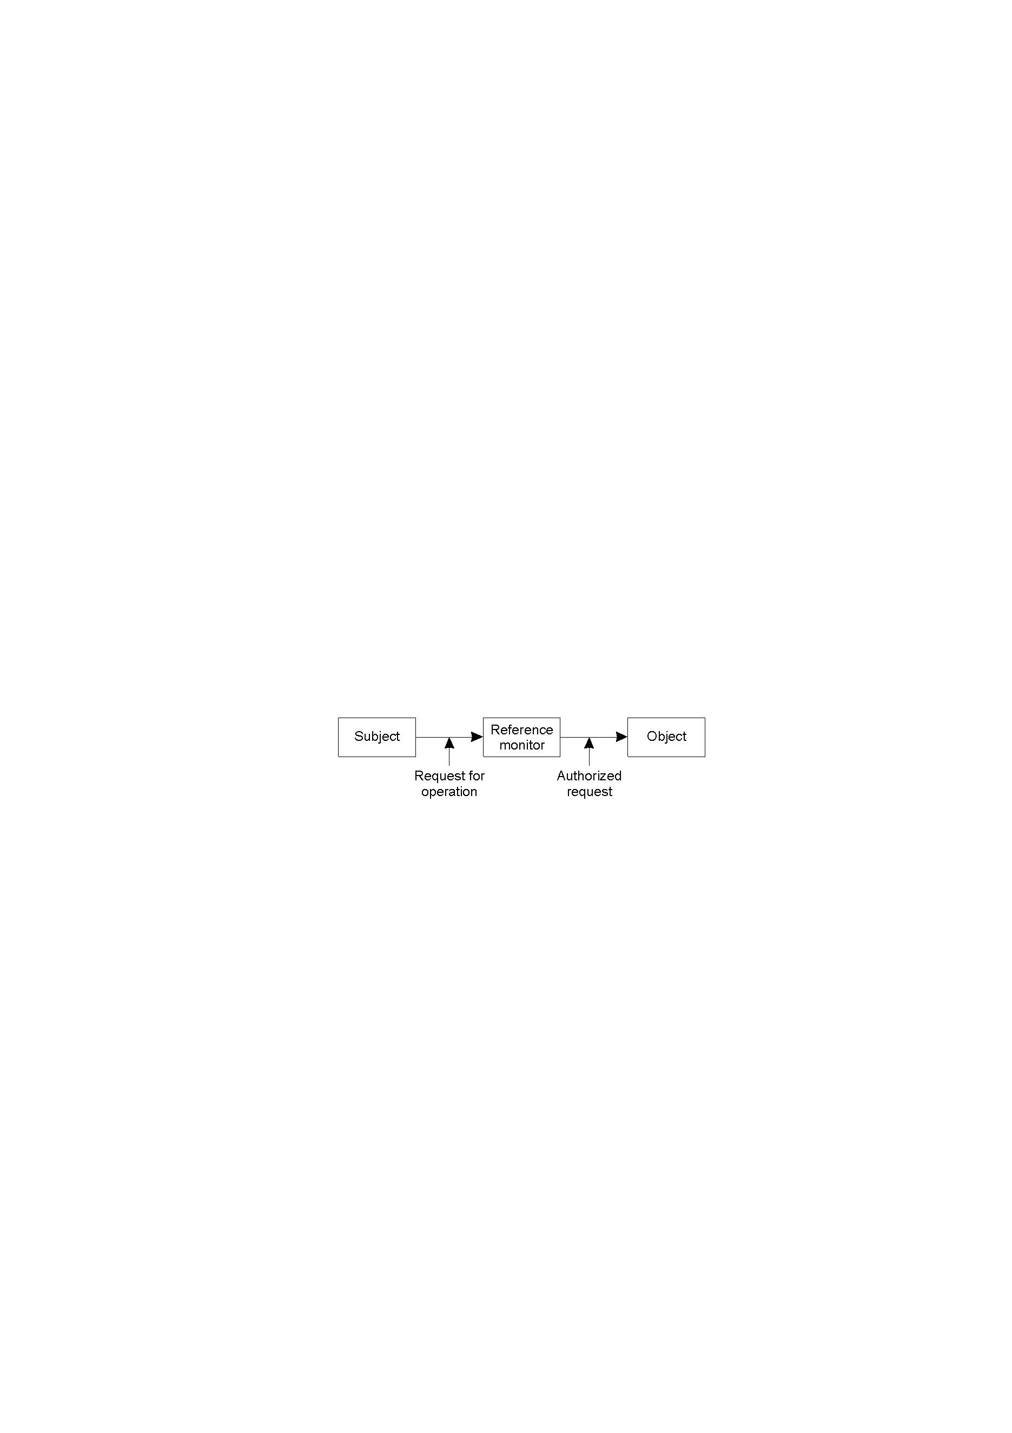
General Issues in Access Control
General model of controlling access to objects.

Slide 25
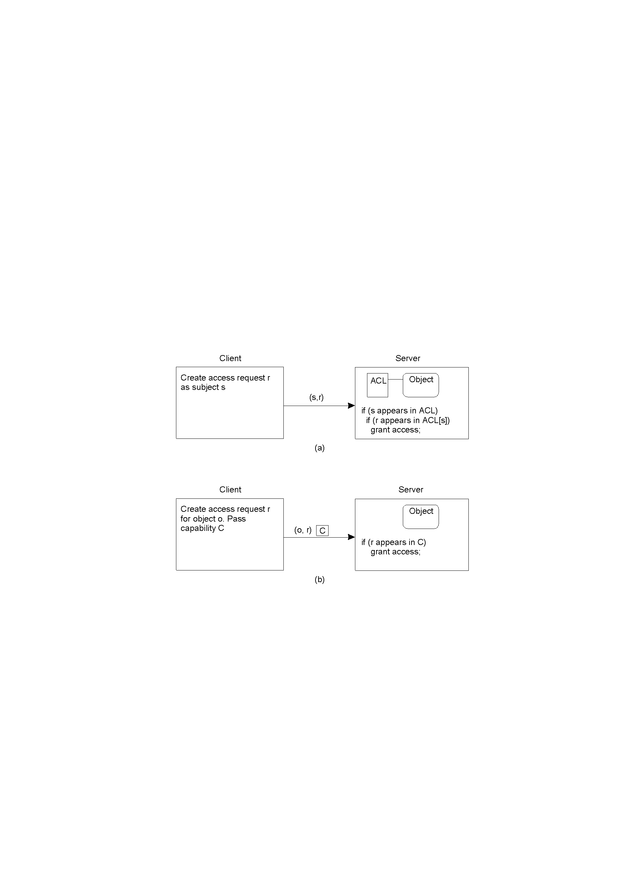
Access Control Matrix
Comparison between ACLs and capabilities for protecting objects.
Using an ACL
Using capabilities.

Slide 26
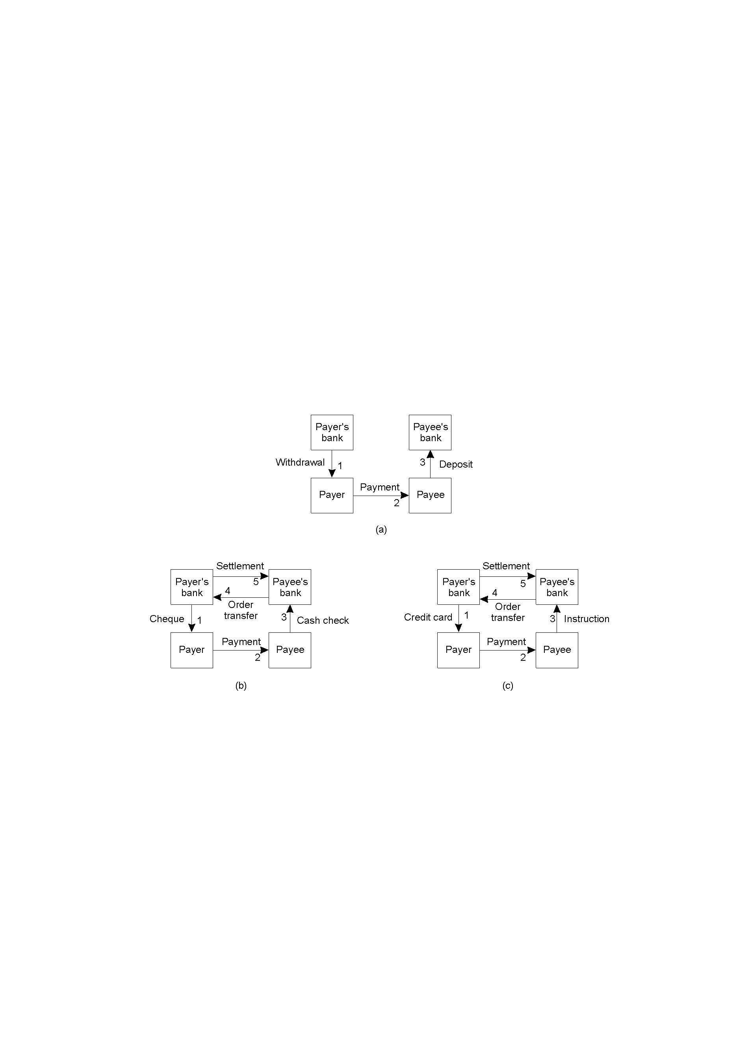
Electronic Payment Systems
Payment systems based on direct payment between customer and merchant.
Paying in cash.
Using a check.
Using a credit card.

Slide 27
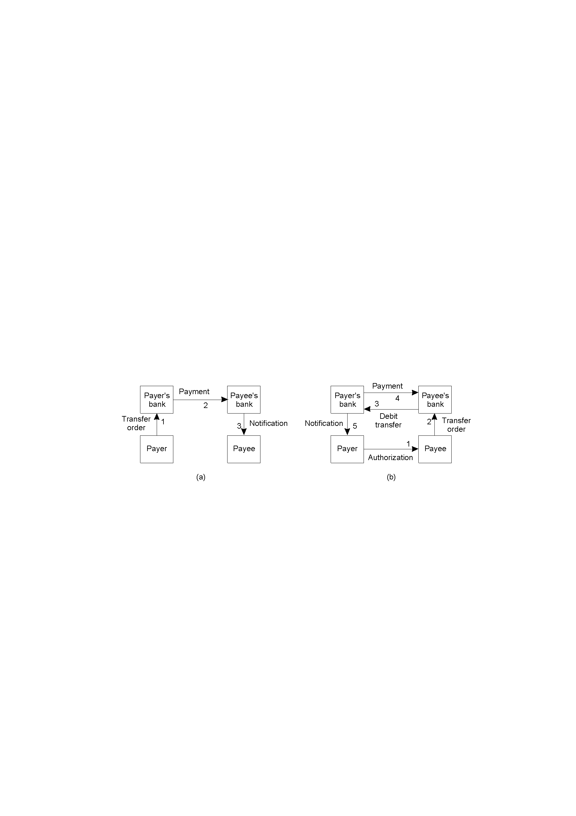
Electronic Payment Systems
Payment systems based on money transfer between banks.
Payment by money order.
Payment through debit order.

Slide 28


5 The Byzantine Generals Problem:
By Leslie Lamport, Robert Shostak, Marshall Pease
It is much more interesting to write about treacherous generals then a cpu failing
A reliable computer system must be able to cope with a failure of one or more of its components
A failed computer behavior in this case:
  Sending conflicting messages to different parts of the system
  Not sending some of the messages

Slide 29



Byzantine Generals (Abstract Expression)
Several divisions of the byzantine army are camped outside a city, each division has a general.
The generals can communicate with each other using a messenger
The generals must decide upon a common plan of action
Some of the generals might be traitors!
We will assume that there is a single commanding general (Commander), and the rest of the generals are his subordinates (Lieutenants)

Slide 30

Objective
A: All loyal generals decide upon the same plan of action
B: A small number of traitors will not cause the loyal generals to adopt a bad plan
Formally: The Byzantine Generals Problem
All loyal lieutenants obey the same order
If the commander is loyal, then every loyal
lieutenant obeys the order he sends
Notes:
Conditions 1,2 are called interactive consistency conditions
If the commander is loyal, then cond1 follows from cond2

Slide 31


Outline
Minimal bound on the number of traitors
Oral messages algorithm to reach agreement
Written messages algorithm to reach agreement

