Slide 1
Name Services (Devam)

Slide 2
General Name Service Requirements
  Handle arbitrary number of names and to serve arbitrary number of administrative organizations.
  A long lifetime
  High availability
  Fault isolation
  Tolerance of mistrust

Slide 3
Design Issues
Name spaces
Name Resolution
The domain name system

Slide 4
Name Spaces
A name space is a collection of all valid names recognized by a particular service
Allow simple but meaningful names to be used
Potentially infinite number of names
Structured
  to allow similar subnames without clashes
  to group related names
Allow re-structuring of name trees
  for some types of change, old programs should continue to work
Management of trust

Slide 5
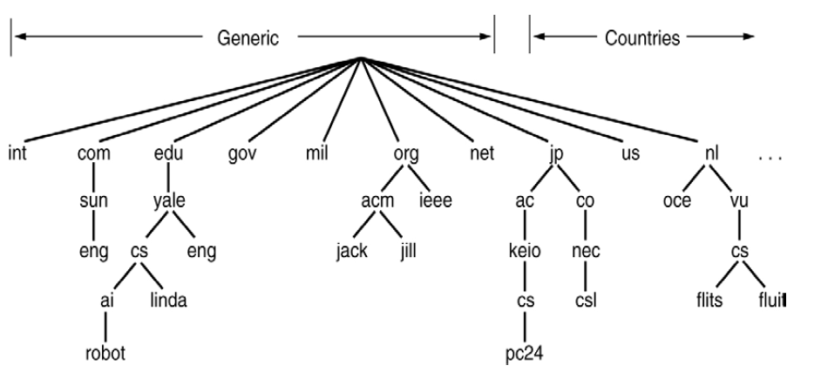
Name Space

Slide 6
Name Resolution
Resolution is an iterative process whereby a name is repeatedly presented to the naming contexts.
The name is first presented to some initial naming context; resolution iterates as long as further context and derived names are output.
Example1: /etc/passwd in which ‘etc’ is presented to context / and ‘passwd’ is presented to context /etc.
Example 2: www.dcs.qmw.ac.uk in which the alias is resolved to another domain name such as copper.dcs.qmw.ac.uk which is further resolved to produce IP address.
Notes:
Name resolution in the presence of cooperating name servers is called navigation and may be performed by the client or by the server.

Slide 7
Name Servers and Navigation
Any name service stores a very large database.
Data is partitioned into servers according to its domain.
Partitioning of the data implies that the local name server cannot answer all the enquiries without the help of other name servers.
Process of locating naming data from among more than one name server in order to resolve a name is called navigation. Ex: Iterative Navigation model(DNS)

Slide 8
Iterative navigation
NS2
2
Name
1
NS1
servers
Client
3
NS3
A client iteratively contacts name servers NS1–NS3 in order to resolve a name

Slide 9
Non-recursive and recursive server-controlled navigation
Figure 9.3
NS2
NS2
2
2
1
4
3
NS1
1
NS1
client
client
4
3
5
NS3
NS3
Non-recursive
Recursive
server-controlled
server-controlled
A name server NS1 communicates with other name servers on behalf of a client
DNS offers recursive navigation as an option, but iterative is the standard technique. Recursive navigation must be used in domains that limit client access to their DNS information for security reasons.
*

Slide 10
Caching
Client name resolution software and servers maintain a cache of previous name resolutions.
How long a resolver caches a DNS response (i.e. how long a DNS response remains valid) is determined by a value called the time to live.
Server may use data from its own cache or other server cache it is authorized to access.
Caching is key to performance and fault tolerance.

Slide 11
The Domain Name System
A distributed naming database
Name structure reflects administrative structure of the Internet
Rapidly resolves domain names to IP addresses
  exploits caching heavily
  typical query time ~100 milliseconds
Scales to millions of computers
  partitioned database
  caching
Resilient to failure of a server
  replication
Notes:
The Domain Name System resolves names on a world-wide scale and represents a considerable engineering achievement.

Slide 12
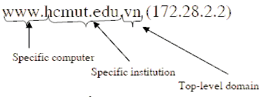
Parts of a domain name
Usually consists of two or more parts (technically labels), separated by dots. .
The rightmost label conveys the top-level domain.
Each label to the left specifies a subdivision, or subdomain of the domain above it.

Slide 13
DNS name servers
The Domain Name System consists of a hierarchical set of DNS servers
Each domain or subdomain has one or more authoritative DNS servers that publish information about that domain and the name servers of any domains "beneath" it
The hierarchy of authoritative DNS servers matches the hierarchy of domains.
At the top of the hierarchy stand the root nameservers: the servers to query when looking up (resolving) a top-level domain name

Slide 14
Basic DNS algorithm for name resolution
Look for the name in the local cache
Try a superior DNS server, which responds with:
  another recommended DNS server
  the IP address (which may not be entirely up to date)

Slide 15
DNS name servers
Figure 9.4
a.root-servers.net
(root)
uk
ns1.nic.uk
purdue.edu
Note: Name server names are in italics, and the corresponding domains are in parentheses.
Arrows denote name server entries
(uk)
yahoo.com
....
ns.purdue.edu
co.uk
(purdue.edu)
ac.uk
...
ns0.ja.net
(ac.uk)
* .purdue.edu
ic.ac.uk
authoritative path to lookup:
jeans-pc.dcs.qmw.ac.uk
qmw.ac.uk
...
alpha.qmw.ac.uk
dns0.dcs.qmw.ac.uk
dns0-doc.ic.ac.uk
(qmw.ac.uk)
(dcs.qmw.ac.uk)
(ic.ac.uk)
dcs.qmw.ac.uk
*.dcs.qmw.ac.uk
*.ic.ac.uk
*.qmw.ac.uk
*

Slide 16
DNS in typical operation
a.root-servers.net
Without caching
(root)
uk
ns1.nic.uk
purdue.edu
(uk)
yahoo.com
....
ns.purdue.edu
co.uk
(purdue.edu)
ac.uk
...
ns0.ja.net
(ac.uk)
* .purdue.edu
ic.ac.uk
qmw.ac.uk
...
IP: alpha.qmw.ac.uk
2
alpha.qmw.ac.uk
dns0.dcs.qmw.ac.uk
dns0-doc.ic.ac.uk
client.ic.ac.uk
(qmw.ac.uk)
(dcs.qmw.ac.uk)
(ic.ac.uk)
IP:jeans-pc.dcs.qmw.ac.uk
IP:ns0.ja.net
dcs.qmw.ac.uk
*.dcs.qmw.ac.uk
*.ic.ac.uk
1
4
*.qmw.ac.uk
jeans-pc.dcs.qmw.ac.uk ?
3
IP:dns0.dcs.qmw.ac.uk
*
Notes:
Animation: reveals each step in looking up jeans-pc.dcs.qmw.ac.uk from a client in the ic.ac.uk domain
Discuss how caching reduces the number of steps.

Slide 17
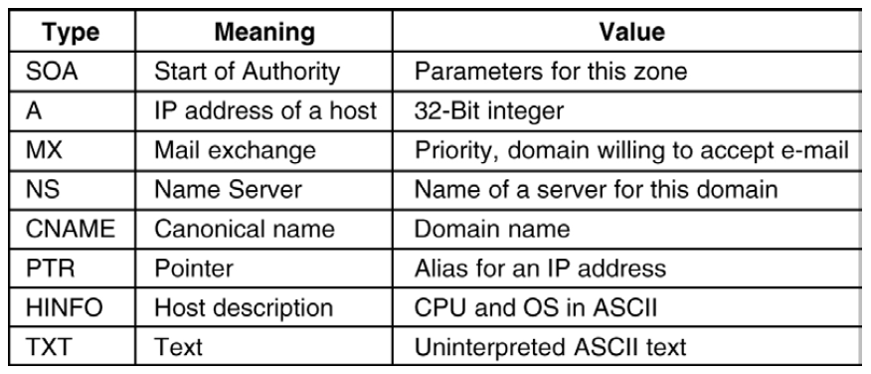
Resource Records

Slide 18
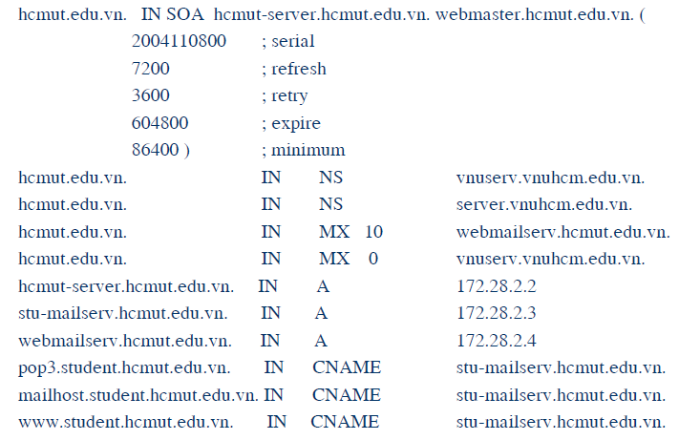
Example of resource record

Slide 19
DNS issues
Name tables change infrequently, but when they do, caching can result in the delivery of stale data.
  Clients are responsible for detecting this and recovering
Its design makes changes to the structure of the name space difficult. For example:
  merging previously separate domain trees under a new root
  moving subtrees to a different part of the structure (e.g. if Scotland became a separate country, its domains should all be moved to a new country-level domain.

Slide 20
Directory and Discovery Services
Directory services
  Attribute-based name services
  Attributes are used as values to be looked up
  Textual name can be considered to be just another attribute

Slide 21
Directory and Discovery Services
Discovery services
  Directory service that registers services provided in a spontaneous networking environment
  Provide an interface for automatically registering and de-registering services, as well as an interface for clients to look up the services they require
  Ex : a printer (or the service that manages it) may register its attributes with the discovery service as follows :
    ‘resourceClass = printer, type=laser, color=yes, resolution=600dpi, location=room101, url=http://www.hotelNW.com/services/printer98’

Slide 22
Jini Discovery Service
Designed to be used for spontaneous networking
Entirely java-based
Computers communicate by means of RMI, and can download code if necessary
Discovery-related components in a Jini system are look up services
A Jini service (such as printing service) may be registered with many look up services

Slide 23
Jini Discovery Service
How to locate the look up service ?
  Using a well-known multicast IP address
  Multicast the request using a “time to live” value
  Look up services announce their existence to the same multicast address
Service instance is configured with one or more group names such as ‘finance’, ‘sales’, ‘admin’, which act as scoping labels.
Limited period of time

Slide 24
Service Discovery in Jini
admin
Printing
Client
1. ‘finance’
service
lookup service?
admin
Lookup
Client
service
Network
2. Here I am: .....
4. Use printing
service
admin, finance
3. Request
Lookup
Corporate
Printing
printing
service
infoservice
service
finance

Slide 25
Global Name Service (GNS)
Designed and implemented by Lampson and colleagues at the DEC Systems Research Center (1986)
Provide facilities for resource location, email addressing and authentication
When the naming database grows from small to large scale, the structure of name space may change
  the service should accommodate it
Cache consistency ?

Slide 26
GNS Structure
Tree of directories holding names and values
Muti-part pathnames refer to the root or relative working directory (like Unix file system)
Unique Directory Identifier (DI)
A directory contains list of names and references
Leaves of tree contain value trees (structured values)

Slide 27
GNS directory tree and value tree
DI: 599
(EC)
DI: 543
UK
FR
DI: 574
DI: 437
AC
DI: 322
QMW
Peter.Smith
mailboxes
password
Alpha
Beta
Gamma

Slide 28
Accommodating changes
DI: 633
(WORLD)
Well-known directories:
#599 = #633/EC
#642 = #633/NORTH AMERICA
EC
NORTH AMERICA
DI: 599
DI: 642
UK
FR
US
CANADA
DI: 543
DI: 574
DI: 732
DI: 457
How to integrate naming trees of two previously separate GNS services
But what is for ‘/UK/AC/QMV, Peter.Smith’ ?

Slide 29
Using DI to solve changes
DI: 633
(WORLD)
Well-known directories:
#599 = #633/EC
#642 = #633/NORTH AMERICA
EC
NORTH AMERICA
DI: 599
DI: 642
UK
FR
US
CANADA
DI: 543
DI: 574
DI: 732
DI: 457
Using the name ‘#599/UK/AC/QMV, Peter.Smith’

Slide 30
Restructuring of database
DI: 633
(WORLD)
Well-known directories:
#599 = #633/EC
#642 = #633/NORTH AMERICA
EC
NORTH AMERICA
DI: 599
DI: 642
UK
FR
US
US
CANADA
DI: 543
DI: 574
DI: 732
DI: 457
#633/EC/US
Using symbolic links

