Slide 1
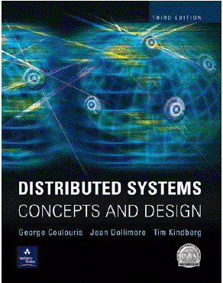
Introduction to Distributed Systems and Characterisation
Most concepts are
drawn from Chapter 1
© Pearson Education

Slide 2
Presentation Outline
Introduction
Defining Distributed Systems
Characteristics of Distributed Systems
Example Distributed Systems
Challenges of Distributed Systems
Summary

Slide 3
Introduction
Networks of computers are everywhere!
  Mobile phone networks
  Corporate networks
  Factory networks
  Campus networks
  Home networks
  In-car networks
  On board networks in aero planes and trains
This subject aims:
  to cover characteristics of networked computers that impact system designers and implementers, and
  to present the main concepts and techniques that have been developed to help in the tasks of designing and implementing systems and applications that are based on networks.

Slide 4
Defining Distributed Systems
“A system in which hardware or software components located at networked computers communicate and coordinate their actions only by message passing.” [Coulouris]
“A distributed system is a collection of independent computers that appear to the users of the system as a single computer.” [Tanenbaum]
Def of Distributed Systems says:
  Concurrency
    Concurrent program execution, working together as a single, integrated computing resource.
  No global clock
    Computers: Synchronize their clocks. Limits to the accuracy
  Independent failure

Slide 5
Leslie Lamport’s Definition
"A distributed system is one on which I cannot get any work done because some machine I have never heard of has crashed.“
  Leslie Lamport – a famous researcher on timing, message ordering, and clock synchronization in distributed systems.

Slide 6
Networks vs. Distributed Systems
Networks: A media for interconnecting local and wide area computers and exchange messages based on protocols. Network entities are visible and they are explicitly addressed (IP address).
Distributed System: existence of multiple autonomous computers is transparent
However,
  many problems (e.g., openness, reliability) in common, but at different levels.
    Networks focuses on packets, routing, etc., whereas distributed systems focus on applications.
    Every distributed system relies on services provided by a computer network.
Distributed Systems
Computer Networks

Slide 7
Reasons for Distributed Systems
Functional Separation:
  Existence of computers with different capability and purpose:
    Clients and Servers
    Data collection and data processing
Inherent distribution:
    Information:
      Different information is created and maintained by different persons (e.g., Web pages)
    People
      Computer supported collaborative work (virtual teams, engineering, virtual surgery)
    Retail store and inventory systems for supermarket chain
Power imbalance and load variation:
    Distribute computational load among different computers.
Reliability:
  Long term preservation and data backup (replication) at different location.
Economies:
  Sharing a printer by many users and reduce the cost of ownership.
  Building a supercomputer out of a network of computers.

Slide 8
Consequences of Distributed Systems
Computers in distributed systems may be on separate continents, in the same building, or the same room. DS have the following consequences:
  Concurrency – each system is autonomous.
    Carry out tasks independently
    Tasks coordinate their actions by exchanges messages.
  Heterogeneity (variety, difference): networks, hw, os, PLan,
  No global clock
  Independent Failures

Slide 9
Characteristics of distributed systems
Parallel activities
  Autonomous components executing concurrent tasks
Communication via message passing
  No shared memory
Resource sharing
  Printer, database, other services
No global state
  No single process can have knowledge of the current global state of the system
No global clock
  Only limited precision for processes to synchronize their clocks

Slide 10
Goals of Distributed Systems
Connecting Users and Resources: access services and run applications
Transparency: hide that resources and processes are distributed across a network
Openness: standard rules about syntax and semantics of services
Scalability: more users/resources, geography, administration
Enhanced Availability

Slide 11
Differentiation with parallel systems [1]
Multiprocessor systems
  Shared memory
  Bus-based interconnection network
  E.g. SMPs (symmetric multiprocessors) with two or more CPUs
Multicomputer systems
  No shared memory
  Homogeneous in hardware and software
    Massively Parallel Processors (MPP)
      Tightly coupled high-speed network
    PC/Workstation clusters
      High-speed networks/switches based connection.
Notes:
Most of today’s supercomputers are MPPs

Slide 12
Differentiation with parallel systems is blurring
Extensibility of clusters leads to heterogeneity
  Adding additional nodes as requirements grow
Extending clusters to include user desktops by harnessing their idle resources.
  E.g., SETI@Home
Leading to the rapid convergence various concepts of parallel and distributed systems.

Slide 13
Examples of Distributed Systems
They are based on familiar and widely used computer networks:
  Internet: interconnected collection of computer networks of many different types.
    Apps: pass msgs to interact
    Dist. System: users make use of www, email, file transfer, other services (open-ended)
  Intranet: subnetwork operated by a company or other organization. Has a boundary with local security policy.
    Linked by backbones(a network link w/ high transmission capacity like satellite connections, fiber optic cables, etc.
  wireless networks

Slide 14
A typical portion of the Internet and its services:
Multimedia services providing access to music, radio, TV channels, video conferencing and supporting several users.
intranet

ISP



backbone
satellite link
desktop computer:
server:
network link:
The Internet is a vast collection of computer networks of many different types and hosts various types of services.

Slide 15
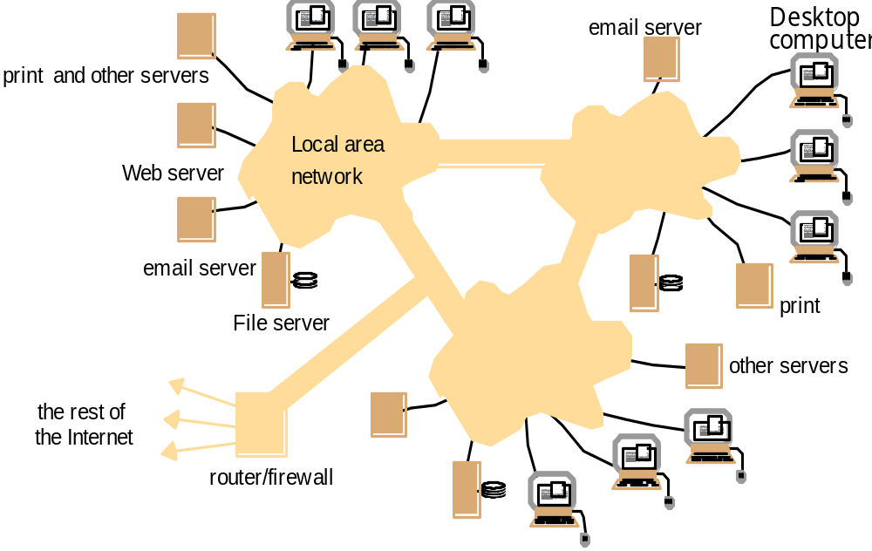
A typical intranet:
A portion of Internet that is separately administered & supports internal sharing of resources (file/storage systems and printers)

Slide 16
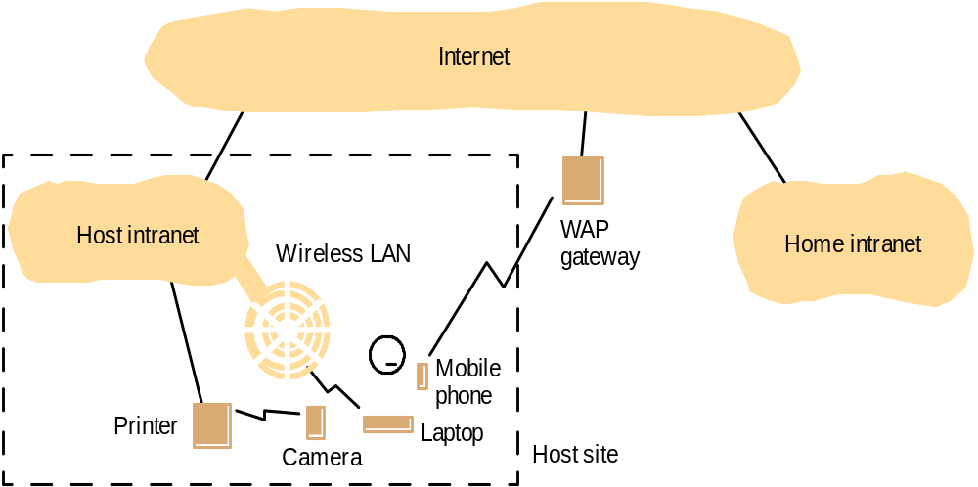
Mobile and ubiquitous computing: portable and handheld devices in a distributed system
Support continued access to Home intranet resources via wireless and provision to utilise resources (e.g., printers) that are conveniently located (location-aware computing).

Slide 17
Resource sharing and the Web: open protocols, scalable servers, and pluggable browsers
http://www.google.com/search?q=Hakkoymaz
www.google.com
Web servers
Browsers
www.cdk3.net
Internet
http://www.cdk3.net/
www.w3c.org
File system of
http://www.w3c.org/Protocols/Activity.html
www.w3c.org
Protocols
Activity.html

Slide 18
Business Example and Challenges
Online bookstore (e.g. in the World Wide Web)
  Customers can connect their computer to your computer (web server):
    Browse your inventory
    Place orders
    …

Slide 19
Business example – challenges I
What if
  Your customer uses a completely different hardware? (PC, MAC,…)
  … a different operating system? (Windows, Unix,…)
  … a different way of representing data? (ASCII, EBCDIC,…)
  Heterogeneity (networks, h/w, os, prog lan, impl)
Or
  You want to move your business and computers to the South (because of the weather)?
  Your client moves to the South (more likely)?
  Location / Migration / Distribution transparency

Slide 20
Business example – challenges II
What if
  Two customers want to order the same item at the same time?
  Concurrency
Or
  The database with your inventory information crashes?
  Your customers computer crashes in the middle of an order?
  Fault tolerance

Slide 21
Business example – challenges III
What if
  Someone tries to break into your system to steal data?
  … sniffs for information?
  … your customer orders something and doesn’t accept the delivery saying he didn’t?
  Security
Or
  You are so successful that millions of people are visiting your online store at the same time?
  Scalability

Slide 22
Business example – challenges IV
When building the system…
  Do you want to write the whole software on your own (network, database,…)?
  What about updates, new technologies?
  Reuse and Openness (Standards)

Slide 23
Overview challenges I
Heterogeneity
  Heterogeneous components must be able to interoperate
Distribution transparency
  Distribution should be hidden from the user as much as possible
Fault tolerance
  Failure of a component (partial failure) should not result in failure of the whole system
Scalability
  System should work efficiently with an increasing number of users
  System performance should increase with inclusion of additional resources.

Slide 24
Overview challenges II
Concurrency
  Shared access to resources must be possible
Openness
  Interfaces should be publicly available to ease adding new components
Security
  The system should only be used in the way intended

Slide 25
Heterogeneity
Heterogeneous components must be able to interoperate
  Operating systems
  Hardware architectures
  Communication architectures
  Programming languages
  Software interfaces
  Security measures
  Information representation

Slide 26
Distribution Transparency I
To hide from the user and the application programmer of the separation/distribution of components, so that the system is perceived as a whole rather than a collection of independent components.
ISO Reference Model for Open Distributed Processing (ODP) identifies the following forms of transparencies:
Access transparency
  Access to local or remote resources is via identical operations
  e.g. Network File System
Location transparency
  Access resources without knowledge of their physical location
  e.g. separation of domain name from machine address.
Failure transparency
  Tasks can be completed despite failures
  e.g. message retransmission, failure of a Web server node should not bring down the website.

Slide 27
Distribution Transparency II
Replication transparency
  Access to replicated resources as if there was just one. And provide enhanced reliability and performance without knowledge of the replicas by users or application programmers.
Migration (mobility/relocation) transparency
  Allow the movement of resources and clients within a system without affecting the operation of users or applications.
  e.g. switching from one name server to another at runtime; migration of an agent/process form one node to another.

Slide 28
Distribution Transparency III
Concurrency transparency
  A process should not notice that there are other processes sharing the same resources
Performance transparency:
  Allows the system to be reconfigured to improve performance as loads vary.
  e.g., dynamic addition/deletion of components. switching from linear structures to hierarchical structures when the number of users increase.
Scaling transparency:
  Allows the system and applications to expand in scale without change to the system structure or the application algorithms.
Network transparency: access + location transparencies

Slide 29
Failure Transparency:Fault tolerance
Failure: an offered service no longer complies with its specification
Fault: cause of a failure (e.g. failure of a component)
Fault tolerance: no failure despite faults
  Ex: Eventual delivery of e-mail messages

Slide 30
Fault tolerance mechanisms
Fault detection
  Checksums, heartbeat, …
Fault masking
  Retransmission of corrupt messages, redundancy, …
Fault toleration
  Exception handling, timeouts,…
Fault recovery
  Rollback mechanisms,…

Slide 31
Scalability
System should work efficiently at many different scales, ranging from a small Intranet to the Internet.
Remain effective when there is a significant increase in the number of resources and the number of users.
Challenges of designing scalable distributed systems:
  Cost of physical resources
    Cost should linearly increase with system size
  Performance Loss
    For example, in hierarchically structure data, search performance loss due to data growth should not be beyond O(log n), where n is the size of data.
  Preventing software resources running out:
    Numbers used to represent Internet address (32 bit->64bit)
    Y2K like problem.
  Avoiding performance bottlenecks:
    Use decentralized algorithms (dns: centralized vs decentralized).

Slide 32
Concurrency
Resource access: one client at a time → limited througput
Multiple client requests: concurrently
Provide and manage concurrent access shared resources:
  Fair scheduling
  Preserve dependencies (e.g. distributed transactions)
  Avoid deadlocks

Slide 33
Openness and Interoperability
Open system:
"... a system that implements sufficient open specifications for interfaces, services, and supporting formats to enable properly engineered applications software to be ported across a wide range of systems with minimal changes, to interoperate with other applications on local and remote systems, and to interact with users in a style which facilitates user portability" (Guide to the POSIX Open Systems Environment, IEEE POSIX 1003.0).
Open spec/standard developers - communities:
  ANSI, IETF, W3C, ISO, IEEE, OMG, Trade associations,...
New services can be added w/o disturbing existing components.

Slide 34
Security I
The resources are accessible to authorized users and used in the way they are intended.
Confidentiality
  Protection against disclosure to an unauthorized individuals.
  E.g. ACLs (access control lists) to provide authorized access to information.
Integrity
  Protection against alteration, changes or corruption.
  e.g. changing the account number or amount value in a money order
Notes:
Link auf Heiss

Slide 35
Security II
Availability
  Protection against interference with the means to access the resources.
  E.g. denial of service attacks
Non-repudiation
  Proof of sending / receiving an information
  e.g. digital signature

Slide 36
Security mechanisms
Encryption
  E.g. Blowfish, RSA
Authentication
  E.g. password, public key authentication
Authorization
  E.g. access control lists

Slide 37
Summary
Distributed Systems are everywhere.
The Internet enables users throughout the world to access its services wherever they are located.
Resource sharing is the main motivating factors for constructing distributed systems.
Construction of DS produces many challenges:
  Heterogeneity, Openness, Security, Scalability, Failure handling, Concurrency, and Transparency.
Distributed systems enable globalization:
  Community (Virtual teams, organizations, social networks)
  Science (e-Science)
  Business (e-Bussiness)

