Slide 1
Communication Skills

Slide 2
How to Improve English Communication Skills
Practise makes a man perfect.
Start your practise with lot of interest.
Motivation
0-<number>

Slide 3
8 steps
Read the dictionary and remember five to ten words a day. (Why? Vocabulary)
When you read a word, find some examples of how to use that word in many ways. (Why? Usage, practice)
Ask your friends and family. Get guidance if you really don't know the meaning of the word or are unclear about how to use the word properly.(Why? usage,communication)
0-<number>

Slide 4
8 steps (cont’d)
Feel free to talk in English even though you are learning. (Why? Learn via trial-error)
Think before you speak and your message will be clearer.(Why? Brain power)
Do not feel shy or nervous to learn from others.(Why? Win-win strategy)
Apply simple English words in your routine. The practice will help you to a great extent. (Why? Use what you know)
Never lose your desire to learn new words. Always keep up the practise.(How? Motivation)
0-<number>

Slide 5
Tips
Practice daily.
Do not feel overwhelmed. Take it one word at a time and be happy for the having learned each new word.
Listen carefully and jot down any words to look up in the dictionary.
Speak, learn, and practice with confidence.
0-<number>

Slide 6
Motivation
story
0-<number>

Slide 7
Database Systems
Database Fundamentals
The Relational Model
Object-Oriented Model
Maintaining Database Integrity
Social Impact of Database Technology
0-<number>

Slide 8
Database
A collection of data that is multidimensional in the sense that internal links between its entries make the information accessible from a variety of perspectives
0-<number>

Slide 9
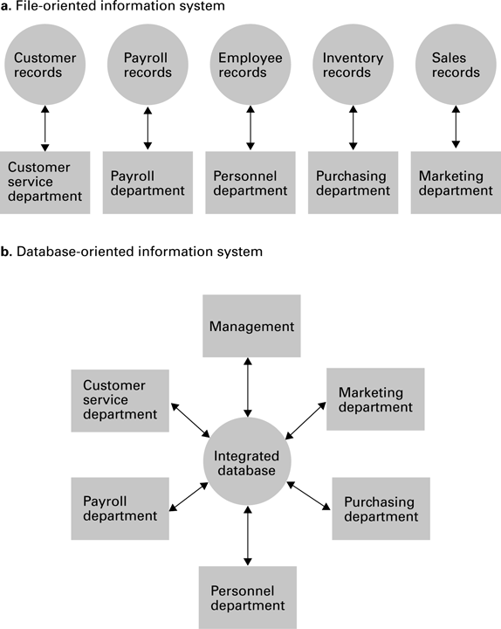
A file versus a database organization
0-<number>

Slide 10
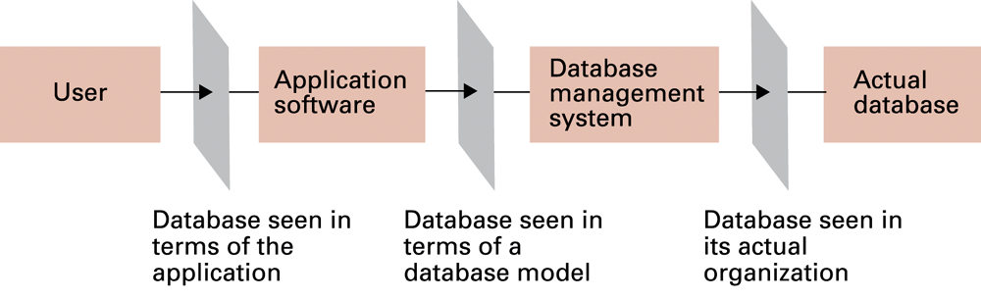
The conceptual layers of a database implementation
0-<number>

Slide 11
Schemas
Schema: A description of the structure of an entire database, used by database software to maintain the database
Subschema: A description of only that portion of the database pertinent to a particular user’s needs, used to prevent sensitive data from being accessed by unauthorized personnel
0-<number>

Slide 12
Database Management Systems
Database Management System (DBMS): A software layer that manipulates a database in response to requests from applications
Distributed Database: A database stored on multiple machines
  DBMS will mask this organizational detail from its users
Data independence: The ability to change the organization of a database without changing the application software that uses it
0-<number>

Slide 13
Database Models
Database model: A conceptual view of a database
  Relational database model
  Object-oriented database model
0-<number>

Slide 14
Relational Database Model
Relation: A rectangular table
  Attribute: A column in the table
  Tuple: A row in the table
0-<number>

Slide 15
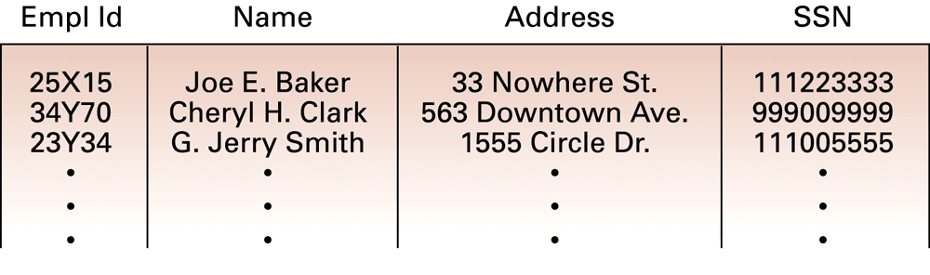
A relation containing employee information
0-<number>

Slide 16
Relational Design
Avoid multiple concepts within one relation
Otherwise(multiple concepts in one relation)
  Can lead to redundant data
  Deleting a tuple could also delete necessary but unrelated information
0-<number>

Slide 17
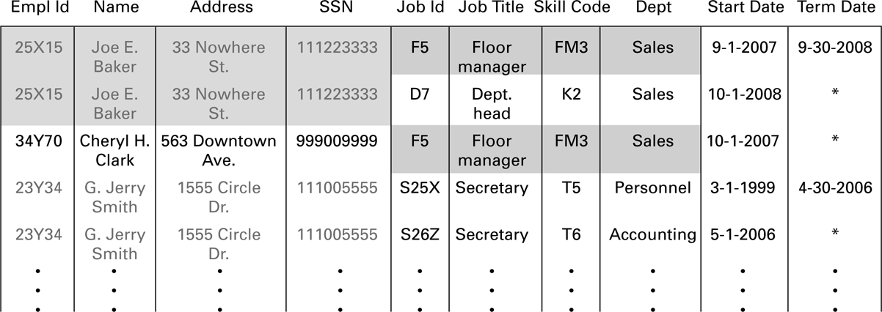
A relation containing redundancy
0-<number>

Slide 18
Improving a Relational Design
Decomposition: Dividing the columns of a relation into two or more relations, duplicating those columns necessary to maintain relationships
  Lossless or nonloss decomposition: A “correct” decomposition that does not lose any information
0-<number>

Slide 19
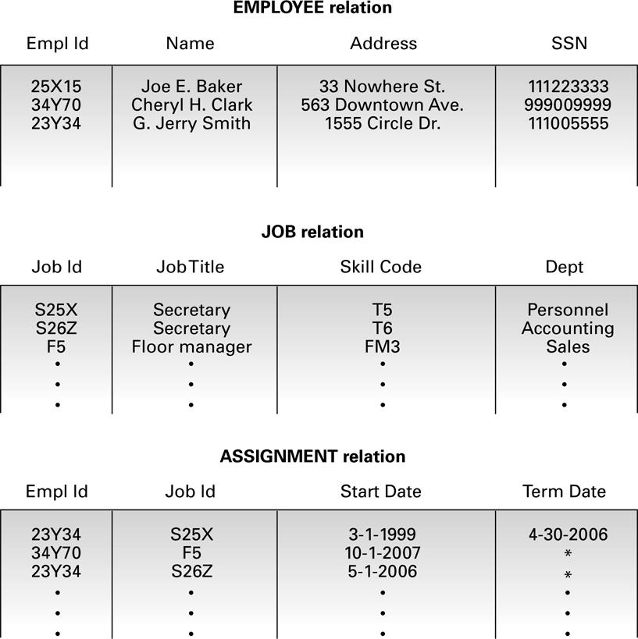
An employee database consisting of three relations
0-<number>

Slide 20
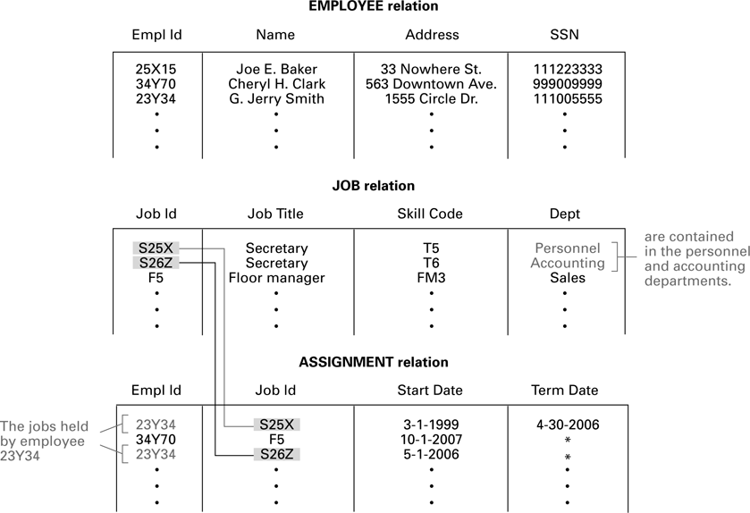
Finding the departments in which employee 23Y34 has worked
0-<number>

Slide 21
Relational Operations
Select: Choose rows
Project: Choose columns
Join: Assemble information from two or more relations
Product: Cartesian product
0-<number>

Slide 22
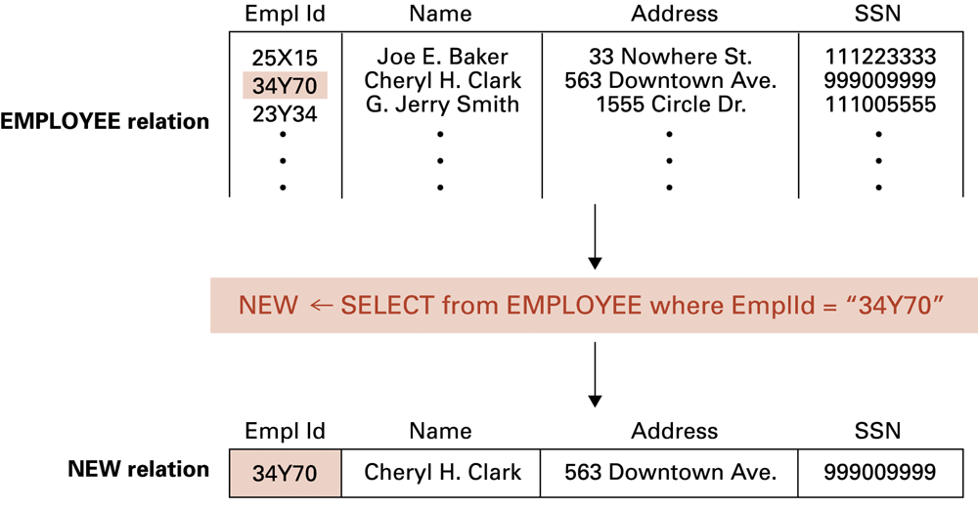
The SELECT operation
0-<number>

Slide 23
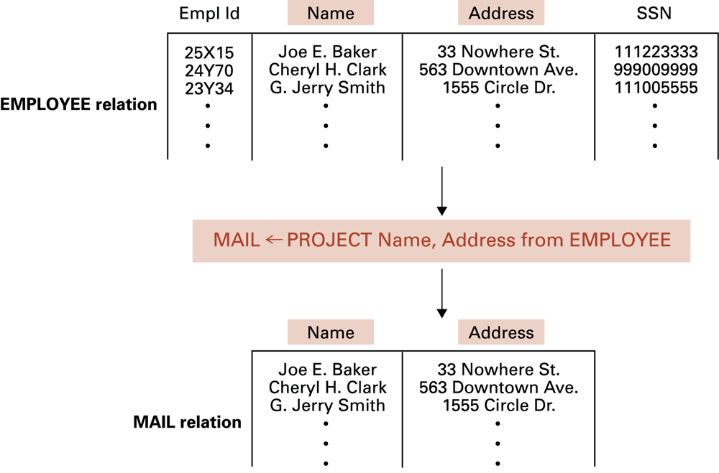
The PROJECT operation
0-<number>

Slide 24
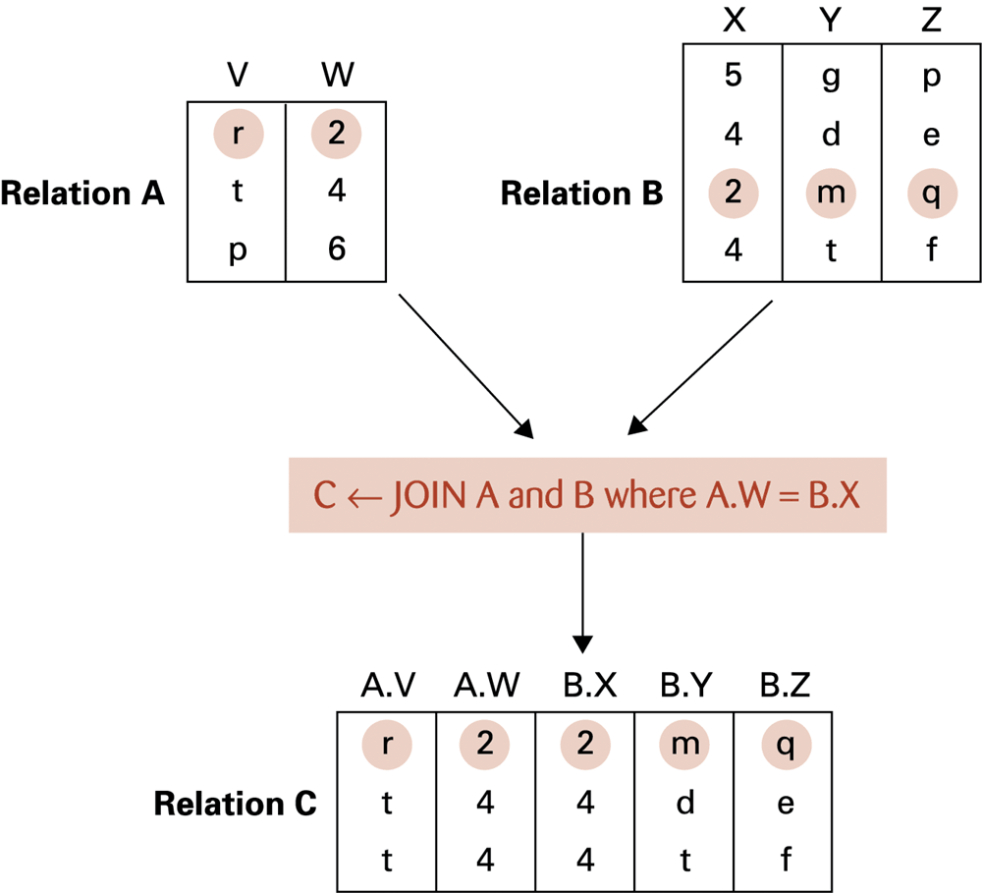
The JOIN operation
0-<number>

Slide 25
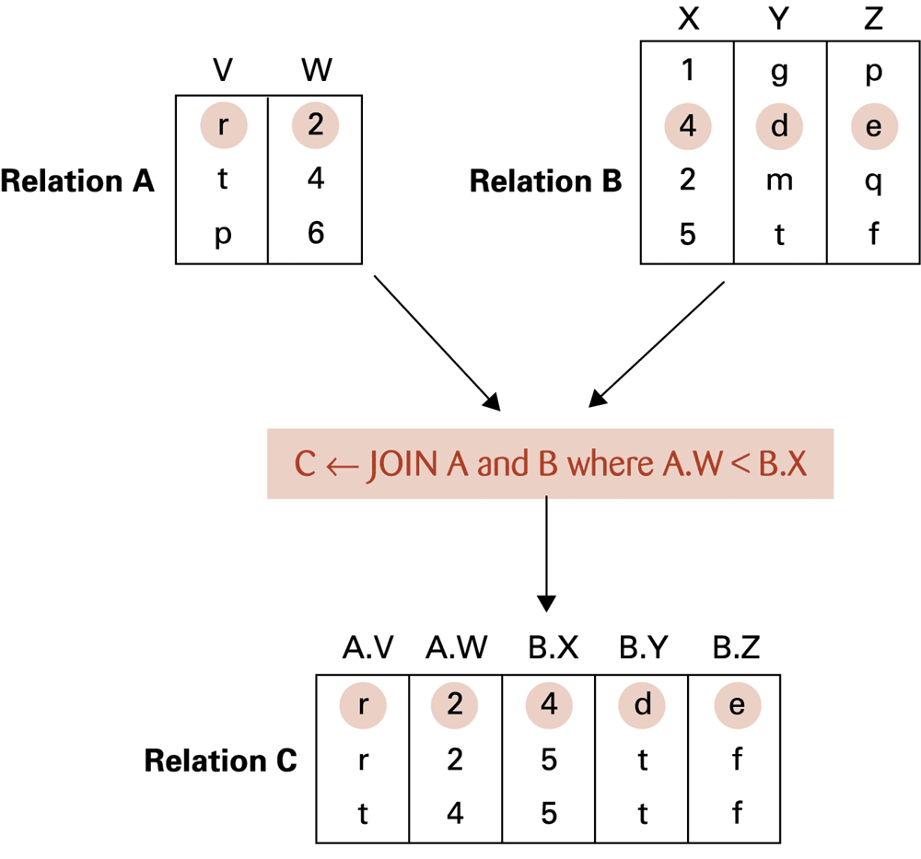
Another example of the JOIN operation
0-<number>

Slide 26
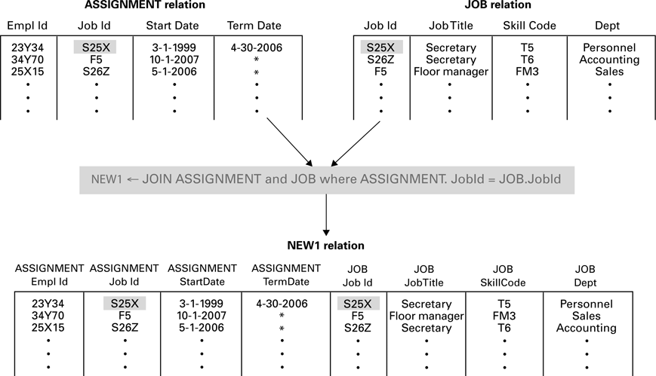
An application of the JOIN operation
0-<number>

Slide 27
Product Operation
Operation to manipulate two relations A and B:
  Take a tuple of A, concatenate it with every tuple of B
  Repeat until no tuple left in A
0-<number>

Slide 28
Structured Query Language (SQL)
Operations to manipulate tuples
  insert
  update
  delete
  select
0-<number>

Slide 29
SQL Examples
select EmplId, Dept
from ASSIGNMENT, JOB
where ASSIGNMENT.JobId = JOB.JobId
and ASSIGNMENT.TermData = “*”
insert into EMPLOYEE
values (‘43212’, ‘Sue A. Burt’,
’33 Fair St.’, ‘444661111’)
0-<number>

Slide 30
SQL Examples (continued)
delete from EMPLOYEE
where Name = ‘G. Jerry Smith’
update EMPLOYEE
set Address = ‘1812 Napoleon Ave.’
where Name = ‘Joe E. Baker’
0-<number>

Slide 31
Object-oriented Databases
Object-oriented Database: A database constructed by applying the object-oriented paradigm
  Each entity stored as a persistent object
  Relationships indicated by links between objects
  DBMS maintains inter-object links
0-<number>

Slide 32
Advantages of Object-oriented Databases
Matches design paradigm of object-oriented applications
Intelligence can be built into attribute handlers
Can handle exotic data types
  Example: multimedia
0-<number>

Slide 33
Maintaining Database Integrity
Transaction: A sequence of operations that must all happen together
  Example: transferring money between bank accounts
Transaction log: A non-volatile record of each transaction’s activities, built before the transaction is allowed to execute
  Commit point: The point at which a transaction has been recorded in the log
  Roll-back: The process of undoing a transaction
0-<number>

Slide 34
Maintaining database integrity (continued)
Simultaneous access problems
  Incorrect summary problem
  Lost update problem
Locking = preventing others from accessing data being used by a transaction
  Shared lock: used when reading data
  Exclusive lock: used when altering data
0-<number>

Slide 35
Data Mining
Data Mining: The area of computer science that deals with discovering patterns in collections of data
Data warehouse: A static data collection to be mined
  Data cube: Data presented from many perspectives to enable mining
0-<number>

Slide 36
Data Mining Strategies
Class description
Class discrimination
Cluster analysis
Association analysis
Outlier analysis
Sequential pattern analysis
0-<number>

Slide 37
Social Impact of Database Technology
Problems
  Massive amounts of personal data are being collected
    Often without knowledge or meaningful consent of affected people
  Data merging produces new, more invasive information
  Errors are widely disseminated and hard to correct
Remedies
  Existing legal remedies often difficult to apply
  Negative publicity may be more effective
0-<number>

