Slide 1
VERİ TABANI DERS NOTLARI
Ders #3: Relational Model (İlişkisel Model)
References
Examples from “Elmasri, Navathe, Fund. of Database Systems, Addison Wesley”

Slide 2

İlişkisel Veri Modeli (Relational Model)
İlişkisel Model’de Kısıtlamalar (Constraints)
İlişkisel Model’de Şema (Schemas) ve Olgu
Dönüştürme: Varlık-Bağıntı Modeli (ER) → İlişkisel Model (RM)
  Varlık Kümelerini dönüştürme
  Bağıntı Kümelerini dönüştürme
Slide 5- <number>

Slide 3
Relational model: after hierarchical & network models
  First commercial implementations available in early 1980s
  Implemented in a large number of commercial system
İlişkisel Model, bildirim (declarative) esaslı bir modeldir.
  Bildirim esaslı model, kullanıcıya «NE İSTEDİĞİNİ» aktarma imkanı sağlar. Verinin nasıl yerleşeceği veya nasıl erişileceği ile ilgilenilmez. Diğer bir ifade ile, donanım ve gerçekleştirim ortamından veri bağımsızlığı (data independence) sağlanmış olur.
İlişkisel model, SQL isimli veri işleme (tanımlama / sorgulama) dili kullanır.
Model, geliştiricisi Codd (IBM Research): "A Relational Model of Data for Large Shared Data Banks," Communications of the ACM, June 1970. Yazarına ACM Turing Award ödülünü kazandırır (1981)
Öncü ilişkisel VTYS örnekleri: System R (IBM) ve Ingres (UC-Berkeley)
Slide 5- <number>

Slide 4
Relational Model Concepts
İlişkisel veri modeli, VT’nındaki bütün «veri ve bağıntıların» tablolar (çizelgeler) olarak gösterimine dayalıdır. Yani, bu modelin temel yapı taşı TABLO (ÇİZELGE)dir
Represents data as a collection of relations
Table of values
  Row
    Represents a collection of related data values
    Fact typically corresponds to a real-world entity or relationship
    Tuple
  Table name and column names: Interpret the meaning of the values in each row attribute

Slide 5

RM verileri ilişkiler topluluğu olarak modeller.
İlişki (relation) iki boyutlu bir değerler tablosu (table of values).
İlişkide, satır kümesi var (set of rows). Satırlar tuples-çoklu diye de adlandırılır.
Satır (çoklu) tekrarına izin verilmez.
Her satırdaki veri elemanları belirli gerçekleri (nesne yada bağıntı) gösterir (entity or relationship).
Her sütun-kolon (column) bir niteliği gösterir. Kolon başlığı, o kolondaki verinin anlamını belirtir (nitelik-attribute).
  Nitelik yalın değer içermeli yani çok-değerli niteliğe izin yok
  Her nitelik bir tanım kümesi (domain, type) elemanlarından bir değer alır
Slide 5- <number>

Slide 6
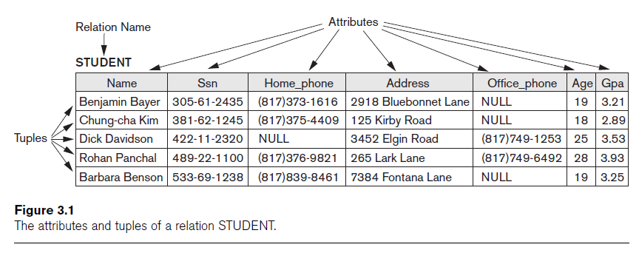
RM Concepts: İlişki Örneği

Slide 7
Domains, Attributes, Tuples, and Relations
Domain D
  Set of atomic values
Atomic
  Each value indivisible
Specifying a domain
  Data type specified for each domain

Slide 8
Domains,Attributes,Tuples,Relations (cont’d.)
Relation schema R
  Denoted by R(A₁, A₂, ...,A_{n})
  Made up of a relation name R and a list of attributes, A₁, A₂, ..., A_{n}
Attribute A_{i}
  Name of a role played by some domain D in the relation schema R
Degree (or arity) of a relation
  Number of attributes n of its relation schema, n-tuple relation
  İlişkinin derecesi: ilişki şemasındaki nitelik sayısı

Slide 9

Bir ilişki şeması (schema, description):
  R(A1, A2, .....An) biçiminde gösterilir.
  R ilişki adı (name ), A1, A2, ..., An ise ilişkinin nitelikleri(attributes)
  İlişkinin derecesi: ilişki şemasındaki nitelik sayısı
Örnek:
  CUSTOMER (Cust-id, Cust-name, Address, Phone#)
    ilişki ismi: CUSTOMER, ilişki derecesi: 4
    Nitelikler: Cust-id, Cust-name, Address, Phone#.
A relation is a set of tuples (rows). A tuple is an ordered set of values (enclosed in angled brackets ‘< … >’). Each value is derived from an appropriate domain.
  A row in CUSTOMER relation is a 4-tuple and consists of four values:
  <632895, "John Smith", "101 Main St. Atlanta, GA 30332", "(404)894-2000">
Slide 5- <number>

Slide 10
Domains, Attributes, Tuples, and Relations (cont’d.)
Relation (or relation state)
  Set of n-tuples r = {t₁, t₂, ..., t_{m}}
  Each n-tuple t
    Ordered list of n values t =<v₁, v₂, ..., v_{n}>
    Each value v_{i}, 1 ≤ i ≤ n, is an element of dom(A_{i}) or is a special NULL value
Relation (or relation state) r(R)
  Mathematical relation of degree n on the domains dom(A₁), dom(A₂), ..., dom(A_{n})
  Subset of the Cartesian product of the domains that define R:
    r(R) ⊆ (dom(A₁) × dom(A₂) × ... × dom(A_{n}))

Slide 11
Domains, Attributes, Tuples, and Relations (cont’d.)
Current relation state
  Relation state at a given time
  Reflects only the valid tuples that represent a particular state of the real world
Attribute names
  Indicate different roles, or interpretations, for the domain

Slide 12
Characteristics of Relations
Ordering of tuples in a relation
  Relation defined as a set of tuples
  Elements have no order among them
Ordering of values within a tuple
  Order of attributes and values is not that important as long as correspondence b/w attributes&values maintained
Alternative definition of a relation
  Tuple considered as a set of (<attribute>, <value>) pairs
  Each pair gives the value of the mapping from an attribute A_{i} to a value v_{i} from dom(A_{i})
Use the first definition of relation
  Attributes and the values within tuples are ordered
  Simpler notation

Slide 13
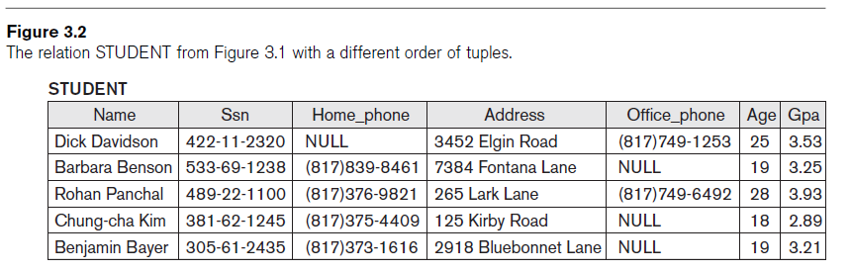
Characteristics of Relations (cont’d.)

Slide 14
Characteristics of Relations (cont’d.)
Values and NULLs in tuples
  Each value in a tuple is atomic
  Flat relational model
    Composite and multivalued attributes not allowed
    First normal form assumption
  Multivalued attributes
    Must be represented by separate relations
  Composite attributes
    Represented only by simple component attributes in basic relational model

Slide 15
Characteristics of Relations (cont’d.)
NULL values
  Represent the values of attributes that may be unknown or may not apply to a tuple
  Meanings for NULL values
    Value unknown
    Value exists but is not available
    Attribute does not apply to this tuple (also known as value undefined)

Slide 16
Characteristics of Relations (cont’d.)
Interpretation (meaning) of a relation
  Assertion
    Each tuple in the relation is a fact or a particular instance of the assertion
  Predicate
    Values in each tuple interpreted as values that satisfy predicate

Slide 17

Formally, given R(A1, A2, .........., An)
  r(R) ⊂ dom (A1) X dom (A2) X ....X dom(An)
  R(A1, A2, …, An) is the schema of the relation
  r(R): a specific state (or "value" or “population”) of relation R – this is a set of tuples (rows)
    r(R) = {t1, t2, …, tm} where each ti is an n-tuple
    ti = <v1, v2, …, vn> where each vj element-of dom(Aj)
Let R(A1, A2) be a relation schema:
  Let dom(A1) = {0,1}, Let dom(A2) = {a,b,c}
  Then: dom(A1) X dom(A2) is all possible combinations:
  {<0,a> , <0,b> , <0,c>, <1,a>, <1,b>, <1,c> }
    The relation state r(R) ⊂ dom(A1) X dom(A2)
  For example: r(R) could be {<0,a> , <0,b> , <1,c> }
    this is one possible state (population or extension) r of the relation R, defined over A1 and A2.
    It has three 2-tuples: <0,a> , <0,b> , <1,c>
Slide 5- <number>

Slide 18
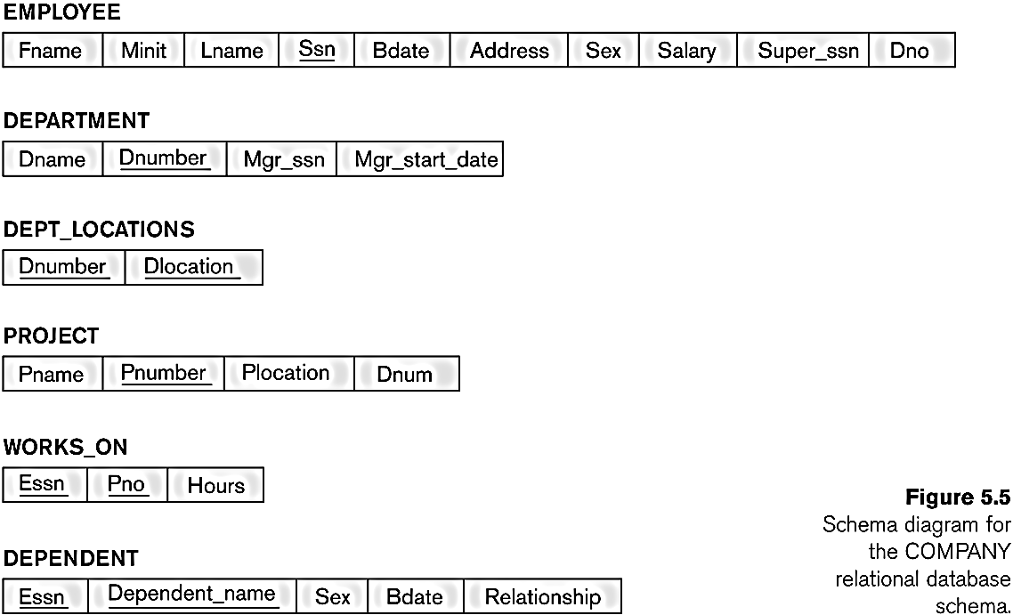
  A set S of relation schemas that belong to the same database.
  S is the name of the whole database schema
  S = {R1, R2, ..., Rn}
  R1, R2, …, Rn are the names of the individual relation schemas within the database S
Example: COMPANY db schema w/ 6 relation schemas:
Slide 5- <number>

Slide 19

Informal Terms (Pratik model) |  | Formal Terms (Biçimsel model)
Table |  | Relation
Column Header |  | Attribute
All possible Column Values |  | Domain
Row |  | Tuple
Table Definition |  | Schema of a Relation
Populated Table |  | State of the Relation

Slide 20

Constraints
  Restrictions on the actual values in a db state. (i.e., conditions that must hold on all valid relation states)
  Derived from the rules in the miniworld that the database represents
There are three main types of constraints in the relational model:
  Key constraints (anahtar kısıtı)
  Entity integrity constraints (varlık bütünlük kısıtı)
  Referential integrity constraints (ima bütünlük kısıtı)
Another implicit constraint is the domain constraint
  Every value in a tuple must be from the domain of its attribute (or it could be null, if allowed for that attribute)
Yet another constraint is Semantic constraints..
Slide 5- <number>

Slide 21
Domain Constraints
Typically include:
  Numeric data types for integers and real numbers
  Characters
  Booleans
  Fixed-length strings
  Variable-length strings
  Date, time, timestamp
  Money
  Other special data types

Slide 22

Key Constraints: Key def’n
Key Constraint: No two tuples can have the same combination of values for all their attributes in key.
Superkey SK: No two distinct tuples in any state r of R can have the same value for SK
Key
  Superkey of R
  Removing any attribute A from K leaves a set of attributes K that is not a superkey of R any more
Key satisfies two properties:
  Two distinct tuples in any state of relation cannot have identical values for (all) attributes in key
  Minimal superkey: Cannot remove any attributes and still have uniqueness constraint in above condition hold

Slide 23
Key Constraints: Key def’n
Candidate key
  Relation schema may have more than one key
Primary key of the relation
  Designated among candidate keys
  Underline attribute
Other candidate keys are designated as unique keys

Slide 24
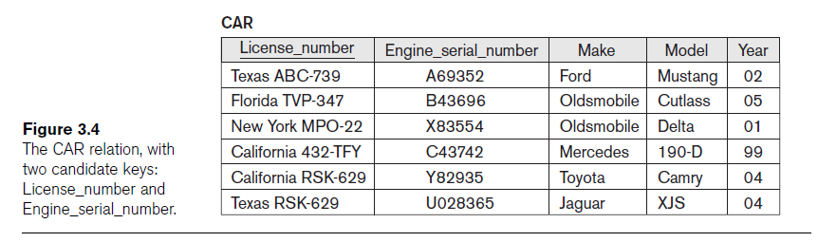
Key Constraints and Constraints on NULL Values (cont’d.)

Slide 25
Integrity, Referential Integrity, and Foreign Keys
Entity integrity constraint
  No primary key value can be NULL
Referential integrity constraint
  Specified between two relations
  Maintains consistency among tuples in two relations

Slide 26
Integrity, Referential Integrity, and Foreign Keys (cont’d.)
Foreign key rules:
  The attributes in FK have the same domain(s) as the primary key attributes PK
  Value of FK in a tuple t₁ of the current state r₁(R₁) either occurs as a value of PK for some tuple t₂ in the current state r₂(R₂) or is NULL

Slide 28
Integrity, Referential Integrity, and Foreign Keys (cont’d.)
Diagrammatically display referential integrity constraints
  Directed arc from each foreign key to the relation it references
All integrity constraints should be specified on relational database schema

Slide 29
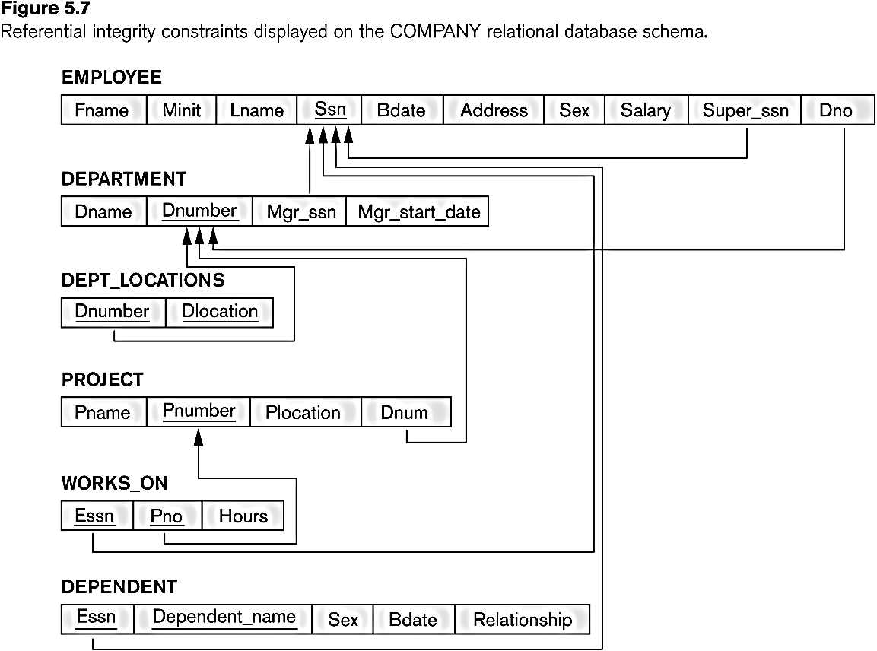
Each relation schema can be displayed as a row of attribute names
The name of the relation is written above the attribute names
The primary key attribute (or attributes) will be underlined
A foreign key (referential integrity) constraints is displayed as a directed arc (arrow) from the foreign key attributes to the referenced table
  Can also point the the primary key of the referenced relation for clarity
COMPANY relational schema diagram:
Slide 5- <number>

Slide 30

Each relation will have many tuples in its current relation state
The relational database state is a union of all the individual relation states
Whenever the database is changed, a new state arises
Basic operations for changing the database:
  INSERT a new tuple in a relation
  DELETE an existing tuple from a relation
  MODIFY an attribute of an existing tuple
Ops on example state for the COMPANY database
Slide 5- <number>

Slide 31
The Insert Operation
Provides a list of attribute values for a new tuple t that is to be inserted into a relation R
Can violate any of the four types of constraints
If an insertion violates one or more constraints
  Default option is to reject the insertion

Slide 32
The Delete Operation
Can violate only referential integrity
  If tuple being deleted is referenced by foreign keys from other tuples
  Restrict
    Reject the deletion
  Cascade
    Propagate the deletion by deleting tuples that reference the tuple that is being deleted
  Set null or set default
    Modify the referencing attribute values that cause the violation

Slide 33
The Update Operation
Necessary to specify a condition on attributes of relation
  Select the tuple (or tuples) to be modified
If attribute not part of a primary key nor of a foreign key
  Usually causes no problems
Updating a primary/foreign key
  Similar issues as with Insert/Delete

Slide 34
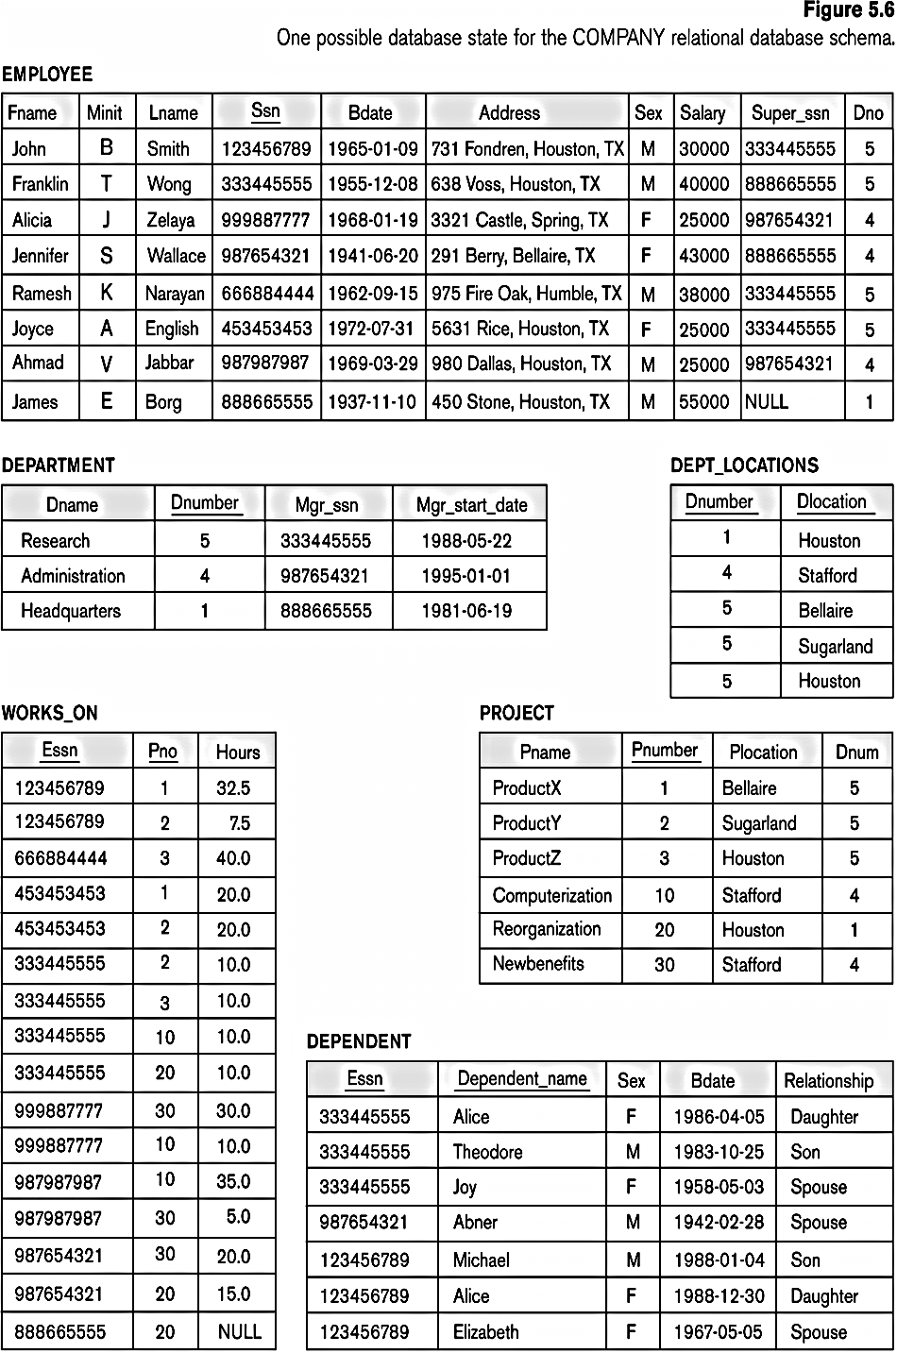
Populated database state for COMPANY
INSERT a tuple.
DELETE a tuple.
MODIFY a tuple.
Integrity constraints should not be violated by the update operations.
Several update operations may have to be grouped together.
Updates may propagate to cause other updates automatically. This may be necessary to maintain integrity constraints.
Slide 5- <number>

Slide 35
  CREATE TABLE DEPT (
  DNAME VARCHAR(10) NOT NULL,
  DNUMBER INTEGER NOT NULL,
  MGRSSN CHAR(9) DEFAULT ‘000’,
  MGRSTARTDATE CHAR(9),
  PRIMARY KEY (DNUMBER),
  UNIQUE (DNAME),
  FOREIGN KEY (MGRSSN) REFERENCES EMP
  ON DELETE SET DEFAULT ON UPDATE CASCADE);
  CREATE TABLE EMP(
  ENAME VARCHAR(30)NOT NULL,
  ESSN CHAR(9),
  BDATE DATE,
  DNO INTEGER DEFAULT 1,
  SUPERSSN CHAR(9),
  PRIMARY KEY (ESSN),
  FOREIGN KEY (DNO) REFERENCES DEPT ON DELETE SET DEFAULT ON UPDATE CASCADE,
  FOREIGN KEY (SUPERSSN) REFERENCES EMP ON DELETE SET NULL ON UPDATE CASCADE);
ÖNEMLİ: Yukarıdaki SQL DDL tablo oluşturma komutları 2 farklı sıra için de (DEPT, EMP ve EMP,DEPT) çalıştırmak mümkün olmuyor. Çünkü imalar mevcut omayan başka bir tabloya işaret edemez. O yüzden, ima kısıtlarını temel tabloyu oluşturduktan sonra ALTER TABLE ... yardımcı komutu ile ekleyebilriz.
Aynı durum DROP TABLE için de geçerli.
Slide 5- <number>

Slide 36

Aynı dikkat, INSERT TABLE için de geçerli. Bu sefer UPDATE komutu yardımı ile eksikler tamamlanır. O yüzden önceki sayfadaki VT’da eklemelerin aşağıdaki gibi olması gerek: örneğin:
INSERT INTO EMP VALUES
('James', '888665555','10-NOV-27',null,null);
INSERT INTO EMP VALUES
('Franklin','T','Wong','333445555','08-DEC-45','638 Voss, Houston, TX','M',40000,'888665555',null);
.....
INSERT INTO DEPT VALUES ('Research', 5, '333445555', '22-MAY-78');
INSERT INTO DEPT VALUES ('Headquarters', 1, '888665555', '19-JUN-71');
UPDATE employee SET dno = 5 WHERE ssn = '333445555';
UPDATE employee SET dno = 1 WHERE ssn = '888665555';
Slide 5- <number>

Slide 37
Exercise-1
(Taken from Exercise 5.15)
Consider the following relations for a database that keeps track of student enrollment in courses and the books adopted for each course: Draw a relational schema diagram
STUDENT(SSN, Name, Major, Bdate)
COURSE(Course#, Cname, Dept)
ENROLL(SSN, Course#, Quarter, Grade)
BOOK_ADOPTION(Course#, Quarter, Book_ISBN)
TEXT(Book_ISBN, Book_Title, Publisher, Author)

