Slide 1
ER-to-Relational Mapping Outline
ER-to-Relational Mapping Algorithm
  Step 1: Mapping of Regular Entity Types
  Step 2: Mapping of Weak Entity Types
  Step 3: Mapping of Binary 1:1 Relation Types
  Step 4: Mapping of Binary 1:N Relationship Types.
  Step 5: Mapping of Binary M:N Relationship Types.
  Step 6: Mapping of Multivalued attributes.
  Step 7: Mapping of N-ary Relationship Types.
Mapping EER Model Constructs to Relations
  Step 8: Options for Mapping Specialization or Generalization.
  Step 9: Mapping of Shared Classes
1

Slide 2
ER-to-Relational Mapping Algorithm
Step 1: Mapping of Regular Entity Types.
  For regular (strong) entity type E in ER schema, set up a relation R that includes all simple attributes of E.
  Choose one of key attributes of E as primary key for R.
  If chosen key of E is composite, set of its simple attributes will together form primary key of R.
Example: We create the relations EMPLOYEE, DEPARTMENT, and PROJECT in the relational schema corresponding to the regular entities in the ER diagram.
SSN, DNUMBER, and PNUMBER are primary keys for relations EMPLOYEE, DEPARTMENT, and PROJECT.

Slide 3

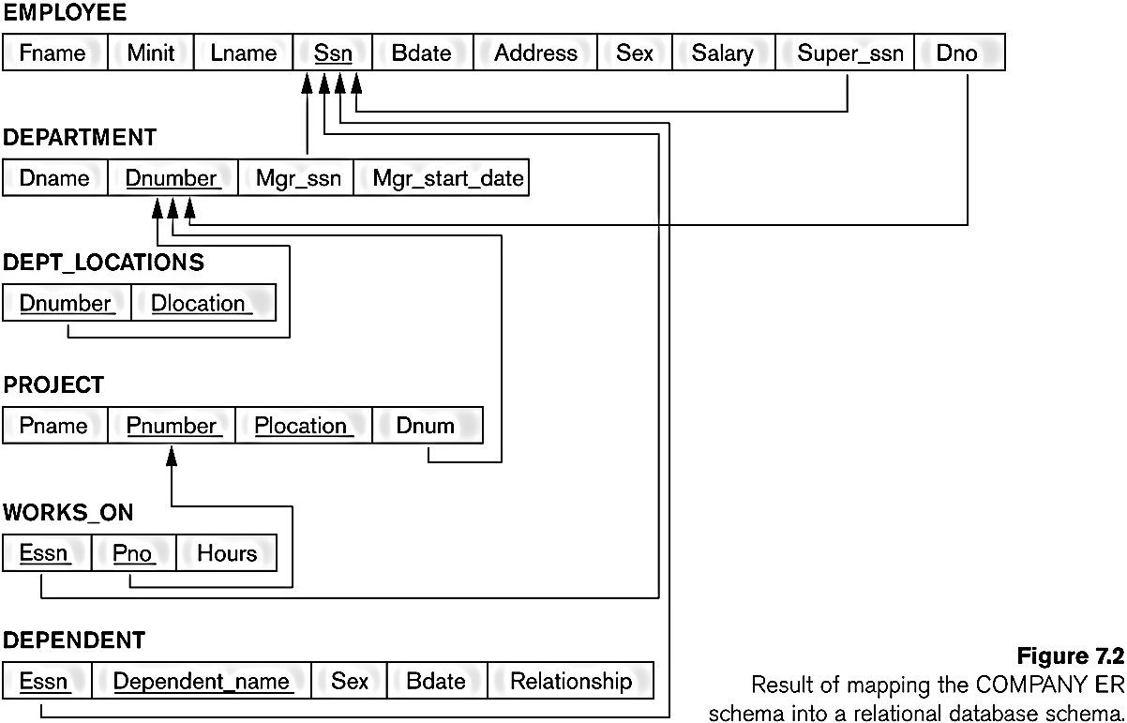
FIGURE 7.1 from elmasri navathe
The ER conceptual schema diagram for the COMPANY database.

Slide 4
Weak Entity Types
Step 2: Mapping of Weak Entity Types
  For each weak entity type W in ER schema with owner entity type E, set up a relation R & include all simple attributes (simple components of composite attributes) of W as attributes of R.
  Include as foreign key attributes of R the primary key attribute(s) of the relation(s) that correspond to the owner entity type(s).
  Primary key of R is the combination of the primary key(s) of the owner(s) and the partial key of the weak entity type W, if any.
Example: Create the relation DEPENDENT in this step to correspond to the weak entity type DEPENDENT.
  Include SSN of the EMPLOYEE relation as a foreign key attribute of DEPENDENT (renamed to ESSN).
  The primary key of the DEPENDENT relation is the combination {ESSN, DEPENDENT_NAME} because DEPENDENT_NAME is the partial key of DEPENDENT.

Slide 5
FIGURE 7.1 from elmasri navathe
The ER conceptual schema diagram for the COMPANY database.

Slide 6
ER-to-Relational Mapping Algorithm
Step 3: Mapping of Binary 1:1 Relation Types
  For each binary 1:1 relationship type R in ER schema, identify relations S and T, entity types participating in R.
One approach (Foreign Key approach):
  Choose one of relations -say S- and include as a foreign key in S the primary key of T. It is better to choose an entity type with total participation in R in the role of S. (WHY?)
Example: 1:1 relation MANAGES is mapped by choosing the participating entity type DEPARTMENT to serve in the role of S, because its participation in the MANAGES relationship type is total.

Slide 7
FIGURE 7.1 from elmasri navathe
The ER conceptual schema diagram for the COMPANY database.

Slide 8
ER-to-Relational Mapping Algorithm
Step 4: Mapping of Binary 1:N Relationship Types.
  For each regular binary 1:N relationship type R (from T to S), identify the relation S that represent the participating entity type at the N-side of the relationship type.
  Include as foreign key in S the primary key of the relation T that represents the other entity type participating in R.
  Include any simple attributes of the 1:N relation type as attributes of S.
Example: 1:N relationship types WORKS_FOR, CONTROLS, and SUPERVISION in the figure.
  For WORKS_FOR we include the primary key DNUMBER of the DEPARTMENT relation as foreign key in the EMPLOYEE relation and call it DNO.

Slide 9
FIGURE 7.1 from elmasri navathe
The ER conceptual schema diagram for the COMPANY database.

Slide 10
M:N Relationship Types
Step 5: Mapping of Binary M:N Relationship Types.
  For each regular binary M:N relationship type R, set up a new relation S to represent R.
  Include as foreign key attributes in S primary keys of the relations that represent participating entity types; they form primary key of S.
  Include any simple attributes of the M:N relationship type (or simple components of composite attributes) as attributes of S.
Example: The M:N relationship type WORKS_ON from the ER diagram is mapped by creating a relation WORKS_ON in the relational database schema.
The primary keys of the PROJECT and EMPLOYEE relations are included as foreign keys in WORKS_ON and renamed PNO and ESSN, respectively. Attribute HOURS in WORKS_ON represents the HOURS attribute of relation type. The primary key of the WORKS_ON relation is combination of the foreign key attributes {ESSN, PNO}.

Slide 11
FIGURE 7.1 from elmasri navathe
The ER conceptual schema diagram for the COMPANY database.

Slide 12
ER-to-Relational Mapping Algorithm
Step 6: Mapping of Multivalued attributes.
  For each multivalued attribute A, set up a new relation R.
  This relation R will include an attribute corresponding to A, plus the primary key attribute K-as a foreign key in R-of the relation that represents the entity type of relationship type that has A as an attribute.
  The primary key of R is the combination of A and K. If the multivalued attribute is composite, we include its simple components.
  Example: The relation DEPT_LOCATIONS is created.
  Attribute DLOCATION represents multivalued attribute LOCATIONS of DEPARTMENT,
  while DNUMBER-as foreign key-represents the primary key of the DEPARTMENT relation.
  The primary key of R is the combination of {DNUMBER, DLOCATION}.

Slide 13
FIGURE 7.1 from elmasri navathe
The ER conceptual schema diagram for the COMPANY database.

Slide 14
N-ary Relationship Types
Step 7: Mapping of N-ary Relationship Types.
  For each n-ary relationship type R, where n>2, set up a new relation S to represent R.
  Include as foreign key attributes in S the primary keys of the relations that represent the participating entity types.
  Also include any simple attributes of the n-ary relationship type (or simple components of composite attributes) as attributes of S.
  Example: The relationship type SUPPY in the ER on the next slide.
  This can be mapped to the relation SUPPLY shown in the relational schema, whose primary key is the combination of the three foreign keys {SNAME, PARTNO, PROJNAME} in case the cardinalities are N:N:N

Slide 15

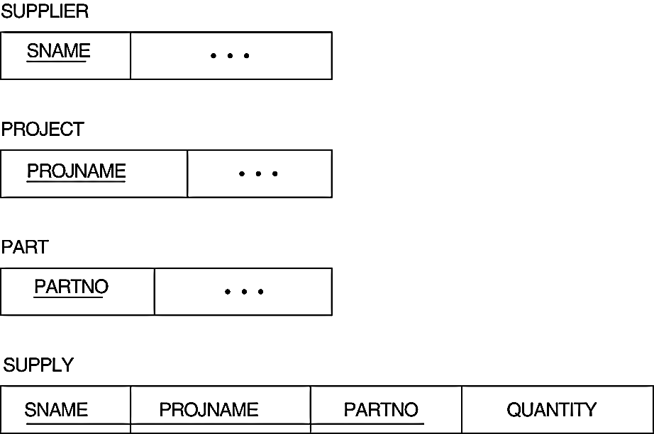
ER-to-Relational Mapping Algorithm-step 7 example
Note that PK depends on the cardinalities of SUPPLY

Slide 16
Summary of Mapping constructs and constraints
Table 7.1 Correspondence between ER and Relational Models
ER Model Relational Model
Entity type “Entity” relation
1:1 or 1:N relationship type Foreign key (or “relationship” relation)
M:N relationship type “Relationship” relation and two foreign keys
n-ary relationship type “Relationship” relation and n foreign keys
Simple attribute Attribute
Composite attribute Set of simple component attributes
Multivalued attribute Relation and foreign key
Value set Domain
Key attribute Primary (or secondary) key

Slide 17
Mapping EER Model Constructs to Relations
Step8: Options for Mapping Specialization or Generalization.
  Convert each specialization with m subclasses {S1, S2,….,Sm} and generalized superclass C, where the attributes of C are {k,a1,…an} and k is the (primary) key, into relational schemas using one of the four following options:
    Option 8A: Multiple relations-Superclass and subclasses
    Option 8B: Multiple relations-Subclass relations only
    Option 8C: Single relation with one type attribute
    Option 8D: Single relation with multiple type attributes
a1
an
k..
C
S₁
S₂
......
S_{m}

Slide 18
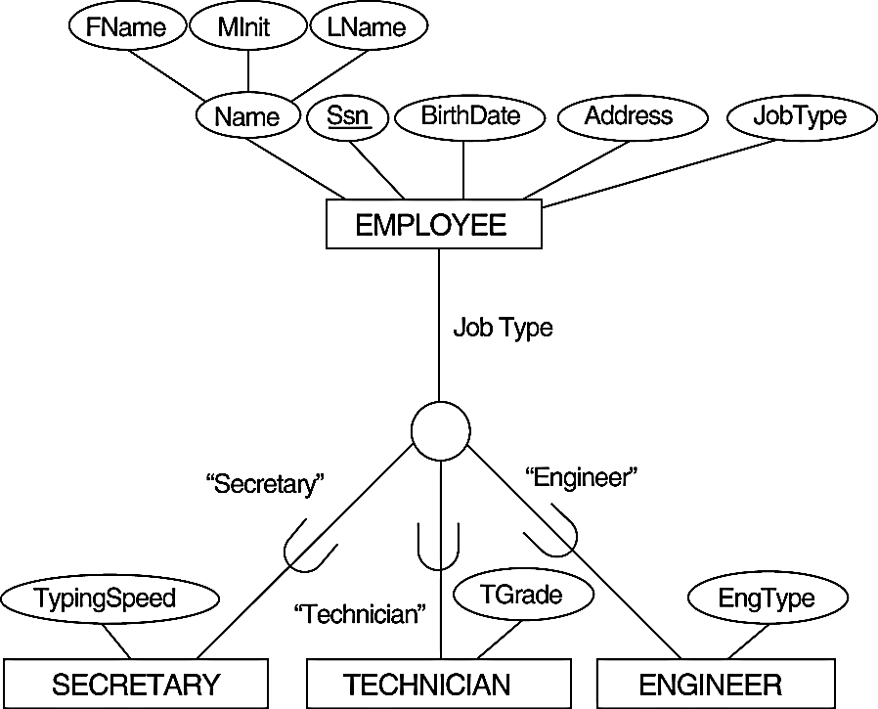
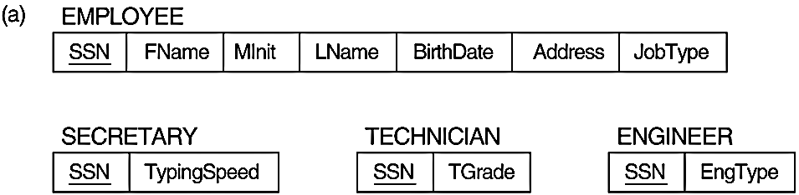
Mapping EER Model Constructs to Relations
Option 8A: Multiple relations-Superclass and subclasses
  set up a single relation L for C with attributes Attrs(L) = {k,a1,…an} and PK(L) = k. set up relation Li for each subclass Si, 1 < i < m, with the attributesAttrs(Li) = {k} U {attributes of Si} and PK(Li)=k.
  This option works for any specialization (total or partial, disjoint of over-lapping).

Slide 19
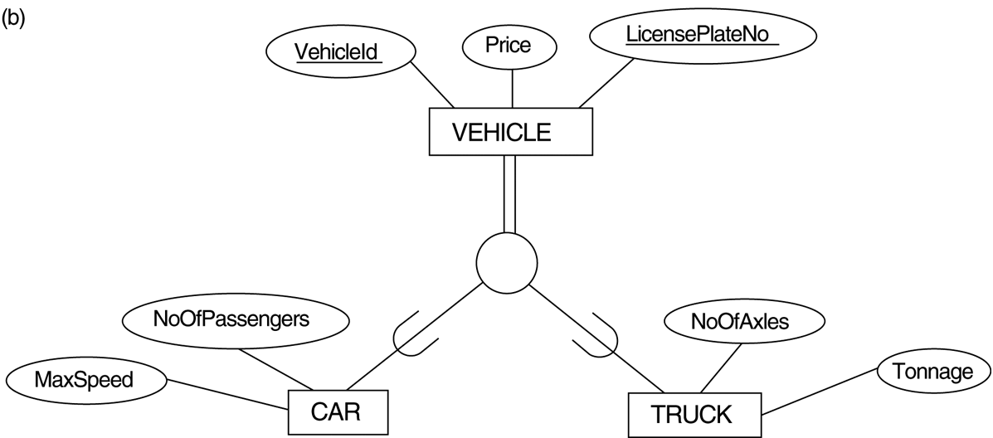

Mapping EER Model Constructs to Relations
Option 8B: Multiple relations-Subclass relations only
  set up a single relation Li for each subclass Si, 1 < i < m, with the attributes Attr(Li) = {attributes of Si} U {k,a1…,an} and PK(Li) = k.
  This option only works for a specialization whose subclasses are total (every entity in the superclass must belong to (at least) one of the subclasses).

Slide 20
Mapping EER Model Constructs to Relations
Option 8C: Single relation with one type attribute
  set up a single relation L with attributes Attrs(L) = {k,a₁,…a_{n}} U {attributes of S₁} U…U {attributes of S_{m}} U {t} and PK(L) = k. The attribute t is called a type (or discriminating) attribute that indicates the subclass to which each tuple belongs.
  Used for disjoint type of specializations...
Dom(t) ={1,2,....m}
İf specialization is partial t can be null.
d
EngType

Slide 21

Mapping EER Model Constructs to Relations
Option 8D: Single relation with multiple type attributes
  set up a single relation schema L with attributes Attrs(L) = {k,a₁,…a_{n}} U {attributes of S₁} U…U {attributes of S_{m}} U {t₁, t₂,…,t_{m}} and PK(L) = k. Each t_{i}, 1 < i < m, is a Boolean type attribute indicating whether a tuple belongs to the subclass S_{i}.
  Used for specializations having overlapping subclasses
o

Slide 22
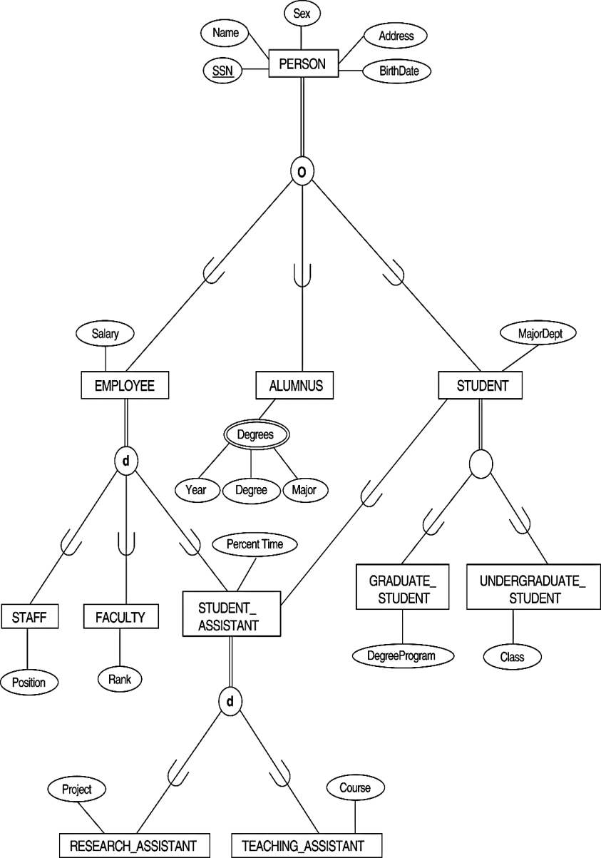
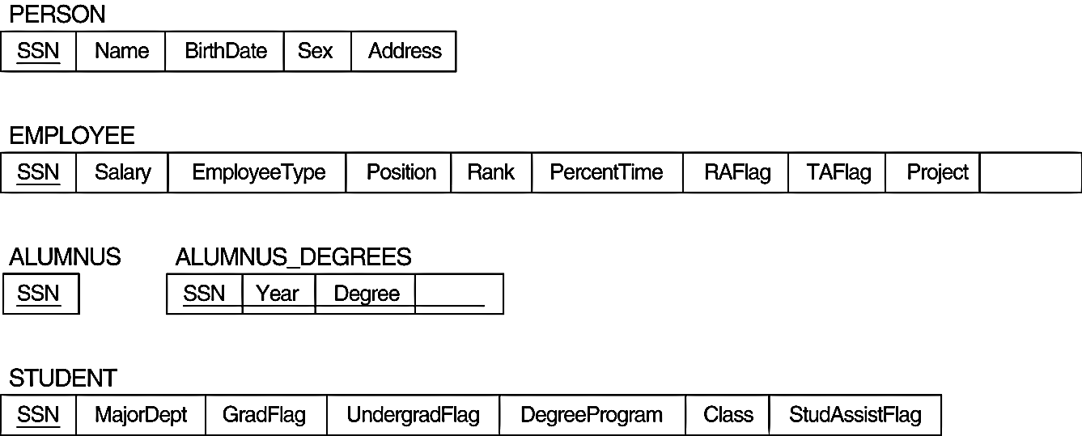
Mapping EER Model Constructs to Relations
Step9 : Mapping of Shared Subclasses (Multiple Inheritance)
  A shared subclass, such as STUDENT_ASSISTANT, is a subclass of several classes, indicating multiple inheritance.
  We can apply any of the options discussed in Step 8 to a shared subclass, subject to the restriction discussed in Step 8 of the mapping algorithm. Below both 8C and 8D are used for the shared class STUDENT_ASSISTANT.
8C
8D
Course
o
8D

Slide 23
Example-1
Dünya üzerindeki gemi limanları ve gemi hareketlerini tutan bir veri tabanı tasarımı.
Limanların hangi ülkede hangi okyanusta olduğu saklanıyor. Limanların sadece isimleri saklanıyor. Farklı ülkelerde aynı isimde limanlar olabilir.
Bir geminin bir limanı ziyaret ile ilgili sadece giriş ve çıkış tarihleri saklanmalı. Gemi aynı limana çok defalar uğrayabilir. Her geminin bağlı olduğu bir liman vardır.
Gemilerin tipleri (denizaltı, yolcu, tekne, savaş gemisi gibi.) var, hangi tiplerin varolduğu listelenebilmeli..
Gemi hareketleri, geminin tarihçesi ile tutulmalı. Bu tarihçe bilgisi geminin hangi gün va zamanda hangi enlem boylamda bulunduğu bilgilerinden örnekler saklamaktadır. Gemi tabiki aynı noktada farklı zamanlarda bulunabilir.

Slide 24

Example-1: ER
FIGURE 7.7 from Elamsri/Navathe
An ER schema for a SHIP_TRACKING database.

Slide 25
Example-1: Relations
SHIP [ Sname, Owner, scName, Pname, Type ]
PORT[scName, Pname, solName]
STATE/COUNTRY [Name, Continent]
SEA/OCEAN/LAKE [Name]
SHIP_MOVEMENT [ Sname, Date, Time, Longitude, Latitude ]
SHIP_TYPE [ Type, Tonnage, Hull]
VISITS [ scName, Pname, Sname, startDate, EndDate]

Slide 26
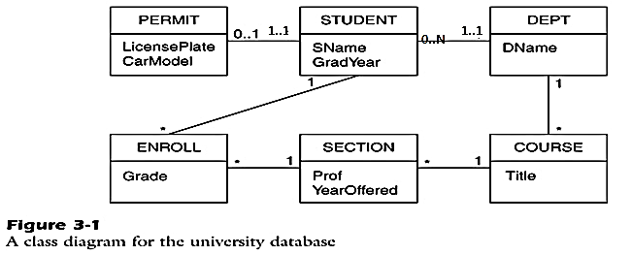
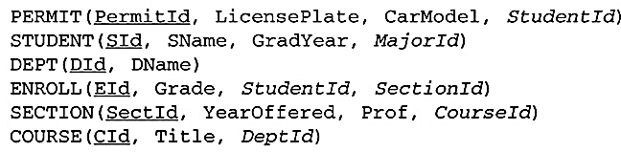
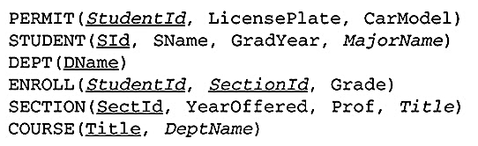
Example-2

