Slide 1
ER-to-Relational Mapping Outline
ER-to-Relational Mapping Algorithm
  Step 1: Mapping of Regular Entity Types
  Step 2: Mapping of Weak Entity Types
  Step 3: Mapping of Binary 1:1 Relation Types
  Step 4: Mapping of Binary 1:N Relationship Types.
  Step 5: Mapping of Binary M:N Relationship Types.
  Step 6: Mapping of Multivalued attributes.
  Step 7: Mapping of N-ary Relationship Types.
1

Slide 2
ER-to-Relational Mapping Algorithm
Mapping of Regular Entity Types.
For entity type E in ER schema, set up a relation R that includes all simple attributes of E.
Choose key attributes of E as primary key for R.
Example: Relations EMPLOYEE, DEPARTMENT, and PROJECT in the relational schema corresponding to the regular entities in the ER diagram.
SSN, DNUMBER, and PNUMBER are primary keys for relations EMPLOYEE, DEPARTMENT, and PROJECT.

Slide 3

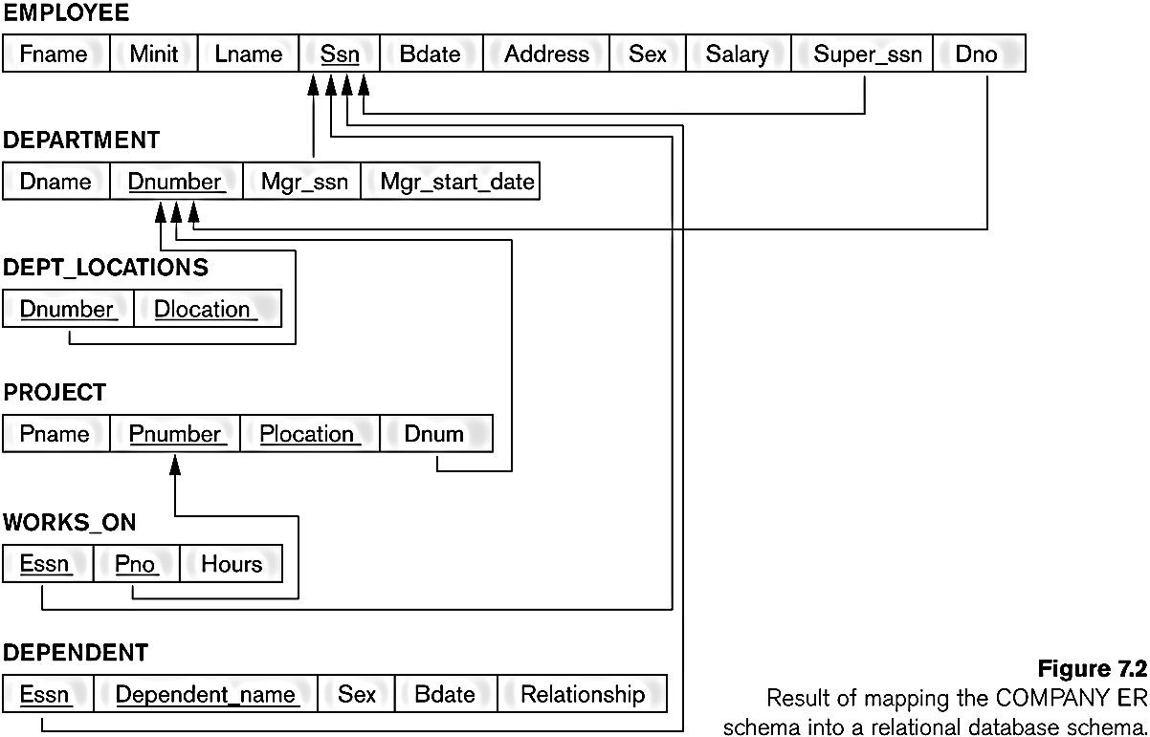
FIGURE 7.1 from elmasri navathe
The ER conceptual schema diagram for the COMPANY database.

Slide 4
Weak Entity Types
Mapping of Weak Entity Types
For weak entity type W with owner entity type E, set up a relation R & include all simple attributes into R.
Include as foreign key of R the primary key attribute(s) of relation(s) that correspond to the owner entity type(s).
Primary key of R is the combination of the primary key(s) of the owner(s) and the partial key of the weak entity type W, if any.
Ex: rel DEPENDENT for weak entity type DEPENDENT.
  Include SSN of EMPLOYEE relation as foreign key attribute of DEPENDENT (renamed to ESSN).
  primary key of DEPENDENT relation is combination {ESSN, DEPENDENT_NAME} because DEPENDENT_NAME is partial key of DEPENDENT.

Slide 5
FIGURE 7.1 from elmasri navathe
The ER conceptual schema diagram for the COMPANY database.

Slide 6
ER-to-Relational Mapping Algorithm
Step 3: Mapping of Binary 1:1 Relation Types
  For each binary 1:1 relationship type R in ER schema, identify relations S and T, entity types participating in R.
One approach (Foreign Key approach):
  Choose one of relations -say S- and include as a foreign key in S the primary key of T. It is better to choose an entity type with total participation in R in the role of S. (WHY?)
Example: 1-to-1 relation MANAGES is mapped by choosing the participating entity type DEPARTMENT to serve in the role of S, because its participation in the MANAGES relationship type is total.

Slide 7
FIGURE 7.1 from elmasri navathe
The ER conceptual schema diagram for the COMPANY database.

Slide 8
ER-to-Relational Mapping Algorithm
Step 4: Mapping of Binary 1:N Relationship Types.
  For each regular binary 1:N relationship type R (from T to S), identify the relation S that represent the participating entity type at the N-side of the relationship type.
  Include as foreign key in S the primary key of the relation T that represents the other entity type participating in R.
  Include any simple attributes of the 1:N relation type as attributes of S.
Example: 1-to-N relationship types WORKS_FOR, CONTROLS, and SUPERVISION in the figure.
  For WORKS_FOR we include the primary key DNUMBER of the DEPARTMENT relation as foreign key in the EMPLOYEE relation and call it DNO.

Slide 9
FIGURE 7.1 from elmasri navathe
The ER conceptual schema diagram for the COMPANY database.

Slide 10
M:N Relationship Types
Step 5: Mapping of Binary M:N Relationship Types.
  For each regular binary M:N relationship type R, set up a new relation S to represent R.
  Include as foreign key attributes in S primary keys of the relations that represent participating entity types; they form primary key of S.
  Include any simple attributes of the M:N relationship type (or simple components of composite attributes) as attributes of S.
Example: The M:N relationship type WORKS_ON from the ER diagram is mapped by creating a relation WORKS_ON in the relational database schema.
The primary keys of the PROJECT and EMPLOYEE relations are included as foreign keys in WORKS_ON and renamed PNO and ESSN, respectively. Attribute HOURS in WORKS_ON represents the HOURS attribute of relation type. The primary key of the WORKS_ON relation is combination of the foreign key attributes {ESSN, PNO}.

Slide 11
FIGURE 7.1 from elmasri navathe
The ER conceptual schema diagram for the COMPANY database.

Slide 12
ER-to-Relational Mapping Algorithm
Step 6: Mapping of Multivalued attributes.
  For each multivalued attribute A, set up a new relation R.
  This relation R will include an attribute corresponding to A, plus the primary key attribute K-as a foreign key in R-of the relation that represents the entity type of relationship type that has A as an attribute.
  The primary key of R is the combination of A and K. If the multivalued attribute is composite, we include its simple components.
  Example: The relation DEPT_LOCATIONS is created.
  Attribute DLOCATION represents multivalued attribute LOCATIONS of DEPARTMENT,
  while DNUMBER-as foreign key-represents the primary key of the DEPARTMENT relation.
  The primary key of R is the combination of {DNUMBER, DLOCATION}.

Slide 13
FIGURE 7.1 from elmasri navathe
The ER conceptual schema diagram for the COMPANY database.

Slide 14
N-ary Relationship Types
Step 7: Mapping of N-ary Relationship Types.
  For each n-ary relationship type R, where n>2, set up a new relation S to represent R.
  Include as foreign key attributes in S the primary keys of the relations that represent the participating entity types.
  Also include any simple attributes of the n-ary relationship type (or simple components of composite attributes) as attributes of S.
  Example: The relationship type SUPPY in the ER on the next slide.
  This can be mapped to the relation SUPPLY shown in the relational schema, whose primary key is the combination of the three foreign keys {SNAME, PARTNO, PROJNAME} in case the cardinalities are N:N:N

Slide 15

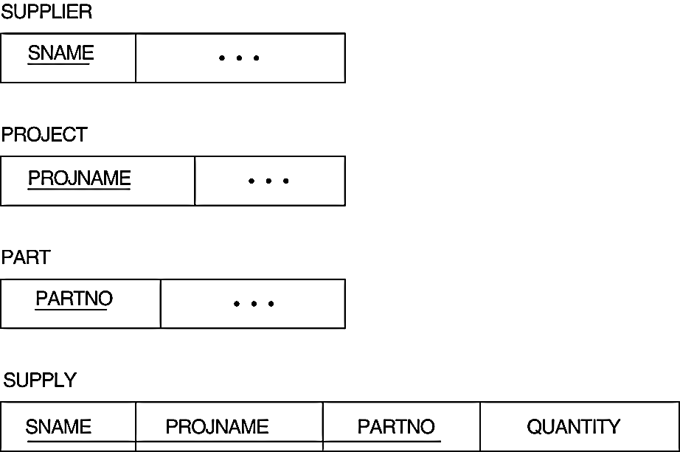
ER-to-Relational Mapping Algorithm-step 7 example
Note that PK depends on the cardinalities of SUPPLY

Slide 16
Summary of Mapping constructs and constraints
Table 7.1 Correspondence between ER and Relational Models
ER Model Relational Model
Entity type “Entity” relation
1:1 or 1:N relationship type Foreign key (or “relationship” relation)
M:N relationship type “Relationship” relation and two foreign keys
n-ary relationship type “Relationship” relation and n foreign keys
Simple attribute Attribute
Composite attribute Set of simple component attributes
Multivalued attribute Relation and foreign key
Value set Domain
Key attribute Primary (or secondary) key

Slide 17
Example-1
Dünya üzerindeki gemi limanları ve gemi hareketlerini tutan bir veri tabanı tasarımı.
Limanların hangi ülkede hangi okyanusta olduğu saklanıyor. Limanların sadece isimleri saklanıyor. Farklı ülkelerde aynı isimde limanlar olabilir.
Bir geminin bir limanı ziyaret ile ilgili sadece giriş ve çıkış tarihleri saklanmalı. Gemi aynı limana çok defalar uğrayabilir. Her geminin bağlı olduğu bir liman vardır.
Gemilerin tipleri (denizaltı, yolcu, tekne, savaş gemisi gibi.) var, hangi tiplerin varolduğu listelenebilmeli..
Gemi hareketleri, geminin tarihçesi ile tutulmalı. Bu tarihçe bilgisi geminin hangi gün va zamanda hangi enlem boylamda bulunduğu bilgilerinden örnekler saklamaktadır. Gemi tabiki aynı noktada farklı zamanlarda bulunabilir.

Slide 18

Example-1: ER
FIGURE 7.7 from Elamsri/Navathe
An ER schema for a SHIP_TRACKING database.

Slide 19
Example-1: Relations
SHIP [Sname, Owner, scName, Pname, Type ]
PORT[scName, Pname, solName]
STATE/COUNTRY [Name, Continent]
SEA/OCEAN/LAKE [Name]
SHIP_MOVEMENT [ Sname, Date, Time, Longitude, Latitude ]
SHIP_TYPE [ Type, Tonnage, Hull]
VISITS [ scName, Pname, Sname, startDate, EndDate]

Slide 20
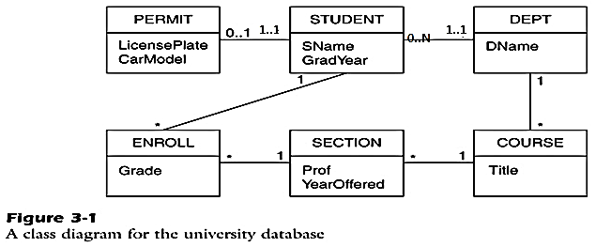
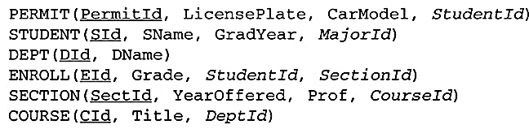
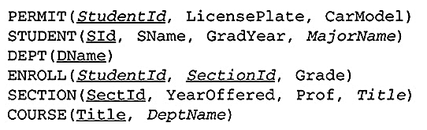
Example-2

