Slide 1
Introduction to SQL

Slide 2
History
IBM Sequel language developed as part of System R project at the IBM San Jose Research Laboratory
  Renamed Structured Query Language (SQL)
  ANSI and ISO standard SQL:
  SQL-86
  SQL-89
  SQL-92
  SQL:1999 (language name became Y2K compliant!)
  SQL:2003
Comm. systems offer SQL-92 features, plus varying feature sets from later standards and special proprietary features.
  Not all examples here may work on your particular system

Slide 3
Domain Types in SQL
char(n).Fixed length character string, with user-specified length n.
varchar(n).Variable length character strings, with user-specified maximum length n.
int.Integer (a finite subset of the integers that is machine-dependent).
smallint.Small integer (a machine-dependent subset of the integer domain type).
numeric(p,d).Fixed point number, with user-specified precision of p digits, with n digits to the right of decimal point.
real, double precision.Floating point and double-precision floating point numbers, with machine-dependent precision.
float(n).Floating point number, with user-specified precision of at least n digits.

Slide 4
Create Table Construct
An SQL relation is defined using the create table command:
create table r(A1 D1, A2 D2, ..., An Dn,
      (integrity-constraint1),
      ...
      (integrity-constraintk))
  r is the name of the relation
  each Ai is an attribute name in the schema of relation r
  Di is the data type of values in the domain of attribute Ai
Example: create table instructor(
        ID char(5),
        name varchar(20) not null,
        dept_namevarchar(20),
        salarynumeric(8,2))
insert into instructor values (‘10211’, ’Smith’, ’Biology’, 66000);
insert into instructor values (‘10211’, null, ’Biology’, 66000);

Slide 5
Integrity Constraints in Create Table
not null
primary key(A1, ..., An )
foreign key (Am, ..., An ) references r
Example: create table instructor(
      ID char(5),
      name varchar(20) not null,
      dept_name varchar(20),
      salary numeric(8,2),
      primary key (ID),
      foreign key (dept_name) references department))
primary key declaration on an attribute automatically ensures not null

Slide 6
More Relation Definitions
create table student(
    ID varchar(5) primary key,
    name varchar(20) not null,
    dept_name varchar(20),
    tot_cred numeric(3,0),
    foreign key (dept_name) references department) );
create table takes(
      ID varchar(5) primary key,
      course_id varchar(8),
      sec_id varchar(8),
      semester varchar(6),
      year numeric(4,0),
      grade varchar(2),
      foreign key (ID) references student,
      foreign key (course_id, sec_id, semester, year) references section);

Slide 7
create table course(
    course_id varchar(8) primary key,
    title varchar(50),
    dept_name varchar(20),
    credits numeric(2,0),
    foreign key (dept_name) references department) );
Some foreign keys may cause errors
  Specified either via:
    Circular references, or
    they refer to a table that has not yet been created

Slide 8
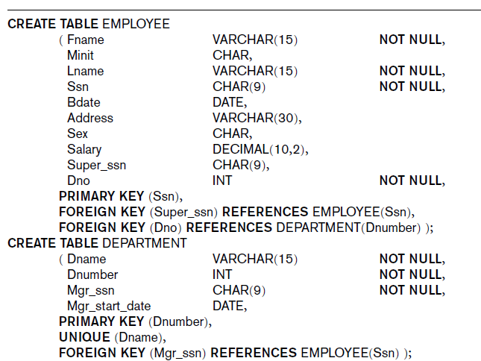
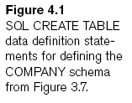

Slide 9
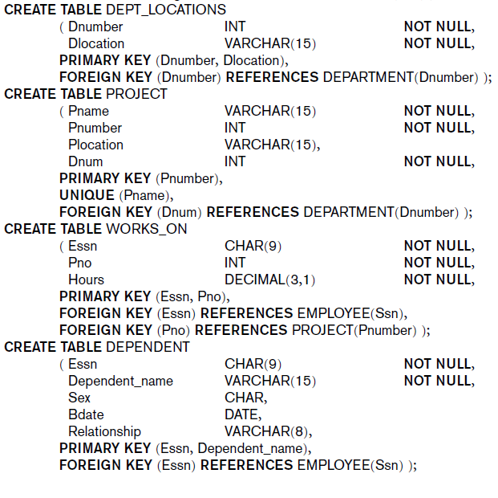

Slide 10
Drop and Alter Table Constructs
drop table
alter table
alter table r add A D
  A is the name of the attribute to be added to relation r and D is the domain of A.
All tuples in the relation are assigned null as the value for the new attribute.
alter table r drop A
  where A is the name of an attribute of relation r
Dropping of attributes not supported by many databases.

Slide 11


INSERT, DELETE, and UPDATE Statements to modify the database
INSERT: Specify the relation name and a list of values for the tuple

Slide 12

The DELETE Command
Removes tuples from a relation
  Includes a WHERE clause to select the tuples to be deleted

Slide 13

The UPDATE Command
Modify attribute values of one or more selected tuples
Additional SET clause in the UPDATE command
  Specifies attributes to be modified and new values

Slide 14
Basic Retrieval Queries in SQL
SELECT statement: for retrieving information from a database
  select A1, A2, ..., An
from r1, r2, ..., rm
where P
  Ai represents an attribute
  Ri represents a relation
  P is a predicate.
SQL allows a table to have two or more tuples that are identical in all their attribute values
  Unlike relational model (RA)
  Multiset or bag behavior
  DISTINCT option makes result table: set of tuples

Slide 15

Structure of Basic SQL Queries
Basic form of the SELECT statement:

Slide 16
Structure of Basic SQL Queries
Logical comparison operators: =,<,<=,>,>=,and <>
Projection attributes (project of RA)
  Attributes whose values are to be retrieved
  Example: find the names of all instructors:
select name
from instructor
NOTE: SQL names are case insensitive (i.e., you may use upper-or lower-case letters.)E.g., Name≡NAME≡name
Selection condition (select of RA)
  Boolean condition that must be true for any retrieved tuple

Slide 17
The select Clause
SQL allows duplicates in relations as well as in query results.
To force the elimination of duplicates, insert the keyword distinct after select.
Find the names of all departments with instructor, and remove duplicates
select distinct dept_name
  from instructor
The keyword all specifies that duplicates not be removed.
select all dept_name
from instructor

Slide 18
The select Clause
An asterisk in the select clause denotes “all attributes”
select *
  from instructor
The select clause can contain arithmetic expressions involving the operation, +, –, ∗, and /, and operating on constants or attributes of tuples.
The query:
select ID, name, salary/12
  from instructor
would return a relation that is the same as the instructor relation, except that the value of the attribute salary is divided by 12.

Slide 19
The where Clause
where clause specifies conditions the result must satisfy
Corresponds to the selection predicate of the RA.
To find all instructors in Comp. Sci. dept with salary > 80000
select name
  from instructor
  where dept_name=‘Comp. Sci.'and salary > 80000
Comparison results can be combined using the logical connectives and, or, and not.
Comparisons can be applied to results of arithmetic expressions.

Slide 20
The from Clause
The from clause lists the relations involved in the query
Corresponds to the Cartesian product operation of the relational algebra.
Find the Cartesian product instructor X teaches
select ∗
  from instructor, teaches
generates every possible instructor –teaches pair, with all attributes from both relations.

Slide 21
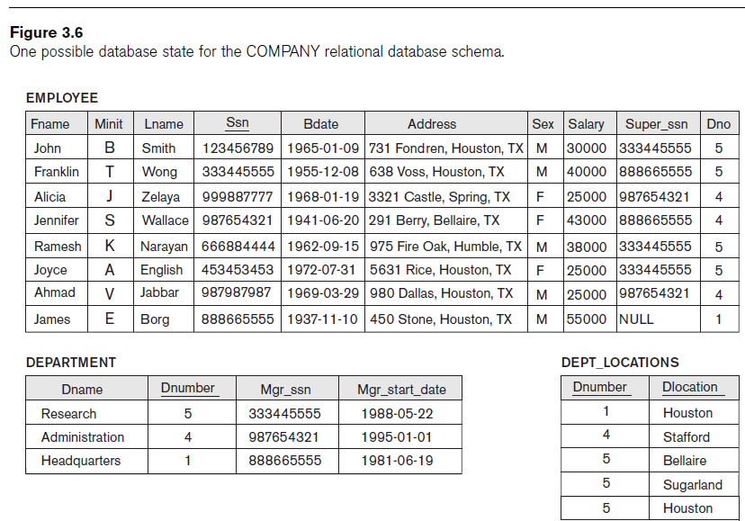

Slide 22
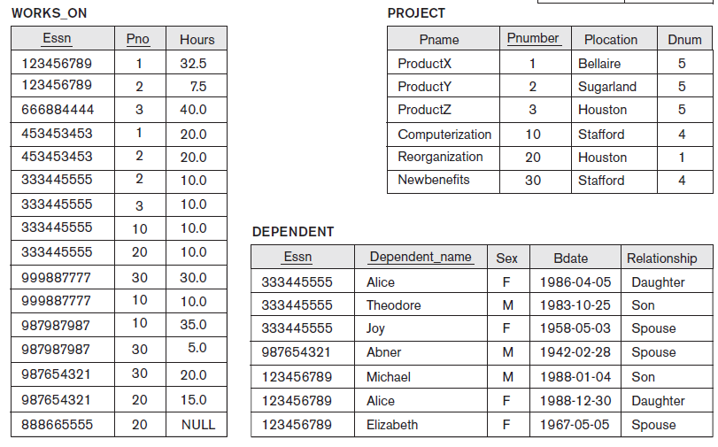

Slide 23
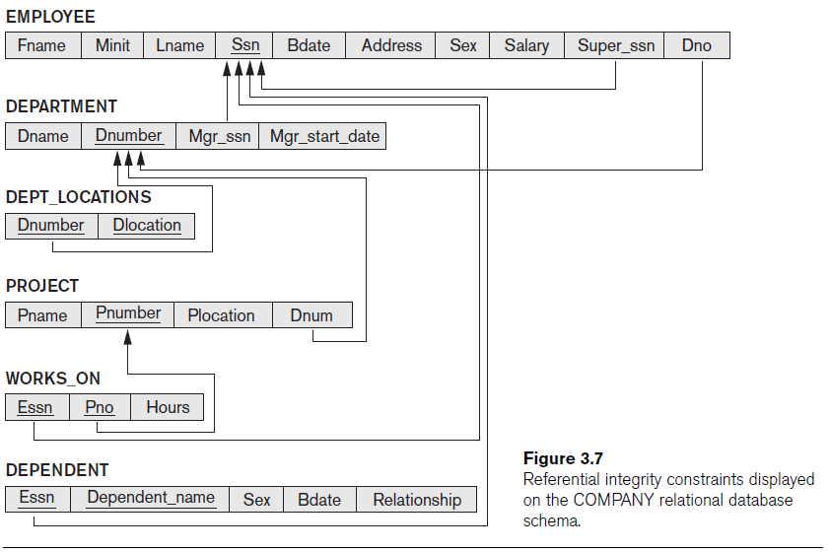

Slide 24
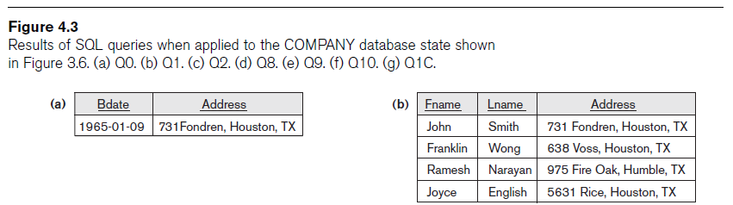



Slide 25


