Slide 1
Ch 21: Transaction Processing
Transaction Definitions
Transaction and System Concepts
Desirable Properties of Transactions
Characterizing Schedules based on Recoverability
Characterizing Schedules based on Serializability
Transaction Support in SQL

Slide 2
Transaction Processing (1)
Single-User System:
  At most one user at a time can use the system.
Multiuser System:
  Many users can access the system concurrently.
Concurrency
  Interleaved processing:
    Concurrent execution of processes is interleaved in a single CPU
  Parallel processing:
    Processes are concurrently executed in multiple CPUs.
Ex: Airline reservation sys, db sys in banks, stock markets, supermarkets, insurance companies...

Slide 3
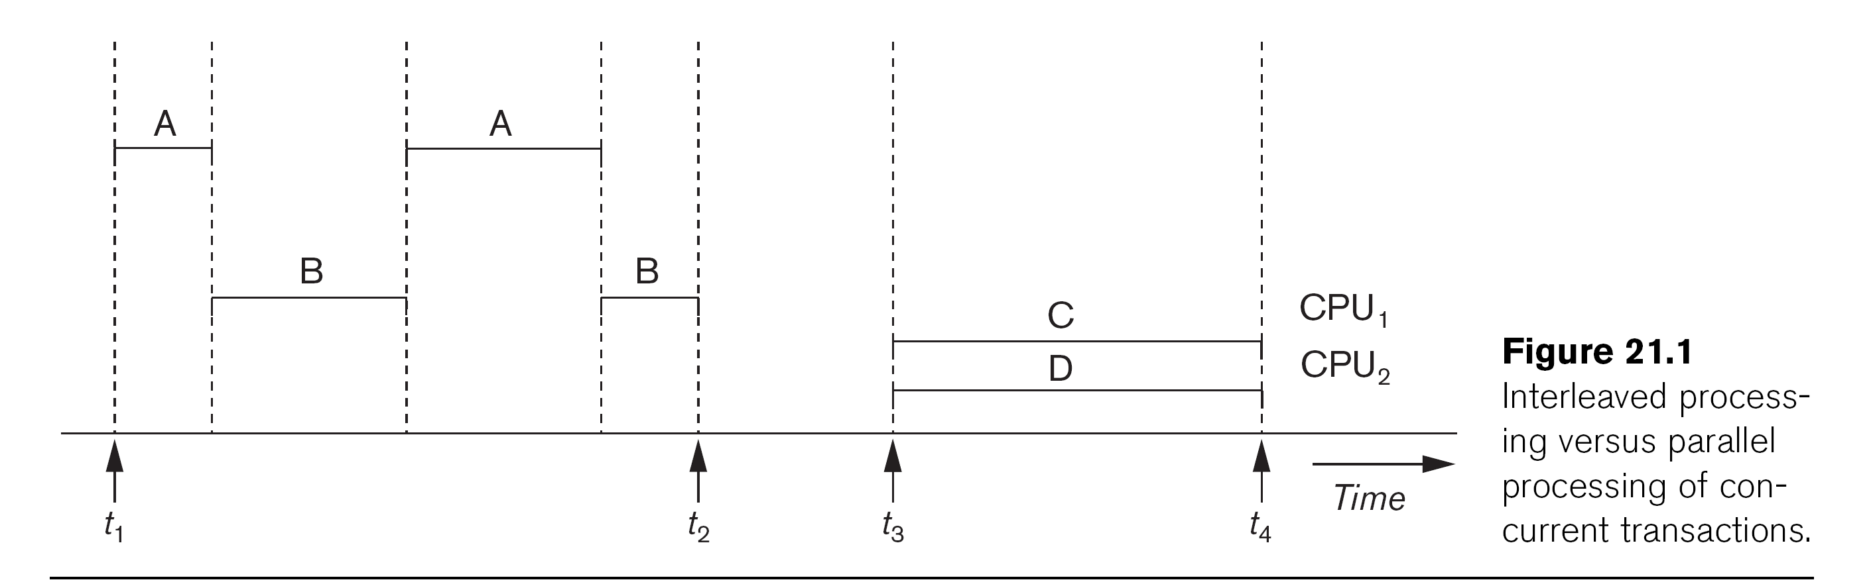

Slide 4
Transaction Processing:Definition
A Transaction:
  Logical unit of database processing that includes one or more access operations (read -retrieval, write - insert or update, delete).
A transaction (set of operations) may be stand-alone specified in a high level language like SQL submitted interactively, or may be embedded within a program.
Transaction boundaries:
  Begin and End transaction.
An application program may contain several transactions separated by the Begin and End transaction boundaries.
Read-only transaction (only retrieve ops, no update) vs. read-write transaction

Slide 5
Transaction Processing: Model
SIMPLE MODEL OF A DATABASE (for purposes of discussing transactions):
A database is a collection of named data items
Granularity of data - a field, a record , or a whole disk block (Concepts are independent of granularity)
Basic operations are read and write
  read_item(X): Reads a database item named X into a program variable. To simplify our notation, we assume that the program variable is also named X.
  write_item(X): Writes the value of program variable X into the database item named X.

Slide 6
Transaction Processing:read & write ops
Basic unit of data transfer from the disk to the computer main memory is one block. In general, a data item (what is read or written) will be the field of some record in the database. But it may be a larger unit such as a record or even a whole block.
read_item(X) command includes the following steps:
  Find the address of the disk block that contains item X.
  Copy that disk block into a buffer in main memory (if that disk block is not already in some main memory buffer).
  Copy item X from the buffer to the program variable named X.
write_item(X) command includes the following steps:
  Find the address of the disk block that contains item X.
  Copy that disk block into a buffer in main memory (if that disk block is not already in some main memory buffer).
  Copy item X from the program variable named X into its correct location in the buffer.
  Store the updated block from the buffer back to disk (either immediately or at some later point in time).

Slide 7
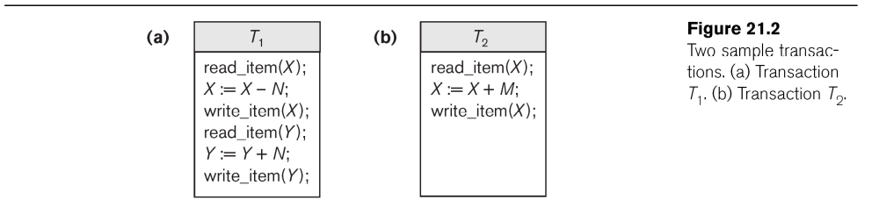
Two Sample Transactions: contains read-ıtem, write-item read-set=write-set={X, Y}

Slide 8
Concurrency Control and Recovery
Concerned with db commands in a transaction
Many transactions may execute concurrently, access and update the same db items. If uncontrolled, result in some problems (ie, inconsistent database)
Ex: a record for each airline flight includes #of reserved seats
  T1: transfers N reservations from one flight (item X) to another flight (item Y)
  T2: just reserves M seats on the first flight (item X)
  Ignore portions of transactions such as check for seat availability
  Parameters in DB program: flight number, date, number of seats (to book)

Slide 9
Transaction Processing:Why need Concurrency Control
The Lost Update Problem
  This occurs when two transactions that access the same database items have their operations interleaved in a way that makes the value of some database item incorrect. Final value of X is incorrect since T2 reads X before T1 changes it in the db. (X=80, N=5, M=4 -> X=84 (79))
The Temporary Update (or Dirty Read) Problem
  This occurs when one transaction updates a database item and then the transaction fails for some reason.
  The updated item is accessed by another transaction before it is changed back to its original value. T1 updates X and fails. Change X to original. But before that T2 reads temp value of X (which is not permenant in db)
The Incorrect Summary Problem
  If one transaction is calculating an aggregate summary function on a number of records while other transactions are updating some of these records, the aggregate function may calculate some values before they are updated and others after they are updated. T3: total number of reservations on all flights while T1 is executing. T3 is off by N since T3 reads X after N seats are subtracted but reads Y before N seats added to Y

Slide 10
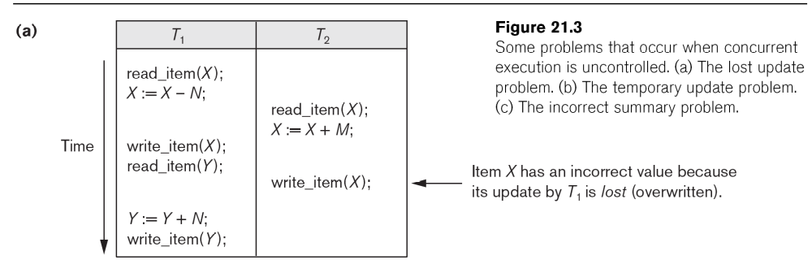
Concurrent execution is uncontrolled: (a) The lost update problem.

Slide 11
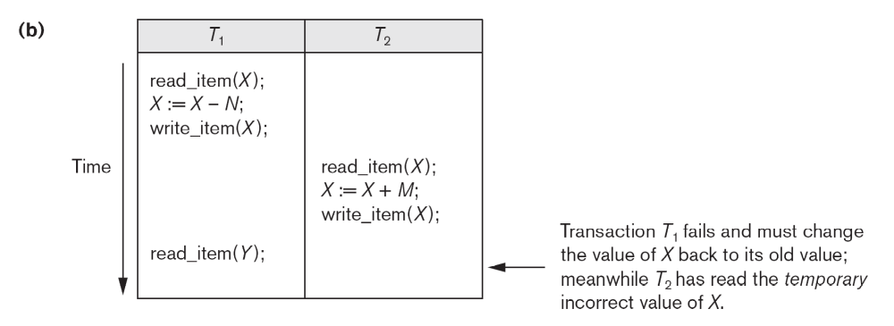
Concurrent execution is uncontrolled: (b) The temporary update problem.

Slide 12
Concurrent execution is uncontrolled: (c) The incorrect summary problem.

Slide 13
Transaction Processing: recovery
When a trans is submitted to a DBMS, either all operations in it are completed successfully and their effect is recorded permenantly in db (committed) or trans has no effect in the db or any other transactions (trans is aborted). Transaction cannot be partially applied to the db. T fails after some ops applied, then these ops must be undone and have no lasting effect.
Why recovery is needed (What causes a Transaction to fail)
1. A computer failure (system crash):
  A hardware/software error occurs in the computer system during transaction execution. If the hardware crashes, the contents of the computer’s internal memory may be lost.
2. A transaction or system error:
  Some operation in the transaction may cause it to fail, such as integer overflow or division by zero. Transaction failure may also occur because of erroneous parameter values or because of a logical programming error. In addition, the user may interrupt the transaction during its execution.

Slide 14
Transaction Processing: recovery
3. Local errors or exception conditions detected by the transaction:
  Certain conditions necessitate cancellation of the transaction. For example, data for the transaction may not be found. A condition, such as insufficient account balance in a banking database, may cause a transaction, such as a fund withdrawal from that account, to be canceled.
  A programmed abort in the transaction causes it to fail.
4. Concurrency control enforcement:
  The concurrency control method may decide to abort the transaction, to be restarted later, because it violates serializability or because several transactions are in a state of deadlock
  5. Disk failure:
  Some disk blocks may lose their data because of a read or write malfunction or because of a disk read/write head crash. This may happen during a read or a write operation of the transaction.
  6. Physical problems and catastrophes:
  This refers to an endless list of problems that includes power or air-conditioning failure, fire, theft, sabotage, overwriting disks or tapes by mistake, and mounting of a wrong tape by the operator.

Slide 15
2 Transaction and System Concepts
A transaction is an atomic unit of work that is either completed in its entirety or not done at all.
  For recovery purposes, the system needs to keep track of when the transaction starts, terminates, and commits or aborts.
Transaction states:
  Active state
  Partially committed state
  Committed state
  Failed state
  Terminated State

Slide 16
Transaction and System Concepts: ops
Recovery manager keeps track of the following operations:
  begin_transaction: This marks the beginning of transaction execution.
  read or write: These specify read or write operations on the database items that are executed as part of a transaction.
  end_transaction: This specifies that read and write transaction operations have ended and marks the end limit of transaction execution.
    At this point it may be necessary to check whether the changes introduced by the transaction can be permanently applied to the database or whether the transaction has to be aborted because it violates concurrency control or for some other reason.

Slide 17
Transaction and System Concepts:ops
  commit_transaction: This signals a successful end of the transaction so that any changes (updates) executed by the transaction can be safely committed to the database and will not be undone.
  rollback (or abort): This signals that the transaction has ended unsuccessfully, so that any changes or effects that the transaction may have applied to the database must be undone.

Slide 18
State Transition Diagram Illustrating the States for Transaction Execution

Slide 19
Transaction and System Concepts: recovery ops
Recovery techniques use the following operators:
  undo: Similar to rollback except that it applies to a single operation rather than to a whole transaction.
  redo: This specifies that certain transaction operations must be redone to ensure that all the operations of a committed transaction have been applied successfully to the database.

