Slide 1
Ch 21: Transaction Processing
Transaction Definitions
Transaction and System Concepts
Desirable Properties of Transactions
Characterizing Schedules based on Recoverability
Characterizing Schedules based on Serializability
Transaction Support in SQL

Slide 2
Transaction and System Concepts: recovery ops
Based on log: seq and append-only file consisting of log records
If transaction fails, recovery:undo or redo transaction ops individually from the log.
Recovery techniques use the following operators:
  undo: Similar to rollback except that it applies to a single operation rather than to a whole transaction. Trace backward (W ops of T)
  redo: This specifies that certain transaction operations must be redone to ensure that all the operations of a committed transaction have been applied successfully to the database. (write OK in log but not on disk)

Slide 3
The System Log
  Log or Journal: The log keeps track of all transaction operations that affect the values of database items.
    This information may be needed to permit recovery from transaction failures.
    The log is kept on disk, so it is not affected by any type of failure except for disk or catastrophic failure.
    In addition, the log is periodically backed up to archival storage (tape) to guard against such catastrophic failures.

Slide 4
The System Log (cont):
  T in the following discussion refers to a unique transaction-id that is generated automatically by the system and is used to identify each transaction:
  Types of log record:
    [start_transaction,T]: Records that transaction T has started execution.
    [write_item,T,X,old_value,new_value]: Records that transaction T has changed the value of database item X from old_value to new_value.
    [read_item,T,X]: Records that transaction T has read the value of database item X.
    [commit,T]: Records that transaction T has completed successfully, and affirms that its effect can be committed (recorded permanently) to the database.
    [abort,T]: Records that transaction T has been aborted.

Slide 5
The System Log (cont):
  Protocols for recovery that avoid cascading rollbacks do not require that read operations be written to the system log, whereas other protocols (or auditing=keep track of all db operations) require these entries for recovery.
  Strict protocols require simpler write entries that do not include new_value (see Section 21.4).

Slide 6
Recovery using log records:
If the system crashes, we can recover to a consistent database state by examining the log and using one of the techniques.
  Because the log contains a record of every write operation that changes the value of some database item, it is possible to undo the effect of these write operations of a transaction T by tracing backward through the log and resetting all items changed by a write operation of T to their old_values.
  We can also redo the effect of the write operations of a transaction T by tracing forward through the log and setting all items changed by a write operation of T (that did not get done permanently) to their new_values.

Slide 7
Commit Point of a Transaction:
Definition a Commit Point:
  A transaction T reaches its commit point when all its operations that access the database have been executed successfully and the effect of all the transaction operations on the database has been recorded in the log.
  Beyond the commit point, the transaction is said to be committed, and its effect is assumed to be permanently recorded in the database.
  The transaction then writes an entry [commit,T] into the log.
Roll Back of transactions:
  Needed for transactions that have a [start_transaction,T] entry into the log but no commit entry [commit,T] into the log.

Slide 8
Commit Point of a Transaction (cont):
Redoing transactions:
  Transactions that have written their commit entry in the log must also have recorded all their write operations in the log; otherwise they would not be committed, so their effect on the database can be redone from the log entries. (Notice that the log file must be kept on disk.
  At the time of a system crash, only the log entries that have been written back to disk are considered in the recovery process because the contents of main memory may be lost.)
Force writing a log:
  Before a transaction reaches its commit point, any portion of the log that has not been written to the disk yet must now be written to the disk.
  This process is called force-writing the log file before committing a transaction.

Slide 9
3 Desirable Properties of Transactions (1)
ACID properties:
Atomicity: A transaction is an atomic unit of processing; it is either performed in its entirety or not performed at all.
Consistency preservation: A correct execution of the transaction must take the database from one consistent state to another.
Isolation: A transaction should not make its updates visible to other transactions until it is committed; this property, when enforced strictly, solves the temporary update problem and makes cascading rollbacks of transactions unnecessary (see Chapter 21).
Durability or permanency: Once a transaction changes the database and the changes are committed, these changes must never be lost because of subsequent failure.

Slide 10
4 Characterizing Schedules Based on Recoverability (1)
Transaction schedule or history:
  When transactions are executing concurrently in an interleaved fashion, the order of execution of operations from the various transactions forms what is known as a transaction schedule (or history).
A schedule (or history) S of n transactions T1, T2, …, Tn:
  It is an ordering of the operations of the transactions subject to the constraint that, for each transaction Ti that participates in S, the operations of T1 in S must appear in the same order in which they occur in T1.
  Note, however, that operations from other transactions Tj can be interleaved with the operations of Ti in S.

Slide 11
Characterizing Schedules Based on Recoverability (read)
Schedules classified on recoverability:
Recoverable schedule:
  One where no transaction needs to be rolled back.
  A schedule S is recoverable if no transaction T in S commits until all transactions T’ that have written an item that T reads have committed.
Cascadeless schedule:
  One where every transaction reads only the items that are written by committed transactions.

Slide 12
Characterizing Schedules Based on Recoverability (read)
Schedules classified on recoverability (cont.):
Schedules requiring cascaded rollback:
  A schedule in which uncommitted transactions that read an item from a failed transaction must be rolled back.
Strict Schedules:
  A schedule in which a transaction can neither read or write an item X until the last transaction that wrote X has committed.

Slide 13
5 Characterizing Schedules Based on Serializability
Serial schedule:
  A schedule S is serial if, for every transaction T participating in the schedule, all the operations of T are executed consecutively in the schedule.
    Otherwise, the schedule is called nonserial schedule.
Serializable schedule:
  A schedule S is serializable if it is equivalent to some serial schedule of the same n transactions.

Slide 14
Characterizing Schedules Based on Serializability (read)
Result equivalent:
  Two schedules are called result equivalent if they produce the same final state of the database.
Conflict equivalent:
  Two schedules are said to be conflict equivalent if the order of any two conflicting operations is the same in both schedules.
Conflict serializable:
  A schedule S is said to be conflict serializable if it is conflict equivalent to some serial schedule S’.

Slide 15
Characterizing Schedules Based on Serializability
Being serializable is not the same as being serial
Being serializable implies that the schedule is a correct schedule.
  It will leave the database in a consistent state.
  The interleaving is appropriate and will result in a state as if the transactions were serially executed, yet will achieve efficiency due to concurrent execution.

Slide 16
Characterizing Schedules Based on Serializability
Serializability is hard to check.
  Interleaving of operations occurs in an operating system through some scheduler
  Difficult to determine beforehand how the operations in a schedule will be interleaved.

Slide 17
Characterizing Schedules Based on Serializability
Practical approach:
Come up with methods (protocols) to ensure serializability.
It’s not possible to determine when a schedule begins and when it ends.
  Hence, we reduce the problem of checking the whole schedule to checking only a committed project of the schedule (i.e. operations from only the committed transactions.)
Current approach used in most DBMSs:
  Use of locks with two phase locking

Slide 18
Characterizing Schedules Based on Serializability (11)
Testing for conflict serializability: Algorithm 21.1:
  Looks at only read_Item (X) and write_Item (X) operations
  Constructs a precedence graph (serialization graph) - a graph with directed edges
  An edge is created from Ti to Tj if one of the operations in Ti appears before a conflicting operation in Tj
  The schedule is serializable if and only if the precedence graph has no cycles.

Slide 19
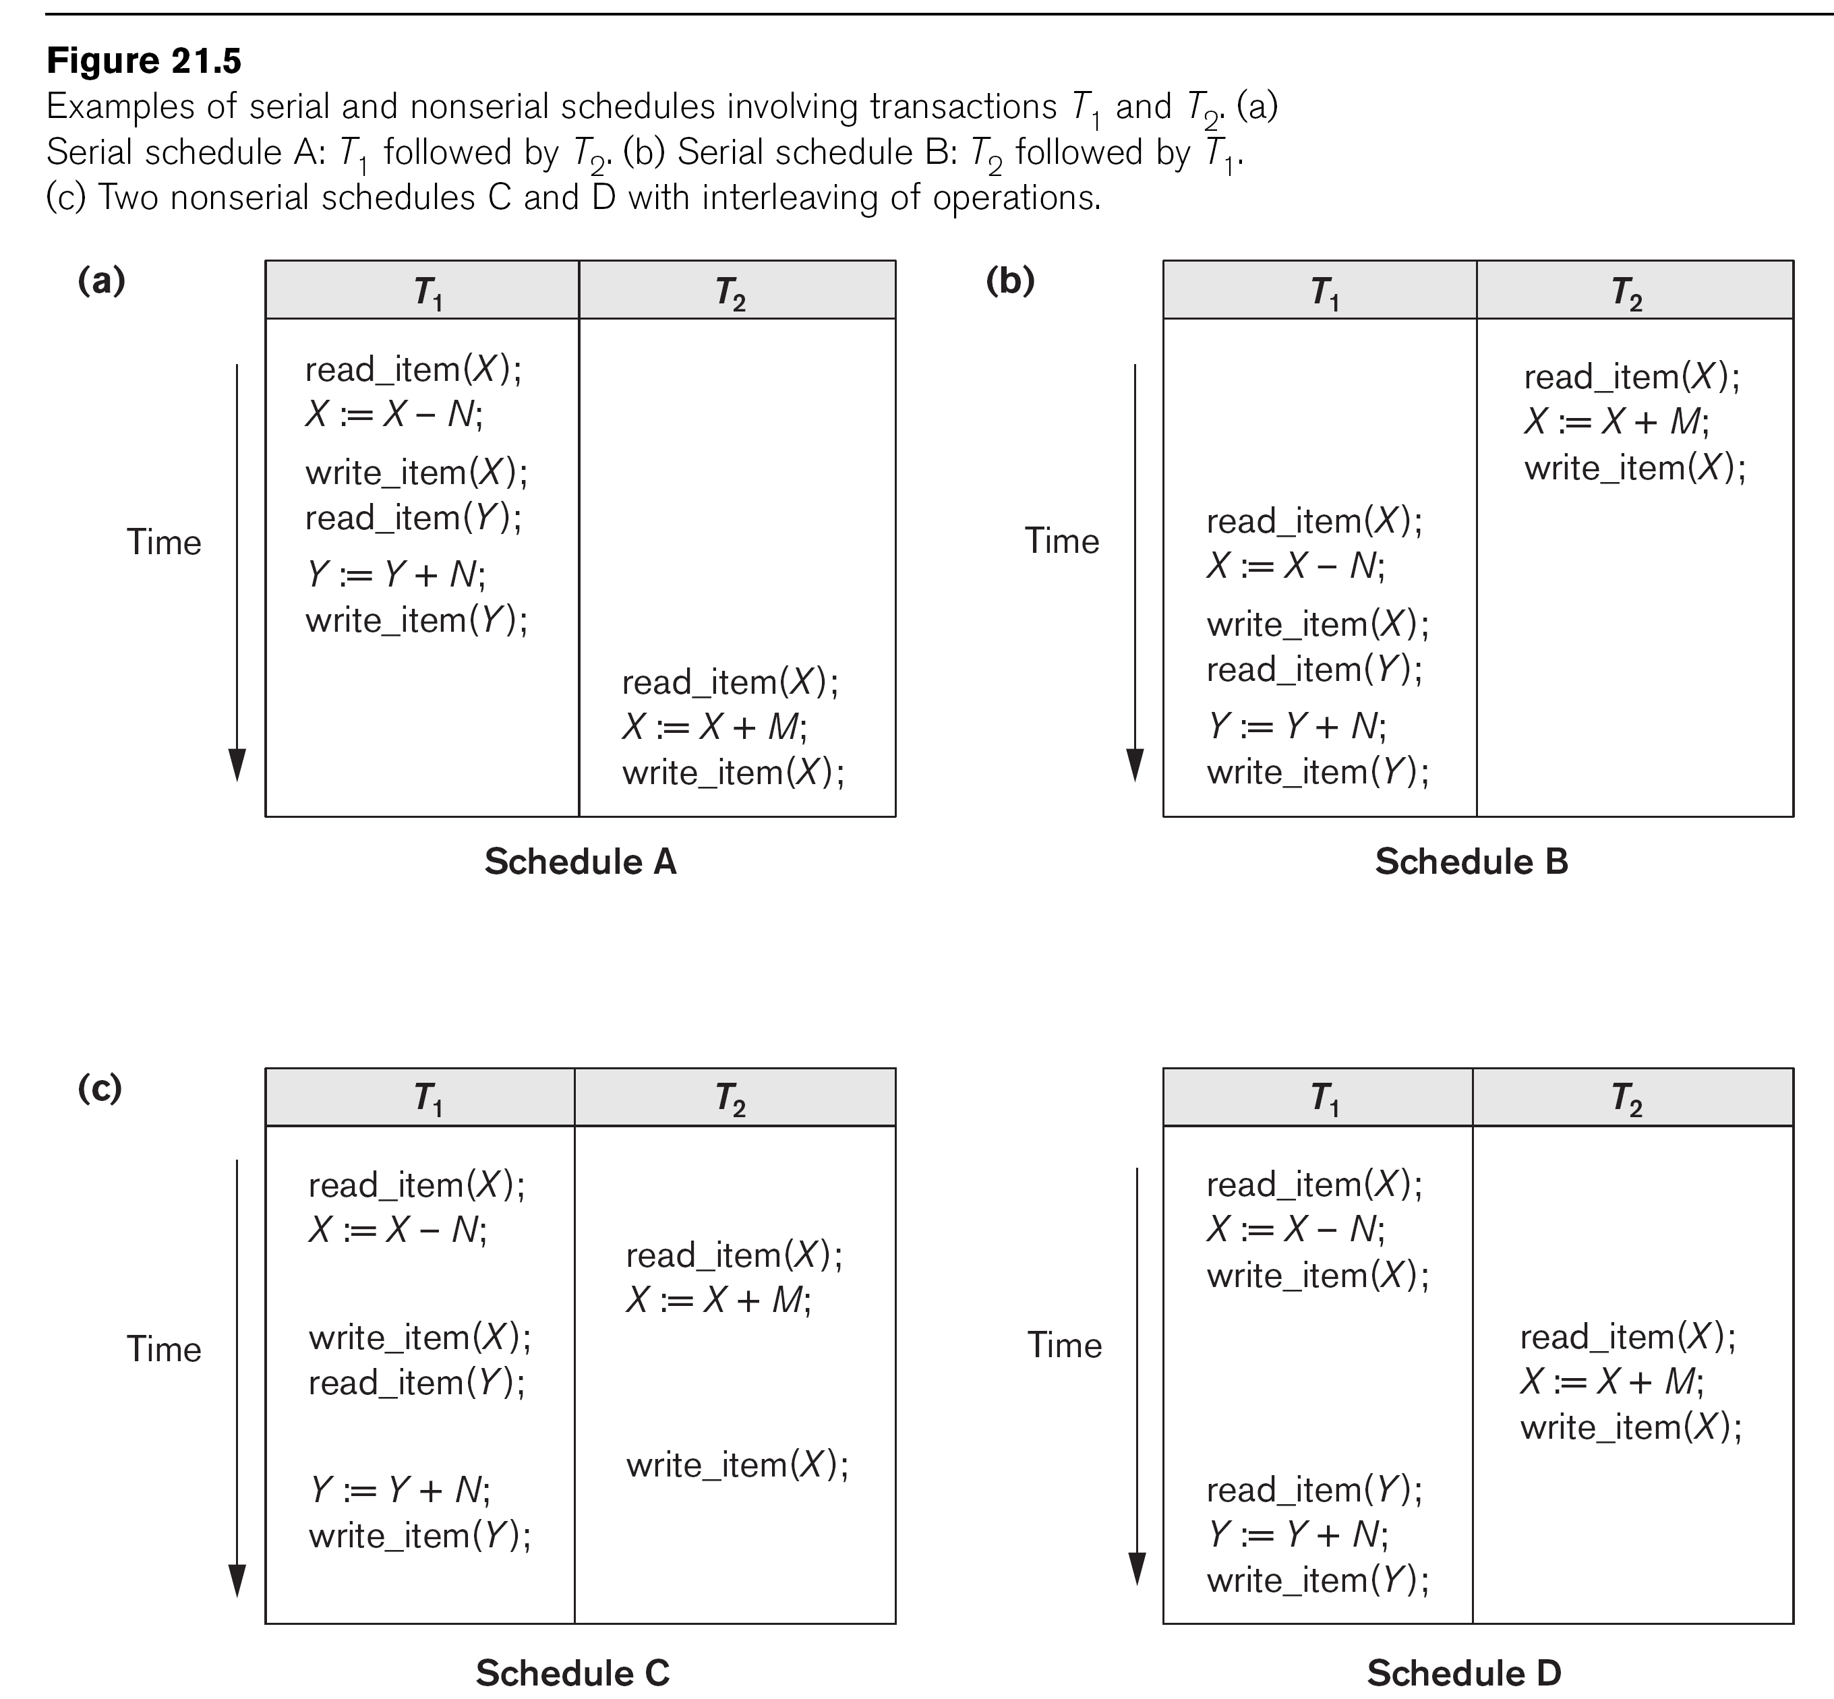

Slide 20
Precedence Graphs of Sch. A-D

Slide 23
6 Transaction Support in SQL2 (1)
A single SQL statement is always considered to be atomic.
  Either the statement completes execution without error or it fails and leaves the database unchanged.
With SQL, there is no explicit Begin Transaction statement.
  Transaction initiation is done implicitly when particular SQL statements are encountered.
Every transaction must have an explicit end statement, which is either a COMMIT or ROLLBACK.

Slide 24
Transaction Support in SQL2 (2)
Characteristics specified by a SET TRANSACTION statement in SQL2:
Access mode:
  READ ONLY or READ WRITE.
    The default is READ WRITE unless the isolation level of READ UNCOMITTED is specified, in which case READ ONLY is assumed.
Diagnostic size n, specifies an integer value n, indicating the number of conditions that can be held simultaneously in the diagnostic area.

Slide 25
Transaction Support in SQL2 (3)
Characteristics specified by a SET TRANSACTION statement in SQL2 (cont.):
Isolation level <isolation>, where <isolation> can be READ UNCOMMITTED, READ COMMITTED, REPEATABLE READ or SERIALIZABLE. The default is SERIALIZABLE.
  With SERIALIZABLE: the interleaved execution of transactions will adhere to our notion of serializability.
  However, if any transaction executes at a lower level, then serializability may be violated.

Slide 26
Transaction Support in SQL2 (4)
Potential problem with lower isolation levels:
Dirty Read:
  Reading a value that was written by a transaction which failed.
Nonrepeatable Read:
  Allowing another transaction to write a new value between multiple reads of one transaction.
  A transaction T1 may read a given value from a table. If another transaction T2 later updates that value and T1 reads that value again, T1 will see a different value.
    Consider that T1 reads the employee salary for Smith. Next, T2 updates the salary for Smith. If T1 reads Smith's salary again, then it will see a different value for Smith's salary.

Slide 27
Transaction Support in SQL2 (5)
Potential problem with lower isolation levels (cont.):
  Phantoms:
    New rows being read using the same read with a condition.
      A transaction T1 may read a set of rows from a table, perhaps based on some condition specified in the SQL WHERE clause.
      Now suppose that a transaction T2 inserts a new row that also satisfies the WHERE clause condition of T1, into the table used by T1.
      If T1 is repeated, then T1 will see a row that previously did not exist, called a phantom.

Slide 28
Transaction Support in SQL2 (6)
Sample SQL transaction:
  EXEC SQL whenever sqlerror go to UNDO;
  EXEC SQL SET TRANSACTION
  READ WRITE
  DIAGNOSTICS SIZE 5
  ISOLATION LEVEL SERIALIZABLE;
  EXEC SQL INSERT
  INTO EMPLOYEE (FNAME, LNAME, SSN, DNO, SALARY)
  VALUES ('Robert','Smith','991004321',2,35000);
  EXEC SQL UPDATE EMPLOYEE
  SET SALARY = SALARY * 1.1
  WHERE DNO = 2;
  EXEC SQL COMMIT;
  GOTO THE_END;
  UNDO: EXEC SQL ROLLBACK;
  THE_END: ...

Slide 29
Transaction Support in SQL2 (7)
Possible violation of serializabilty:
Type of Violation
Isolation Dirty nonrepeatable
level read read phantom
_______________________________________________________
READ UNCOMMITTED yes yes yes
READ COMMITTED no yes yes
REPEATABLE READ no no yes
SERIALIZABLE no no no

Slide 30
Summary
Transaction and System Concepts
Desirable Properties of Transactions
Schedules or History
Characterizing Schedules based on Serializability
Transaction Support in SQL

