Slide 1
Ch 22: Databases Concurrency Control
  Purpose of Concurrency Control
  Two-Phase locking
  Limitations of CCMs
  Index Locking
  Lock Compatibility Matrix
  Lock Granularity

Slide 2
Database Concurrency Control
1 Purpose of Concurrency Control
  To enforce Isolation (through mutual exclusion) among conflicting transactions.
  To preserve database consistency through consistency preserving execution of transactions.
  To resolve read-write and write-write conflicts.
Example:
  In concurrent execution environment if T1 conflicts with T2 over a data item A, then the existing concurrency control decides if T1 or T2 should get the A and if the other transaction is rolled-back or waits.

Slide 3
Database Concurrency Control
Two-Phase Locking Techniques
  Locking is an operation which secures
    (a) permission to Read
    (b) permission to Write a data item for a transaction.
  Example:
    Lock (X). Data item X is locked in behalf of the requesting transaction.
  Unlocking is an operation which removes these permissions from the data item.
  Example:
    Unlock (X): Data item X is made available to all other transactions.
  Lock and Unlock are Atomic operations.

Slide 4
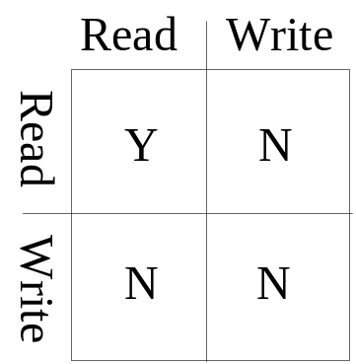
Database Concurrency Control
Two-Phase Locking Techniques: Essential components
  Two locks modes:
    (a) shared (read) (b) exclusive (write).
  Shared mode: shared lock (X)
    More than one transaction can apply share lock on X for reading its value but no write lock can be applied on X by any other transaction.
  Exclusive mode: Write lock (X)
    Only one write lock on X can exist at any time and no shared lock can be applied by any other transaction on X.
  Conflict matrix

Slide 5
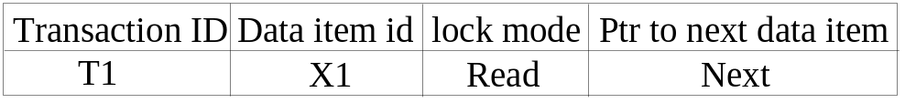
Database Concurrency Control
Two-Phase Locking Techniques: Essential components
  Lock Manager:
    Managing locks on data items.
  Lock table:
    Lock manager uses it to store the identify of transaction locking a data item, the data item, lock mode and pointer to the next data item locked. One simple way to implement a lock table is through linked list.

Slide 6
Database Concurrency Control
Two-Phase Locking Techniques: Essential components
  Database requires that all transactions should be well-formed. A transaction is well-formed if:
    It must lock the data item before it reads or writes to it.
    It must not lock an already locked data items and it must not try to unlock a free data item.

Slide 7
Database Concurrency Control
Two-Phase Locking Techniques: Essential components
  The following code performs the lock operation:
  B: if LOCK (X) = 0 (*item is unlocked*)
  then LOCK (X) ← 1 (*lock the item*)
  else begin
  wait (until lock (X) = 0) and
  the lock manager wakes up the transaction);
  goto B
  end;

Slide 8
Database Concurrency Control
Two-Phase Locking Techniques: Essential components
  The following code performs the unlock operation:
  LOCK (X) ← 0 (*unlock the item*)
  if any transactions are waiting then
  wake up one of the waiting the transactions;

Slide 9
Database Concurrency Control
Two-Phase Locking Techniques: Essential components
  The following code performs the read operation:
B: if LOCK (X) = “unlocked” then
  begin LOCK (X) ← “read-locked”;
  no_of_reads (X) ← 1;
  end
  else if LOCK (X) ← “read-locked” then
  no_of_reads (X) ← no_of_reads (X) +1
  else begin wait (until LOCK (X) = “unlocked” and
  the lock manager wakes up the transaction);
  go to B
  end;

Slide 10
Database Concurrency Control
Two-Phase Locking Techniques: Essential components
  The following code performs the write lock operation:
B: if LOCK (X) = “unlocked” then
  LOCK (X) ← “write-locked”;
  else begin
  wait (until LOCK (X) = “unlocked” and
  the lock manager wakes up the transaction);
  go to B
  end;

Slide 11
Database Concurrency Control
Two-Phase Locking Techniques: Essential components
  The following code performs the unlock operation:
if LOCK (X) = “write-locked” then
  begin LOCK (X) ← “unlocked”;
  wakes up one of the transactions, if any
  end
  else if LOCK (X) ← “read-locked” then
  begin
  no_of_reads (X) ← no_of_reads (X) -1
  if no_of_reads (X) = 0 then
  begin
  LOCK (X) = “unlocked”;
  wake up one of the transactions, if any
  end
  end;

Slide 13
Database Concurrency Control
Two-Phase Locking Techniques: Essential components
Lock conversion
  Lock upgrade: existing read lock to write lock
if Ti has a read-lock (X) and Tj has no read-lock (X) (i ≠ j) then
  convert read-lock (X) to write-lock (X)
  else
  force Ti to wait until Tj unlocks X
  Lock downgrade: existing write lock to read lock
  Ti has a write-lock (X) (*no transaction can have any lock on X*)
  convert write-lock (X) to read-lock (X)

Slide 14
Database Concurrency Control
Two-Phase Locking Techniques: The algorithm
Two Phases:
  (a) Locking (Growing)
  (b) Unlocking (Shrinking).
Locking (Growing) Phase:
  A transaction applies locks (read or write) on desired data items one at a time.
Unlocking (Shrinking) Phase:
  A transaction unlocks its locked data items one at a time.
Requirement:
  For a transaction these two phases must be mutually exclusively, that is, during locking phase unlocking phase must not start and during unlocking phase locking phase must not begin.

Slide 15
Database Concurrency Control
Two-Phase Locking Techniques: The algorithm
T1 T2 Result
read_lock (Y); read_lock (X); Initial values: X=20; Y=30
read_item (Y); read_item (X); Result of serial execution
unlock (Y); unlock (X); T1 followed by T2
write_lock (X); Write_lock (Y); X=50, Y=80.
read_item (X); read_item (Y); Result of serial execution
X:=X+Y; Y:=X+Y; T2 followed by T1
write_item (X); write_item (Y); X=70, Y=50
unlock (X); unlock (Y);

Slide 16
Database Concurrency Control
Two-Phase Locking Techniques: The algorithm
T1 T2 Result
read_lock (Y); X=50; Y=50
read_item (Y); Nonserializable because it.
unlock (Y); violated two-phase policy.
read_lock (X);
read_item (X);
unlock (X);
write_lock (Y);
read_item (Y);
Y:=X+Y;
write_item (Y);
unlock (Y);
write_lock (X);
read_item (X);
X:=X+Y;
write_item (X);
unlock (X);
Time

Slide 17
Database Concurrency Control
Two-Phase Locking Techniques: The algorithm
T’1 T’2
read_lock (Y); read_lock (X); T1 and T2 follow two-phase
read_item (Y); read_item (X); policy but they are subject to
write_lock (X); Write_lock (Y); deadlock, which must be
unlock (Y); unlock (X); dealt with.
read_item (X); read_item (Y);
X:=X+Y; Y:=X+Y;
write_item (X); write_item (Y);
unlock (X); unlock (Y);

Slide 18
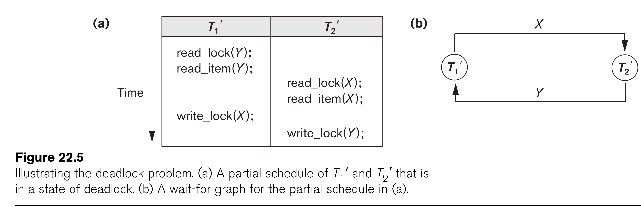

Slide 19
Database Concurrency Control
Two-Phase Locking Techniques: The algorithm
Two-phase policy generates two locking algorithms
  (a) Basic
  (b) Conservative
Conservative:
  Prevents deadlock by locking all desired data items before transaction begins execution.
Basic:
  Transaction locks data items incrementally. This may cause deadlock which is dealt with.
  Strict:
    A more stricter version of Basic algorithm where unlocking is performed after a transaction terminates (commits or aborts and rolled-back). This is the most commonly used two-phase locking algorithm.

Slide 20
Database Concurrency Control
Dealing with Deadlock and Starvation
  Deadlock
T’1 T’2
read_lock (Y); T1 and T2 did follow two-phase
read_item (Y); policy but they are deadlock
read_lock (X);
read_item (Y);
write_lock (X);
(waits for X) write_lock (Y);
(waits for Y)
  Deadlock (T’1 and T’2)

Slide 21
Database Concurrency Control
Dealing with Deadlock and Starvation
Deadlock prevention
  A transaction locks all data items it refers to before it begins execution.
  This way of locking prevents deadlock since a transaction never waits for a data item.
  The conservative two-phase locking uses this approach.

Slide 22
Database Concurrency Control
Dealing with Deadlock and Starvation
Deadlock detection and resolution
  In this approach, deadlocks are allowed to happen. The scheduler maintains a wait-for-graph for detecting cycle. If a cycle exists, then one transaction involved in the cycle is selected (victim) and rolled-back.
  A wait-for-graph is created using the lock table. As soon as a transaction is blocked, it is added to the graph. When a chain like: Ti waits for Tj waits for Tk waits for Ti or Tj occurs, then this creates a cycle. One of the transaction o

Slide 23
Database Concurrency Control
Dealing with Deadlock and Starvation
Deadlock avoidance
  There are many variations of two-phase locking algorithm.
  Some avoid deadlock by not letting the cycle to complete.
  That is as soon as the algorithm discovers that blocking a transaction is likely to create a cycle, it rolls back the transaction.
  Wound-Wait and Wait-Die algorithms use timestamps to avoid deadlocks by rolling-back victim.

Slide 24
Database Concurrency Control
Dealing with Deadlock and Starvation
Starvation
  Starvation occurs when a particular transaction consistently waits or restarted and never gets a chance to proceed further.
  In a deadlock resolution it is possible that the same transaction may consistently be selected as victim and rolled-back.
  This limitation is inherent in all priority based scheduling mechanisms.
  In Wound-Wait scheme a younger transaction may always be wounded (aborted) by a long running older transaction which may create starvation.

Slide 25
Database Concurrency Control
Timestamp based concurrency control algorithm
Timestamp
  A monotonically increasing variable (integer) indicating the age of an operation or a transaction. A larger timestamp value indicates a more recent event or operation.
  Timestamp based algorithm uses timestamp to serialize the execution of concurrent transactions.

Slide 26
Database Concurrency Control
Multiversion concurrency control techniques
  This approach maintains a number of versions of a data item and allocates the right version to a read operation of a transaction. Thus unlike other mechanisms a read operation in this mechanism is never rejected.
  Side effect:
    Significantly more storage (RAM and disk) is required to maintain multiple versions. To check unlimited growth of versions, a garbage collection is run when some criteria is satisfied.

Slide 27
Database Concurrency Control
Others...(no detail, for detail see textbook)
Multiversion technique based on timestamp ordering
Multiversion Two-Phase Locking Using Certify Locks
Validation (Optimistic) Concurrency Control Schemes

Slide 28
Database Concurrency Control
Granularity of data items and Multiple Granularity Locking
A lockable unit of data defines its granularity. Granularity can be coarse (entire database) or it can be fine (a tuple or an attribute of a relation).
Data item granularity significantly affects concurrency control performance. Thus, the degree of concurrency is low for coarse granularity and high for fine granularity.
Example of data item granularity:
  A field of a database record (an attribute of a tuple)
  A database record (a tuple or a relation)
  A disk block
  An entire file
  The entire database

Slide 29
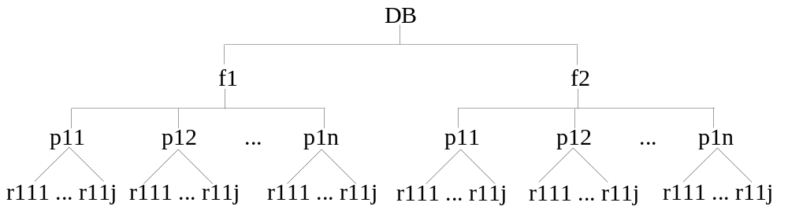
Database Concurrency Control
Granularity of data items and Multiple Granularity Locking
The following diagram illustrates a hierarchy of granularity from coarse (database) to fine (record).

Slide 30
Database Concurrency Control
Granularity of data items and Multiple Granularity Locking
To manage such hierarchy, in addition to read and write, three additional locking modes, called intention lock modes are defined:
  Intention-shared (IS): indicates that a shared lock(s) will be requested on some descendent nodes(s).
  Intention-exclusive (IX): indicates that an exclusive lock(s) will be requested on some descendent node(s).
  Shared-intention-exclusive (SIX): indicates that the current node is locked in shared mode but an exclusive lock(s) will be requested on some descendent nodes(s).

Slide 31
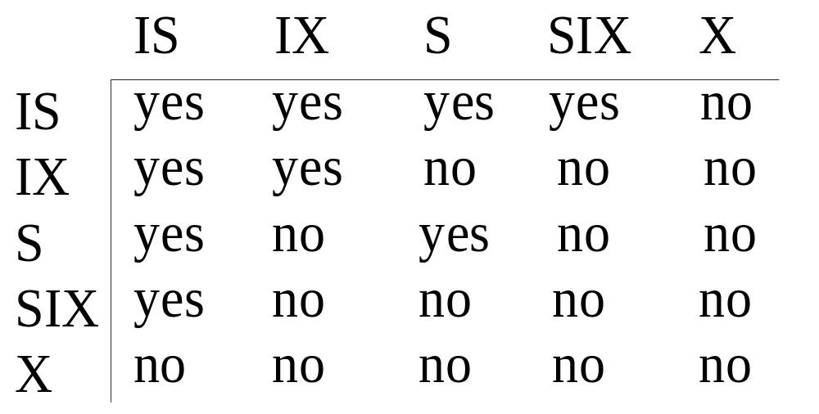
Database Concurrency Control
Granularity of data items and Multiple Granularity Locking
These locks are applied using the following compatibility matrix:
  Intention-shared (IS
  Intention-exclusive (IX)
  Shared-intention-exclusive (SIX)

Slide 32
Database Concurrency Control
Granularity of data items and Multiple Granularity Locking
The set of rules which must be followed for producing serializable schedule are
  The lock compatibility must adhered to.
  The root of the tree must be locked first, in any mode..
  A node N can be locked by a transaction T in S or IX mode only if the parent node is already locked by T in either IS or IX mode.
  A node N can be locked by T in X, IX, or SIX mode only if the parent of N is already locked by T in either IX or SIX mode.
  T can lock a node only if it has not unlocked any node (to enforce 2PL policy).
  T can unlock a node, N, only if none of the children of N are currently locked by T.

Slide 33
Database Concurrency Control
Granularity of data items and Multiple Granularity Locking: An example of a serializable execution:
  T1 T2 T3
  IX(db)
  IX(f1)
  IX(db)
  IS(db)
  IS(f1)
  IS(p11)
  IX(p11)
  X(r111)
  IX(f1)
  X(p12)
  S(r11j)
  IX(f2)
  IX(p21)
  IX(r211)
  Unlock (r211)
  Unlock (p21)
  Unlock (f2)
  S(f2)

Slide 34
Database Concurrency Control
Granularity of data items and Multiple Granularity Locking: An example of a serializable execution (continued):
  T1 T2 T3
  unlock(p12)
  unlock(f1)
  unlock(db)
  unlock(r111)
  unlock(p11)
  unlock(f1)
  unlock(db)
  unlock (r111j)
  unlock (p11)
  unlock (f1)
  unlock(f2)
  unlock(db)

Slide 35
Summary
Databases Concurrency Control
  Purpose of Concurrency Control
  Two-Phase locking
  Limitations of CCMs
  Index Locking
  Lock Compatibility Matrix
  Lock Granularity

