Slide 1
Ders # 8
Web DB Programming: PHP
From Elmasri/Navathe textbook Ch9,26
Sciore textbook, Ch 9-10

Slide 2
Web Programming w/ PHP
Overview
    PHP (PHP Hypertext Preprocessor {recursive acronym})
PHP Examples
Basic features of PHP
  PHP Arrays
  PHP Functions
PHP Database programming
  Connect
  Query
  Retrieval Queries
Slide 9- <number>

Slide 3
PHP:
for programming dynamic features into Web
Open source scripting language
Interpreter engine in C;
  free of charge
  Can be used on nearly all computer types
Particularly suited for manipulation of text pages
Manipulates at the Web server
  Conversely, JavaScript is downloaded and executed on the client
dynamic web pages: part of info is extracted from databases
Has libraries of functions for accessing databases
Slide 9- <number>

Slide 4
Where is PHP
DBMS: Bottom-tier database server
PHP: Middle-tier Web server
HTML: Client tier
A simple PHP Example:
  Suppose the file P1 is stored at www.myserver.com/example/greeting.php

Slide 5
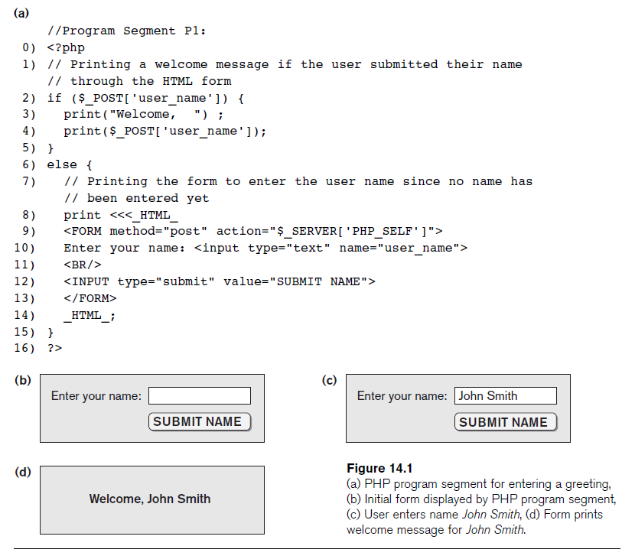

Slide 6
A Simple PHP Example (cont’d.)
<?php
  PHP start tag
?>
  PHP end tag
Comments: // or /* */
$_POST
  Auto-global predefined PHP variable
  Array that holds all the values entered through form parameters
Arrays are dynamic
Long text strings:
  Between opening <<<_HTML_ and closing _HTML_;
PHP variable names : Start with $ sign

Slide 7
Basic features of PHP
PHP variables, data types, and constructs
  Variable names: characters, letters, numbers, and _.
    No other special characters are permitted
    Are case sensitive and Can’t start with a number after $
  Variables: no types (PHP is typeless lang)
    Values assigned to variables determine their type
    Assignments can change the type
  Assignment op is =
Main ways to express strings and text
  Single-quoted strings
  Double-quoted strings
  Here documents
  Single and double quotes
Slide 9- <number>

Slide 8
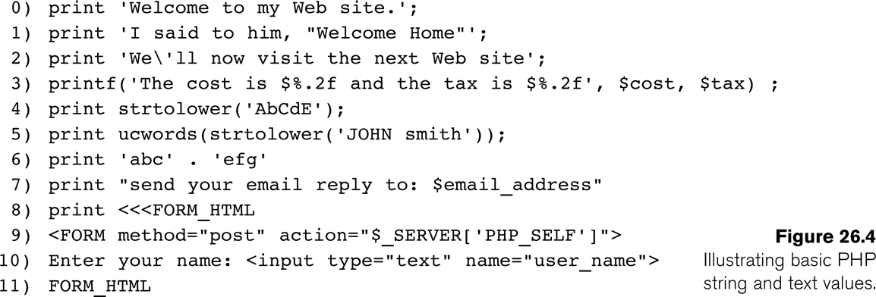
Basic features of PHP
Main ways to express strings
  Single-quoted strings (lines 0, 1, 2): Literal strings that contain no PHP program variables. \' represents a quote in a string
  Double-quoted strings (line 7): Values in var names are interpolated
  Here documents (line 8-11)
    Enclose between <<<DOCNAME and end it with a single line containing the doc name DOCNAME
    Values from variables need to be interpolated into string
String operations: (.) is concatenate as in Line 6
    (strtolower()) converts string into lower case;
Slide 9- <number>

Slide 9
Programming Constructs
Numeric data types: Integers and floating points; follow C rules
Programming language constructs
  For-loops, while-loops, and conditional if-statements
Boolean expressions
Comparison operators
  == (equal), != (not equal), > (greater than), >= (greater than or equal), < (less than), and <= (less than or equal)

Slide 10
PHP Arrays
Database query results
  Two-dimensional arrays
  First dimension representing rows of a table
  Second dimension representing columns (attributes) within a row
Main types of arrays:
  Numeric and associative
Numeric: Associates a numeric index with each element in the array
  Indexes are integer numbers
    Start at zero
    Grow incrementally
Associative: Provides pairs of (key => value) elements

Slide 11
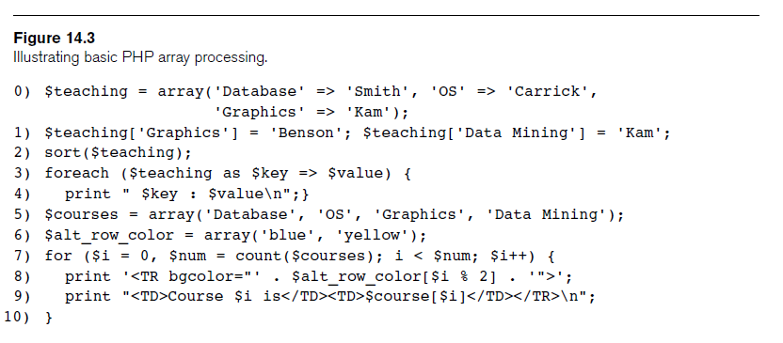
PHP Arrays (cont’d.)

Slide 12
PHP Arrays (cont’d.)
Techniques for looping through arrays in PHP
Count function
  Returns current number of elements in array
Sort function
  Sorts array based on element values in it

Slide 13
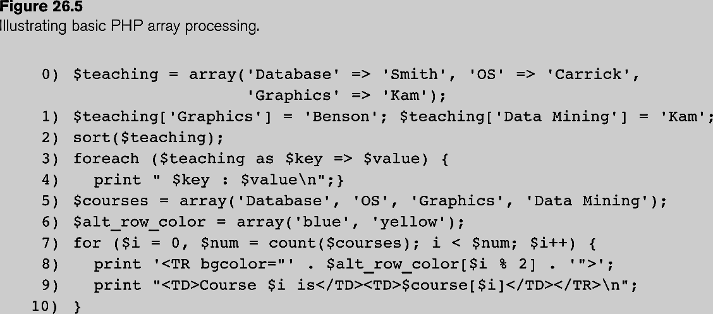
programming constructs
Other programming constructs similar to C language constructs
  for-loops
  while-loops
  if-statements
Boolean logic
  True/false is equivalent no non-zero/zero
PHP Arrays
  Allow a list of elements
  Can be 1-dimensional or multi-dimensional
  Can be numeric or associative
    Numeric array is based on a numeric index
    Associative array is based on a key => value pair
  Associative
    Line 0: $teaching is a associative array
    Line 1 shows how the array can be updated/accessed
  Numeric
    Line 5: $courses is a numeric array
    No key is provided =>; numeric array
  There are several ways of looping through arrays
    Line 3 and 4 show “for each” construct for looping through each and every element in the array
    Line 7 and 10 show a traditional “for loop” construct for iterating through an array
Slide 9- <number>

Slide 14
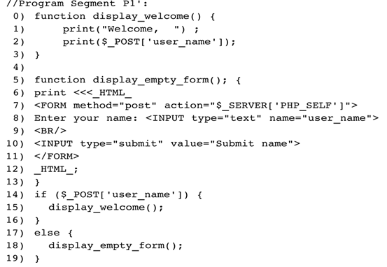
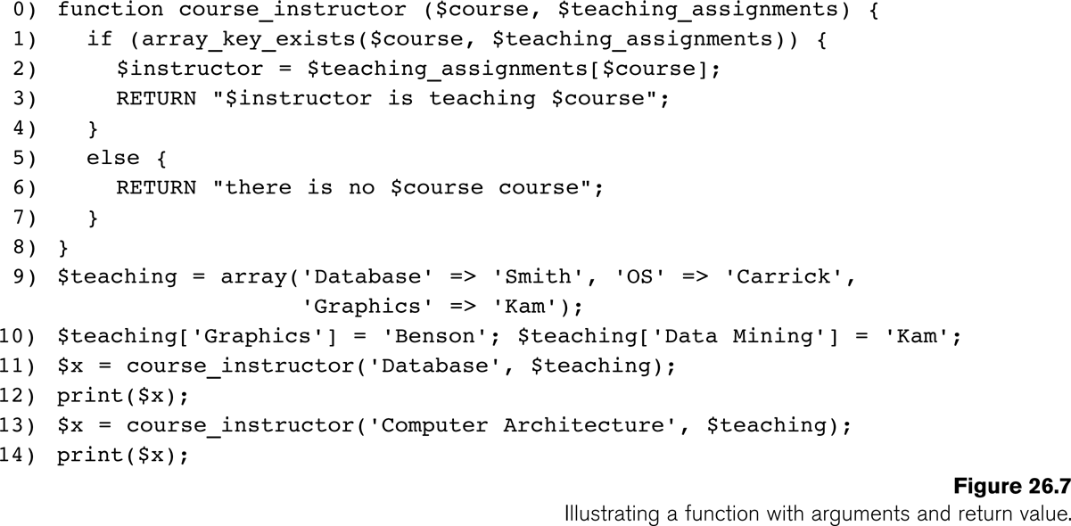
PHP Functions
to structure complex program and share common sections of code
Arguments passed by value
Code P1’ has now two functions: display_welcome() and display_empty_form()
Line 14-18 show how these functions can be called
Fcn course_instructor(): A function with arguments and return value
Slide 9- <number>

Slide 15
PHP Server Variables and Forms
  Provides useful information about server where the PHP interpreter is running
Number of built-in entries in PHP function: $_SERVER
    $_SERVER['SERVER_NAME‘]
      This provides the Website name of the server computer where PHP interpreter is running
    $_SERVER['REMOTE_ADDRESS']
      IP address of client computer that is accessing the server
    $_SERVER['REMOTE_HOST']
      Website name of the client user computer
    $_SERVER['PATH_INFO']
      The part of the URL address that comes after backslash (/) at the end of the URL
    $_SERVER['QUERY_STRING']
      The string that holds the parameters in the IRL after ?.
    $_SERVER['DOCUMENT_ROOT']
      The root directory that holds the files on the Web server
$_POST
  Provides input values submitted by the user through HTML forms specified in <INPUT> tag
Slide 9- <number>

Slide 16
PHP Database Programming
PEAR DB library
  PHP Extension and Application Repository (PEAR)
  Provides functions for database access
Library module DB.php must be loaded
DB library functions accessed using DB::<function_name>
DB::connect('string')
  Function for connecting to a database
  Format for 'string' is: <DBMS software>://<user account>:<password>@<database server>
Slide 9- <number>

Slide 17
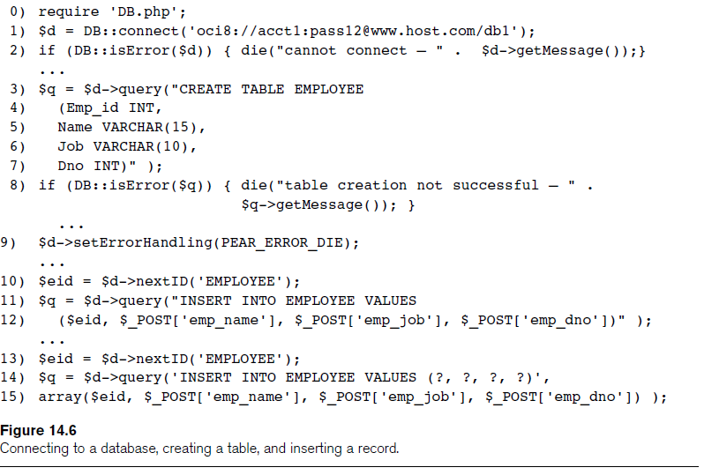

Slide 18
Connecting to a Database (cont’d.)
Query function
  $d->query takes an SQL command as its string argument
  Sends query to database server for execution
$d–>setErrorHandling(PEAR_ERROR_DIE)
  Terminate program and print default error messages if any subsequent errors occur

Slide 19
Collecting Data from Forms and Inserting Records
Collect information through HTML or other types of Web forms
Create unique record identifier for each new record inserted into the database
PHP has a function $d–>nextID to create a sequence of unique values for a particular table
Placeholders
  Specified by ? symbol

Slide 20
Querying DB
Query function
  $d->query takes an SQL command as its string argument
  Sends query to database server for execution
$d–>setErrorHandling(PEAR_ERROR_DIE)
  Terminate program and print default error messages if any subsequent errors occur
Query result
  $q->fetchRow() retrieve next record in query result and control loop
$d=>getAll
  Holds all the records in a query result in a single variable called $allresult
Slide 9- <number>

Slide 21
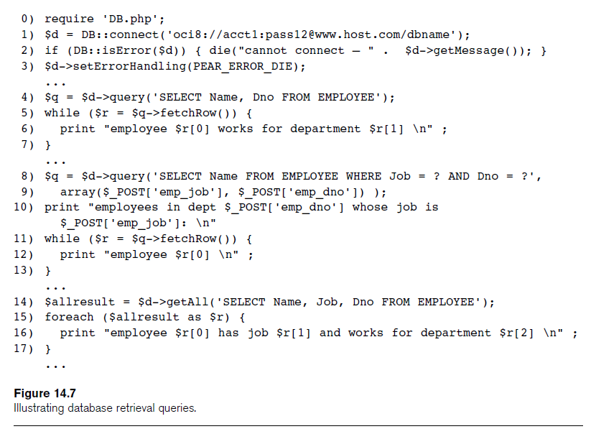

Slide 22
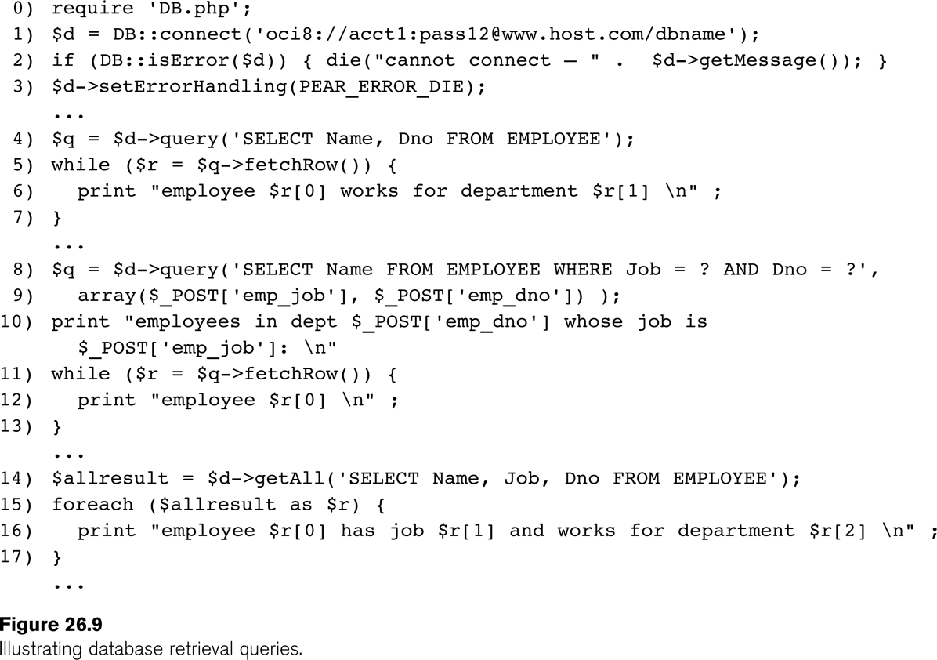
Retrieval queries
Retrieval queries and Database tables
  Lines 4-7 retrieves name and department number of all employee records
  Lines 8-13 is a dynamic query (conditions based on user selection)
    Values for these are entered through forms
  Lines 14-17 is an alternative way of specifying a query and looping over its records
    Function $d->getAll holds all the records in $allresult
Slide 9- <number>

Slide 23
Summary
PHP scripting language
  Very popular for Web database programming
PHP basics for Web programming
Data types
Database commands include:
  Creating tables, inserting new records, and retrieving database records

