Slide 1
Ders # 9
Web DB Programming: XML
From Elmasri/Navathe textbook Ch9,26
Sciore textbook, Ch 9-10

Slide 2
Hypertext documents
  Common method of specifying contents
  Various languages
    HTML (HyperText Markup Language)
      Used for generating static web pages
    XML (eXtensible Markup Language)
      Standard for exchanging data over the web
    PHP (PHP Hypertext Preprocessor {recursive acronym})
      Dynamic web pages
Slide 9- <number>

Slide 3
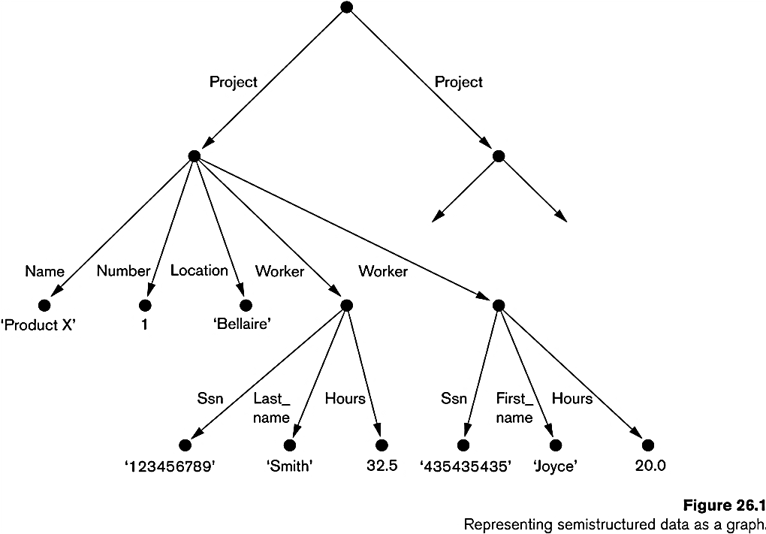
Structured, semi-structured, and unstructured data
Structured data
  Strict format (predefined schema)
  Disadv: In real world, not all data collected is structured
  Ex: Information stored in DB
Semi-structured data
  Data may have certain structure but not all information collected has identical structure
  No exact pre-defined schema but
    Semi-structured data (names of attributes, relationships, and classes) is mixed in with its schema (self-describing data)
    Can be displayed as a graph
  Some attributes may exist in some of the entities of a particular type but not in others
  Ex: XML
Unstructured data
  Very limited indication of data type
  No schema information
    E.g., a simple text document
    HTML
Slide 9- <number>

Slide 4
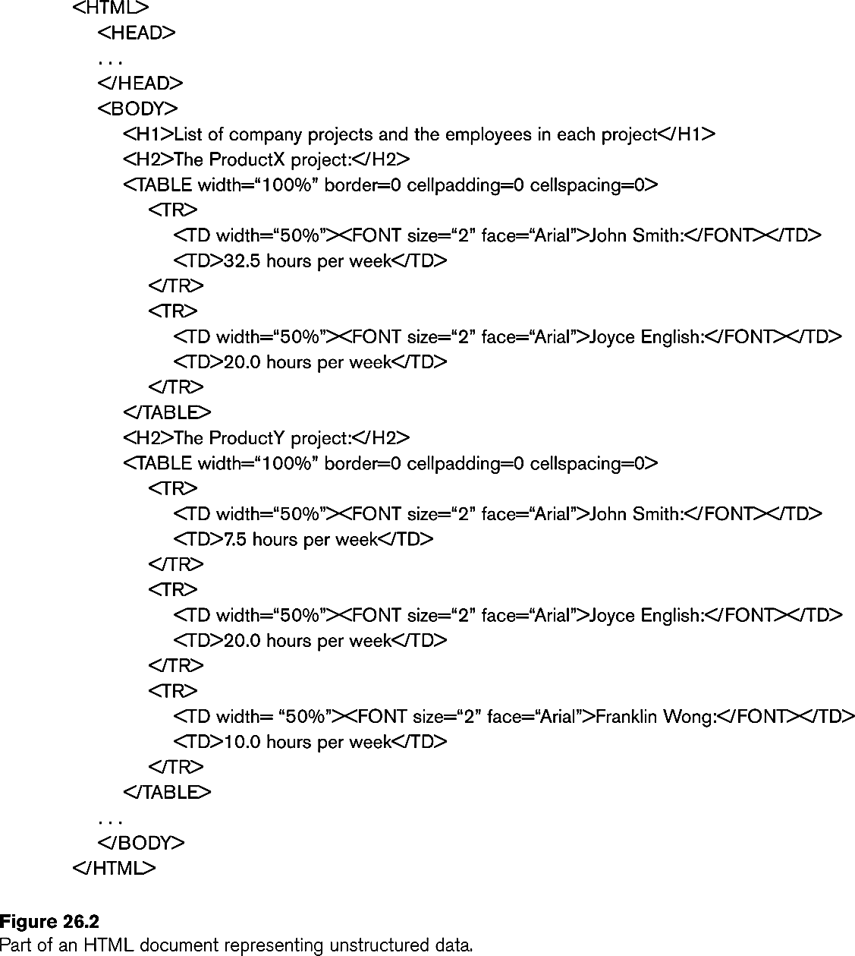
Unstructured data:
Limited indication of data types
  E.g., web pages in html contain some unstructured data
  Figure shows part of HTML document representing unstructured data
Diffucult to interpret by computer programs BECAUSE no schema ( type of data) information is known.
  XML, conversely, provides easier interpretation and exchange Web documents b/w computers.
Slide 9- <number>

Slide 5
XML data model
Goal:
  To provide info. about structure and meaning of data on Web page
  used as a model for data storage and retrieval
A comparison:
  Relational model is a flat stucture
  XML is tree (hierarchical) stucture
Languages to specify the tree structure
  DTD (Document Type Definition)
  XML Schema
XML query languages
  XPath
  XQuery
Slide 9- <number>

Slide 6
Main Concepts
Basic object : document
A document contains the following concepts
  Elements
  Attributes
  Identifiers
  References
3 types of XML documents:
  Data-centric : small data items with a specific structure. Mostly extracted from a relational DB. Structured data
  Documents-centric : large data items without any structure s.a. text, news articles, books..Semi-structured data
  Hybrid XML documents
<?xml version= ‘’1.0’’ standalone= ‘’yes’’?>
  standalone attribute shows the type of document..schemaless? or structured?
Slide 9- <number>

Slide 7
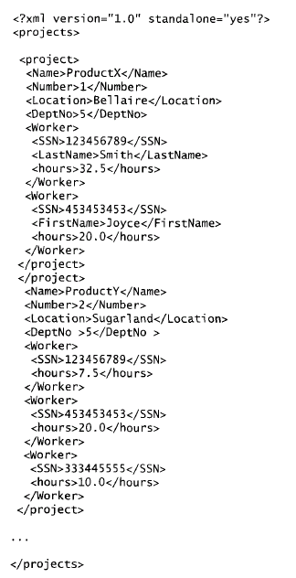
Elements, attributes
    Elements can be complex or simple.
      Tag name conveys the meaning of the element.
      Attributes describe characteristics of elements.
    Well-formed XML document is sytactically correct. This helps interpretation.
XML
DOM
Streaming XML
SAX
Slide 9- <number>

Slide 8
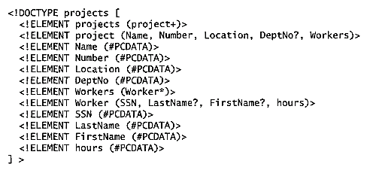
XML DTD for defining a well-formed doc.
DTD uses a special syntax to specify the elements and their nested structures.
Study the meaning of
  PCDATA, *,+,?, ,(
To enforce conformance to a DTD;
<?xml version= ‘’1.0’’ standalone= ‘no’’?>
<!DOCTYPE Projects SYSTEM ‘’proj.dtd’’>
Limitations of DTD:
  Data types in DTD are not general.
  Special syntax requires specialized processing.
  Only defines ordered elements; unordered are not permitted.
Slide 9- <number>

Slide 9
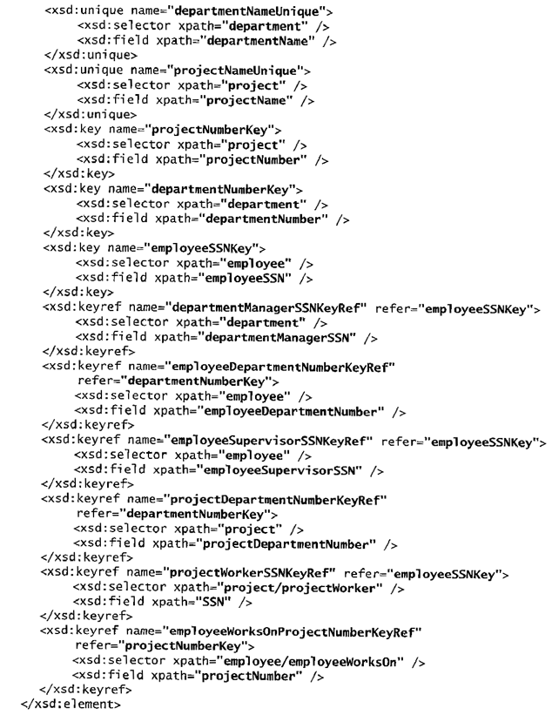
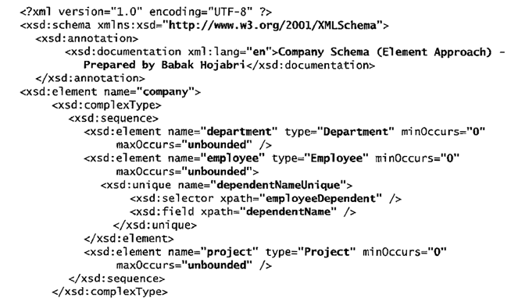
XML Schema for defining a well-formed doc.: COMPANY DB system
XML schema document uses same syntax rules as regular XML document.
Use element, attributes PLUS keys, references, identifiers, entities..
Slide 9- <number>

Slide 10
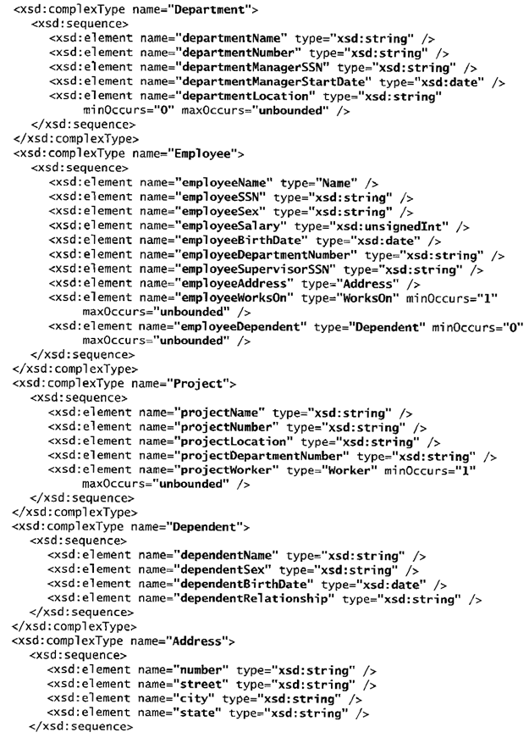
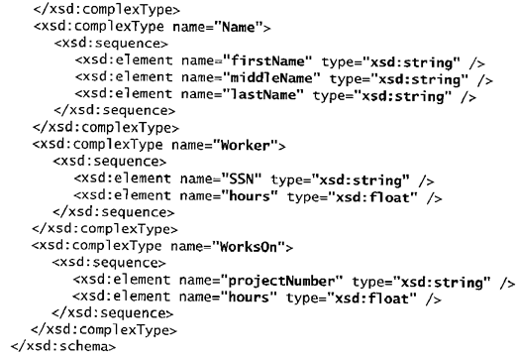
..cont..
Slide 9- <number>

Slide 11
Storing XML documents
Store XML doc as text fields within DBMS records / objects
  Used for schemaless and document-centric XML
Store document contents as data elements in DBMS
  Store documents that conforms specific DTD or XML Schema.
  Requires mapping algorithms to develop DB schema that is compatible with XML document structure.
Native XML database
  Based on XML tree model
  Specialized indexing and querying and data compression techniques
Customized XML documents
  By Conversion from preexisting relational database
  This XML documents is used exchanging and displaying over the Web.
  Conversion:
    Construct the coresponding XML SChema
      RM ➔XML hierarchy ➔ XML Schema
      ER ➔ XML hierarchy ➔ XML Schema
    Correct SQL queries to extract desired info for XML document
    SQL query result set must be structured from flat relational model to XML tree structure
Slide 9- <number>

Slide 12
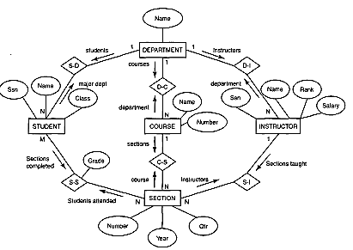
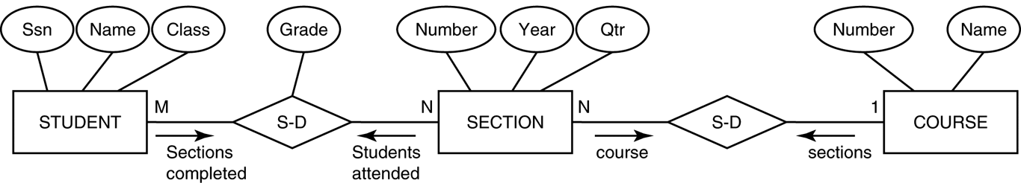
Extracting XML Documents from Relational Databases
Suppose that an application needs to extract XML documents for student, course, and grade information from the university database.
The data needed for these documents is contained in the database attributes of the entity types course, section, and student as shown below (part of the main ER), and the relationships s-s and c-s between them.
Related Database subset:
Slide 9- <number>

Slide 13
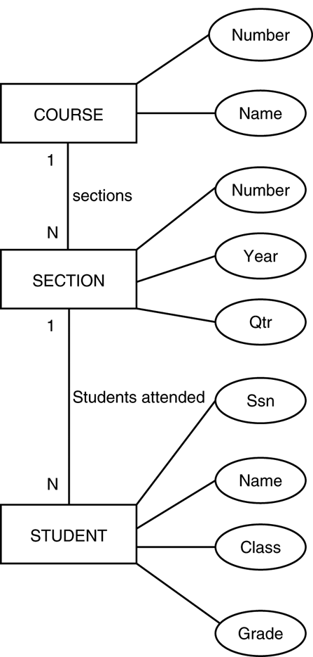
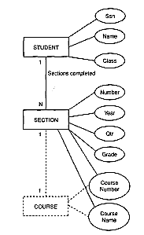
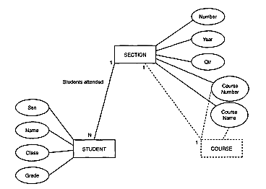
3 possible hierarchies that can be extracted from the database subset
There can be numerous hierarchical document views, each corresponding to a different root and structure..
1)
2)
3)
Slide 9- <number>

Slide 14
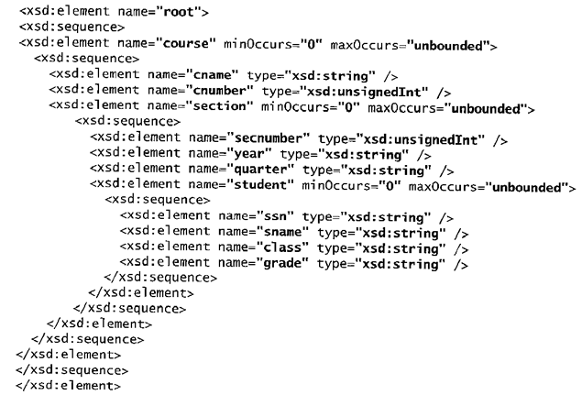
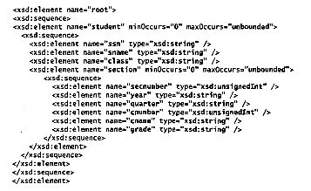
XML Schema documents for 1) and 2)
Slide 9- <number>

Slide 15
XML Query Language: XPath
Uses path expressions to identify certain nodes(elements) in XML document.
XPath expression contains node names (element or attribute names in xml doc) with additional qualifier conditions s.a. / or //.
/company => returns company root node and all its decendant
/company/department => return all departments (in order as in xml doc) and all their decendant.
//employee[employeeSalary gt 7000]/employeeName => this expression is mostly used in schemaless documants. Returns all qualified employeeName nodes that are direct children of an employee node.
/company/employee/[employeeSalary gt 7000]/ employeeName => ?
/company/project/projectWorker [hours ge 20.0] => ?
Slide 9- <number>

Slide 16
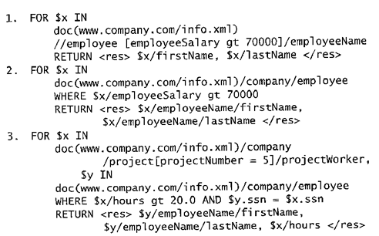
XML Query Language: XQuery
Uses XPath expressions with addtional constructs for more general queries➔FLWR expressions.
FOR <individual nodes>
LET <colloections of nodes>
WHERE <qualifier cond.>
RETURN <result spec.>
This query retrieves the first and last names of employees who earn more than 70000. The variable $x is bound to each employeeName element that is a child of an employee element, but only for employee elements that satisfy the qualifier that their employeeSalary is greater that 70000.
This is an alternative way of retrieving the same elements retrieved by the first query.
This query illustrates how a join operation can be performed by having more than one variable. Here, the $x variable is bound to each projectWorker element that is a child of project number 5, whereas the $y variable is bound to each employee element. The join condition matches SSN values in order to retrieve the employee names.
Slide 9- <number>

Slide 17
Summary
  Web Programming with PHP
  PHP Examles
  Programming constructs: Vars, Arrays, functions
  Structured, Semi-Structured and Unstructured Data
  XML
  XML Examples
  XML Query Languages
Slide 9- <number>

