Slide 1

XML: Extensible Markup Language
XML Concepts
Structured, Semistructured and Unstructured Data
XML Hierarchical (Tree) Data Model
XML Documents, DTD, and XML Schema
Storing and Extracting XML Documents from Databases
XML Languages: XPath, XQuery
Extracting XML Documents from Relational Databases

Slide 2
XML: Extensible Markup Language
Data sources
  Databases storing data for Internet applications
  i.e., E-commerce apps to access info stored in DBs
2-tier or 3-tier client/server architectures(next 3 slides)
Interact with users via Web interfaces to display webpages
Hypertext documents
  Common method of specifying contents and formatting of Web pages, HTML
A new language, XML: std for structuring and exchange of data over the Web
XML data model
Possible for data storage and retrieval (XML-based DBMS)

Slide 3
(Application Layering : 3-tiered)
The user-interface level
  Interface to users to interact with apps. Display mgmt.
The processing level
  Contains the apps
The data level
  Manage the actual data (a database)

Slide 4
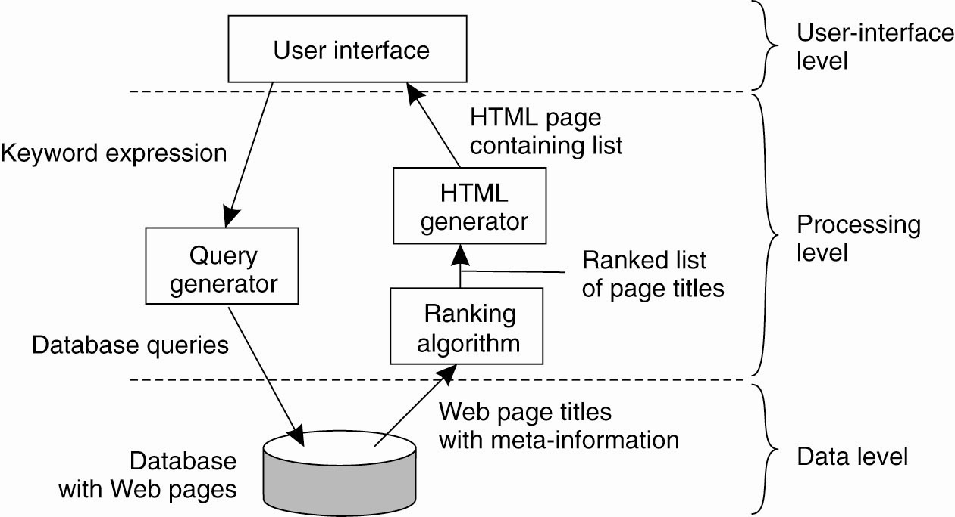
Ex: Application Layering
The simplified organization of an Internet search engine into three different layers.

Slide 5
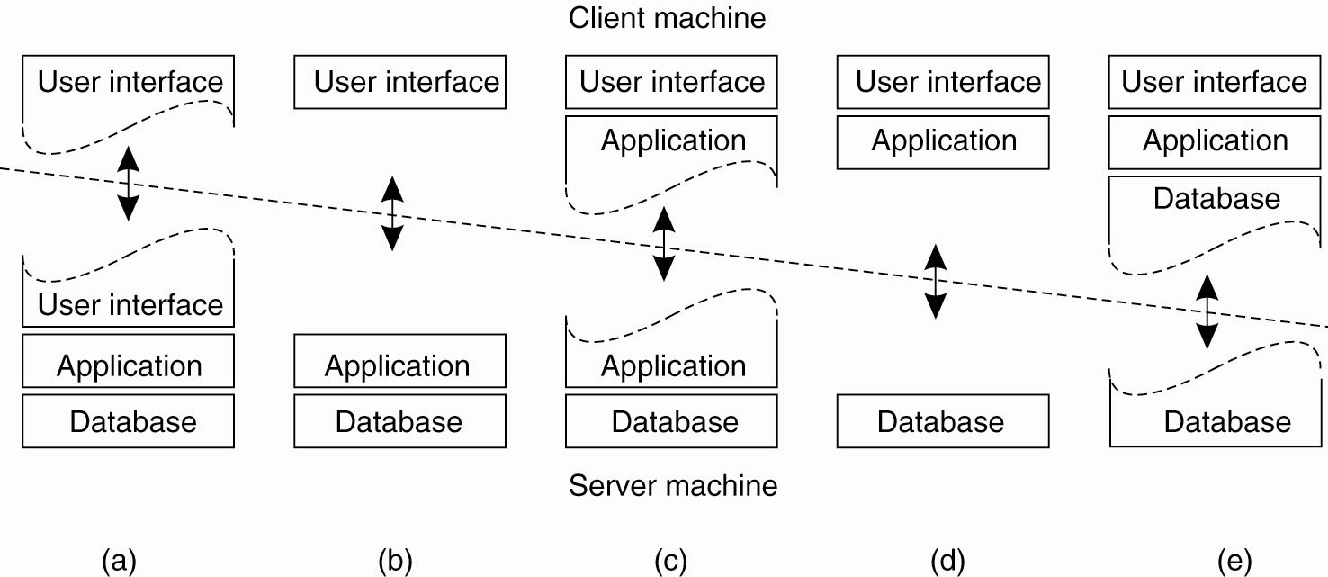
Multitiered Architectures
Alternative client-server organizations (a)–(e).
Notes:
Terminal dependent part of user interface on the client and app has a remote control over how data presented.
Entire user-interface sw on the client and rest of app and data are on the server
Move part of app to front end (fill the forms before processing)
and e) most of apps running on client machine, all operations on files and db entries go to server. Transactions on bank’s server (d), local disk contains part of data (cache of recent web pages) (e)

Slide 6
Structured, Semistructured, and Unstructured Data
Structured data
  Represented in a strict format
  Example: information stored in databases
Semistructured data
  Has a certain structure; not all information collected will have identical structure
  Schema information mixed in with data values
  Self-describing data
  May be displayed as a directed graph
    Labels or tags on directed edges represent: Schema names, Names of attributes, Object types (or entity types or classes), Relationships

Slide 7
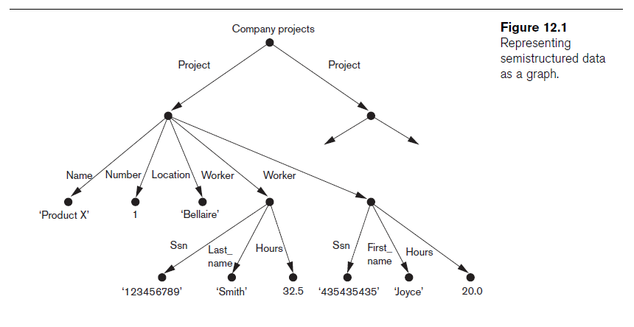
Semistructured Data: representation

Slide 8
Unstructured Data
  Limited indication of the type of data
  Ex.,text document that contains information embedded within it; i.e., web pages in HTML
HTML tag: Text that appears between angled brackets: <...>
End tag:Tag with a slash: </...>
HTML uses a large number of predefined tags (see next page)
  Head, Body, H1, H2,Table, TR, TD
HTML documents: Do not include schema information about type of data
Static HTML page: All information to be displayed explicitly spelled out as fixed text in HTML file
Dynamic Web pages: Some info to be extracted from a database and actual data items displayed will vary.

Slide 9
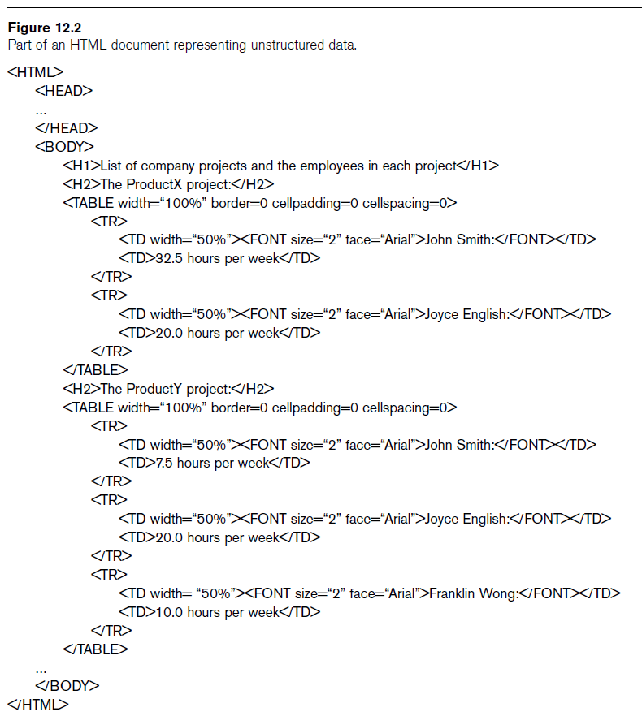

Slide 10
XML Hierarchical (Tree) Data Model
Basic object in XML is the XML Document
Elements and attributes: Two main structuring concepts used to construct an XML document
Elements: of two types
Complex elements:Constructed from other elements hierarchically
Simple elements:Contain data values
XML tag names
  Describe the meaning of the data elements in the document, instead of how text to be displayed
  Automatic processing of data elements in XML Doc by comp programs
XML tag(element) names: defined in another doc (schema doc) to give a semantic meaning

Slide 11
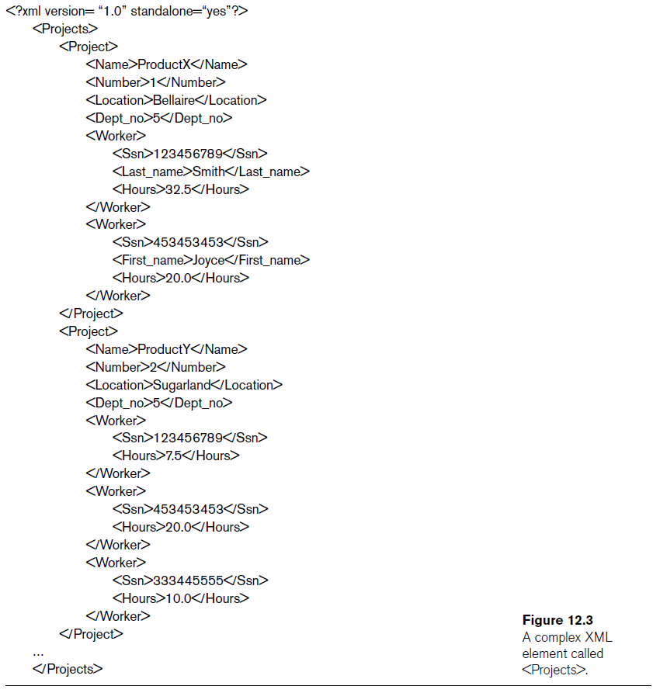

Slide 12
XML Hierarchical (Tree) Data Model
XML textual rep (fig12.3) vs tree structure (fig12.1)
Tree model or hierarchical model
  In tree model, internal nodes represent complex elements, leaf nodes represent simple elements
  simple elements : tag names w/ <Name>, <Number>, <Location>,...
  complex elements : tag names w/ <Projects>, <Project>, <Worker>
  No limit on nesting levels
Main types of XML documents
  Data-centric: many small data items in a structure (from a DB)
  Document-centric: no struc, large amounts of text, news, books
  Hybrid: some parts containing struc data and other parts textual

Slide 13
XML Data Model
XML attributes
  Describe properties and characteristics of the elements (tags) within which they appear
May reference another element in another part of the XML document
  Common to use attribute values in one element as the references
Schemaless XML documents: Do not follow a predefined schema of element names and corresponding tree structure

Slide 14
XML Documents, DTD, and XML Schema
Well formed : syntactically correct
  Has XML declaration: Indicates version of XML being used as well as any other relevant attributes
  Every element must have matching pair of start and end tags within start and end tags of parent element
DOM (Document Object Model) : API functions
  Manipulate resulting tree representation corresponding to a well-formed XML document
SAX (Simple API for XML)
  Processing of XML documents on the fly
    Notifies processing program through callbacks whenever a start or end tag is encountered
  Makes it easier to process large documents
  Allows for streaming XML documents:process tags as encountered

Slide 15
XML Documents and DTD
Valid
  Document must be well formed
  Document must follow a particular schema
  Start and end tag pairs must follow structure specified in separate XML DTD (Document Type Definition) file or XML schema file
Notation for specifying elements in XML Doc
XML DTD
  Data types in DTD are not very general
  Special syntax:Requires specialized processors
  All DTD elements always forced to follow the specified ordering of the document; unordered elements not permitted
Specify in XML DTD :
  1) Root tag, 2) Elements and their nested structure

Slide 16
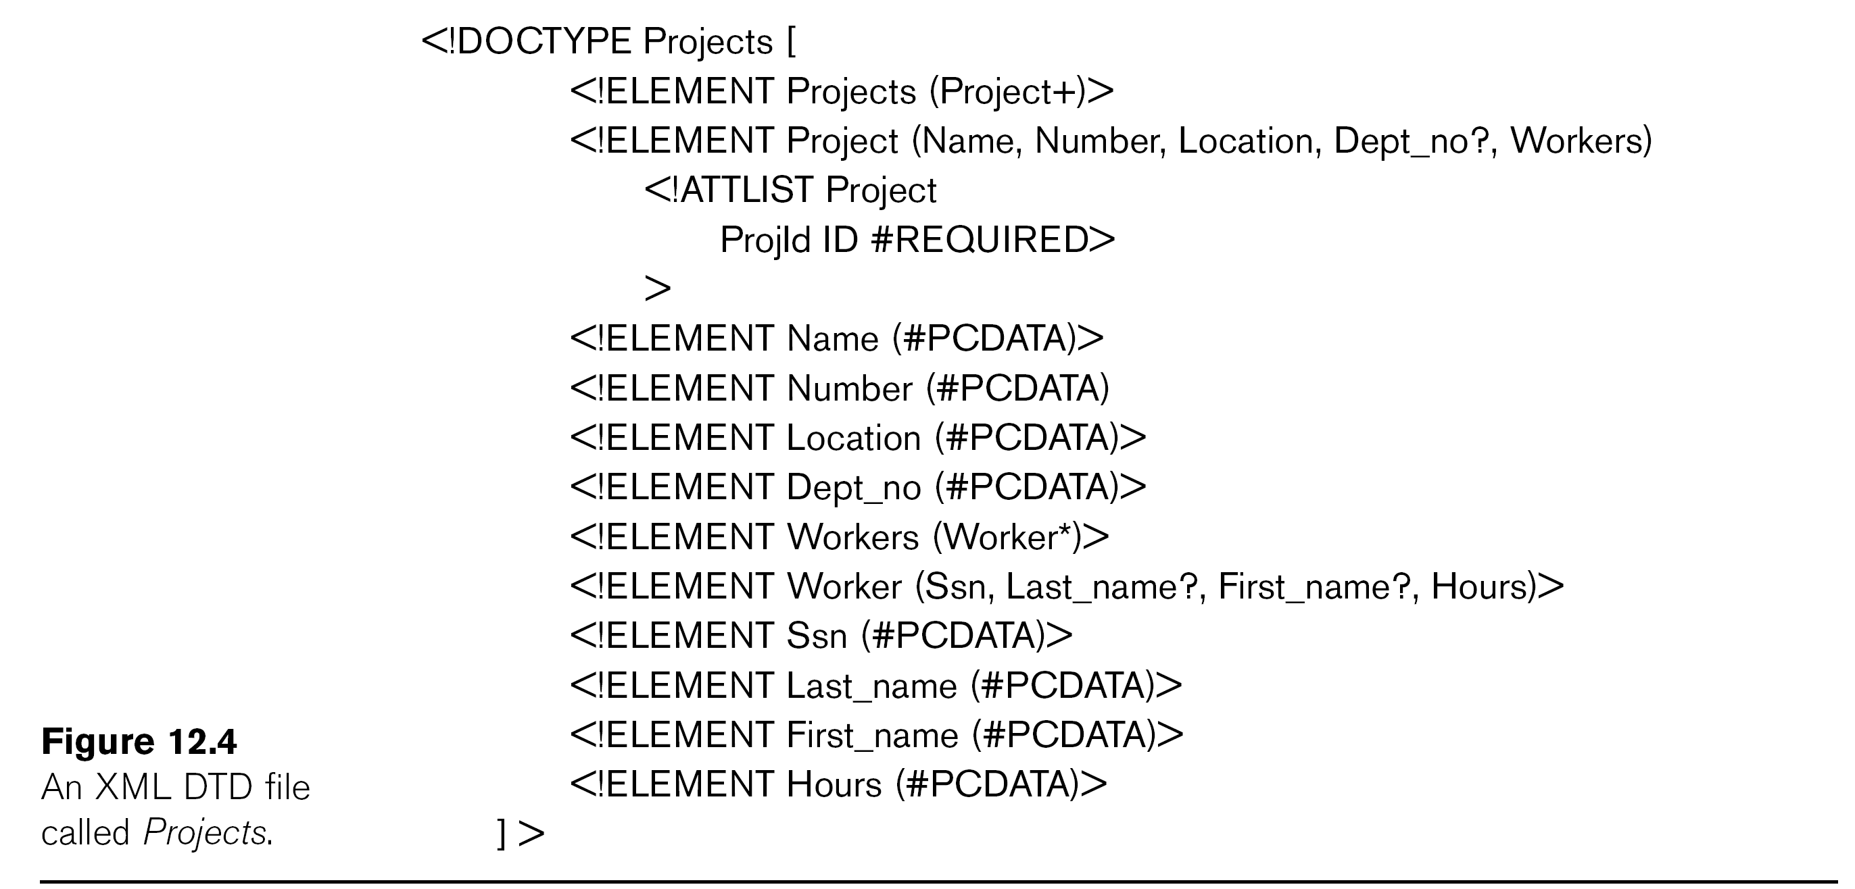
Notation: a*:repeat 0/more times(optional multi-value element), a+: repeat 1/more times(required multi-value element), a?: repeat 0/1 times(optional single-value), #PCDATA (leaf node): parsed char data, a string

Slide 17
XML Schema
XML schema language
  Standard for specifying the structure of XML documents
  Uses same syntax rules as regular XML documents
    Same processors can be used on both
  XML doc vs XML schema doc to specify an XML schema
Based on tree data model
  elements and attributes
  Concepts from db, objects: Keys, references, and identifiers

Slide 18
Continues…

Slide 19
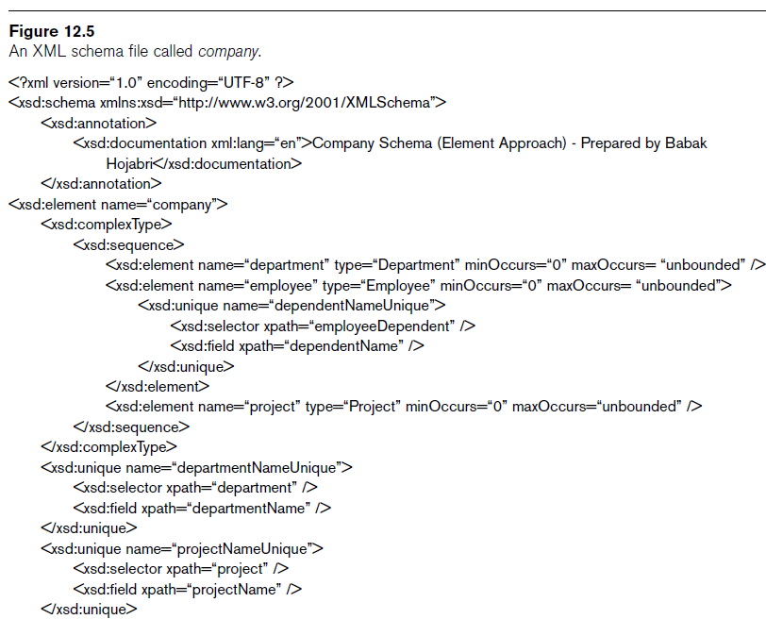

Slide 20
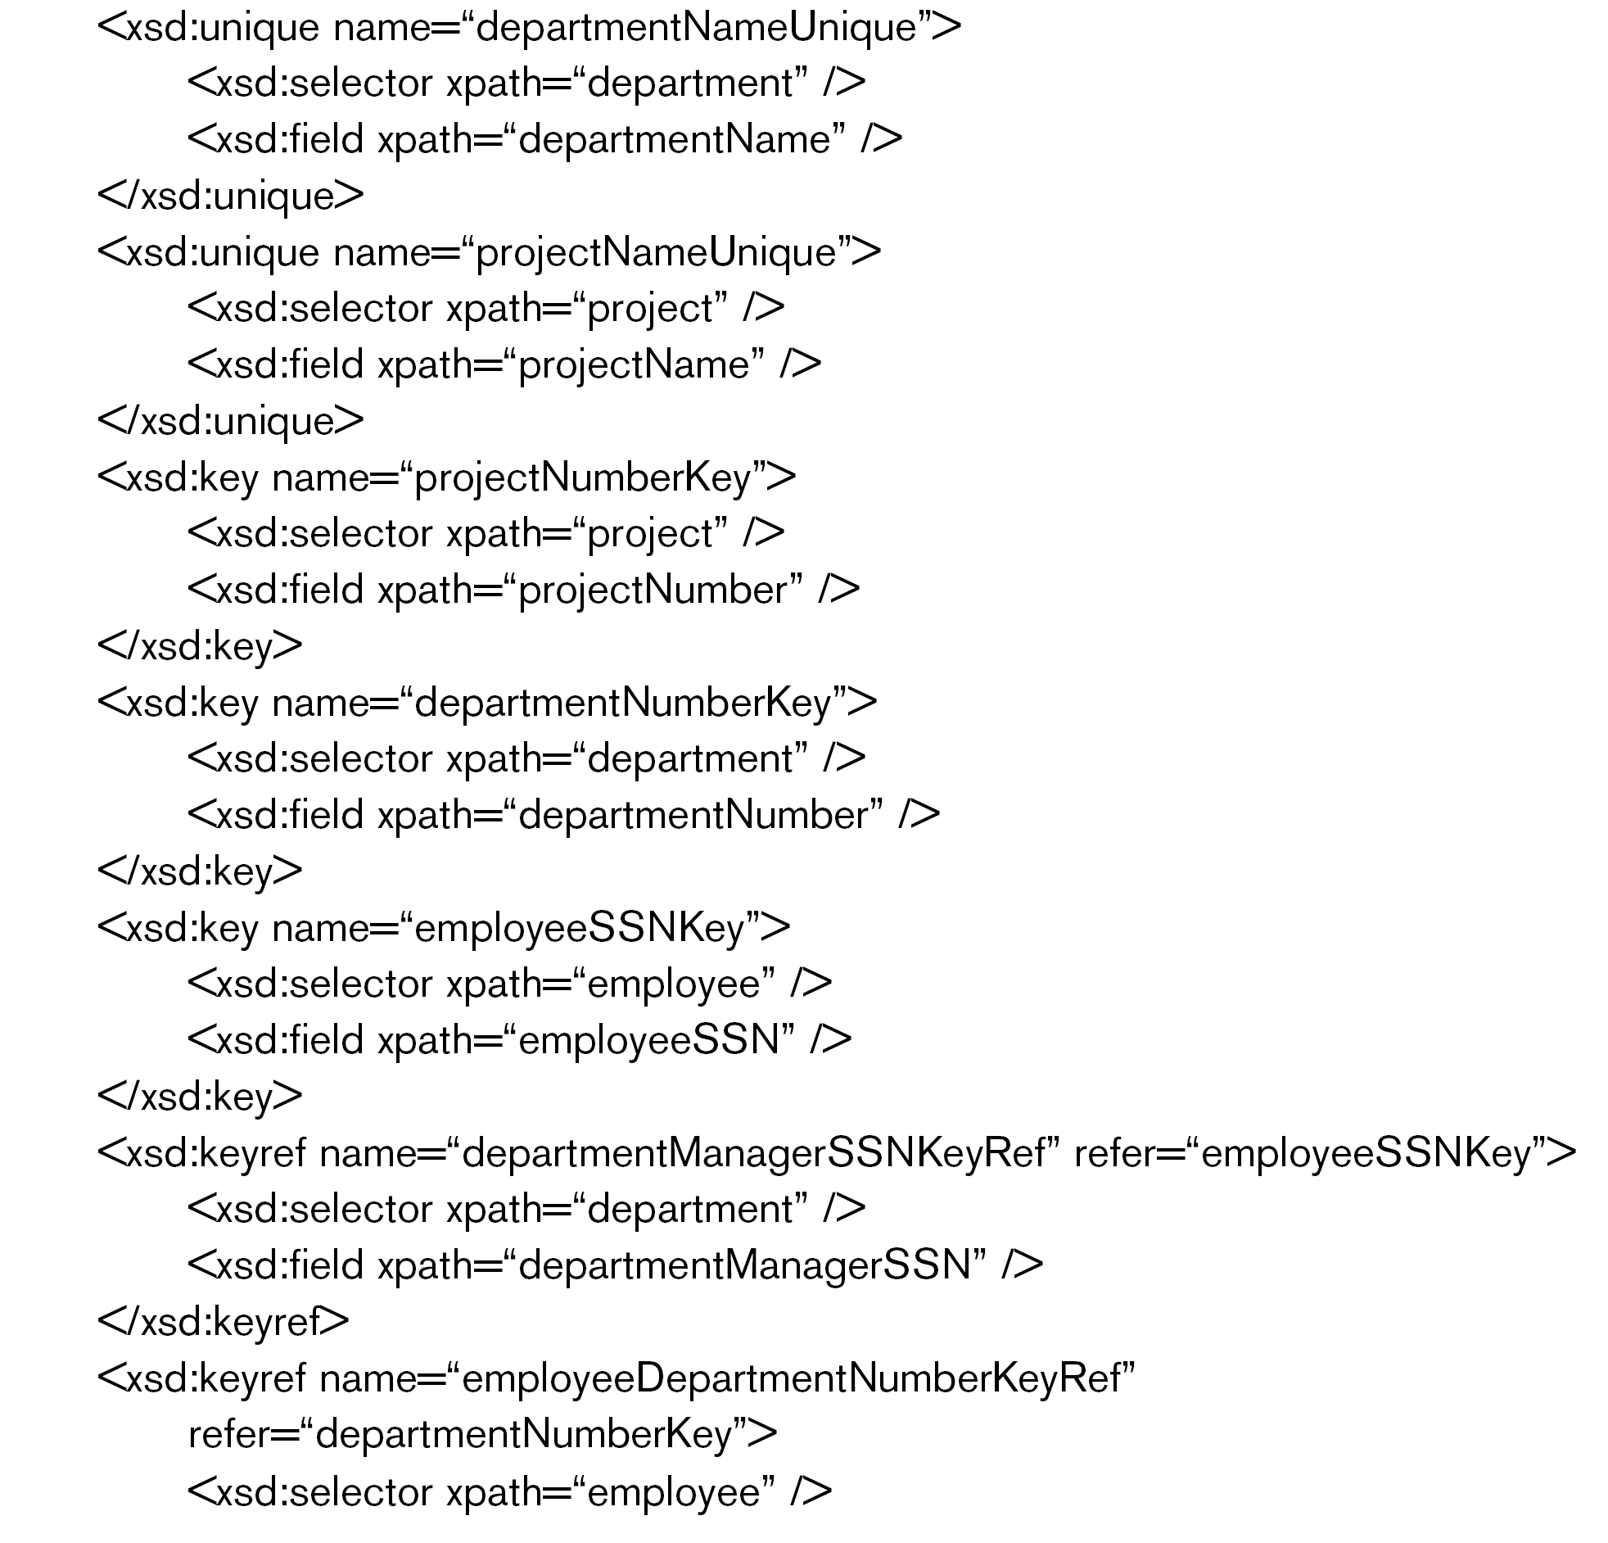
Continues…

Slide 21
Continues…

Slide 25
XML Schema
Identify specific set of XML schema language elements (tags) being used. Specify a file stored at a Web site location
XML namespace
  Defines the set of commands (names) that can be used
XML schema concepts:
  Description and XML namespace
  Annotations, documentation, language
  Elements and types
  First level element
  Element types, minOccurs, and maxOccurs
  Keys
  Structures of complex elements
  Composite attributes

Slide 26
Storing and Extracting XML Documents from Databases (common approaches)
Use a DBMS to store the documents as text
  Can be used if DBMS has a special module for document processing
Use a DBMS to store document contents as data elements
  Require mapping algorithms to design a database schema that is compatible with XML document structure
Designing a specialized system for storing native XML data, Called Native XML DBMSs
Creating or publishing customized XML documents from preexisting relational databases
  Use a separate middleware software layer to handle conversions

Slide 27
XML Languages: 2 query lang. standards
XPath
    Language constructs
    Specify path expressions to identify certain nodes (elements) or attributes within an XML document that match specific patterns
XQuery
    More general queries
    Uses XPath expressions
    but has additional constructs

Slide 28
XPath: Specifying Path Expressions in XML
XPath expression
  Returns a sequence of items that satisfy a certain pattern as specified by the expression
  Either values (from leaf nodes) or elements or attributes
  Qualifier conditions: Further restrict nodes that satisfy pattern
Separators used when specifying a path:
  Single slash (/tag):tag is a direct child of parent tag
  double slash (//tag):tag is a descendant of parent tag (any level)
Attribute name prefixed by the @ symbol
Wildcard symbol *
  Stands for any element
  Example: /company/*

Slide 29
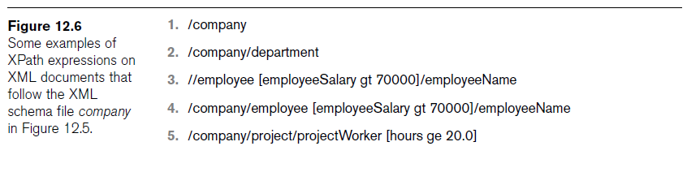
XPath: Specifying Path Expressions in XML
Assume company XML is stored in www.company.com/info.XML
doc(www.company.com/info.XML)/company
  Returns company root node and all its descendants
/company/department
  Returns all department nodes and their descendant subtrees
Use // if full pathname unknown, but some tags known
  Returns all employeeName nodes that are direct children of an employee node, s.t employee node has another child node employeeSalary whose value > 70K

Slide 30
XPath: Specifying Path Expressions in XML
Axes
  Move in multiple directions from current node to form more complex path expressions
  Include self, child, descendent, attribute, parent, ancestor(at any level), previous sibling(left), and next sibling(right)
Main restriction of XPath path expressions
  Path that specifies the pattern also specifies the items to be retrieved
  Difficult to specify certain conditions on the pattern while separately specifying which result items should be retrieved

Slide 31
XQuery: Specifying Queries in XML
Typical form of XQuery: FLWR expression
  Four main clauses of XQuery
    FOR <variable bindings to individual nodes (elements)>
    LET <variable bindings to collections of nodes (elements)>
    WHERE <qualifier conditions>
    RETURN <query result specification>
  Zero or more instances of FOR and LET clauses
XQuery contains powerful constructs to specify complex queries
www.w3.org : Contains documents describing the latest standards related to XML and XQuery

Slide 32
XQuery Example
Query for Dept name, manager name and manager salary for every department
FOR $x IN doc(www.company.com/info.xml) /company/department,
$y IN doc(www.company.com/info.xml) /company/employee
WHERE $x/departmentManagerSSN = $y/employeeSSN
RETURN <res> $x/departmentName, $y/employeeName, $y/employeeSalary </res>

Slide 33
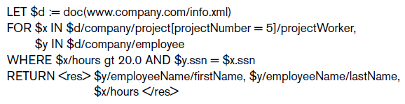
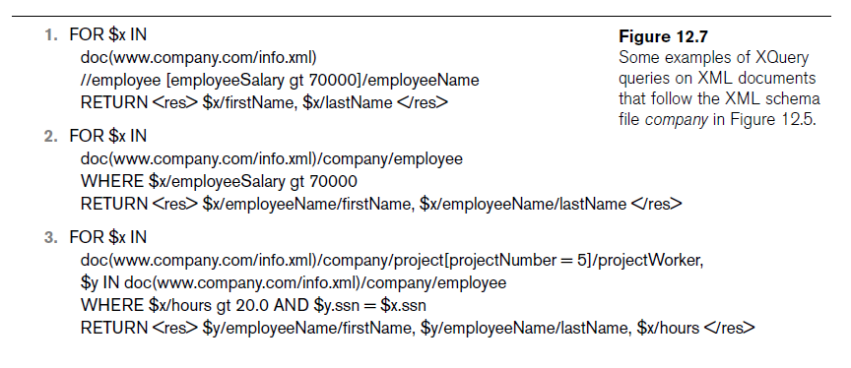

Slide 34
Other Languages and Protocols Related to XML
Extensible Stylesheet Language (XSL)
  Define how a document should be rendered for display by a Web browser
Extensible Stylesheet Language for Transformations (XSLT)
  Transform one structure into different structure
Web Services Description Language (WSDL)
  Description of Web Services in XML
Simple Object Access Protocol (SOAP)
  Platform- and programming language-independent protocol for messaging and remote procedure calls
Resource Description Framework (RDF)
  Languages and tools for exchanging and processing of meta-data (schema) descriptions and specifications over the Web

Slide 35
Extracting XML Documents from Relational Databases
Creating hierarchical XML views over flat or graph-based data
  Representational issues arise when converting data from a database system into XML documents
UNIVERSITY database example

Slide 36
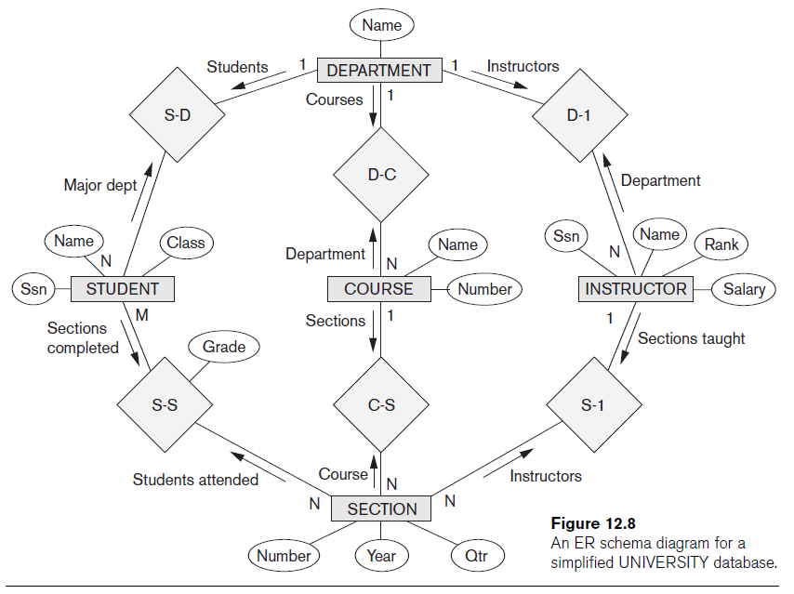

Slide 39
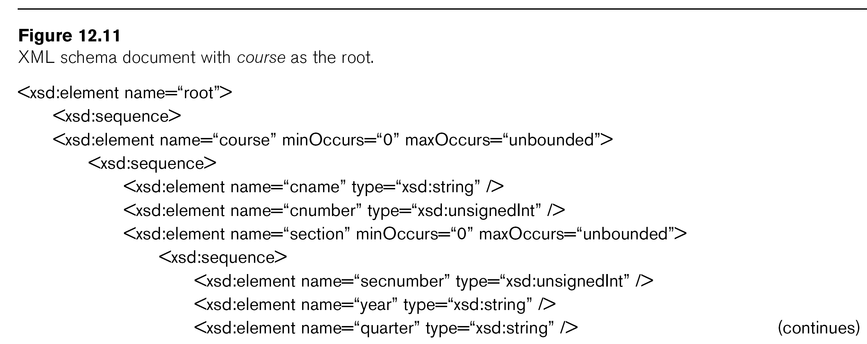

Slide 40
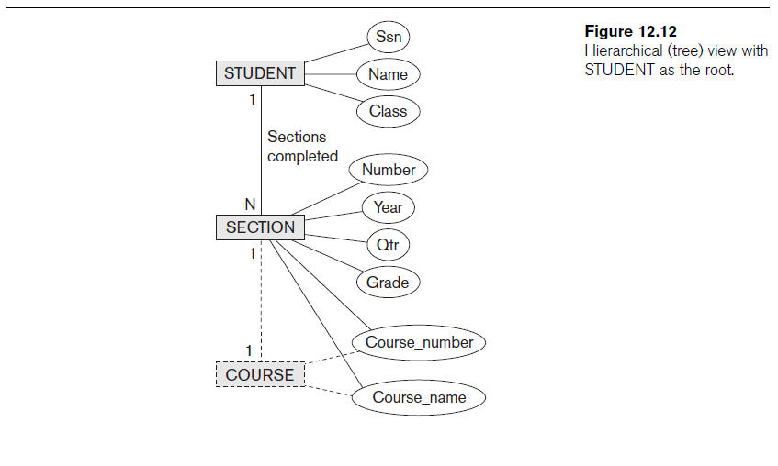

Slide 42
Breaking Cycles to Convert Graphs into Trees
Complex subset with one or more cycles
  Indicate multiple relationships among the entities
  Difficult to decide how to create the document hierarchies
Can replicate the entity types involved to break the cycles

Slide 43
Other Steps for Extracting XML Documents from Databases
Create correct query in SQL to extract desired information for XML document
Restructure query result from flat relational form to XML tree structure
Customize query to select either a single object or multiple objects into document

Slide 44
Summary
Three main types of data: structured, semi-structured, and unstructured
XML standard
  Tree-structured (hierarchical) data model
  XML documents and the languages for specifying the structure of these documents
XPath and XQuery languages
  Query XML data

