Slide 1
Introduction
An interrupt is an event which informs the CPU that its service (action) is needed.
Sources of interrupts:
  internal fault (e.g.. divide by zero, overflow)
  software
  external hardware :
    maskable
    nonmaskable
  reset

Slide 2
Basic Procedure for Processing Interrupts
When an interrupt is executed, the μp:
  finishes executing its current instruction (if any).
  saves (PUSH) the flag register, IP and CS register in the stack.
  goes to a fixed memory location.
  reads the address of the associated ISR.
  Jumps to that address and executes the ISR.
  gets (PULL) the flag register, CS:IP register from the stack.
  continues executing the previous job (if any).

Slide 3
8088/86 Hardware Interrupts pins
INTR: Interrupt Request.
  Input signal into the CPU
  If it is activated, the CPU will finish the current instruction and respond with the interrupt acknowledge operation
  Can be masked (ignored) thru instructions CLI and STI
NMI: NonMaskable interrupt.
  Input signal
  Cannot be masked or unmasked thru CLI and STI
  Examples of use: power frailer. Memory error
INTA: Interrupt Acknowledge.
  Output signal

Slide 4
The Interrupt flag
IF (Interrupt Enable Flag) D9: used to mask any hardware interrupt that may come in from the INTR pin.
When IF=0, all hardware interrupt requests through INTR are masked.
This has no effect on interrupts coming from the NMI pin or “INT nn” instructions.
CLI sets IF to 0, STI sets IF to 1.

Slide 5
INT n and ISR
n is multiplied by 4
In the address “4n” the offset address the ISR is found.
Example:Intel has set aside INT 2 for the NMI interrupt.
Whenever the NMI pin is activated, the CPU jumps to physical memory location 00008 to fetch the CS:IP of the interrupt service routine associated with the NMI.

Slide 6
8259
8259 is Programmable Interrupt Controller (PIC)
It is a tool for managing the interrupt requests.
8259 is a very flexible peripheral controller chip:
  PIC can deal with up to 64 interrupt inputs
  interrupts can be masked
  various priority schemes can also programmed.
originally (in PC XT) it is available as a separate IC
Later the functionality of (two PICs) is in the motherboards chipset.
In some of the modern processors, the functionality of the PIC is built in.

Slide 7
Pin description
8-bit bi-directional data bus, one address line is needed,
  PIC has two control registers to be programmed, you can think of them as two output ports or two memory location.
The direction of data flow is controlled by RD and WR.
CS is as usual connected to the output of the address decoder.
Interrupt requests are output on INT which is connected to the INTR of the processor. Int. acknowledgment is received by INTA.
IR0-IR7 allow 8 separate interrupt requests to be inputted to the PIC.
sp/en=1 for master , sp/en=0 for slave.
CAS0-3 inputs/outputs are used when more than one PIC to cascaded.

Slide 8
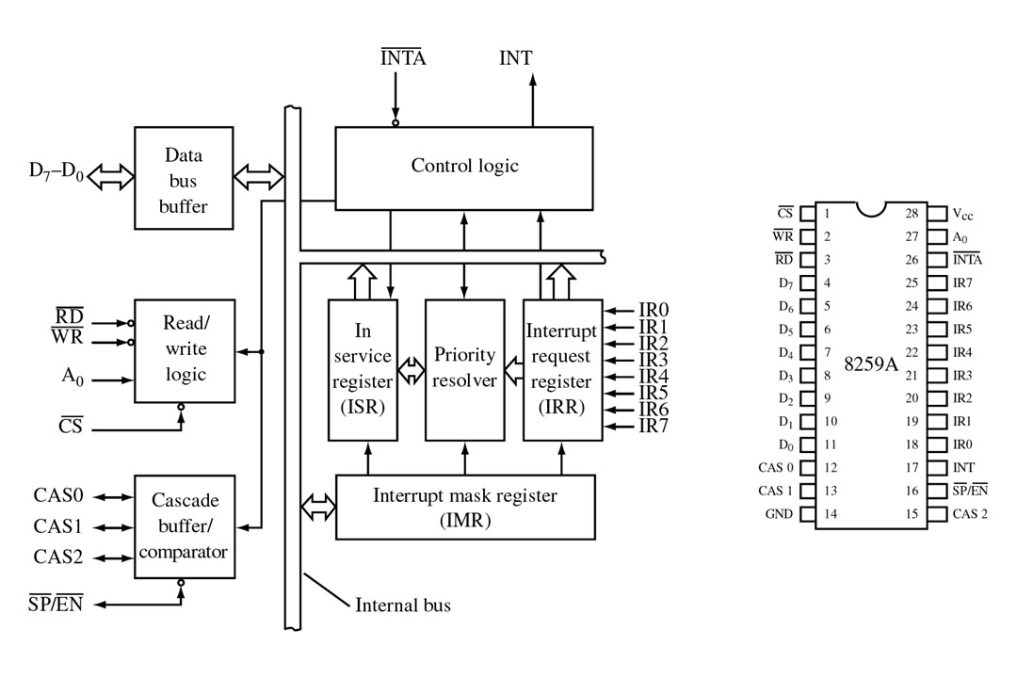
FIGURE 9-4 Block diagram and pin definitions for the 8259A Programmable Interrupt Controller (PIC). (Courtesy of Intel Corporation.)
John Uffenbeck
The 80x86 Family: Design, Programming, and Interfacing, 3e
Copyright ©2002 by Pearson Education, Inc.
Upper Saddle River, New Jersey 07458
All rights reserved.

Slide 9
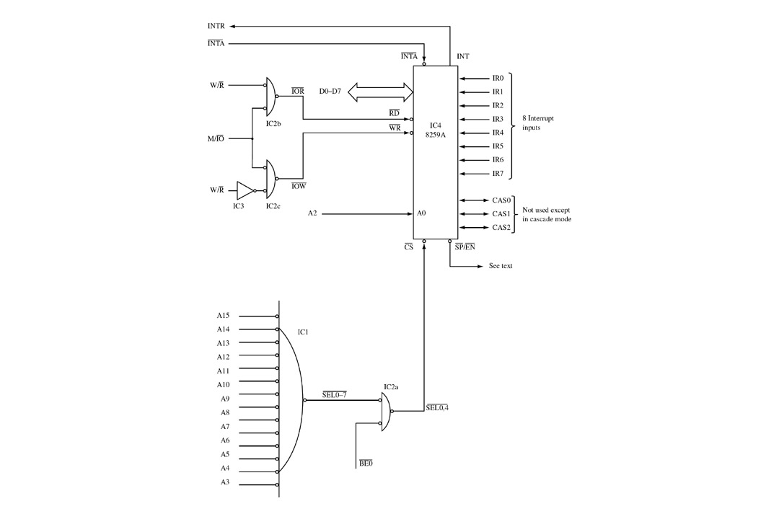
FIGURE 9-5 Interfacing the PIC to the 386 and 486 processors. Two I/O ports are required.
John Uffenbeck
The 80x86 Family: Design, Programming, and Interfacing, 3e
Copyright ©2002 by Pearson Education, Inc.
Upper Saddle River, New Jersey 07458
All rights reserved.

Slide 10
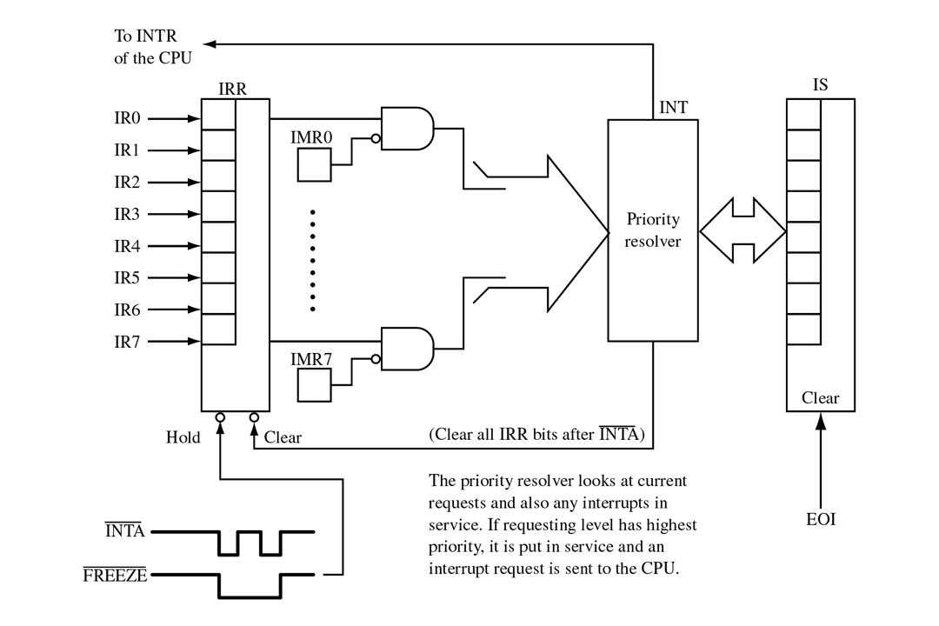
FIGURE 9-7 All interrupt requests must pass through the PIC’s interrupt request register (IRR) and interrupt mask register (IMR). If put in service, the appropriate bit of the in-service (IS) register is set.
John Uffenbeck
The 80x86 Family: Design, Programming, and Interfacing, 3e
Copyright ©2002 by Pearson Education, Inc.
Upper Saddle River, New Jersey 07458
All rights reserved.

Slide 11
Example of two cascaded PICs
8259A
PIC
(master)
8259A
PIC
(slave)
CPU
INTR
Programming is via
I/O-ports 0x20-0x21
Programming is via
I/O-ports 0xA0-0xA1

Slide 12
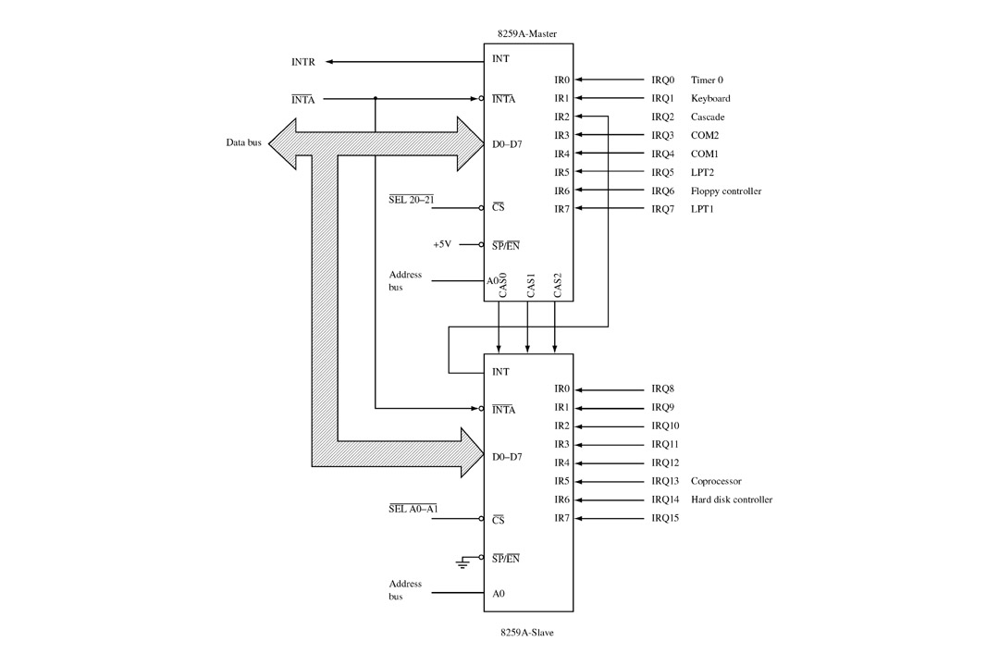
Example of two cascaded PICs

Slide 13
How to program the 8259A
The 8259A has two modes:
  Initialization Mode
  Operational Mode
Operational Mode Programming:
  Write a (9-bit) command to the PIC
  Maybe read a return-byte from the PIC
Initialization Mode Programming:
  Write a complete initialization sequence

Slide 14
OPERATION
PIC is to be initialized and programmed to control its operation.
The operation in simple words:
  when an interrupt occurs , the PIC determines the highest priority, activates the processor via its INTR input, and sends the type number onto the data bus when the processor acknowledges the interrupt.
Priority:
What is used in PC is fully nested mode. That is the lowest numbered IRQ input has highest priority. Lower priority interrupts will not be forwarded to the processor until the higher priority interrupts have been serviced.

Slide 15
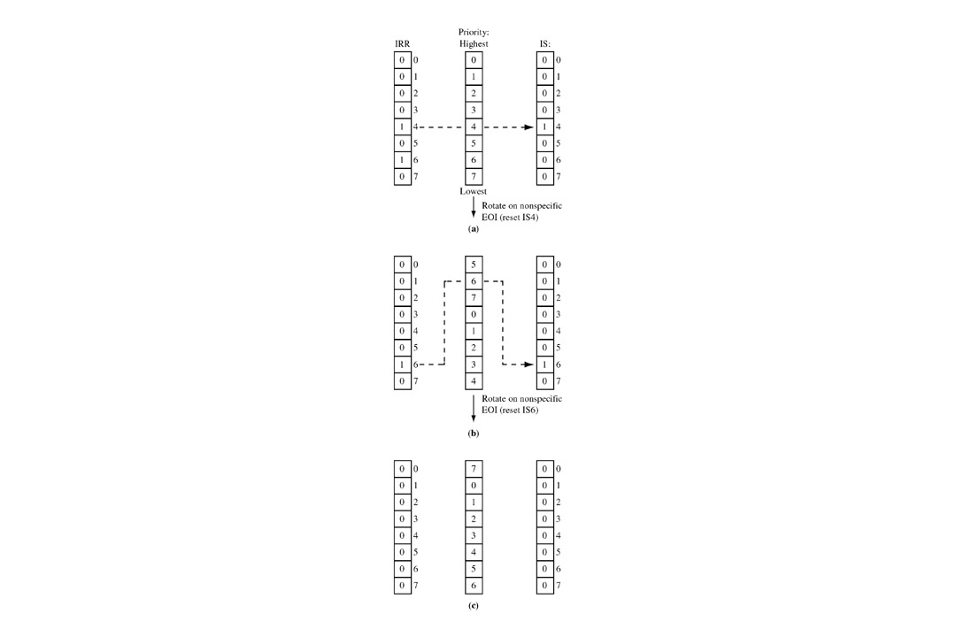
FIGURE 9-8 (a) Simultaneous interrupt requests arrive on IR4 and IR6. IR4 has highest priority and its IS bit is set as the IR4 service routine is put in service. (b) The IR4 service routine issues a rotate-on-nonspecific-EOI command, resetting IS4 and assigning it lowest priority. IR6 is now placed in service. (c) The IR6 service routine issues a rotate-on-nonspecific-EOI command, resetting IS6 and assigning it lowest priority.
John Uffenbeck
The 80x86 Family: Design, Programming, and Interfacing, 3e
Copyright ©2002 by Pearson Education, Inc.
Upper Saddle River, New Jersey 07458
All rights reserved.

Slide 16
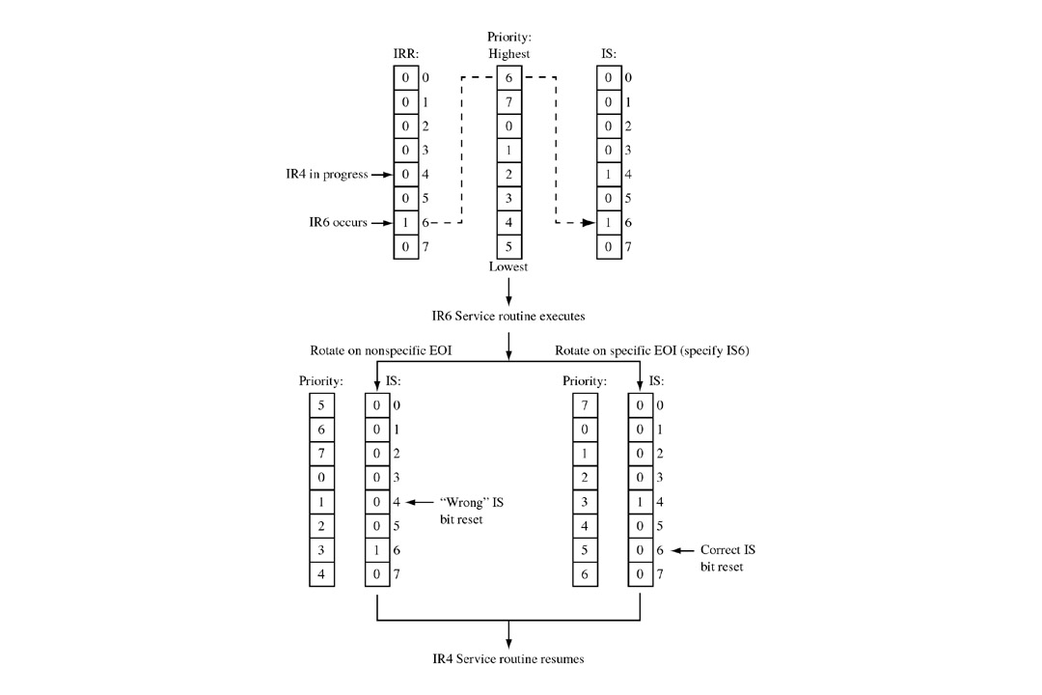
FIGURE 9-9 Example illustrating the difference between the rotate-on-nonspecific-EOI command and the rotate-on-specific-EOI command.
John Uffenbeck
The 80x86 Family: Design, Programming, and Interfacing, 3e
Copyright ©2002 by Pearson Education, Inc.
Upper Saddle River, New Jersey 07458
All rights reserved.

Slide 17
Modes
Fully Nested mode
Special Fully Nested mode
Nonspecific Rotating
Specific Rotating
Special Mask
Polling

Slide 18
Initializing the 8259A
A series of 9-bit values is sent to the PIC
Once it’s begun, it must be completed
Each 9-bit values is called an Initialization Command Word (abbreviated ICW)
The least significant 8 bits are sent on the PC’s data-bus, while the 9th bit is sent as bit 0 on the PC’s address-bus

Slide 19
8259A – ICW (Initialization Command Words)
CS | A0 | Initialization
0 | 0 | ICW1
0 | 1 | ICW2,ICW3,ICW4
1 | X | Not Address

Slide 20
ICW1 & ICW2
AD0 | D7 | D6 | D5 | D4 | D3 | D2 | D1 | D0
0 | 0 | 0 | 0 | 1 | LTIM | 0 | SGNL | IC4
 | 0 for x86 |  |  |  | 1 for Level Trigger 0 for Edge Trigger |  | 1=single 0=Cascade | 1=IC4 needed 0=no IC4 needed
AD0 | D7 | D6 | D5 | D4 | D3 | D2 | D1 | D0
1 | T7 | T6 | T5 | T4 | T3 | T2 | T1 | T0
 | T7=T0 is the assign to IR0, Vector address for ISR

Slide 21
ICW3 slave & ICW3 master & ICW4
AD0 | D7 | D6 | D5 | D4 | D3 | D2 | D1 | D0
1 | S7 | S6 | S5 | S4 | S3 | S2 | S1 | S0
 | Si = 1 ise IR input has a slave Si = 0 ise IR doesn’t have a slave
SGNL=0 ise
kullanılır
AD0 | D7 | D6 | D5 | D4 | D3 | D2 | D1 | D0
1 | 0 | 0 | 0 | 0 | 0 | ID2 | ID1 | ID0
 | (ID2 ID1 ID0) : slave ID
SGNL=0 ise
kullanılır
AD0 | D7 | D6 | D5 | D4 | D3 | D2 | D1 | D0
1 | 0 | 0 | 0 | SFNM | BUF | MS | AEOI | PM
 | PM: 1 for 8086

Slide 22
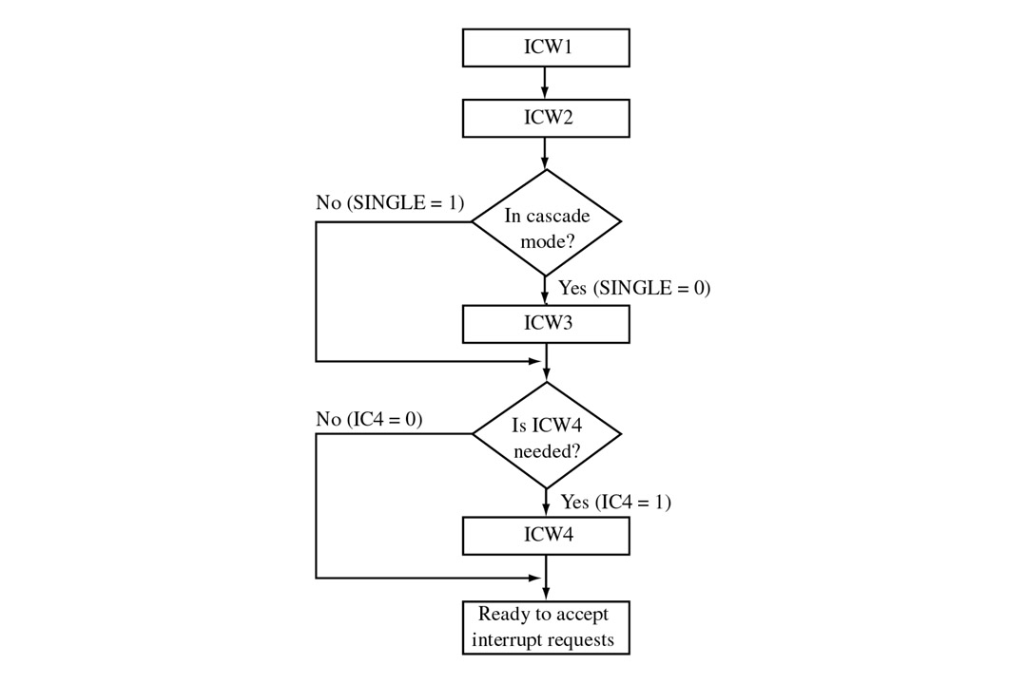
FIGURE 9-12 8259A initialization sequence. (Courtesy of Intel Corporation.)
John Uffenbeck
The 80x86 Family: Design, Programming, and Interfacing, 3e
Copyright ©2002 by Pearson Education, Inc.
Upper Saddle River, New Jersey 07458
All rights reserved.

Slide 23
8259A Ayarlama – OCW’ler
CS | A0 | Operation Command Word
0 | 0 | OCW2, OCW3
0 | 1 | OCW1
1 | X | Not Address

Slide 24
OCW1 & OCW2 & OCW3
AD0 | D7 | D6 | D5 | D4 | D3 | D2 | D1 | D0
1 | M7 | M6 | M5 | M4 | M3 | M2 | M1 | M0
 | Mi: Interrupt mask, 1=mask set, 0=mask reset
AD0 | D7 | D6 | D5 | D4 | D3 | D2 | D1 | D0
0 | R | SL | EOI | 0 | 0 | L2 | L1 | L0
 | Rotate | Specific | EOI |  |  | IR Level to be acted Upon (0-7)
AD0 | D7 | D6 | D5 | D4 | D3 | D2 | D1 | D0
0 | 0 | ESMM | SMM | 0 | 1 | P | RR | RIS
 |  | Special Mask Mode |  |  |  | Poll Command | Register Read Mode

Slide 25
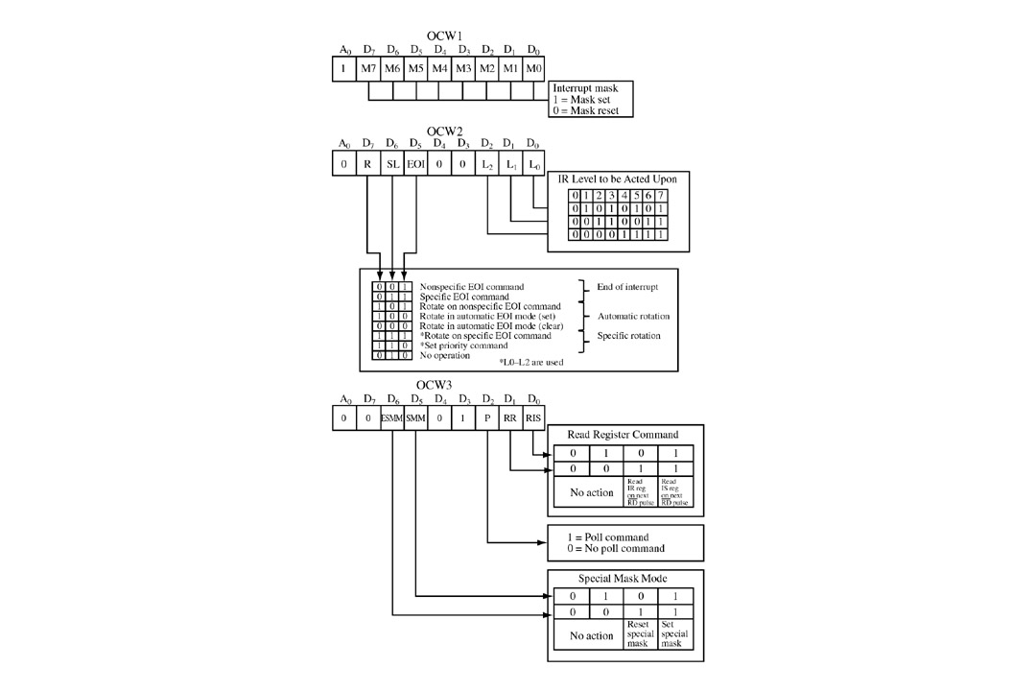
FIGURE 9-13 8259A operation control word format. (Courtesy of Intel Corporation.)
John Uffenbeck
The 80x86 Family: Design, Programming, and Interfacing, 3e
Copyright ©2002 by Pearson Education, Inc.
Upper Saddle River, New Jersey 07458
All rights reserved.

Slide 26

I/O Addresses of 8259

Slide 27
How to access the IMR
If in operational mode, the Interrupt Mask Register (IMR) can be read or written at any time (by doing in/out with A0-line=1)
  Read the master IMR: in al,0x21h
  Write the master IMR: out 0x21h,al
  Read the slave IMR: in al,0xA1h
  Write the slave IMR: out 0xA1h,al

Slide 28
How to read the master IRR
Issue the “read register” command-byte, with RR=1 and RIS=0; read return-byte:
mov al,0x0Ah
out 0x20h,al
in al,0x20h

Slide 29
How to read the master ISR
Issue the “read register” command-byte, with RR=1 and RIS=1; read return-byte:
mov al,0x0Bh
out 0x20h,al
in al,0x20h

