Slide 1
Electronic Circuits
Prof. Nizamettin AYDIN
naydin@yildiz.edu.tr
http://www.yildiz.edu.tr/~naydin
Dr. Gökhan Bilgin
gokhanb@ce.yildiz.edu.tr
Notes:
Copyright 2000 N. AYDIN. All rights reserved.

Slide 2
Electronic systems
Introduction
Electronic systems
Distortion and noise
System design.

Slide 3
Introduction
The world in which we live is constantly changing.
To survive, we need to respond to changes in our environment.
  To respond we sense a changing quantity (the input).
  And modify some other quantity (the output).
We often use machines to respond on our behalf.
  The nature of these machines is that they sense some input quantity, process the information, and then control some output quantity.

Slide 4
Introduction (contd.)
The world about us is characterised by a number of physical properties or quantities.
  e.g. temperature, pressure, humidity, etc.
Physical quantities may be continuous or discrete.
Continuous quantities change smoothly and can take an infinite number of values.
Discrete quantities change abruptly from one value to another.
  Most real-world quantities are continuous.
  Many man-made quantities are discrete.

Slide 5
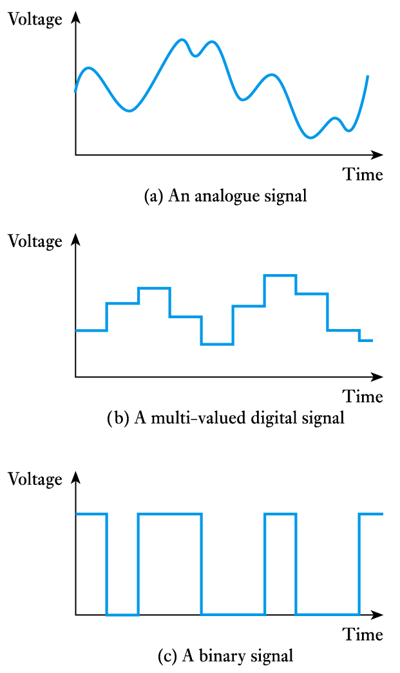
Introduction (contd.)
It is often convenient to represent physical quantities by electrical signals. These can also be continuous or discrete.
Continuous signals are often described as analogue.

Slide 6
Introduction (contd.)
Discrete signals are often described as digital signals.
Many digital signals take only two values and are referred to as binary signals.

Slide 7
Electronic systems
A system can be defined as
  Any closed volume for which all the
  inputs and output are known.
Examples include:
  an engine management system
  an automotive system
  a transportation system
  an ecosystem.
Inputs and outputs will reflect the nature of the system.

Slide 8
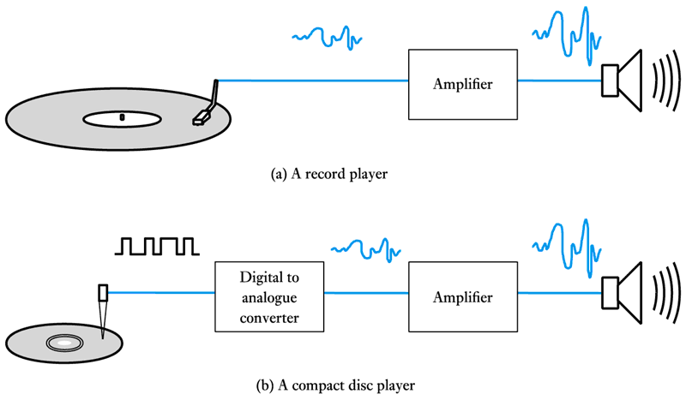
Electronic systems (contd.)
Electronic systems can take many forms, for example.

Slide 9
Electronic systems (contd.)
Components that interact with the outside world are termed sensors and actuators.
  In the previous examples the pickup or laser scanner represents a sensor.
  In the previous examples the loudspeaker represents an actuator.
We will look at sensors and actuators in more detail in later lectures.

Slide 10
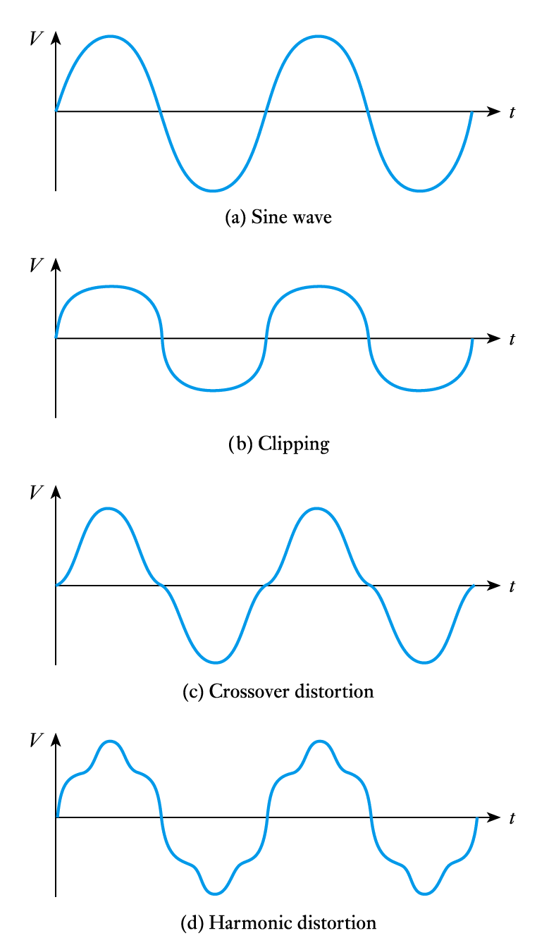
Distortion and noise
All systems distort electrical
signal to some extent
  examples include clipping,
  crossover distortion and
  harmonic distortion.
Distortion is systematic
and is repeatable.

Slide 11
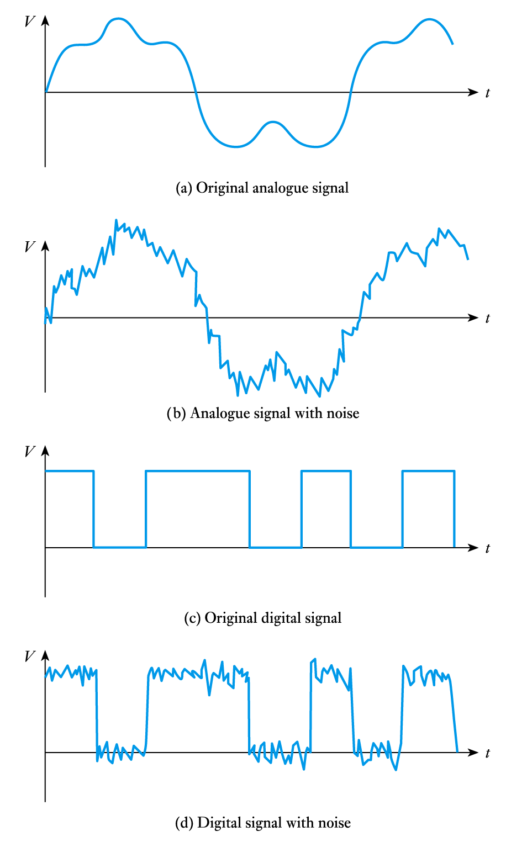
Distortion and noise (contd.)
All systems also add noise
to the signals that pass
through them.
Unlike distortion, noise is
random and not repeatable.
Noise can often be removed
from digital signals but
this is often impossible
with analogue signals.

Slide 12
System design
The task of designing an electronic system can be simplified by adopting a methodical approach.
Generally this involves a top-down approach.
  Customer requirements
  Top-level specification
  Choice of technology
  Top-level design
  Detailed design
  Module construction and testing
  System testing.

Slide 13
System design (contd.)
Electronic design aids
  schematic capture
  circuit simulation
  PCB or VLSI layout packages.
Circuit simulation greatly assists our understanding of the operation of a circuit.
  Common examples include PSpice and Multisim.
  Simulation demonstration files are available to support the material in the course text.

Slide 14
Key points
Systems interact with the world using sensors and actuators.
Physical quantities can be either continuous or discrete.
Physical quantities are often represented by signals.
Useful electronic systems take input signals, process this information and produce appropriate outputs.
Distortion and noise are always present.
System design normally follows a top-down approach.
Electronic design tools, such as simulators, are invaluable.

