Slide 1
Electronic Circuits
Prof. Nizamettin AYDIN
naydin@yildiz.edu.tr
http://www.yildiz.edu.tr/~naydin
Dr. Gökhan Bilgin
gokhanb@ce.yildiz.edu.tr
Notes:
Copyright 2000 N. AYDIN. All rights reserved.

Slide 2
Sensors and actuators
Introduction
Describing sensor performance
Sensors
Actuators
Laboratory measuring equipment.

Slide 3
Introduction
To be useful, systems must interact with their environment. To do this they use sensors and actuators.
Sensors and actuators are examples of transducers.
A transducer is a device that converts
one physical quantity into another.
  examples include:
    a mercury-in-glass thermometer (converts temperature into displacement of a column of mercury)
    a microphone (converts sound into an electrical signal).
We will look at both sensors and actuators in this lecture.

Slide 4
Describing sensor performance
Range
  maximum and minimum values that can be measured.
Resolution or discrimination
  smallest discernible change in the measured value.
Error
  difference between the measured and actual values.
    random errors
    systematic errors
Accuracy, inaccuracy, uncertainty
  accuracy is a measure of the maximum expected error.

Slide 5
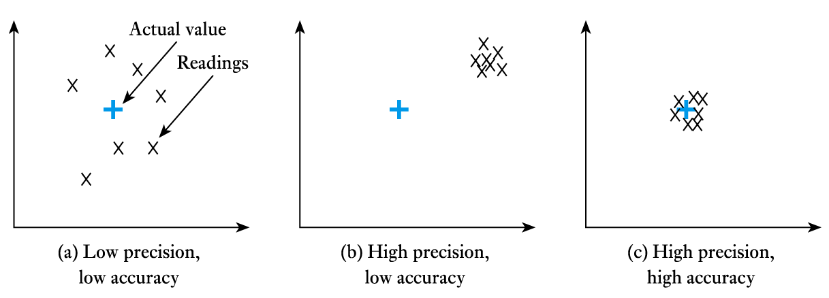
Describing sensor performance (contd.)
Precision
  a measure of the lack of random errors (scatter)

Slide 6




Error, Accuracy, and Precision
Experimental uncertainty is part of all measurements. Error is the difference between the true or best accepted value and the measured value. Accuracy is an indication of the range of error in a measurement.
Precision is a measure of repeatability.
}
Error
Precise, but not accurate.

Slide 7
Describing sensor performance (contd.)
Linearity
  maximum deviation from a ‘straight-line’ response
  normally expressed as a percentage of the full-scale value
Sensitivity
  a measure of the change produced at the output for a given change in the quantity being measured.

Slide 8
Sensors
Almost any physical property of a material that changes in response to some excitation can be used to produce a sensor.
  Widely used sensors include those that are:
    resistive
    inductive
    capacitive
    piezoelectric
    photoresistive
    elastic
    thermal.
  In this lecture we will look at several examples.

Slide 9
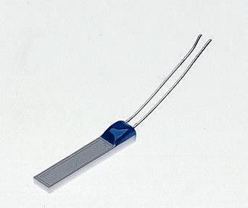
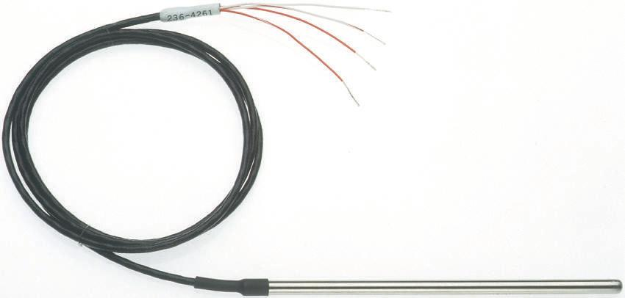
Temperature sensors
Resistive thermometers
  typical devices use platinum wire (such a device is called a platinum resistance thermometers or PRT)
  linear but has poor sensitivity.
  A typical PRT element A sheathed PRT

Slide 10
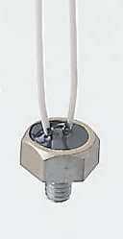
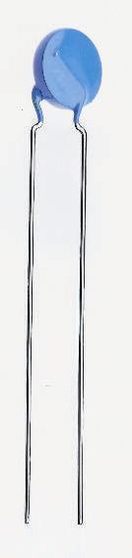
Temperature sensors (contd.)
Thermistors
  use materials with a high thermal coefficient of resistance
  sensitive but highly non-linear.
  A typical disc thermistor A threaded thermistor

Slide 11
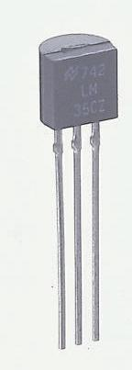
Temperature sensors (contd.)
pn junctions
  a semiconductor device with the
  properties of a diode (we will
  consider semiconductors and
  diodes later)
  inexpensive, linear and easy to use
  limited temperature range (perhaps
  -50°C to 150°C) due to nature of
  semiconductor material.
pn-junction sensor

Slide 12
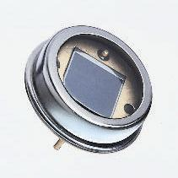
Light sensors
Photovoltaic
  light falling on a pn-junction can be used to generate electricity from light energy
  (as in a solar cell).
  small devices used as sensors are called photodiodes.
  fast acting, but the voltage produced is not linearly related to light intensity.
A typical photodiode

Slide 13
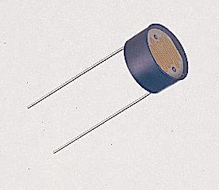
Light sensors (contd.)
Photoconductive
  such devices do not produce electricity, but simply change their resistance.
  photodiodes (as described earlier) can be used in this way to produce linear devices.
  phototransistors act like photodiodes but with greater sensitivity.
  light-dependent resistors (LDRs) are slow, but respond like the human eye.
A light-dependent resistor (LDR)

Slide 14
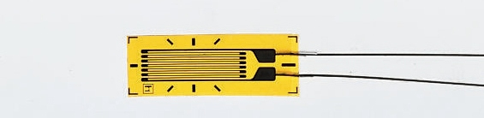
Force sensors
Strain gauge
  stretching in one direction increases the resistance of the device, while stretching perpendicular to this has little effect
  can be bonded to a surface to measure strain
  used within load cells and pressure sensors.
Direction of sensitivity
A strain gauge

Slide 15
Displacement sensors
Potentiometers
  resistive potentiometers are one of the most widely used forms of position sensor.
  can be angular or linear.
  consists of a length of resistive material with a sliding contact onto the resistive track.
  when used as a position transducer a potential is placed across the two end terminals, the voltage on the sliding contact is then proportional to its position.
  an inexpensive and easy to use sensor.

Slide 16
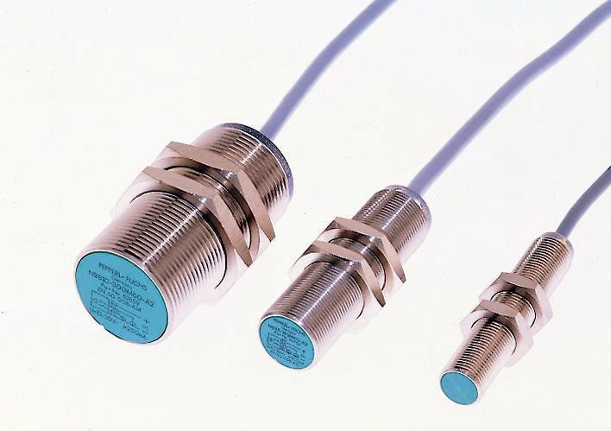
Displacement sensors (contd.)
Inductive proximity sensors
  coil inductance is greatly affected by the presence of ferromagnetic materials.
  here the proximity of a ferromagnetic plate is determined by measuring the inductance of a coil.
Inductive proximity sensors

Slide 17
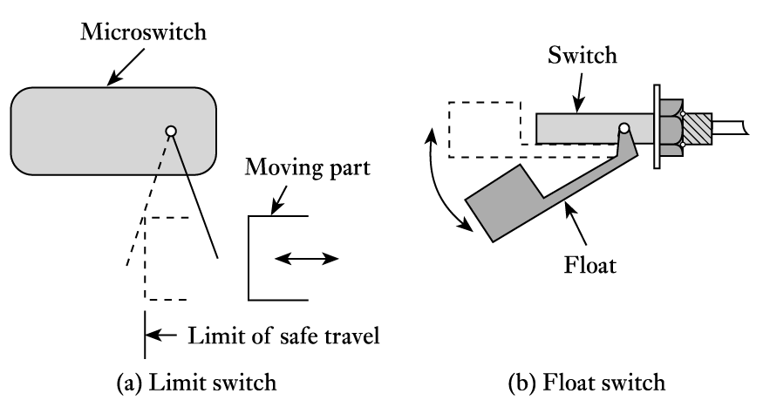
Displacement sensors (contd.)
Switches
  simplest form of digital displacement sensor
    many forms: lever or push-rod operated microswitches, float switches, pressure switches, etc.
A limit switch
A float switch

Slide 18
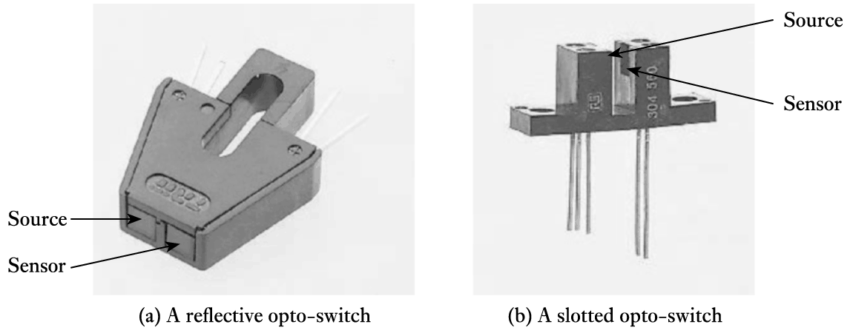
Displacement sensors (contd.)
Opto-switches
  consist of a light source and a light sensor within a single unit.
    2 common forms are the reflective and slotted types.
A reflective opto-switch
A slotted opto-switch

Slide 19
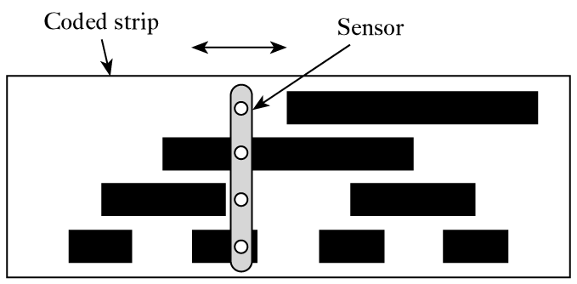
Displacement sensors (contd.)
Absolute position encoders
  A pattern of light and dark strips is printed on to a strip and is detected by a sensor that moves along it.
    The pattern takes the form of a series of lines as shown below.
    It is arranged so that the combination is unique at each point.
    Sensor is an array of photodiodes.

Slide 20
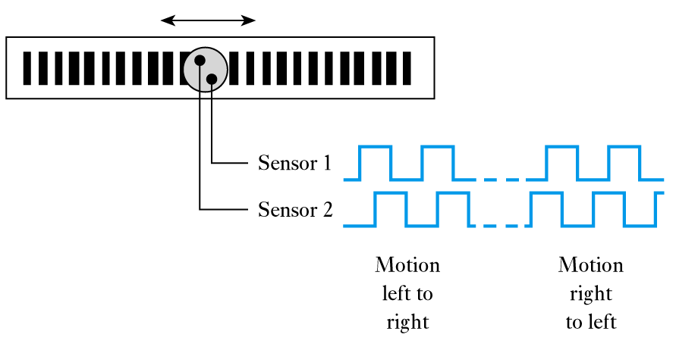
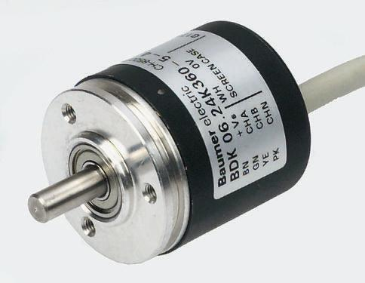
Displacement sensors (contd.)
Incremental position encoder
  uses a single line that alternates black/white
    two slightly offset sensors produce outputs as shown below
    detects motion in either direction, pulses are counted to determine absolute position (which must be initially reset).

Slide 21
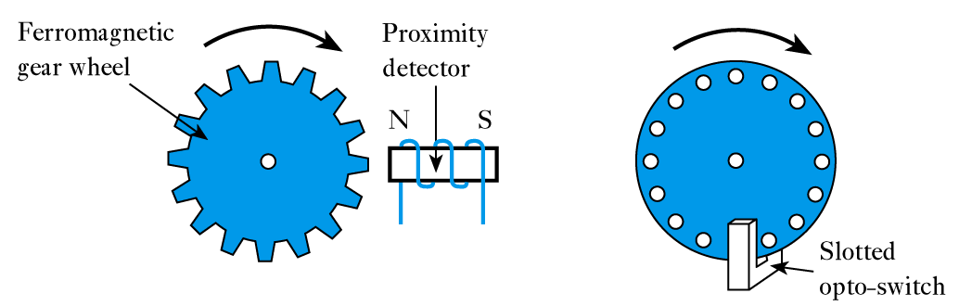
Displacement sensors (contd.)
Other counting techniques
  several methods use counting to determine position
    two examples are given below.
Inductive sensor
Opto-switch sensor

Slide 22
Motion sensors
Motion sensors measure quantities such as velocity and acceleration.
  Can be obtained by differentiating displacement
  Differentiation tends to amplify high-frequency noise.
Alternatively can be measured directly
  some sensors give velocity directly
    e.g. measuring frequency of pulses in the counting techniques described earlier gives speed rather than position.
  some sensors give acceleration directly
    e.g. accelerometers usually measure the force on a mass.

Slide 23
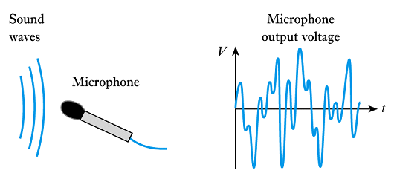
Sound sensors
Microphones
  a number of forms are available
    e.g. carbon (resistive), capacitive, piezoelectric and
    moving-coil microphones
    moving-coil devices use a magnet and a coil attached to a diaphragm.

Slide 24
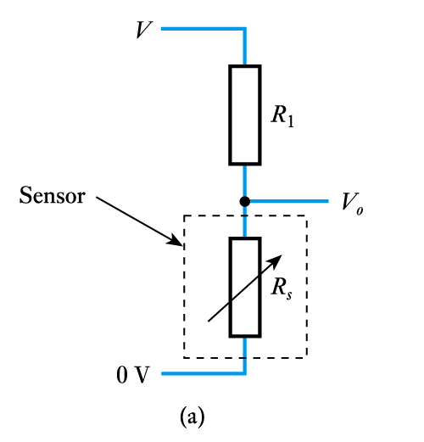
Sensor interfacing
Resistive devices
  can be very simple
    e.g. in a potentiometer, with a fixed voltage across the outer terminals, the voltage on the third is directly related to position
    where the resistance of the device changes with the quantity being measured, this change can be converted into a voltage signal using a potential divider – as shown
    the output of this arrangement is not linearly related to the change in resistance.

Slide 25
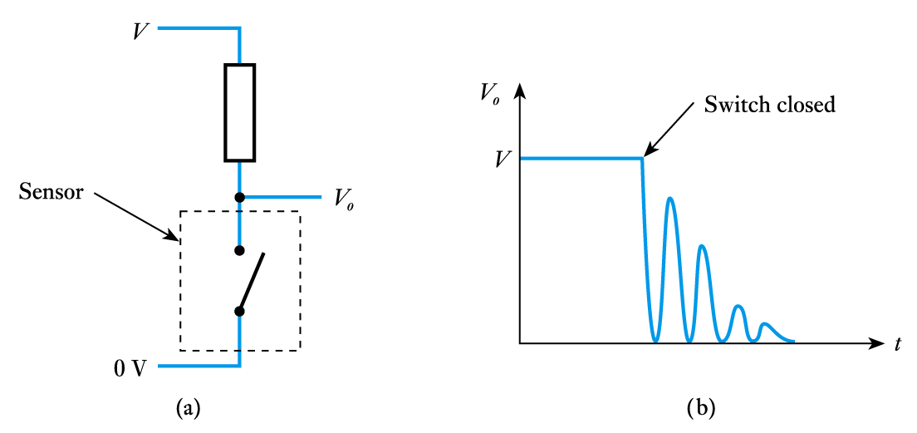
Sensor interfacing (contd.)
Switches
  switch interfacing is also simple
    can use a single resistor as below to produce a voltage output
    all mechanical switches suffer from switch bounce.

Slide 26
Sensor interfacing (contd.)
Capacitive and inductive sensors
  Sensors that change their capacitance or inductance in response to external influences normally require the use of alternating current (AC) circuitry.
  Such circuits need not be complicated.
  We will consider AC circuits in later lectures.

Slide 27
Actuators
In order to be useful an electrical or electronic system must be able to affect its external environment. This is done through the use of one or more actuators.
As with sensors, actuators are transducers, which convert one physical quantity into another.
Here we are interested in actuators that take electrical signals from our system and from them vary some external physical quantity.

Slide 28
Heat actuators
Most heat actuators are simple resistive heaters.
For applications requiring a few watts ordinary resistors of an appropriate power rating can be used.
For higher power applications there are a range of heating cables and heating elements available.

Slide 29
Light actuators
For general illumination it is normal to use conventional incandescent light bulbs or
fluorescent lamps.
  power ratings range from a fraction of a watt to perhaps hundreds of watts
  easy to use but relatively slow in operation
  unsuitable for signalling and communication applications.

Slide 30
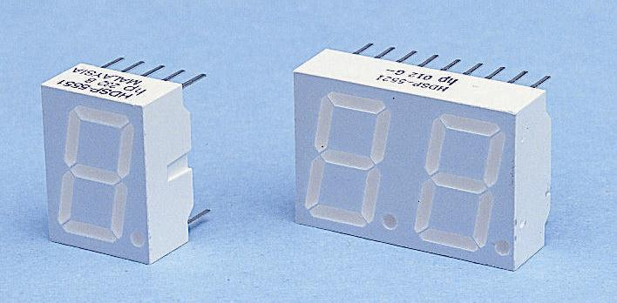
Light actuators (contd.)
Light-emitting diodes (LEDs)
  produce light when electricity is passed through them.
  a range of semiconductor materials can be used to produce light of different colours.
  can be used individually
  or in multiple-segment
  devices such as the
  seven-segment display
  shown here.
LED – seven-segment displays

Slide 31
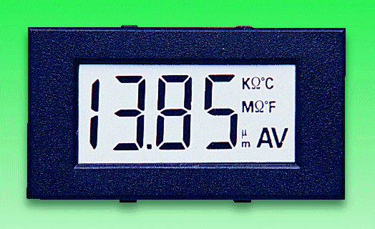
Light actuators (contd.)
Liquid crystal displays
  consist of 2 sheets of polarised glass with a thin layer of oily liquid sandwiched between them.
  an electric field rotates the polarization of the liquid making it opaque.
  can be formed into multi-
  element displays (such
  as 7-segment displays).
  can also be formed into a
  matrix display to display
  any character or image.
A custom LCD display

Slide 32
Light actuators (contd.)
Fibre-optic communication
  used for long-distance communication
  removes the effects of ambient light
  fibre-optic cables can be made of:
    optical polymer
      inexpensive and robust
      high attenuation, therefore short range (up to about 20 metres)
    glass
      much lower attenuation allowing use up to hundreds of kilometres
      more expensive than polymer fibres
  light source would often be a laser diode.

Slide 33
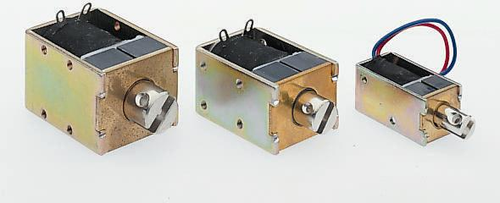
Force, displacement and motion actuators
Solenoids
  basically a coil and a ferromagnetic ‘slug’
  when energised the slug is attracted into the coil
  force is proportional to current
  can produce a force,
  a displacement or
  motion
  can be linear or
  angular
  often used in an
  ON/OFF mode.
Small linear solenoids

Slide 34
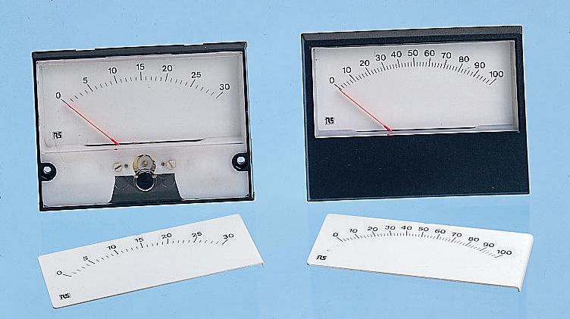
Force, displacement and motion actuators (contd.)
Meters
  moving-iron
    effectively a rotary solenoid plus spring
    can measure DC or AC
  moving-coil
    most common form
    deflection proportional to
    average value of current
    full scale deflection
    typically 50 μA – 1 mA
Moving-coil meters

Slide 35
Force, displacement and motion actuators (contd.)
Motors
  three broad classes
    AC motors
      primarily used in high-power applications
    DC motors
      used in precision position-control applications
    Stepper motors
      a digital actuator used in position control applications.

Slide 36
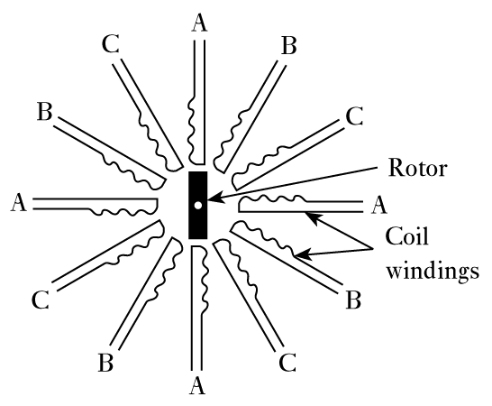
Stepper motors
Stepper motors
  a central rotor surrounded by
  a number of coils (or windings)
  opposite pairs of coils are
  energised in turn
  this ‘drags’ the rotor round
  one ‘step’ at a time
  speed proportional to frequency
  typical motor might require
  48-200 steps per revolution.

Slide 37
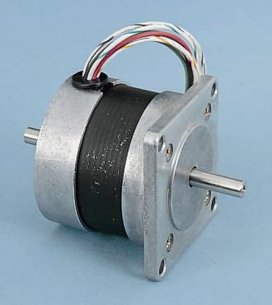
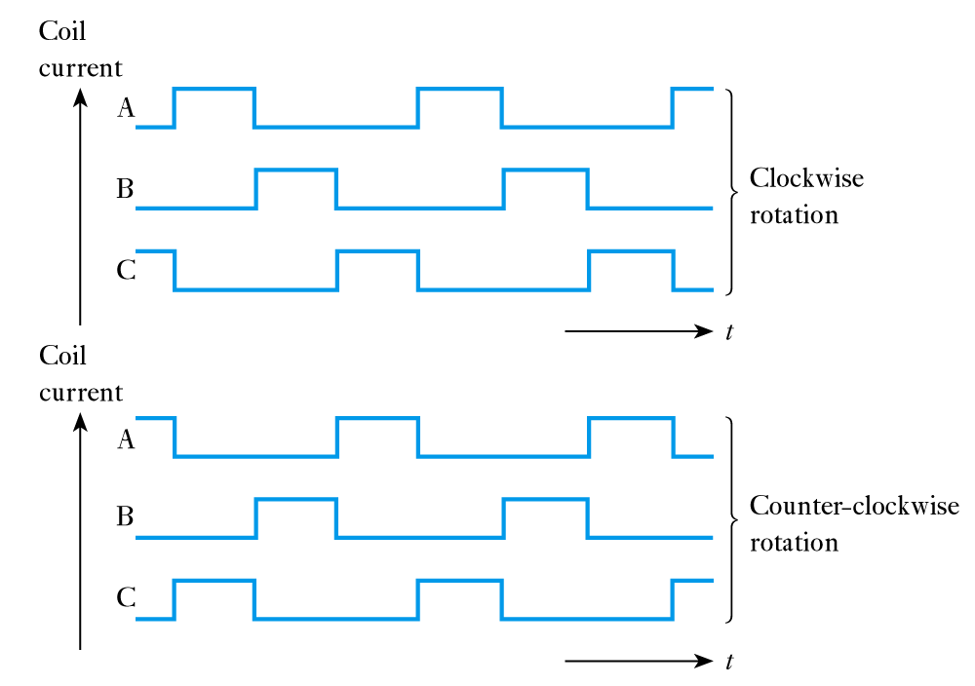
Stepper motors (contd.)
Stepper-motor current waveforms
A typical stepper-motor

Slide 38
Sound actuators
Speakers
  usually use a permanent magnet and a movable coil connected to a diaphragm.
  input signals produce current in the coil causing it to move with respect to the magnet.
Ultrasonic transducers
  at high frequencies speakers are often replaced by piezoelectric actuators
  operate over a narrow frequency range.

Slide 39
Actuator interfacing
Resistive devices
  Interfacing involves controlling the power in the device.
  In a resistive actuator, power is related to the voltage.
  For high-power devices the problem is in delivering sufficient power to drive the actuator.
  High-power electronic circuits will be considered later.
  High-power actuators are often controlled in an ON/OFF manner.
  These techniques use electrically operated switches
    discussed in later lectures.

Slide 40
Actuator interfacing (contd.)
Capacitive and inductive devices
  Many actuators are capacitive or inductive (such as motors and solenoids).
  These create particular problems – particularly when using switching techniques.
  We will return to look at these problems when we have considered capacitors and inductors in more detail.

Slide 41
Laboratory measuring instruments
Often the object of sensing a physical quantity is to measure it.
Here we will look at three forms of measuring instrument:
  analogue oscilloscope
  digital oscilloscope
  digital multimeter.

Slide 42
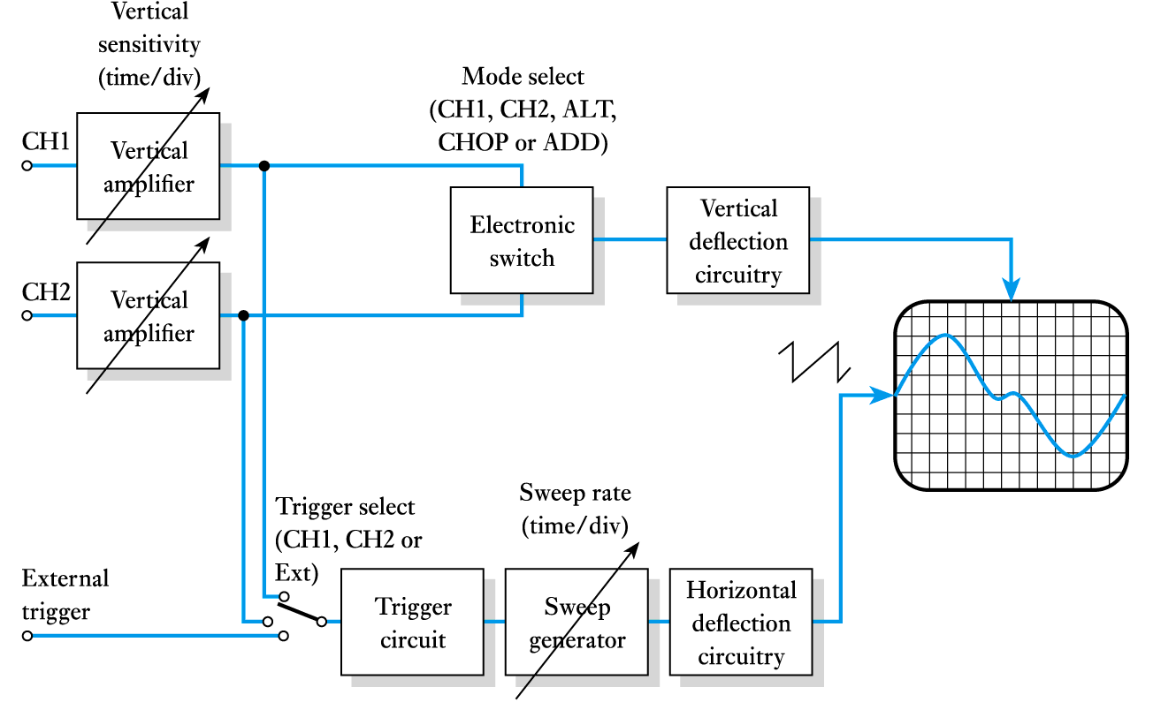
Analogue oscilloscope
An oscilloscope displays voltage waveforms.
A simplified block diagram

Slide 43
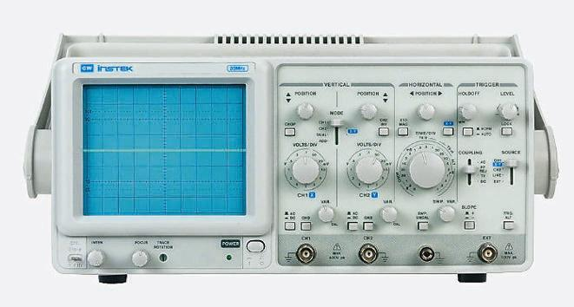
Analogue oscilloscope (contd.)
A typical analogue oscilloscope

Slide 44
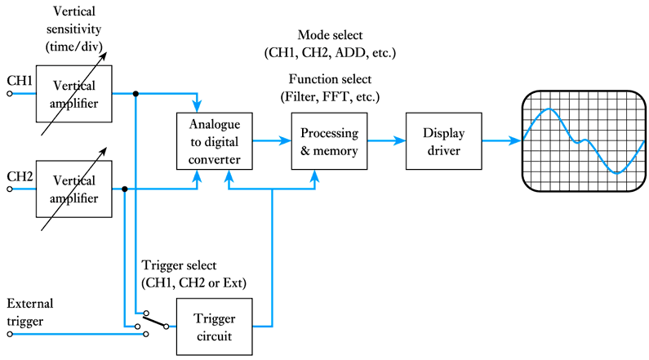
Digital oscilloscope
Digital oscilloscopes use an analogue-to-digital converter (ADC) and appropriate processing.
A simplified block diagram

Slide 45
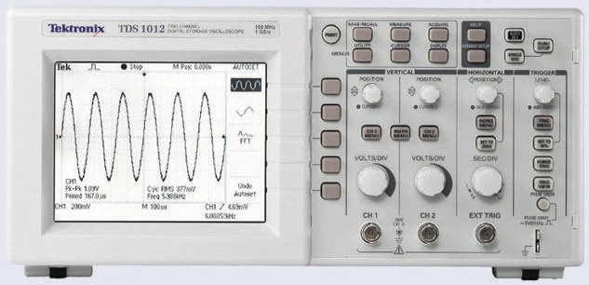
Digital oscilloscope (contd.)
A typical digital oscilloscope

Slide 46
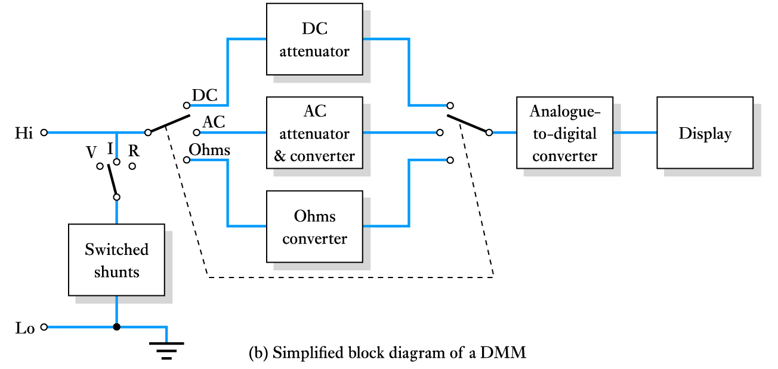
Digital multimeters
Digital multimeters (DMMs) are often (inaccurately) referred to as digital voltmeters or DVMs.
  At their heart is an analogue-to-digital converter (ADC).
A simplified block diagram

Slide 47
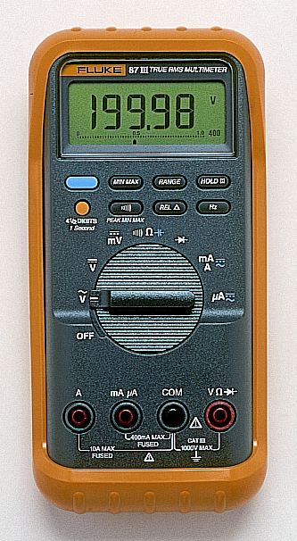
Digital multimeters (contd.)
Measurement of voltage, current and resistance is achieved using appropriate circuits to produce a voltage proportional to the quantity to be measured.
  In simple DMMs alternating signals are rectified as in analogue multimeters to give their average value which is multiplied by 1.11 to directly display the r.m.s. value of sine waves.
  More sophisticated devices use a true r.m.s. converter, which accurately produces a voltage proportional to the r.m.s. value of an input waveform.
A typical digital multimeter

Slide 48
Key points
A wide range of sensors is available.
Some sensors produce an output voltage related to the measured quantity and therefore supply power.
Other devices simply change their physical properties.
Interfacing may be required to produce signals in the correct form.
Most actuators take power from their inputs in order to deliver power at the output – the efficiency is often low.
We often sense quantities in order to measure them – there are a number of standard measuring instruments.

