Slide 1
Electronic Circuits
Prof. Nizamettin AYDIN
naydin@yildiz.edu.tr
http://www.yildiz.edu.tr/~naydin
Dr. Gökhan Bilgin
gokhanb@ce.yildiz.edu.tr
Notes:
Copyright 2000 N. AYDIN. All rights reserved.

Slide 2
Control and feedback
Introduction
Open-loop and closed-loop systems
Automatic control systems
Feedback systems
Negative feedback
The effects of negative feedback
Negative feedback – a summary

Slide 3
Introduction
Control is one of the basic functions performed by many systems
  this often involves regulation or command
Invariably, the goal is to determine the value or state of some physical quantity
  and often to maintain it at that value, despite variations in the system or the environment

Slide 4
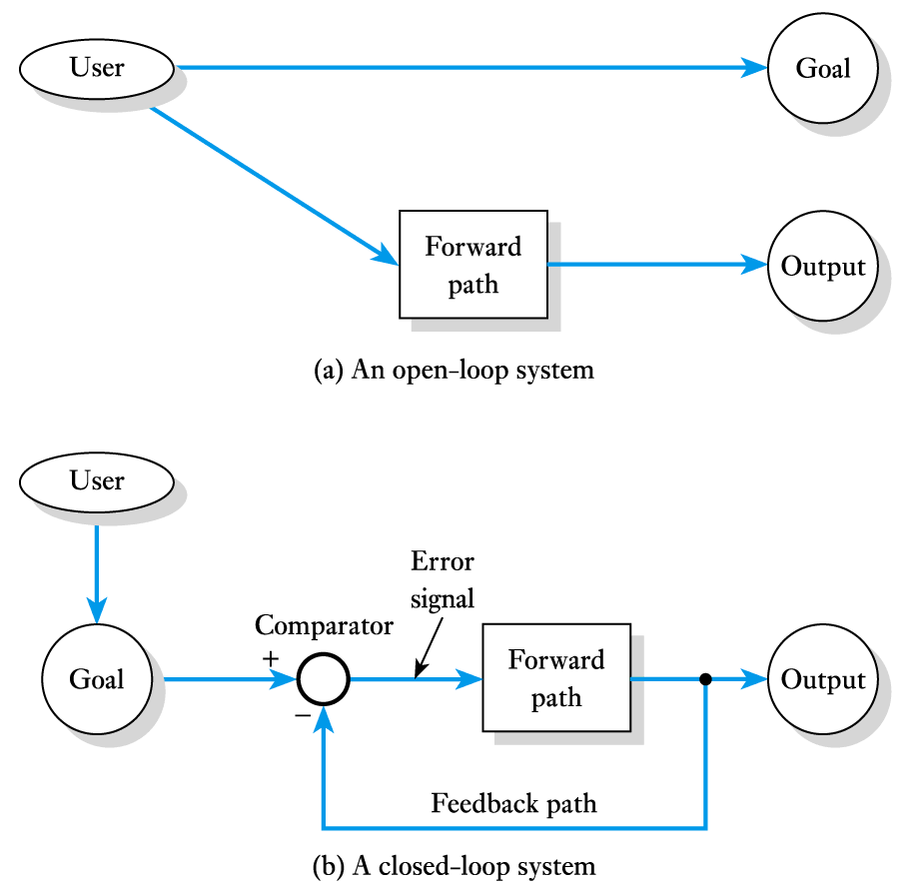
Open-loop and closed-loop systems
Simple control is often open-loop
  user has a goal and selects an input to a system to try to achieve this

Slide 5
Open-loop and closed-loop systems (contd.)
More sophisticated arrangements are closed-loop
  user inputs the goal to the system

Slide 6
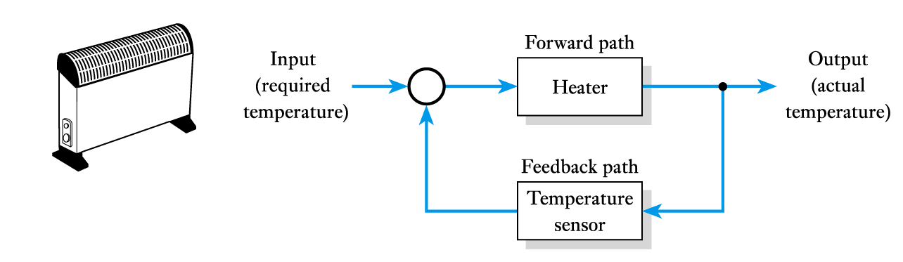
Automatic control systems
Examples of automatic control systems:
  temperature control using a room heater

Slide 7

Automatic control systems (contd.)
Examples of automatic control systems:
  cruise control in a car

Slide 8
Automatic control systems (contd.)
Examples of automatic control systems:
  position control in a human limb

Slide 9
Automatic control systems (contd.)
Examples of automatic control systems:
  level control in a dam

Slide 10
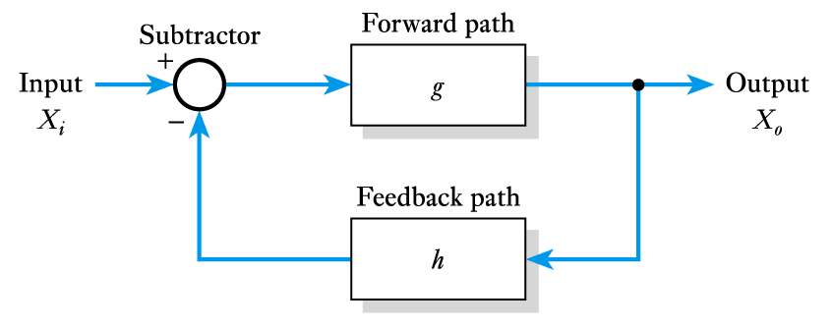
Feedback systems
A generalised feedback system

Slide 11
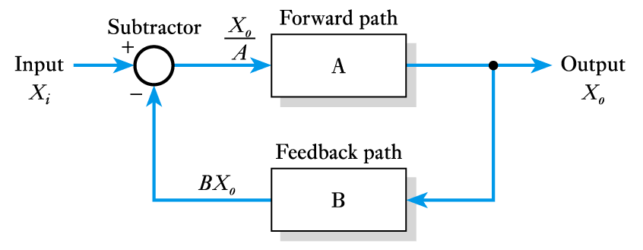
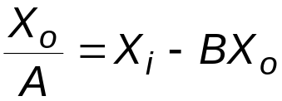
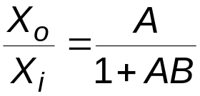
Feedback systems (contd.)
By inspection of diagram we can add values
or rearranging

Slide 12
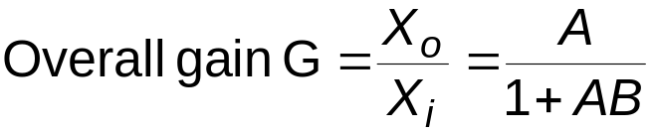
Feedback systems (contd.)
Thus
This is the transfer function of the arrangement
Terminology:
    A is also known as the open-loop gain
    G is the overall or closed-loop gain

Slide 13
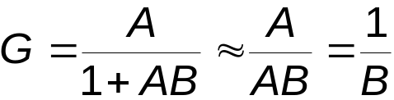
Feedback systems (contd.)
Effects of the product AB
  If AB is negative
    If AB is negative and less than 1, (1 + AB) < 1
    In this situation G > A and we have positive feedback
  If AB is positive
    If AB is positive then (1 + AB) > 1
    In this situation G < A and we have negative feedback
    If AB is positive and AB >>1
    gain is independent of the gain of the forward path A

Slide 14
Negative feedback
Negative feedback can be applied in many ways
  X_{i} and X_{o} could be temperatures, pressures, etc.
  here we are mainly interested in voltages and currents
Is particularly important in overcoming variability
  all active devices suffer from variability
    their gain and other characteristics vary with temperature and between devices
  we noted above that using negative feedback we can produce an arrangement where the gain is independent of the gain of the forward path
    this gives us a way of overcoming problems of variability

Slide 15
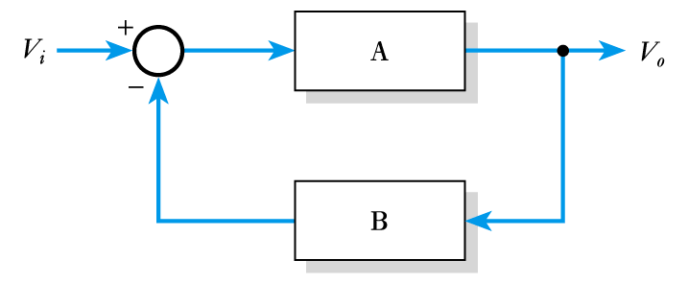
Negative feedback – an example
Consider the following example
We will base our design on our standard feedback arrangement
Example: Design an arrangement with a stable voltage gain of 100 using a high-gain active amplifier. Determine the effect on the overall gain of the circuit if the voltage gain of the active amplifier varies from 100,000 to 200,000.

Slide 16
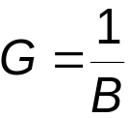
Negative feedback – an example (contd.)
We will use our active
amplifier for A and a stable
feedback arrangement for B
Since we require an overall gain of 100 and
we will use B = 1/100 or 0.01

Slide 17
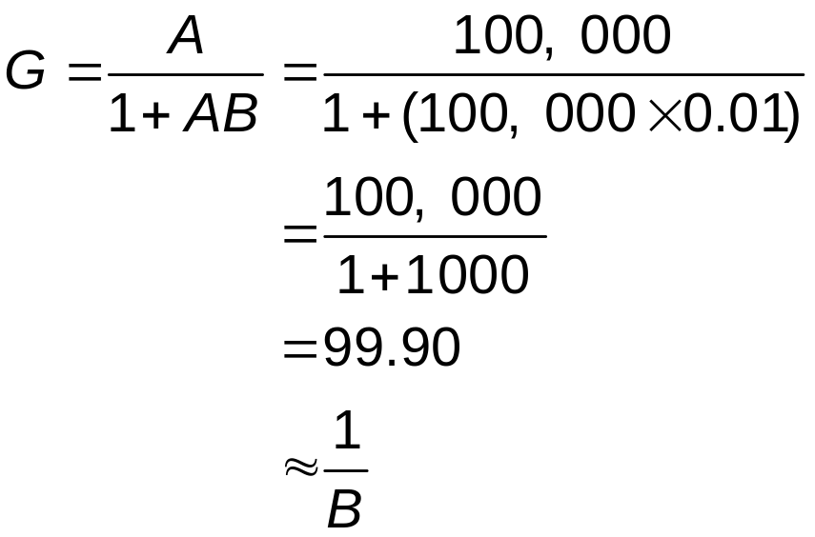
Negative feedback – an example (contd.)
Now consider the gain of the circuit when the gain of the active amplifier A is 100,000

Slide 18
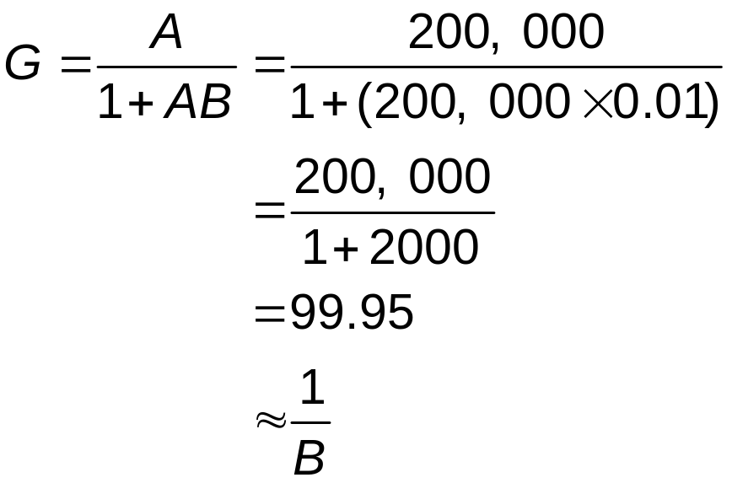
Negative feedback – an example (contd.)
Now consider the gain of the circuit when the gain of the active amplifier A is 200,000

Slide 19
Negative feedback – an example (contd.)
Note that a change in the gain
of the active amplifier of 100%
causes a change in the overall
gain of just 0.05 %
Thus, the use of negative feedback makes the gain largely independent of the gain of the active amplifier
However, it does require that B is stable
  fortunately, B can be based on stable passive components

Slide 20
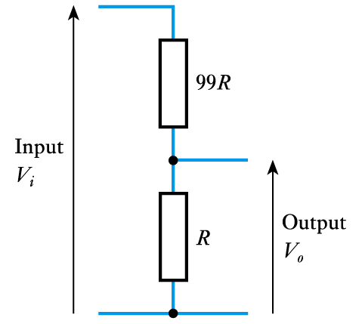
Negative feedback – an example (contd.)
Implementing the passive feedback path
  to get an overall gain of greater than 1 requires a feedback gain B of less than 1
  in the previous example the value of B is 0.01
  this can be achieved using a simple potential divider

Slide 21
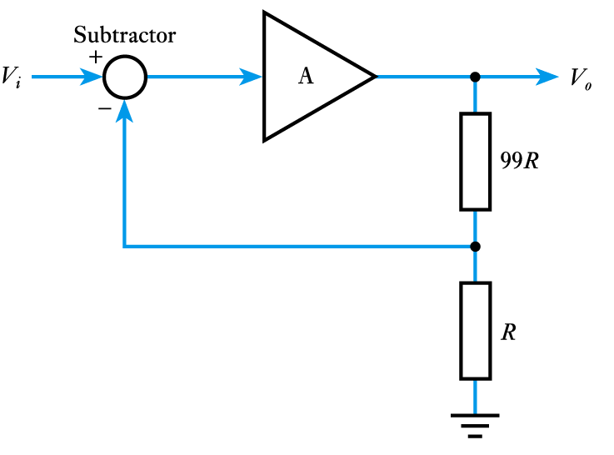
Negative feedback – an example (contd.)
Thus, we can implement our feedback arrangement using an active amplifier and a passive feedback network to produce a stable amplifier
The arrangement on
the right has a gain
of 100 …
… but how do we
implement the
subtractor?

Slide 22
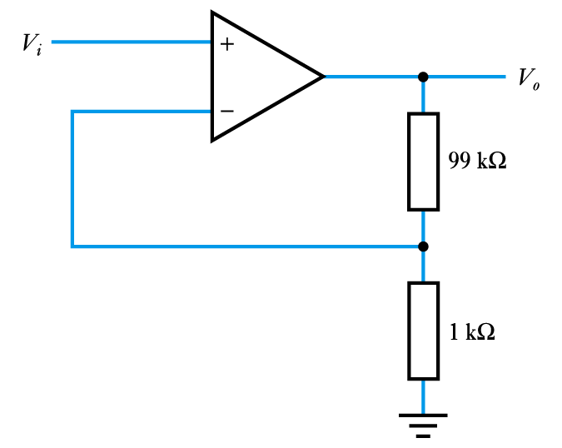
Negative feedback – an example (contd.)
A differential amplifier is effectively an active amplifier combined with a subtractor. A common form is the operational amplifier or op-amp
The arrangement on
the right has a gain
of 100.

Slide 23
Negative feedback – an example (contd.)
In this circuit the gain is determined
by the passive components and we
do not need to know the gain of the
op-amp
  however, earlier we assumed
  that AB >> 1
  that is, A >> 1/B
  that is, open-loop gain >> closed-loop gain
  therefore, the gain of the circuit must be much less than the gain of the op-amp

Slide 24
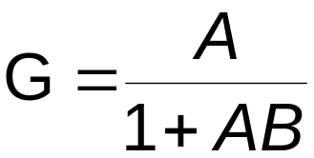
The effects of negative feedback
Effects on gain
  negative feedback produces a gain given by
  there, feedback reduces the gain by a factor of 1 + AB
  this is the price we pay for the beneficial effects of negative feedback

Slide 25
The effects of negative feedback (contd.)
Effects on frequency response
  from earlier lectures we know that all amplifiers have a limited frequency response and bandwidth
  with feedback we make the overall gain largely independent of the gain of the active amplifier
  this has the effect of increasing the bandwidth, since the gain of the feedback amplifier remains constant as the gain of the active amplifier falls
  however, when the open-loop gain is no longer much greater than the closed-loop gain the overall gain falls

Slide 26
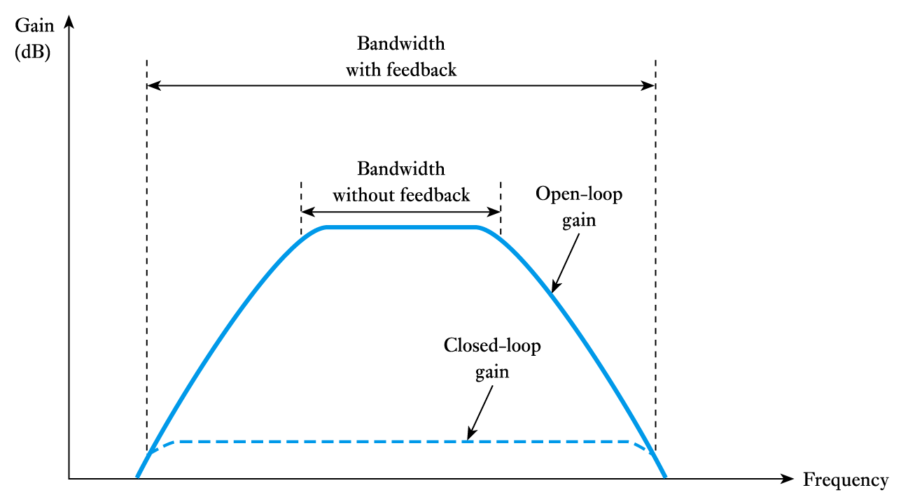
The effects of negative feedback (contd.)
  therefore the bandwidth increases as the gain is reduced with feedback
  in some cases the gain x bandwidth = constant

Slide 27
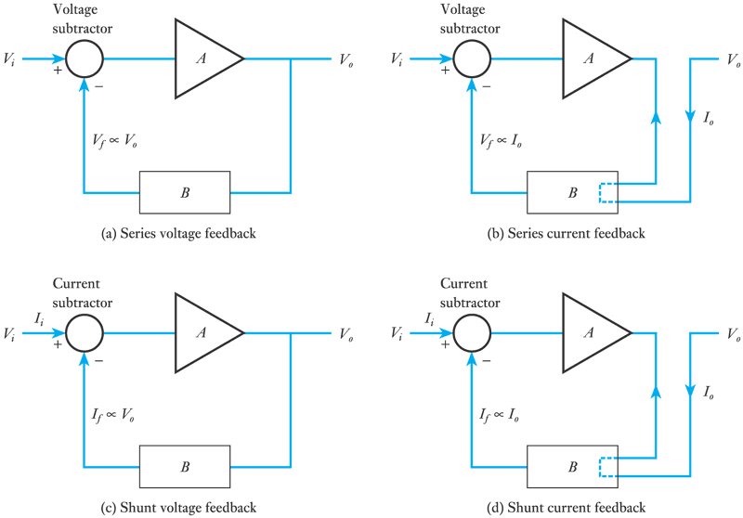
The effects of negative feedback (contd.)
Effects on input and output resistance
  negative feedback can be used in a number of ways.

Slide 28
The effects of negative feedback (contd.)
negative feedback can either increase or decrease the input or output resistance depending on how it is used.
  if the output voltage is fed back this tends to make the output voltage more stable by decreasing the output resistance
  if the output current is fed back this tends to make the output current more stable by increasing the output resistance
  if a voltage related to the output is subtracted from the input voltage this increases the input resistance
  if a current related to the output is subtracted from the input current this decreases the input resistance
  the factor by which the resistance changes is (1 + AB)
  we will apply this to op-amps in a later lecture

Slide 29
The effects of negative feedback (contd.)
Effects on distortion and noise
  many forms of distortion are caused by a non-linear amplitude response
    that is, the gain varies with the amplitude of the signal
  since feedback tends to stabilise the gain it also tends to reduce distortion – often by a factor of (1 + AB)
  noise produced within an amplifier is also reduced by negative feedback – again by a factor of (1 + AB)
    note that noise already corrupting the input signal is not reduced in this way – this is amplified along with the signal

Slide 30
The effects of negative feedback (contd.)
Effects on stability
  from earlier we know that
  so far we have assumed that A and B are positive real numbers
  real amplifiers produce phase shifts at some frequencies
  a phase shift of 180° represents an inversion of the gain
  this will turn negative feedback into positive feedback
  therefore, feedback has implication for stability
  we will return to look at stability in later lectures

Slide 31
Negative feedback – a summary
All negative feedback systems share some properties
  They tend to maintain their output independent of variations in the forward path or in the environment
  They require a forward path gain that is greater than that which would be necessary to achieve the required output in the absence of feedback
  The overall behaviour of the system is determined by the nature of the feedback path
Unfortunately, negative feedback does have implications for the stability of circuits – this is discussed in later lectures

Slide 32

Key points
Feedback is used in almost all automatic control systems
Feedback can be either negative or positive
If the gain of the forward path is A, the gain of the feedback path is B and the feedback is subtracted from the input then
If AB is positive and much greater than 1, then G ≈ 1/B
Negative feedback can be used to overcome problems of variability within active amplifiers
Negative feedback can be used to increase bandwidth, and to improve other circuit characteristics.

