Slide 1
Electronic Circuits
Yrd.Doç.Dr. Gökhan Bilgin
gokhanb@ce.yildiz.edu.tr
Notes:
Copyright 2000 N. AYDIN. All rights reserved.

Slide 2
Operational amplifiers
Introduction
An ideal operational amplifier
Basic operational amplifier circuits
Other useful circuits
Real operational amplifiers
Selecting component values
Effects of feedback on op-amp circuits

Slide 3
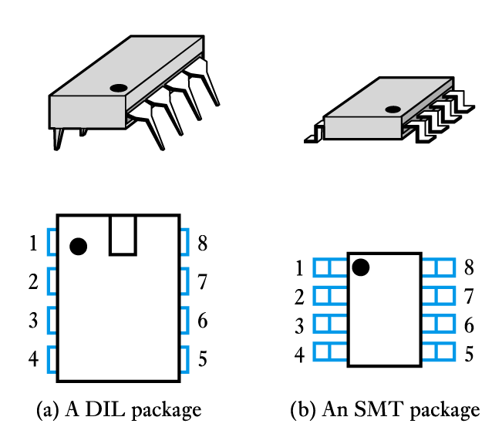
Introduction
Operational amplifiers (op-amps) are among the most widely used building blocks in electronics
  they are integrated circuits (ICs)
    often DIL or SMT

Slide 4
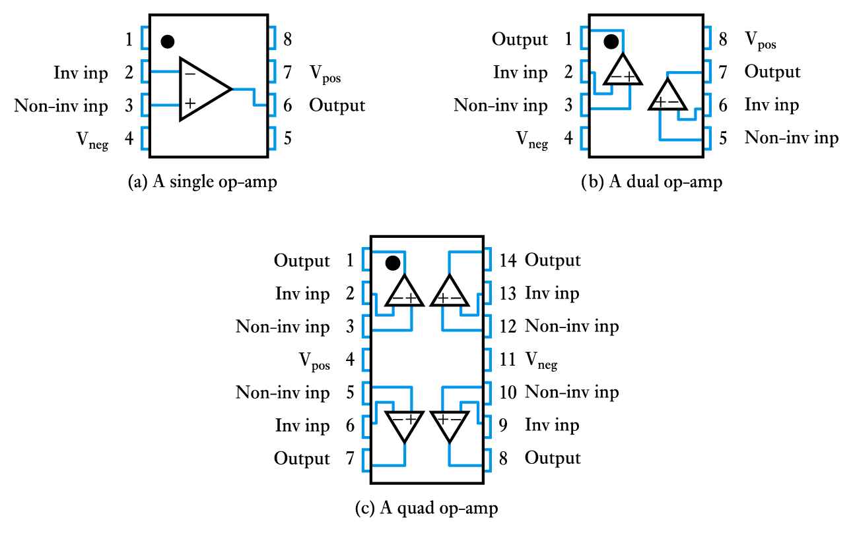
Introduction (contd.)
A single package will often contain several op-amps

Slide 5
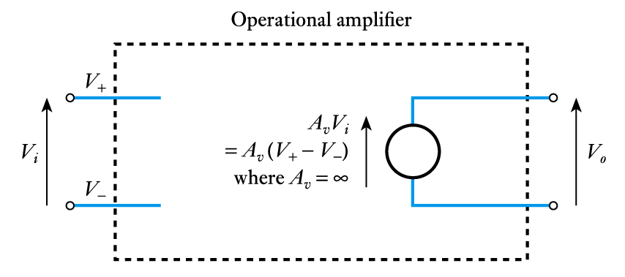
An ideal operational amplifier
An ideal op-amp would be an ideal voltage amplifier and would have: A_{v} = ∞, R_{i} = ∞ and R_{o} = 0
Equivalent circuit of an ideal op-amp

Slide 6
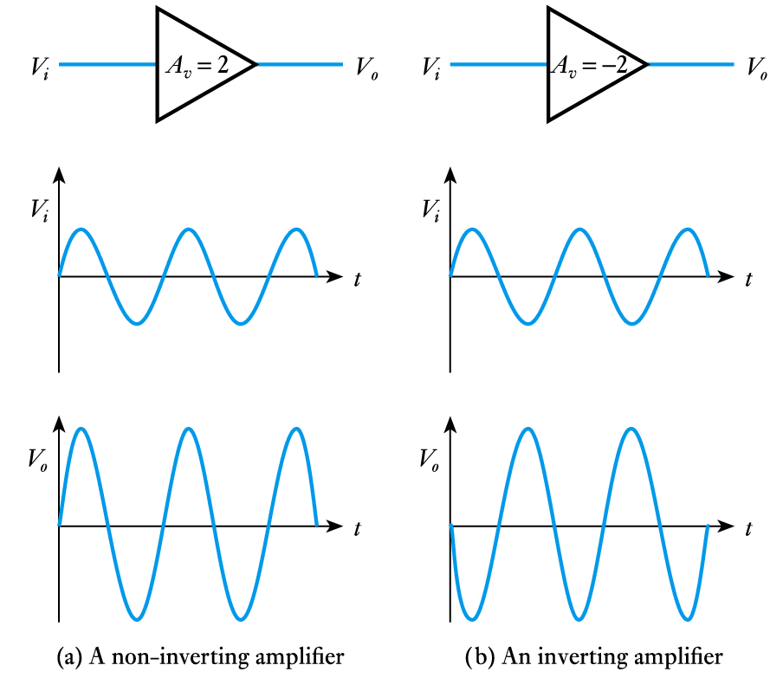
Basic operational amplifier circuits
Inverting and non-inverting amplifiers

Slide 7
Basic operational amplifier circuits (contd.)
When looking at feedback we derived the circuit of an amplifier from ‘first principles’
Normally we use standard ‘cookbook’ circuits and select component values to suit our needs
In analysing these we normally assume the use of ideal op-amps
  in demanding applications we may need to investigate the appropriateness of this assumption
  the use of ideal components makes the analysis of these circuits very straightforward

Slide 8
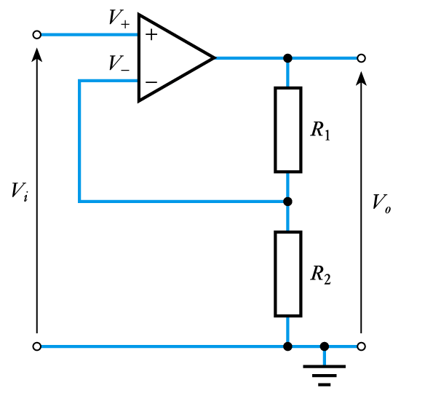

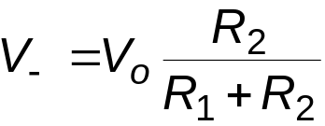
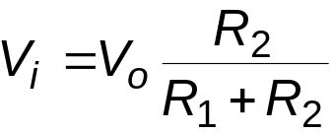
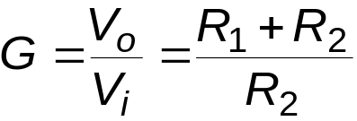
Basic operational amplifier circuits (contd.)
A non-inverting amplifier
Analysis
Since the gain is assumed infinite, if V_{o} is finite
then the input voltage must be zero. Hence
Since the input resistance of the op-amp is ∞
and hence, since V– = V₊ = V_{i}
and

Slide 9
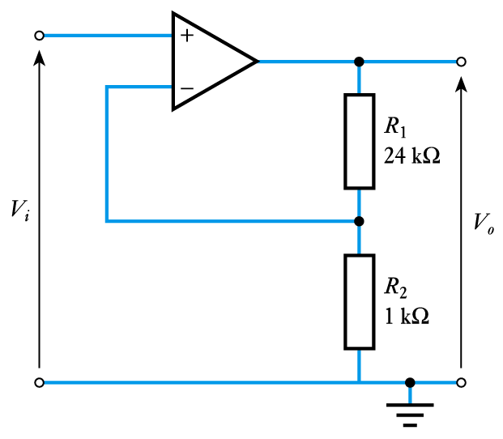
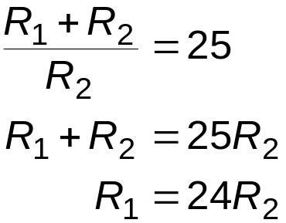
Basic operational amplifier circuits (contd.)
Example
Design a non-inverting amplifier with a gain of 25
From above
If G = 25 then
Therefore choose R₂ = 1 kΩ and R₁ = 24 kΩ
(choice of values will be discussed later)

Slide 10
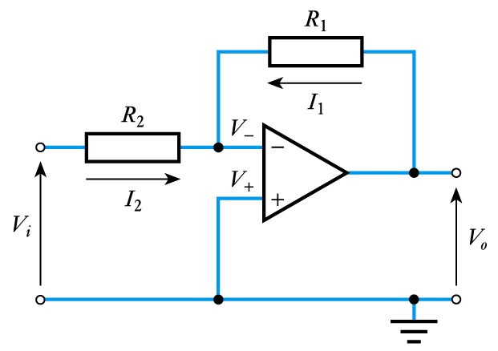


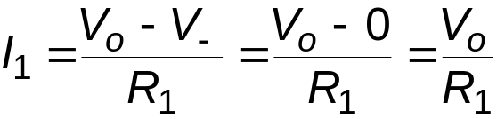
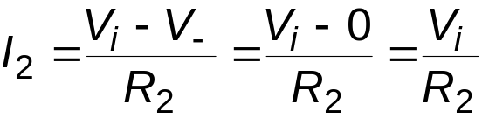
Basic operational amplifier circuits (contd.)
An inverting amplifier
Analysis
Since the gain is assumed infinite, if V_{o} is
finite the input voltage must be zero. Hence
Since the input resistance of the op-amp is ∞
its input current must be zero, and hence
Now

Slide 11
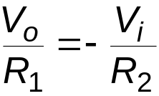
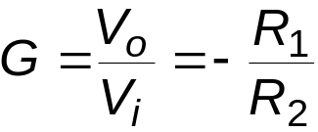
Basic operational amplifier circuits (contd.)
Analysis (continued)
Therefore, since I₁ = -I₂
or, rearranging
Here V– is held at zero volts by the operation of the circuit, hence the circuit is known as a virtual earth circuit

Slide 12
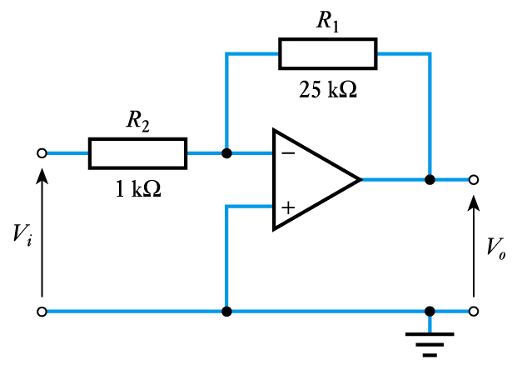
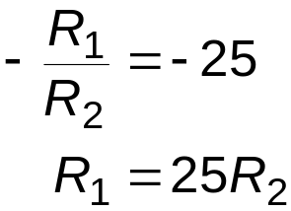
Basic operational amplifier circuits (contd.)
Example
Design an inverting amplifier with a gain of –25
From above
If G = –25 then
Therefore choose R₂ = 1 kΩ and R₁ = 25 kΩ
(we will consider the choice of values later)

Slide 13
Other useful circuits
In addition to simple amplifiers, op-amps can also be used in a range of other circuit
The next few slides show a few examples of op-amp circuits for a range of purposes
The analysis of these circuits is similar to that of the non-inverting and inverting amplifiers but (in most cases) this is not included here
For more details of these circuits see the relevant section of the course text (as shown on the slides)

Slide 14
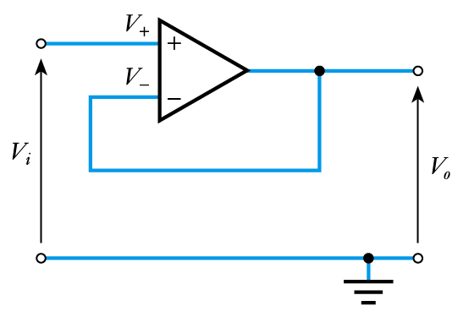
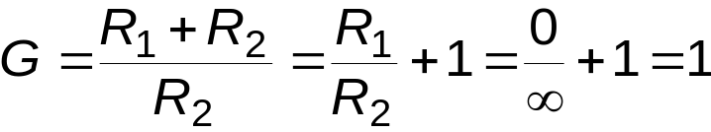
Other useful circuits (contd.)
A unity gain buffer amplifier
Analysis
This is a special case of the non-inverting
amplifier with R₁ = 0 and R₂ = ∞
Hence
Thus the circuit has a gain of unity
At first sight this might not seem like a very useful circuit, however, it has a high input resistance and a low output resistance and is therefore useful as a buffer amplifier

Slide 15
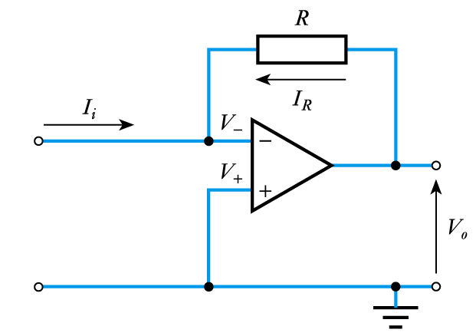

Other useful circuits (contd.)
A current to voltage converter

Slide 16
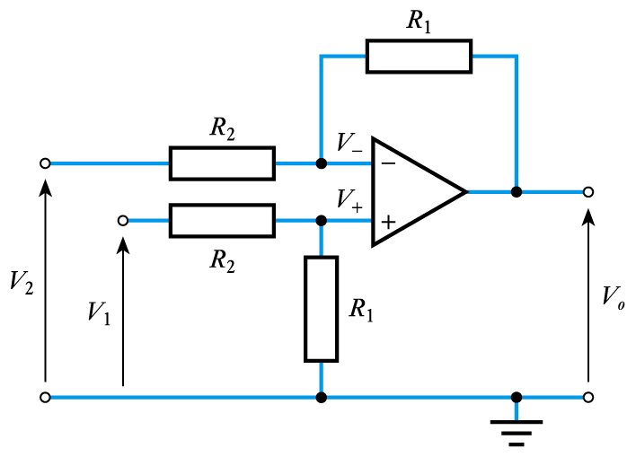
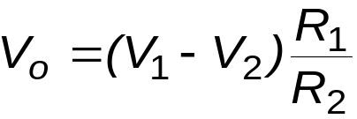
Other useful circuits (contd.)
A differential amplifier (or subtractor)

Slide 17
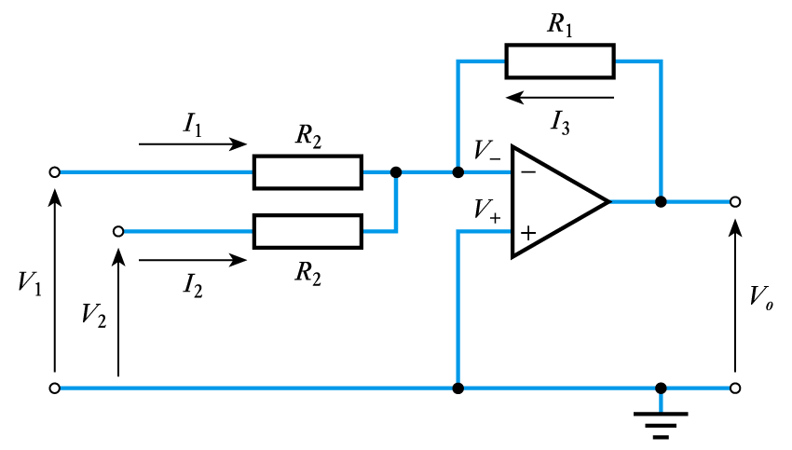
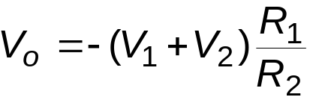
Other useful circuits (contd.)
An inverting summing amplifier

Slide 18
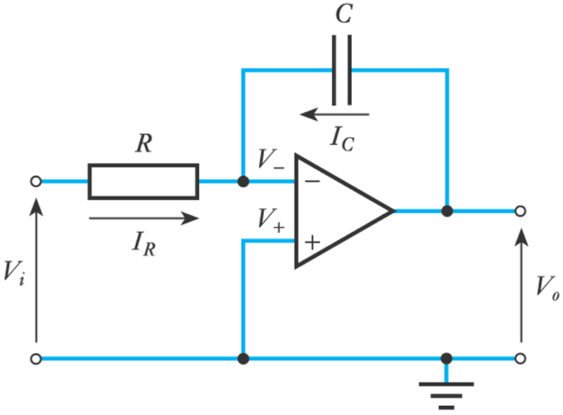
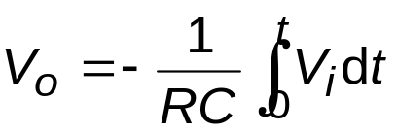
Other useful circuits (contd.)
An integrator

Slide 19
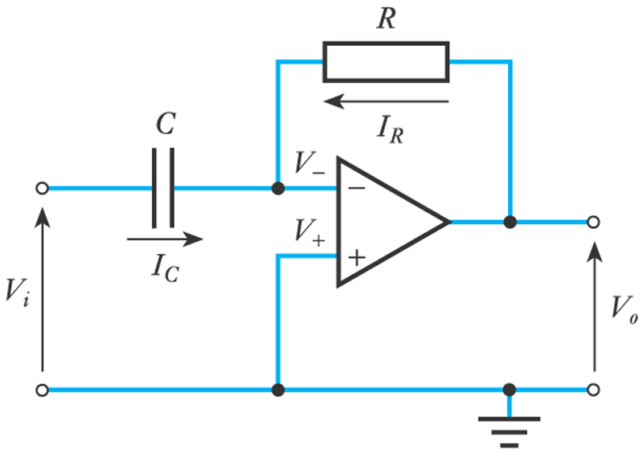
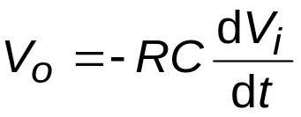
Other useful circuits (contd.)
A differentiator

Slide 20
Real operational amplifiers
So far we have assumed the use of ideal op-amps
  these have A_{v} = ∞, R_{i} = ∞ and R_{o} = 0
Real components do not have these ideal characteristics (though in many cases they approximate to them)
In this section we will look at the characteristics of typical devices
  perhaps the most widely used general purpose op-amp is the 741

Slide 21
Real operational amplifiers (contd.)
Voltage gain
  typical gain of an operational amplifier might be
  100 – 140 dB (voltage gain of 10⁵ – 10⁶)
  741 has a typical gain of 106 dB (2 × 10⁵)
  high gain devices might have a gain of 160 dB (10⁸)
  while not infinite, the gain of most op-amps is
  ‘high-enough’
  however, gain varies between devices and with temperature

Slide 22
Real operational amplifiers (contd.)
Input resistance
  typical input resistance of a 741 is 2 MΩ
  very variable, for a 741 it can be as low as 300 kΩ
  the above value is typical for devices based on
  bipolar transistors
  op-amps based on field-effect transistors generally have a much higher input resistance – perhaps 10¹² Ω
  we will discuss bipolar and field-effect transistors later

Slide 23
Real operational amplifiers (contd.)
Output resistance
  typical output resistance of a 741 is 75 Ω
  again very variable
  often of more importance, is the maximum output current
  the 741 will supply 20 mA
  high-power devices may supply an amp or more

Slide 24
Real operational amplifiers (contd.)
Supply voltage range
  a typical arrangement would use supply voltages of +15 V and – 15 V, but a wide range of supply voltages is usually possible
  the 741 can use voltages in the range ±5 to ±18 V
  some devices allow voltages up to ±30 V or more
  others, designed for low voltages, may use ±1.5 V
  many op-amps permit single voltage supply operation, typically in the range 4 to 30 V

Slide 25
Real operational amplifiers (contd.)
Common-mode rejection ratio
  an ideal op-amp would not respond to common-mode signals.
  real amplifiers do respond to some extent
  the common-mode rejection ratio (CMRR) is the ratio of the response produced by a differential-mode signal to that produced by a common-mode signal
  typical values for CMRR might be in the range 80 to 120 dB
    741 has a CMRR of about 90 dB

Slide 26
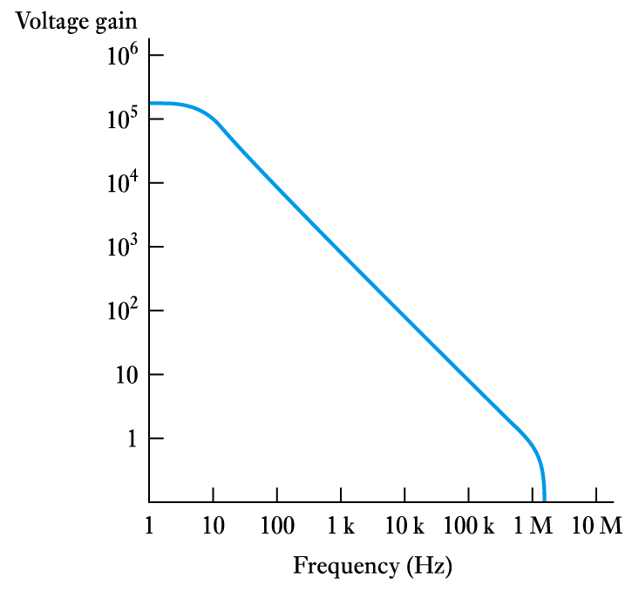
Real operational amplifiers (contd.)
Frequency response
  typical 741 frequency response is shown here
  upper cut-off frequency is a few hertz
  frequency range generally described by the
  unity-gain bandwidth
  high-speed devices may operate up to several gigahertz

Slide 27
Selecting component values
Our analysis assumed the use of an ideal op-amp
When using real components we need to ensure that our assumptions are valid
In general this will be true if we:
  limit the gain of our circuit to much less than the
  open-loop gain of our op-amp
  choose external resistors that are small compared with the input resistance of the op-amp
  choose external resistors that are large compared with the output resistance of the op-amp.
Generally we use resistors in the range 1 to 100 kΩ

Slide 28
Effects of feedback on op-amp circuits
Effects of feedback on the Gain
  negative feedback reduces gain from A to A/(1 + AB)
  in return for this loss of gain we get consistency, provided that the open-loop gain is much greater than the closed-loop gain (that is, A >> 1/B)
  using negative feedback, standard cookbook circuits can be used – greatly simplifying the design
  these can be analysed without a detailed knowledge of the op-amp itself

Slide 29
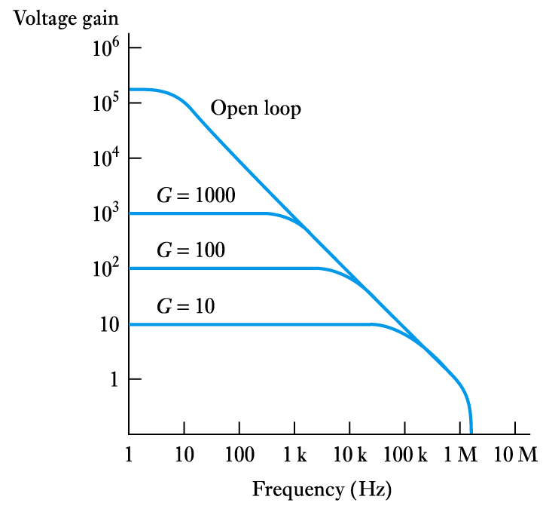
Effects of feedback on op-amp circuits (contd.)
Effects of feedback on frequency response
  as the gain is reduced the
  bandwidth is increased
  gain × bandwidth ≈ constant
    since gain is reduced by (1 + AB)
    bandwidth is increased by (1 + AB)
  for a 741,
  gain × bandwidth ≈ 10⁶
    if gain = 1000 BW ≈ 1000 Hz
    if gain = 100 BW ≈ 10,000 Hz

Slide 30
Effects of feedback on op-amp circuits (contd.)
Effects of feedback on input and output resistance
  input/output resistance can be increased or decreased depending on how feedback is used.
    we looked at this in an earlier lecture
    in each case the resistance is changed by a factor of (1 + AB)
  Example
  if an op-amp with a gain of 2 × 10⁵ is used to produce an amplifier with a gain of 100 then:
  A = 2 × 10⁵
  B = 1/G = 0.01
  (1 + AB) = (1 + 2000) ≈ 2000

Slide 31
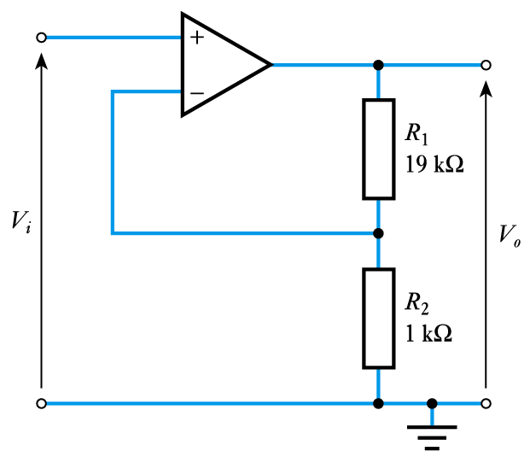
Effects of feedback on op-amp circuits (contd.)
Example
  determine the input and output resistance of the following circuit assuming op-amp is a 741
Open-loop gain (A) of a 741 is 2 × 10⁵
Closed-loop gain (1/B) is 20, B = 1/20 = 0.05
(1 + AB) = (1 + 2 × 10⁵ × 0.05) = 10⁴
Feedback senses output voltage therefore it reduces output resistance of op-amp (75 Ω) by 10⁴ to give 7.5 mΩ
Feedback subtracts a voltage from the input, therefore it increases the input resistance of the op-amp (2 MΩ) by 10⁴ to give 20 GΩ

Slide 32
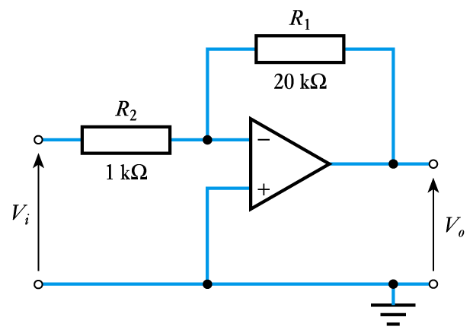
Effects of feedback on op-amp circuits (contd.)
Example
  determine the input and output resistance of the following circuit assuming op-amp is a 741
Open-loop gain (A) of a 741 is 2 × 10⁵
Closed-loop gain (1/B) is 20, B = 1/20 = 0.05
(1 + AB) = (1 + 2 × 10⁵ × 0.05) = 10⁴
Feedback senses output voltage therefore, it reduces output resistance of op-amp (75 Ω) by 10⁴ to give 7.5 mΩ
Feedback subtracts a current from the input, therefore it decreases the input resistance. In this case the input sees R₂ to a virtual earth, therefore the input resistance is 1 kΩ

Slide 33
Key points
Operational amplifiers are among the most widely used building blocks in electronic circuits
An ideal operational amplifier would have infinite voltage gain, infinite input resistance and zero output resistance
Designers often make use of cookbook circuits
Real op-amps have several non-ideal characteristics However, if we choose components appropriately this
should not affect the operation of our circuits
Feedback allows us to increase bandwidth by trading gain against bandwidth
Feedback also allows us to alter other circuit characteristics

Slide 34
Op-Amp Applications
Constant-gain multiplier
Voltage summing
Voltage buffer
Controlled sources
Instrumentation circuits
Active filters

Slide 35
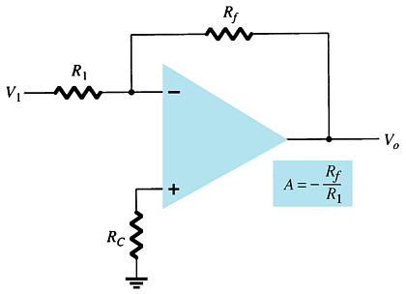
Constant-Gain Amplifier
Inverting Version
more…

Slide 36
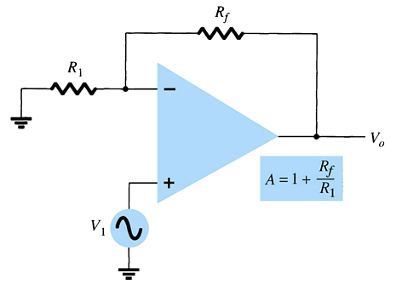
Constant-Gain Amplifier
Noninverting Version

Slide 37
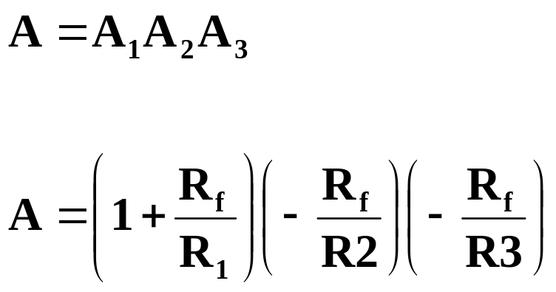
Multiple-Stage Gains
The total gain (3-stages) is given by:
or

Slide 38
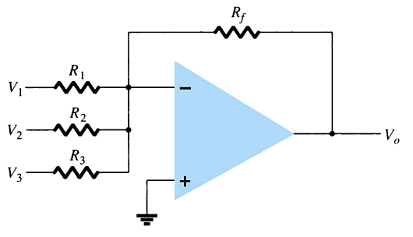
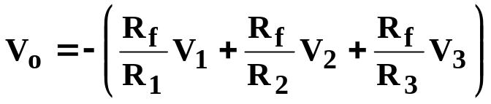
    Voltage Summing
The output is the sum of individual signals times the gain:
[Formula 14.3]

Slide 39
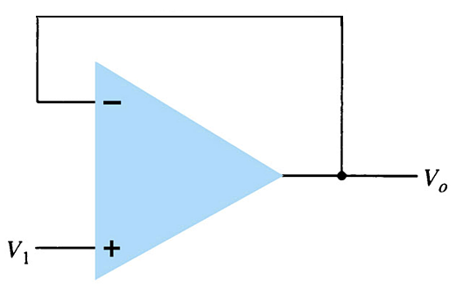
Voltage Buffer
Any amplifier with no gain or loss is called a unity gain amplifier.
The advantages of using a unity gain amplifier:
  Very high input impedance
  Very low output impedance
Realistically these circuits are designed using equal resistors (R₁ = R_{f}) to avoid problems with offset voltages.

Slide 40
Controlled Sources
  Voltage-controlled voltage source
  Voltage-controlled current source
  Current-controlled voltage source
  Current-controlled current source

Slide 41
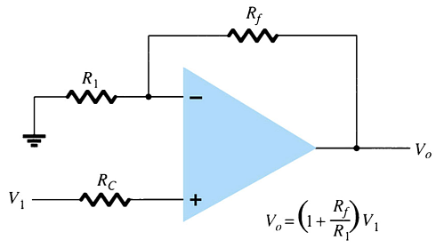
Voltage-Controlled Voltage Source
The output voltage is the gain times the input voltage. What makes an op-amp different from other amplifiers is its impedance characteristics and gain calculations that depend solely on external resistors.
Noninverting Amplifier Version
more…

Slide 42
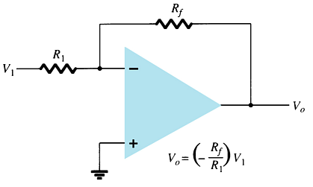
Voltage-Controlled Voltage Source
The output voltage is the gain times the input voltage. What makes an op-amp different from other amplifiers is its impedance characteristics and gain calculations that depend solely on external resistors.
Inverting Amplifier Version

Slide 43
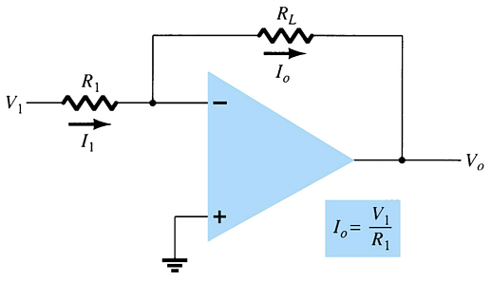
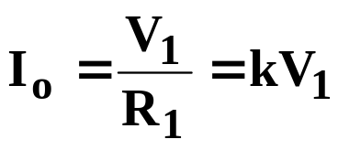
Voltage-Controlled Current Source
The output current is:

Slide 44
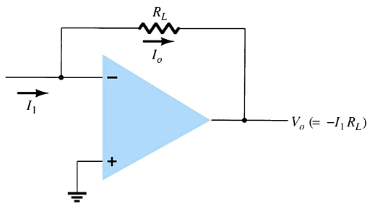
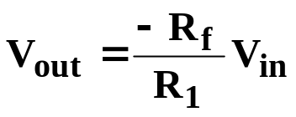

Current-Controlled Voltage Source
This is simply another way of applying the op-amp operation. Whether the input is a current determined by V_{in}/R₁ or as I₁:
or

Slide 45
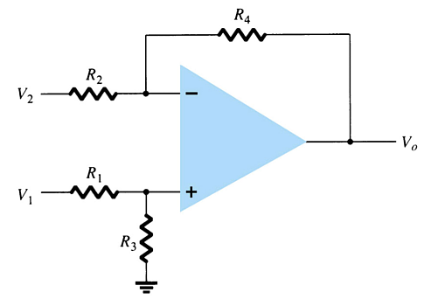
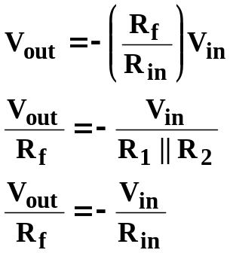
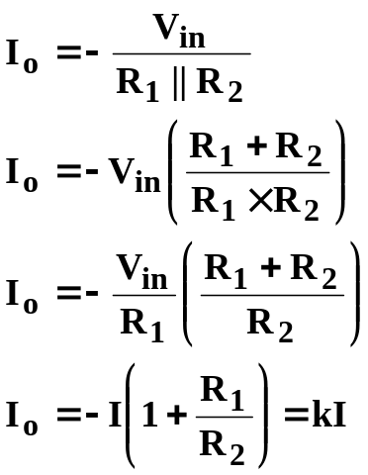
Current-Controlled Current Source
This circuit may appear more complicated than
the others but it is really the same thing.

Slide 46
Instrumentation Circuits
Some examples of instrumentation circuits using op-amps:
  Display driver
  Instrumentation amplifier

Slide 47
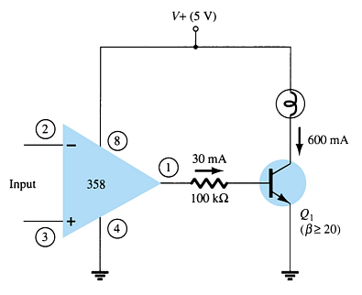
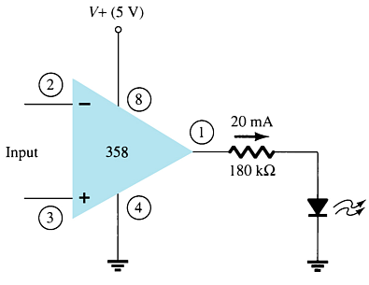
Display Driver

Slide 48
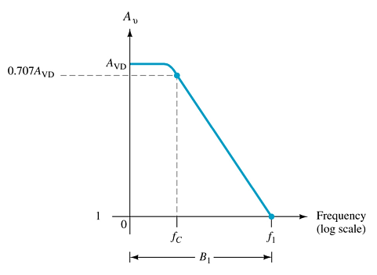

Instrumentation Amplifier
For all Rs at the same value (except R_{p}):

Slide 49
Active Filters
Adding capacitors to op-amp circuits provides external control of the cutoff frequencies. The op-amp active filter provides controllable cutoff frequencies and controllable gain.
  Low-pass filter
  High-pass filter
  Bandpass filter

Slide 50



Low-Pass Filter—First-Order
The upper cutoff frequency and voltage gain are given by:

Slide 51

Low-Pass Filter—Second-Order
The roll-off can be made steeper by adding more RC networks.

Slide 52



High-Pass Filter
The cutoff frequency is determined by:

Slide 53


Bandpass Filter
There are two cutoff frequencies: upper and lower. They can be calculated using the same low-pass cutoff and high-pass cutoff frequency formulas in the appropriate sections.

