Slide 1
Electronic Circuits
hj. Gökhan Bilgin
gokhanb@ce.yildiz.edu.tr
Notes:
Copyright 2000 N. AYDIN. All rights reserved.

Slide 2

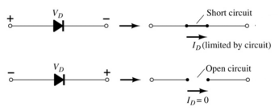
Diodes
The diode is a 2-terminal device.
A diode ideally conducts in only one direction.

Slide 3
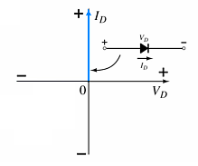
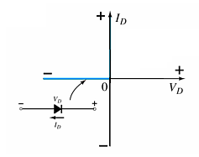
Diode Characteristics
Conduction Region
Non-Conduction Region
The voltage across the diode is 0 V
The current is infinite
The forward resistance is defined as
R_{F} = V_{F} / I_{F}
The diode acts like a short
All of the voltage is across the diode
The current is 0 A
The reverse resistance is defined as R_{R} = V_{R} / I_{R}
The diode acts like open

Slide 4
Semiconductor Materials
Materials commonly used in the development of semiconductor devices:
Silicon (Si)
Germanium (Ge)
Gallium Arsenide (GaAs)

Slide 5
Doping
The electrical characteristics of silicon and germanium are improved by adding materials in a process called doping.
There are just two types of doped semiconductor materials:
n-type
p-type
n-type materials contain an excess of conduction band electrons.
p-type materials contain an excess of valence band holes.

Slide 6
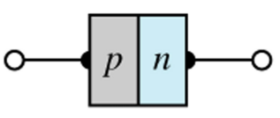
p-n Junctions
One end of a silicon or germanium crystal can be doped as a p-type material and the other end as an n-type material.
The result is a p-n junction.

Slide 7
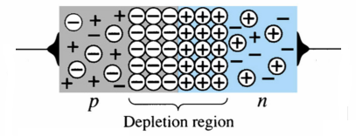
p-n Junctions
At the p-n junction, the excess conduction-band electrons on the n-type side are attracted to the valence-band holes on the p-type side.
The electrons in the n-type material migrate across the junction to the p-type material (electron flow).
The electron migration results in a negative charge on the p-type side of the junction and a positive charge on the n-type side of the junction.
The result is the formation of a depletion region around the junction.

Slide 8
Doping of semiconductors
Doping
  the addition of small amounts of impurities drastically affects its properties
  some materials form an excess of electrons and produce an n-type semiconductor
  some materials form an excess of holes and produce a p-type semiconductor
  both n-type and p-type materials have much greater conductivity than pure semiconductors
  this is extrinsic conduction.

Slide 9
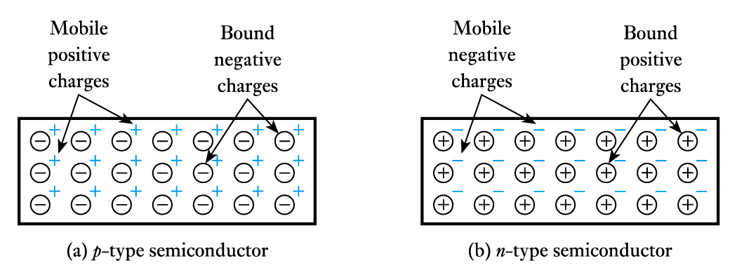
Doping of semiconductors (contd.)
The dominant charge carriers in a doped semiconductor (e.g. electrons in n-type material) are called majority charge carriers. The other type are minority charge carriers.
The overall doped material is electrically neutral.

Slide 10
pn Junctions
When p-type and n-type materials are joined, this forms a pn junction
  the majority charge carriers on each side diffuse across the junction where they combine with (and remove) the charge carriers of the opposite polarity.
  hence, around the junction there are few free charge carriers and we have a depletion layer (also called a space-charge layer).

Slide 11
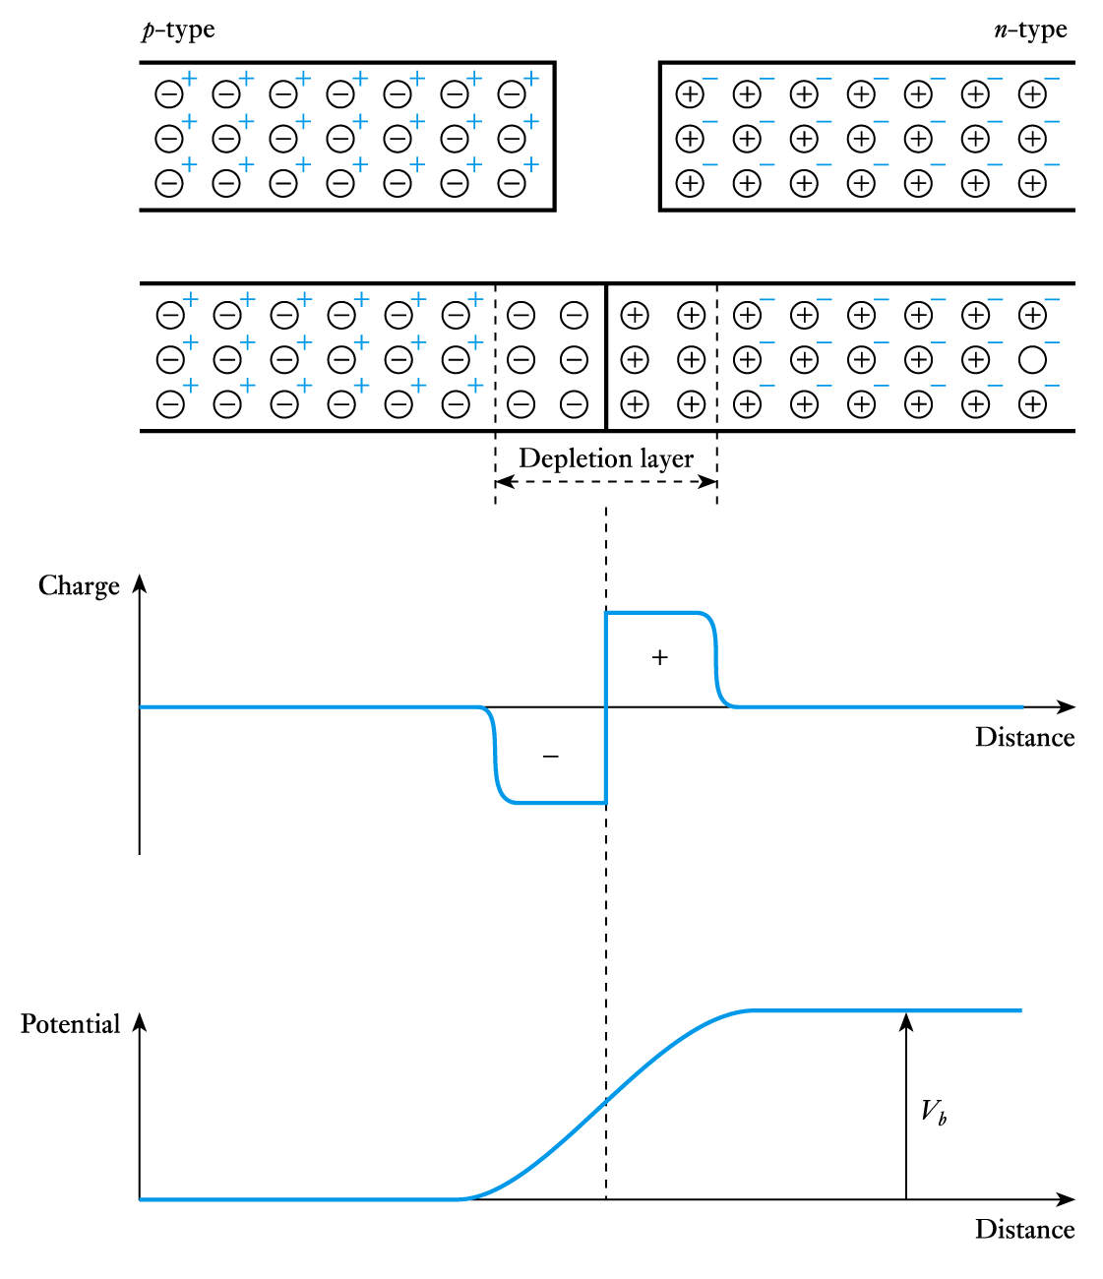
pn Junctions (contd.)
The diffusion of positive charge in one direction and negative charge in the other produces a charge imbalance
  this results in a potential barrier across the junction.

Slide 12
pn Junctions (contd.)
Potential barrier
  the barrier opposes the flow of majority charge carriers and only a small number have enough energy to surmount it.
    This generates a small diffusion current.
  the barrier encourages the flow of minority carriers and any that come close to it will be swept over
    This generates a small drift current.
  for an isolated junction these two currents must balance each other and the net current is zero.

Slide 13
pn Junctions (contd.)
Forward bias
  if the p-type side is made positive with respect to the
  n-type side the height of the barrier is reduced
  more majority charge carriers have sufficient energy to surmount it
  the diffusion current therefore increases while the drift current remains the same
  there is thus a net current flow across the junction which increases with the applied voltage.

Slide 14
pn Junctions (contd.)
Reverse bias
  if the p-type side is made negative with respect to the
  n-type side the height of the barrier is increased
  the number of majority charge carriers that have sufficient energy to surmount it rapidly decreases
  the diffusion current therefore vanishes while the drift current remains the same
  thus the only current is a small leakage current caused by the (approximately constant) drift current
  the leakage current is usually negligible (a few nA).

Slide 15
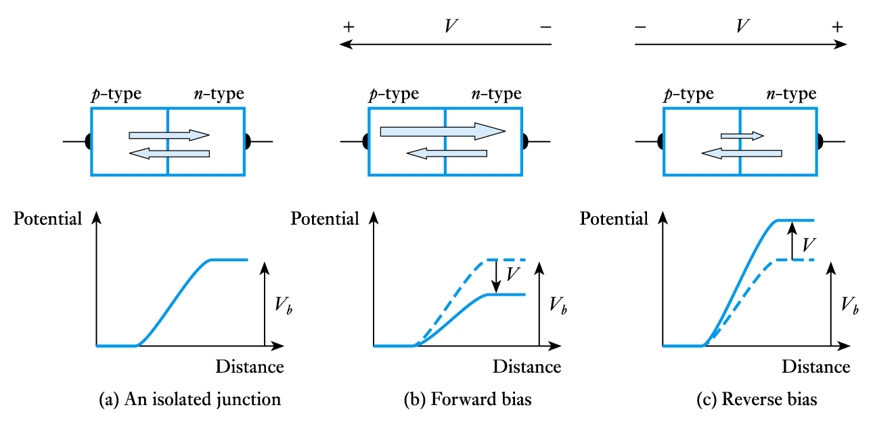
pn Junctions (contd.)
Currents in a pn junction

Slide 16
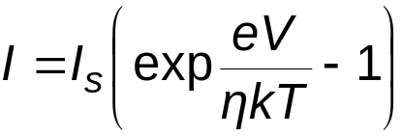
pn Junctions (contd.)
Forward and reverse currents
  pn junction current is given approximately by
  where I is the current, e is the electronic charge, V is the applied voltage, k is Boltzmann’s constant, T is the absolute temperature and η (Greek letter eta) is a constant in the range 1 to 2 determined by the junction material
  for most purposes we can assume η =1.

Slide 17
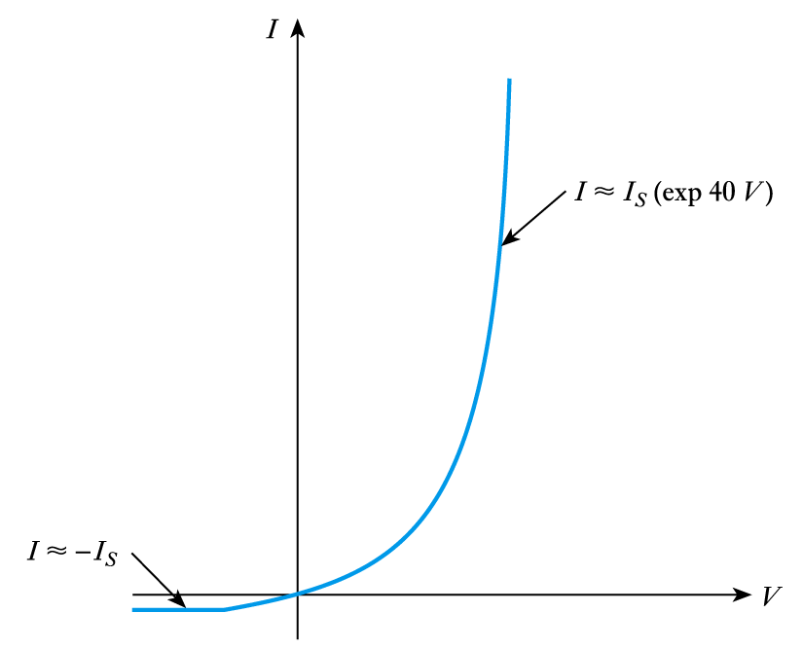
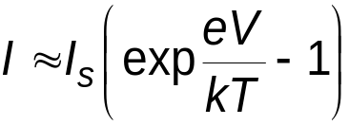
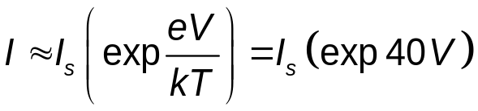

pn Junctions (contd.)
Thus,
  at room temperature e/kT ~ 40 V⁻¹
If V > + 0.1 V,
If V < – 0.1 V,
  I_{S} is the reverse saturation current.

Slide 18
Diode Operating Conditions
A diode has three operating conditions:
No bias
Forward bias
Reverse bias

Slide 19
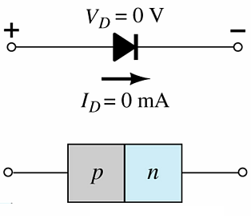
Diode Operating Conditions
No Bias
No external voltage is applied: V_{D} = 0 V
No current is flowing: I_{D} = 0 A
Only a modest depletion region exists

Slide 20
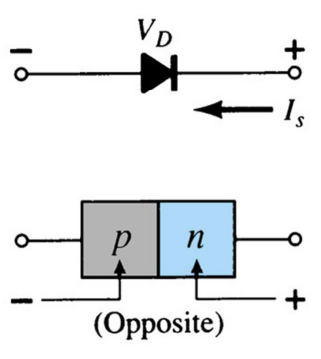
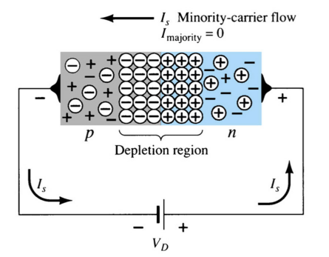
Diode Operating Conditions
Reverse Bias
External voltage is applied across the p-n junction in the opposite polarity of the p- and n-type materials.
The reverse voltage causes the depletion region to widen.
The electrons in the n-type material are attracted toward the positive terminal of the voltage source.
The holes in the p-type material are attracted toward the negative terminal of the voltage source.

Slide 21
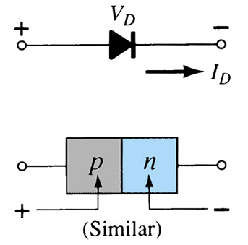
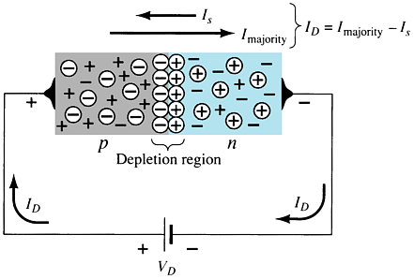
Diode Operating Conditions
Forward Bias
External voltage is applied across the p-n junction in the same polarity as the p- and n-type materials.
The forward voltage causes the depletion region to narrow.
The electrons and holes are pushed toward the p-n junction.
The electrons and holes have sufficient energy to cross the p-n junction.

Slide 22
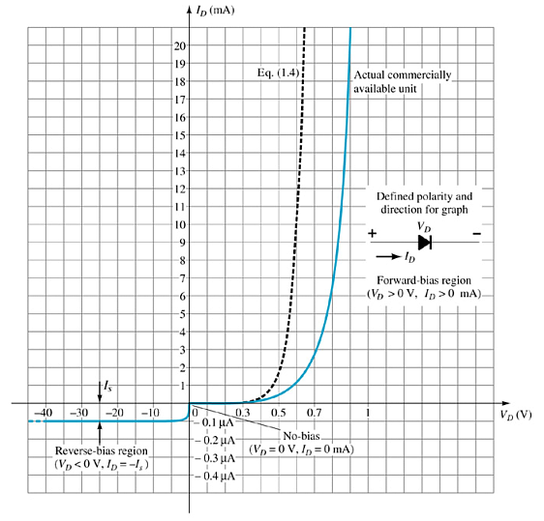
Actual Diode Characteristics
Note the regions for no bias, reverse bias, and forward bias conditions.
Carefully note the scale for each of these conditions.

Slide 23
Majority and Minority Carriers
Two currents through a diode:
Majority Carriers
The majority carriers in n-type materials are electrons.
The majority carriers in p-type materials are holes.
Minority Carriers
The minority carriers in n-type materials are holes.
The minority carriers in p-type materials are electrons.

Slide 24
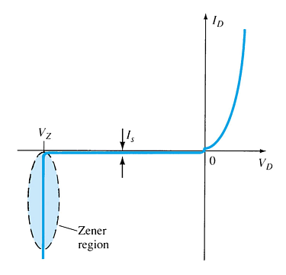
Zener Region
The Zener region is in the diode’s reverse-bias region.
At some point the reverse bias voltage is so large the diode breaks down and the reverse current increases dramatically.
The maximum reverse voltage that won’t take a diode into the zener region is called the peak inverse voltage or peak reverse voltage.
The voltage that causes a diode to enter the zener region of operation is called the zener voltage (V_{Z}).

Slide 25
Forward Bias Voltage
The point at which the diode changes from no-bias condition to forward-bias condition occurs when the electrons and holes are given sufficient energy to cross the p-n junction. This energy comes from the external voltage applied across the diode.
The forward bias voltage required for a:
  gallium arsenide diode ≅ 1.2 V
  silicon diode ≅ 0.7 V
  germanium diode ≅ 0.3 V

Slide 26
Temperature Effects
As temperature increases it adds energy to the diode.
It reduces the required forward bias voltage for forward-bias conduction.
It increases the amount of reverse current in the reverse-bias condition.
It increases maximum reverse bias avalanche voltage.
Germanium diodes are more sensitive to temperature variations than silicon or gallium arsenide diodes.

Slide 27
Resistance Levels
Semiconductors react differently to DC and AC currents.
There are three types of resistance:
• DC (static) resistance
• AC (dynamic) resistance
• Average AC resistance

Slide 28
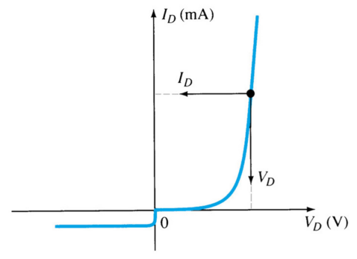
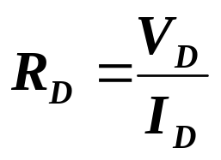
DC (Static) Resistance
For a specific applied DC voltage V_{D}, the diode has a specific current I_{D}, and a specific resistance R_{D}.

Slide 29
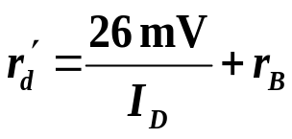

AC (Dynamic) Resistance
In the forward bias region:
The resistance depends on the amount of current (I_{D}) in the diode.
The voltage across the diode is fairly constant (26 mV for 25°C).
r_{B} ranges from a typical 0.1 Ω for high power devices to 2 Ω for low power, general purpose diodes. In some cases r_{B} can be ignored.
In the reverse bias region:
The resistance is effectively infinite. The diode acts like an open.

Slide 30
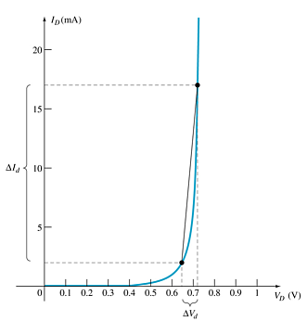
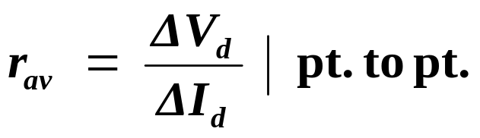
Average AC Resistance
AC resistance can be calculated using the current and voltage values for two points on the diode characteristic curve.

Slide 31
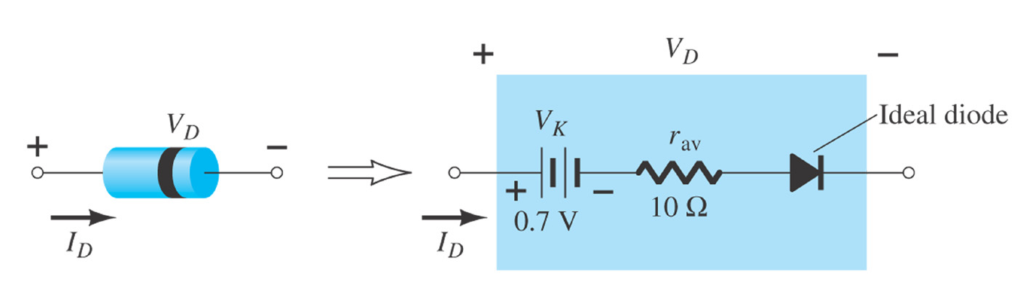
Diode Equivalent Circuit

Slide 32
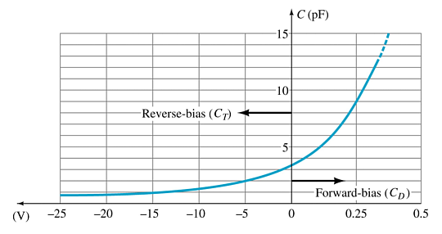
Diode Capacitance
In reverse bias, the depletion layer is very large. The diode’s strong positive and negative polarities create capacitance, C_{T}. The amount of capacitance depends on the reverse voltage applied.
In forward bias storage capacitance or diffusion capacitance (C_{D}) exists as the diode voltage increases.

Slide 33
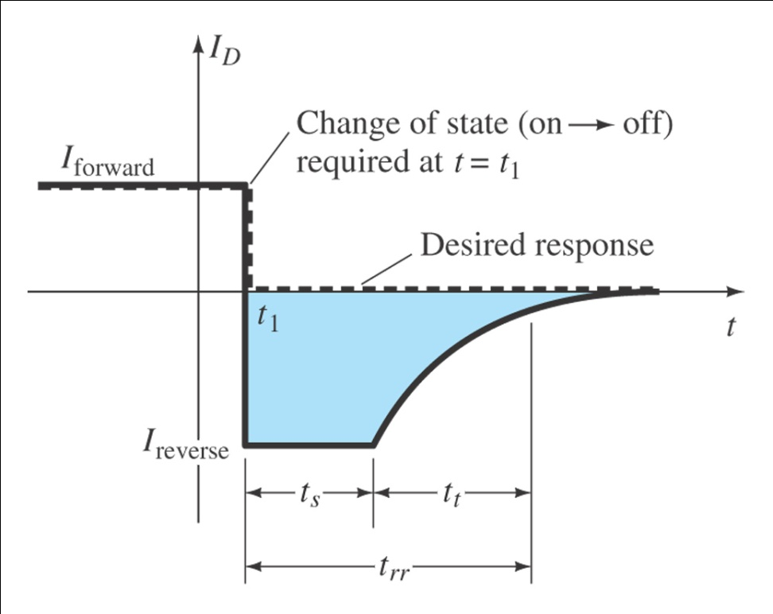
Reverse Recovery Time (t_{rr})
Reverse recovery time is the time required for a diode to stop conducting once it is switched from forward bias to reverse bias.

Slide 34
Diode Specification Sheets
Data about a diode is presented uniformly for many different diodes. This makes cross-matching of diodes for replacement or design easier.
Forward Voltage (V_{F}) at a specified current and temperature
Maximum forward current (I_{F}) at a specified temperature
Reverse saturation current (I_{R}) at a specified voltage and temperature
Reverse voltage rating, PIV or PRV or V(BR), at a specified temperature
Maximum power dissipation at a specified temperature
Capacitance levels
Reverse recovery time, t_{rr}
Operating temperature range

Slide 35
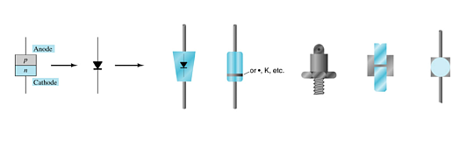
Diode Symbol and Packaging
The anode is abbreviated A
The cathode is abbreviated K

Slide 36
Diode Testing
Diode checker
Ohmmeter
Curve tracer

Slide 37
Diode Checker
Many digital multimeters have a diode checking function.
The diode should be tested out of circuit.
A normal diode exhibits its forward voltage:
Gallium arsenide ≅ 1.2 V
Silicon diode ≅ 0.7 V
Germanium diode ≅ 0.3 V

Slide 38
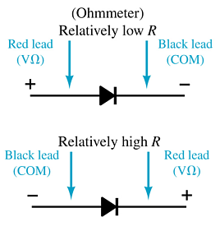
Ohmmeter
An ohmmeter set on a low Ohms scale can be used to test a diode. The diode should be tested out of circuit.

Slide 39
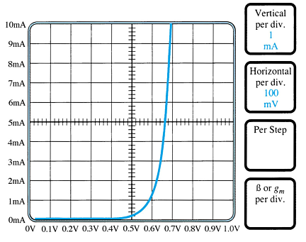
Curve Tracer
A curve tracer displays the characteristic curve of a diode in the test circuit. This curve can be compared to the specifications of the diode from a data sheet.

Slide 40
Other Types of Diodes
Zener diode
Light-emitting diode
Diode arrays

Slide 41

Zener Diode
A Zener is a diode operated in reverse bias at the Zener voltage (V_{Z}).
Common Zener voltages are between 1.8 V and 200 V

Slide 42

Light-Emitting Diode (LED)
An LED emits photons when it is forward biased.
These can be in the infrared or visible spectrum.
The forward bias voltage is usually in the range of 2 V to 3 V.

Slide 43
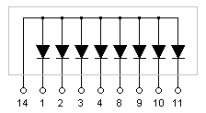

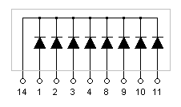
Diode Arrays
Multiple diodes can be packaged together in an integrated circuit (IC).
Common Anode
A variety of combinations exist.
Common Cathode

