Slide 1
Electronic Circuits
Yrd. Doç. Dr. Gökhan Bilgin
gokhanb@ce.yildiz.edu.tr
Notes:
Copyright 2000 N. AYDIN. All rights reserved.

Slide 2
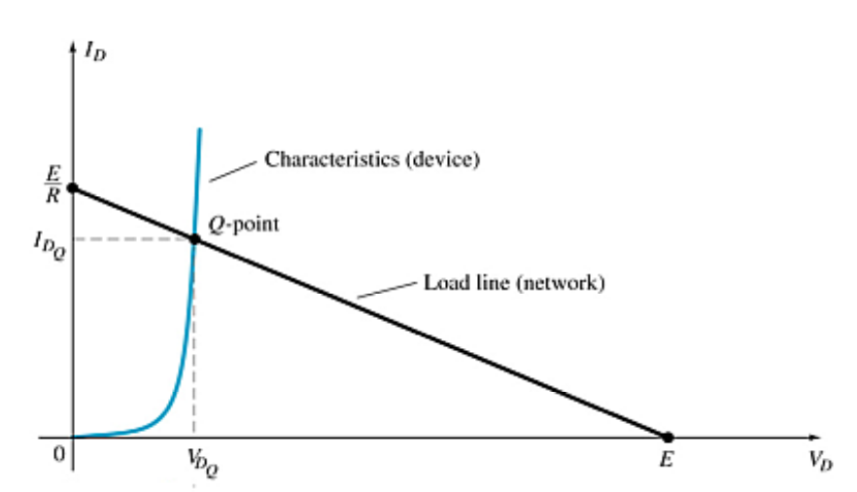
Load-Line Analysis
The load line plots all possible combinations of diode current (I_{D}) and voltage (V_{D}) for a given circuit. The maximum I_{D} equals E/R, and the maximum V_{D} equals E.
The point where the load line and the characteristic curve intersect is the Q-point, which identifies I_{D} and V_{D} for a particular diode in a given circuit.

Slide 3
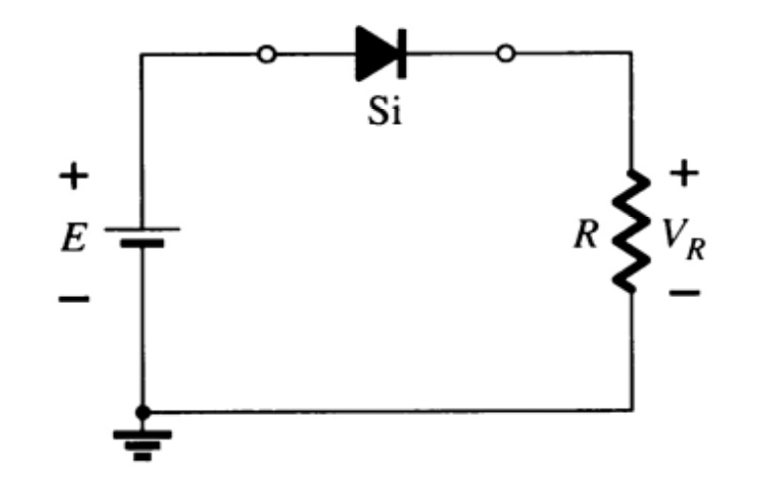
Series Diode Configurations
Forward Bias
Constants
Silicon Diode: V_{D} = 0.7 V
Germanium Diode: V_{D} = 0.3 V
Analysis (for silicon)
V_{D} = 0.7 V (or V_{D} = E if E < 0.7 V)
V_{R} = E – V_{D}
I_{D} = I_{R} = I_{T} = V_{R} / R

Slide 4
Series Diode Configurations
Reverse Bias
Diodes ideally behave as open circuits
Analysis
V_{D} = E
V_{R} = 0 V
I_{D} = 0 A

Slide 5
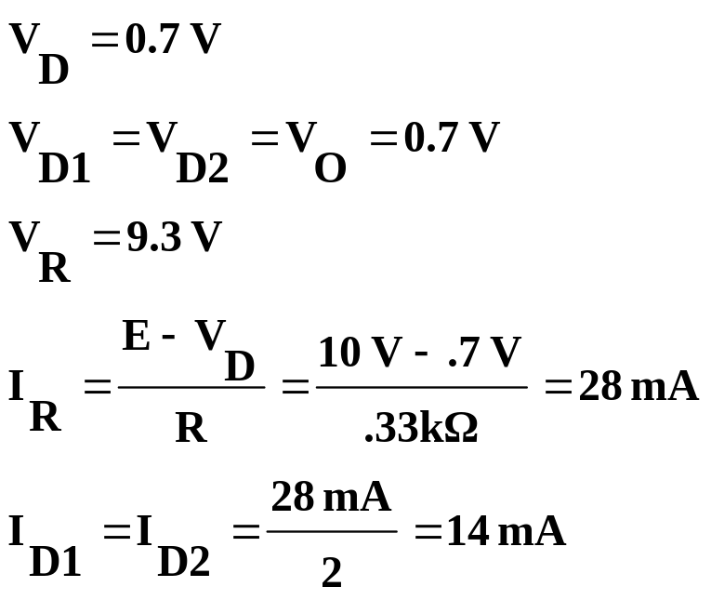
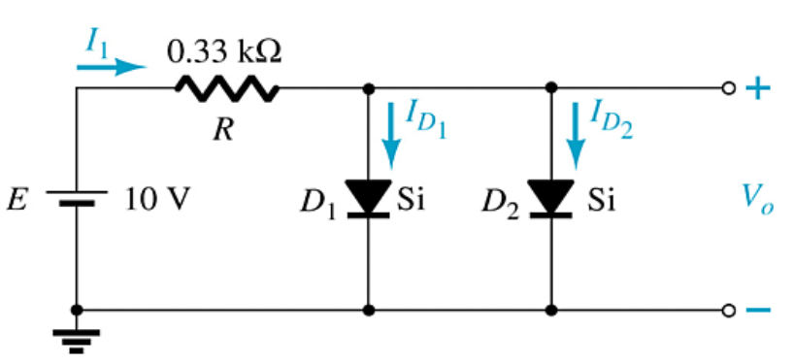
Parallel Configurations

Slide 6
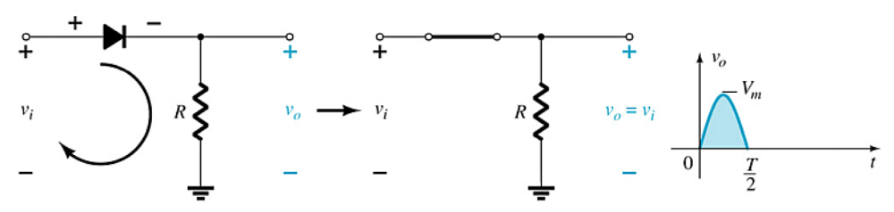
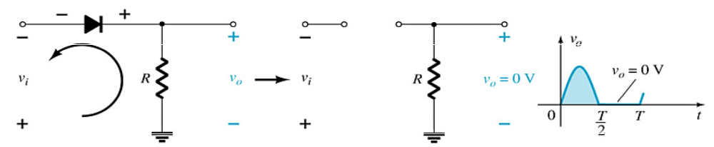
Half-Wave Rectification
The diode only conducts when it is forward biased, therefore only half of the AC cycle passes through the diode to the output.
The DC output voltage is 0.318V_{m}, where V_{m} = the peak AC voltage.

Slide 7
PIV (PRV)
Because the diode is only forward biased for one-half of the AC cycle, it is also reverse biased for one-half cycle.
It is important that the reverse breakdown voltage rating of the diode be high enough to withstand the peak, reverse-biasing AC voltage.
      PIV (or PRV) > V_{m}
PIV = Peak inverse voltage
PRV = Peak reverse voltage
V_{m} = Peak AC voltage

Slide 8


Full-Wave Rectification
The rectification process can be improved by using a full-wave rectifier circuit.
Full-wave rectification produces a greater DC output:
  Half-wave: V_{dc} = 0.318V_{m}
  Full-wave: V_{dc} = 0.636V_{m}

Slide 9
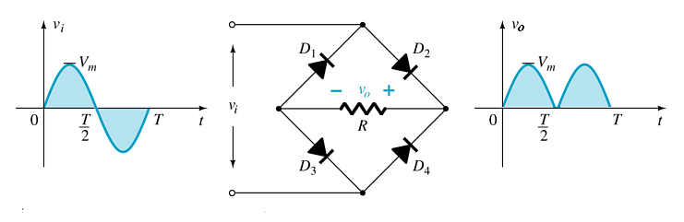
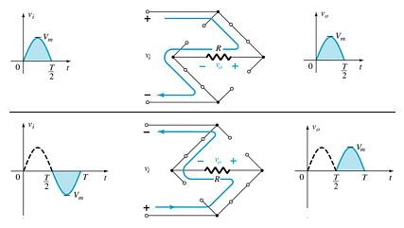
Full-Wave Rectification
Bridge Rectifier
Four diodes are connected in a bridge configuration
V_{DC} = 0.636V_{m}

Slide 10
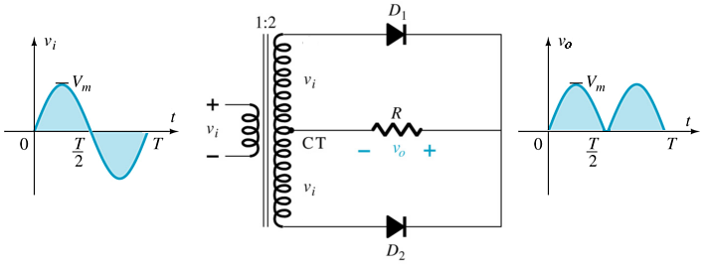
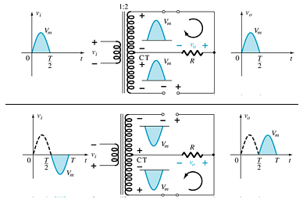
Full-Wave Rectification
Center-Tapped Transformer Rectifier
Requires
  Two diodes
  Center-tapped transformer
    V_{DC} = 0.636V_{m}

Slide 11
Summary of Rectifier Circuits
Rectifier | Ideal V_{DC} | Realistic V_{DC}
Half Wave Rectifier | V_{DC} = 0.318V_{m} | V_{DC} = 0.318V_{m} – 0.7
Bridge Rectifier | V_{DC} = 0.636V_{m} | V_{DC} = 0.636V_{m} – 2(0.7 V)
Center-Tapped Transformer Rectifier | V_{DC} = 0.636V_{m} | V_{DC} = 0.636V_{m} – 0.7 V
V_{m} = peak of the AC voltage.
In the center tapped transformer rectifier circuit, the peak AC voltage is the transformer secondary voltage to the tap.

Slide 12
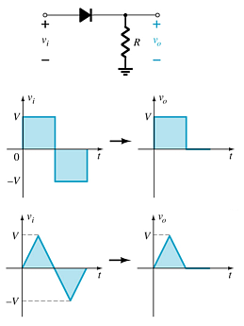
Diode Clippers
The diode in a series clipper “clips” any voltage that does not forward bias it:
A reverse-biasing polarity
A forward-biasing polarity less than 0.7 V (for a silicon diode)

Slide 13
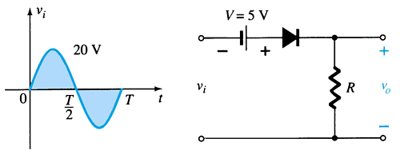
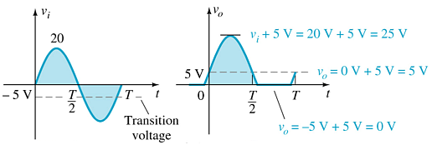
Biased Clippers
Adding a DC source in series with the clipping diode changes the effective forward bias of the diode.

Slide 14
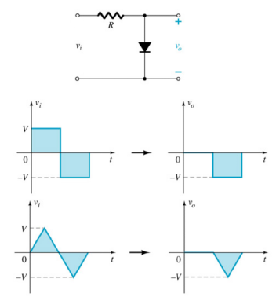
Parallel Clippers
The diode in a parallel clipper circuit “clips” any voltage that forward bias it.
DC biasing can be added in series with the diode to change the clipping level.

Slide 15
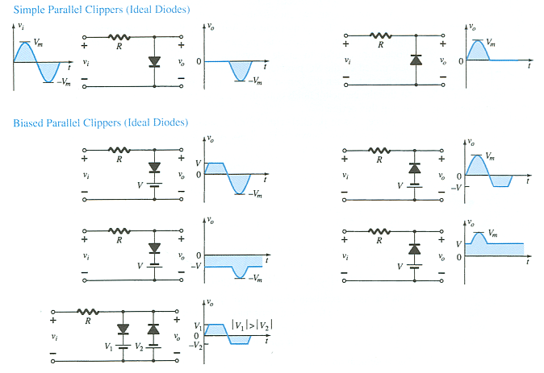
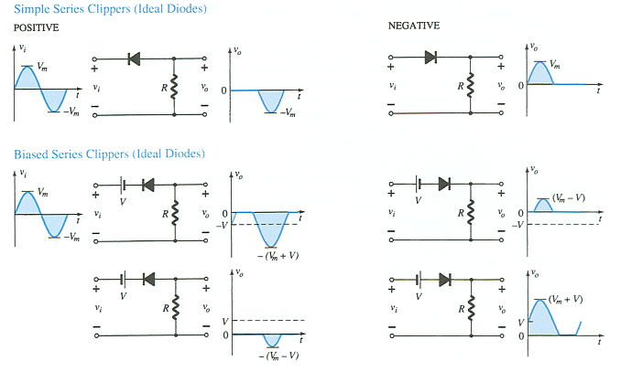
Summary of Clipper Circuits
more…

Slide 16
Summary of Clipper Circuits

Slide 17
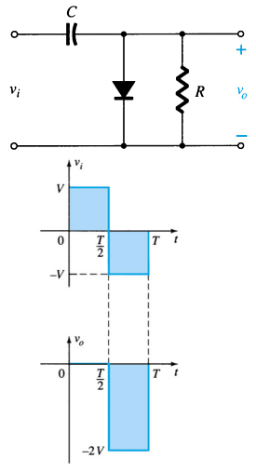
Clampers
A diode and capacitor can be combined to “clamp” an AC signal to a specific DC level.

Slide 18
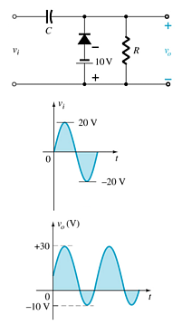
Biased Clamper Circuits
The input signal can be any type of waveform such as sine, square, and triangle waves.
The DC source lets you adjust the DC camping level.

Slide 19
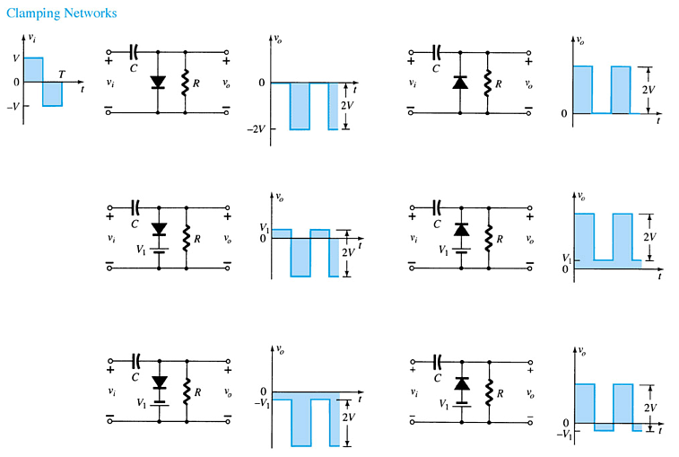
Summary of Clamper Circuits

Slide 20
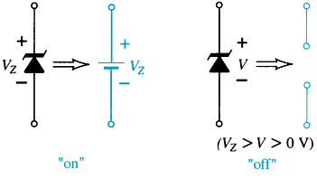
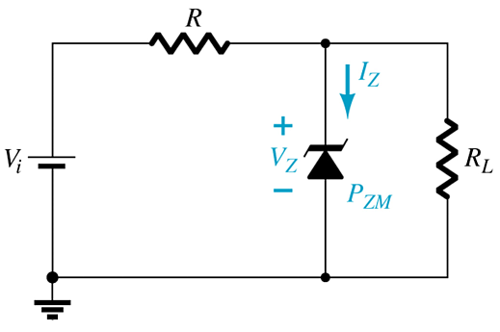
Zener Diodes
The Zener is a diode operated in reverse bias at the Zener Voltage (V_{z}).
When V_{i} ≥ V_{Z}
  The Zener is on
  Voltage across the Zener is V_{Z}
  Zener current: I_{Z} = I_{R} – I_{RL}
  The Zener Power: P_{Z} = V_{Z}I_{Z}
When V_{i} < V_{Z}
  The Zener is off
  The Zener acts as an open circuit

Slide 21

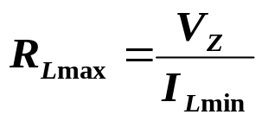
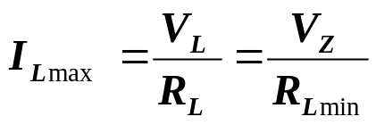
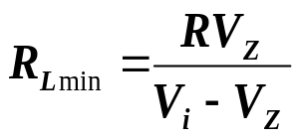
Zener Resistor Values
If R is too large, the Zener diode cannot conduct because the available amount of current is less than the minimum current rating, I_{ZK}. The minimum current is given by:
The maximum value of resistance is:
If R is too small, the Zener current exceeds the maximum current rating, I_{ZM} . The maximum current for the circuit is given by:
The minimum value of resistance is:

Slide 22
Voltage-Multiplier Circuits
Voltage multiplier circuits use a combination of diodes and capacitors to step up the output voltage of rectifier circuits.
Voltage Doubler
Voltage Tripler
Voltage Quadrupler

Slide 23
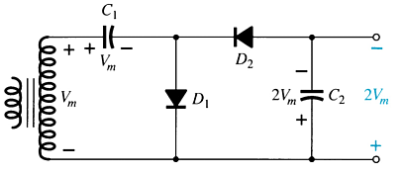
Voltage Doubler
This half-wave voltage doubler’s output can be calculated by:
    V_{out} = V_{C2} = 2V_{m}
  where V_{m} = peak secondary voltage of the transformer

Slide 24
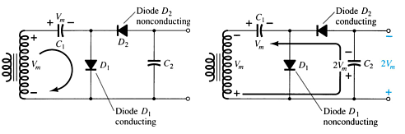
Voltage Doubler
Positive Half-Cycle
  D₁ conducts
  D₂ is switched off
  Capacitor C₁ charges to V_{m}
Negative Half-Cycle
  D₁ is switched off
  D₂ conducts
  Capacitor C₂ charges to V_{m}
V_{out} = V_{C2} = 2V_{m}

Slide 25
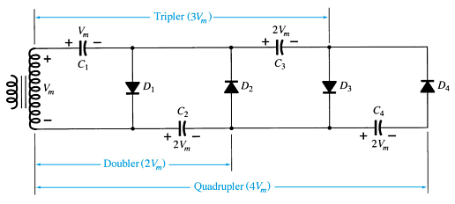
Voltage Tripler and Quadrupler

Slide 26
Practical Applications
Rectifier Circuits
  Conversions of AC to DC for DC operated circuits
  Battery Charging Circuits
Simple Diode Circuits
  Protective Circuits against
  Overcurrent
  Polarity Reversal
  Currents caused by an inductive kick in a relay circuit
Zener Circuits
  Overvoltage Protection
  Setting Reference Voltages

