Slide 1
Electronic Circuits
Dr. Gökhan Bilgin
gokhanb@ce.yildiz.edu.tr
Notes:
Copyright 2000 N. AYDIN. All rights reserved.

Slide 2
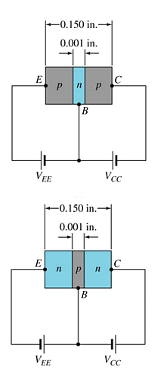
Transistor Construction
There are two types of transistors:
  pnp
  npn
The terminals are labeled:
  E - Emitter
  B - Base
  C - Collector
pnp
npn

Slide 3
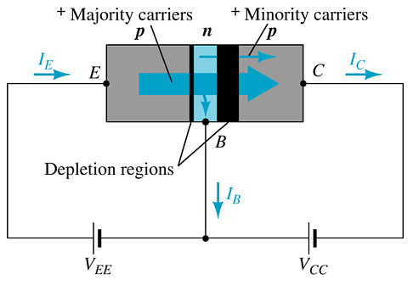
Transistor Operation
With the external sources, V_{EE} and V_{CC}, connected as shown:
  The emitter-base junction is forward biased
  The base-collector junction is reverse biased

Slide 4
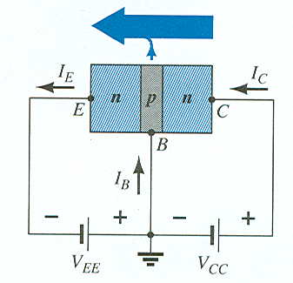

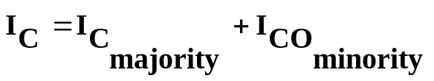
Currents in a Transistor
Emitter current is the sum of the collector and base currents:
The collector current is comprised of two currents:

Slide 5
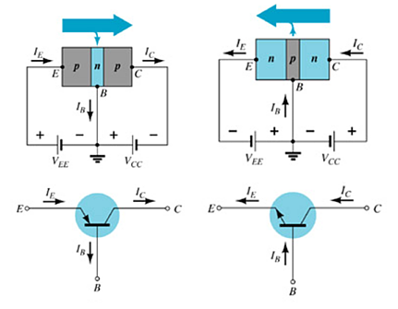
Common-Base Configuration
The base is common to both input (emitter–base) and output (collector–base) of the transistor.

Slide 6
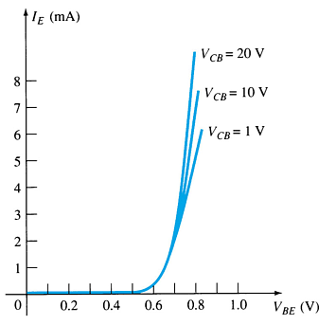
Common-Base Amplifier
Input Characteristics
This curve shows the relationship between of input current (I_{E}) to input voltage (V_{BE}) for three output voltage (V_{CB}) levels.

Slide 7
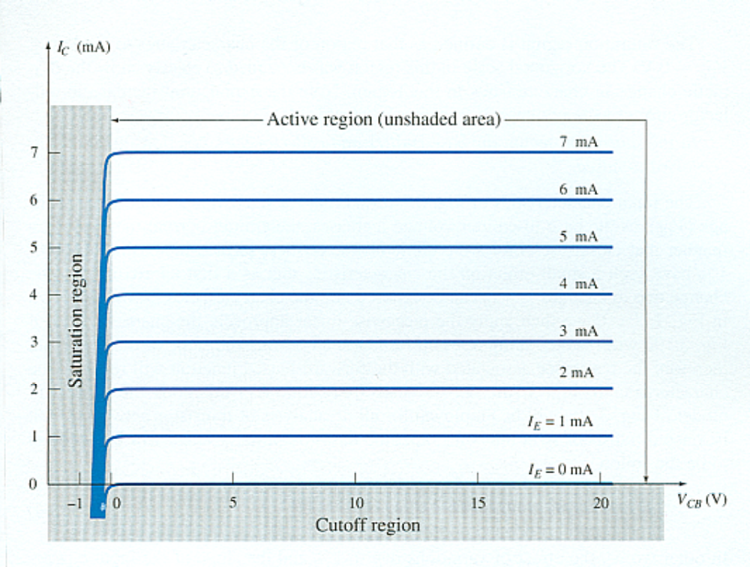
Common-Base Amplifier
Output Characteristics
This graph demonstrates the output current (I_{C}) to an output voltage (V_{CB}) for various levels of input current (I_{E}).

Slide 8
Operating Regions
Active – Operating range of the amplifier.
Cutoff – The amplifier is basically off. There is voltage, but little current.
Saturation – The amplifier is full on. There is current, but little voltage.

Slide 9


Approximations
Emitter and collector currents:
Base-emitter voltage:

Slide 10
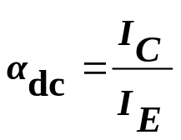
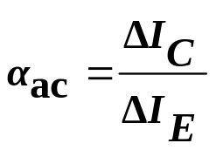
Alpha (α)
Alpha (α) is the ratio of I_{C} to I_{E} :
    Ideally: α = 1
    In reality: α is between 0.9 and 0.998
Alpha (α) in the AC mode:

Slide 11
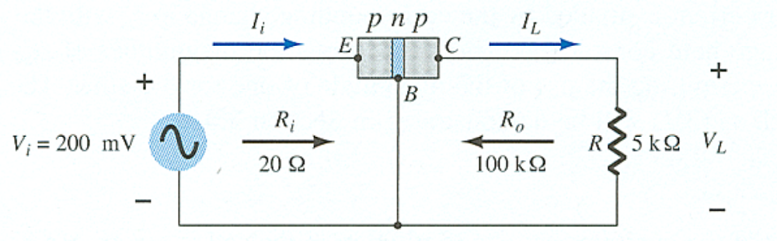
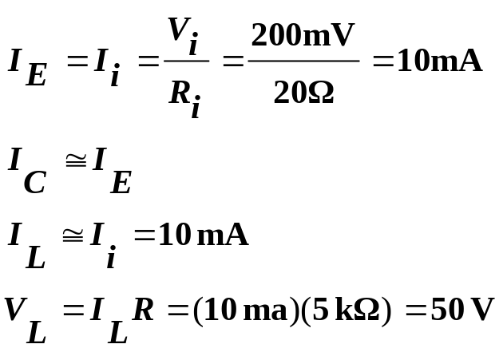
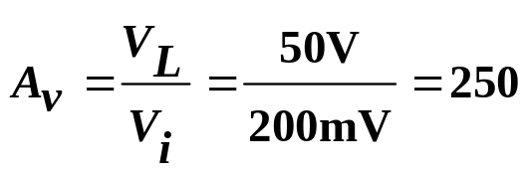
Transistor Amplification
Currents and Voltages:
Voltage Gain:

Slide 12
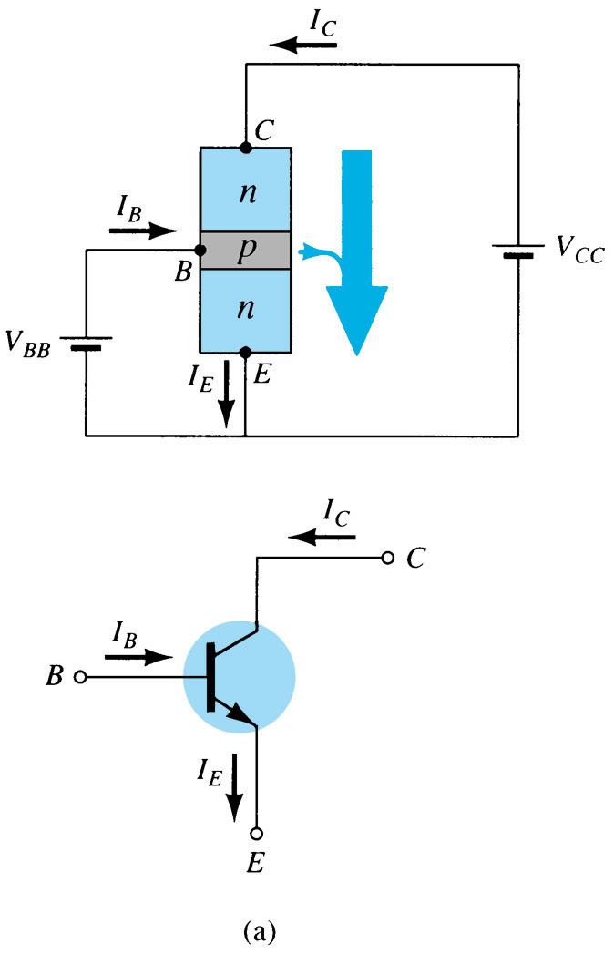
Common–Emitter Configuration
The emitter is common to both input (base-emitter) and output (collector-emitter).
The input is on the base and the output is on the collector.

Slide 13
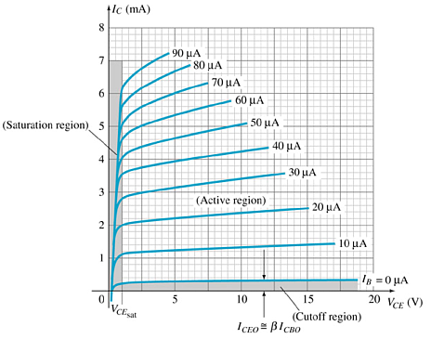
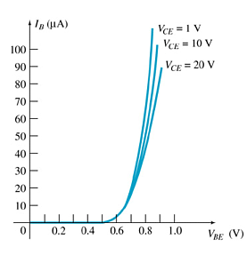
Common-Emitter Characteristics
Collector Characteristics
Base Characteristics

Slide 14
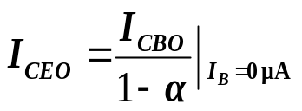
Common-Emitter Amplifier Currents
Ideal Currents
  I_{E} = I_{C} + I_{B} I_{C} = α I_{E}
Actual Currents
  I_{C} = α I_{E} + I_{CBO}
    where I_{CBO} = minority collector current
      I_{CBO} is usually so small that it can be ignored, except in high
      power transistors and in high temperature environments.
When I_{B} = 0 μA the transistor is in cutoff, but there is some minority current flowing called I_{CEO}.

Slide 15
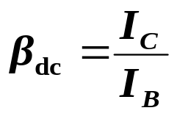
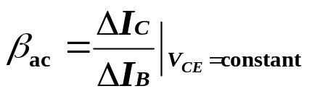
Beta (β)
β represents the amplification factor of a transistor. (β is sometimes referred to as h_{fe}, a term used in transistor modeling calculations)
In DC mode:
In AC mode:

Slide 16
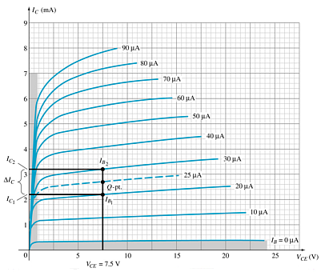
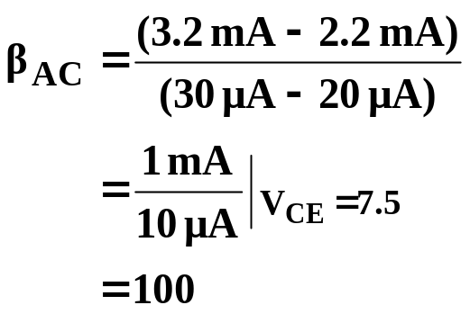
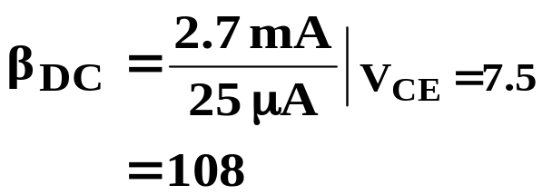
Beta (β)
Determining β from a Graph

Slide 17
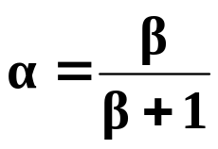
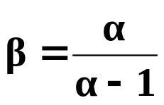


Beta (β)
Relationship between amplification factors β and α
Relationship Between Currents

Slide 18
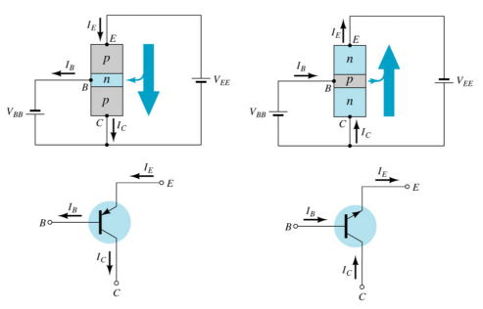
Common–Collector Configuration
The input is on the base and the output is on the emitter.

Slide 19
Common–Collector Configuration
The characteristics are similar to those of the common-emitter configuration, except the vertical axis is I_{E}.

Slide 20
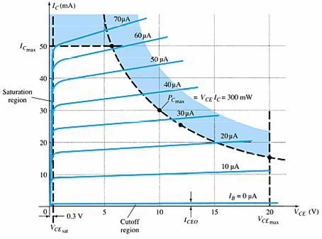
Operating Limits for Each Configuration
V_{CE} is at maximum and I_{C} is at minimum (I_{Cmax}= I_{CEO}) in the cutoff region.
I_{C} is at maximum and V_{CE} is at minimum (V_{CE max} = V_{CEsat} = V_{CEO}) in the saturation region.
The transistor operates in the active region between saturation and cutoff.

Slide 21



Power Dissipation
Common-base:
Common-emitter:
Common-collector:

Slide 22
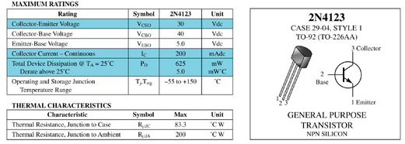
Transistor Specification Sheet

Slide 23
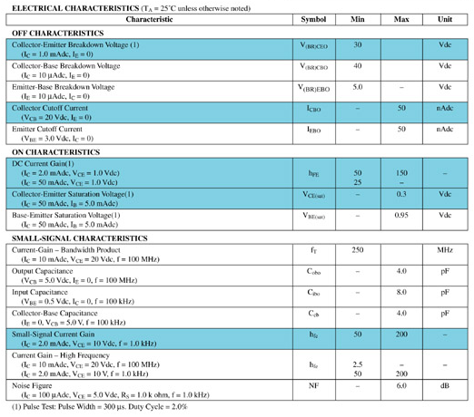
Transistor Specification Sheet

Slide 24
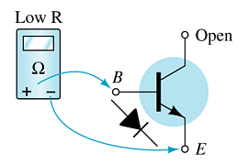
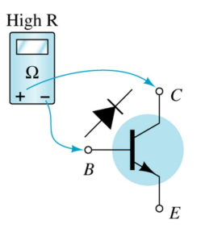
Transistor Testing
Curve Tracer
    Provides a graph of the characteristic curves.
DMM
    Some DMMs measure β_{DC} or h_{FE}.
Ohmmeter

Slide 25
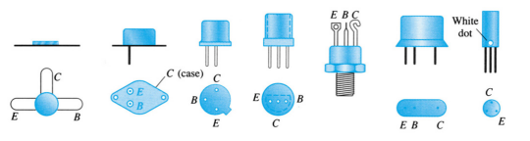
Transistor Terminal Identification

