Slide 1
Electronic Circuits
Prof. Nizamettin AYDIN
naydin@yildiz.edu.tr
http://www.yildiz.edu.tr/~naydin
Dr. Gökhan Bilgin
gokhanb@ce.yildiz.edu.tr
Notes:
Copyright 2000 N. AYDIN. All rights reserved.

Slide 2
BJT Transistor Modeling
  A model is an equivalent circuit that represents the AC characteristics of the transistor.
  A model uses circuit elements that approximate the behavior of the transistor.
  There are two models commonly used in small signal AC analysis of a transistor:
    r_{e} model
    Hybrid equivalent model

Slide 3
The r_{e} Transistor Model
BJTs are basically current-controlled devices; therefore the r_{e} model
uses a diode and a current source to duplicate the behavior of the
transistor.
One disadvantage to this model is its sensitivity to the DC level. This
model is designed for specific circuit conditions.

Slide 4
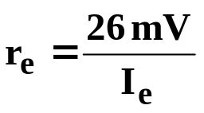
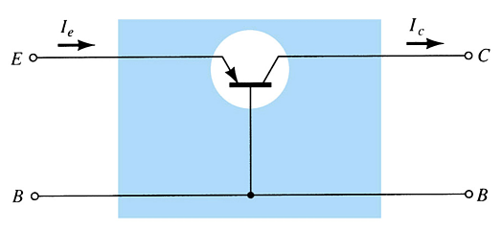



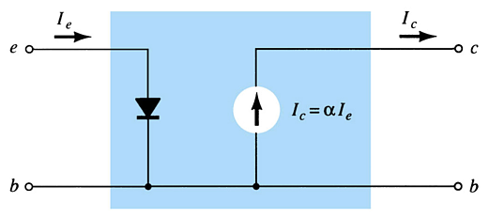
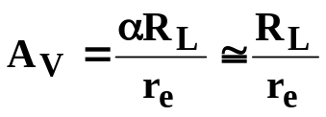

Common-Base Configuration
Input impedance:
Output impedance:
Voltage gain:
Current gain:

Slide 5


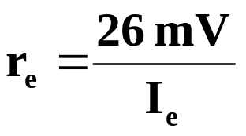
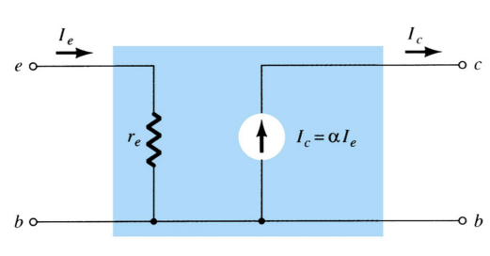
Common-Emitter Configuration
The diode r_{e} model can be replaced by the resistor r_{e}.
more…

Slide 6


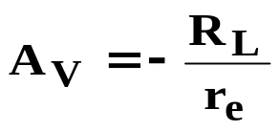
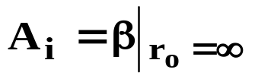
Common-Emitter Configuration
Input impedance:
Output impedance:
Voltage gain:
Current gain:

Slide 7


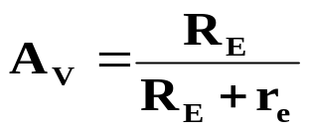

Common-Collector Configuration
Input impedance:
Output impedance:
Voltage gain:
Current gain:

Slide 8
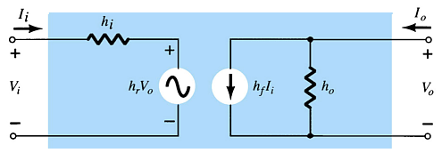
The Hybrid Equivalent Model
The following hybrid parameters are developed and used for modeling the transistor. These parameters can be found on the specification sheet for a transistor.
h_{i} = input resistance
h_{r} = reverse transfer voltage ratio (V_{i}/V_{o}) ≅ 0
h_{f} = forward transfer current ratio (I_{o}/I_{i})
h_{o} = output conductance

Slide 9
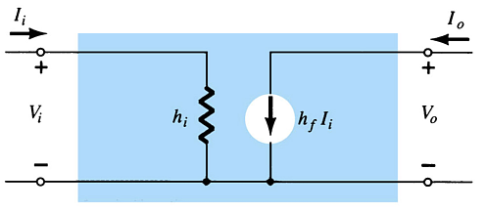
Simplified General h-Parameter Model
h_{i} = input resistance
h_{f} = forward transfer current ratio (I_{o}/I_{i})

Slide 10
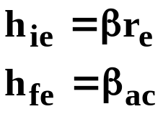
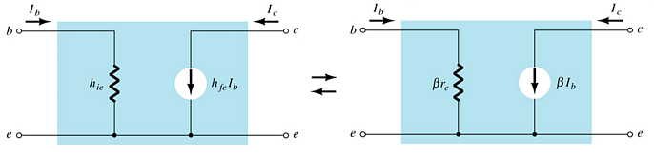
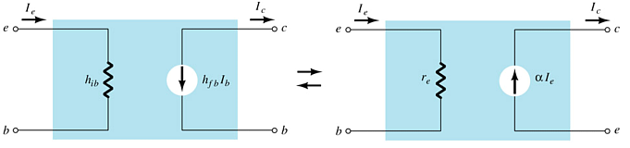
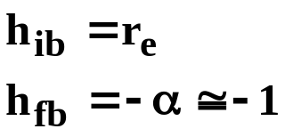
r_{e} vs. h-Parameter Model
Common-Emitter
Common-Base

Slide 11
The Hybrid π Model
The hybrid π model is most useful for analysis of high-frequency transistor applications.
At lower frequencies the hybrid π model closely approximate the r_{e} parameters, and can be replaced by them.

Slide 12
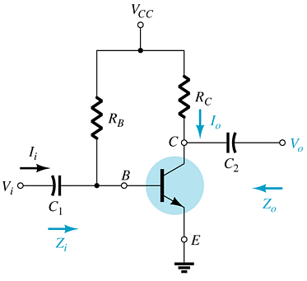
Common-Emitter Fixed-Bias Configuration
The input is applied to the base
The output is from the collector
High input impedance
Low output impedance
High voltage and current gain
Phase shift between input and output is 180°

Slide 13
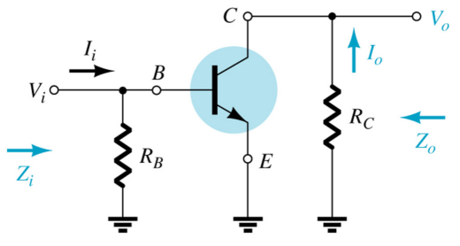
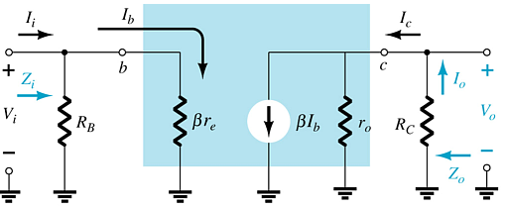
Common-Emitter Fixed-Bias Configuration
  AC equivalent
  r_{e} model

Slide 14
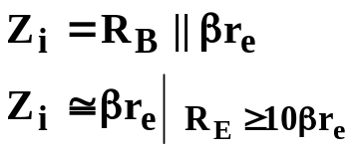
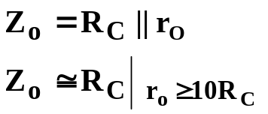
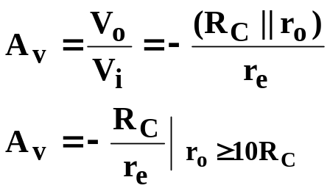
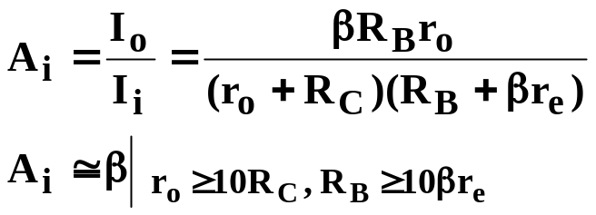
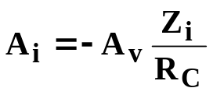
Common-Emitter Fixed-Bias Calculations
Input impedance:
Output impedance:
Voltage gain:
Current gain:
Current gain from voltage gain:

Slide 15
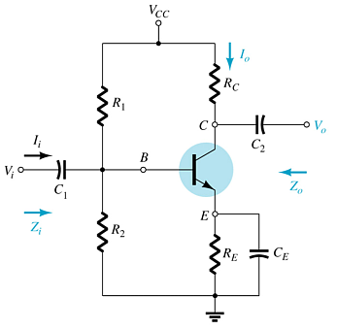
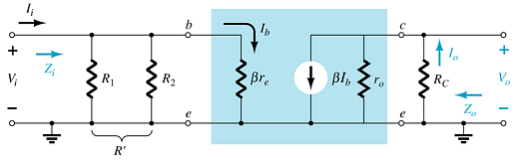
Common-Emitter Voltage-Divider Bias
r_{e} model requires you to determine β, r_{e}, and r_{o}.

Slide 16
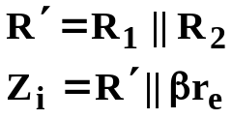
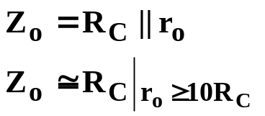
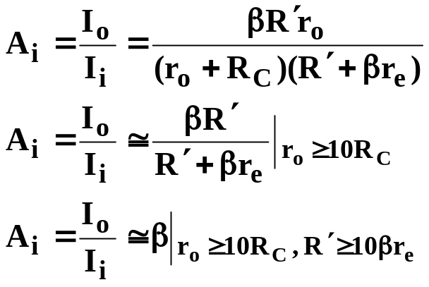
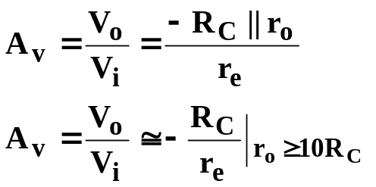
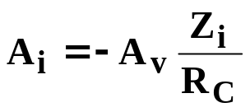
Common-Emitter Voltage-Divider Bias Calculations
Input impedance:
Output impedance:
Current gain:
Voltage gain:
Current gain from voltage gain:

Slide 17
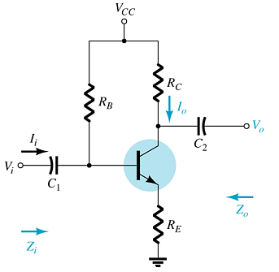
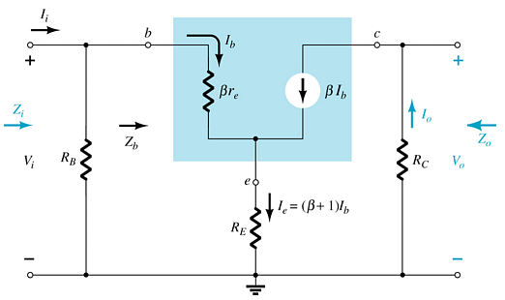
Common-Emitter Emitter-Bias Configuration

Slide 18
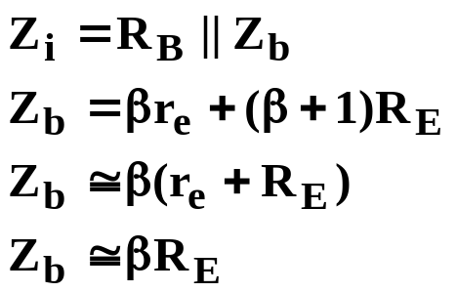

Impedance Calculations
Input impedance:
Output impedance:

Slide 19
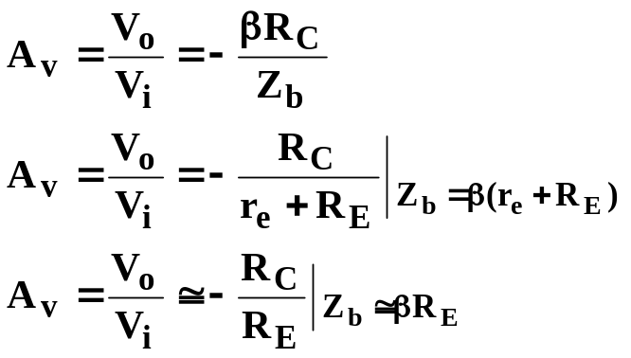
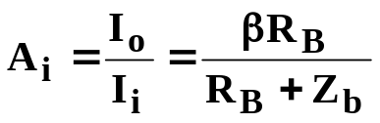
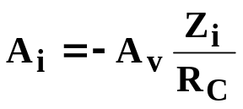
Gain Calculations
Voltage gain:
Current gain:
Current gain from voltage gain:

Slide 20
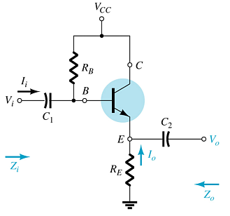
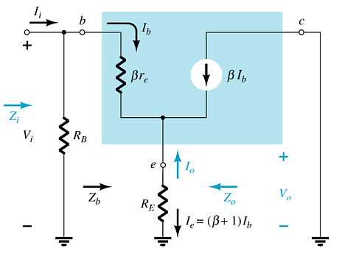
Emitter-Follower Configuration
This is also known as the common-collector configuration.
The input is applied to the base and the output is taken from the emitter.
There is no phase shift between input and output.

Slide 21
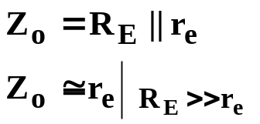
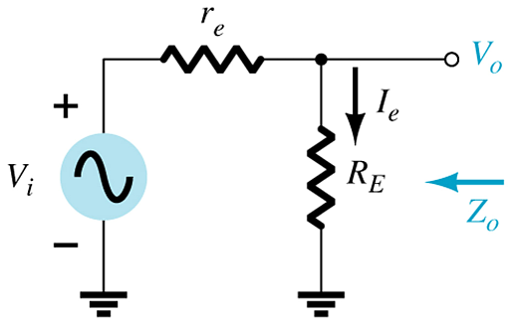
Impedance Calculations
Input impedance:
Output impedance:

Slide 22
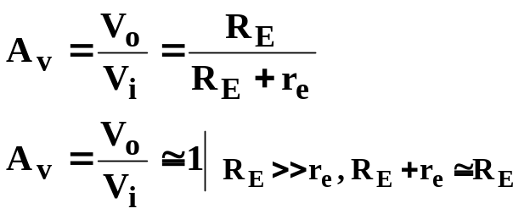
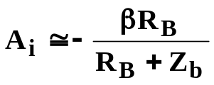
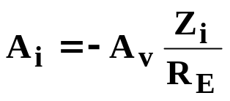
Gain Calculations
Voltage gain:
Current gain:
Current gain from voltage gain:

Slide 23
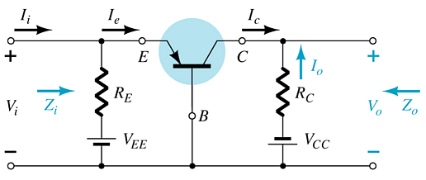
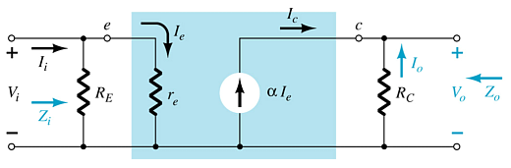
Common-Base Configuration
The input is applied to the emitter.
The output is taken from the collector.
Low input impedance.
High output impedance.
Current gain less than unity.
Very high voltage gain.
No phase shift between input and output.

Slide 24


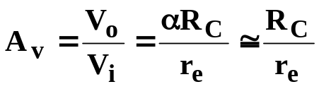
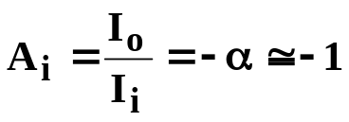
Calculations
Input impedance:
Output impedance:
Voltage gain:
Current gain:

Slide 25
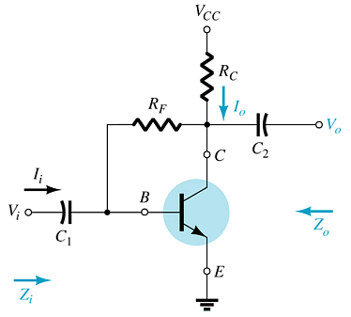
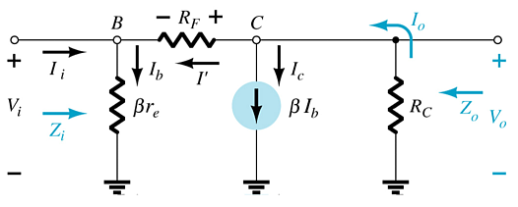
Common-Emitter Collector Feedback Configuration
This is a variation of the common-emitter fixed-bias configuration
Input is applied to the base
Output is taken from the collector
There is a 180° phase shift between input and output

Slide 26
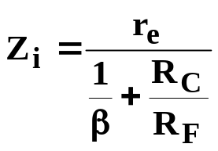



Calculations
Input impedance:
Output impedance:
Voltage gain:
Current gain:

Slide 27


Collector DC Feedback Configuration
This is a variation of the common-emitter, fixed-bias configuration
The input is applied to the base
The output is taken from the collector
There is a 180° phase shift between input and output

Slide 28

Calculations
Input impedance:
Output impedance:
Voltage gain:
Current gain:

Slide 29



Two-Port Systems Approach
This approach:
  Reduces a circuit to a two-port system
  Provides a “Thévenin look” at the output terminals
  Makes it easier to determine the effects of a changing load
With V_{i} set to 0 V:
The voltage across the open terminals is:
where A_{vNL} is the no-load voltage gain.

Slide 30



Effect of Load Impedance on Gain
This model can be applied to any current- or voltage-controlled amplifier.
Adding a load reduces the gain of the amplifier:

Slide 31



Effect of Source Impedance on Gain
The fraction of applied signal that reaches the input of the amplifier is:
The internal resistance of the signal source reduces the overall gain:

Slide 32



Combined Effects of R_{S} and R_{L} on Voltage Gain
Effects of R_{L}:
Effects of R_{L} and R_{S}:

Slide 33
Cascaded Systems
The output of one amplifier is the input to the next amplifier
The overall voltage gain is determined by the product of gains of the individual stages
The DC bias circuits are isolated from each other by the coupling capacitors
The DC calculations are independent of the cascading
The AC calculations for gain and impedance are interdependent

Slide 34




R-C Coupled BJT Amplifiers
Input impedance, first stage:
Output impedance, second stage:
Voltage gain:

Slide 35

Cascode Connection
This example is a CE–CB combination. This arrangement provides high input impedance but a low voltage gain.
The low voltage gain of the input stage reduces the Miller input capacitance, making this combination suitable for high-frequency applications.

Slide 36

Darlington Connection
The Darlington circuit provides a very high current gain—the product of the individual current gains:
  β_{D} = β₁β₂
The practical significance is that the circuit provides a very high input impedance.

Slide 37





DC Bias of Darlington Circuits
Base current:
Emitter current:
Emitter voltage:
Base voltage:

Slide 38

Feedback Pair
This is a two-transistor circuit that operates like a Darlington pair, but it is not a Darlington pair.
It has similar characteristics:
  High current gain
  Voltage gain near unity
  Low output impedance
  High input impedance
    The difference is that a Darlington uses a pair of like transistors, whereas the feedback-pair configuration uses complementary transistors.

Slide 39

Current Mirror Circuits
Current mirror circuits provide constant current in integrated circuits.

Slide 40


Current Source Circuits
Constant-current sources can be built using FETs, BJTs, and combinations of these devices.
  I_{E} ≅ I_{C}
more…

Slide 41

Current Source Circuits
  V_{GS} = 0V
  I_{D} = I_{DSS} = 10 mA

Slide 42






Fixed-Bias Configuration
Input impedance:
Output impedance:
Voltage gain:
Current gain:

Slide 43





Voltage-Divider Configuration
Input impedance:
Output impedance:
Voltage gain:
Current gain:

Slide 44






Emitter-Follower Configuration
Input impedance:
Output impedance:
Voltage gain:
Current gain:

Slide 45






Common-Base Configuration
Input impedance:
Output impedance:
Voltage gain:
Current gain:

Slide 46
Troubleshooting
Check the DC bias voltages
  If not correct, check power supply, resistors, transistor. Also check the coupling capacitor between amplifier stages.
Check the AC voltages
  If not correct check transistor, capacitors and the loading effect of the next stage.

