Slide 1
Electronic Circuits
Prof. Nizamettin AYDIN
naydin@yildiz.edu.tr
http://www.yildiz.edu.tr/~naydin
Dr. Gökhan Bilgin
gokhanb@ce.yildiz.edu.tr
Notes:
Copyright 2000 N. AYDIN. All rights reserved.

Slide 2
FETs vs. BJTs
  Similarities:
    • Amplifiers
    • Switching devices
• Impedance matching circuits
  Differences:
• FETs are voltage controlled devices. BJTs are current controlled
devices.
• FETs have a higher input impedance. BJTs have higher gains.
• FETs are less sensitive to temperature variations and are more easily
integrated on ICs.
• FETs are generally more static sensitive than BJTs.

Slide 3
FET Types
JFET: Junction FET
MOSFET: Metal–Oxide–Semiconductor FET
  D-MOSFET: Depletion MOSFET
  E-MOSFET: Enhancement MOSFET

Slide 4
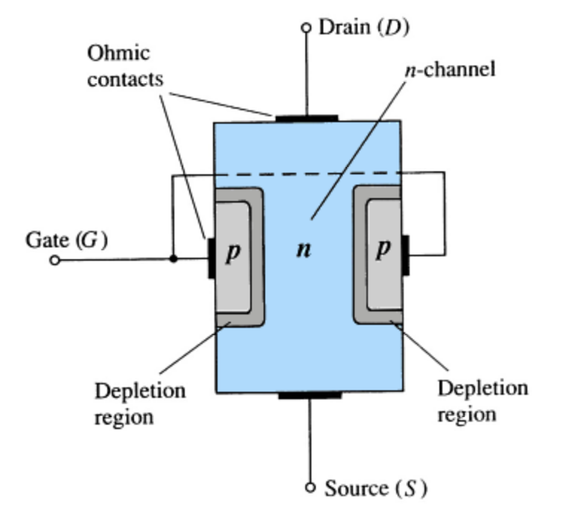
JFET Construction
There are two types of JFETs
  n-channel
  p-channel
The n-channel is more widely used.
There are three terminals:
  Drain (D) and Source (S) are connected to the n-channel
  Gate (G) is connected to the p-type material

Slide 5
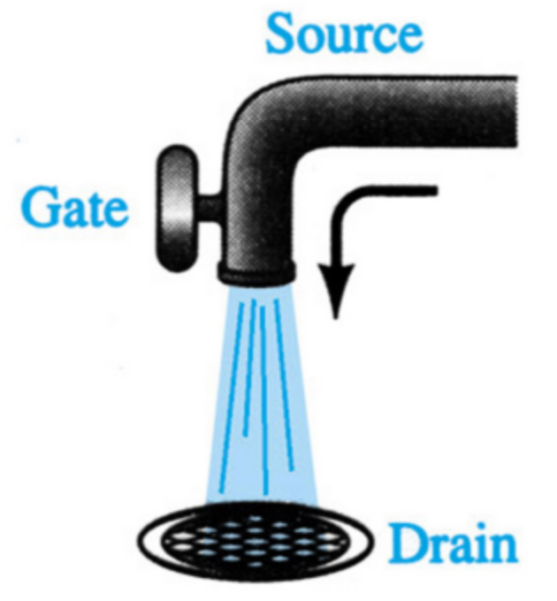
JFET Operation: The Basic Idea
JFET operation can be compared to a water spigot.
The source of water pressure is the accumulation of electrons at the negative pole of the drain-source voltage.
The drain of water is the electron deficiency (or holes) at the positive pole of the applied voltage.
The control of flow of water is the gate voltage that controls the width of the n-channel and, therefore, the flow of charges from source to drain.

Slide 6
JFET Operating Characteristics
There are three basic operating conditions for a JFET:
  V_{GS} = 0, V_{DS} increasing to some positive value
  V_{GS} < 0, V_{DS} at some positive value
  Voltage-controlled resistor

Slide 7
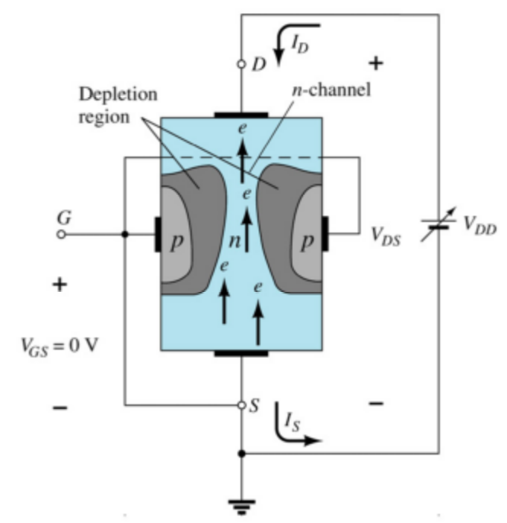
JFET Operating Characteristics: V_{GS} = 0 V
Three things happen when V_{GS} = 0 and V_{DS} is increased from 0 to a more positive voltage
  The depletion region between p-gate and n-channel increases as electrons from n-channel combine with holes from p-gate.
  Increasing the depletion region, decreases the size of the n-channel which increases the resistance of the n-channel.
  Even though the n-channel resistance is increasing, the current (I_{D}) from source to drain through the n-channel is increasing. This is because V_{DS} is increasing.

Slide 8
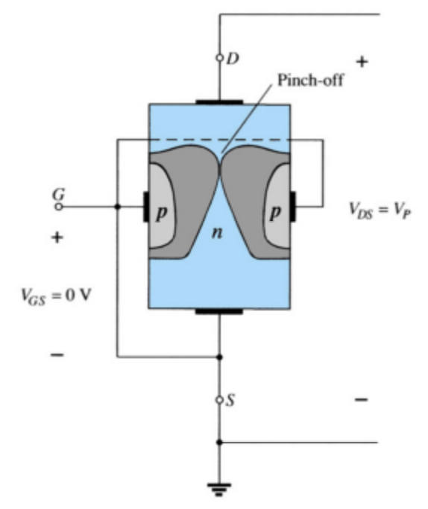
JFET Operating Characteristics: Pinch Off
If V_{GS} = 0 and V_{DS} is further increased to a more positive voltage, then the depletion zone gets so large that it pinches off the n-channel.
This suggests that the current in the n-channel (I_{D}) would drop to 0A, but it does just the opposite–as V_{DS} increases, so does I_{D}.

Slide 9
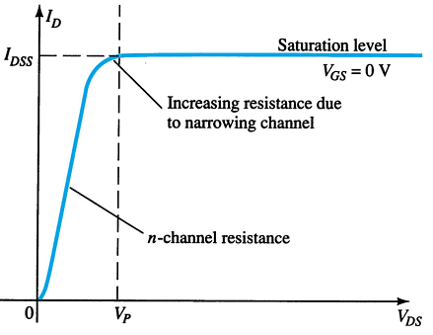
JFET Operating Characteristics: Saturation
At the pinch-off point:
Any further increase in V_{GS} does not produce any increase in I_{D}. V_{GS} at pinch-off is denoted as V_{p}.
I_{D} is at saturation or maximum. It is referred to as I_{DSS}.
The ohmic value of the channel is maximum.

Slide 10
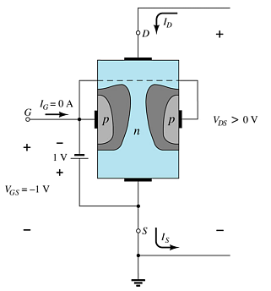
JFET Operating Characteristics
As V_{GS} becomes more negative, the depletion region increases.

Slide 11
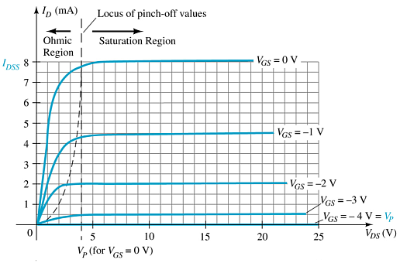
JFET Operating Characteristics
As V_{GS} becomes more negative:
The JFET experiences pinch-off at a lower voltage (V_{P}).
I_{D} decreases (I_{D} < I_{DSS}) even though V_{DS} is increased.
Eventually I_{D} reaches 0 A. V_{GS} at this point is called V_{p} or V_{GS(off)}..
Also note that at high levels of V_{DS} the JFET reaches a breakdown situation. I_{D} increases uncontrollably if V_{DS} > V_{DSmax}.

Slide 12
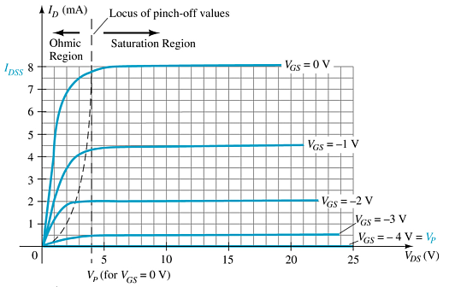
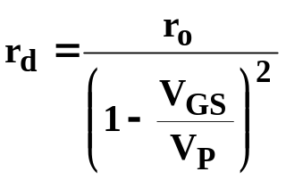
JFET Operating Characteristics:
Voltage-Controlled Resistor
The region to the left of the pinch-off point is called the ohmic region.
The JFET can be used as a variable resistor, where V_{GS} controls the drain-source resistance (r_{d}). As V_{GS} becomes more negative, the resistance (r_{d}) increases.

Slide 13
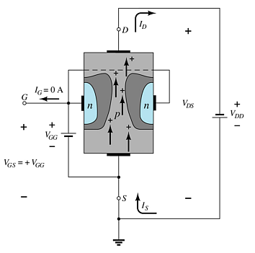
p-Channel JFETS
The p-channel JFET behaves the same as the n-channel JFET, except the voltage polarities and current directions are reversed.

Slide 14
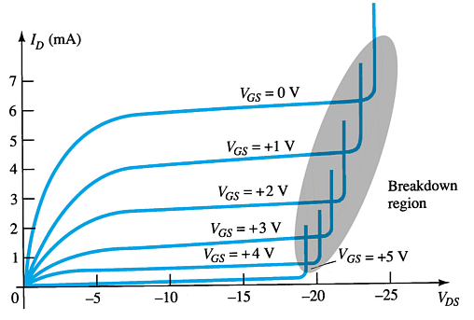
p-Channel JFET Characteristics
As V_{GS} increases more positively
  The depletion zone increases
  I_{D} decreases (I_{D} < I_{DSS})
  Eventually I_{D} = 0 A
Also note that at high levels of V_{DS} the JFET reaches a breakdown situation: I_{D} increases uncontrollably if V_{DS} > V_{DSmax}.

Slide 15
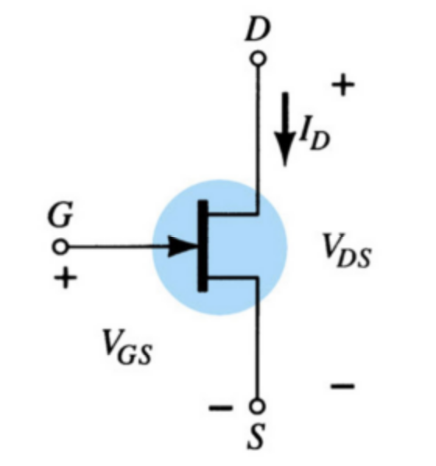
N-Channel JFET Symbol

Slide 16
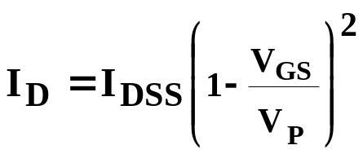
JFET Transfer Characteristics
The transfer characteristic of input-to-output is not as straightforward in a JFET as it is in a BJT.
In a BJT, β indicates the relationship between I_{B} (input) and I_{C} (output).
In a JFET, the relationship of V_{GS} (input) and I_{D} (output) is a little more complicated:

Slide 17
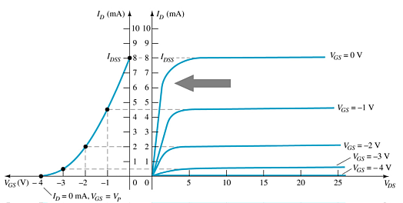
JFET Transfer Curve
This graph shows the value of I_{D} for a given value of V_{GS}.

Slide 18
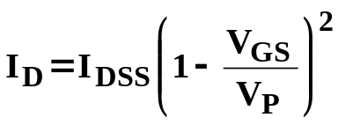
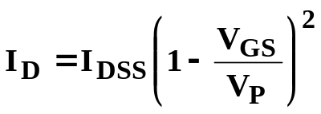
Plotting the JFET Transfer Curve
Using I_{DSS} and Vp (V_{GS(off)}) values found in a specification sheet, the transfer curve can be plotted according to these three steps:
Step 1
Solving for V_{GS} = 0V I_{D} = I_{DSS}
Step 2
Solving for V_{GS} = V_{p} (V_{GS(off)}) I_{D} = 0A
Step 3
Solving for V_{GS} = 0V to V_{p}

Slide 19
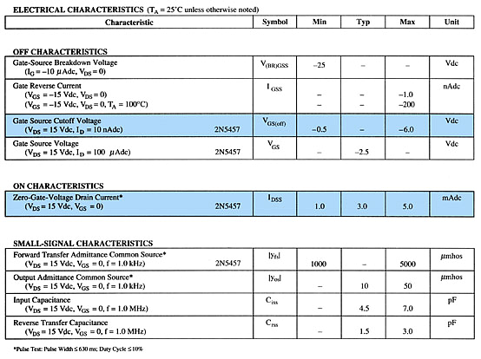
JFET Specifications Sheet
Electrical Characteristics

Slide 20
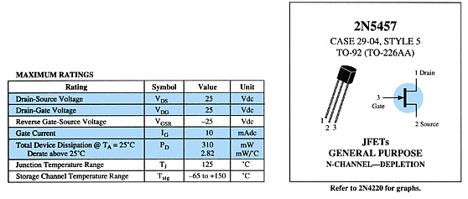
JFET Specifications Sheet
Maximum Ratings
more…

Slide 21
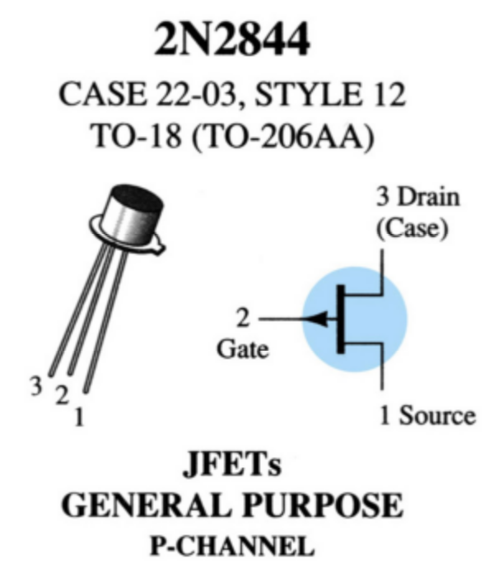
Case and Terminal Identification

Slide 22
Testing JFETs
Curve Tracer
    A curve tracer displays the I_{D} versus V_{DS} graph for various levels of V_{GS}.
Specialized FET Testers
    These testers show I_{DSS} for the JFET under test.

Slide 23
MOSFETs
MOSFETs have characteristics similar to JFETs and additional characteristics that make then very useful.
There are two types of MOSFETs:
  Depletion-Type
  Enhancement-Type

Slide 24
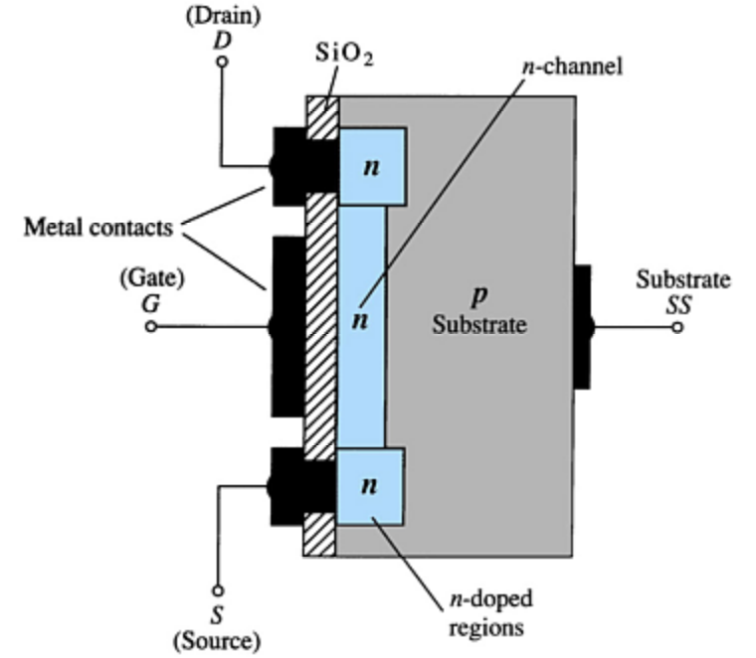
Depletion-Type MOSFET Construction
The Drain (D) and Source (S) connect to the to n-doped regions. These n-doped regions are connected via an n-channel. This n-channel is connected to the Gate (G) via a thin insulating layer of SiO₂.
The n-doped material lies on a p-doped substrate that may have an additional terminal connection called Substrate (SS).

Slide 25
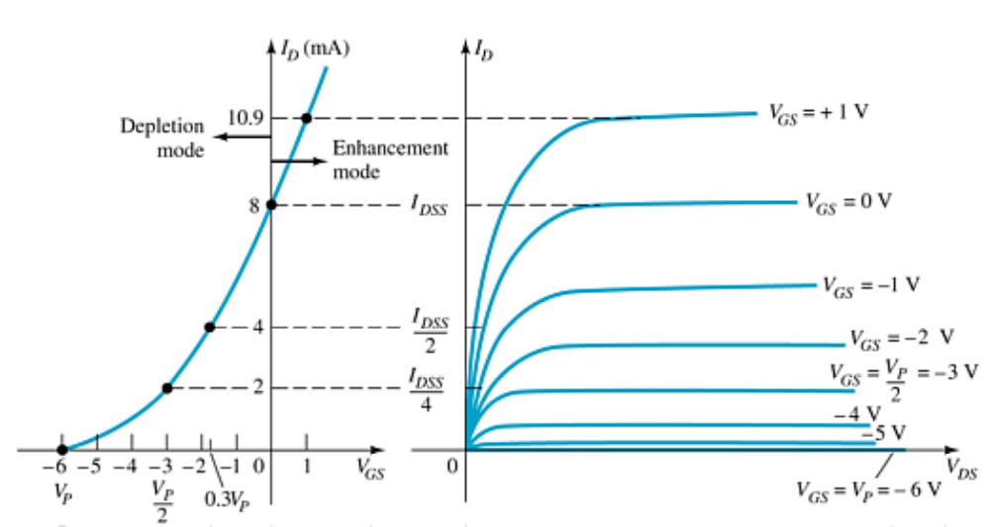
Basic MOSFET Operation
A depletion-type MOSFET can operate in two modes:
  Depletion mode
  Enhancement mode

Slide 26
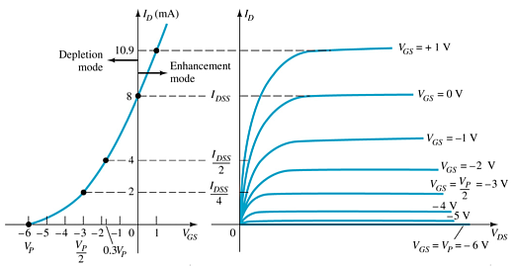
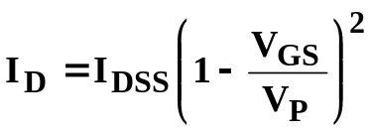
D-Type MOSFET in Depletion Mode
Depletion Mode
The characteristics are similar to a JFET.
  When V_{GS} = 0 V, I_{D} = I_{DSS}
  When V_{GS} < 0 V, I_{D} < I_{DSS}
  The formula used to plot the transfer curve still applies:

Slide 27
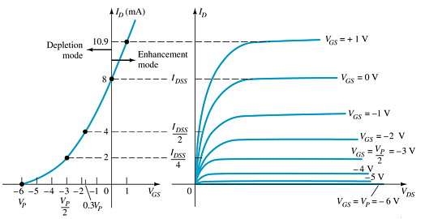

D-Type MOSFET in Enhancement Mode
Enhancement Mode
V_{GS} > 0 V
I_{D} increases above I_{DSS}
The formula used to plot the transfer curve still applies:
Note that V_{GS} is now a positive polarity

Slide 28
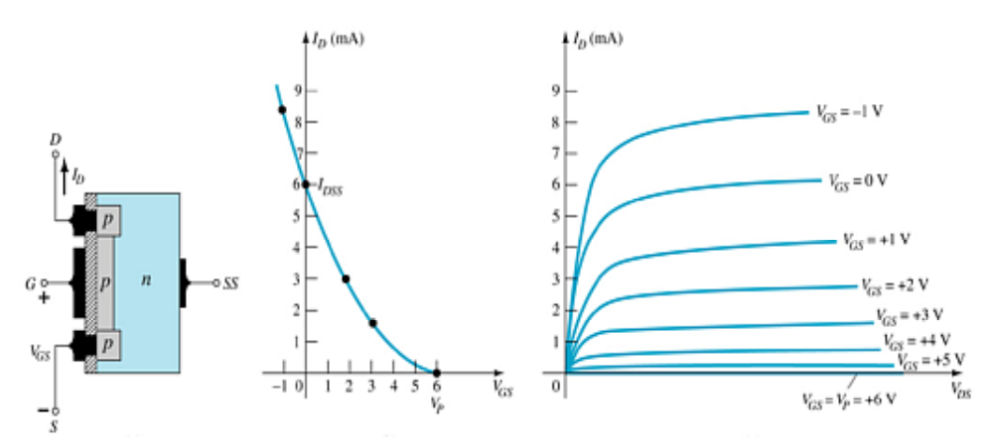
p-Channel D-Type MOSFET

Slide 29
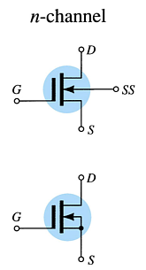
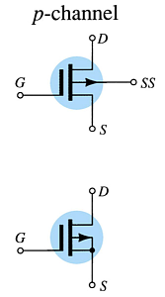
D-Type MOSFET Symbols

Slide 30
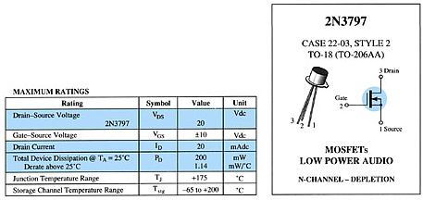
Specification Sheet
Maximum Ratings
more…

Slide 31
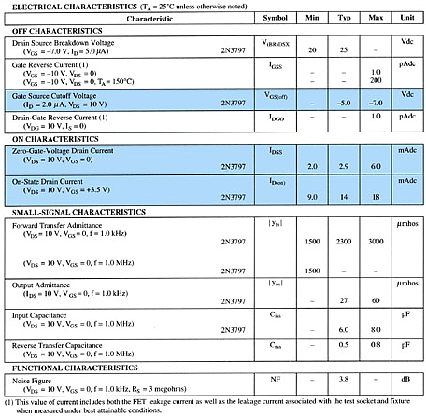
Specification Sheet
Electrical Characteristics

Slide 32
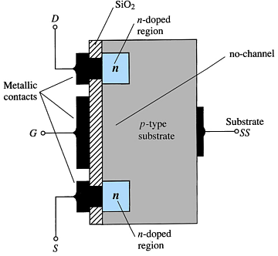
E-Type MOSFET Construction
The Drain (D) and Source (S) connect to the to n-doped regions. These n-doped regions are connected via an n-channel
The Gate (G) connects to the p-doped substrate via a thin insulating layer of SiO₂
There is no channel
The n-doped material lies on a p-doped substrate that may have an additional terminal connection called the Substrate (SS)

Slide 33
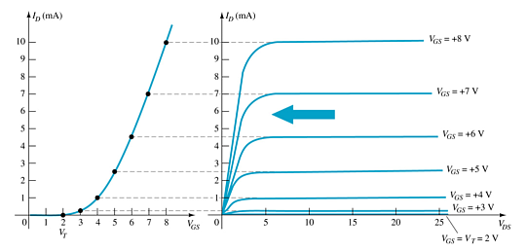
Basic Operation of the E-Type MOSFET
The enhancement-type MOSFET operates only in the enhancement mode.
V_{GS} is always positive
As V_{GS} increases, I_{D} increases
As V_{GS} is kept constant and V_{DS} is increased, then I_{D} saturates (I_{DSS}) and the saturation level, V_{DSsat} is reached

Slide 34
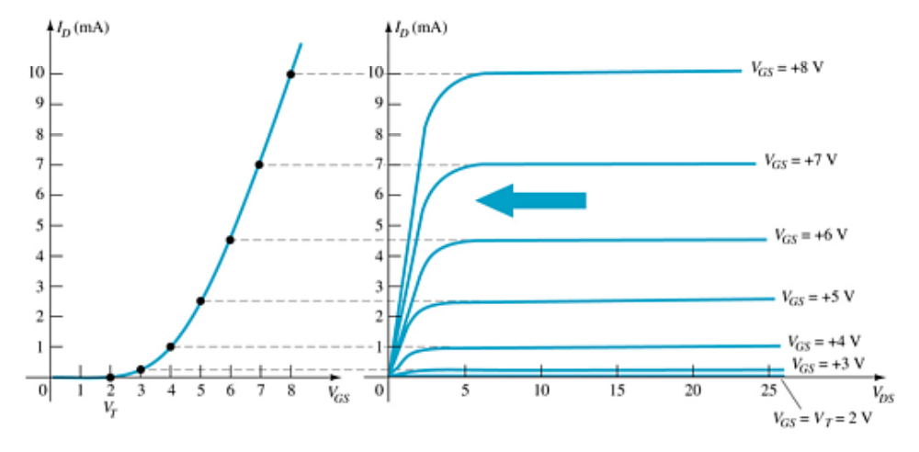


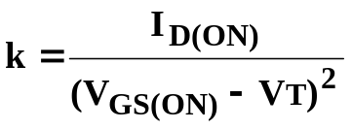
E-Type MOSFET Transfer Curve
To determine I_{D} given V_{GS}:
Where:
  V_{T} = threshold voltage or voltage at which the MOSFET turns on
k, a constant, can be determined by using values at a specific point and the formula:
V_{DSsat} can be calculated by:

Slide 35
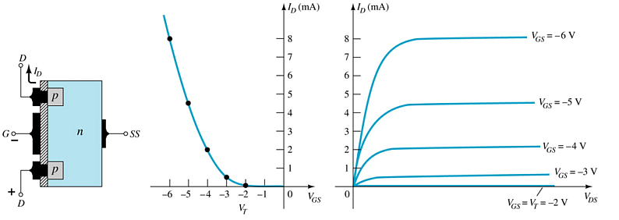
p-Channel E-Type MOSFETs
The p-channel enhancement-type MOSFET is similar to the n-channel, except that the voltage polarities and current directions are reversed.

Slide 36
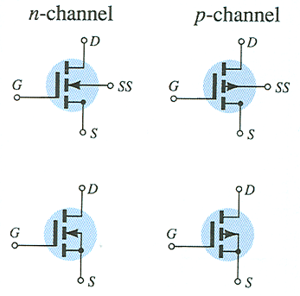
MOSFET Symbols

Slide 37
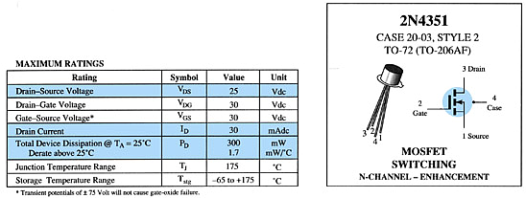
Specification Sheet
Maximum Ratings
more…

Slide 38
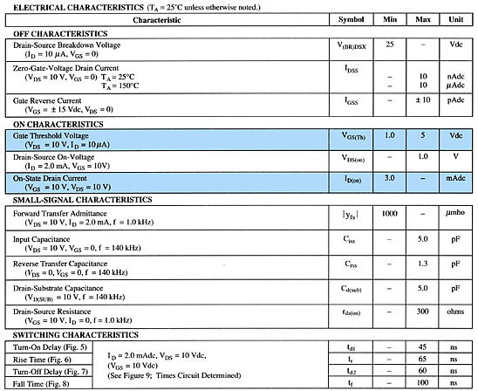
Specification Sheet
Electrical Characteristics

Slide 39
Handling MOSFETs
MOSFETs are very sensitive to static electricity. Because of the very thin SiO₂ layer between the external terminals and the layers of the device, any small electrical discharge can create an unwanted conduction.
Protection
  Always transport in a static sensitive bag
  Always wear a static strap when handling MOSFETS
  Apply voltage limiting devices between the gate and source, such as back-to-back Zeners to limit any transient voltage.

Slide 40
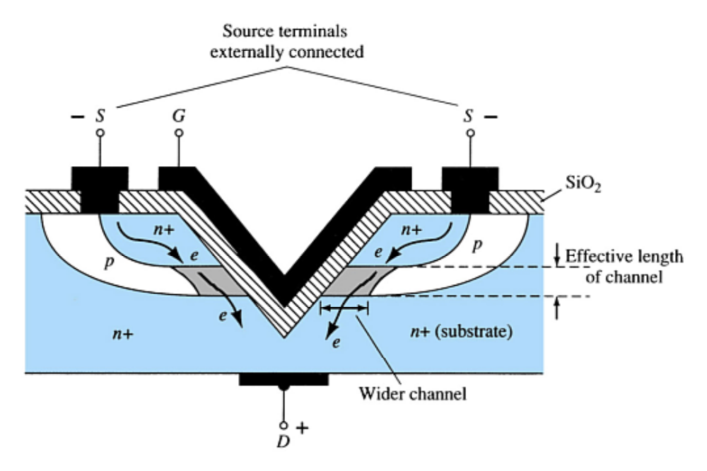
VMOS Devices
VMOS (vertical MOSFET) increases the surface area of the device.
Advantages
VMOS devices handle higher currents by providing more surface area to dissipate the heat.
VMOS devices also have faster switching times.

Slide 41
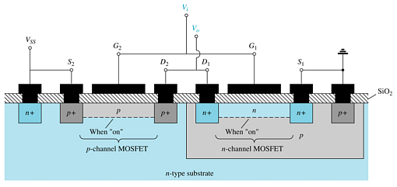
CMOS Devices
CMOS (complementary MOSFET) uses a p-channel and n-channel MOSFET; often on the same substrate as shown here.
Advantages
Useful in logic circuit designs
Higher input impedance
Faster switching speeds
Lower operating power levels

Slide 42
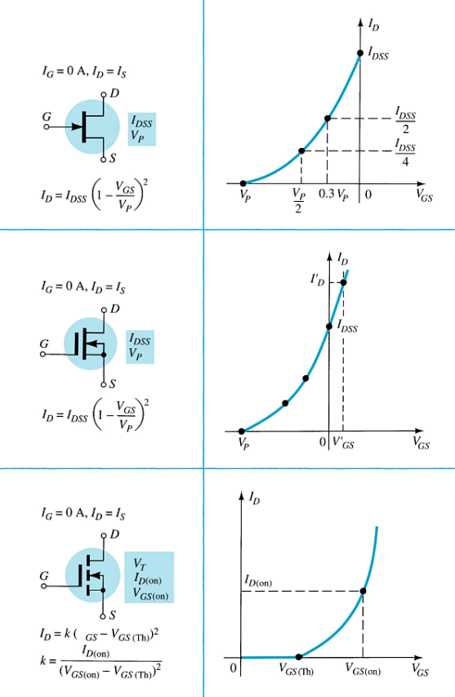
Summary Table

