Slide 1
Electronic Circuits
Prof. Nizamettin AYDIN
naydin@yildiz.edu.tr
http://www.yildiz.edu.tr/~naydin
Dr. Gökhan Bilgin
gokhanb@ce.yildiz.edu.tr
Notes:
Copyright 2000 N. AYDIN. All rights reserved.

Slide 2
Common FET Biasing Circuits
JFET Biasing Circuits
  Fixed – Bias
  Self-Bias
  Voltage-Divider Bias
D-Type MOSFET Biasing Circuits
  Self-Bias
  Voltage-Divider Bias
E-Type MOSFET Biasing Circuits
  Feedback Configuration
  Voltage-Divider Bias

Slide 3


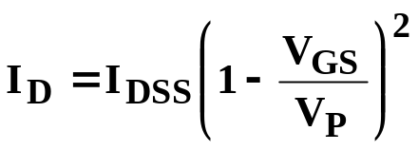

Basic Current Relationships
For all FETs:
For JFETS and D-Type MOSFETs:
For E-Type MOSFETs:

Slide 4
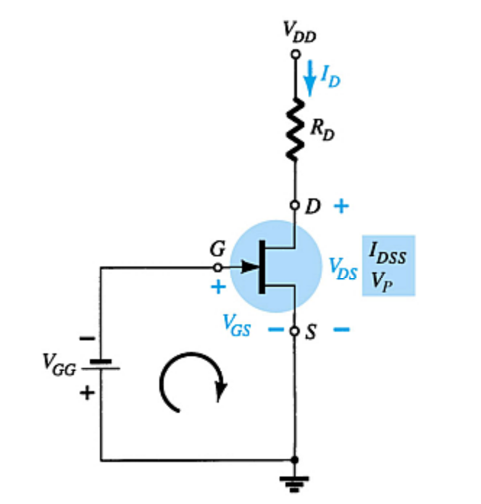
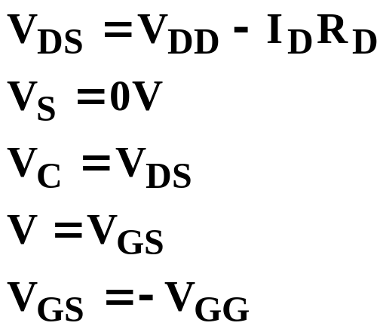
Fixed-Bias Configuration

Slide 5
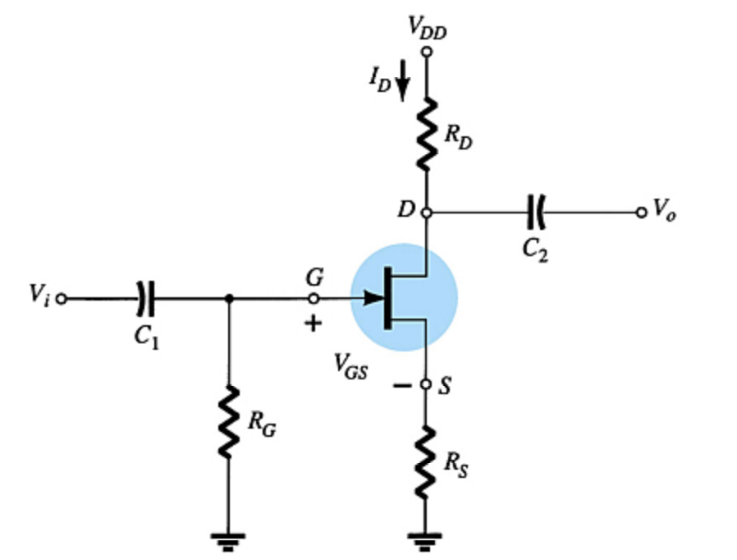
Self-Bias Configuration

Slide 6

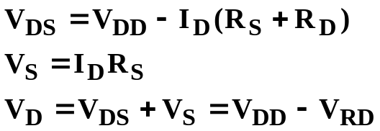
Self-Bias Calculations
For the indicated loop,
To solve this equation:
  Select an I_{D} < I_{DSS} and use the component value of R_{S} to calculate V_{GS}
  Plot the point identified by I_{D} and V_{GS}. Draw a line from the origin of the axis to this point.
  Plot the transfer curve using I_{DSS} and
  V_{P} (V_{P} = V_{GSoff} in specification sheets) and a few points such as I_{D} = I_{DSS} / 4 and I_{D} = I_{DSS} / 2 etc.
The Q-point is located where the first line intersects the transfer curve. Use the value of I_{D} at the Q-point (I_{DQ}) to solve for the other voltages:

Slide 7
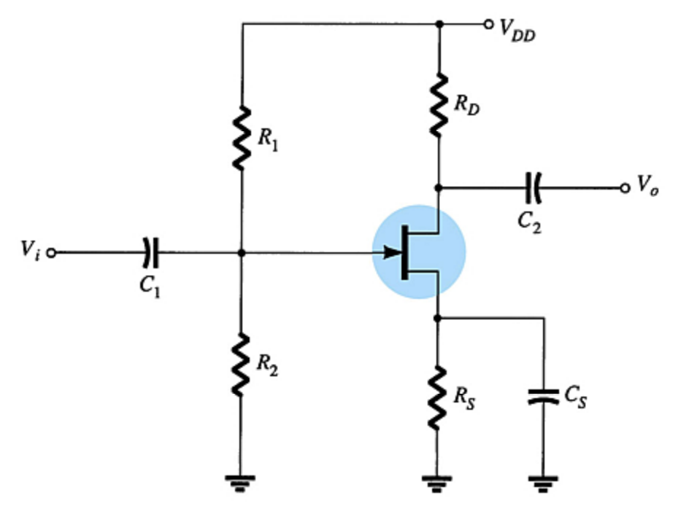
Voltage-Divider Bias
I_{G} = 0 A
I_{D} responds to changes in V_{GS}.

Slide 8
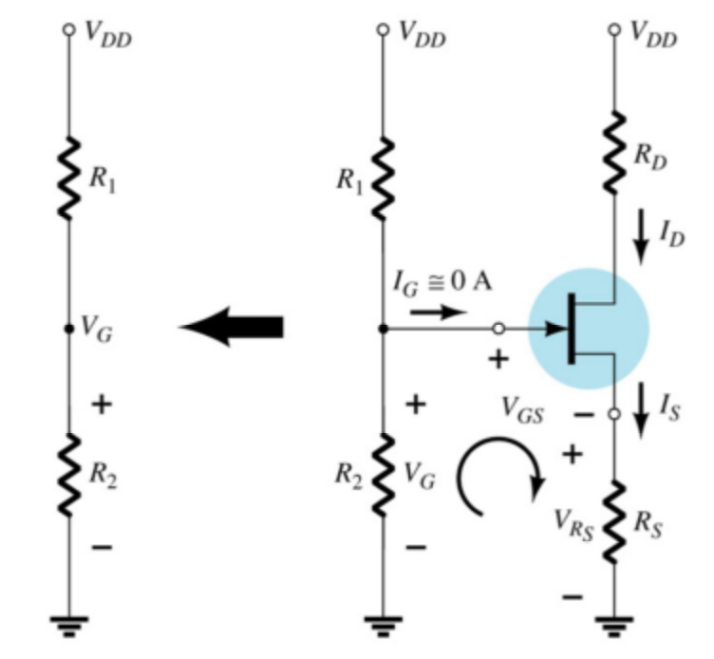
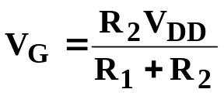

Voltage-Divider Bias Calculations
V_{G} is equal to the voltage across divider resistor R₂:
Using Kirchhoff’s Law:
The Q point is established by plotting a line that intersects the transfer curve.

Slide 9
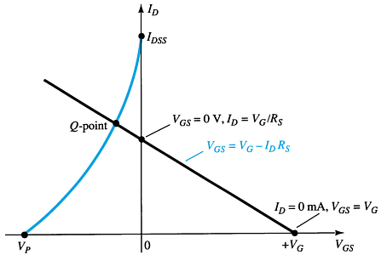
Voltage-Divider Q-point
Step 1
Plot the line by plotting two points:
  V_{GS} = V_{G}, I_{D} = 0 A
  V_{GS} = 0 V, I_{D} = V_{G} / R_{S}
Step 2
Plot the transfer curve by plotting I_{DSS}, V_{P} and the calculated values of I_{D}
Step 3
The Q-point is located where the line intersects the transfer curve

Slide 10
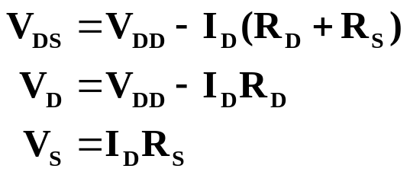
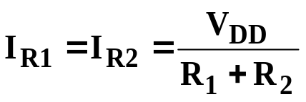
Voltage-Divider Bias Calculations
Using the value of I_{D} at the Q-point, solve for the other variables in the voltage-divider bias circuit:

Slide 11
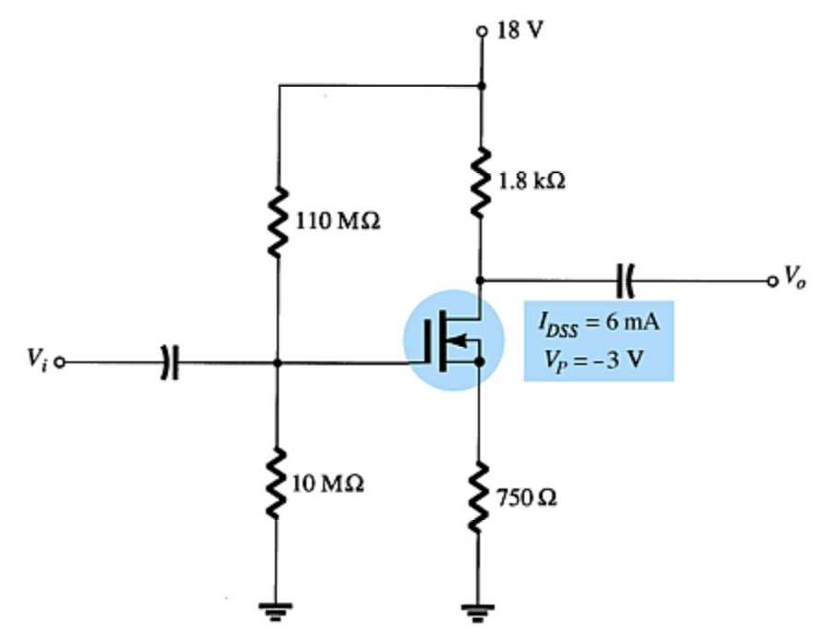
D-Type MOSFET Bias Circuits
Depletion-type MOSFET bias circuits are similar to those used to bias JFETs. The only difference is that depletion-type MOSFETs can operate with positive values of V_{GS} and with I_{D} values that exceed I_{DSS}.

Slide 12
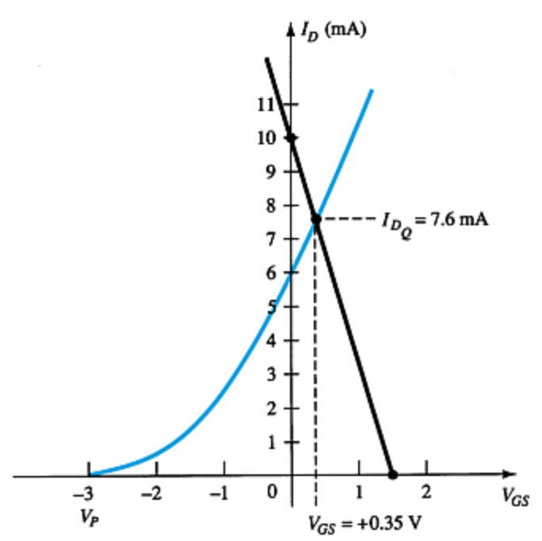
Self-Bias
Step 1
Plot line for
  V_{GS} = V_{G}, I_{D} = 0 A
  I_{D} = V_{G}/R_{S}, V_{GS} = 0 V
Step 2
Plot the transfer curve using I_{DSS}, V_{P} and calculated values of I_{D}
Step 3
The Q-point is located where the line intersects the transfer curve. Use the I_{D} at the Q-point to solve for the other variables in the voltage-divider bias circuit.
These are the same steps used to analyze JFET self-bias circuits.

Slide 13
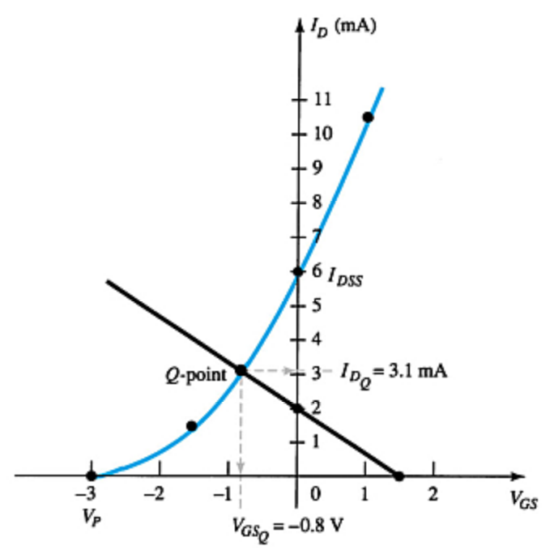
Voltage-Divider Bias
Step 1
Plot the line for
  V_{GS} = V_{G}, I_{D} = 0 A
  I_{D} = V_{G}/R_{S}, V_{GS} = 0 V
Step 2
Plot the transfer curve using I_{DSS}, V_{P} and calculated values of I_{D}.
Step 3
The Q-point is located where the line intersects the transfer curve is. Use the I_{D} at the Q-point to solve for the other variables
in the voltage-divider bias circuit.
These are the same steps used to analyze JFET voltage-divider bias circuits.

Slide 14
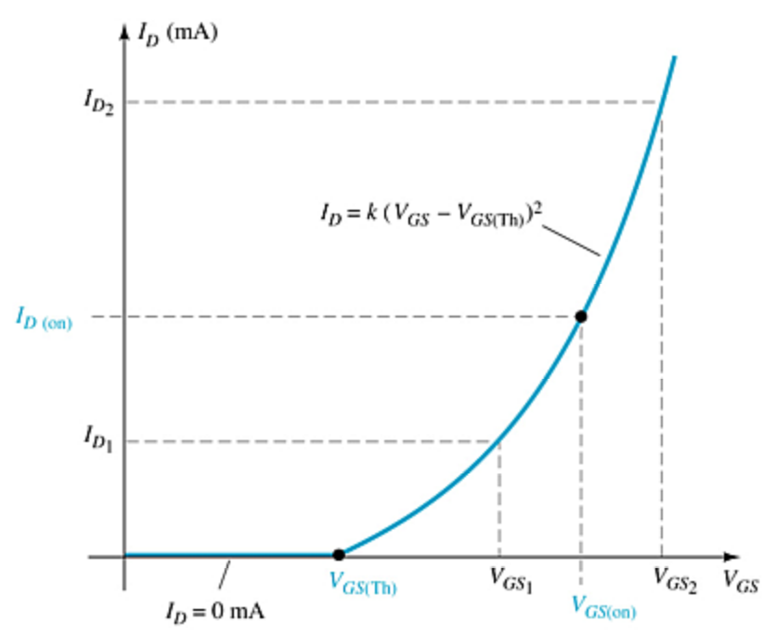
E-Type MOSFET Bias Circuits
The transfer characteristic for the e-type MOSFET is very different from that of a simple JFET or the d-type MOSFET.

Slide 15
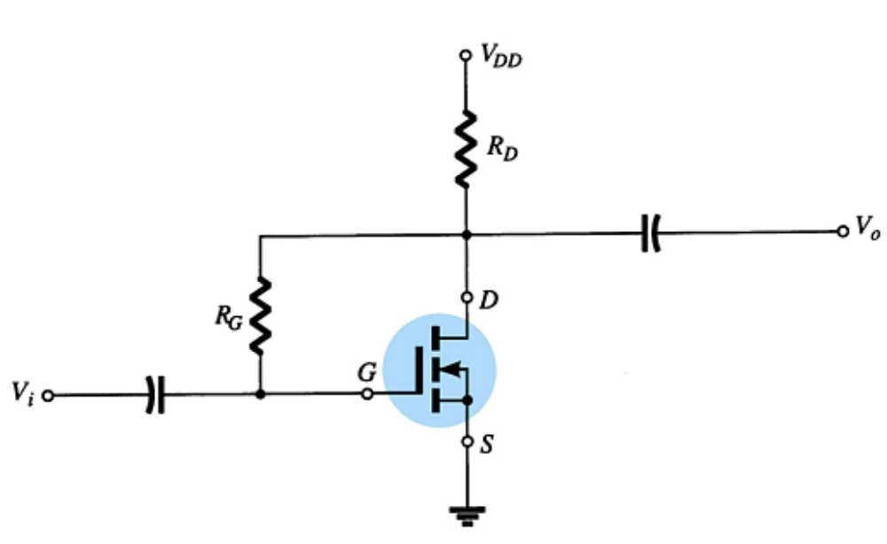
Feedback Bias Circuit
I_{G} = 0 A
V_{RG} = 0 V
V_{DS} = V_{GS}
V_{GS} = V_{DD} – I_{D}R_{D}

Slide 16
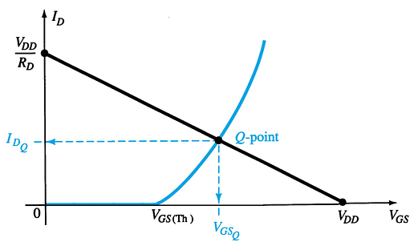
Feedback Bias Q-Point
Step 1
Plot the line using
  V_{GS} = V_{DD}, I_{D} = 0 A
  I_{D} = V_{DD} / R_{D} , V_{GS} = 0 V
Step 2
Using values from the specification sheet, plot the transfer curve with
  V_{GSTh} , I_{D} = 0 A
  V_{GS(on)}, I_{D(on)}
Step 3
The Q-point is located where the line and the transfer curve intersect
Step 4
Using the value of I_{D} at the Q-point, solve for the other variables in the bias circuit

Slide 17
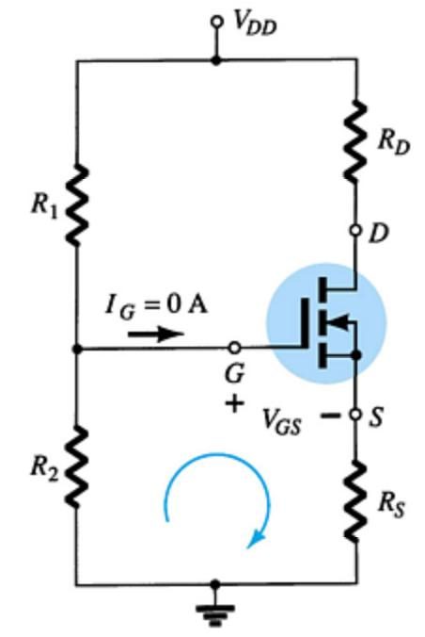
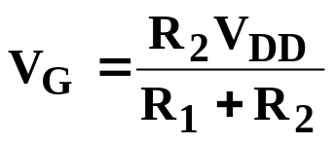
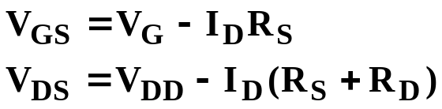
Voltage-Divider Biasing
Plot the line and the transfer curve to find the Q-point. Use these equations:

Slide 18
Voltage-Divider Bias Q-Point
Step 1
Plot the line using
  V_{GS} = V_{G} = (R₂V_{DD}) / (R₁ + R₂), I_{D} = 0 A
  I_{D} = V_{G}/R_{S} , V_{GS} = 0 V
Step 2
Using values from the specification sheet, plot the transfer curve with
  V_{GSTh}, I_{D} = 0 A
  V_{GS(on)} , I_{D(on)}
Step 3
The point where the line and the transfer curve intersect is the Q-point.
Step 4
Using the value of I_{D} at the Q-point, solve for the other circuit values.

Slide 19
p-Channel FETs
For p-channel FETs the same calculations and graphs are used, except that the voltage polarities and current directions are reversed.
The graphs are mirror images of the n-channel graphs.

Slide 20
Applications
Voltage-controlled resistor
JFET voltmeter
Timer network
Fiber optic circuitry
MOSFET relay driver

