Slide 1
Electronic Circuits
Prof. Nizamettin AYDIN
naydin@yildiz.edu.tr
http://www.yildiz.edu.tr/~naydin
Dr. Gökhan Bilgin
gokhanb@ce.yildiz.edu.tr
Notes:
Copyright 2000 N. AYDIN. All rights reserved.

Slide 2
FET Amplifiers
FETs provide:
  Excellent voltage gain
  High input impedance
  Low-power consumption
  Good frequency range

Slide 3
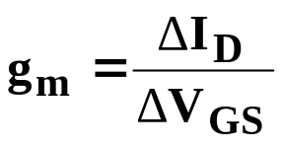
    FET Small-Signal Model
Transconductance
  The relationship of a change in I_{D} to the corresponding change in V_{GS} is called transconductance
  Transconductance is denoted g_{m} and given by:

Slide 4
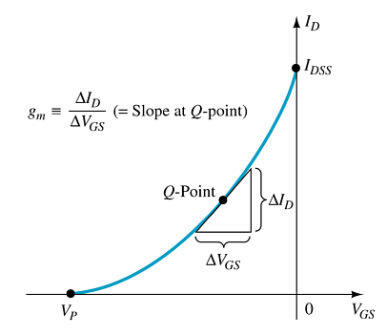
    Graphical Determination of g_{m}

Slide 5
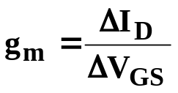
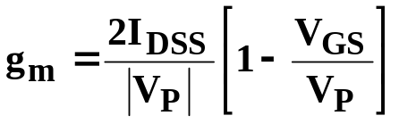
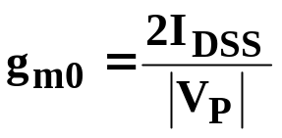
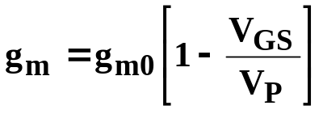
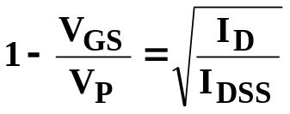
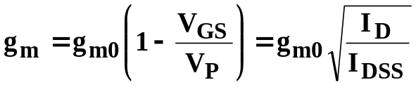
Mathematical Definitions of g_{m}
Where V_{GS} =0V
Where

Slide 6

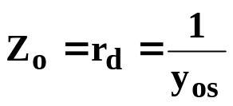
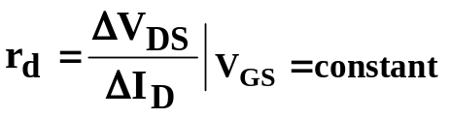
FET Impedance
Input impedance:
Output Impedance:
where:
y_{os}= admittance parameter listed on FET specification sheets.

Slide 7
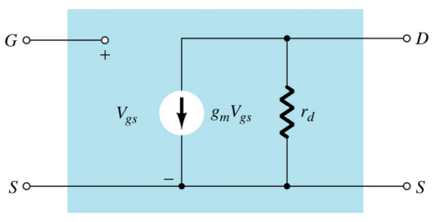
FET AC Equivalent Circuit

Slide 8
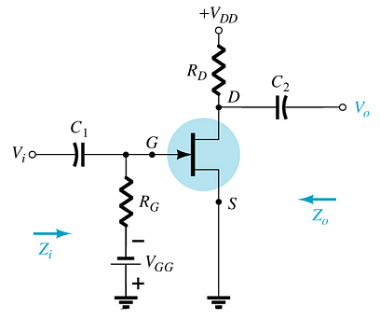
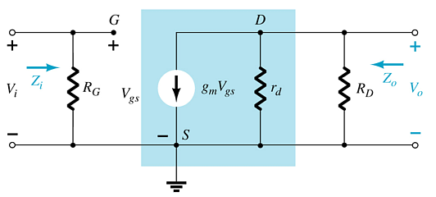
Common-Source (CS) Fixed-Bias Circuit
The input is on the gate and the output is on the drain
There is a 180° phase shift between input and output

Slide 9

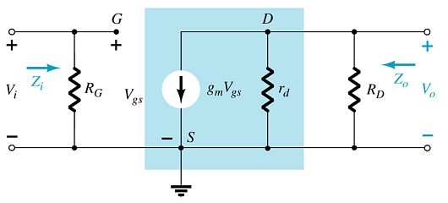

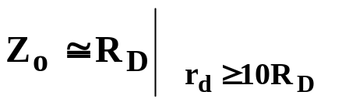
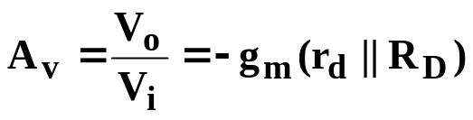
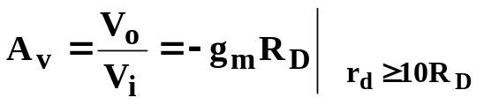
Calculations
Input impedance:
Output impedance:
Voltage gain:

Slide 10
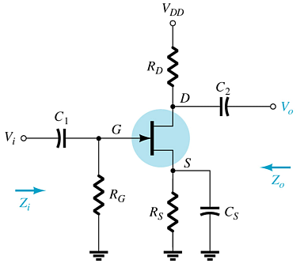

Common-Source (CS) Self-Bias Circuit
This is a common-source amplifier configuration, so the input is on the gate and the output is on the drain
There is a 180° phase shift between input and output

Slide 11
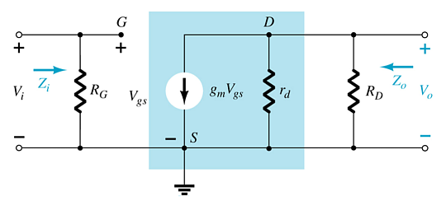


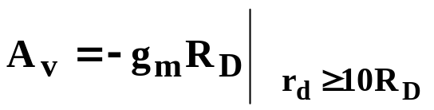
Calculations
Input impedance:
Output impedance:
Voltage gain:

Slide 12
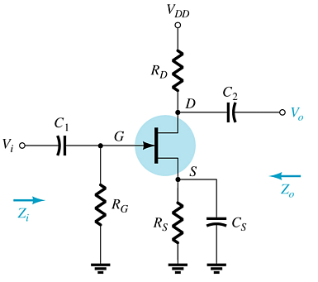
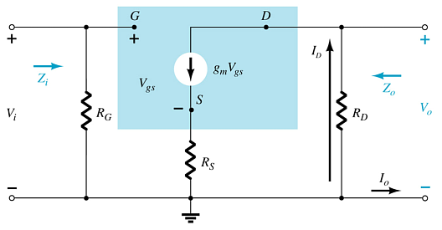
Common-Source (CS) Self-Bias Circuit
Removing C_{s} affects the gain of the circuit.

Slide 13
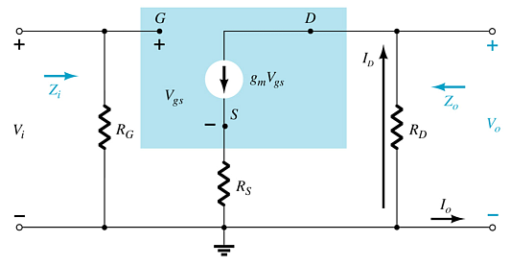
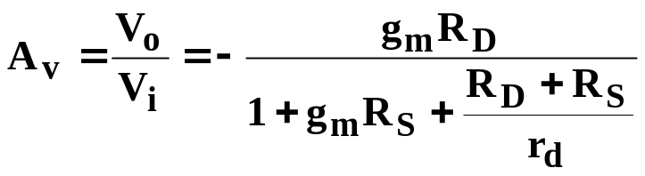
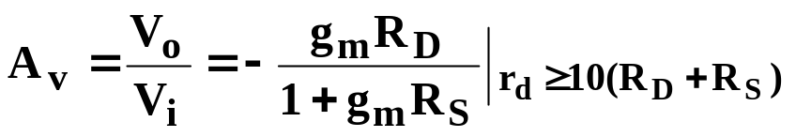
Calculations
Input impedance:
Output impedance:
Voltage gain:

Slide 14
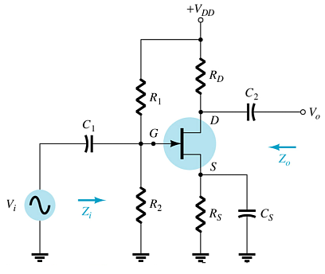
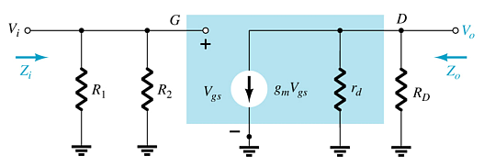
Common-Source (CS) Voltage-Divider Bias
This is a common-source amplifier configuration, so the input is on the gate and the output is on the drain.

Slide 15


Impedances
Input impedance:
Output impedance:
Voltage gain:

Slide 16
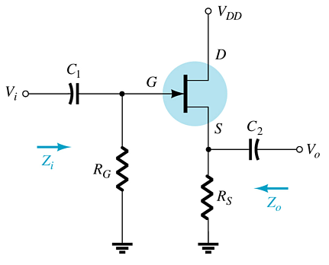
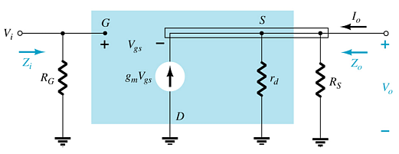
Source Follower (Common-Drain) Circuit
In a common-drain amplifier configuration, the input is on the gate, but the output is from the source.
There is no phase shift between input and output.

Slide 17

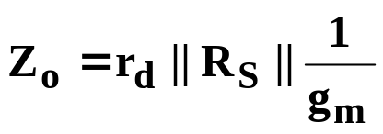
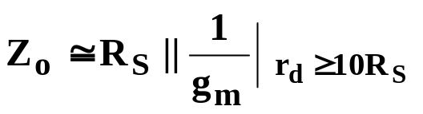
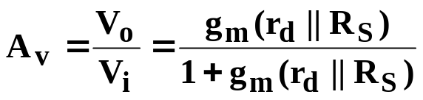
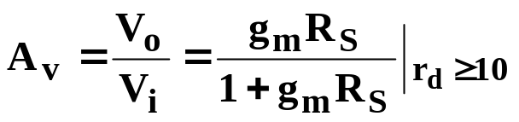
Impedances
Input impedance:
Output impedance:
Voltage gain:

Slide 18
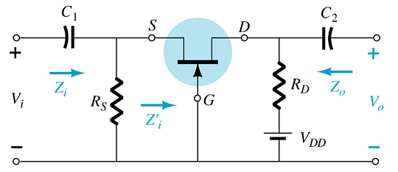
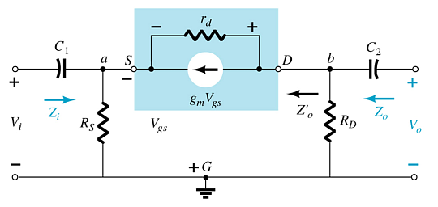
Common-Gate (CG) Circuit
The input is on the source and the output is on the drain.
There is no phase shift between input and output.

Slide 19
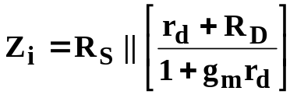



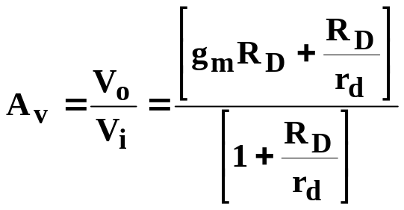

Calculations
Input impedance:
Output impedance:
Voltage gain:

Slide 20
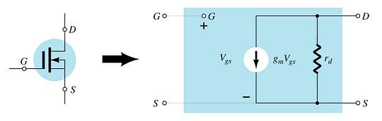
D-Type MOSFET AC Equivalent

Slide 21
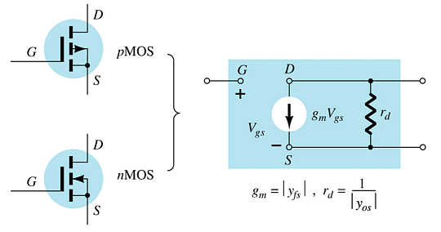
E-Type MOSFET AC Equivalent
g_{m} and r_{d} can be found in the specification sheet for the FET.

Slide 22
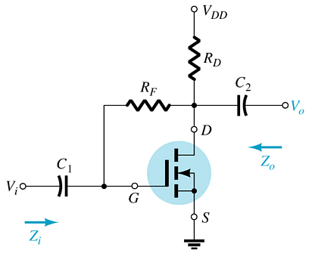
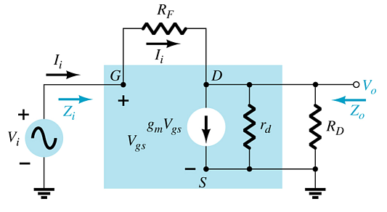
Common-Source Drain-Feedback
There is a 180° phase shift between input and output.

Slide 23
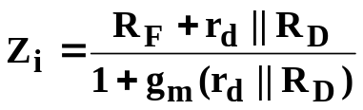
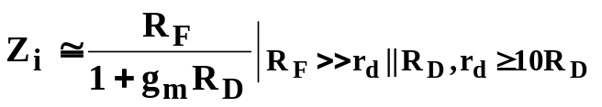




Calculations
Input impedance:
Output impedance:
Voltage gain:

Slide 24
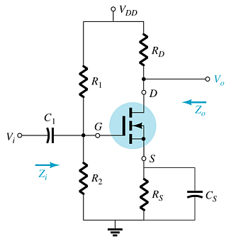
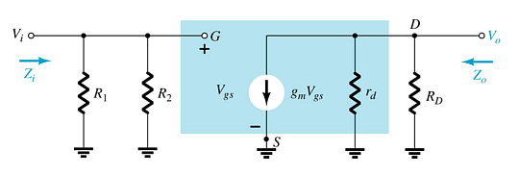
Common-Source Voltage-Divider Bias

Slide 25




Calculations
Input impedance:
Output impedance:
Voltage gain:

Slide 26
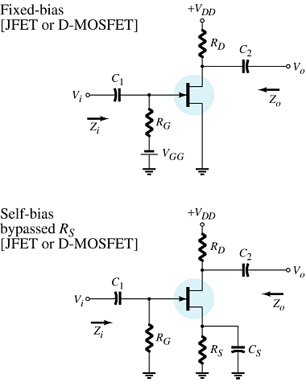
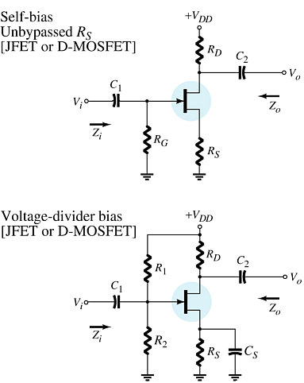
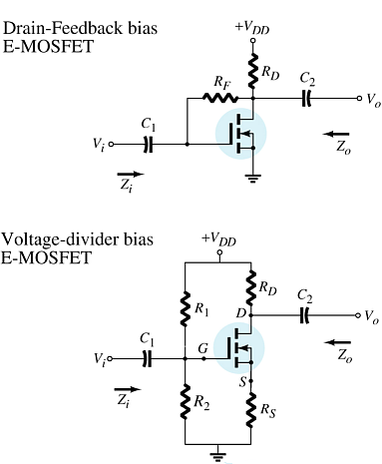
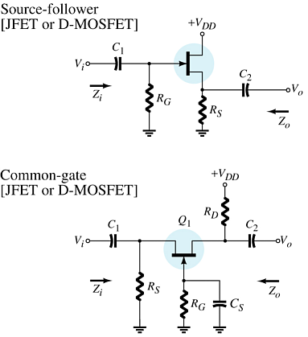
Summary Table
more…

Slide 27
Summary Table

Slide 28
Troubleshooting
Check the DC bias voltages:
  If not correct check power supply, resistors, FET. Also check to ensure that the coupling capacitor between amplifier stages is OK.
Check the AC voltages:
  If not correct check FET, capacitors and the loading effect of the next stage
.

Slide 29
    Practical Applications
Three-Channel Audio Mixer
Silent Switching
Phase Shift Networks
Motion Detection System

