Slide 1
Electronic Circuits
Prof. Nizamettin AYDIN
naydin@yildiz.edu.tr
http://www.yildiz.edu.tr/~naydin
Dr. Gökhan Bilgin
gokhanb@ce.yildiz.edu.tr
Notes:
Copyright 2000 N. AYDIN. All rights reserved.

Slide 2
BJT and FET Frequency Response

Slide 3
General Frequency Considerations
The frequency response of an amplifier refers to the frequency range in which the amplifier will operate with negligible effects from capacitors and device internal capacitance. This range of frequencies can be called the mid-range.
  At frequencies above and below the midrange, capacitance and any inductance will affect the gain of the amplifier.
  At low frequencies the coupling and bypass capacitors lower the gain.
  At high frequencies stray capacitances associated with the active device lower the gain.
  Also, cascading amplifiers limits the gain at high and low frequencies.

Slide 4
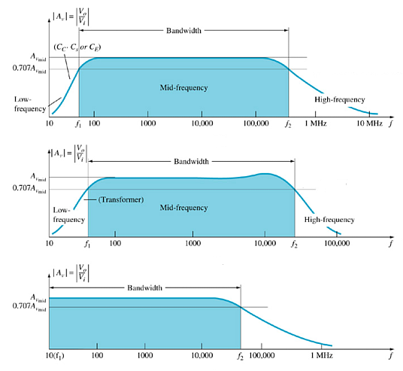
Bode Plot
A Bode plot indicates the frequency response of an amplifier.
The horizontal scale indicates the frequency (in Hz) and the vertical scale indicates the gain (in dB).

Slide 5
Cutoff Frequencies
The mid-range frequency range of an amplifier is called the bandwidth of the amplifier.
The bandwidth is defined by the lower and upper cutoff frequencies.
Cutoff – any frequency at which the gain has dropped by 3 dB.

Slide 6
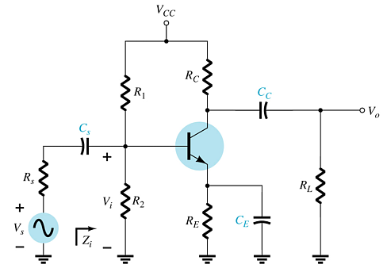
BJT Amplifier Low-Frequency Response
At low frequencies, coupling capacitor (C_{S}, C_{C}) and bypass capacitor (C_{E}) reactances affect the circuit impedances.

Slide 7
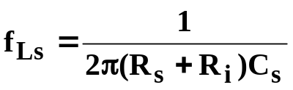

Coupling Capacitor (C_{S})
The cutoff frequency due to C_{S} can be calculated by
where

Slide 8
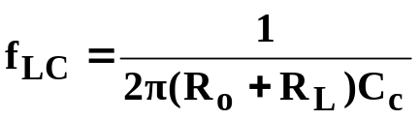

Coupling Capacitor (C_{C})
The cutoff frequency due to C_{C} can be calculated with
where

Slide 9
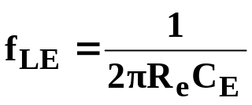
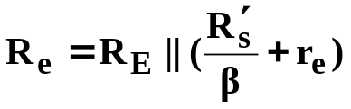

Bypass Capacitor (C_{E})
The cutoff frequency due to C_{E} can be calculated with
where
and

Slide 10
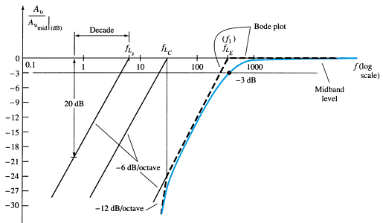
BJT Amplifier Low-Frequency Response
The Bode plot indicates that each capacitor may have a different cutoff frequency.
It is the device that has the highest lower cutoff frequency (f_{L}) that dominates the overall frequency response of the amplifier.

Slide 11
Roll-Off of Gain in the Bode Plot
The Bode plot not only indicates the cutoff frequencies of the various capacitors it also indicates the amount of attenuation (loss in gain) at these frequencies.
The amount of attenuation is sometimes referred to as roll-off.
The roll-off is described as dB loss-per-octave or dB loss-per-decade.

Slide 12
Roll-off Rate (-dB/Decade)
-dB/decade refers to the attenuation for every 10-fold change in frequency.
For attenuations at the low-frequency end, it refers to the loss in gain from the lower cutoff frequency to a frequency that is one-tenth the cutoff value.
In this example:
  f_{LS} = 9kHz gain is 0dB
  f_{LS}/10 = .9kHz gain is –20dB
  Thus the roll-off is 20dB/decade
  The gain decreases by –20dB/decade

Slide 13
Roll-Off Rate (–dB/Octave)
-dB/octave refers to the attenuation for every 2-fold change in frequency.
For attenuations at the low-frequency end, it refers to the loss in gain from the lower cutoff frequency to a frequency one-half the cutoff value.
In this example:
  f_{LS} = 9kHz gain is 0dB
  f_{LS} / 2 = 4.5kHz gain is –6dB
  Therefore the roll-off is 6dB/octave.
This is a little difficult to see on this graph because the horizontal scale is a logarithmic scale.

Slide 14
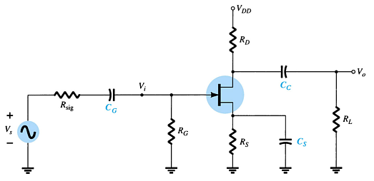
FET Amplifier Low-Frequency Response
At low frequencies, coupling capacitor (C_{G}, C_{C}) and bypass capacitor (C_{S}) reactances affect the circuit impedances.

Slide 15
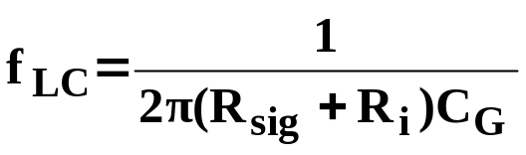

Coupling Capacitor (C_{G})
The cutoff frequency due to C_{G} can be calculated with
where

Slide 16
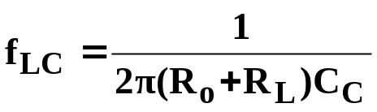

Coupling Capacitor (C_{C})
The cutoff frequency due to C_{C} can be calculated with
where

Slide 17
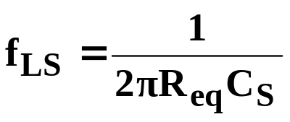
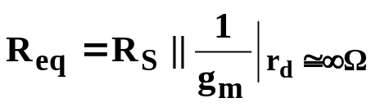
Bypass Capacitor (C_{S})
The cutoff frequency due to C_{S} can be calculated with
where

Slide 18
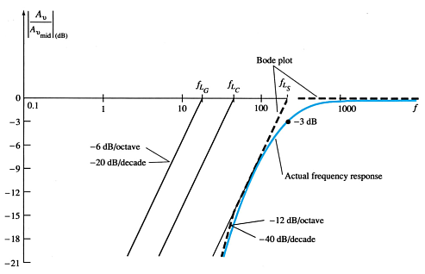
FET Amplifier Low-Frequency Response
The Bode plot indicates that each capacitor may have a different cutoff frequency.
The capacitor that has the highest lower cutoff frequency (f_{L}) is closest to the actual cutoff frequency of the amplifier.

Slide 19
Miller Capacitance
Any p-n junction can develop capacitance. In a BJT amplifier, this capacitance becomes noticeable across:
  The base-collector junction at high frequencies in common-emitter BJT amplifier configurations
  The gate-drain junction at high frequencies in common-source FET amplifier configurations.
These capacitances are represented as separate input and output capacitances, called the Miller Capacitances.

Slide 20
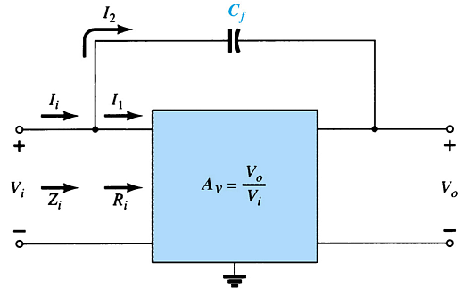

Miller Input Capacitance (C_{Mi})
Note that the amount of Miller capacitance is dependent on inter-electrode capacitance from input to output (C_{f}) and the gain (A_{v}).

Slide 21
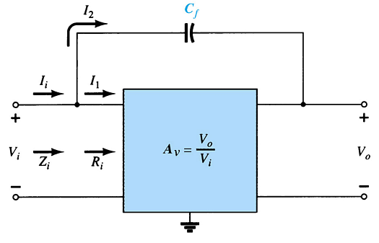
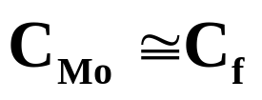
Miller Output Capacitance (C_{Mo})
If the gain (A_{v}) is considerably greater than 1, then

Slide 22
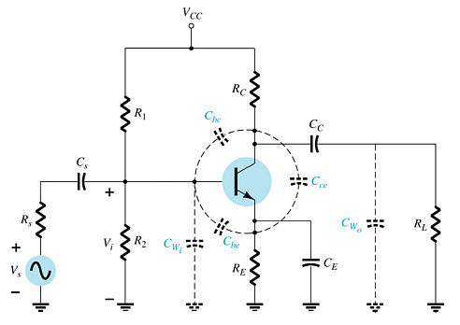
BJT Amplifier High-Frequency Response
Capacitances that affect the high-frequency response are
  Junction capacitances
    C_{be}, C_{bc}, C_{ce}
  Wiring capacitances
    C_{wi}, C_{wo}
  Coupling capacitors
    C_{S}, C_{C}
  Bypass capacitor
    C_{E}

Slide 23
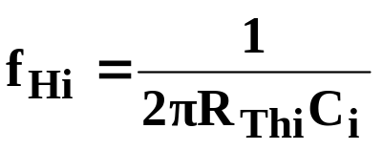

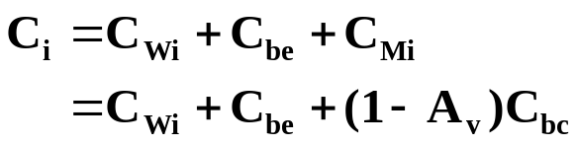
Input Network (f_{Hi}) High-Frequency Cutoff
where
and

Slide 24
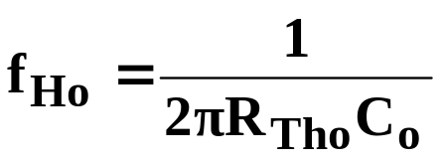


Output Network (f_{Ho}) High-Frequency Cutoff
where
and

Slide 25
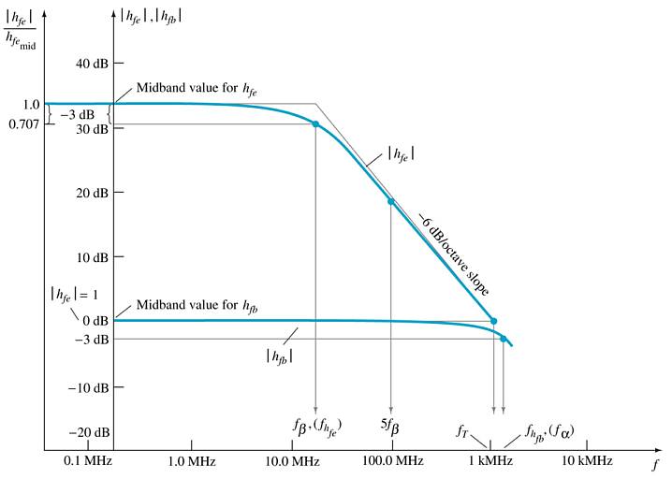
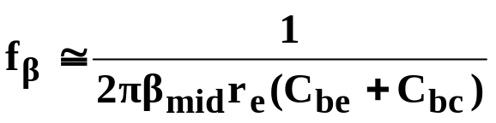
h_{fe} (or β) Variation
The h_{fe} parameter (or β) of a transistor varies with frequency

Slide 26
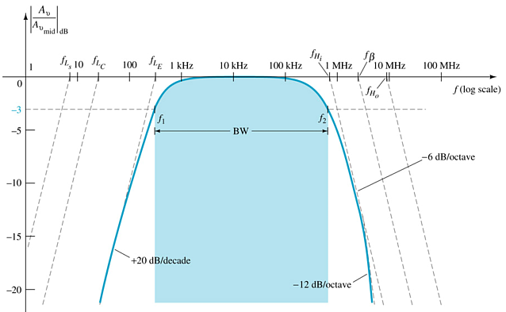
BJT Amplifier Frequency Response
Note the highest lower cutoff frequency (f_{L}) and the lowest upper cutoff frequency (f_{H}) are closest to the actual response of the amplifier.

Slide 27
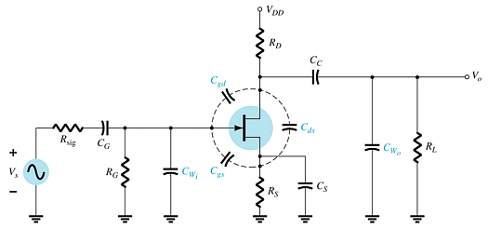
FET Amplifier High-Frequency Response
Capacitances that affect the high-frequency response are
  Junction capacitances
    C_{gs}, C_{gd}, C_{ds}
  Wiring capacitances
    C_{wi}, C_{wo}
  Coupling capacitors
    C_{G}, C_{C}
  Bypass capacitor
    C_{S}

Slide 28
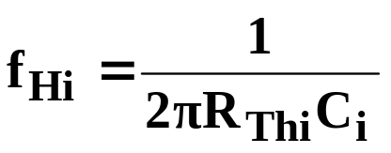



Input Network (f_{Hi}) High-Frequency Cutoff

Slide 29
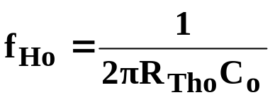

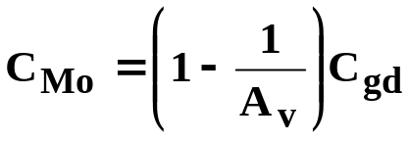

Output Network (f_{Ho}) High-Frequency Cutoff

Slide 30
Multistage Frequency Effects
Each stage will have its own frequency response, but the output of one stage will be affected by capacitances in the subsequent stage. This is especially so when determining the high frequency response. For example, the output capacitance (C_{o}) will be affected by the input Miller Capacitance (C_{Mi}) of the next stage.

Slide 31
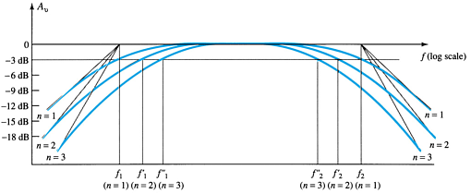
Multistage Amplifier Frequency Response
Once the cutoff frequencies have been determined for each stage (taking into account the shared capacitances), they can be plotted.
Note the highest lower cutoff frequency (f_{L}) and the lowest upper cutoff frequency (f_{H}) are closest to the actual response of the amplifier.

Slide 32
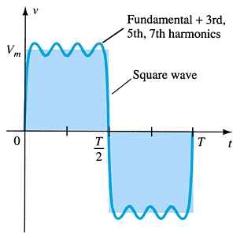
Square Wave Testing
In order to determine the frequency response of an amplifier by experimentation, you must apply a wide range of frequencies to the amplifier.
One way to accomplish this is to apply a square wave. A square wave consists of multiple frequencies (by Fourier analysis: it consists of odd harmonics).

Slide 33
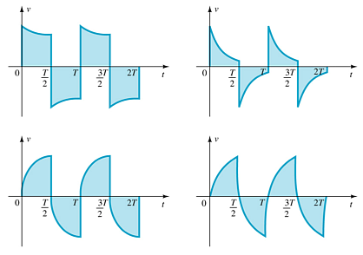
Square Wave Response Waveforms
If the output of the amplifier is not a perfect square wave then the amplifier is ‘cutting’ off certain frequency components of the square wave.

