Slide 1
Electronic Circuits
Prof. Nizamettin AYDIN
naydin@yildiz.edu.tr
http://www.yildiz.edu.tr/~naydin
Dr. Gökhan Bilgin
gokhanb@ce.yildiz.edu.tr
Notes:
Copyright 2000 N. AYDIN. All rights reserved.

Slide 2
Power Amplifiers

Slide 3
Definitions
In small-signal amplifiers the main factors are:
  Amplification
  Linearity
  Gain
Since large-signal, or power, amplifiers handle relatively large voltage signals and current levels, the main factors are:
  Efficiency
  Maximum power capability
  Impedance matching to the output device

Slide 4
Amplifier Types
Class A
  The amplifier conducts through the full 360° of the input. The Q-point is set near the middle of the load line.
Class B
  The amplifier conducts through 180° of the input. The Q-point is set at the cutoff point.
Class AB
  This is a compromise between the class A and B amplifiers. The amplifier conducts somewhere between 180° and 360° . The Q-point is located between the mid-point and cutoff.
more…

Slide 5
Amplifier Types
Class C
  The amplifier conducts less than 180 of the input. The Q-point is located below the cutoff level.
Class D
  This is an amplifier that is biased especially for digital signals.

Slide 6
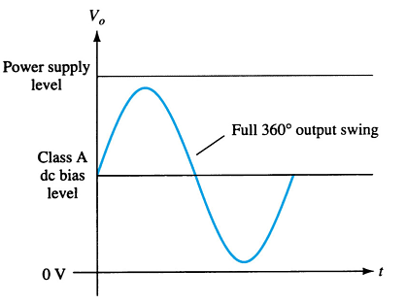
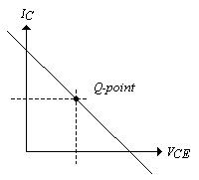
Class A Amplifier
The output of a class A amplifier conducts for the full 360° of the cycle.
The Q-point is set at the middle of the load line so that the AC signal can swing a full cycle.
  Remember that the DC load line indicates the maximum and minimum limits set by the DC power supply.

Slide 7
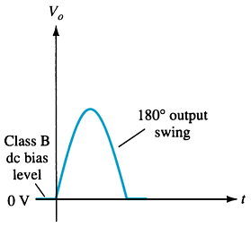
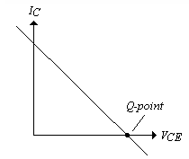
Class B Amplifier
A class B amplifier output only conducts for 180° or one-half of the AC input signal.
The Q-point is at 0V on the load line, so that the AC signal can only swing for one-half cycle.

Slide 8
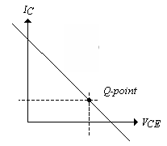
Class AB Amplifier
This amplifier is a compromise between the class A and class B amplifier—the Q-point is above that of the Class B but below the class A.
The output conducts between 180° and 360° of the AC input signal.

Slide 9
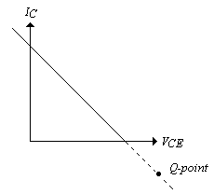
Class C
The output of the class C conducts for less than 180° of the AC cycle. The Q-point is below cutoff.

Slide 10
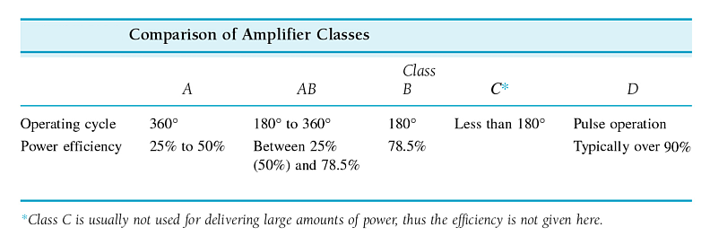
Amplifier Efficiency
Efficiency refers to the ratio of output to input power. The lower the amount of conduction of the amplifier the higher the efficiency.

Slide 11
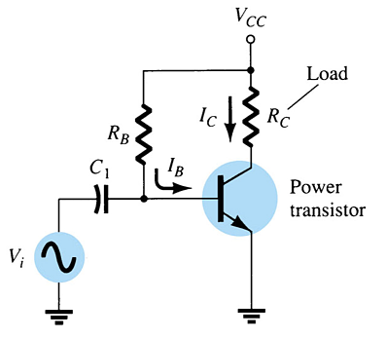
Series-Fed Class A Amplifier
This is similar to the small-signal amplifier except that it will handle higher voltages. The transistor used is a high-power transistor.

Slide 12
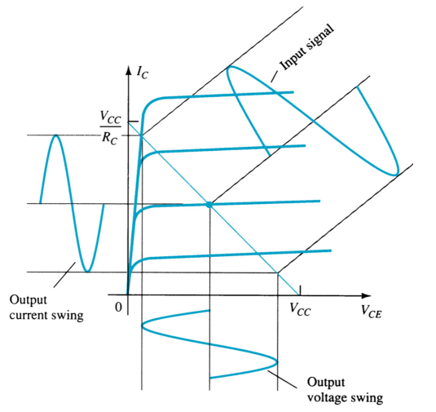
Series-Fed Class A Amplifier
A small input signal causes the output voltage to swing to a maximum of V_{cc} and a minimum of 0V. The current can also swing from 0mA to I_{CSAT} (V_{CC}/R_{C})

Slide 13

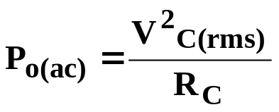
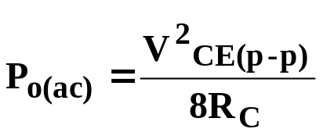
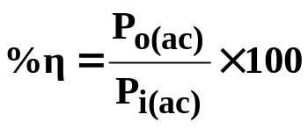
Series-Fed Class A Amplifier
Input Power
The power into the amplifier is from the DC supply. With no input signal, the DC current drawn is the collector bias current, I_{CQ}.
Output Power
or
Efficiency

Slide 14
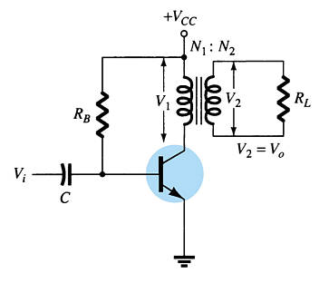
Transformer-Coupled Class A Amplifier
This circuit uses a transformer to couple to the load. This improves the efficiency of the Class A to 50%.

Slide 15
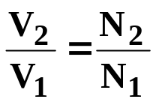
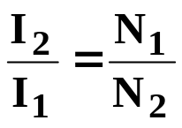
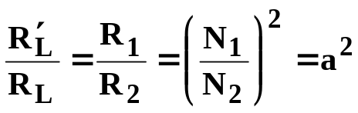
Transformer Action
A transformer improves the efficiency because it is able to transform the voltage, current, and impedance
  Voltage Ratio
  Current Ratio
  Impedance Ratio

Slide 16
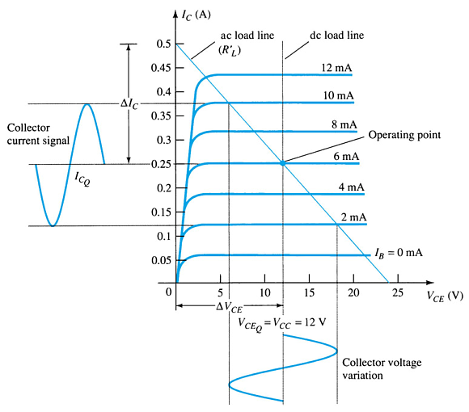
Transformer-Coupled Class A Amplifier
DC Load Line
As in all class A amplifiers the Q-point is established close to the midpoint of the DC load line.
AC Load Line
The saturation point (I_{Cmax}) is at V_{cc}/R′_{L} and the cutoff point is at V₂ (the secondary voltage of the transformer). This increases the maximum output swing because the minimum and maximum values of I_{C} and V_{CE} are spread further apart.

Slide 17


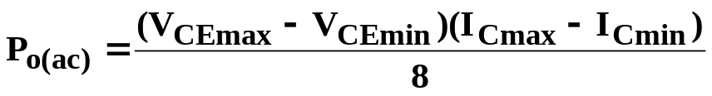
Transformer-Coupled Class A Amplifier
Signal Swing and Output AC Power
The voltage swing:
The current swing:
The AC power:

Slide 18


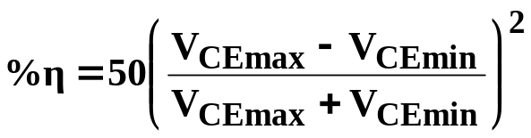
Transformer-Coupled Class A Amplifier Efficiency
Power input from the DC source:
Power dissipated as heat across the transistor:
Note: The larger the input and output signal, the lower the heat dissipation.
Maximum efficiency:
Note: The larger V_{CEmax} and smaller V_{CEmin}, the closer the efficiency approaches the theoretical maximum of 50%.

Slide 19
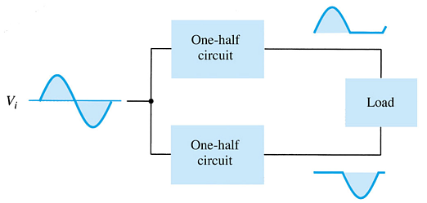
Class B Amplifier
In class B, the transistor is biased just off. The AC signal turns the transistor on.
The transistor only conducts when it is turned on by one-half of the AC cycle.
In order to get a full AC cycle out of a class B amplifier, you need two transistors:
An npn transistor that provides the negative half of the AC cycle
A pnp transistor that provides the positive half.

Slide 20
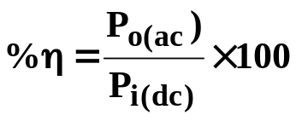
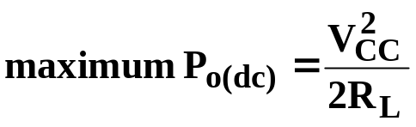
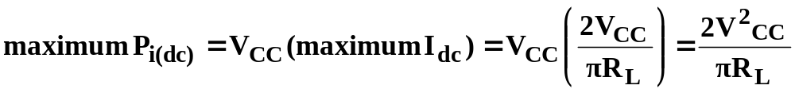
    Class B Amplifier: Efficiency
The maximum efficiency of a class B is 78.5%..
For maximum power, V_{L}=V_{CC}

Slide 21
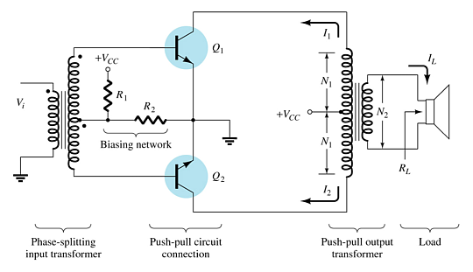
Transformer-Coupled Push-Pull
Class B Amplifier
The center-tapped transformer on the input produces opposite polarity signals to the two transistor inputs.
The center-tapped transformer on the output combines the two halves of the AC waveform together.

Slide 22
Class B Amplifier Push-Pull Operation
During the positive half-cycle of the AC input, transistor Q₁ (npn) is conducting and Q₂ (pnp) is off.
During the negative half-cycle of the AC input, transistor Q₂ (pnp) is conducting and Q₁ (npn) is off.
Each transistor produces one-half of an AC cycle. The transformer combines the two outputs to form a full AC cycle.

Slide 23
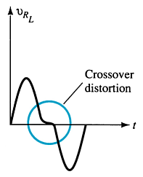
Crossover Distortion
If the transistors Q₁ and Q₂ do not turn on and off at exactly the same time, then there is a gap in the output voltage.

Slide 24
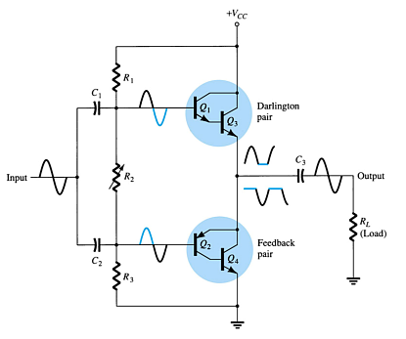
Quasi-Complementary Push-Pull Amplifier
A Darlington pair and a feedback pair combination perform the push-pull operation. This increases the output power capability.

Slide 25
Amplifier Distortion
If the output of an amplifier is not a complete AC sine wave, then it is distorting the output. The amplifier is non-linear.
This distortion can be analyzed using Fourier analysis. In Fourier analysis, any distorted periodic waveform can be broken down into frequency components. These components are harmonics of the fundamental frequency.

Slide 26
Harmonics
Harmonics are integer multiples of a fundamental frequency.
If the fundamental frequency is 5kHz:
  1st harmonic 1 x 5kHz
  2nd harmonic 2 x 5kHz
  3rd harmonic 3 x 5kHz
  4th harmonic 4 x 5kHz
  etc.
Note that the 1st and 3rd harmonics are called odd harmonics and the 2nd and 4th are called even harmonics.

Slide 27
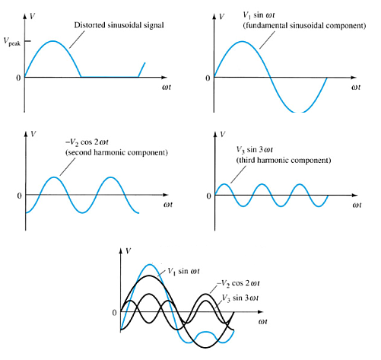
Harmonic Distortion
According to Fourier analysis, if a signal is not purely sinusoidal, then it contains harmonics.

Slide 28
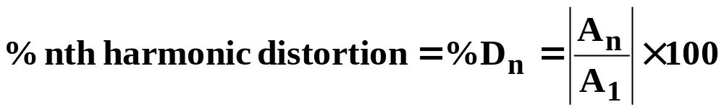
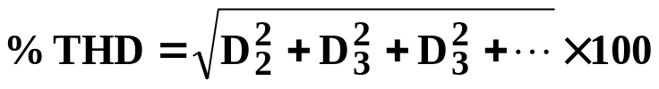
Harmonic Distortion Calculations
Harmonic distortion (D) can be calculated:
where
  A_{n} is the amplitude of the fundamental frequency
  A_{n} is the amplitude of the highest harmonic
The total harmonic distortion (THD) is determined by:

Slide 29
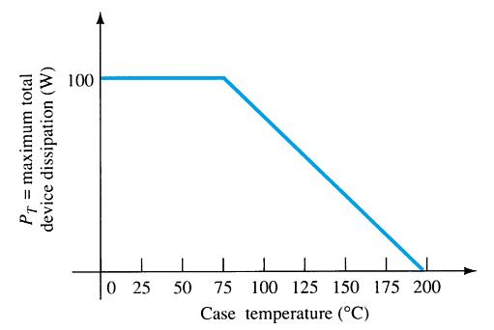
Power Transistor Derating Curve
Power transistors dissipate a lot of power in heat. This can be destructive to the amplifier as well as to surrounding components.

Slide 30
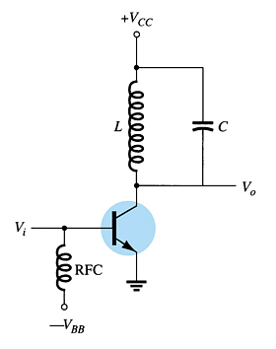
Class C Amplifiers
A class C amplifier conducts for less than 180°. In order to produce a full sine wave output, the class C uses a tuned circuit (LC tank) to provide the full AC sine wave.
Class C amplifiers are used extensively in radio communications circuits.

Slide 31
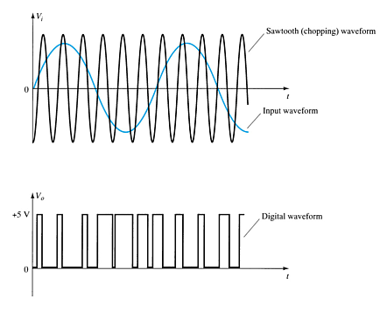
Class D Amplifier
A class D amplifier amplifies pulses, and requires a pulsed input.
There are many circuits that can convert a sinusoidal waveform to a pulse, as well as circuits that convert a pulse to a sine wave. This circuit has applications in digital circuitry.

