Slide 1
Electronic Circuits
Prof. Nizamettin AYDIN
naydin@yildiz.edu.tr
http://www.yildiz.edu.tr/~naydin
Dr. Gökhan Bilgin
gokhanb@ce.yildiz.edu.tr
Notes:
Copyright 2000 N. AYDIN. All rights reserved.

Slide 2
Digital devices
Introduction
Gate characteristics
Logic families
TTL
CMOS
Interfacing
Noise and EMC in digital systems.

Slide 3
Introduction
Earlier we looked at a range of digital applications based on logic gates – at that time we treated the gates as ‘black boxes’.
We will now consider the construction of such gates, and their characteristics.
Many terms are used to describe integration level.
In this lecture we will concentrate on small- and medium-scale integration circuits containing just a handful of gates.

Slide 4
Introduction (contd.)
Integration level | Number of transistors
Zero scale integration (ZSI) | 1
Small scale integration (SSI) | 2–30
Medium scale integration (MSI) | 30 - 10³
Large scale integration (LSI) | 10³ - 10⁵
Very large scale integration (VLSI) | 10⁵ – 10⁷
Ultra large scale integration (ULSI) | 10⁷ – 10⁹
Giga-scale integration (GSI) | 10⁹ – 10¹¹
Tera-scale integration (TSI) | 10¹¹ – 10¹³

Slide 5
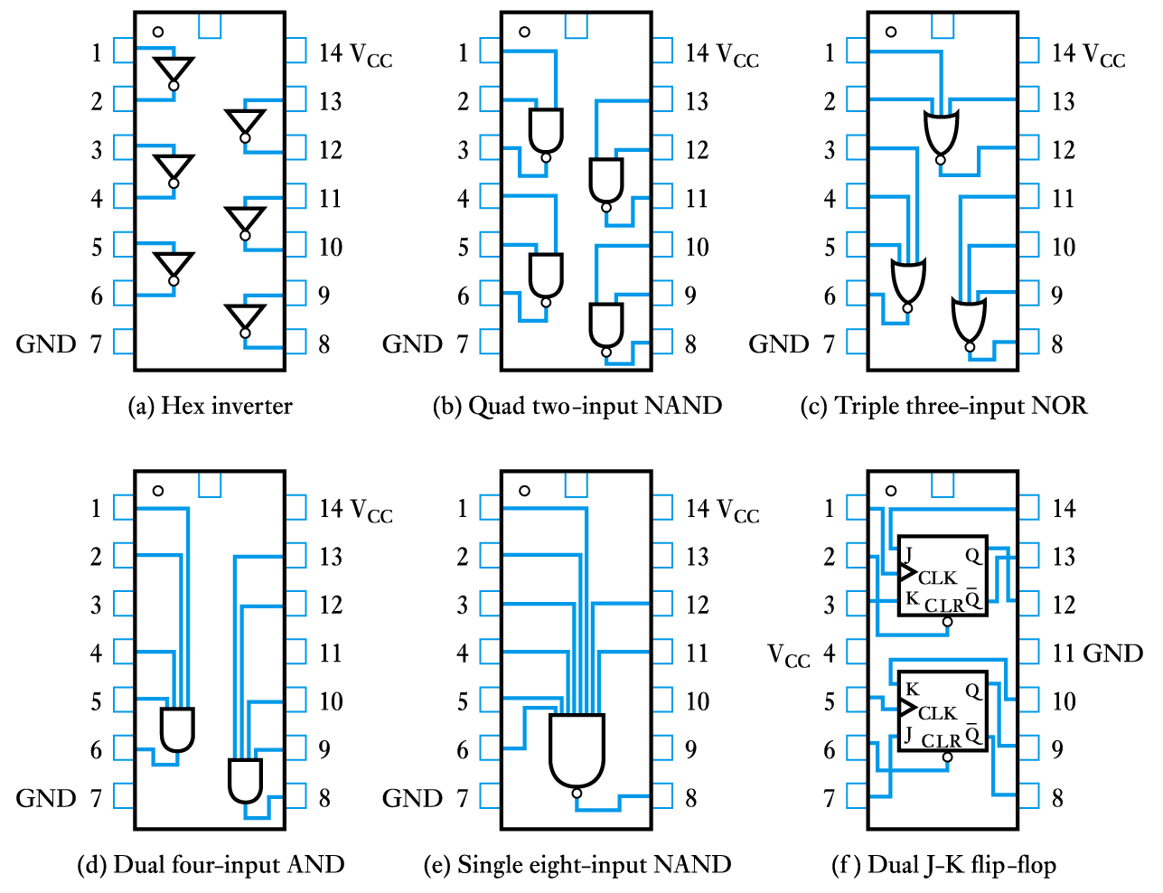
Introduction (contd.)
Typical logic device pin-outs.

Slide 6
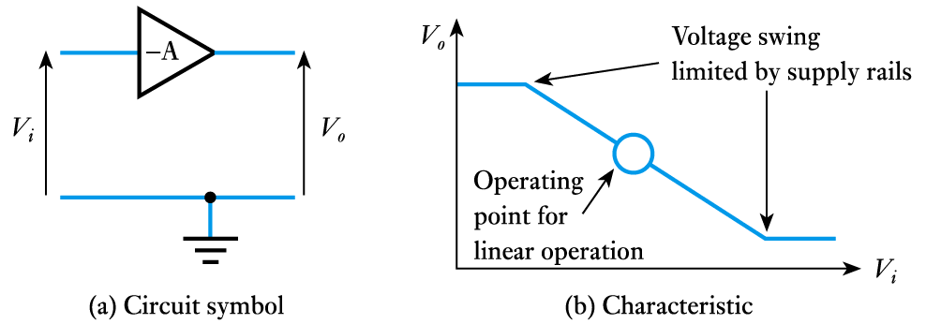
Gate characteristics
The inverter or NOT gate
  consider the characteristics of a simple inverting amplifier as shown below
  we normally use only the linear region.

Slide 7
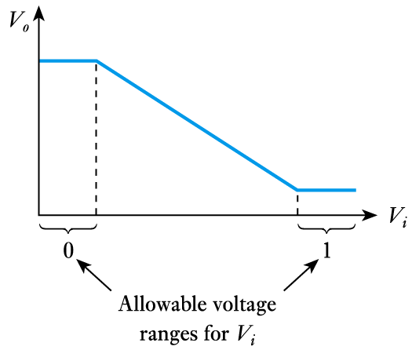
Gate characteristics (contd.)
We can use an inverting amplifier as a logical inverter but using only the non-linear region.

Slide 8
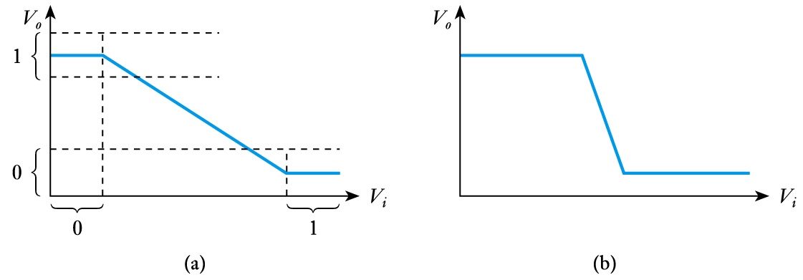
Gate characteristics (contd.)
  We choose input values to ensure that we are always outside of the linear region – as in (a).
  Unlike linear amplifiers, we use circuits with a rapid transition between the non-linear regions – as in (b).

Slide 9
Gate characteristics (contd.)
Logic levels
  The voltage ranges representing ‘0’ and ‘1’ represent the logic levels of the circuit.
  Often logic 0 is represented by a voltage close to 0 V but the allowable voltage range varies considerably.
  The voltage used to represent logic 1 also varies greatly. In some circuits it might be 2-4 V, while in others it might be 12-15 V.
  In order for one gate to work with another the logic levels must be compatible.

Slide 10
Gate characteristics (contd.)
Noise immunity
  Noise is present in all real systems.
  This adds random fluctuations to voltages representing logic levels.
  To cope with noise, the voltage ranges defining the logic levels are more tightly constrained at the output of a gate than at the input.
  Thus small amounts of noise will not affect the circuit.
  The maximum noise voltage that can be tolerated by a circuit is termed its noise immunity, V_{NI} .

Slide 11
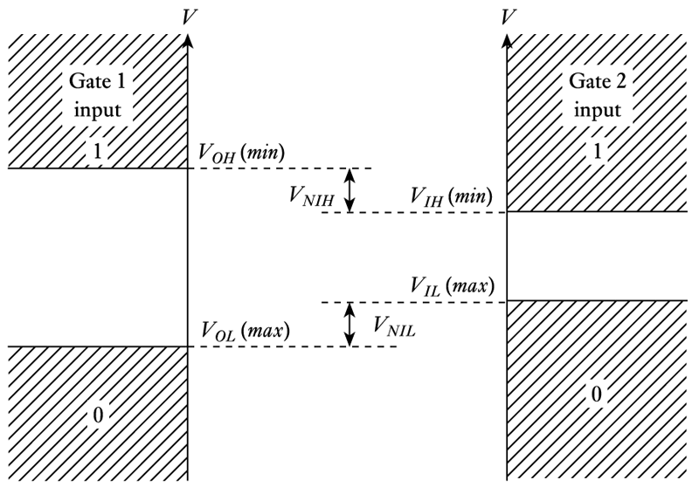
Gate characteristics (contd.)
A graphical representation of noise immunity.

Slide 12
Gate characteristics (contd.)
Transistors as switches
  Both FETs and bipolar transistors make good switches.
  Neither form produce ideal switches and their characteristics are slightly different.
  Both forms of device take a finite time to switch and this produces a slight delay in the operation of the gate.
  This is termed the propagation delay of the circuit.

Slide 13
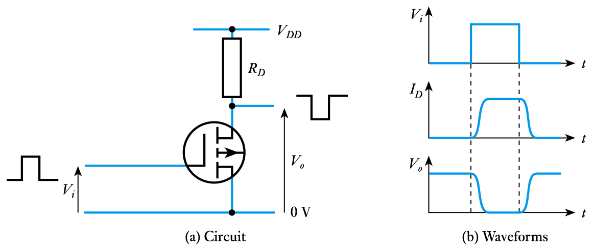
Gate characteristics (contd.)
The FET as a logical switch

Slide 14
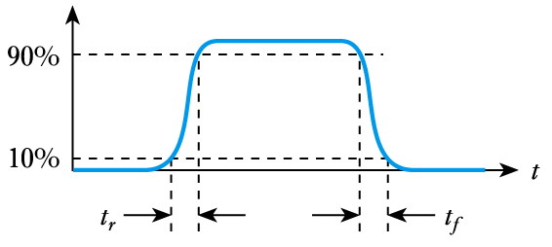
Gate characteristics (contd.)
Rise and fall times
  because the waveforms are not perfectly square we need a way of measuring switching times
  we measure the rise time, t_{r} and fall time, t_{f} as shown below

Slide 15
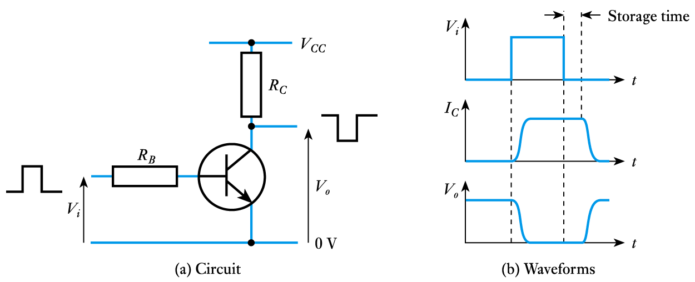
Gate characteristics (contd.)
The bipolar transistor as a logical switch

Slide 16
Gate characteristics (contd.)
  When the input voltage to a bipolar transistor is high the transistor turns ON and the output voltage is driven down to its saturation voltage, which is about 0.1 V.
  However, saturation of the transistor results in the storage of excess charge in the base region.
  This increases the time taken to turn OFF the device – an effect known as storage time.
  This makes the device faster to turn ON than OFF.
  Some switching circuits increase speed by preventing the transistors from entering saturation.

Slide 17
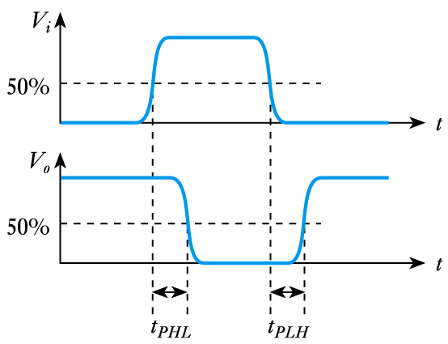

Gate characteristics (contd.)
Timing considerations
  all gates have a certain propagation delay time, t_{PD}
  this is the average of the two switching times.

Slide 18
Logic families
We have seen that different devices use different voltages ranges for their logic levels.
They also differ in other characteristics.
In order to assure correct operation when gates are interconnected they are normally produced in families.
We will look briefly at a range of logic families, then concentrate on the most important ones, namely TTL and CMOS.

Slide 19
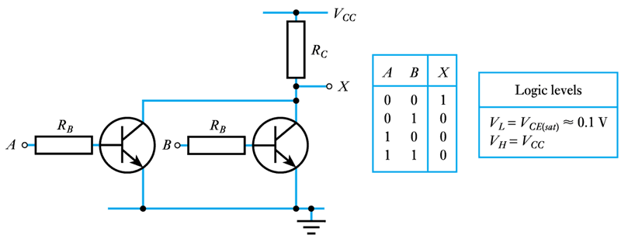
Logic families (contd.)
Resistor-transistor logic (RTL)
  an RTL NOR gate

Slide 20
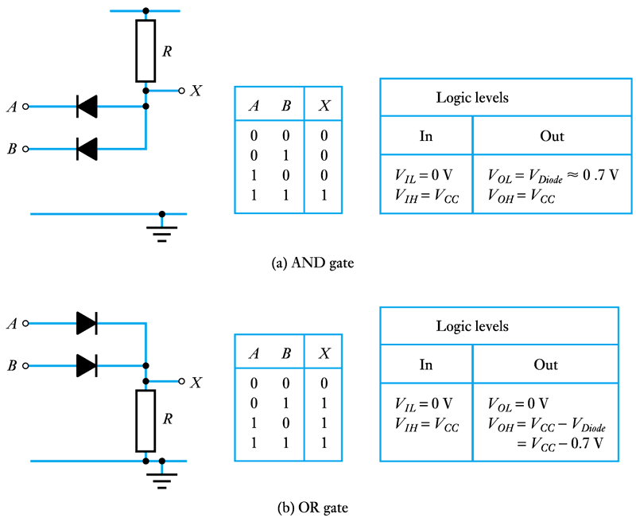
Logic families (contd.)
Diode logic

Slide 21
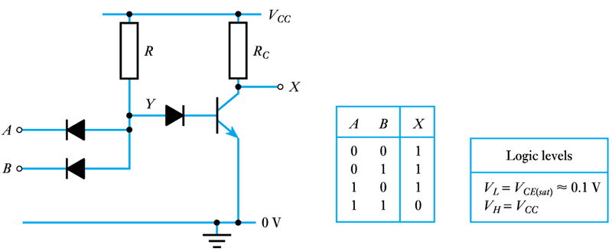
Logic families (contd.)
Diode-transistor logic
  A DTL NAND gate

Slide 22
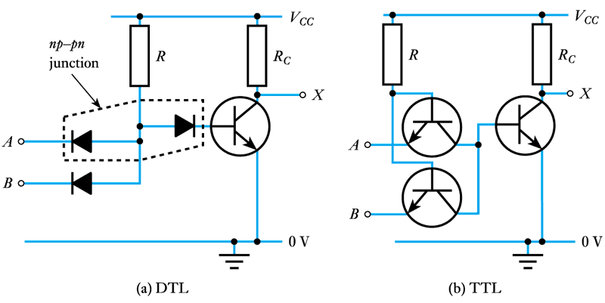
Logic families (contd.)
Replacing the diodes of a DTL gate with transistors

Slide 23
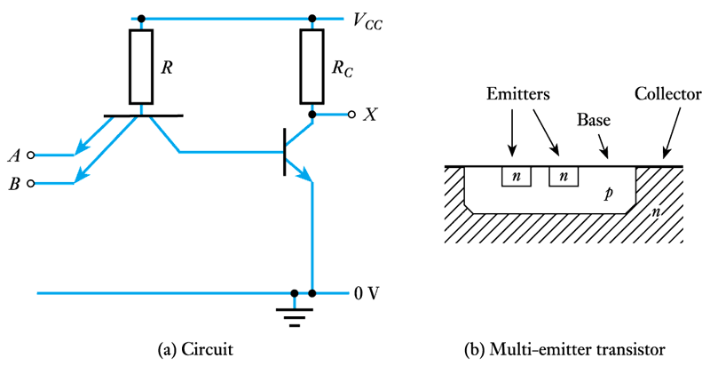
Logic families (contd.)
Transistor-transistor logic (TTL)
  a simple TTL NAND gate

Slide 24
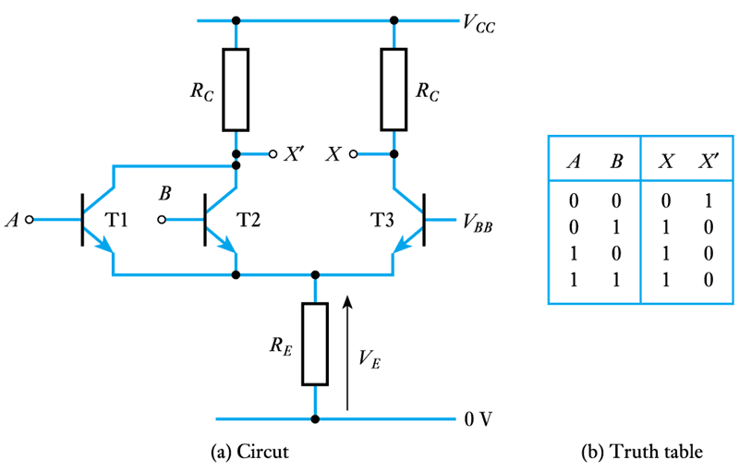
Logic families (contd.)
A non-saturating logic gate.

Slide 25
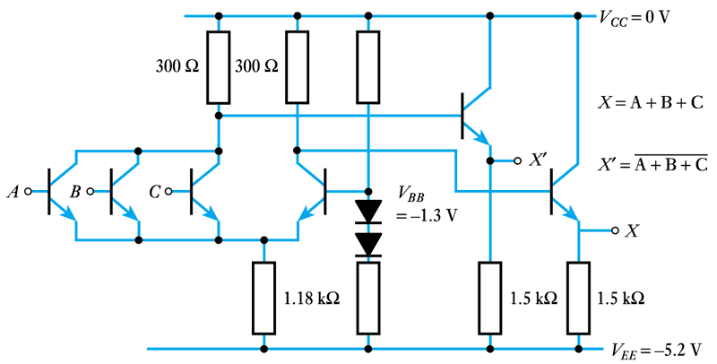
Logic families (contd.)
Emitter-coupled logic (ECL)
  a three-input ECL OR/NOR gate

Slide 26
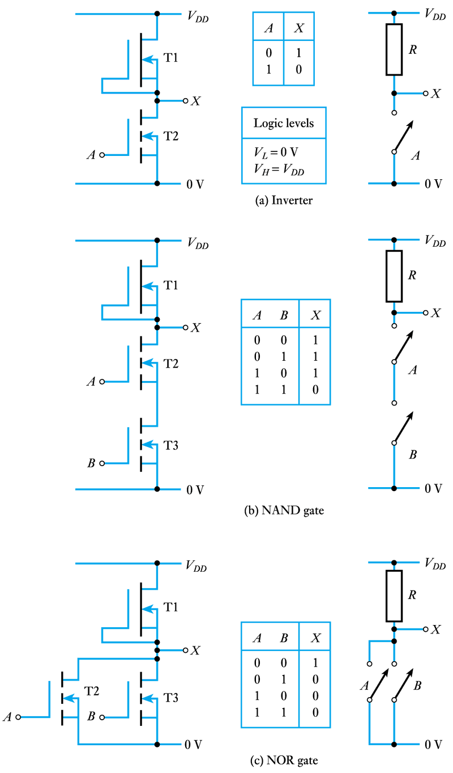
Logic families (contd.)
Metal oxide semiconductor (MOS) logic
  NMOS gates

Slide 27
Logic families (contd.)
  NMOS NAND
  and NOR gates

Slide 28
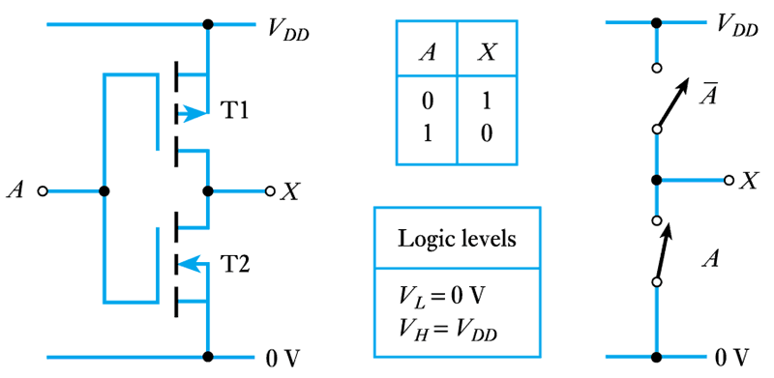
Logic families (contd.)
Complementary metal oxide semiconductor (CMOS) logic
  a CMOS inverter

Slide 29
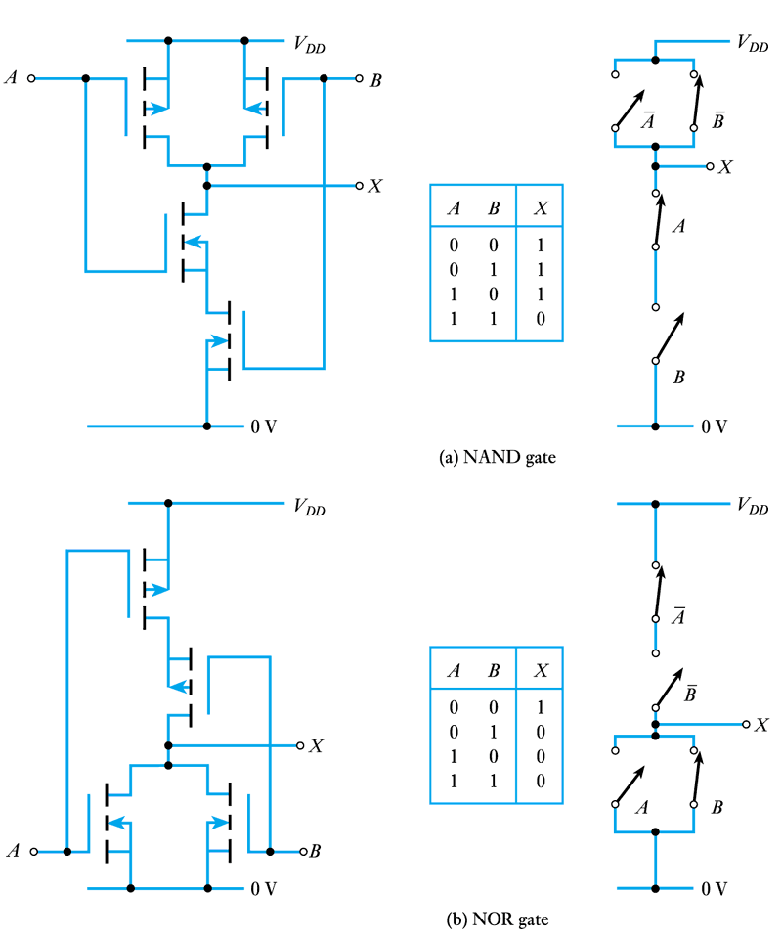
Logic families (contd.)
  two-input
  CMOS gates

Slide 30
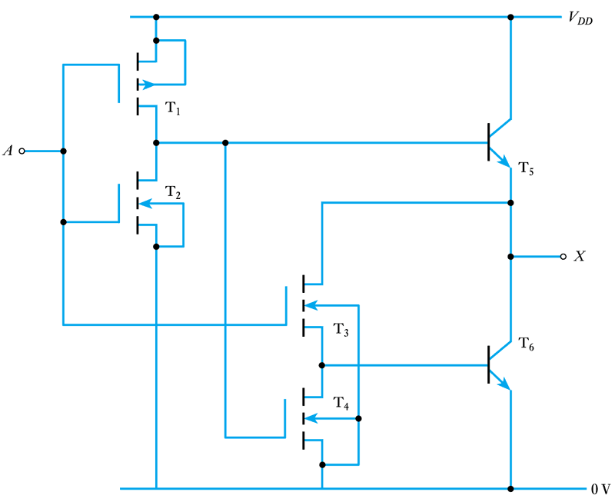
Logic families (contd.)
Bipolar CMOS (BiCMOS) logic
  a simple BiCMOS inverter

Slide 31
A comparison of logic families
Parameter
TTL
ECL
CMOS
Basic gate
NAND
OR/NOR
NAND-NOR
Fan-out
10
25
>50
Power per gate (mW)
1 – 22
4 – 55
1@1 MHz
Noise immunity
Very good
Good
Excellent
T_{PD} (ns)
1.5 – 33
1 – 4
1.5 – 200

Slide 32
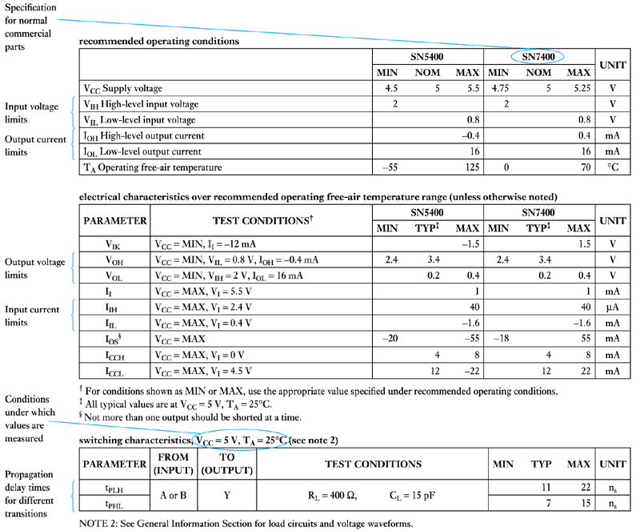
TTL
Standard TTL
  part of a typical
  TTL data sheet

Slide 33
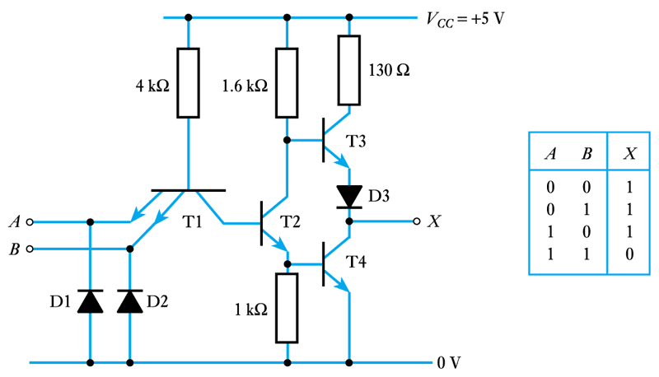
TTL (contd.)
  a TTL two-input NAND gate

Slide 34
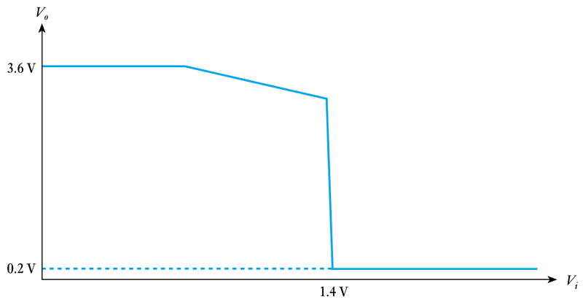
TTL (contd.)
  TTL transfer function

Slide 35
TTL (contd.)
  input and output voltage levels for 74 family devices
  noise immunity in logic 1 (high) V_{NIH} = V_{OH(min)} - V_{IH(min)}
  = 2.4 – 2.0
  = 0.4 V
  noise immunity in logic 0 (low) V_{NIL} = V_{IL(max)} - V_{OL(max)}
  = 0.8 – 0.4
  = 0.4 V
 | Minimum | Typical | Maximum
V_{IL} | — | — | 0.8
V_{IH} | 2.0 | — | —
V_{OL} | — | 0.2 | 0.4
V_{OH} | 2.4 | 3.6 | —

Slide 36
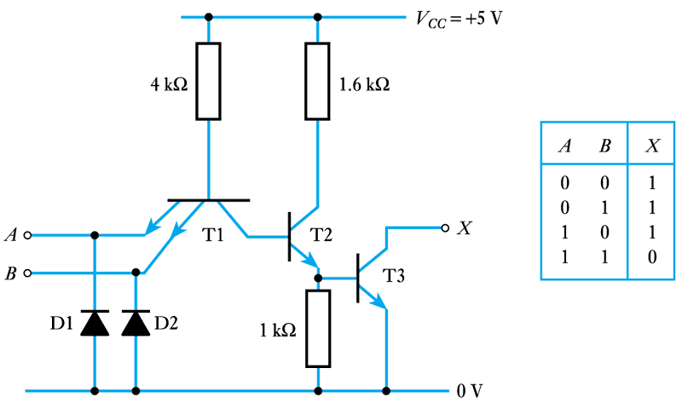
TTL (contd.)
Open collector devices
  the 7401 two-input NAND gate with open collector output.

Slide 37
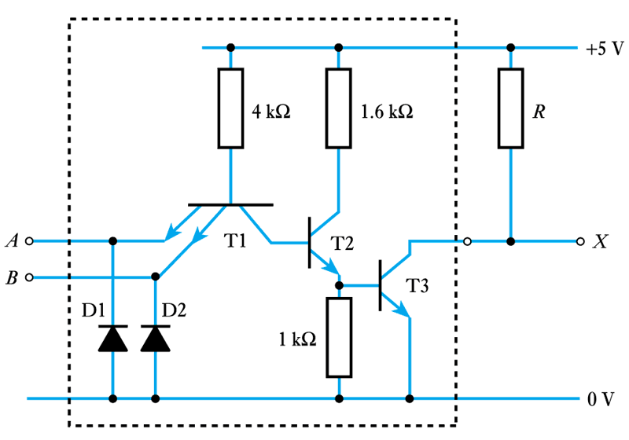
TTL (contd.)
  use of an open collector gate with an external load

Slide 38
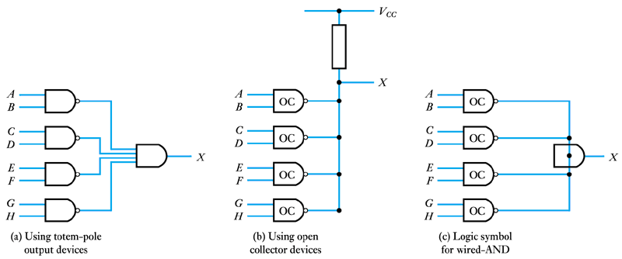
TTL (contd.)
Wired-AND operation

Slide 39
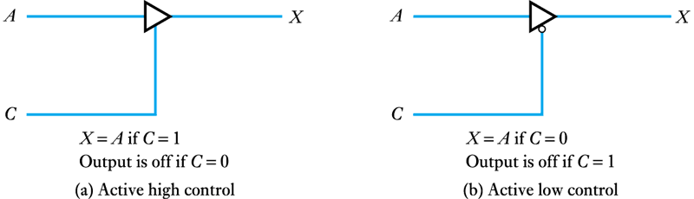
TTL (contd.)
Three-state outputs

Slide 40
TTL (contd.)
TTL inputs
  unused inputs, if left unconnected, will float to logical 1
  it is unadvisable to allow them to float since they are then very susceptible to noise
  unused inputs should be tied to ground (logic 0) or through a resistor to the positive supply rail (logic 1)
    unused inputs to an AND or NAND gate should be tied high
    unused inputs to an OR or NOR gate should be tied low.

Slide 41
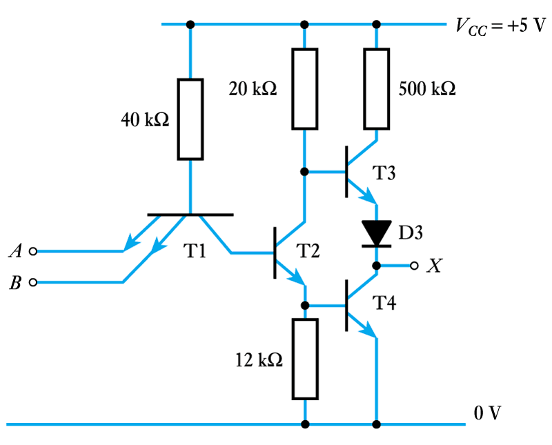
Other TTL families
Low-power TTL (74L)
  a 74L00 two-input NAND gate

Slide 42
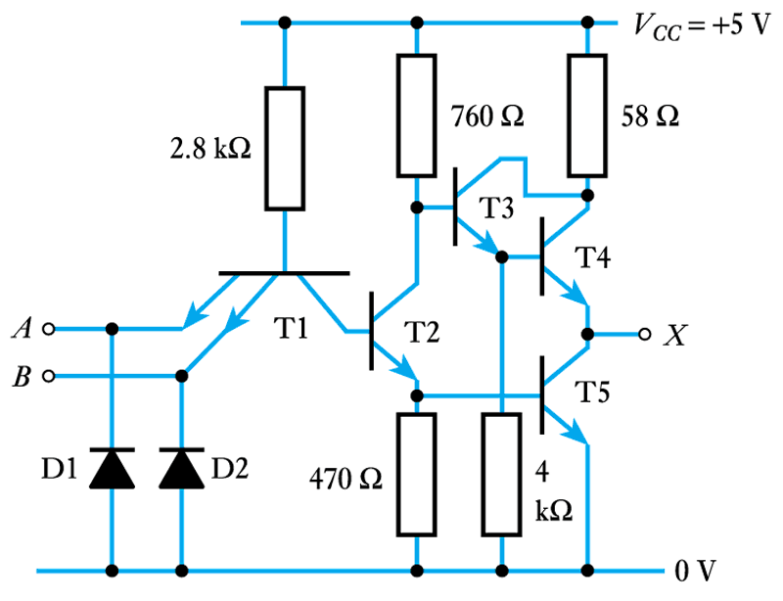
Other TTL families (contd.)
High-speed TTL (74H)
  a 74H00 two-input NAND gate

Slide 43
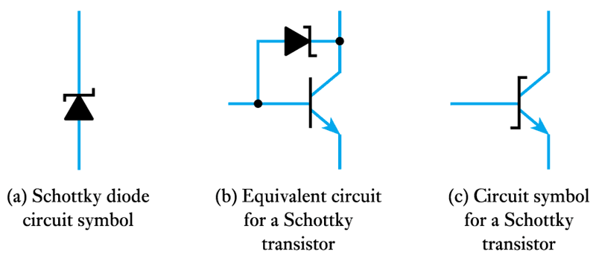
Other TTL families (contd.)
Schottky TTL (74S)
  Schottky diodes and transistors

Slide 44
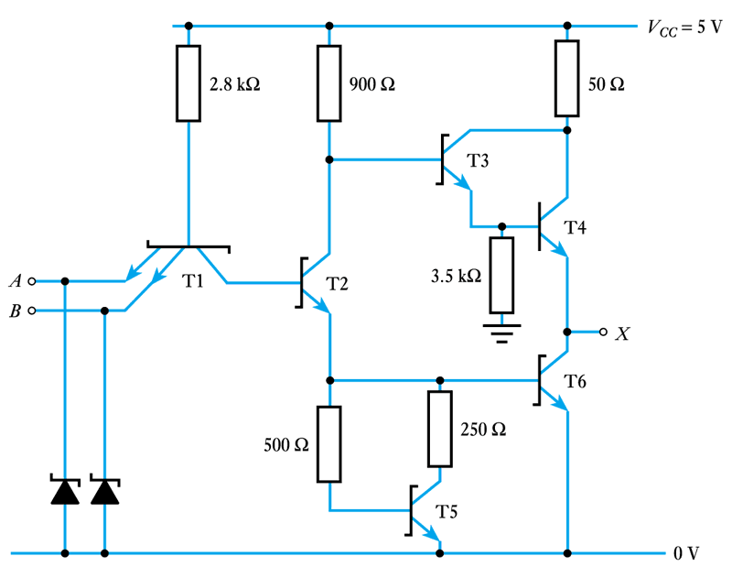
Other TTL families (contd.)
  a 74S00 two-input NAND gate

Slide 45
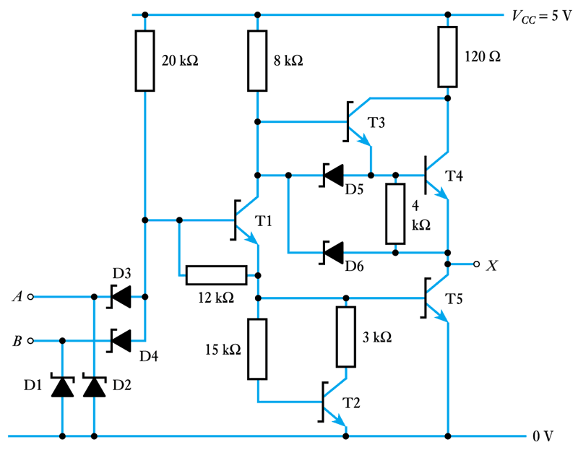
Other TTL families (contd.)
Low-power Schottky TTL (74LS)
  a 74LS00 two-input NAND gate

Slide 46
A comparison of TTL families
Family | Descriptor | T_{PD} (ns) | Power per gate (mW)
Standard | 74XX | 9 | 10
Low-power | 74LXX | 33 | 1
High-speed | 74HXX | 6 | 22
Schottky | 74SXX | 3 | 19
Advanced Schottky | 74ASXX | 1.5 | 8.5
Low-power Schottky | 74LSXX | 9.5 | 2
Advanced low-power Schottky | 74ALSXX | 4 | 1
FAST | 74FXX | 2.7 | 4

Slide 47
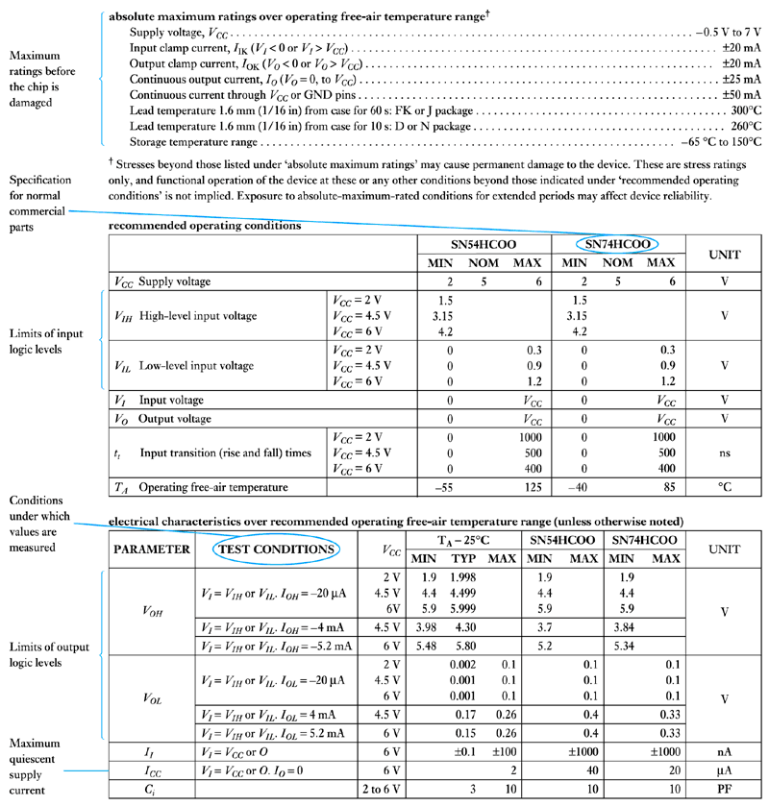
CMOS
CMOS
  part of a typical
  CMOS data sheet

Slide 48
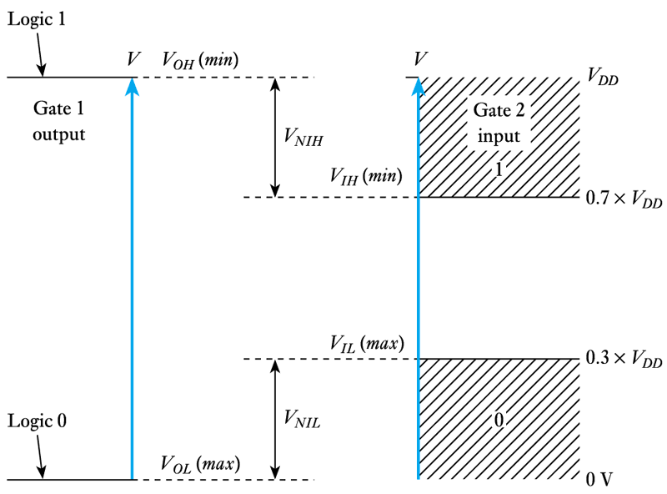
CMOS (contd.)
  CMOS input and
  output voltage levels
  noise immunity in logic 1 (high) V_{NIH} = V_{OH(min)} - V_{IH(min)}
  = V_{DD} – 0.7 × V_{DD}
  = 0.3 × V_{DD}
  noise immunity in logic 0 (low) V_{NIL} = V_{IL(max)} - V_{OL(max)}
  = 0.3 × V_{DD} - 0
  = 0.3 × V_{DD}

Slide 49
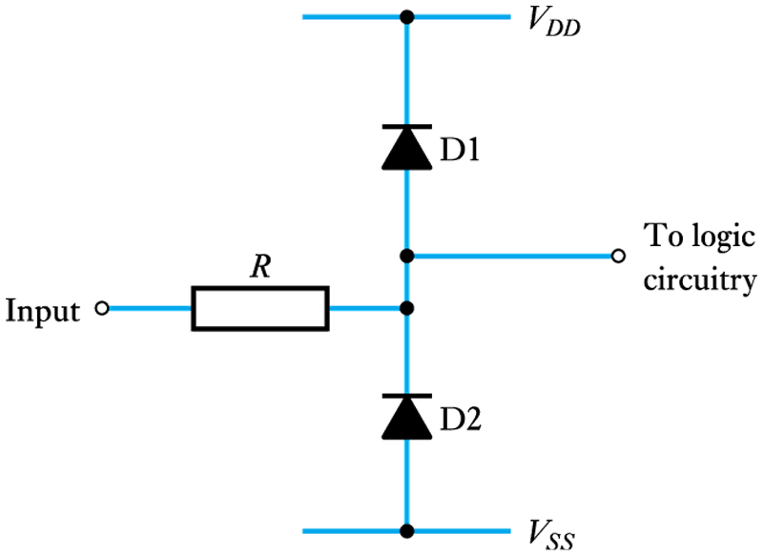
CMOS (contd.)
CMOS inputs
  CMOS gate protection circuitry
  CMOS inputs must not be left unconnected
  unused inputs should be tied to ground (logic 0) or to the positive supply rail (logic 1)
    unused inputs to an AND or NAND gate should be tied high
    unused inputs to an OR or NOR gate should be tied low.

Slide 50
CMOS (contd.)
CMOS outputs
  typical output resistance of about 250Ω (5V operation)
  high input resistance produces a high fan-out
  propagation delay increases with the number of gates being driven
  if high-speed operation is not required, at least 50 gates can be driven from a single output
  no CMOS equivalent of open-collector output
  some CMOS gates have three-state facility.

Slide 51
CMOS families
Standard CMOS (4000B)
  one of the oldest form of CMOS – now largely obsolete
  operates with supply voltages of 3-18 V
  can produce very high noise immunity (typically about 0.45 × V_{CC})
  relatively slow – propagation delay times of 45–125 ns.

Slide 52
CMOS families (contd.)
Standard CMOS with TTL pin-out (74C)
  adopts a device numbering scheme compatible with corresponding TTL parts
  operates with supply voltages of 3–18 V
  can produce very high noise immunity (typically about 0.45 × V_{CC})
  relatively slow – propagation delay times of 30–50 ns.

Slide 53
CMOS families (contd.)
High-speed CMOS (74HC)
  will operate with supply voltages of 2–6 V, but often uses a 5 V supply
  significantly faster than standard CMOS (T_{PD} ≈ 8ns)
High-speed CMOS, TTL compatible inputs (74HCT)
  another high-speed family, which offers TTL compatible inputs
  operates with supply voltages of 4.5–5.5 V
  direct replacements for similar TTL parts, with similar speeds to 74LS parts.

Slide 54
CMOS families (contd.)
Advanced CMOS (74AC)
  offer a significant speed advantage over high-speed CMOS (T_{PD} ≈ 4ns), with similar power consumption
  will operate with supply voltages of 2–6 V
Advanced CMOS , TTL compatible inputs (74ACT)
  offers similar performance to Advanced CMOS, but has TTL compatible inputs
  operates with supply voltages of 4.5–5.5 V.

Slide 55
CMOS families (contd.)
Low-voltage CMOS (74LV)
  can be used with supply voltages of 2 – 5.5 V, permitting low voltage operation where necessary
Advanced, low-voltage CMOS (74ALVC)
  this advanced low-voltage family can be used with supply voltages between 1.65 and 3.6 V
  provides considerable speed advantage compared to the 74LV series
  T_{PD} might be 3 ns when used with a supply voltage of 3.0 V, increasing to 4.4 ns when used at 1.8 V.

Slide 56
CMOS families (contd.)
BiCMOS (74BCT)
  provides a range of high-speed input/output and device driver circuits
  normally used with a supply voltage of 5 V, but will accept supply voltages in the range 4.5 – 5.5 V
  typical T_{PD} about 3–4 ns.
Low-voltage BiCMOS (74LVT)
  offers BiCMOS operation in a family that can be used with supply voltages between 2.7 and 3.6 V.

Slide 57
A comparison of CMOS families
Family | Descriptor | T_{PD} (ns) | Static power per gate (μW)
Standard | 4000B | 75 | 50
Standard, TTL pin-out High-speed High-speed, TTL compatible | 74CXX 74HCXX 74HCTXX | 50 8 12 | 50 25 25
Advanced | 74ACXX | 4 | 25
Advanced, TTL compatible | 74ACTXX | 6 | 25
Low-voltage | 74LVXX | 9 | 50
Advanced, low-voltage | 74ALVCXX | 3 | 50
BiCMOS | 74BCTXX | 3.5 | 600
Low-voltage BiCMOS | 74LVTXX | 4 | 400

Slide 58
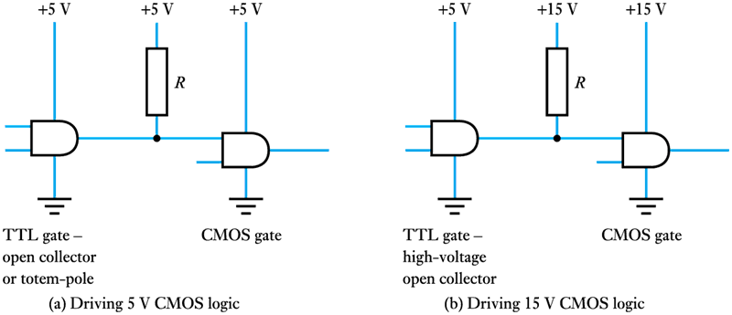
Interfacing TTL and CMOS
Driving CMOS from TTL

Slide 59
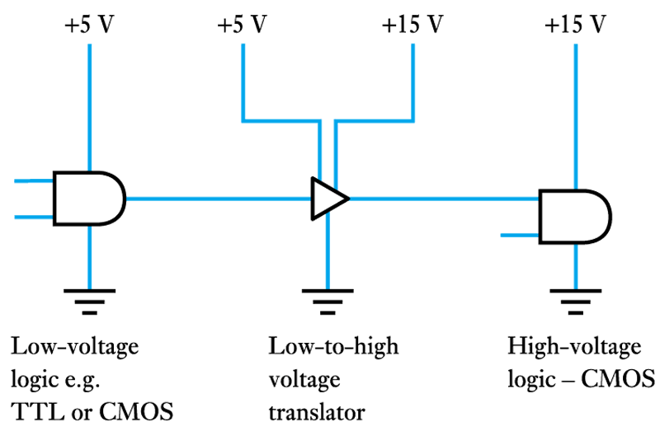
Interfacing TTL and CMOS (contd.)
  use of a low-to-high voltage translator

Slide 60
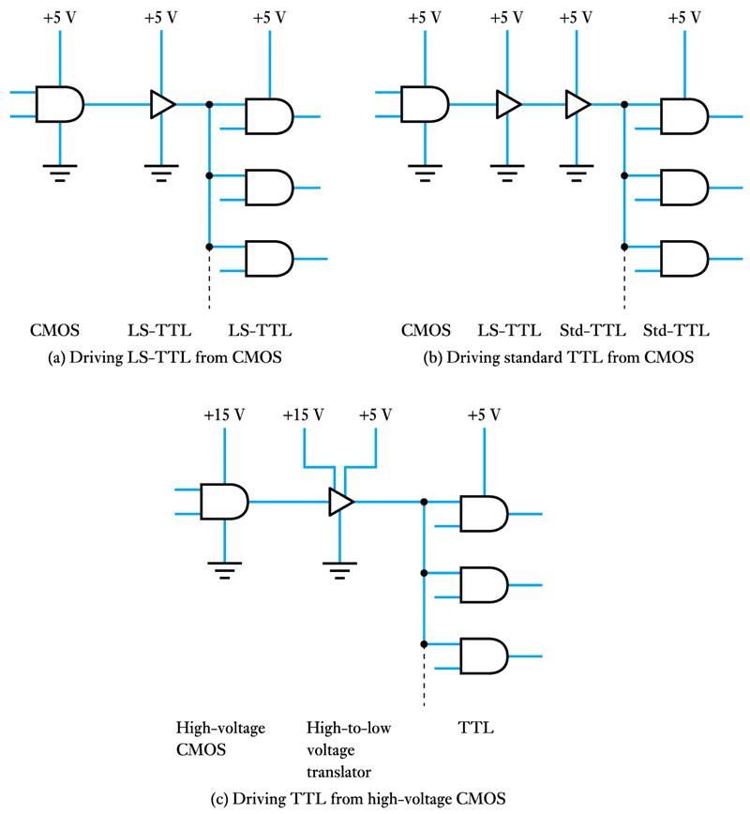
Interfacing TTL and CMOS (contd.)
Driving TTL from CMOS

Slide 61
Interfacing TTL and CMOS (contd.)
  using a high-to-low voltage translator

Slide 62
Noise and EMC in digital systems
Digital noise sources
  Electronic noise
  Interference
  Internal noise
  Power supply noise
  CMOS switching transients.

Slide 63
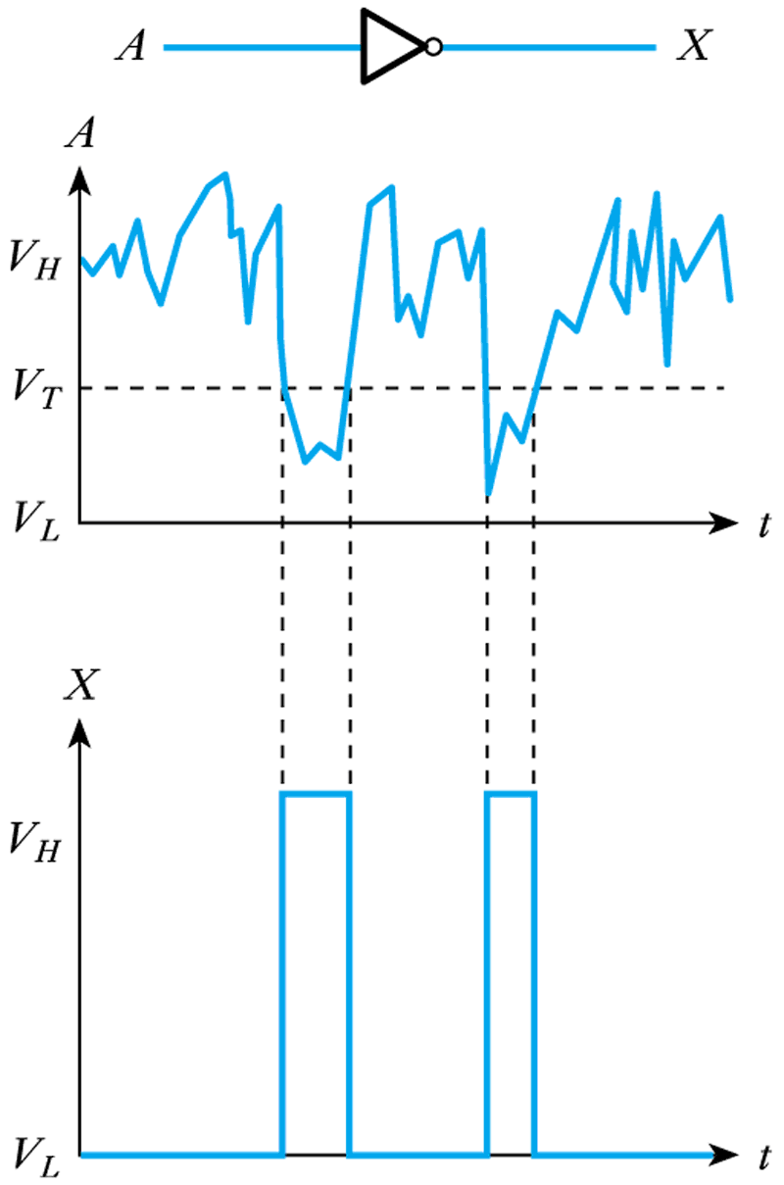
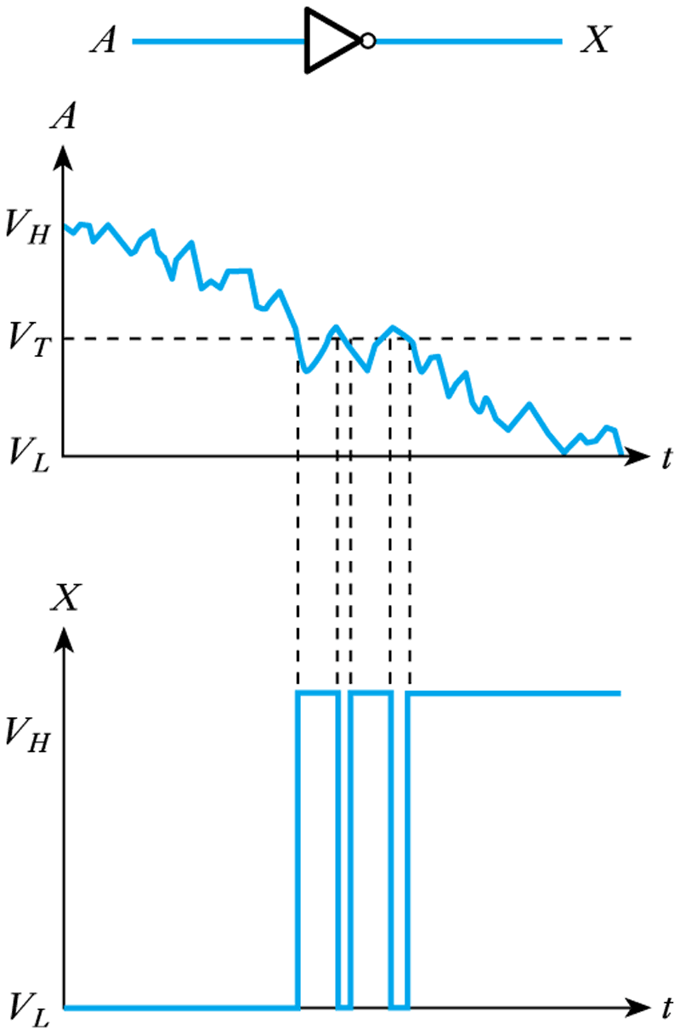
Noise and EMC in digital systems (contd.)
The effects of noise in digital systems
      Steady logic voltages
      Slowly varying signals

Slide 64
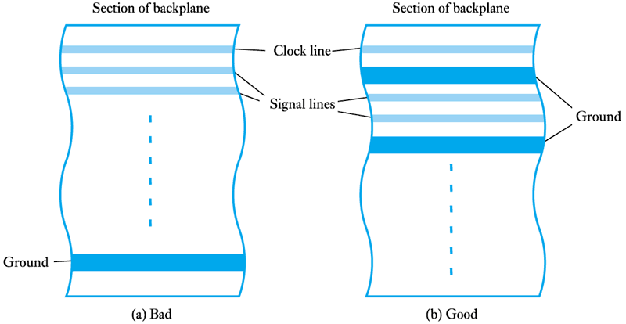
Noise and EMC in digital systems (contd.)
Designing digital systems for EMC
  backplane arrangements

Slide 65
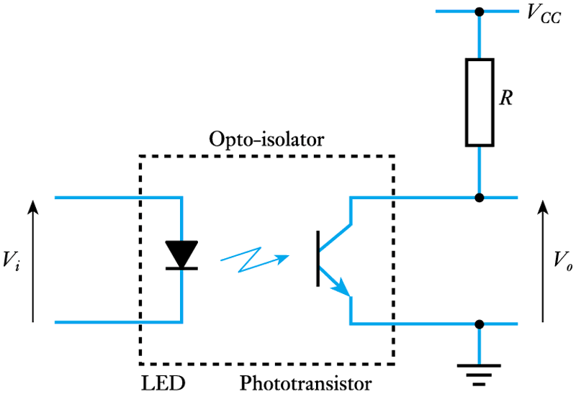
Noise and EMC in digital systems (contd.)
  opto-isolation

Slide 66
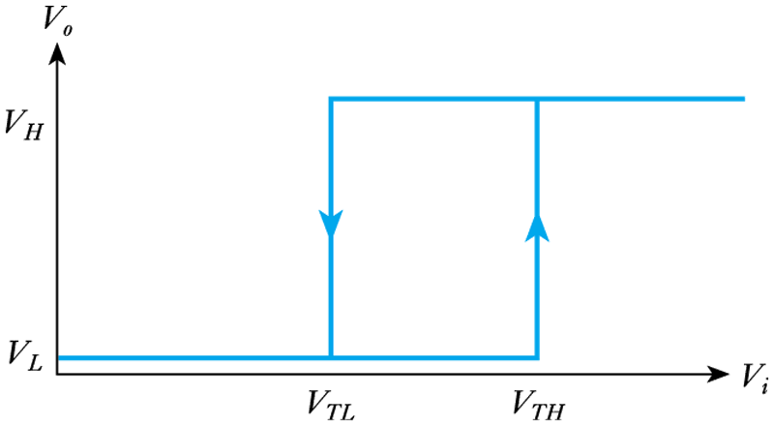
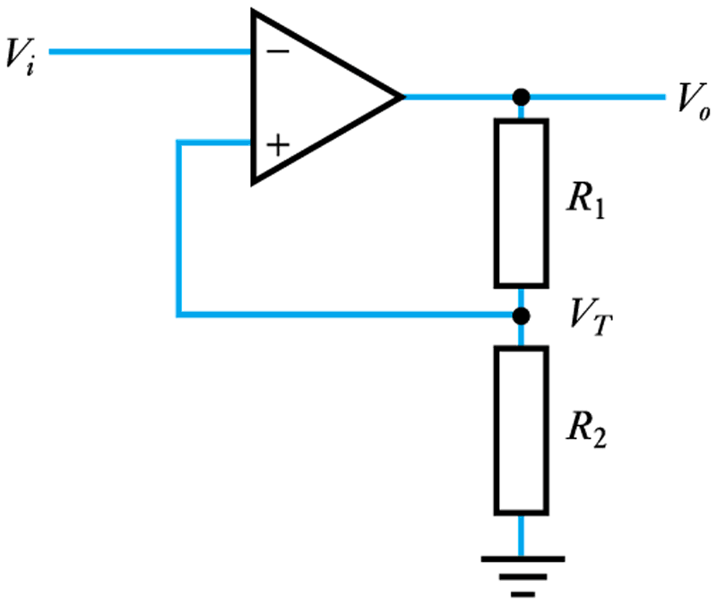
Noise and EMC in digital systems (contd.)
  Schmitt trigger inputs
      Transfer characteristics
      A simple Schmitt trigger circuit

Slide 67
Noise and EMC in digital systems (contd.)
A design example
An industrial control system
  A system is connected to two remote mechanical switches, and to an AC heater and an AC motor. The controller is required to take signals from the switches and to turn the heater and motor ON and OFF according to some control algorithm. The system is to be used in an environment with a high level of electrical noise. Suggest how the unit could be designed to minimize the effects of noise on its operation.

Slide 68
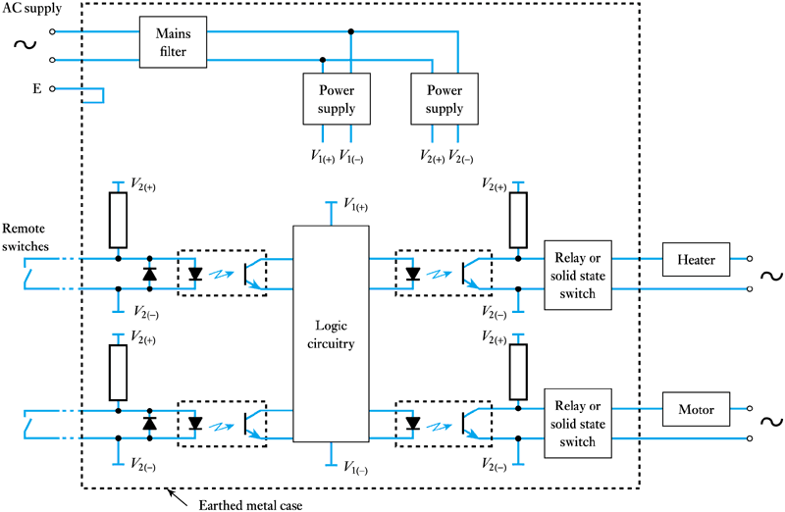
Noise and EMC in digital systems (contd.)

Slide 69
Key points
Physical gates are not ideal components.
Logic gates are manufactured in a range of logic families.
The ability of a gate to ignore noise is its ‘noise immunity’.
Both MOSFETs and bipolar transistors are used in gates.
All logic gates exhibit a propagation delay.
The most widely used logic families are TTL and CMOS.
Both TTL and CMOS gates are produced in a range of versions, each optimised for a particular characteristic.
Interface circuitry may be needed to link devices of different families.
Noise and EMC issues must be considered during design.

