Slide 1
Electronic Circuits
Prof. Nizamettin AYDIN
naydin@yildiz.edu.tr
http://www.yildiz.edu.tr/~naydin
Dr. Gökhan Bilgin
gokhanb@ce.yildiz.edu.tr
Notes:
Copyright 2000 N. AYDIN. All rights reserved.

Slide 2
Linear Digital ICs
Comparators
Digital/analog converters
Timers
Voltage-controlled oscillators
Phase-locked loop circuits
Interface circuits

Slide 3
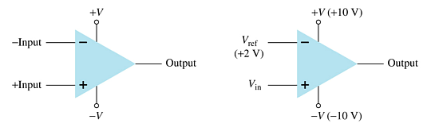
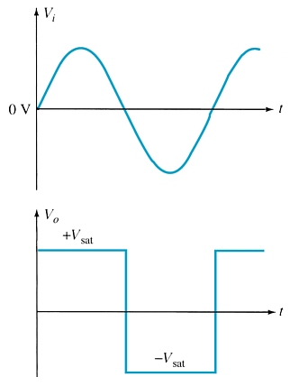
Comparator Circuit
The operation is a basic comparison. The output swings between its maximum and minimum voltage, depending upon whether one input (V_{in}) is greater or less than the other (V_{ref}).
The output is always a square wave where:
  The maximum high output voltage is +V_{SAT}.
  The minimum low output voltage is –V_{SAT}.

Slide 4
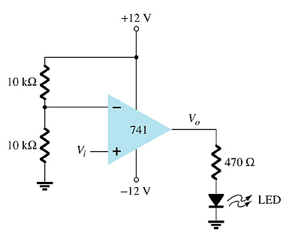
Noninverting Op-Amp Comparator
For a noninverting op-amp comparator:
  The output goes to +V_{SAT} when input V_{i} is greater than the reference voltage.
  The output goes to –V_{SAT} when input V_{i} is less than the reference voltage.
Example:
  V_{ref} in this circuit is +6V (taken from the voltage divider)
  +V_{SAT} = +V, or +12V
  −V_{SAT} = −V or –12V
When V_{i} is greater than +6V the output swings to +12V and the LED goes on.
When V_{i} is less than +6V the output is at –12V and the LED goes off.

Slide 5
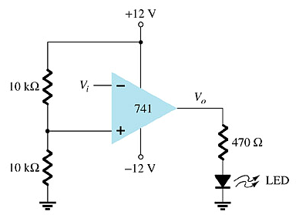
Inverting Op-Amp Comparator
For an inverting op-amp comparator:
  The output goes to –V_{SAT} when input V_{i} is greater than the reference voltage.
  The output goes to +V_{SAT} when input V_{i} is less than the reference voltage.
Example:
  V_{ref} in this circuit is +6V (taken from the voltage divider)
  +V_{SAT} = +V, or +12V
  −V_{SAT} = −V or –12V
When V_{i} is greater than +6V the output swings to –12V and the LED goes off.
When V_{i} is less than +6V the output is at +12V and the LED goes on.

Slide 6
Comparator ICs
Advantages:
  Faster switching
  Built-in noise immunity
  Outputs capable of directly driving loads

Slide 7
Digital-Analog Converters
Types:
  Digital-to-analog converters (ADCs)
  Analog-to-digital converters (DACs)

Slide 8
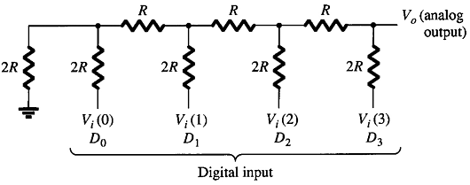
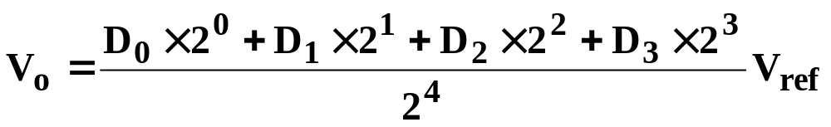
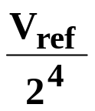
Digital-to Analog Converter:
Ladder Network Version
Output Voltage, V_{o}:
Voltage Resolution:

Slide 9
Analog-to-Digital Converters
Types:
  Dual Slope Conversion
  Ladder Network Conversion

Slide 10
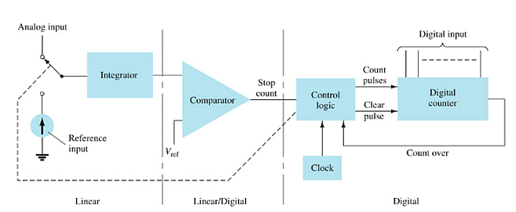
Analog-to-Digital Conversion
Dual Slope Conversion
The analog input voltage is applied to an integrator or ramp-generator circuit.
The digital output is obtained from a digital counter that is operated during both positive and negative slope (ramp) intervals of the integrator.

Slide 11
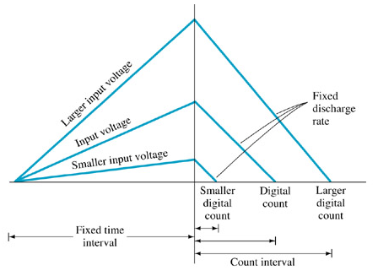
Dual Slope Conversion
Rising Slope
For a fixed interval the analog voltage is applied to the integrator. The integrator output rises to some positive level. This positive voltage is applied to a comparator. At the end of the fixed interval, the counter is reset to 0. An electronic switch connects the integrator input to a fixed input or reference voltage.
Falling Slope
The integrator output decreases at a fixed rate. The counter advances during this time. When the integrator output (connected to the comparator input) falls below the reference level of the comparator, control logic stops the counter.The digital counter output is the digital conversion of the analog input.

Slide 12
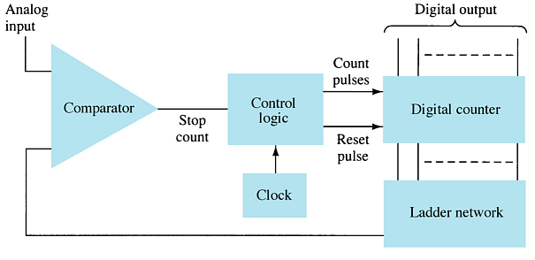
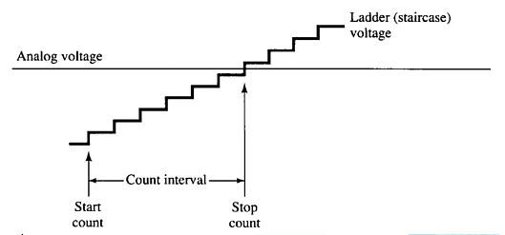
Ladder Network Conversion
A digital counter advances from zero while a ladder network converts the digital count to a staircase analog voltage.
When the staircase voltage into the comparator equals the analog input voltage, the counter stops.
The last count is the digital conversion of the analog input.

Slide 13
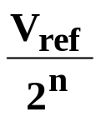
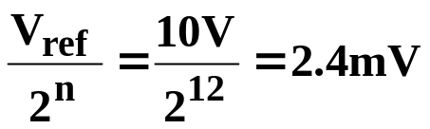
Resolution of Analog-to-Digital Converters
The resolution depends on the amount of voltage per step (digital bit):
where n is the number of digital bits
Example: A 12-bit ADC with a 10V reference level has the following resolution:

Slide 14
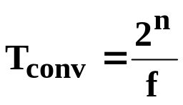
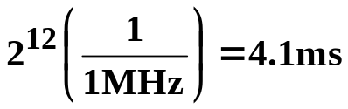
Analog-to-Digital Conversion Time
The conversion time depends on the clock frequency of the counter.
where
  T_{conv} = conversion time (seconds)
  n = number of binary bits
  f = clock frequency for the counter
Example: A 12bit ADC with a 1MHz clock has a maximum conversion time.

Slide 15
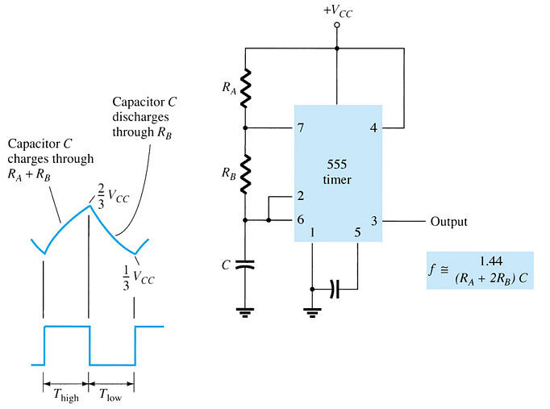
555 Timer Circuit
The 555 Timer is an example of a versatile Timer IC.
Astable Operation
The timer output is a repetitive square wave.
The output frequency can be calculated as shown here.

Slide 16
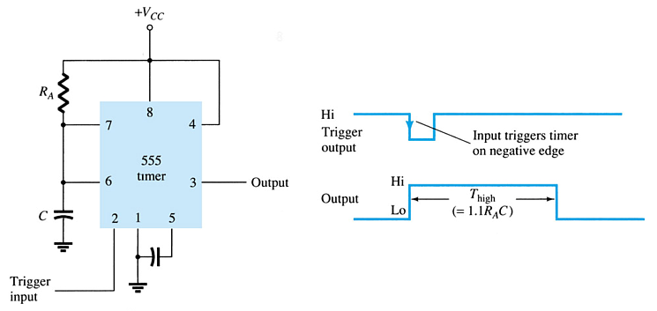
555 Timer Circuit
Monostable Operation
The timer output is a one shot pulse. When an input is received it triggers a one shot pulse. The time for which the output remains high can be calculated as shown.

Slide 17
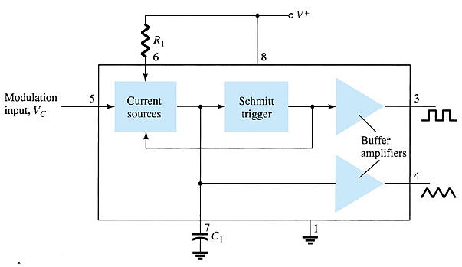
Voltage-Controlled Oscillator
The oscillator output is a variable frequency square wave or triangular wave. The output frequency depends on the modulation input voltage (V_{C}).

Slide 18
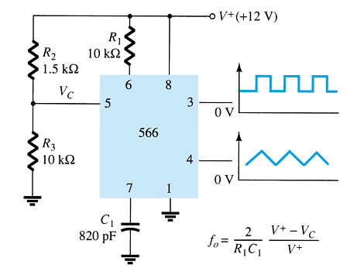
566 Voltage-Controlled Oscillator
The output frequency can be calculated as shown in the graph.
Note that the formula also indicates other circuit parameters that affect the output frequency.

Slide 19
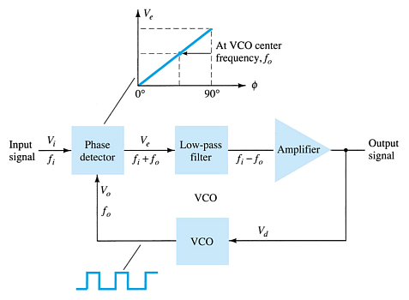
Phase-Locked Loop
The input signal is a frequency and the output signal is a voltage representing the difference in frequency between the input and the internal VCO.

Slide 20
Basic Operation of the Phase-Locked Loop
Three operating modes:
  Lock
  f_{i} = f_{VCO}
  Tracking
  f_{i} ≠ f_{VCO}, but the f_{VCO} adjusts until f_{VCO}= f_{i}
  Out-of-Lock
    f_{i} ≠ f_{VCO}, and they never will be the same

Slide 21
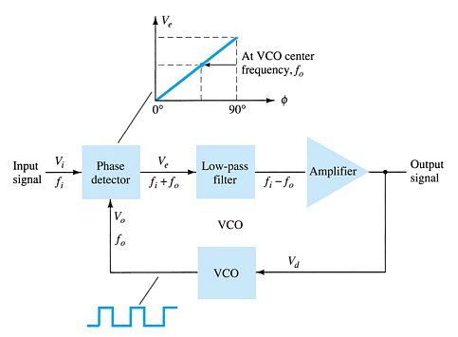
Phase-Locked Loop: Lock Mode
The input frequency and the internal VCO output frequency are applied to the phase comparator.
If they are the same, the phase comparator output voltage indicates no error.
This no-error voltage is filtered and amplified before it is made available to the output.
The no-error voltage is also applied to the internal VCO input to maintain the VCO’s output frequency.

Slide 22
Phase-Locked Loop: Tracking Mode
If the input frequency does not equal the VCO frequency then the phase comparator outputs an error voltage.
This error voltage is filtered and amplified and made available to the output.
The error voltage is also applied to the VCO input. This causes the VCO to change output frequency.
This looping continues until the VCO has adjusted to the new input frequency and they are equal again.

Slide 23
Phase-Locked Loop: Out-of-Lock Mode
If the input frequency does not equal the VCO frequency and the resulting error voltage does not cause the VCO to catch up to the input frequency, then the system is out of lock. The VCO will never equal the input frequency.

Slide 24
Phase-Locked Loop: Frequency Ranges
Lock Range—The range of input frequencies for which the VCO will track.
Capture Range —A narrow range of frequencies into which the input frequency must fall before the VCO can track. If the input frequency falls out of the lock range it must first enter into the capture range.

Slide 25
Phase-Locked Loop
Applications:
  FM demodulator
  Frequency Synthesizer
  FSK decoder

Slide 26
Interface Circuitry
Interface circuitry:
  Driving loads
  Producing output signals at proper voltage or current levels
  Impedance matching
  Strobing or timing signals

Slide 27
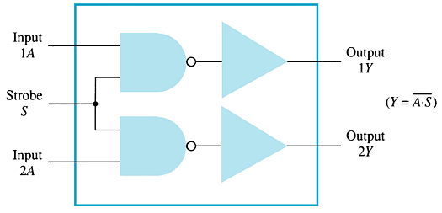
Interface Circuitry: Dual Line Drivers
The input is TTL digital logic signal levels.
The output is capable of driving TTL or CMOS devise circuits.

Slide 28
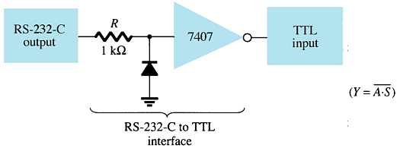
RS-232-to-TTL Converter
The input is RS-232 electronic industry standard for serial communications.
The output will drive TTL circuitry.

