Slide 1
Electronic Circuits
Prof. Nizamettin AYDIN
naydin@yildiz.edu.tr
http://www.yildiz.edu.tr/~naydin
Dr. Gökhan Bilgin
gokhanb@ce.yildiz.edu.tr
Notes:
Copyright 2000 N. AYDIN. All rights reserved.

Slide 2
Feedback and Oscillator Circuits
Power Supplies

Slide 3
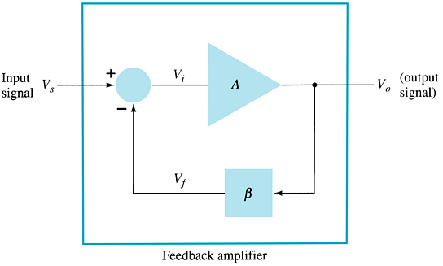
Feedback Concepts
The effects of negative feedback on an amplifier:
  Disadvantage
    Lower gain
  Advantages
    Higher input impedance
    More stable gain
    Improved frequency response
    Lower output impedance
    Reduced noise
    More linear operation

Slide 4
Feedback Connection Types
Voltage-series feedback
Voltage-shunt feedback
Current-series feedback
Current-shunt feedback

Slide 5
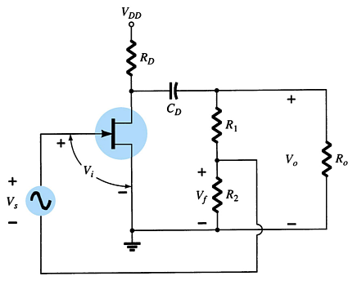
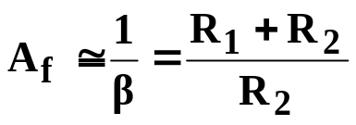
Voltage-Series Feedback
For voltage-series feedback, the output voltage is fed back in series to the input.
The feedback gain is given by:

Slide 6
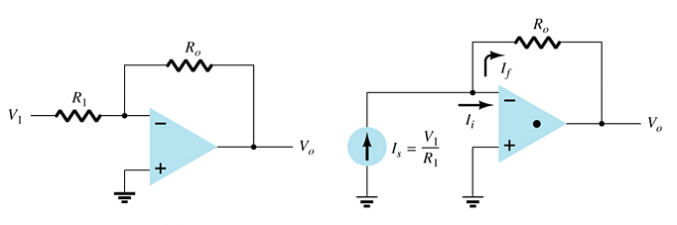
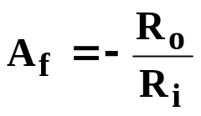
    Voltage-Shunt Feedback
For a voltage-shunt feedback amplifier, the output voltage is fed back in parallel with the input.
The feedback gain is given by

Slide 7
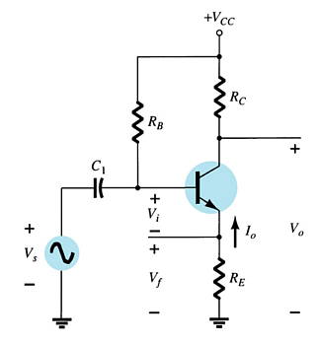
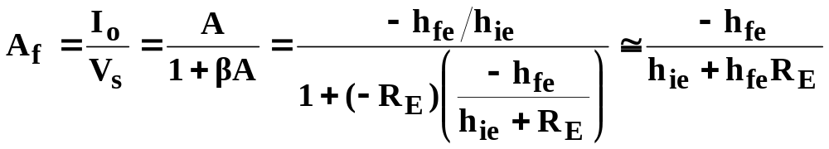
Current-Series Feedback
For a current-series feedback amplifier, a portion of the output current is fed back in series with the input.
To determine the feedback gain:

Slide 8
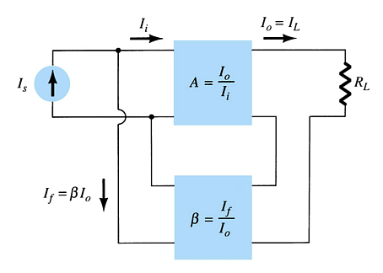
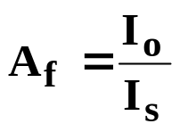
    Current-Shunt Feedback
For a current-shunt feedback amplifier, a portion of the output current is directed back in parallel with the input.
The feedback gain is given by:

Slide 9
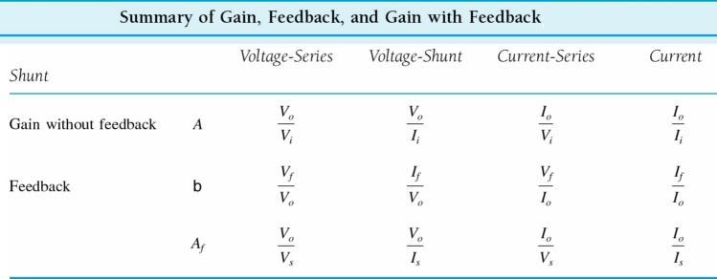
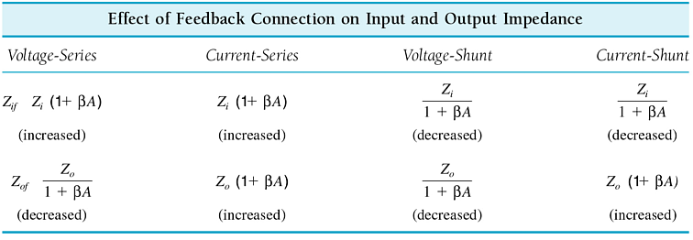
    Summary of Feedback Effects

Slide 10
Frequency Distortion with Feedback
If the feedback network is purely resistive, then the gain with feedback will be less dependent on frequency variations. In some cases the resistive feedback removes all dependence on frequency variations.
If the feedback includes frequency dependent components (capacitors and inductors), then the frequency response of the amplifier will be affected.

Slide 11
Noise and Nonlinear Distortion
The feedback network reduces noise by cancellation. The phase of the feedback signal is often opposite the phase of the input signal.
Nonlinear distortion is also reduced simply because the gain is reduced. The amplifier is operating in midrange and not at the extremes.

Slide 12
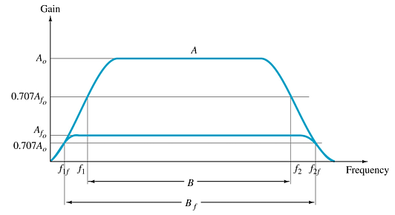
Bandwidth with Feedback
Feedback increases the bandwidth of an amplifier.

Slide 13
    Gain Stability with Feedback
Gain calculations with feedback are often based on external resistive elements in the circuit. By removing gain calculations from internal variations of β and g_{m}, the gain becomes more stable.

Slide 14
Phase and Frequency Considerations
At higher frequencies the feedback signal may no longer be out of phase with the input. The feedback is thus positive and the amplifier, itself, becomes unstable and begins to

Slide 15
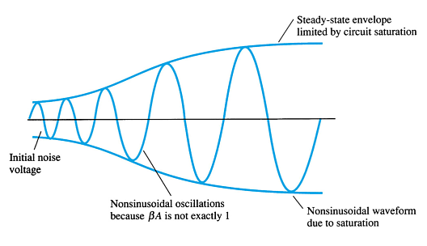
    Oscillator Operation
The feedback signal must be positive.
  If the feedback signal is not positive or the gain is less than one, the oscillations dampens out.
The overall gain must equal one (unity gain).
  If the overall gain is greater than one, the oscillator eventually saturates.

Slide 16
    Types of Oscillator Circuits
Phase-shift oscillator
Wien bridge oscillator
Tuned oscillator circuits
Crystal oscillators
Unijunction oscillator

Slide 17
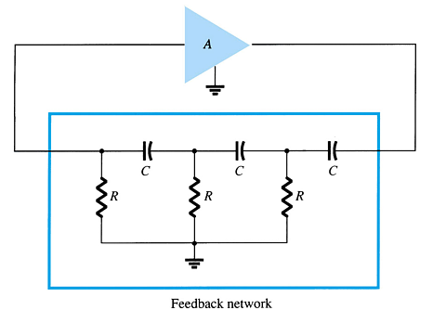
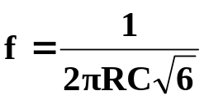
    Phase-Shift Oscillator
The amplifier must supply enough gain to compensate for losses. The overall gain must be unity.
The RC networks provide the necessary phase shift for a positive feedback.
The values of the RC components also determine the frequency of oscillation:
more…

Slide 18
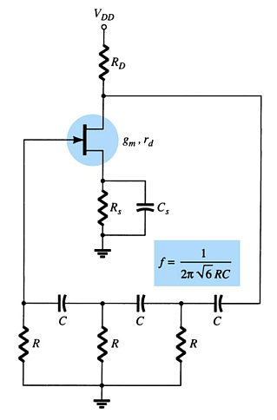
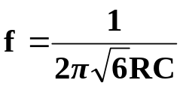
    Phase-Shift Oscillator
The amplifier must supply enough gain to compensate for losses. The overall gain must be unity.
The RC networks provide the necessary phase shift for a positive feedback.
The values of the RC components also determine the frequency of oscillation:
more…

Slide 19
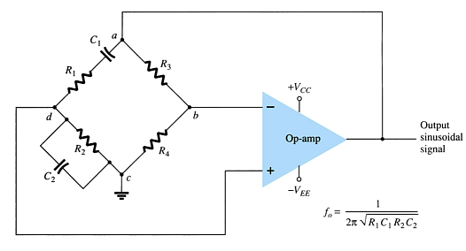
Wien Bridge Oscillator
The amplifier must supply enough gain to compensate for losses. The overall gain must be unity.
The feedback resistors are R₃ and R₄.
The phase-shift components are R₁, C₁ and R₂, C₂.

Slide 20
Tuned Oscillator Circuits
Tuned oscillators use a parallel LC resonant circuit (LC tank) to provide the oscillations.
There are two common types:
  Colpitts—The resonant circuit is an inductor and two capacitors.
  Hartley—The resonant circuit is a tapped inductor or two inductors and one capacitor.

Slide 21
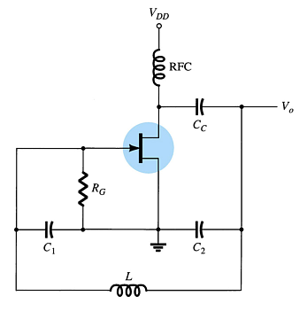
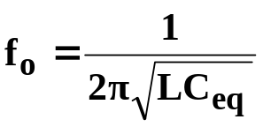
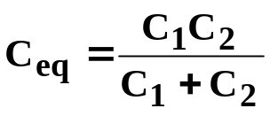
Colpitts Oscillator Circuit
The frequency of oscillation is determined by:
where:

Slide 22
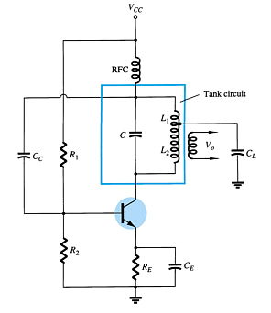
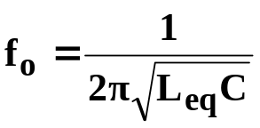

Hartley Oscillator Circuit
The frequency of oscillation is determined by:
where:

Slide 23
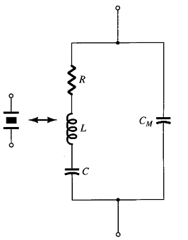
Crystal Oscillators
The crystal appears as a resonant circuit.
The crystal has two resonant frequencies:
Series resonant condition
  RLC determine the resonant frequency
  The crystal has a low impedance
Parallel resonant condition
  RL and C_{M} determine the resonant frequency
  The crystal has a high impedance
The series and parallel resonant frequencies are very close, within 1% of each other.

Slide 24
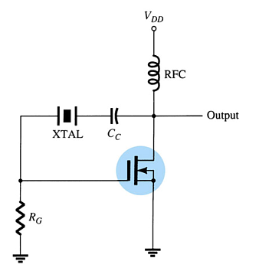
Series Resonant Crystal Oscillator
    RLC determine the resonant frequency
    The crystal has a low impedance

Slide 25
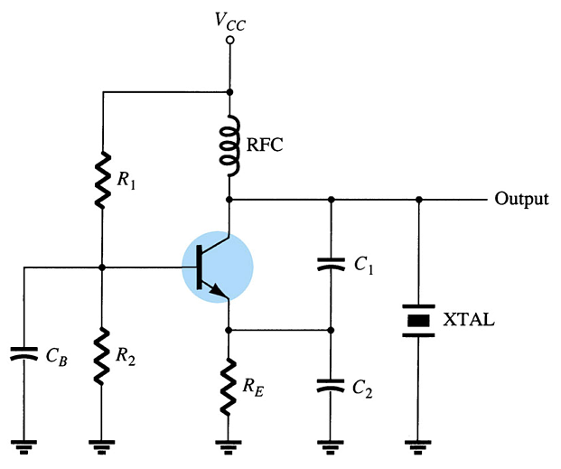
Parallel Resonant Crystal Oscillator
R_{L} and C_{M} determine the resonant frequency
The crystal has a high impedance

Slide 26
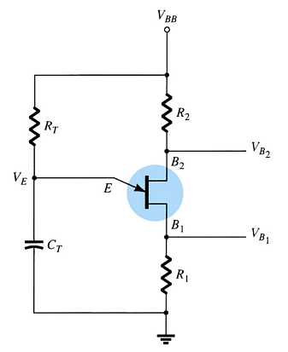
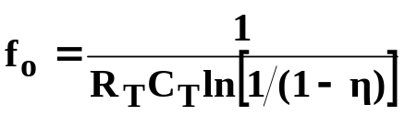
Unijunction Oscillator
The output frequency is determined by:
Where η is a rating of the unijunction transistor with values between 0.4 and 0.6.

Slide 27
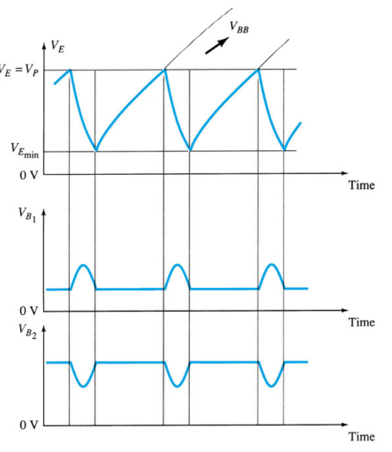
Unijunction Oscillator Waveforms
The unijunction oscillator (or relaxation oscillator) produces a sawtooth waveform.

Slide 28
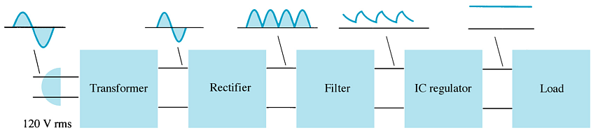
Power Supply Diagram

Slide 29
Filter Circuits
The output from the rectifier section is a pulsating DC.
The filter circuit reduces the peak-to-peak pulses to a small ripple voltage.

Slide 30
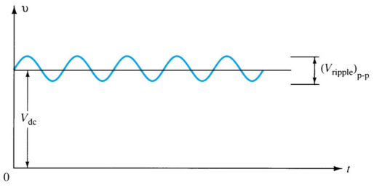
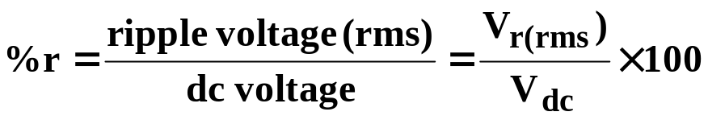
Ripple Factor
After the filter circuit a small amount of AC is still remaining. The amount of ripple voltage can be rated in terms of ripple factor (r).

Slide 31




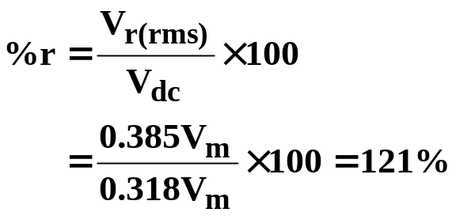
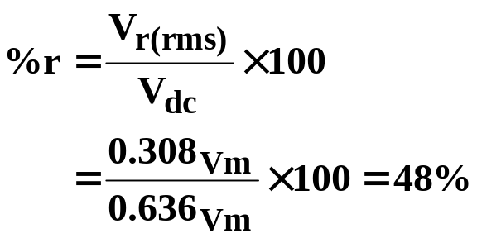
Rectifier Ripple Factor
Half-Wave
Full-Wave
DC output:
DC output:
AC ripple output:
AC ripple output:
Ripple factor:
Ripple factor:

Slide 32
Types of Filter Circuits
Capacitor Filter
RC Filter

Slide 33
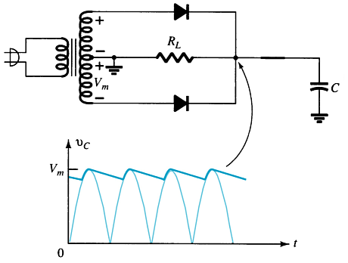
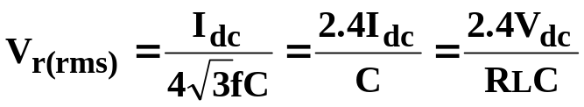
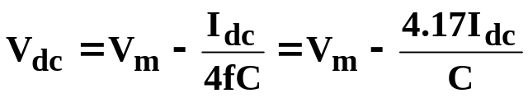
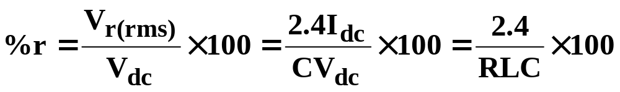
Capacitor Filter
Ripple voltage
The larger the capacitor the smaller the ripple voltage.
DC output
Ripple factor

Slide 34
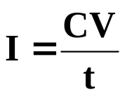
Diode Ratings with Capacitor Filter
The size of the capacitor increases the current drawn through the diodes—the larger the capacitance, the greater the amount of current.
Peak Current vs. Capacitance:
where
  C = capacitance
  V = change in capacitor voltage during charge/discharge
  t = the charge/discharge time

Slide 35
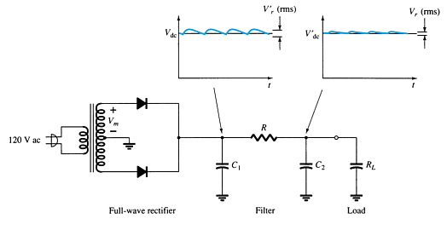
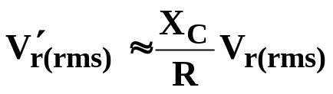
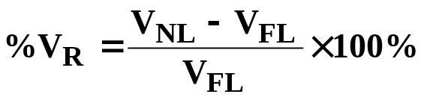
RC Filter Circuit
Adding an RC section further reduces the ripple voltage and decrease the surge current through the diodes.
V′_{r(rms)} = ripple voltage after the RC filter
V_{r(rms)} = ripple voltage before the RC filter
R = resistor in the added RC filter
X_{C} = reactance of the capacitor in the added RC filter
V_{NL} = no-load voltage
V_{FL} = full-load voltage

Slide 36
Voltage Regulation Circuits
There are two common types of circuitry for voltage regulation:
  Discrete Transistors
  IC’s

Slide 37
Discrete-Transistor Regulators
Series voltage regulator
Current-limiting circuit
Shunt voltage regulator

Slide 38
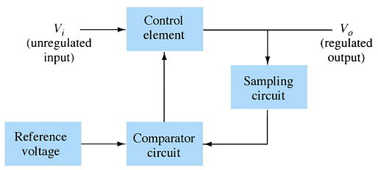
Series Voltage Regulator Circuit
The series element controls the amount of the input voltage that gets to the output.
If the output voltage increases (or decreases), the comparator circuit provides a control signal to cause the series control element to decrease (or increase) the amount of the output voltage.

Slide 39
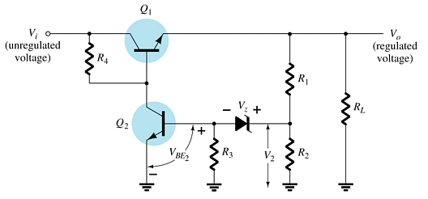
Series Voltage Regulator Circuit
R₁ and R₂ act as the sampling circuit
Zener provides the reference voltage
Q₂ controls the base current to Q₁
Q₁ maintains the constant output voltage
When the output increases:
  The voltage at V₂ and V_{BE} of Q₂ increases
  The conduction of Q₂ increases
  The conduction of Q₁ decreases
  The output voltage decreases
When the output decreases:
  The voltage at V₂ and V_{BE} of Q₂ decreases
  The conduction of Q₂ decreases
  The conduction of Q₁ increases
  The output voltage increases

Slide 40
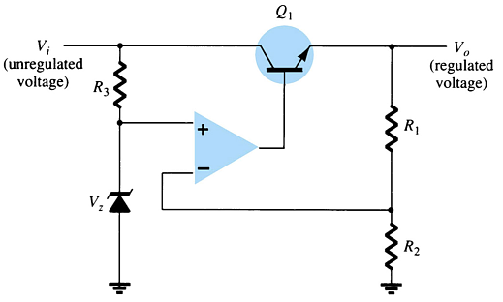
Series Voltage Regulator Circuit
The op-amp compares the Zener diode voltage with the output voltage (at R₁ and R₂) and controls the conduction of Q₁.

Slide 41
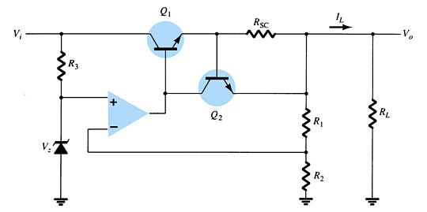
Current-Limiting Circuit
When I_{L} increases:
  The voltage across R_{SC} increases
  The increasing voltage across R_{SC} drives Q₂ on
  Conduction of Q₂ reduces current for Q₁ and the load

Slide 42
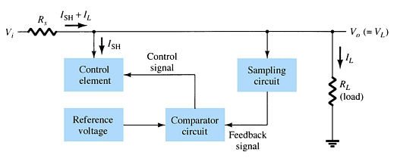
Shunt Voltage Regulator Circuit
The shunt voltage regulator shunts current away from the load.
The load voltage is sampled and fed back to a comparator circuit. If the load voltage is too high, control circuitry shunts more current away from the load.

Slide 43
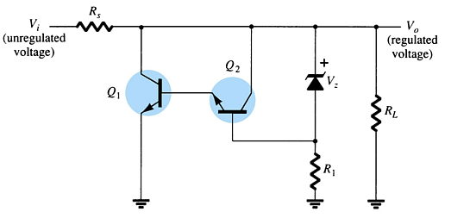
Shunt Voltage Regulator Circuit
When the output voltage increases:
  The Zener current increases
  The conduction of Q₂ increases
  The voltage drop at R_{s} increases
  The output voltage decreases
When the output voltage decreases:
  The Zener current decreases
  The conduction of Q₂ decreases
  The voltage drop at R_{s} decreases
  The output voltage increases

Slide 44
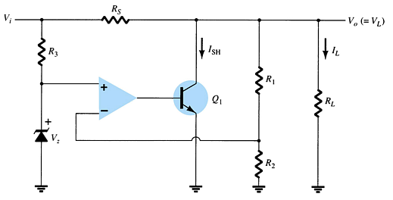
Shunt Voltage Regulator Circuit

Slide 45
IC Voltage Regulators
Regulator ICs contain:
    Comparator circuit
    Reference voltage
    Control circuitry
    Overload protection
Types of three-terminal IC voltage regulators
    Fixed positive voltage regulator
    Fixed negative voltage regulator
    Adjustable voltage regulator

Slide 46
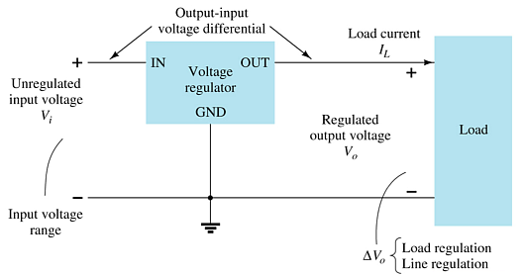
Three-Terminal Voltage Regulators
The specifications for this IC indicate:
  The range of input voltages that can be regulated for a specific range of output voltage and load current
  Load regulation—variation in output voltage with variations in load current
  Line regulation—variation in output voltage with variations in input voltage

Slide 47

Fixed Positive Voltage Regulator
These ICs provide a fixed positive output voltage.

Slide 48

Fixed Negative Voltage Regulator
These ICs output a fixed negative output voltage.

Slide 49

Adjustable Voltage Regulator
These regulators have adjustable output voltages.
The output voltage is commonly selected using a potentiometer.

Slide 50
Practical Power Supplies
DC supply (linear power supplies)
Chopper supply (switching power supplies)
TV horizontal high voltage supply
Battery chargers

