Slide 1
Electronic Circuits
Prof. Nizamettin AYDIN
naydin@yildiz.edu.tr
http://www.yildiz.edu.tr/~naydin
Dr. Gökhan Bilgin
gokhanb@ce.yildiz.edu.tr
Notes:
Copyright 2000 N. AYDIN. All rights reserved.

Slide 2
Other Two-Terminal Devices
Schottky diode
Varactor diode
Power diodes
Tunnel diode
Photodiode
Photoconductive cells
IR emitters
Liquid crystal displays
Solar cells
Thermistors

Slide 3

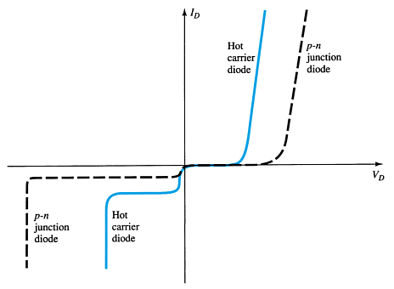
Schottky Diode
Also called Schottky-barrier, surface-barrier, or hot-carrier diode.
Characteristics
(Compared with general-purpose diodes)
Lower forward voltage drop (0.2-.63V)
Higher forward current (up to 75A)
Significantly lower PIV
Higher reverse current
Faster switching rate
Applications
High frequency switching applications
Low-voltage high-current applications
AC-to-DC converters
Communication equipment
Instrumentation circuits

Slide 4
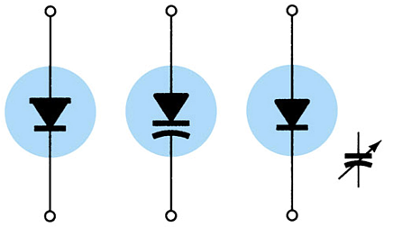
Varactor Diode
Also called a varicap, VVC (voltage-variable capacitance), or tuning diode.
It basically acts like a variable capacitor.

Slide 5
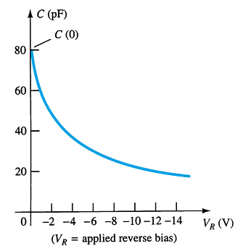
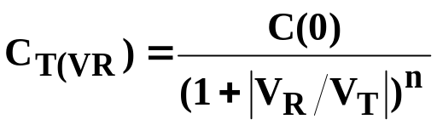
Varactor Diode Operation
A reverse-biased varactor acts like a capacitor. Furthermore, the amount of reverse bias voltage determines the capacitance. As V_{R} increases the capacitance decreases.
where
  C(0) = the capacitance with no reverse bias applied
  n = ¹/₂ for alloy and ¹/₃ for diffused junctions
  V_{T} = maximum reverse bias voltage
  V_{R} = applied reverse bias voltage

Slide 6
Varactor Diode Applications
FM modulator
Automatic-frequency-control devices
Adjustable bandpass filters
Parametric amplifiers

Slide 7
Power Diodes
Power diodes used in high-power and high-temperature applications, such as power rectifier circuits, must be rated for power
Power diodes are sometimes referred to as rectifiers
They have the same symbol and operation as a general-purpose diode
Power diodes are physically larger than general-purpose diodes, and they require heat sinking.

Slide 8
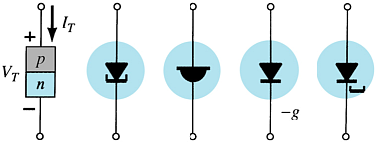
Tunnel Diodes
A tunnel diode has a negative resistance region, which means its current decreases as the forward-bias voltage increases.

Slide 9
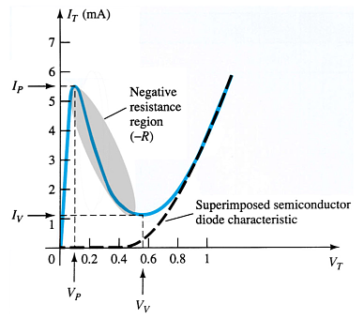
Tunnel Diodes
Operation
The characteristics of the tunnel diode indicate the negative resistance region. Note that this is only a small region of the characteristic curve.
If the forward bias voltage is beyond the negative resistance region, the tunnel diode acts like a general-purpose diode.
If the forward bias voltage is in the negative resistance region then the diode can be used as an oscillator.

Slide 10
Tunnel Diode Applications
High frequency circuits
Oscillators
Switching networks
Pulse generators
Amplifiers

Slide 11
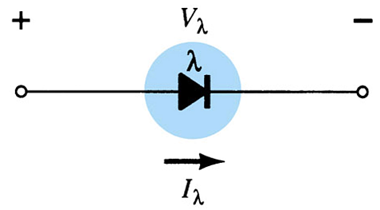
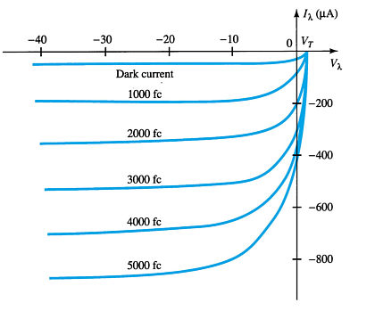
Photodiodes
A photodiode conducts when light is applied to the junction.
Operation
The photodiode is operated in reverse bias. When light of a particular wavelength strikes the junction it conducts. The higher the intensity of light (measured in foot-candles), the higher the conduction through the photodiode.
Applications
Instrumentation circuits as a sensor
Alarm system sensor
Detection of objects on a conveyor belt
Note that the diode conducts somewhat with no light applied, this is called the dark current.

Slide 12
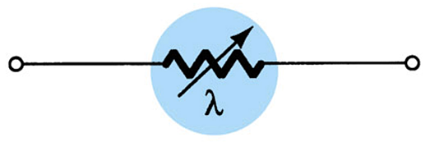
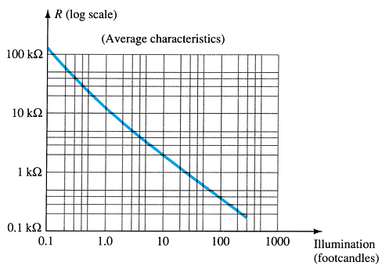
Photoconductive Cells
Operation
A photoconductive cell varies resistance with intensity of light.
Like a common resistor, a photoconductive cell has no polarity and can be placed into the circuit in either direction.
Applications
Light/darkness detection
Controlling intensity of lighting systems

Slide 13
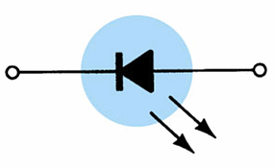
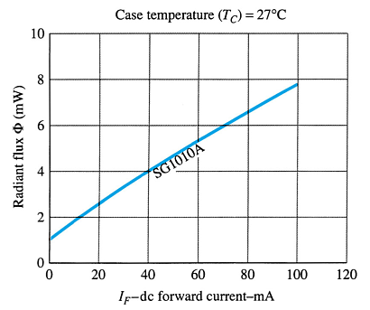
IR Emitters
These are diodes that emit IR (infrared radiation)
Operation
IR emitter produce infrared radiation when forward biased. The higher the forward bias current, the greater the intensity of infrared radiation.
The radiation pattern can vary from widely dispersed to a very narrow, focused beam.
Applications
Card readers
Shaft encoders
Intrusion alarms
IR Transmitters

Slide 14
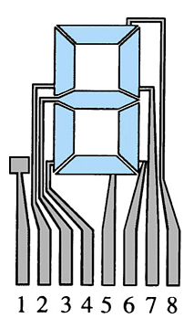
Liquid Crystal Displays (LCDs)
There are two varieties—those with a light background and dark display or those with a dark background and light display.
Operation
The background is either light or dark, when a voltage is applied to a segment then the alphanumeric display is visible. The amount of voltage necessary for display varies depending on the type of display, from 2 to 20V.
Low power LCDs require less power than LEDs. But LEDs have faster response times and longer life.
Applications
Digital clocks
Digital thermometers
Odometers

Slide 15
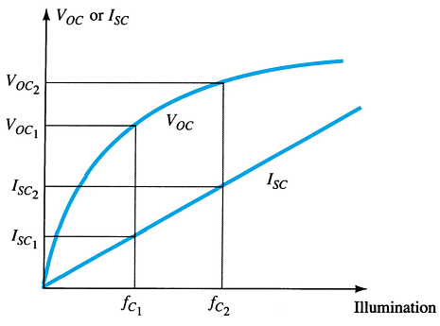
Solar Cells
Solar cells produce a voltage when subjected to light energy.
The greater the light intensity, the greater amount of voltage produced.

Slide 16
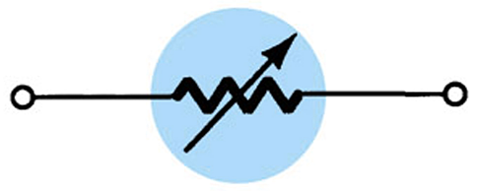
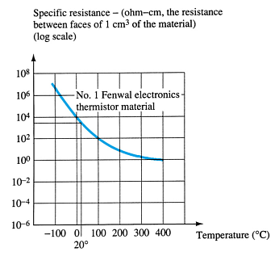
Thermistors
Thermistors are resistors whose value changes with temperature.
Operation
Thermistors are negative-coefficient devices—their resistance decreases as the temperature increases.
Applications
Sensors in instrumentation circuits
Temperature correction circuitry

Slide 17
pnpn Devices
SCR—silicon-controlled rectifier
SCS – silicon-controlled switch
GTO – gate turn-off switch
LASCR – light-aActivated SCR
Shockley diode
Diac
Triac

Slide 18
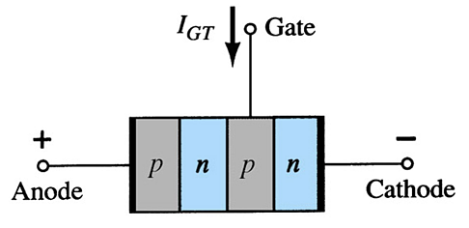
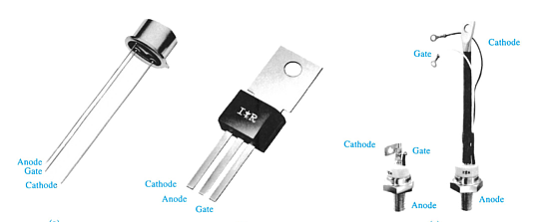
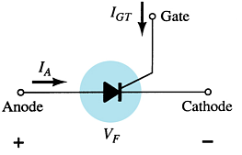
SCR—Silicon-Controlled Rectifier
The SCR is a switching device for high-voltage and high-current operations.
Like an ordinary rectifier, an SCR conducts in one direction
The terminals are:
  Anode
  Cathode
  Gate

Slide 19
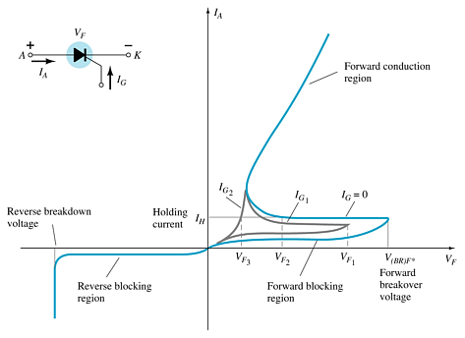
SCR Operation
To switch on an SCR:
  Forward bias the anode-cathode terminals (V_{F})
  AND
  Apply sufficient gate voltage (V_{gate}) and gate current (I_{GT})
Once an SCR is switched on, it remains latched on, even when the gate signal is removed.
Holding current (I_{H}) is the minimum required current from anode to cathode
Reverse breakdown voltage is the maximum reverse bias voltage for the SCR

Slide 20
SCR Operation
To switch off an SCR:
Remove the power source the anode and cathode terminals
OR
Reverse bias the anode and cathode terminals
An SCR cannot be switched off by simply removing the gate voltage.
Commutation circuitry can be used for satisfying either of the conditions for switching off an SCR.

Slide 21
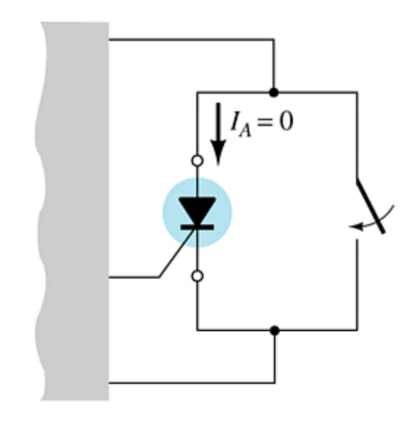
SCR Commutation
Commutation circuitry is simply a class of switching devices connected in parallel with the SCR.
A control signal activates the switching circuitry and provides a low impedance bypass for the anode to cathode current. This momentary loss of current through the SCR turns it off.
The switching circuitry can also apply a reverse bias voltage across the SCR, which also will turn off the SCR.

Slide 22
SCR False Triggering
An SCR can be forced to trigger conduction under several conditions that must be avoided:
Excessively high voltage from anode to cathode
High frequency signal from gate to cathode
High operating temperature

Slide 23
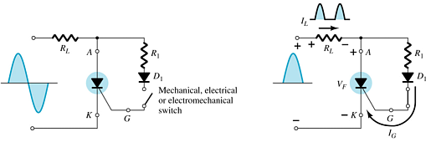
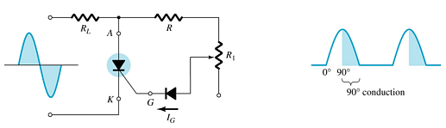
SCR Phase Control
The gate voltage can be set to fire the SCR at any point in the AC cycle.
In this example, the SCR fires as soon as the AC cycle crosses 0V. Therefore it acts like a half-wave rectifier.
In this example, the SCR fires later—at the 90° point—on the positive half-cycle.

Slide 24
SCR Applications
In these applications the SCR gate circuit is used to monitor a situation and trigger the SCR to turn on a portion of the circuit.
Battery-charging regulator
Temperature controller circuit
Emergency-lighting system

Slide 25
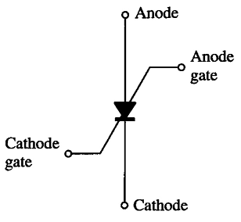
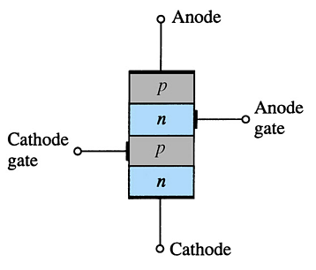
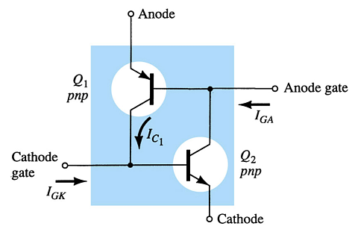
SCS—Silicon-Controlled Switch
An SCS is like an SCR, except that it has two gates: a cathode gate and an anode gate.
Either gate can fire the SCS
  A positive pulse or voltage on the cathode gate
  A negative pulse or voltage on the anode gate
Either gate can switch off the SCS
  A negative pulse or voltage on the Cathode gate
  A positive pulse or voltage on the anode gate
Note: The anode gate requires higher voltages than the cathode gate.

Slide 26
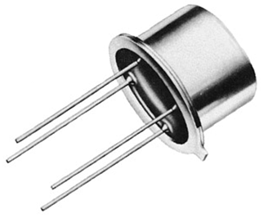
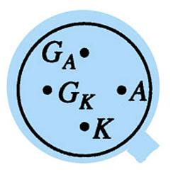
SCS
Comparison of the SCR and SCS:
  The SCS has a much lower power capability compared to the SCR
  The SCS has faster switching times than the SCR
  The SCS can be switched off by gate control
Applications
  Pulse generator
  Voltage sensor
  Alarm circuits
Pin Identification

Slide 27
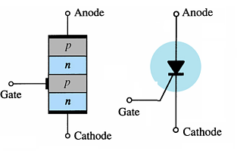
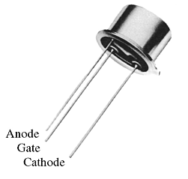
GTO—Gate Turn-Off Switch
GTOs are similar to SCRs, except that the gate can turn the GTO on and off.
It conducts only in one direction.
Applications
Counters
Pulse generators
Oscillators
Voltage regulators

Slide 28
GTO
Comparison of the GTO and SCS:
  GTO is a low power device
  The gate signal necessary to fire the GTO is larger than the SCR gate signal.
  The gate signal necessary to turn the GTO off is similar to that of SCS
  The switching rate for turning the GTO off is much faster than the SCR

Slide 29
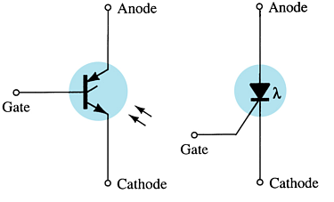
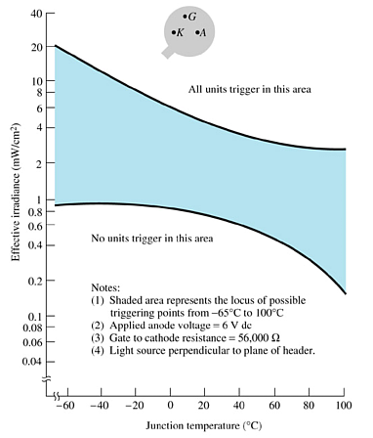
LASCR—Light-Activated SCR
The LASCR is an SCR that is fired by a light beam striking the gate-cathode junction or by applying a gate voltage.
  Applications
Optical light controls
Relays
Phase control
Motor control
Computer applications

Slide 30
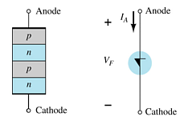
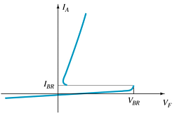
Shockley Diode
The Shockley diode conducts once the breakover voltage is reached. It only conducts in one direction.
Operation
The Shockley diode must be forward biased, and then once the voltage reaches the breakover level it will conduct. Like an SCR it only conducts in one direction.
Application
Trigger switch for an SCR

Slide 31
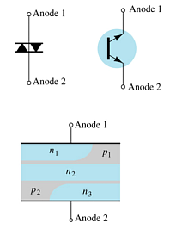
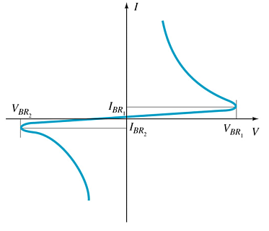
Diac
The Diac is a breakover type device.
Operation
Once the breakover voltage is reached the Diac conducts. The Diac, though, can conduct in both directions. The breakover voltage is approximately symmetrical for a positive and a negative breakover voltage.
Applications
Trigger circuit for the Triac
Proximity sensor circuit

Slide 32
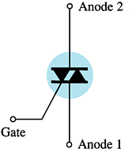
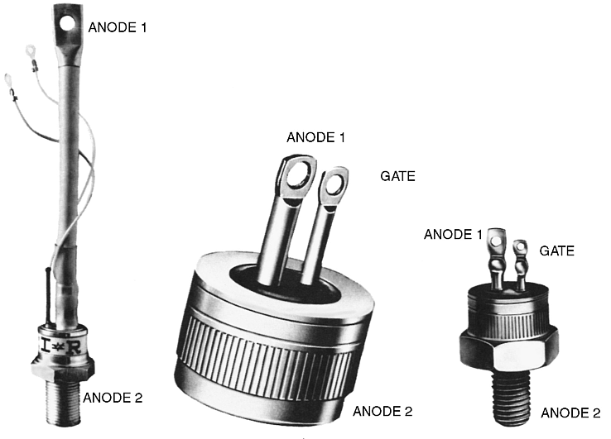
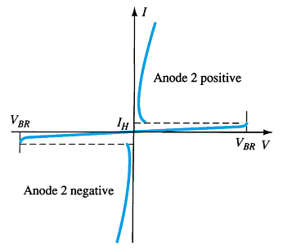
Triac
A triac is like a diac with a gate terminal.
Operation
When fired by the gate or by exceeding the breakover voltage, a triac conducts in both directions.
Applications
AC power control circuits
Terminal Identification
more…

Slide 33
Triac Terminal Identification

Slide 34
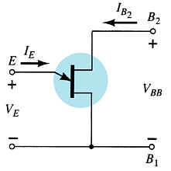
The Unijunction Transistor (UJT)
The unijunction transistor (UJT) has two base terminals (B₁ and B₂) and an emitter terminal (E).
The UJT symbol resembles the FET symbol. The emitter terminal is angled as shown.

Slide 35
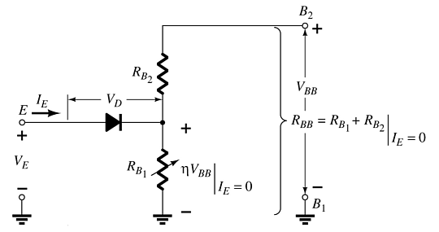

UJT Equivalent Circuit
The interbase resistance (R_{BB}) is the total resistance between the two base terminals when I_{E} = 0 A.
The intrinsic standoff ratio (η) is the ratio of R_{B1} to R_{BB} when I_{E} = 0 A.
Conduction through the emitter terminal begins when the emitter voltage reaches the firing potential, given as

Slide 36
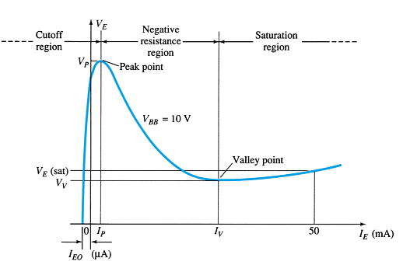
UJT Negative Resistance Region
After a UJT fires, emitter voltage decreases as emitter current increases.
The negative resistance region of operation is definced by the peak point (V_{P}) and the valley point (V_{V}).

Slide 37
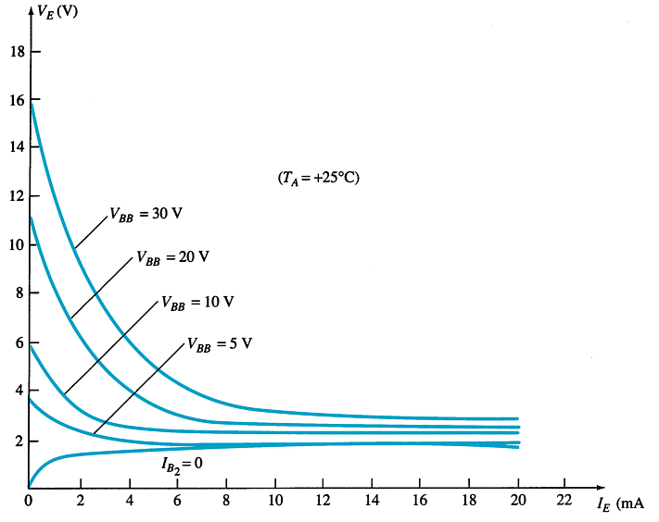
UJT Emitter Curves
The UJT emitter curves show the effect of V_{BB} on UJT firing voltage (V_{P}).
The higher the value of V_{BB}, the higher the value of (V_{P}) required to fire the component.

Slide 38
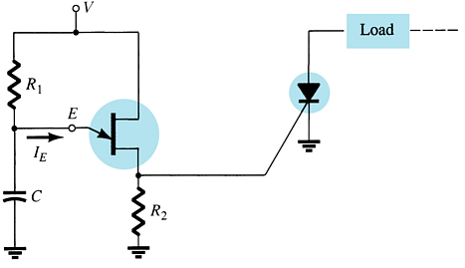
Using a UJT to trigger an SCR
The UJT is commonly used as a triggering device for other breakover devices, like the SCR.
The SCR shown is triggered when the UJT emitter circuit conducts.
As the capacitor charges, V_{E} increases. When it reaches V_{P}, the UJT fires. The voltage developed across R₂ triggers the SCR.

Slide 39
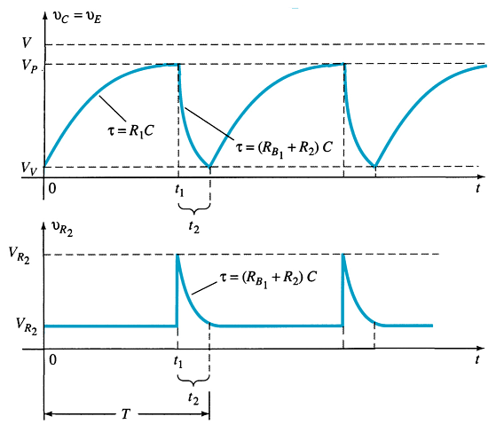
Using a UJT to trigger an SCR
The V_{E} and V_{R2} waveforms for the SCR triggering circuit (below) are shown.

Slide 40
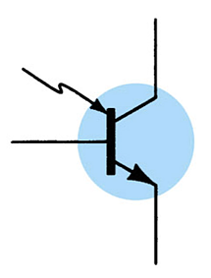

The Phototransistor
The phototransistor is a light-controlled transistor. The current through the collector and emitter circuits is controlled by the light input at the base.
The collector current is the product of the transistor current gain (h_{fe}) and the light induced base current (I_{λ}).

Slide 41
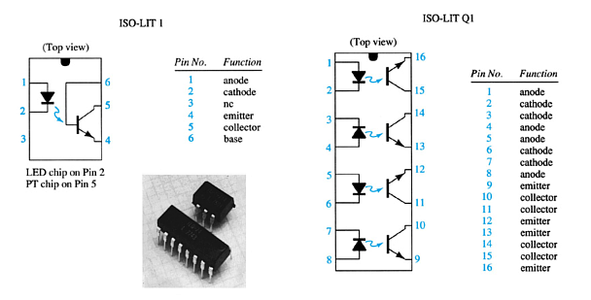
Phototransistor IC Package

Slide 42
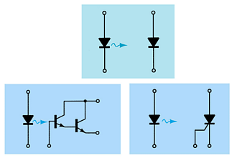
Opto-Isolators
Photodiode
Photo-Darlington
Photo-SCR

Slide 43
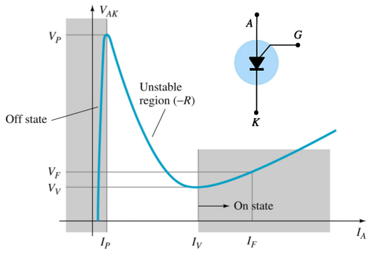
PUT—Programmable UJT
Characteristics
In some of its operating characteristics, a PUT is more like an SCR.
Like the UJT, the PUT has a negative resistance region. But this region is unstable in the PUT. The PUT is operated between the on and off states.

Slide 44
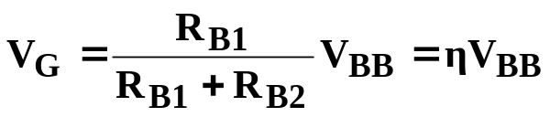
PUT Firing
Reducing or removing the gate voltage dies not turn off the PUT. Instead, like an SCR, the Anode to Cathode voltage must drop sufficiently to reduce the current below a holding level.
The gate voltage required to turn the PUT on is determined by external components, and not by specifications of the device as in the η value for the UJT.

