Slide 1

Final project- Piano with metronome and 2.5 octave scales
106062119 王元廷

Slide 2
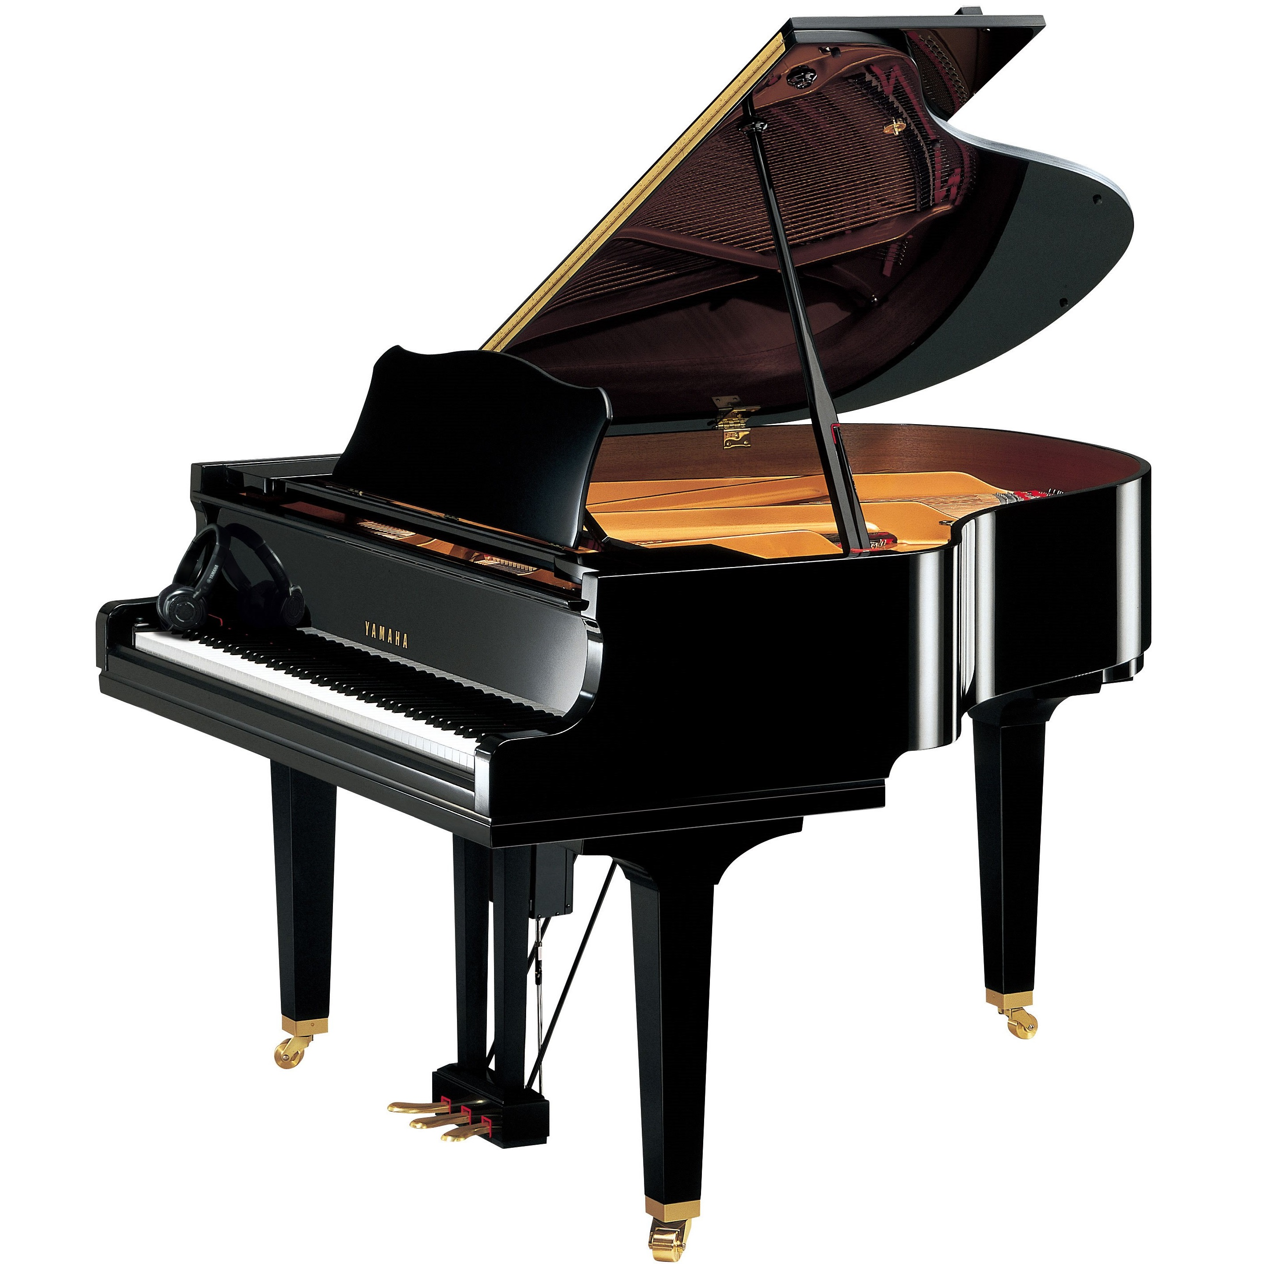
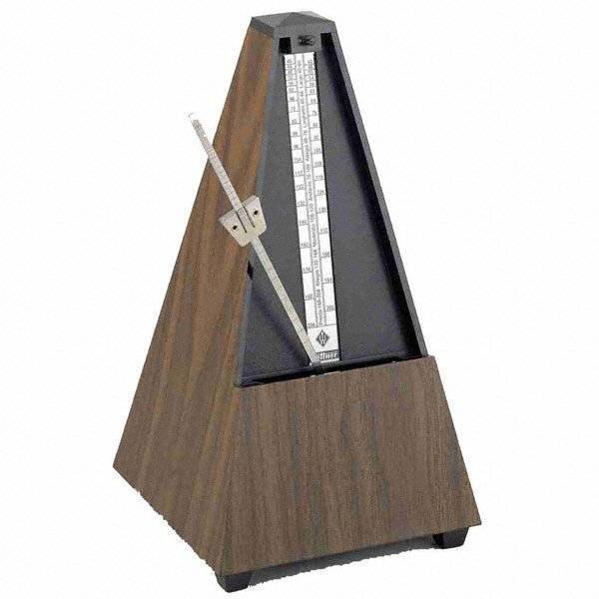
concept

Slide 3
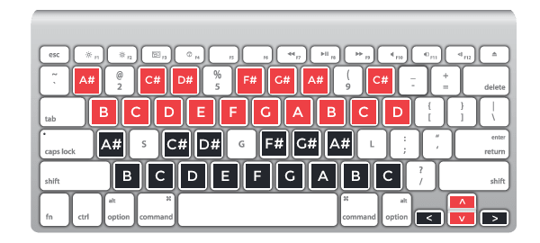
piano
The keys highlighted in red and black represent an octave.
Change the pitch of the octave using the arrow keys.
The left and right arrows change the octave of the black keys.
The up and down arrows modify the red keys.
Audio amplifier plays the corresponding sound pressed by keyboard.

Slide 4
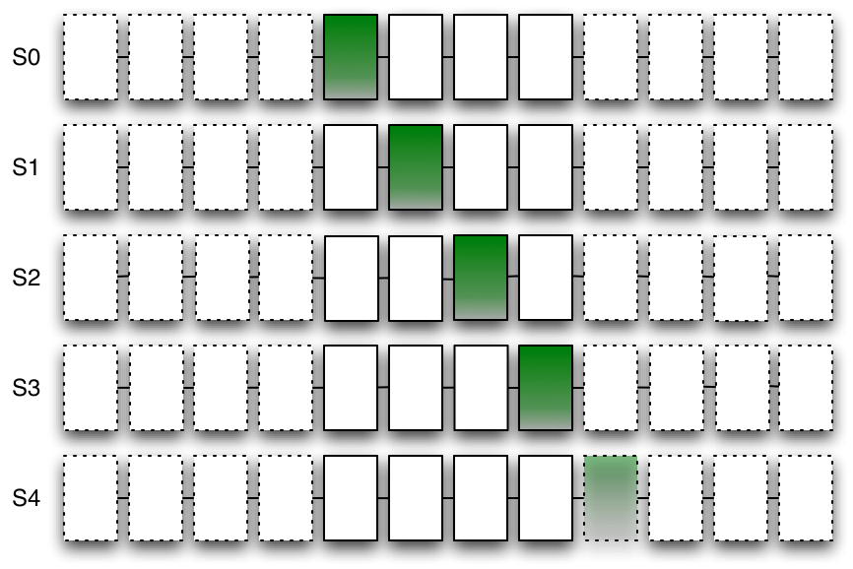
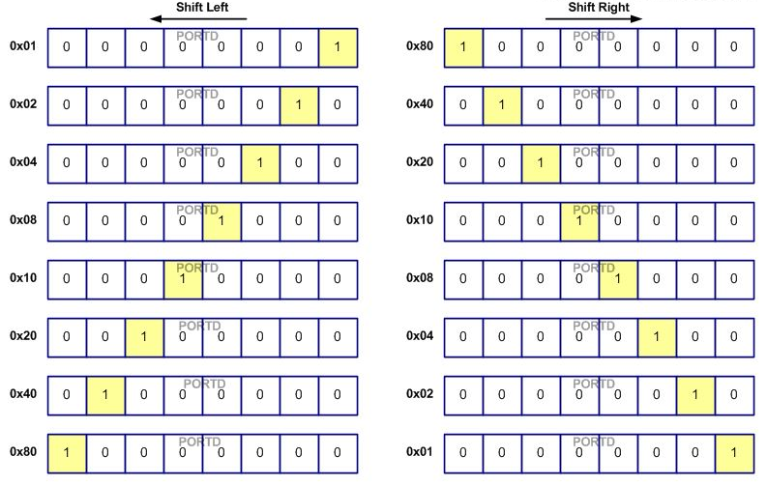
metronome
LED serves as a metronome which shifts from left to right or from right to left at a cycle based on the BPM value.
The BPM value will be displayed on the three rightmost 7-segment displays and can be modified using BTNU and BTND.
A sound of 880Hz will be played when LED is on at both sides.
The sound of metronome could be mute using the leftmost switch.

Slide 5


Slide 6

schedule
https://github.com/ytwang3579/FPGA_Final_Project-Piano-with-Metronome
12/02
Proposal
submitted
01/08
Test Feature &
Bug fix
01/10
Slides
12/21
Metronome
12/28
Piano

Slide 7


Test feature & bug fixing
Sound mixing in a single audio track
7-segment displaying octaves
Metronome LED strange bugs

Slide 8
THANKS FOR LISTENING

