Slide 1
CG4825相关参考文献

Slide 2
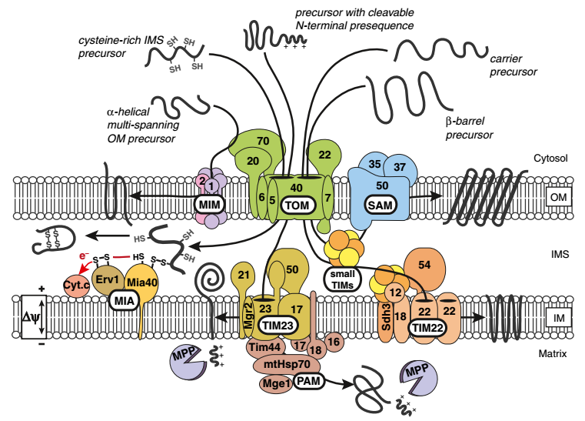
Mitochondrial protein import pathways
Saccharomyces cerevisiae
3
4
5
1
2
1
2
5
4
3
Bottinger, L. et al. J. Bioenerg. Biomembr. (2016).
Notes:
## The functions of mitochondria:
1) ATP production
2) synthesis of lipids, amino acids, heme and iron-sulfur clusters
3) signaling platform for apoptosis
## Mitochondrial protein: ~1000(yeast) or 1500(human) (Reinders et al. 2006; Pagliarini et al.2008)
## the mitochondrial contact site and cristae organizing system (MICOS)
## the endoplasmic reticulum-motichondria encounter structure (ERMES)
## Mitochondrial protein import
### the translocase of the outer membrane (TOM complex):
[the general entry gate for most of mitochondrial precursor proteins]
the pore-forming Tom40
the receptor proteins Tom20, Tom22 and Tom70
three samll Tom proteins
### transport pathway:
1. Mitochondrial outer membrane
1.1 The precursors of β-barrel proteins:
TOM and SAM complex (sorting and assembly machinery)
Sam50 (Tob55) Sam35 (Tob38) Sam37 (Mas37)
The β-barrel proteins are translocated through the TOM channel.
The SAM complex mediates β-barrel folding and insertion into the outer membrane.
1.2 The protein contain transmembrane α-helices:
Proteins are recognized by the receptor protein Tom70, but not translocated through the TOM channel.
The mitochondrial import machinery (MIM complex) mediates membrane insertion and assembly.
The MIM complex : Mim1 and Mim2
2. Mitochondrial inner membrane
2.1The majorityof mitochondrial precursors contain an N-terminal cleavable presequence.
The N-terminal is removed by mitochondrial precessing peptidase (MPP)
Tom20 and Tom22 recognize the precursors and the precursors go though the TOM channel.
And transferred to the TIM23 complex.
2.2 multi-spanning inner membrane proteins lacking a cleavable presequence
recognized by Tom70 receptor and translate by TIM22
2.3 Precursor preotein with cysteine-rich motif
TOM -> Mia40 (mitochondrial intermembrane space import and sssembly machinery MIA)

Slide 3
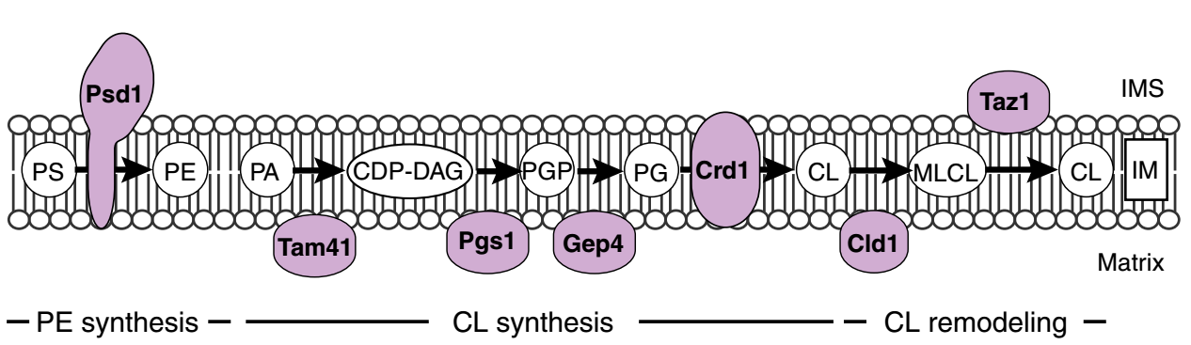
Mitochondrial phospholipid level and biogenesis in yeast
Saccharomyces cerevisiae
The major phospholipid of mitochondrial membranes:
PC PE PI PS and CL.
Sterols (ergosterol) and sphingolipids are present in minor amounts.
Inner membrane : high level of CL
Outer membrane : one quarter of the total mitochondrial CL pool
Prohibitin
UPS1
Bottinger, L. et al. J. Bioenerg. Biomembr. (2016).
Notes:
## ERMES complex forms a molecular tether between the mitochondrial outer membrane and the endoplasmic reticulum

Slide 4
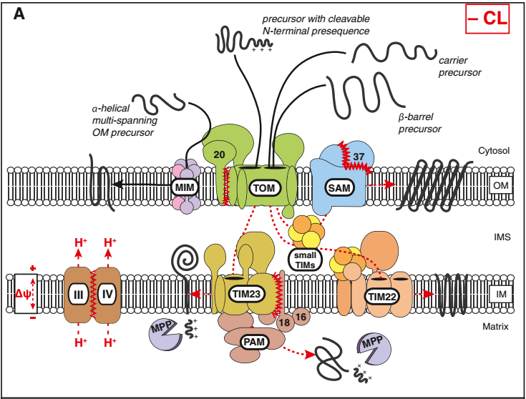
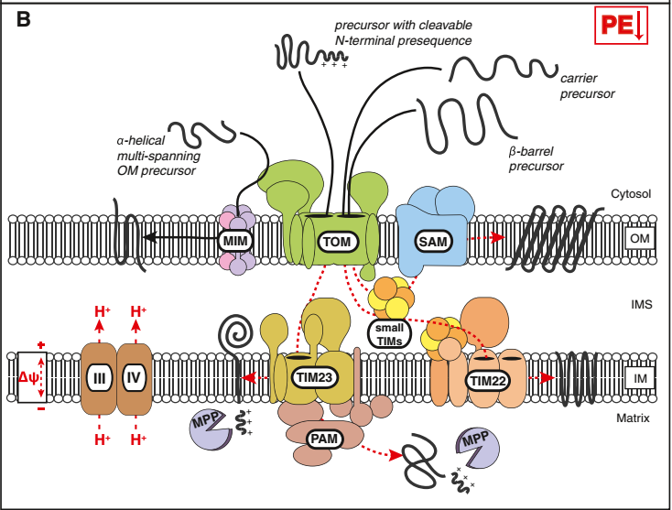
The role of mitochondrial lipids in protein import
Saccharomyces cerevisiae
Bottinger, L. et al. J. Bioenerg. Biomembr. (2016).
Notes:
Cardiolipin and phosphatidylethanolamine exhibit unexpectedly specific functions for the activity of distinct protein translocases.
Both phospholipids are required for full activity of respiratory chain complexes and thus to maintain the membrane potential for protein import.
Cardiolipin is required to maintain structural integrity of mitochondrial protein translocases.
Low sterol content in the mitochondrial outer membrane may contribute to the targeting of some outer membrane proteins with a single alpha-helical membrane anchor.

