Slide 1

ORACLE APEX
|
CAR RENTAL
MANAGEMENT
SYSTEM

Slide 2
DESCRIPTION
A Car Rental Management System developed in Oracle APEX is a web-based application designed to streamline the processes involved in renting and managing cars.Here’s a description of what we have done
-> Loginpage of rental cars
-> Charts for the income
-> Details of our customer (Form)
-> Report for customer details
-> Car details
-> Booking form for rental cars
-> Booking reports

Slide 3
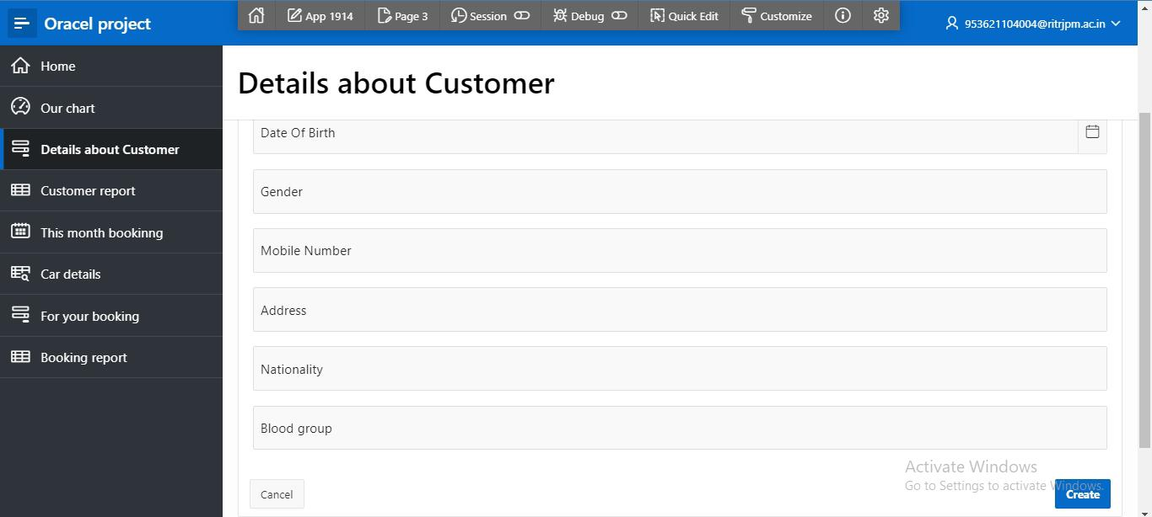
CUSTOMER DETAILS

Slide 4
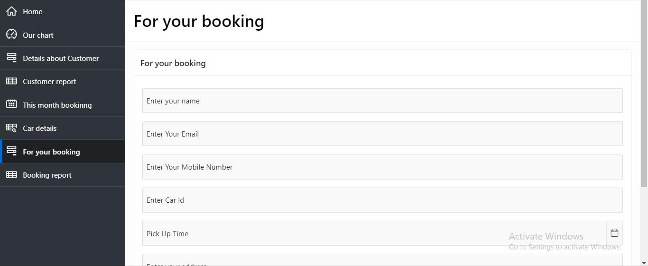
RENTAL CAR BOOKING

Slide 5
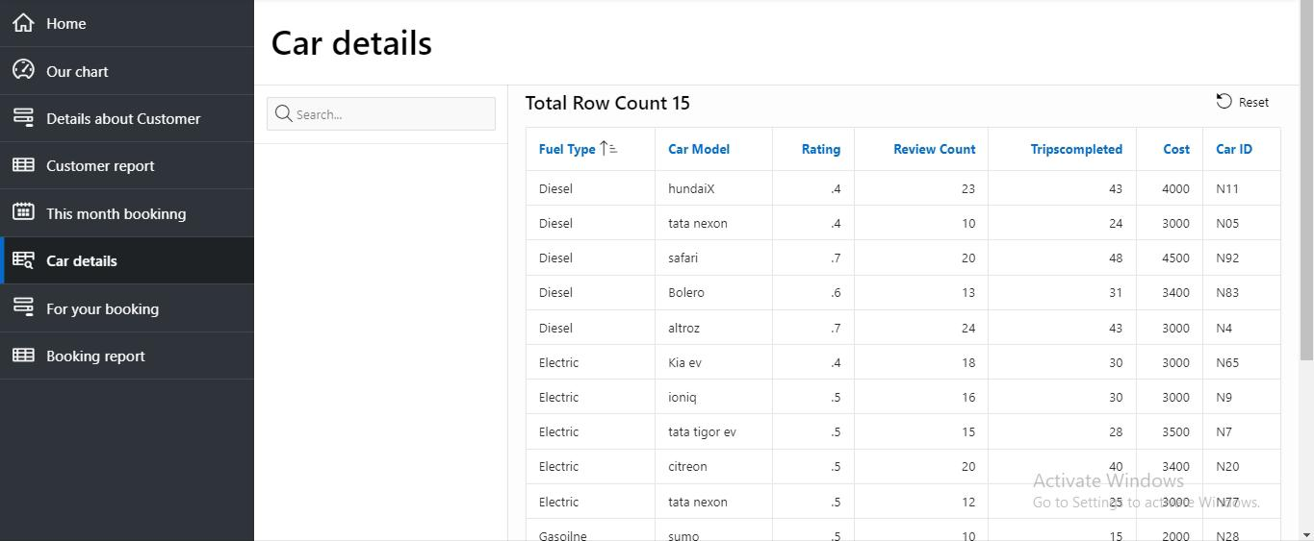
CAR DETAILS

Slide 6
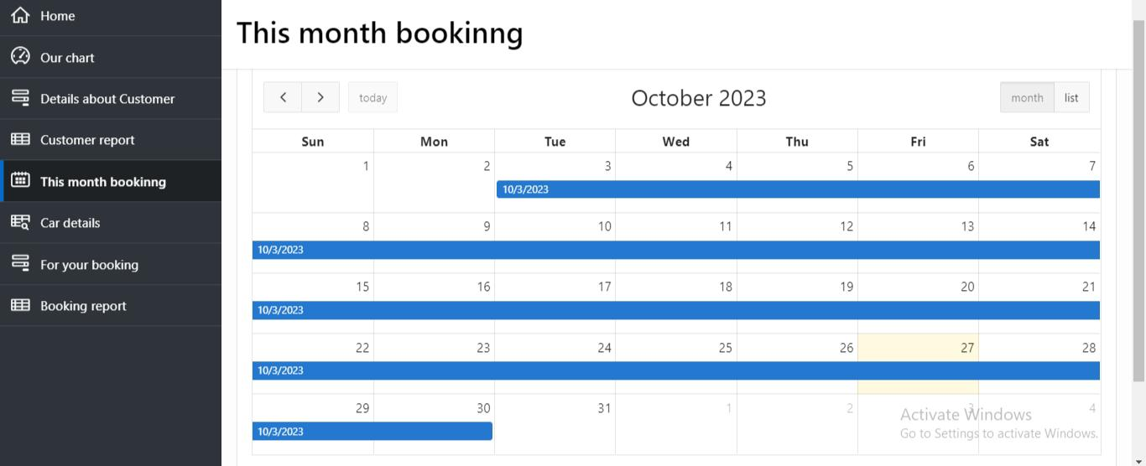
CALENDAR

Slide 7
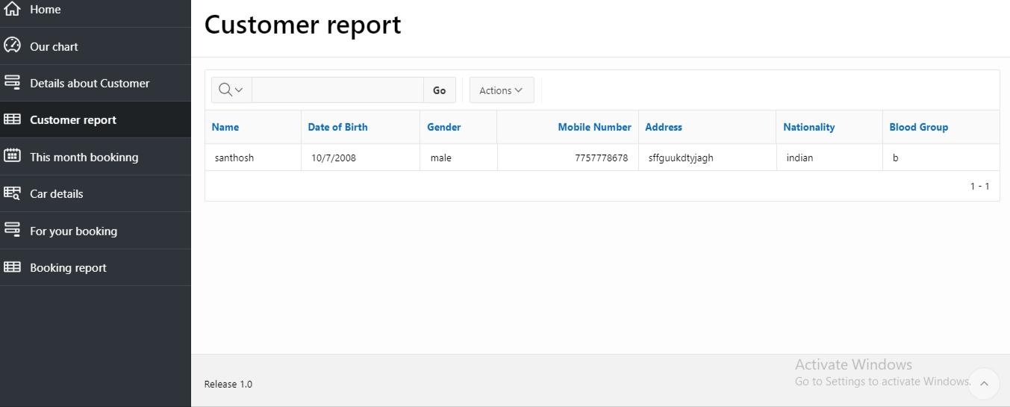
CUSTOMER REPORT

Slide 8
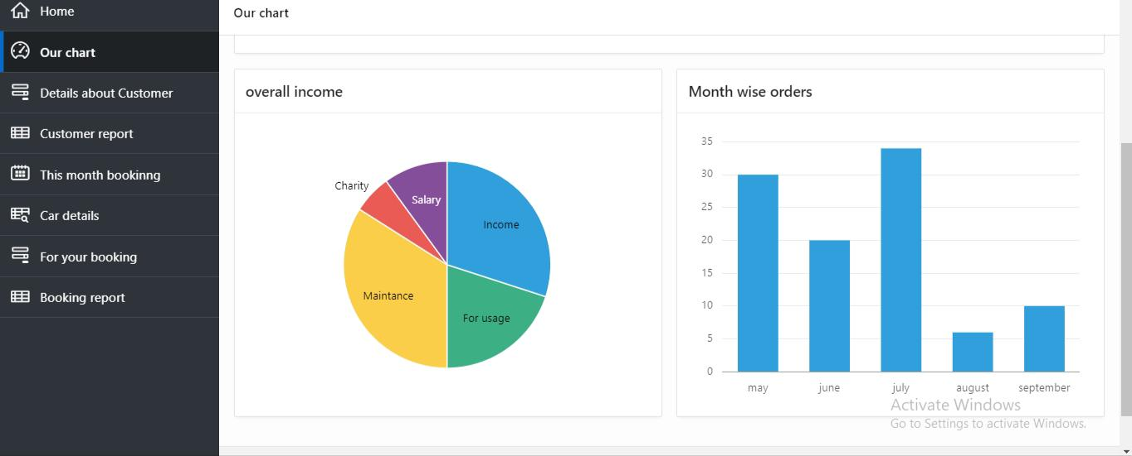
CHART

