Slide 1

Could there be a significant biased connection between the annotator’s background and the way they will rate hate speech?
Our Research Question

Slide 2


Why is this so important? What is already done in this field?
An Empirical Study into Apparent Gender-Based Discrimination in the Display of STEM Career Ads
How an algorithm delivered ads promoting job opportunities in STEM fields that was explicitly intended to be gender-neutral in its delivery. Empirically, however, fewer women saw the ad than men.
Dissecting racial bias in an algorithm used to manage the health of populations
The U.S. health care system uses commercial algorithms to guide health decisions. This research found evidence of racial bias in one widely used algorithm.

Slide 3
Data Overview
The data we used has been published in an article from Berkeley University.
The original data contain 131 variables. We focused on variables that were filled by the annotators.
7912 different annotators were given posts to rate.
In total our data contains 135,556 records

Slide 4
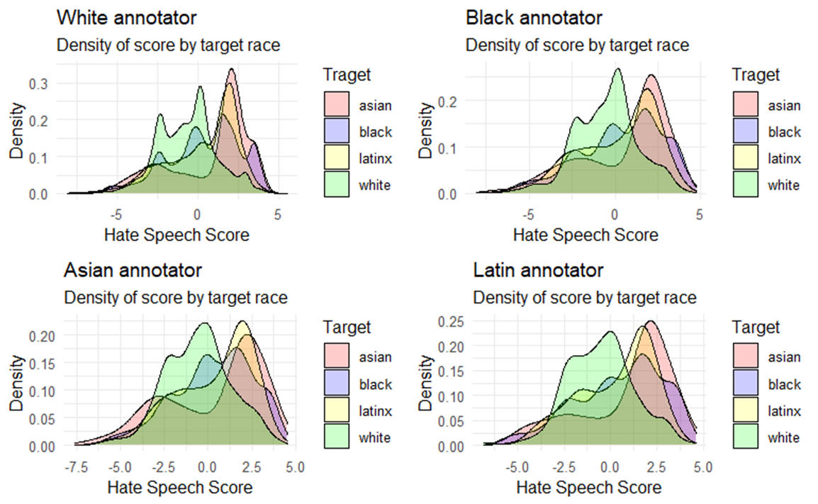
Data Overview

Slide 5
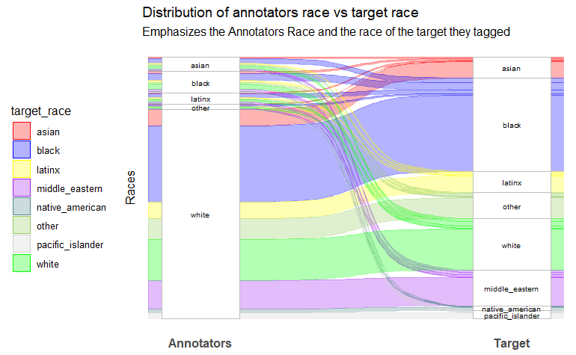
Data Overview

Slide 6
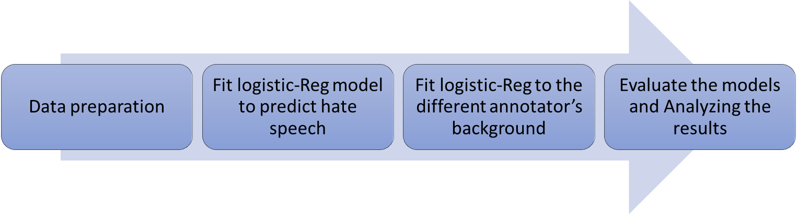
Workflow & Methods

Slide 7
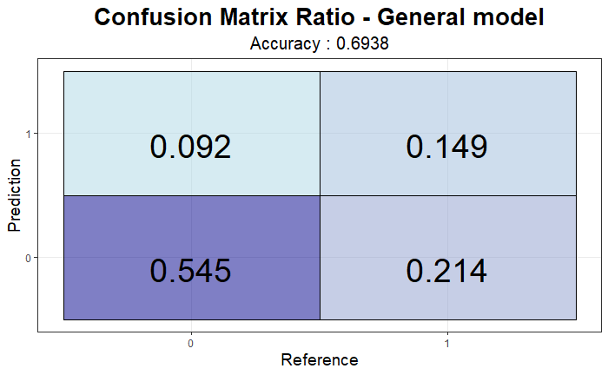
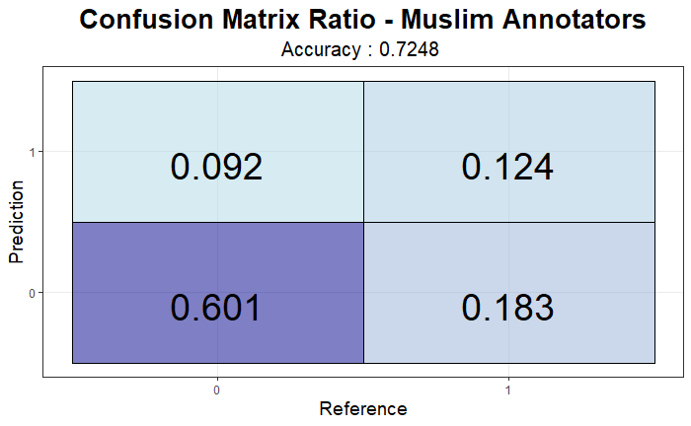
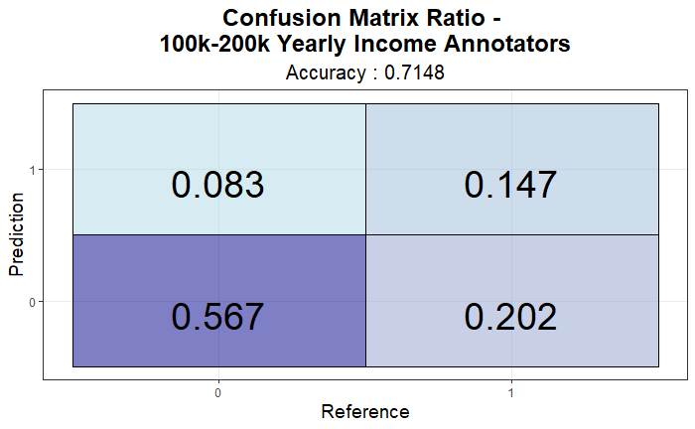
Findings & Key results
By addressing the data through the different categories in the annotator’s background the models :
Predict better than the general model in some cases

Slide 8
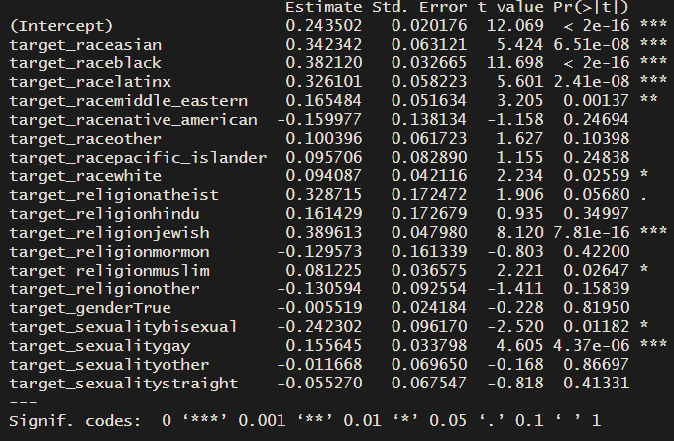
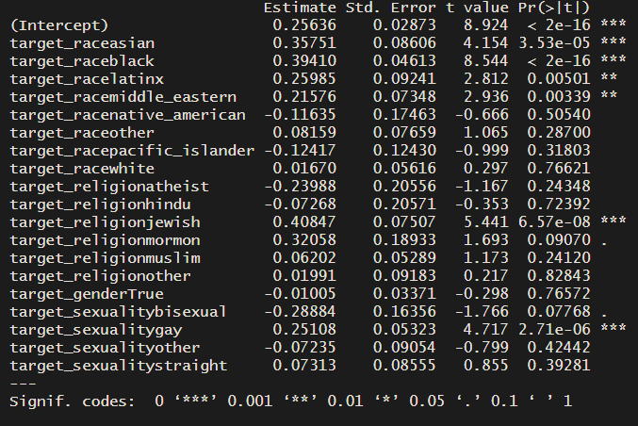
Findings & Key results
By addressing the data through the different categories in the annotator’s background the models :
From the significant coefficients, we learned that groups with different backgrounds grasp different posts that target specific sectors.
Professional Degree
PhD

Slide 9
Thank you!
Do you have any questions?

