Slide 1
GAME TEST LAB
GameTestLab
15
Game generation and process evaluation
Hy3 plans, codes and reviews. Chromium plays.
frozen game tasks
01
Notes:
正式范围：results/process-15-v1/scope.json；15 题全部完成见 results/process-15-v1/FINAL.md。历史 96 题不并入本报告。

Slide 2
GAME TEST LAB
One game's evaluation path
01
Game brief
Rules, win/loss goals and executable checks
02
Hy3's numbered plan
Written before code, with a check for each step
03
Code written with Write/Edit
Reconstructed from tool calls and file hashes
04
Chromium play and Hy3 review
Real input, virtual time and counterexamples
02
Notes:
过程定义、证据哈希与验证设计：reports/analysis-report.md；results/process-15-v1/PROGRESS.md。观察桥仅收集证据，玩家操作来自 Chromium。

Slide 3
GAME TEST LAB
Three result types across 15 tasks
15/15
plan, game, browser play and review
4/11
6/12
Hy3: final game correct / decided
Hy3: plan process valid / decided
Manifest files valid: 8/15
Original path passes: 14/47
Hy3 opinions and raw path scores need independent checking
03
Notes:
所有分母和口径：results/process-15-v1/final-summary.json。原固定路径含已核实的输入、私有断言和 observe 字段问题；声明文件合规也不保证完整运行接口合规。

Slide 4
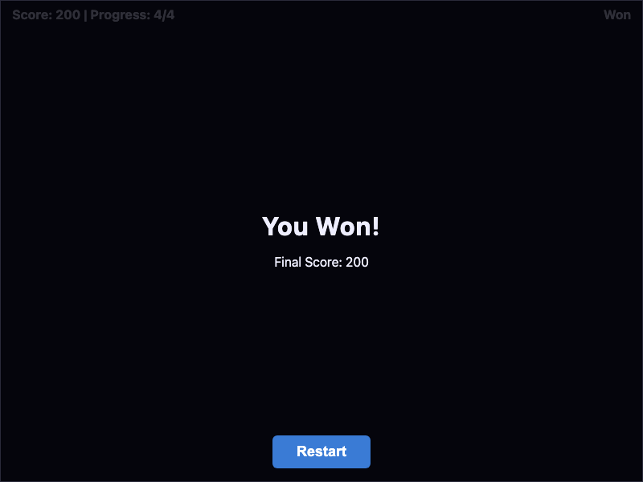
GAME TEST LAB
Step 3 adds 100 points too many
4 × 25 = 100
Score required by the brief
Code adds another 100
Three wins all scored 200
Hy3 detects and locates plan step 3
04
Notes:
公开计分标准、原方案与三次重放：results/process-15-v1/particle-orchestra/score-plan-claim.json；截图是保存的原始 Chromium 执行证据，不是生成示意图。

Slide 5
GAME TEST LAB
How reliable is step localization?
1/3
Original full review: detect and locate
2048 plays correctly
Its plan calls a winning move a loss. A second Hy3 review finds step 3.
One checked correct-core case: real issue 1/1, false alarm 0/1
Small samples cannot establish a general error rate or difficulty threshold
github.com/yu-xin-c/hy3-game-test-lab
05
Notes:
三份公开方案子断言标准与复核结果：results/process-15-v1/PROCESS-VALIDITY.md。2048 补充混元提示不同，不能与原始全题复核合并；这里只描述已核对的一个正确核心游戏、错误过程单例。

