Slide 1


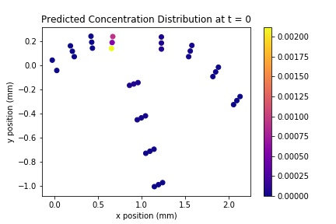
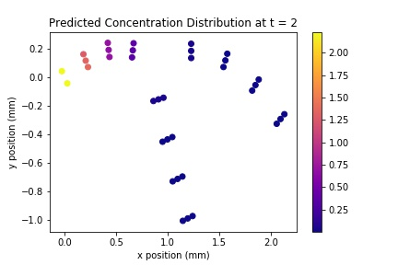
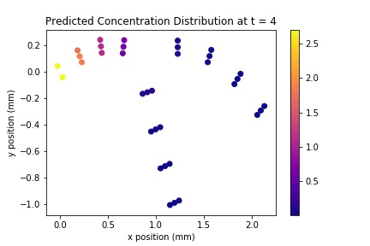
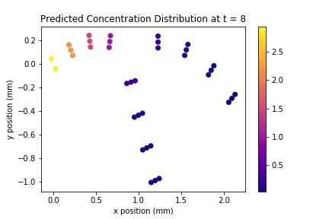
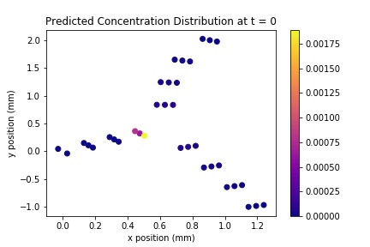
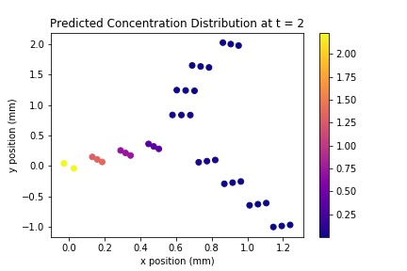
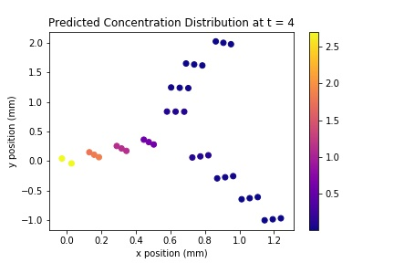
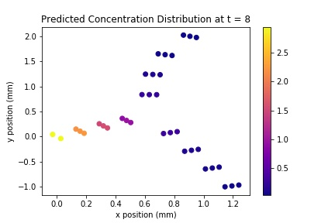
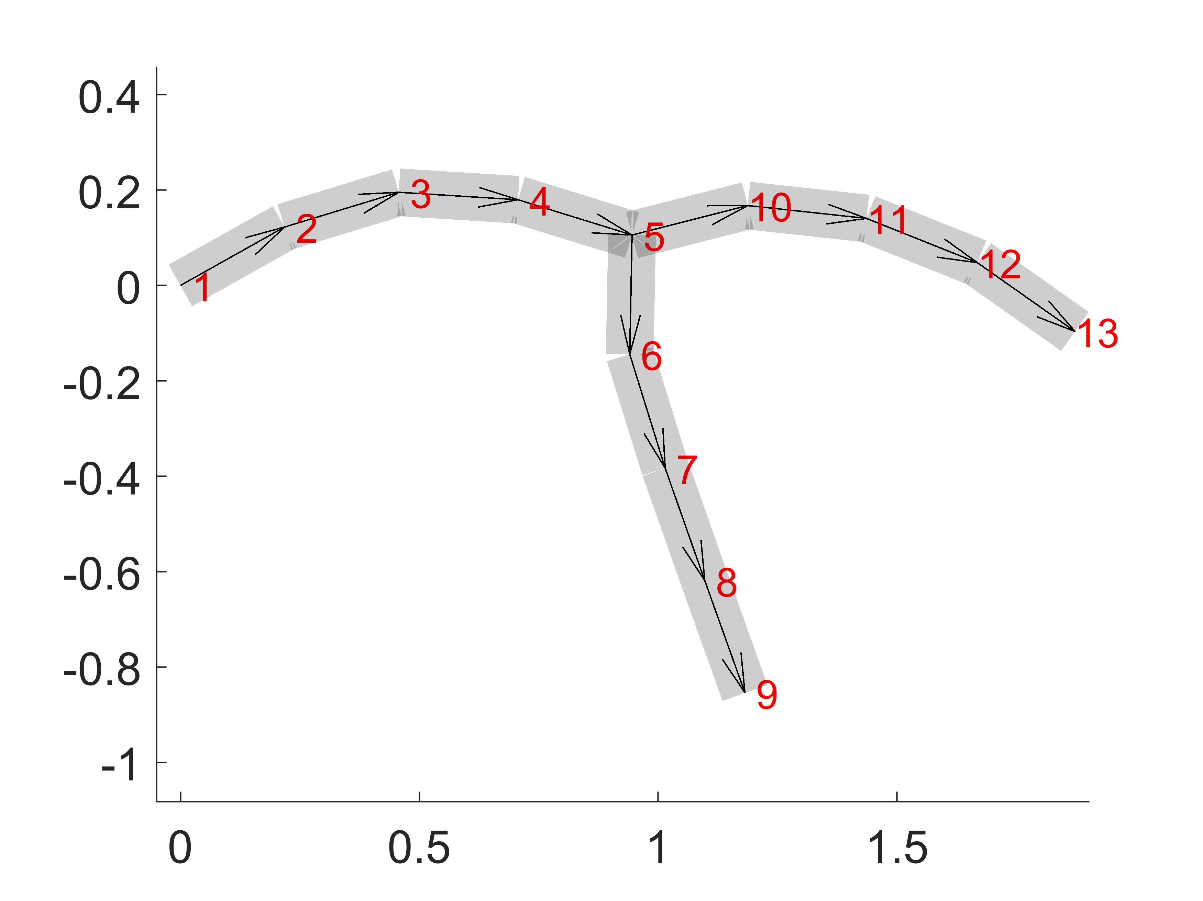
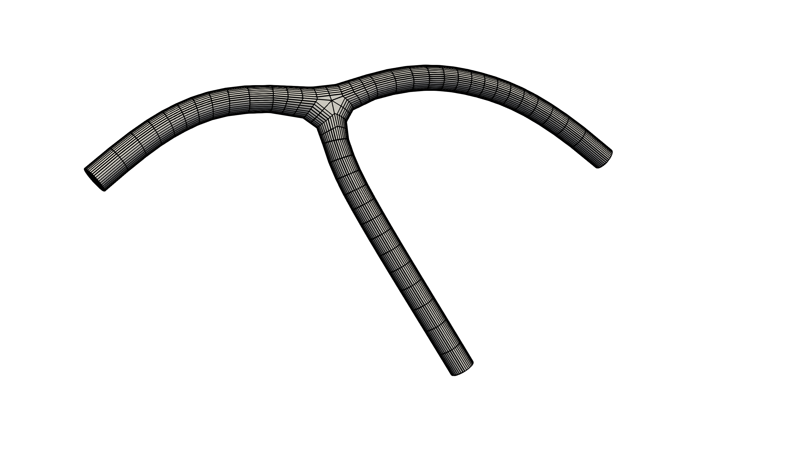
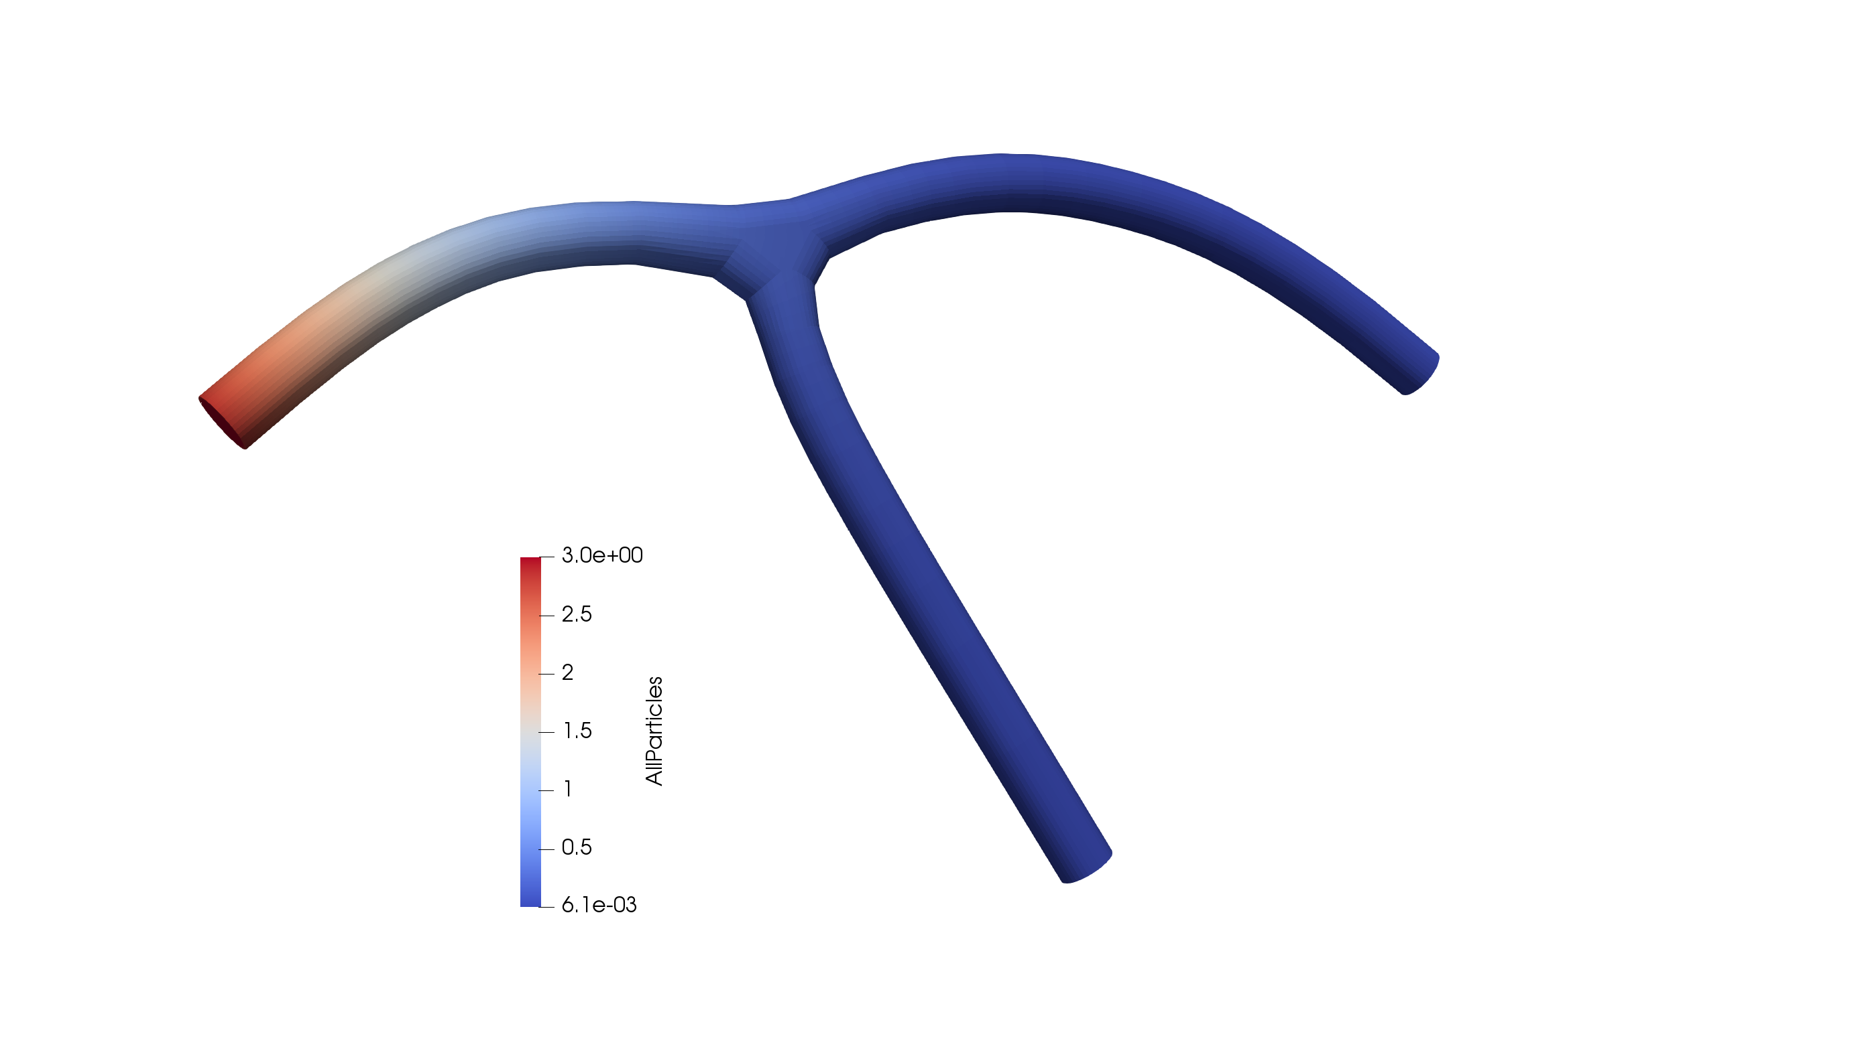
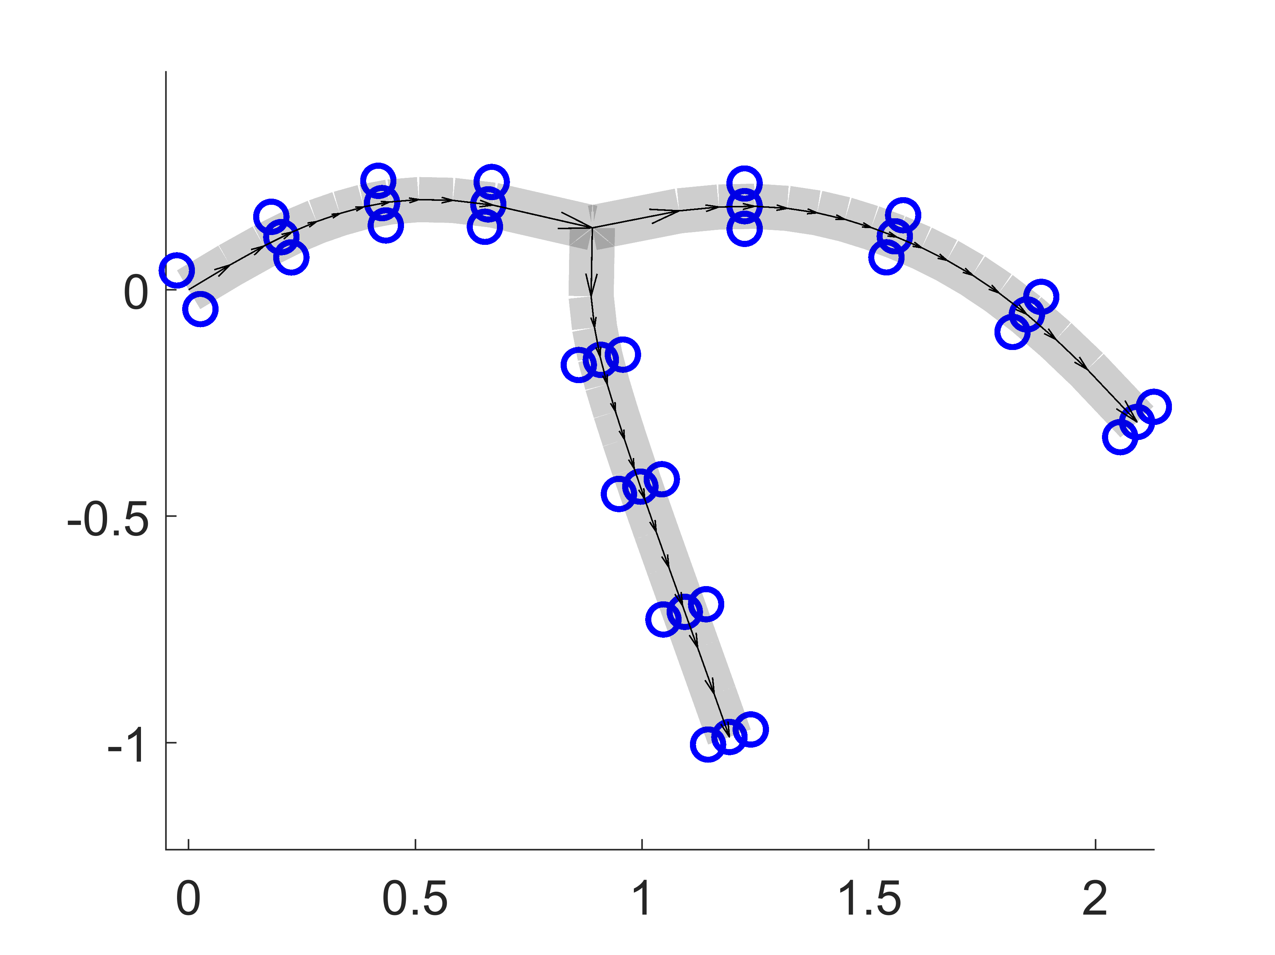
Predicting Neurite Network Concentration using
Multiple Random Forest Regressors and Auto-Encoder
ªYuxuan Yu, ªKuanren Qian, ªAngran Li, ªChanglin Jiang
ªComputational Bio-modeling Laboratory, Department of Mechanical Engineering, Carnegie Mellon University
Introduction
FEA modeling and simulation: We assume each segment as a pipe so that we can describe its location and shape with two end points and their associated diameters. We generate the hexahedral control mesh for each segment by sweeping the quadrilateral mesh of the cross section along the skeleton (Fig. 1(b)). Simulation data comes from Neuron material transport simulation (Fig. 1(c)).
Feature extraction: Completed FEA results are used for feature extraction to collect data for training models. In each case, the result is described by the chosen 35 nodes (coordinate z=0), which have additional information (time t, concentration c) to describe the design (Fig. 1(d)). The chosen 35 nodes are obtained by interpolate a set of points at fixed distances along the centerline and boundary in space.
Model Performance and Prediction
Neurite networks consist of neurons, and the neurons’ structures can be extremely complex and diverse. As a results, the material transport simulation in a neurite network is, therefore, computationally expensive and very time-consuming. Machine learning algorithm, on the contrarily, predicts solution based on weights learned from existing data and does not need sequential equation calculation as finite element method. Therefore, ML shows great potential in supplementing existing finite element simulation. Our study shows that, using multiple random forest regressors, the process of neurite network material transport simulation can be speed up significantly, up to x5647.1 (One model: FEA ~864s, ML ~0.00015s).
The performance of random forest regressor algorithm is evaluated using mean square error. The 6000 data set is split 70/30 as training data and test data. The predicted concentration value of 35 random forest regressor model is compared with corresponding concentration value in test data using mean square error method. The maximum mean square error is found to be : 5.177e-05.
Random Forest Regressor Algorithm
Project Overview
The first machine learning algorithm developed here consist of 35 individual random forest regressors. Each regressor is responsible for learning one concentration value based on x position, y position, and time data. Combining prediction from 35 random forest regressors, the algorithm can predict concentration value on a mesh grid consists of 35 nodes. Figure 2 below illustrates the structure of the developed machine learning algorithm.
The goal of this project is to explore and implement potential machine learning algorithm to boost the speed of the Neurite Network simulation.
The implemented ML algorithms are random forest regression and auto-encoder based convolutional neural network. In random forest regression algorithm, we implemented 35 random forest regressors and the algorithm can predict concentration value at each node with a maximum mean square error of 5.177e-05. Due to our data limitation, auto-encoder, though capable of analyzing complex pattern and finding important features in data structure, proves to be difficult to implement and much more time-consuming when comparing with random forest regressor.
Random Forest Regressors for Nodal Prediction
Model #n (n = 0 to 35 for concentration at 35 nodes)
Input feature data
Scikit-learn Random Forest Regressor
X position
6000 x 35
#data x #node
Y position
6000 x 35
#data x #node
Time
6000 x 35
#data x time
Concentration
6000 x 1
#data x 1
Data Generation
Each model learns concentration
Tree Structure Design Generator: We use a parametric script to batch-generate different tree structure designs for FEA and data collection. The script takes several design parameters as constraints and generates individual tree structures by randomizing the node locations. The nodes are labelled and connected by edges (Fig. 1(a)). The results are topologically consistent while being geometrically and behaviorally varied.
Figure 2. Random forest regressor machine learning model structures
Auto-Encoder Algorithm
The second machine learning algorithm developed uses auto-encoder theory. Like random forest regressor algorithm, the auto-encoder algorithm uses the same data, but layering x position, y position and time into a 3-layer matrix as input. Then, using Pytorch nn package, we developed the following convolution neural network structure, shown in figure 3. The algorithm takes 3 x 6 x 6 matrix as an input and conduct calculations shown in the figure to obtain a 6 x 6 matrix, representing learned concentration. Then, the computed concentration matrix is compared with simulated concentration value using mean square error, and the loss is sent back for iterative optimization.
Figure 4. Neurite network concentration prediction
Conclusion
Based on our study and developed machine learning algorithms that use random forest regressors and convolution neural network, machine learning algorithm is vastly efficient and faster if the simulation target is specific. Even with straight-forward random forest regressor algorithm, machine learning model is x x5647 faster. To simulate One model, finite element analysis took around 864s to finish but random forest regressor finished it in 0.00015s after training. The different in performance showcases that machine learning has great potential in boosting fundamental research.
(a)
(b)
Auto-Encoder Algorithm Structure
Input 3-layer matrix
X position
6 x 6
Output 1-layer matrix
ReLU
Concentration
6 x 6
y position
6 x 6
Conv2D
3 channels to 2 channels
Conv2D 2 channels to 1 channel
t matrix
6 x 6 (same t)
(c)
(d)
Acknowledgment
Figure 1. Data generation overview. (a) neuronal tree structure; (b) Hexahedral control mesh; (b) FEA simulation result for data collection; (b) Feature representation
Figure 3. Auto-Encoder machine learning model structures
Neurite network simulation tool was developed by Angran Li, a Ph.D. student from the Department of mechanical engineering

