Slide 1
Molecular Property Prediction with Chemprop
An AI for Science Approach to Drug Discovery
Graph Neural Networks for Molecular Property Prediction
ESOL Solubility Dataset | Chemprop MPNN | Data Scale Analysis
1/7

Slide 2
AI for Science: Why Molecular Property Prediction?
The drug discovery bottleneck — and how AI can help
• Drug discovery is slow and expensive: ~10 years and $2.6 billion per new drug
• A key bottleneck is early-stage screening: millions of molecules, very few tested
• Molecular property prediction uses AI to predict properties from structure alone
– No wet lab needed for initial screening
– Prioritize promising candidates before expensive synthesis
• Why solubility? It is the first pharmacokinetic hurdle
– If a drug doesn't dissolve, it cannot be absorbed in the gut
– Poor solubility is the #1 cause of late-stage clinical failure
• AI for Science principle: Data quality and structure define the boundary of AI scientific reasoning
– The model is only as good as the data and molecular representation
2/7

Slide 3
Data & Method: ESOL Dataset + Chemprop MPNN
Dataset overview and model architecture
ESOL (Delaney) Dataset
• 1,128 small organic molecules
• Each entry: SMILES string → LogS (aqueous solubility)
• LogS = log₁₀(solubility in mol/L)
• Range: ~−7 to ~+2 (insoluble → highly soluble)
• Widely used benchmark, fast to train
• 80/20 train/test split (fixed random seed)
Chemprop MPNN
• Message-Passing Neural Network
• Molecules as graphs:
– Nodes = atoms (C, N, O, H...)
– Edges = chemical bonds
• Message passing: atoms exchange
information through bonds over
multiple steps (depth = 5)
• Readout: aggregate atom features
→ predict molecular property
• PyTorch-based, modular design
• Chemprop v2: improved efficiency
3/7

Slide 4
Experiment Design
Baseline training + data scale analysis
Experiment 1: Baseline Model Training
– Train Chemprop MPNN on full ESOL dataset
– Architecture: hidden=300, depth=5, dropout=0.1
– Training: Adam optimizer, ReduceLROnPlateau, early stopping (patience=15)
– Evaluation metrics: RMSE, MAE, R²
Experiment 2: Data Scale Analysis (Core Contribution)
– Question: How does model performance improve with more data?
– Train on 20%, 50%, 80%, 100% of training data
– Fixed test set for fair comparison
– 3 random repeats per scale → error bars
Key Design Choices:
– Fixed test set across all experiments (same random seed = 42)
– MPNN treats each molecule independently — no data leakage
– Regression task (continuous LogS values)
4/7

Slide 5
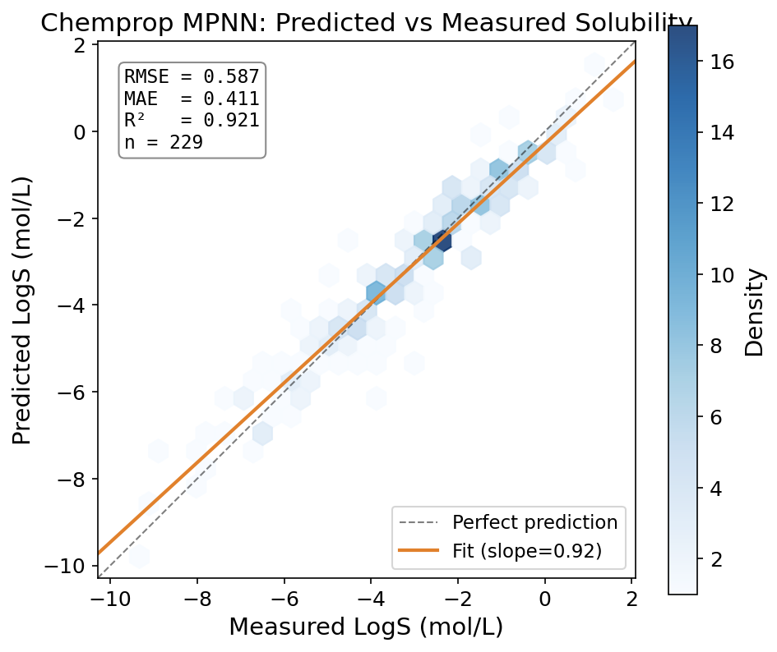
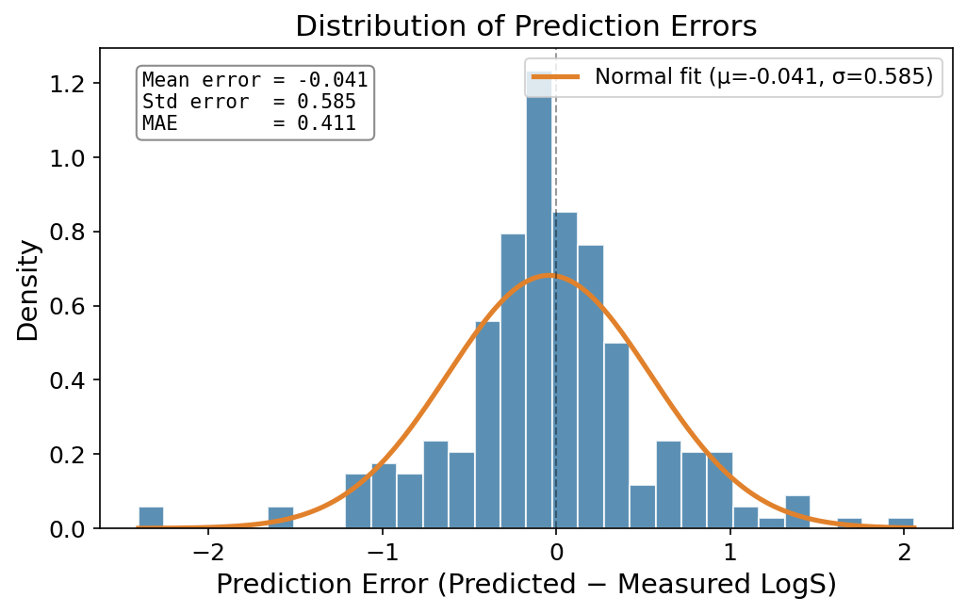
Results: Prediction Performance
Chemprop MPNN accurately predicts aqueous solubility
Left: Predicted vs measured LogS (hexbin density plot). Right: Error distribution with normal fit.
5/7

Slide 6
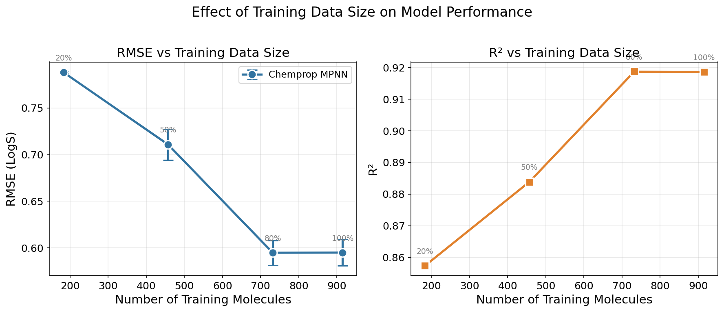
Results: Impact of Training Data Size
More data → better predictions (with diminishing returns)
Key Insight: Model performance improves dramatically from 20%→80% data, with diminishing returns at 100%. This validates the AI for Science principle: data quality and quantity define the upper bound of what models can learn.
6/7

Slide 7
Conclusions: AI + Molecular Science
1
Graph Neural Networks are a natural fit for molecular data
Molecules are graphs — atoms as nodes, bonds as edges. MPNNs learn from this structure directly, without hand-crafted features.
2
Solubility prediction is practical and impactful
Aqueous solubility is the first hurdle for oral drugs. AI screening can prioritize synthesizable candidates early.
3
Data scale drives model quality
Our experiments show RMSE improves substantially with more training data — validating the AI for Science approach.
4
Chemprop lowers the barrier to entry
Modular, well-documented, PyTorch-based. A few hundred lines of code is enough for a complete molecular ML pipeline.
7/7

