Slide 1
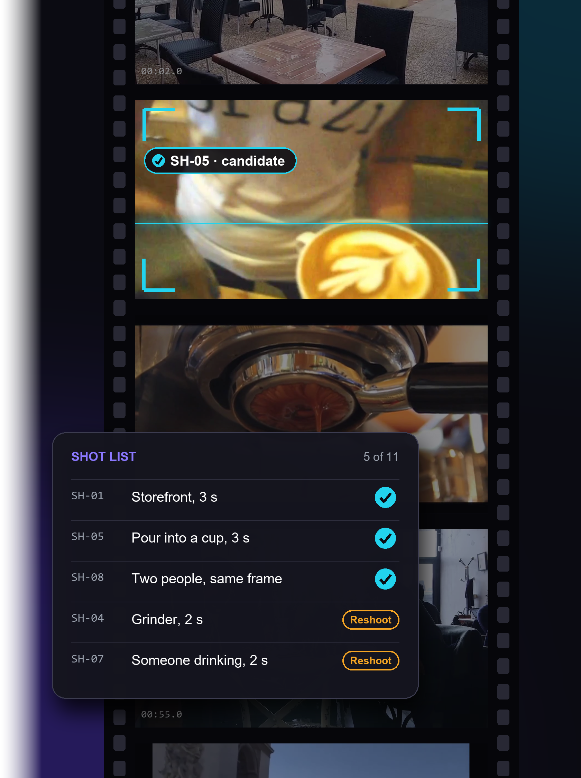
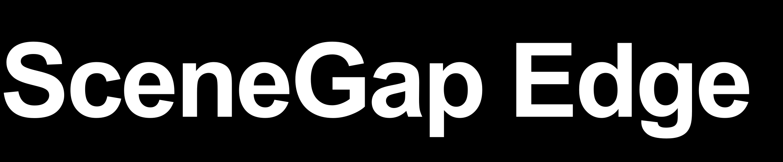
CREATOR AI · LIGHTNING TRACK · ASUS UGEN300
Helps a crew check the shot list against the footage before leaving the location, with playable evidence and a person's decision on every shot.
Runs on your own computer
Evidence for every answer
A person decides
UGen300 port planned
Stage I proposal · rm-rf-1 · github.com/yu9bryan/scenegap-edge

Slide 2

The missing shot is found at 23:00, after the café has closed
PROBLEM
Illustrative scenario · two-person crew, café promo, 11 must-have shots
09:00
Shot list agreed with the client: storefront, interior, beans, grinder, 3 s pour, two barista takes, bag with readable brand.
“We had pours. None of them was three seconds long. We found out in the edit.”
17:40
Wrap. Several cards of footage; nobody has time to watch it all on site.
23:00
The editor scrubs for the pour: every take cuts away after 2 s, and nobody filmed a customer drinking.
Next week
Reshoot day: NT$12,000–28,000 per crew-day in Taiwan, US$800–1,500 per videographer-day in the US, plus café and client again.
Day rates: PRO360 quote statistics (TW), Film Lifestyle mid-level rates (US); docs/research/BUSINESS_FACTS.md.
SceneGap Edge · Stage I

Slide 3
Existing tools find footage; SceneGap adds shot-list rules, evidence and reshoot tracking
PROBLEM
TOOL | FINDS THE MOMENT IN A CLIP | SHOT-LIST RULES (LENGTH, TAKES, SAME FRAME) | RUNS LOCALLY
Premiere Pro media intelligence | yes, In/Out range | not in official docs | yes, on device
DaVinci Resolve 21 IntelliSearch | visual search: whole clips | not in official docs | not stated
Final Cut Pro 12 visual search | yes | not in official docs | not stated
invideo AI script supervisor | not stated | done / pending only | no (upload)
SceneGap Edge | yes, original timecode | checked per rule; a person decides | yes
The difference is the workflow around search: shot list → rules → evidence → a person's decision → reshoot list → re-check.
Vendor documentation, accessed 2026-10-26 (Adobe media intelligence FAQ and others). More tools and prices: A11.
SceneGap Edge · Stage I

Slide 4
What works today, and what still needs proof
PROBLEM
Shown today (live app, real footage)
Not shown yet
Shot list in the crew's words, with rules: length, takes, same frame
Candidate clips with playable evidence on the original timecode
Rule checks: 10 of 12 controlled cases judged right (slide 12)
A person accepts, rejects, or adds the shot to the reshoot list
Demo: 9 Commons clips (5.9 min) analysed in 22 s on a desktop GPU; new footage re-checked file by file
Missing shots on real café video: test 4 met both targets (65% caught, 3.8% wrong reshoots), but on still photos; test 3 video had 12% wrong (slide 15)
Time saved: no user study yet. Proxy: 317 s of candidate clips to play vs 839 s of footage (38%)
UGen300 speed and quality: not run on the device yet
Human-checked labels: current labels are AI-assisted
SceneGap Edge today is a review assistant that keeps evidence and a person's decision; automation grows only as it is proven.
SceneGap Edge · Stage I

Slide 5
From your shot list to a decision you can play back
SOLUTION
1 · Write the shot list
2 · Index footage locally
3 · Check each rule
4 · A person decides
In Chinese, as the crew speaks; a person checks the English search phrase and adds rules. Test list: 11 shots, each with a minimum length; 1 same-frame, 1 two-takes, 1 manual brand check.
Camera cuts, one frame per second on the original timecode, CLIP vectors. Desktop: 2.3 s per minute of video (GPU), 3.1 s (CPU). UGen300 next.
Pass, fail or can't tell per rule; failing clips stay visible. Threshold τ 0.225 set on dev; search over 10,000 segments p95 14 ms.
Accept, reject with a reason, or add to the reshoot list. Only the person's decision counts as done; it is bound to the shot's version.
The AI's four answers (a person's decision is stored separately)
AI ANSWER | MEANING | ON THE 26-CLIP TEST LIBRARY
Candidate | Every rule passes on at least one clip; still needs a person to accept | 10 of 11 shots
Partial | Something matched but a rule failed or can't be decided (too short, one take of two, a manual check) | 1 (SH-10, manual brand check)
Not found | Nothing reached the threshold in the analysed files; not proof of absence | 0; 30 of 38 missing shots still got 'candidate' (slide 15)
Unverifiable | Files failed to decode or are missing, so absence cannot be claimed | 0
SceneGap Edge · Stage I

Slide 6
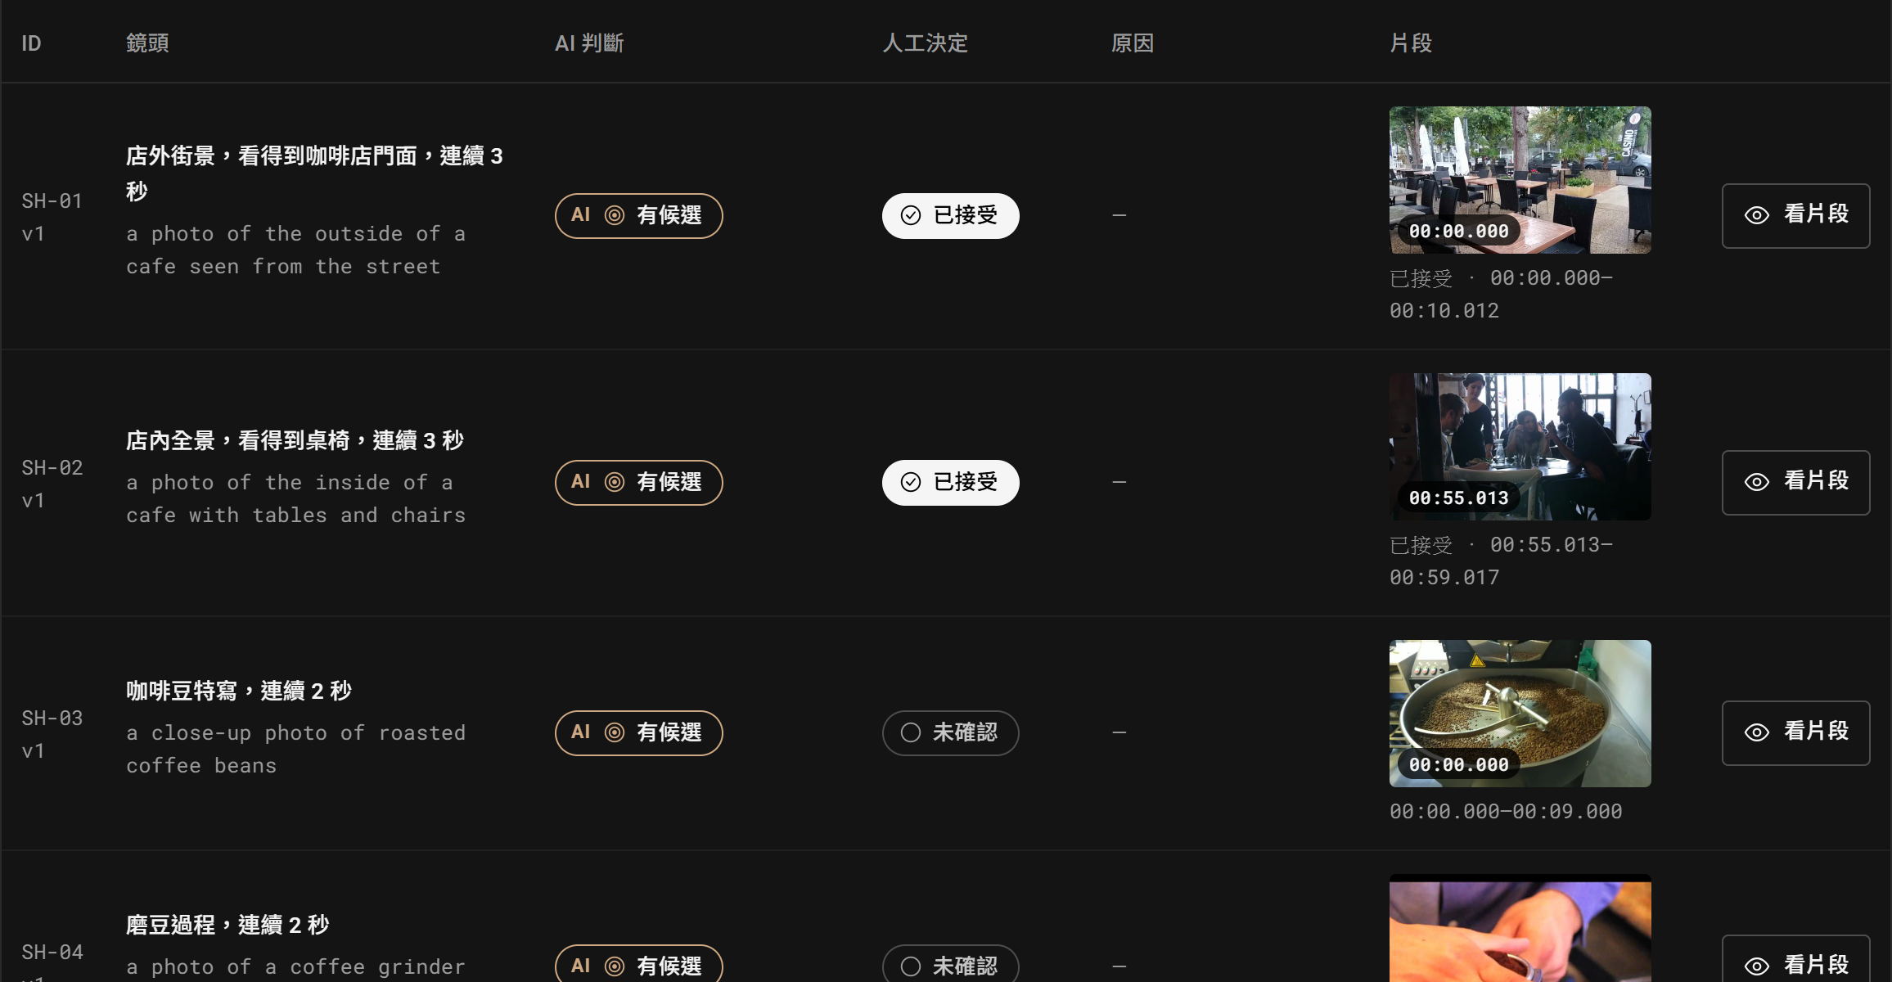
Before leaving, the crew sees which shots are confirmed
SOLUTION
This demo project
9 Commons clips, 5.9 min, analysed in 22 s on a desktop GPU
AI candidate: 10 of 11 shots
Accepted by a person: 5 of 11 (SH-11 needs a second take)
Partial: SH-10 (manual brand check)
Reshoot list: grinder, drinking, coffee bag
Decisions entered as a scripted demo review, not timed
Live app (Coverage page, cropped). Columns: shot · AI answer · person's decision · reason · clip.
SceneGap Edge · Stage I

Slide 7
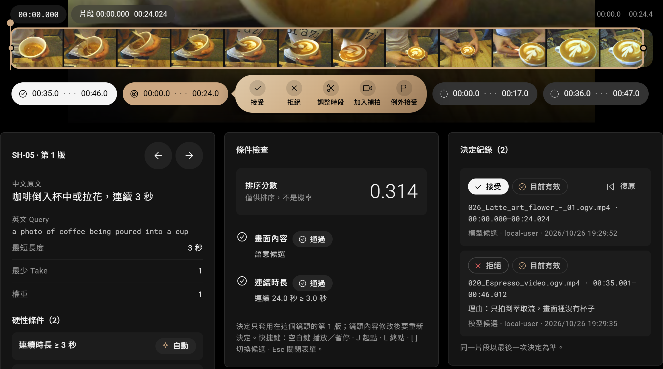
Every answer plays its clip, and a person decides
SOLUTION
SH-05 on this screen
Shot 「咖啡倒入杯中或拉花，連續 3 秒」 as committed before any frame was seen (eval/requirements.json, 10/26 18:09)
Filmstrip and clip ranges on the original timecode
Ranking score 0.314: orders clips, not a probability
Length check 24.0 s ≥ 3 s: how long frames stay close to the query
Log: espresso stream with no cup rejected with a reason; latte-art pour accepted; each can be undone
Live app (clip view, cropped). Original files are never touched.
SceneGap Edge · Stage I

Slide 8
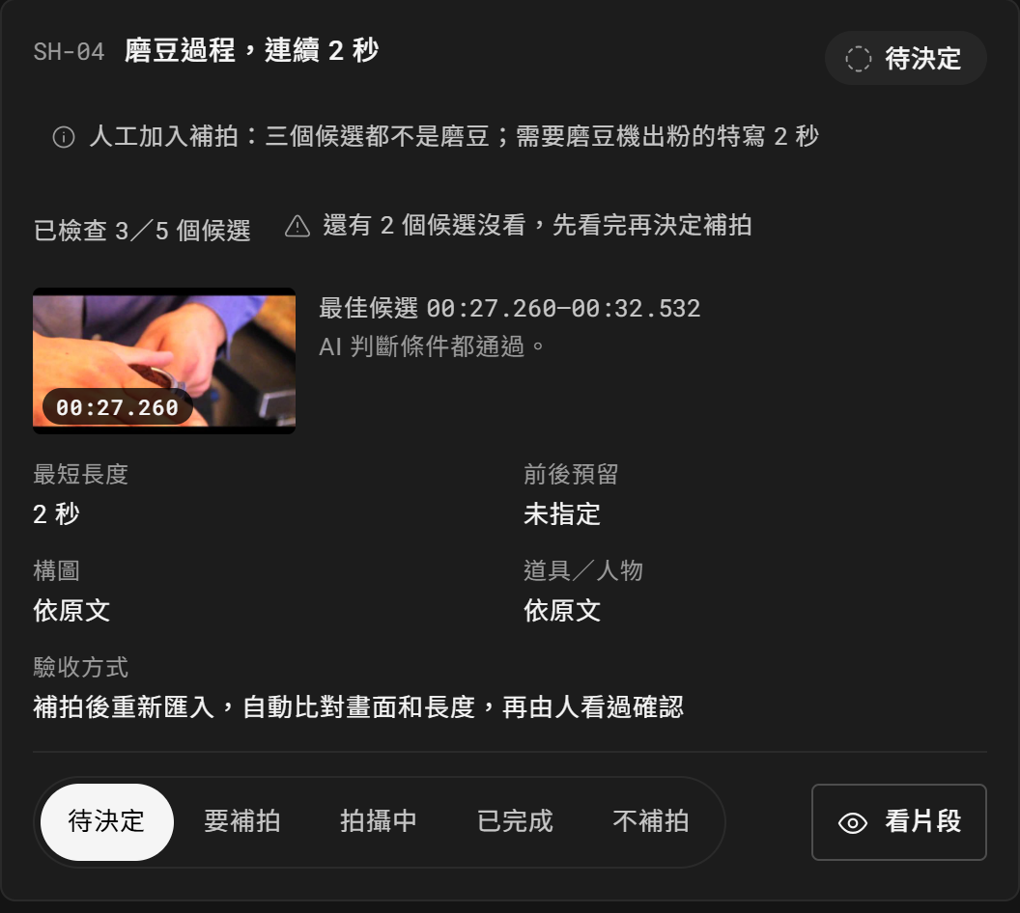
Shots without a usable clip go on the reshoot list
SOLUTION
What the crew gets
One card per shot: why it is missing, the closest clip, minimum length, how it will be checked
The card shows the AI's rules passed; the person decided the clip shows tamping, not grinding
Status: to decide → reshoot → shooting → done / not reshooting
Video demo: the reshot clip was analysed alone in 2.5 s and the grinder shot left the list
The demo review stopped at the top 3; the 4th candidate was a valid grinding clip (next page)
Fixed: the card now shows how many candidates a person checked (已檢查 3／5) and warns when some are unchecked
Live app (reshoot list, SH-04 card). Export: CSV / HTML.
SceneGap Edge · Stage I

Slide 9
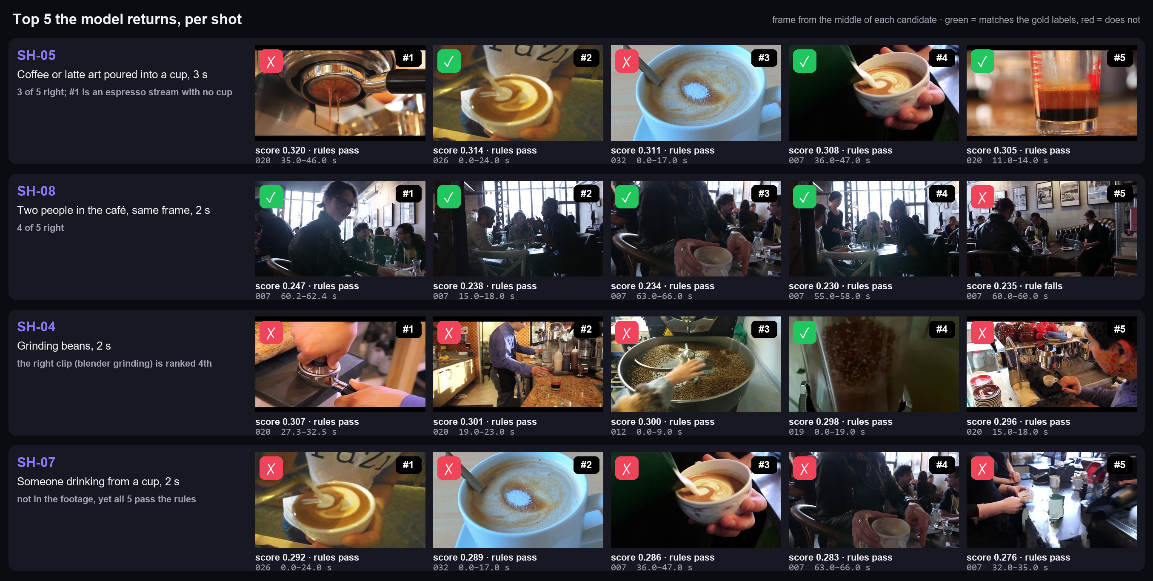
What the model returns: top 5 per shot, checked against labels
EVIDENCE
Read it as
SH-05: right clips are in the list, but #1 is wrong
SH-08: same-frame rule works here (4 of 5)
SH-04: the right clip is 4th; ranking by peak is the fix
SH-07: nothing to find, yet 5 clips pass, so missing shots go undetected
Demo project (9 clips); candidates and scores from the live app; right / wrong from eval/labels/gold.json (≥ 0.5 s overlap). decks/scenegap/fig_top5.py.
SceneGap Edge · Stage I

Slide 10
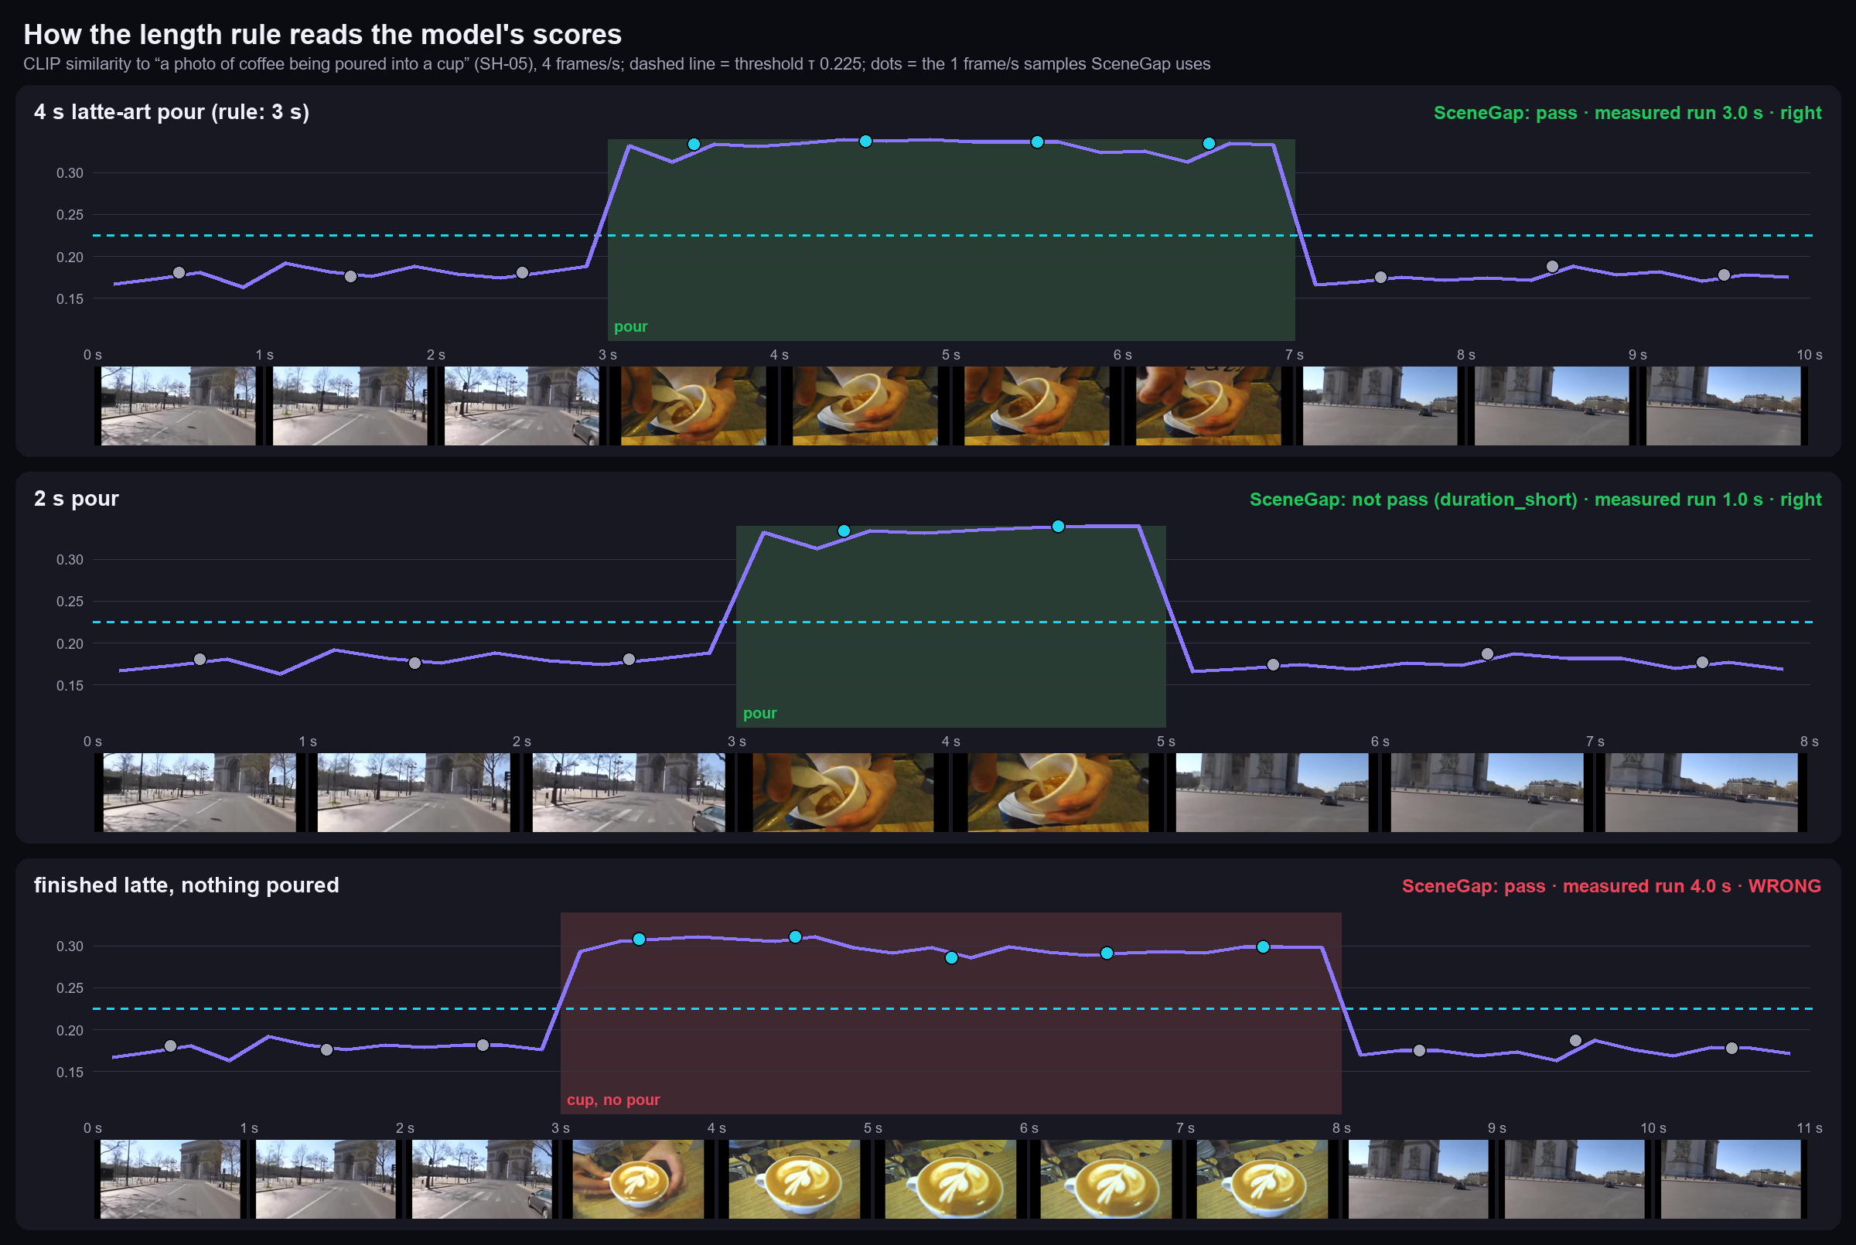
How the length rule reads the model's scores
EVIDENCE
What the curves show
Street frames score about 0.18; the pour about 0.33, well above τ 0.225
SceneGap samples 1 frame per second: a 4 s pour gives 4 samples, a lower bound of 3.0 s, so it passes the 3 s rule
A 2 s pour gives 1.0 s: too short, correctly
A finished latte scores 0.30 with nothing poured: CLIP sees the result, not the action, so a person checks it
Stage II: denser sampling near the edges and an action check for pour-type shots
Rule-check cases cut from real Commons footage (eval/rule_check.py); similarity from the same CLIP model at 4 frames/s. decks/scenegap/fig_curves.py.
SceneGap Edge · Stage I

Slide 11
What each rule measures, and what it cannot tell
EVIDENCE
RULE | WHAT SCENEGAP MEASURES | WHAT IT CANNOT TELL | TODAY
Length | How long frames stay close to the query inside one camera cut (lower and upper bound; re-check every 0.25 s) | Whether the action itself lasts that long; the lower bound runs about 1 s short (4 s pour → 3.0 s) | auto, a person checks
Same frame | Both phrases above the threshold in the same sampled frame | Who is with whom; objects too small for CLIP | auto, a person checks
Takes | Distinct files, by content hash; duplicates of one file are one take | A re-encoded copy of the same take | auto, a person checks
Readable brand | Nothing automatic | Reading text | manual
Not found | Nothing reached the threshold in the analysed files | Proof the shot was never filmed; failed files make it 'can't tell' | auto, scope shown
Dense sampling gives more observations, not certainty: a clip that looks like pouring is still checked by a person.
SceneGap Edge · Stage I

Slide 12
Rule check: 10 of 12 right; both misses are false acceptances
EVIDENCE
CASE (REAL COMMONS FOOTAGE, CUT TO A KNOWN ANSWER) | SHOULD | SCENEGAP | MEASURED RUN (S) | FILES / TAKES | RIGHT?
SH-05 · continuous 4 s latte-art pour | pass | pass | 3.0 | 1 / 1 | yes
SH-05 · 6 s pour from a different shoot | pass | pass | 5.0 | 1 / 1 | yes
SH-05 · pour lasts only 2 s (rule: 3 s) | not pass | not pass (duration_short) | 1.0 | 1 / 0 | yes
SH-05 · two 2 s pours split by another shot | not pass | not pass (duration_short) | 1.0 | 1 / 0 | yes
SH-05 · finished latte, nothing is poured (5 s) | not pass | pass | 4.0 | 1 / 1 | NO
SH-08 · two people at a café table, same frame | pass | pass | 3.0 | 1 / 1 | yes
SH-08 · two people, but outdoors (not in a café) | not pass | not pass (no_candidate) | — | 1 / 0 | yes
SH-08 · two people, then a café interior: separate shots | not pass | not pass (no_candidate) | — | 1 / 0 | yes
SH-11 · one barista clip (rule: 2 takes) | not pass | not pass (takes_short) | 4.0 | 1 / 1 | yes
SH-11 · the same clip copied byte for byte | not pass | not pass (takes_short) | 4.0 | 2 / 1 | yes
SH-11 · the same clip re-encoded (still one take) | not pass | pass | 4.0 | 2 / 2 | NO
SH-11 · two different barista clips | pass | pass | 4.0 | 2 / 2 | yes
Open: an action check (a finished latte passes as 'pouring') and re-encoded-take dedup. Such passes stay 'candidate, a person confirms', never done. eval/rule_check.py, frozen threshold.
SceneGap Edge · Stage I

Slide 13
How we tested: fixed protocol, open footage, AI-assisted labels
EVIDENCE
Protocol and the 11 shots committed before any label; threshold set on dev only; test scored once. Every file below is in the repo.
Footage
Labels
ITEM | VALUE
Source | 44 Wikimedia Commons clips, 25.2 min, H.264 ≤ 1280 px
Dev | 18 clips, 11.2 min: threshold only
Test | 26 clips, 14.0 min: scored once
Distractors | 17 of 44 clips contain none of the 11 shots
Licences | CC BY-SA 19, CC BY 14, CC0 8, public domain 3
Split note | one author pair crosses (022 dev, 025 test); without the 2 projects holding 025, SceneGap still catches 0/31
ITEM | VALUE
Labellers | two independent AI sessions on 1 fps sheets; an AI third pass
Agreement | 472/484 clip × shot pairs (97.5%); κ 0.914 over 16,687 frame samples
Third pass | 143 disputed frame labels decided with 9 written rules
Consistency pass | 78 of 238 agreed positives removed after labelling (65 were SH-11)
Lenient labels | restoring them leaves SceneGap unchanged (7/11, 18/55)
Threshold | τ 0.225: dev F1 0.240, frame precision 14.4%, recall 71.8%
Simulated projects reuse the same clips, so they are not independent shoots. Human-checked labels on the original video come next; details in A5–A7.
SceneGap Edge · Stage I

Slide 14
Right clip in the top 5 for 7 of 11 shots; plain frame search found 8
EVIDENCE
METHOD | RIGHT CLIP IN TOP 5 | TOP-5 PICKS RIGHT
Title keywords (whole clips) | 45% (5/11, CI 21–72%) | 36% (8/22, < 5 returned)
Single-frame search | 73% (8/11, CI 43–90%) | 40% (22/55)
SceneGap, ranked after rule checks | 64% (7/11, CI 35–85%) | 33% (18/55)
Correct clips in the top 5, per shot (of 5)
Why one hit was lost
Lost SH-03 and SH-04, gained SH-06.
Clip 019 is the right answer for both. On its own it passes every rule (5 s and 19 s runs): the rules did not reject it.
Runs are ranked by average similarity; single-frame search uses the peak frame. Stage II ranks by peak.
A hit needs 0.5 s overlap, so this layer does not test the length rule (slide 12 does).
26 held-out clips, 14.0 min, scored once at τ 0.225; Wilson 95% intervals. SH-03 and SH-07 each rest on one 3 s gold clip. Per shot: A5.
SceneGap Edge · Stage I

Slide 15
Missing shots: on test 4 the check layer catches 65% at 3.8% wrong reshoots; both targets met
EVIDENCE
Each test set scored once; targets: caught ≥ 30%, wrong reshoot ≤ 5%
New footage, % of shots
DATA | METHOD | MISSING CAUGHT | WRONG RESHOOT
Test 1 (Oct 26) | system alone | 0/38 (0%) | 0/50 (0%)
Test 2: 24 new clips | check of the top 3 candidates | 32/91 (35%) | 3/41 (7.3%)
Test 3: 39 new clips | check of every second (frozen) | 76/152 (50%) | 8/68 (12%)
Test 3, post hoc | + 3-frame look (simulated) | 76/152 (50%) | 2/68 (2.9%)
Test 4: 150 new photo clips | same check, frozen | 146/226 (65%) | 4/104 (3.8%)
Test 4, preregistered | + 3-frame look (simulated) | 146/226 (65%) | 0/104 (0%)
How: Qwen2-VL-2B answers each shot's check question ('Is ground coffee coming out of a grinder?') for every 1 s frame; 2 confirmed seconds in a row = present.
Test 3's 8 wrong reshoots were borderline frames, so each alert shows the 3 most likely frames; test 4 then scored that look as a preregistered metric, simulated from the labels (assumes the person recognises the shot; not a user test).
Test 4 is Commons photos as 4 s clips: fresh images, but no motion or cuts. Upper 95% bound on wrong reshoots: 9.5%.
Labels: two AI passes and a blind third (κ 0.93–0.98), not yet checked by people. Next: real café video and a timed user test.
Unit: one shot in one simulated 8-clip project. eval/PROTOCOL.md (Stage 1.5–1.7); eval/verify16.py; eval/verify16_evidence.py; A8.
SceneGap Edge · Stage I

Slide 16
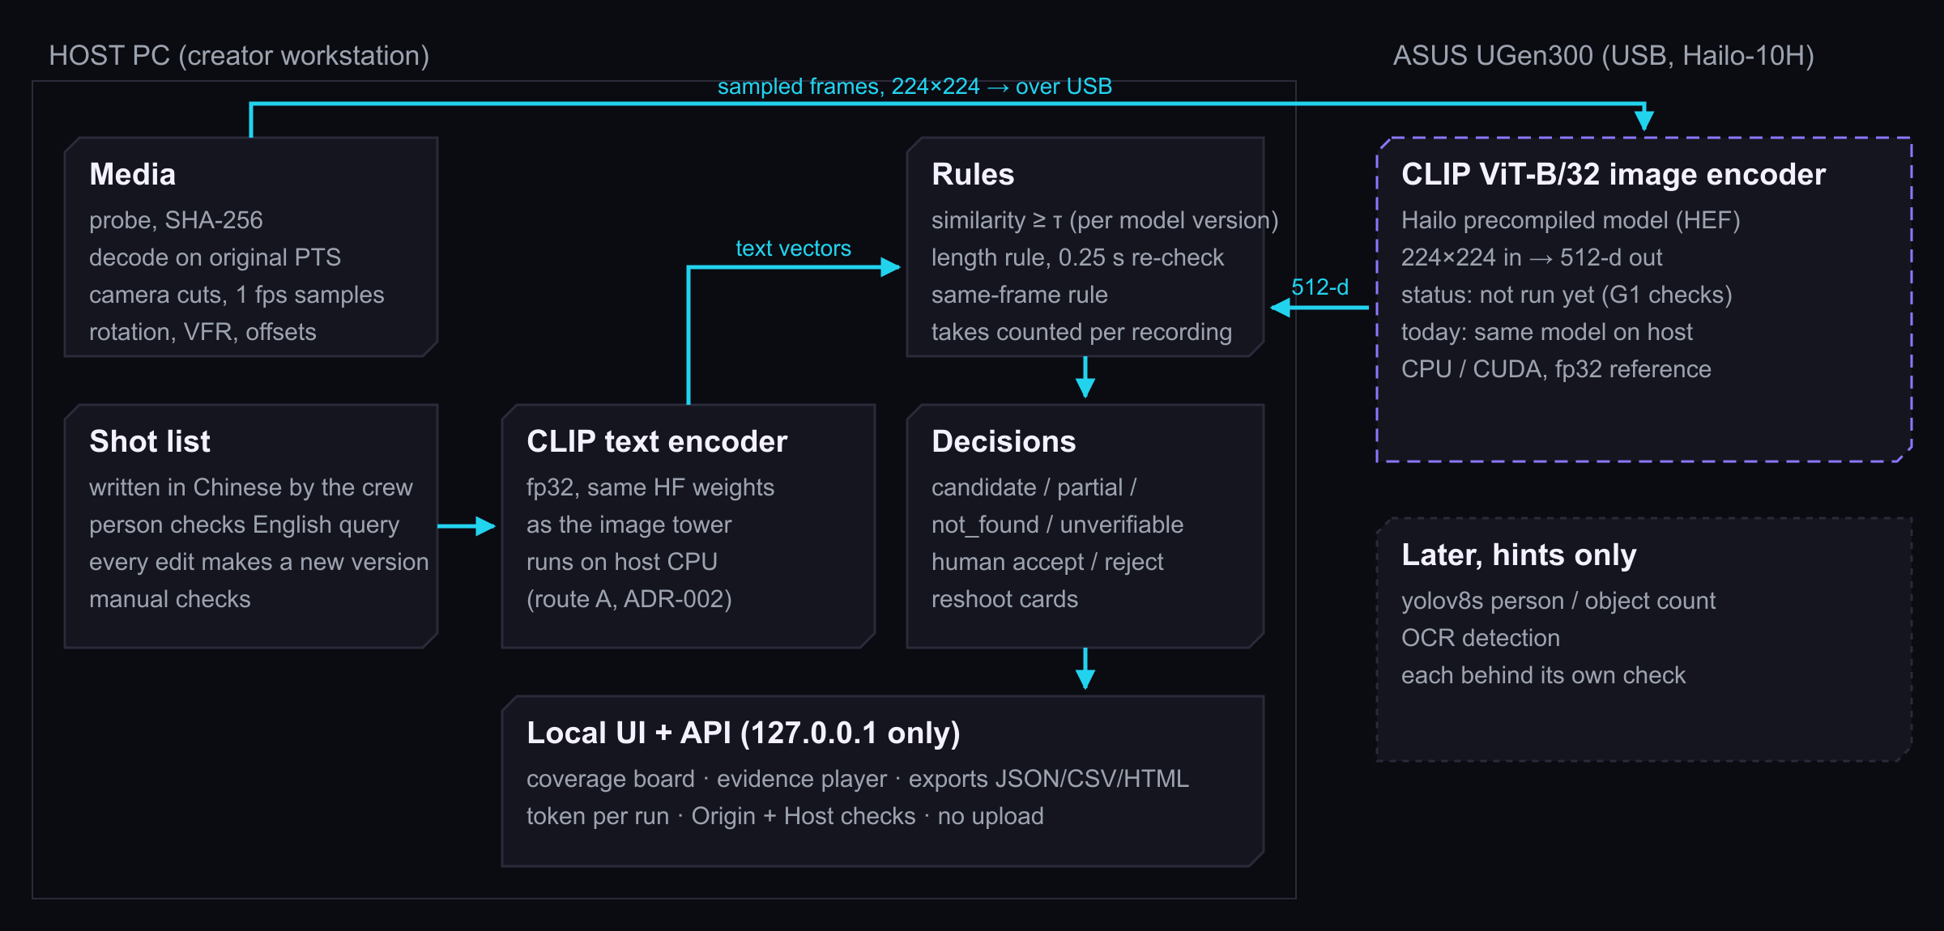
Plan: the image half of CLIP on the UGen300; the PC keeps the rest
HARDWARE
ASUS UGen300
ITEM | VALUE
Chip | Hailo-10H
AI performance | 40 TOPS INT4 / 20 TOPS INT8
Memory | 8 GB LPDDR4, 4266 MT/s
Link | USB 3.1 Gen2 Type-C, 10 Gbps
Power / size | 2.5 W typical; 105 × 50 × 18 mm, 150 g
OS | Windows, Linux, Android (no macOS listed)
Price | $299.99 USB 8 GB (reported)
CLIP ViT-B/32 image encoder | 81.5 / 350 FPS at batch 1 / 8 (Hailo zoo, PCIe)
Second device job: the missing-shot verifier, Qwen2-VL-2B, which Hailo lists for Hailo-10H (slide 15). Frames over USB: about 9 MB per minute (estimate). Both models must pass G1-style checks against the PC first (A1). Demo PC: Windows 11, RTX 4080; Mac: CPU only.
BUSINESS_FACTS.md §2 (ASUS spec; price reported by CNX Software), MODEL_PLAN.md §2, §6; Hailo Model Zoo measures over PCIe, not USB.
SceneGap Edge · Stage I

Slide 17
Measured: decoding is 2.1 of the 2.3 s per minute; a UGen300 would free the GPU or a laptop CPU
HARDWARE
CLIP index, s per minute of video (check layer not timed)
Model and search
BACKEND | MODEL SPEED | MODEL LOAD | SEARCH P50 / P95 (10,000 SEGMENTS)
CPU | 61.5 frames/s | 6.51 s | 11.77 / 14.29 ms
RTX 4080 | 365 frames/s | 1.88 s | 7.61 / 13.39 ms
UGen300 (vendor) | 81.5 / 350 FPS (batch 1 / 8, PCIe) | not run | not run
Playing a 1080p30 test pattern while analysing (budget 33.3 ms)
ANALYSIS | LATE FRAMES | FRAME WORK P95 | ANALYSES FINISHED
none | 0 / 1,800 | 5.7 ms | 0
CPU | 0 / 1,800 | 7.5 ms | 22
GPU | 0 / 1,800 | 6.2 ms | 52
The model is 32% of the CPU run and 7% of the GPU run. Stage II measures an editing app alone vs with CPU, GPU or UGen300 analysis.
eval/results/perf.json (six short clips, 85 s, ≤ 1280 px, warm model; import and hashing not timed), interference.json (synthetic test pattern, not an editing app).
SceneGap Edge · Stage I

Slide 18
Sourced: who pays first is 1–3 person crews and freelance editors
BUSINESS
US floor (BLS OOH, 2025)
Segments (PRD 4.1)
SEGMENT | SIZE SIGNAL | MUST HOLD TRUE
1–3 person crews (first) | ≈ 11,400 self-employed US camera operators; TW crew-day NT$12,000–28,000 | they write a shot list and carry a computer on site
Freelance editors (first) | ≈ 13,800 self-employed US editors; median $75,420/yr | client briefs are specific; a pickup can still be arranged
Student teams | no data | will check a little by hand
Brand content producers | 91% of businesses use video (Wyzowl 2026, partial) | templates stay stable
BLS is a floor: it leaves out YouTubers and in-house marketing staff. Worldwide, ~50M creators and ~4% professional (Goldman Sachs, partly verified).
US BLS OOH accessed 2026-10-26 (39,400 editors + 32,600 camera operators; 35% self-employed; ~5,600 openings a year); self-employed split is our arithmetic. Day rates per videographer.
SceneGap Edge · Stage I

Slide 19
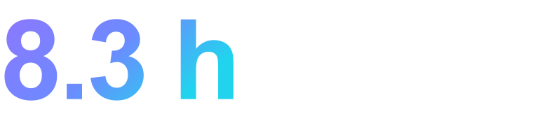
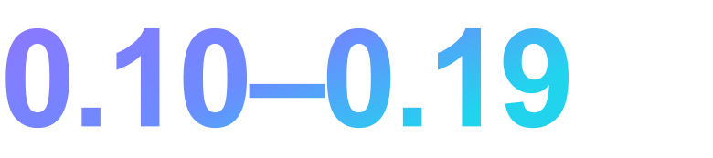
Hypothesis: one prevented reshoot could offset the device cost
BUSINESS
Value = hours saved × hourly cost + reshoot avoided − tool cost
Price per seat, USD per year or one-time
TERM | VALUE USED | STATUS
Hourly cost, editor | $36.26/h = $75,420 ÷ 2,080 h | sourced; 2,080 h assumed
Reshoot day, US, 2 people | $1,600–3,000 = 2 × $800–1,500 | sourced rates; crew of 2 assumed
Reshoot day, Taiwan | NT$12,000–28,000 per crew-day | quote statistics
Tool cost | $299.99 UGen300; core software free | price reported
Hours saved | unmeasured (proxy: 38% of footage to play) | user study, Stage II
Reshoots avoided per project | unmeasured | interviews, Stage II
Open core: the Apache-2.0 checker is free. Paid: a tested UGen300 bundle (installer, driver versions, device-checked model, support) and shot-list templates. Axle FOCUS: $2,995+/yr.
of editor time pays for the device
of one US two-person reshoot day
Device price only: the on-site computer, setup, upkeep and the person's time are extra. Test it: two groups check one card, by hand vs with SceneGap.
BUSINESS_FACTS.md §1c, §2, §4; * vendor page not readable at access. Yearly = 12 × monthly list price.
SceneGap Edge · Stage I

Slide 20
Shown today, proven next
PLAN
SceneGap Edge today: shot list → candidate clips with evidence → a person's decision → reshoot list → re-check, on real footage.
PROOF | TODAY | STAGE II TARGET | SOURCE
1 · Rules | 10 of 12 controlled cases; top 5 right for 7/11; missing shots: test 4 caught 65% at 3.8% wrong reshoots (0% with a simulated 3-frame look; photo clips) | Recall@5 ≥ 90% and wrong reshoot ≤ 5% in the supported scope; ranking by peak; per-shot thresholds | PRD 21.5
2 · Labels | AI-assisted, κ 0.91 | a person labels sampled pairs on the original video | Protocol
3 · People | no study; proxy 38% of footage to play | 3–5 interviews, then 8–12 crews; median task time −30% | PRD 22.1
4 · UGen300 | not run; PC harness cos 1.0000, ρ 0.99999 | G1a cos ≥ 0.98, G1b ρ ≥ 0.95, G1e status ≥ 90%; USB speed, power, editing-app load | MODEL_PLAN §4
5 · Speed | search p95 13–14 ms; CLIP index 2.3 s per minute (GPU); check layer not timed | first result for a 60 s clip ≤ 45 s, timed end to end | PRD NFR-05
6 · Software | 48 automated tests; 30 of 36 acceptance cases pass; clean rebuild passes | the device and user cases (TC-017, 018, 033, 034) | A9, A12
The crew leaves the location with a reshoot list and the evidence a person checked.
SceneGap Edge · Stage I

Slide 21
A1 · G1: six checks before the UGen300 replaces the PC model
APPENDIX
CHECK | MEASURE (DEV FRAMES, SAME PREPROCESSING) | PASS BAR | STATUS
G1a | Cosine, HEF vs fp32 embedding, per frame | median ≥ 0.98, p5 ≥ 0.95 | not run yet
G1b | Spearman ρ of similarity per query | median ≥ 0.95, worst ≥ 0.85 | not run yet
G1c | Top-5 / top-10 shot overlap | ≥ 0.80 / ≥ 0.85 | not run yet
G1d | Dev Hit@5, each backend with its own τ | no dev shot lost vs fp32 | not run yet
G1e | Status agreement on the dev project simulation | ≥ 90% same status; no new 'candidate' on a true gap | not run yet
G1f | Frames/s over USB, 60 s clip end to end | reported, no bar | not run yet
Harness | Same script, CPU vs CUDA fp32 (662 frames, 13 queries; plan ≥ 2,000 / ≥ 40) | ≈ 1.0 expected | cos 1.0000, ρ 0.99999
Vendor: Hailo-10H ViT-B/32 image encoder, CIFAR-100 zero-shot 65.3 float → 64.5 on chip (PCIe, not USB).
docs/MODEL_PLAN.md §2, §4; eval/results/g1_selfcheck.json; Hailo Model Zoo (vendor figures).
SceneGap Edge · Stage I

Slide 22
A1b · After G1: product-level checks on the device
APPENDIX
CHECK | WHAT IT PROTECTS AGAINST | STATUS
Status agreement, UGen300 vs PC, on dev projects | quantisation causing more false acceptances | not run yet
USB end-to-end analysis time for a 60 s clip | a device that is fast in the zoo but slow over USB | not run yet
Editing-app playback and scrubbing with analysis on the device | claiming host relief without measuring it | not run yet
Whole-system extra power (meter at the wall) | quoting 2.5 W as the system's cost | not run yet
Missing shots caught and wrong reshoots on new footage, verifier on the device | judging the device by matching vectors alone | not run yet
Model agreement (G1) is necessary, not sufficient: the product effect is measured on new footage.
SceneGap Edge · Stage I

Slide 23
A2 · What could break, and what we do then
APPENDIX
RISK | FALLBACK
HEF fails G1 (quantisation hurts ranking) | Recalibrate with dev frames; TinyCLIP; else ship the CPU/GPU version and say so
A borderline camera cut splits a long take | The length check says 'can't tell', not 'too short'; the cut is shown
One global threshold fits some shots badly | One threshold per model version now; per type of shot next, set on dev
English phrase drifts from the Chinese shot | A person checks the phrase; a multilingual model only after its own check
AI-assisted labels, Commons footage, small test | Intervals shown; Stage II adds human labels and self-shot projects
Crews will not write shot lists | Templates; the interviews check this first
SceneGap Edge · Stage I

Slide 24
A3 · Stage II order: rules and people first, then the device
APPENDIX
Wk 1–2
Wk 2–3
Wk 3–5
Wk 4–6
Wk 6+
Rules and labels
Missing shots
User study
UGen300
Chinese queries
More controlled cases; a person labels sampled pairs on the original video; rank runs by peak.
Per-shot thresholds with a project-level target; preregister, score once on new footage.
3–5 interviews, then 8–12 crews: by hand vs SceneGap, counterbalanced; time, misses, wrong reshoots.
G1 on the device; editing-app load with CPU, GPU or UGen300 analysis.
A multilingual model (SigLIP 2), adopted only if it finds as many dev shots.
SceneGap Edge · Stage I

Slide 25
A4 · Footage shown in this deck
APPENDIX
# | WIKIMEDIA COMMONS FILE | AUTHOR | LICENCE
001 | Vichy - Grand Café, terrasse sous la grêle.ogv | Romainbehar | CC0
007 | Café Lomi, Paris - Vimeo.webm | ideafarm films | CC BY 3.0
012 | Kaffe - Ystad-2024.ogg | Jonn Leffmann | CC BY 3.0
016 | Lions Almelo zamelt koffie in voor Voedselbank.webm | AAVISIE | CC BY 3.0
019 | MoliendoCafeEnLicuadora ohs02.webm | PetrohsW | CC BY-SA 4.0
020 | Espresso video.ogv | Rosatrieu | CC BY-SA 3.0
026 | Latte art flower - 01.ogv | Anna Frodesiak | CC0
032 | Sugar falling into coffee.webm | Anselm Schüler | CC BY-SA 4.0
041 | Empty Streets of Paris COVID19.webm | CreatorsCloud | CC BY 3.0
Screenshots and cover frames come from these clips. All 44 clips used in the evaluation, with links: docs/CREDITS.md.
SceneGap Edge · Stage I

Slide 26
A5 · The 11 shots and per-shot results (correct / returned, top 5)
APPENDIX
SHOT | IN ENGLISH | RULE | TEST CLIPS WITH GOLD | SCENEGAP | SINGLE-FRAME | KEYWORDS | MISSING IN PROJECTS
SH-01 | Storefront from the street | ≥ 3 s | 3 (36 s) | 2/5 ✓ | 3/5 ✓ | 1/2 ✓ | 3 of 8
SH-02 | Café interior, tables | ≥ 3 s | 2 (39 s) | 2/5 ✓ | 4/5 ✓ | 1/4 ✓ | 1 of 8
SH-03 | Coffee-bean close-up | ≥ 2 s | 1 (3 s) | 0/5 | 1/5 ✓ | 0/3 | 6 of 8
SH-04 | Grinding beans | ≥ 2 s | 2 (18 s) | 0/5 | 1/5 ✓ | 1/1 ✓ | 6 of 8
SH-05 | Coffee or latte art poured | ≥ 3 s | 6 (48 s) | 3/5 ✓ | 2/5 ✓ | 3/4 ✓ | 1 of 8
SH-06 | Cup of coffee on a table | ≥ 2 s | 8 (46 s) | 1/5 ✓ | 0/5 | 0/5 | 0 of 8
SH-07 | Someone drinking | ≥ 2 s | 1 (3 s) | 0/5 | 0/5 | 0/0 | 8 of 8
SH-08 | Two people, same frame | ≥ 2 s, same frame | 3 (56 s) | 4/5 ✓ | 4/5 ✓ | 0/0 | 1 of 8
SH-09 | Espresso extraction | ≥ 2 s | 2 (30 s) | 1/5 ✓ | 2/5 ✓ | 2/3 ✓ | 4 of 8
SH-10 | Bean bag, brand readable | ≥ 1 s, brand (manual) | 2 (4 s) | 0/5 | 0/5 | 0/0 | 6 of 8
SH-11 | Barista, 2 takes | ≥ 3 s, 2 takes | 5 (74 s) | 5/5 ✓ | 5/5 ✓ | 0/0 | 2 of 8
eval/requirements.json, eval/labels/gold.json, eval/results/test_metrics.json. ✓ = a correct clip in the top 5.
SceneGap Edge · Stage I

Slide 27
A6 · Labels: agreement, third pass and the consistency pass
APPENDIX
Agreement between the two AI annotators
Consistency pass (added after labelling, before calibration)
MEASURE | VALUE
Clip × shot pairs agreeing (IoU ≥ 0.5 or both empty) | 472 / 484
Frame samples (1 fps × 11 shots) | 16,687
Both positive / A only / B only | 808 / 46 / 97
Observed agreement / Cohen's κ | 99.1% / 0.914
Disputed labels to third pass | 143
SHOT | AGREED POSITIVES CHECKED | REMOVED | RULE
SH-03 | 17 | 4 | R6
SH-04 | 28 | 9 | R8
SH-09 | 41 | 0 | R2
SH-11 | 152 | 65 | R3
Rules the third pass wrote (examples)
R3 barista: commercial setting, actively preparing coffee
R5 anything poured into the cup → SH-05, not SH-06
R8 grinding: grounds visibly come out of the spout
Only removals were possible; restoring all 78 leaves SceneGap's numbers unchanged (lenient labels, A7).
eval/labels/agreement.json, consistency.json, adjudication_rules.json.
SceneGap Edge · Stage I

Slide 28
A7 · Threshold on dev; lenient labels on test
APPENDIX
Dev sweep (7,282 frame × shot pairs, 432 positive)
Test, with the 78 removed labels restored
τ | TP | FP | FN | PRECISION | RECALL | F1
0.205 | 356 | 2,627 | 76 | 11.9% | 82.4% | 0.2085
0.210 | 351 | 2,374 | 81 | 12.9% | 81.2% | 0.2224
0.215 | 342 | 2,160 | 90 | 13.7% | 79.2% | 0.2331
0.220 | 331 | 1,992 | 101 | 14.2% | 76.6% | 0.2403
0.225 | 310 | 1,837 | 122 | 14.4% | 71.8% | 0.2404
0.230 | 280 | 1,671 | 152 | 14.4% | 64.8% | 0.2350
0.235 | 262 | 1,511 | 170 | 14.8% | 60.6% | 0.2376
0.240 | 239 | 1,370 | 193 | 14.9% | 55.3% | 0.2342
0.245 | 218 | 1,247 | 214 | 14.9% | 50.5% | 0.2298
METHOD | HIT@5 | PRECISION@5 | MISSING CAUGHT
Title keywords | 6/11 (55%) | 9/22 (41%) | 33/37 (89%)
Single-frame | 8/11 (73%) | 22/55 (40%) | 0/37 (0%)
SceneGap | 7/11 (64%) | 18/55 (33%) | 0/37 (0%)
F1 is flat between 0.220 and 0.225; τ 0.225 chosen by the rule written before labels (ties go higher).
Precision stays at 12–15% across the range: no single threshold separates shots well frame by frame.
Centre crop beat padding by 0.0035 F1 (center-crop 0.2404, pad-square 0.2369).
eval/results/calibration.json, test_metrics.json (sensitivity_lenient_gold).
SceneGap Edge · Stage I

Slide 29
A8 · Missing-shot trade-off on dev (not used to rescore)
APPENDIX
SCORE | SETTING | MISSING CAUGHT | WRONG RESHOOT | 'FOUND' WHEN ABSENT
raw cosine | τ 0.225 | 5/89 (6%) | 0/131 (0%) | 80/89 (90%)
raw cosine | τ 0.24 | 13/89 (15%) | 7/131 (5%) | 71/89 (80%)
raw cosine | τ 0.27 | 24/89 (27%) | 14/131 (11%) | 65/89 (73%)
raw cosine | τ 0.285 | 32/89 (36%) | 22/131 (17%) | 49/89 (55%)
raw cosine | τ 0.29 | 41/89 (46%) | 40/131 (31%) | 37/89 (42%)
raw cosine | τ 0.3 | 46/89 (52%) | 62/131 (47%) | 37/89 (42%)
margin over generic prompts | 0.0 | 6/89 (7%) | 0/131 (0%) | 76/89 (85%)
margin over generic prompts | 0.0075 | 11/89 (12%) | 0/131 (0%) | 70/89 (79%)
margin over generic prompts | 0.02 | 16/89 (18%) | 7/131 (5%) | 66/89 (74%)
margin over generic prompts | 0.0475 | 29/89 (33%) | 14/131 (11%) | 51/89 (57%)
margin over generic prompts | 0.05 | 30/89 (34%) | 14/131 (11%) | 51/89 (57%)
eval/results/explore_dev_gap_tradeoff.json: 20 dev projects × 8 clips. Margin = similarity minus the best of 6 generic prompts.
SceneGap Edge · Stage I

Slide 30
A9 · Acceptance cases: 30 of 36 pass by automated check
APPENDIX
STATUS | COUNT | CASES (TC-)
pass | 30 | 001, 002, 003, 004, 005, 006, 007, 008, 009, 010, 011, 012, 013, 014, 016, 019, 020, 021, 022, 023, 024, 025, 026, 027, 028, 029, 030, 031, 035, 036
not applicable | 1 | 015
not run | 1 | 017
partial | 1 | 018
measured | 1 | 032
proxy | 1 | 033
manual check | 1 | 034
48 automated tests; TC-035 is the clean rebuild from the public package index.
eval/results/ACCEPTANCE.md (each case with the test that covers it), clean_env.json.
SceneGap Edge · Stage I

Slide 31
A10 · Hailo-10H model zoo: options for the device
APPENDIX
MODEL (HEF) | ACCURACY, FLOAT → ON CHIP | FPS BATCH 1 / 8 | ROLE
clip_vit_b_32_image_encoder | CIFAR-100 zero-shot 65.3 → 64.5 | 81.5 / 350 | planned: same OpenAI weights as the PC model
clip_vit_b_32_text_encoder | Retrieval@10 90.6 → 89.3 | 48.9 / 98.8 | not planned: text stays on the PC
tinyclip_vit_61m_32 image | 72.8 → 69.8 | 101 / 388 | fallback if G1 fails (new threshold)
siglip2_b_32_256 image | 74.7 → 70.4 | 64.7 / 221 | multilingual option for Chinese shot lists
clip_vit_b_16 image | 68.6 → 64.6 | 51.5 / 158 | finer detail, slower
Qwen2-VL-2B-Instruct (VLM) | listed for Hailo-10H (GenAI zoo) | see vendor page | planned: the missing-shot verifier
At batch 8 the vendor figure (350 FPS) is close to the RTX 4080 we measured (365 frames/s); the device's case is freeing the host, not raw speed.
Hailo Model Zoo, Hailo-10H, PCIe Gen3 ×4 host (not USB); docs/MODEL_PLAN.md §2.
SceneGap Edge · Stage I

Slide 32
A11 · Market and price sources
APPENDIX
FACT | VALUE | SOURCE | VERIFIED
US film and video editors / camera operators | 39,400 / 32,600 (2025); 35% self-employed | US BLS OOH, accessed 2026-10-26 | yes
Median pay, editors / camera operators | $75,420 / $74,990 (May 2025) | US BLS OOH | yes
Day rate, mid-level videographer (US) | $800–1,500 | Film Lifestyle rate guide | yes (estimate)
Event video, full day (Taiwan) | NT$12,000–28,000 | PRO360 quote statistics | yes (estimate)
UGen300 USB 8 GB | $299.99 (M.2 $259.99) | CNX Software; ASUS spec page | partial
Premiere Pro single app / Jumper | $22.99/mo / from $49/mo | Adobe checkout excerpt / Jumper site | no / partial
Resolve Studio / Final Cut Pro | $295 / $299.99 one-time | Blackmagic / Apple | yes
Frame.io Pro / Team; Creator Studio | $15 / $25 per member per month; $129/yr | Frame.io / Apple | yes
Axle AI FOCUS | $2,995–28,995 per year | trade press (IBC 2026) | yes
Creators worldwide | ~50M, ~4% professional | Goldman Sachs | partial
docs/research/BUSINESS_FACTS.md (URLs, access dates and verified flags for every row).
SceneGap Edge · Stage I

Slide 33






A12 · Engineering: 48 tests; 30 of 36 acceptance cases pass
APPENDIX
These show the software is reliable, not that the AI is accurate. Other 6: 1 not applicable, 1 not run, 1 partial, 1 measured, 1 proxy, 1 manual check (needs a UGen300, a detector, or users).
Media edge cases
Logic
Security
Rotation, 29.97 fps, VFR, start offsets, corrupt and unsupported codecs, files still copying, moved files found again by hash.
'Can't tell' stays 'can't tell'; two short clips never count as one long one; duplicates are not two takes; editing a shot voids old decisions.
127.0.0.1 only, per-run token, Origin + Host checks, authorised folders, CSV formula guard, escaped HTML, errors never expose internals.
Offline
Failure
Rebuild
Core flow tested with outbound sockets blocked. Footage never leaves the computer.
Disk full stops safely and resumes; interrupted jobs resume; originals' hashes unchanged.
A fresh venv from the public index passes the test suite; Dockerfile and CI included; Apache-2.0.
eval/results/ACCEPTANCE.md lists all 36 cases with the test that covers each (A9).
SceneGap Edge · Stage I

