Slide 1
热力学基础
习题课

Slide 2

答：B

Slide 3

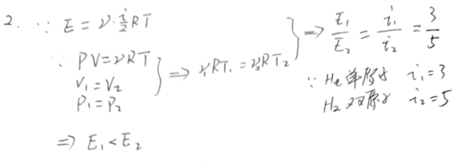
答：C

Slide 4

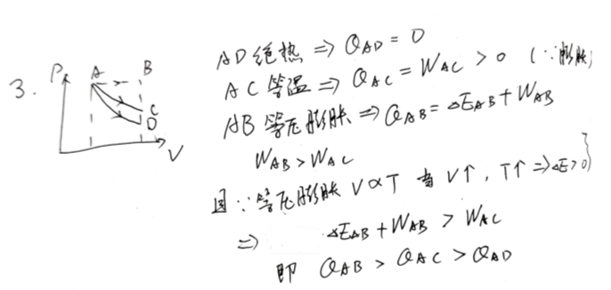
答：A

Slide 5



Slide 6

答：D

Slide 7


答：A

Slide 8
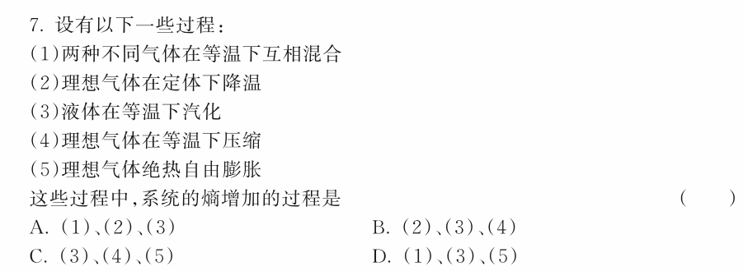
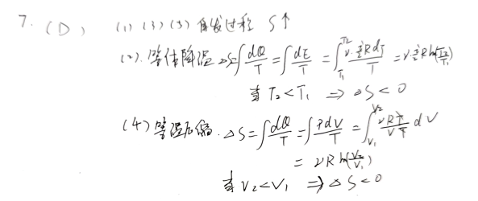

Slide 9


答：C

Slide 10



Slide 12



Slide 14

答：热功转换、热传导

Slide 15

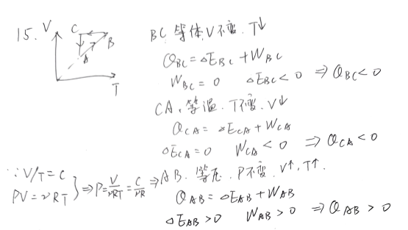
答：A

Slide 16

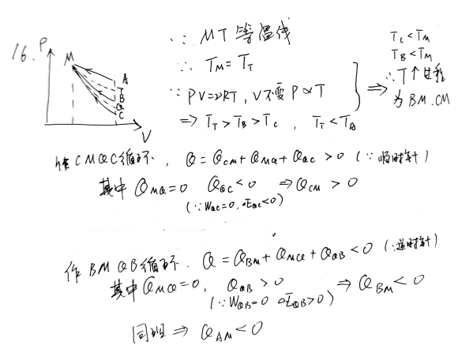

Slide 17

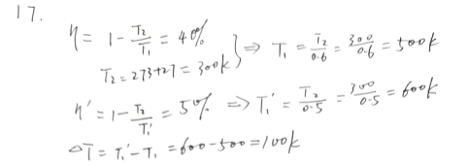

Slide 18

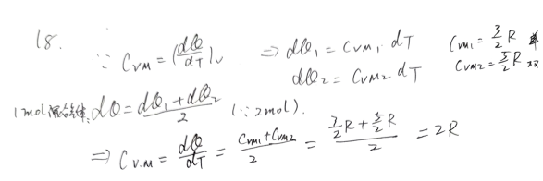

Slide 19

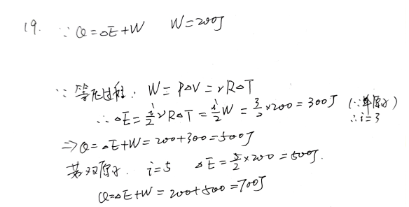

Slide 20



Slide 21

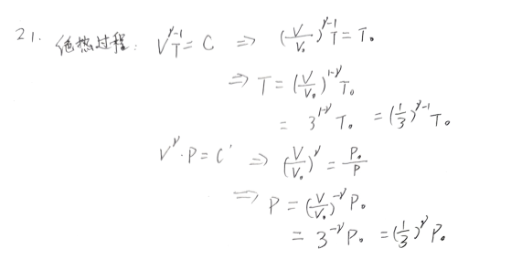

Slide 22
