Slide 1
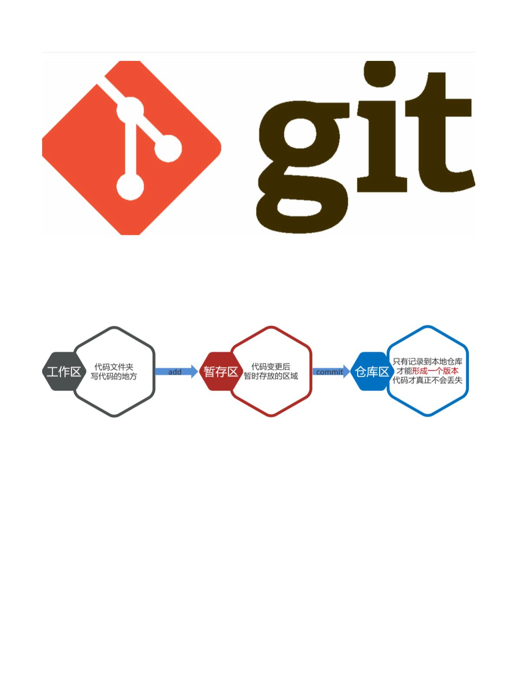
What is Git
Git is a version control system
It helps you keep track of all the ﬁles in a project
Git tracks every change you make
if you make a mistake , it can reset a ﬁle to match a previous version
the collection of all versions of your project ﬁles is known as a Git repoitory
it's basically a folder in which you edit your ﬁles

Slide 2
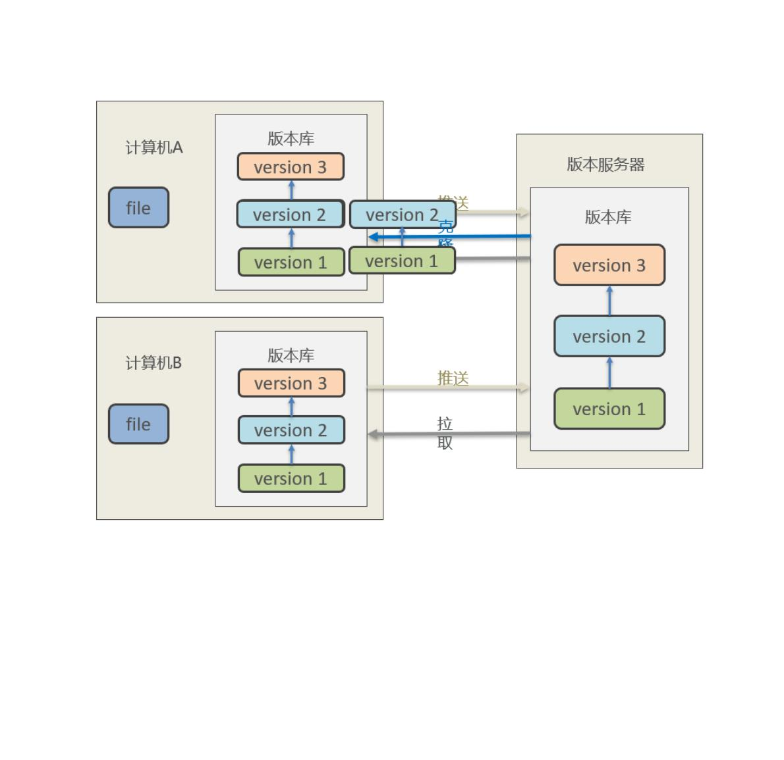
then run Git commands to store your changes and pull in changes from other contributors
Git is used by teams of developers working on a project together
it lets them share changes each person makes and combine those changes to create a ﬁnished project
want to know how to use Git , see www.baidu.com
ꢀ
ꢀ
ꢀ

