Slide 1
Networking in AWS
Xavier Raffin, Solutions Architect AWS
July 17th 2019

Slide 2
Overview
AWS networking services including:
VPC – Extend your network into a virtual private cloud
EIP – Elastic IP
Direct Connect – Physical cross connect into AWS
ELB – Managed load balancer service
Route53 – Managed DNS service

Slide 3
1
Amazon VPC

Slide 4
Amazon Virtual Private Cloud (VPC)
Your own logically isolated section of AWS
Bring your own network:
IP Addresses
Subnets
Network Topology
Routing Tables
Multiple Connectivity Options
Advanced Security Features

Slide 5
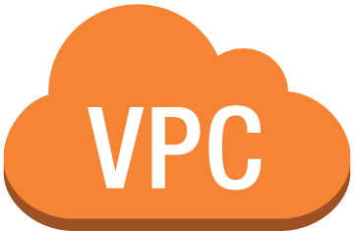
Networking Building Blocks Amazon Virtual Private Cloud (VPC)
Bring your own network
Your Network goes here
VPC – Virtual Private Cloud
Availability Zone A
Availability Zone B

Slide 6
Networking Building Blocks Amazon Virtual Private Cloud (VPC)
Bring your own network
Create your own subnets
Plan CIDRs
VPC Subnet
VPC Subnet
VPC – Virtual Private Cloud
Availability Zone A
Availability Zone B

Slide 7
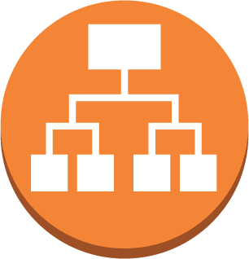


Network Building Blocks Network Control – Security Groups
Anything Else
TCP 443
Inbound Security Group SG-WebELB
Traffic from | Protocol | L4 | Port | Action
0.0.0.0/0 | HTTPS | TCP | 443 | Allow
* | * | * | * | Deny
TCP 80
TCP 80
Inbound Security Group SG-WebTier
Traffic from | Protocol | L4 | Port | Action
SG-WebELB | HTTP | TCP | 80 | Allow
* | * | * | * | Deny
TCP 80
Public Subnet – Web/App Tier
TCP 3306
TCP 3306
Inbound Security Group SG-DatabaseTier
Traffic from | Protocol | L4 | Port | Action
SG-WebTier | MySQL | TCP | 3306 | Allow
* | * | * | * | Deny
TCP 3306
Private Subnet – DB Tier

Slide 8
Network Building Blocks Network Control – Network Access List
Inbound Network ACL
Source | Protocol | L4 | Port | Action
10.0.10.0/0 | TCP | MySQL | 3306 | Allow
* | * | * | * | Deny
10.0.10.0/24
Public Subnet
TCP 3306
*
Outbound Network ACL
Destination | Protocol | L4 | Port | Action
10.0.10.0/0 | TCP | * | * | Allow
* | * | * | * | Deny
10.0.30.0/24
Private Subnet
VPC – Virtual Private Cloud
Notes:
NACLs are stateless (need to explicitly define in and out)
Firewall on the subnet level (one per subnet)
Allow & Deny (blacklist)
Rules are processed in order (separate rules by 100 so you can add more later)
Good for catchall/backstop (no SMTP or telnet ever!)

Slide 9
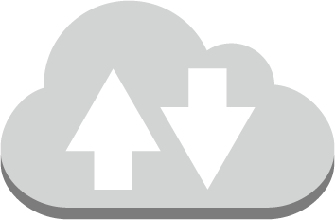
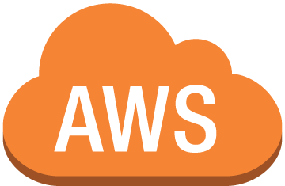




Network Building Blocks Network Control – Route Rules
192.168.0.0/16
10.0.10.0/16
VPC
Public Subnet
10.0.20.0/16
Private Subnet
172.16.0.0/16
VPC – Virtual Private Cloud
AWS Cloud
Corporate Datacenter
Notes:
Because of main route table, all instances can route to other instances in VPC
Routing tables in a VPC are not for intra-VPC communication, but rather to establish routes outside of the VPC.

Slide 10
Network Building Blocks Network Control – Route Rules
Each subnet can have a unique Route Table
Direct traffic out of the VPC
IGW
VGW
VPC Endpoints
Direct Connect
VPC Peering

Slide 11



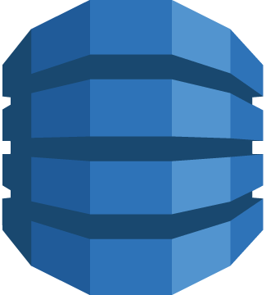



Network Building Blocks VPN – Virtual Private Network (1.25 Gbps max)
API Gateway
Customer Gateway (CGW)
Amazon S3
DynamoDB
2x IPSEC Tunnel
Other AWS Services
VPN Connection
Virtual Private Gateway (VGW)
VPC – Virtual Private Cloud
AWS Cloud
Corporate Datacenter
Notes:
One VGW allowed per VPC

Slide 12

Network Building Blocks AWS Direct Connect (10 Gbps max)
API Gateway
Amazon S3
Public VIF
DynamoDB
Other AWS Services
Private VIF
DirectConnect
VGW
Customer Gateway
VPC – Virtual Private Cloud
WAN
AWS Cloud
DirectConnect Location
Corporate Datacenter
Notes:
VGW is where VPN’s and Direct Connect terminates

Slide 13

Network Building Blocks VPC Gateways – Internet Gateway (IGW)
Public Internet
Internet Gateway
Elastic IP: 198.51.100.2
Private IP: 10.0.10.6
Private IP: 10.0.10.7
Public Subnet
Private IP: 10.0.20.9
Private IP: 10.0.20.9
Private Subnet
VPC – Virtual Private Cloud
AWS Cloud
Notes:
One IGW per VPC – Internet Gateway allows EC2 instances with public or Elastic IPs to communicate with the Internet. You can only assign EIPs or public IPs to public subnets. Private subnets only allow private IPs (can use NAT to get Internet access but we’ll touch on that later)

Slide 14
Network Building Blocks Connecting to Instances – Elastic IP Address
Public Internet
Internet Gateway
Elastic IP: 198.51.100.2
Private IP: 10.0.10.6
Private IP: 10.0.10.7
Public Subnet
Private IP: 10.0.20.9
Private IP: 10.0.20.9
Private Subnet
VPC – Virtual Private Cloud
AWS Cloud
Notes:
One IGW per VPC

Slide 15
Network Building Blocks Connecting to Instances – Load Balancer
Elastic Load Balancer
Public Subnet
Elastic Load Balancer
Private Subnet
VPC – Virtual Private Cloud

Slide 16

Network Building Blocks NAT Gateway
Public Internet
Internet Gateway
NAT Gateway
Public Subnet
Private IP: 10.0.20.9
Private Subnet
VPC – Virtual Private Cloud
AWS Cloud
Notes:
NAT Gateways allow EC2 instances in private subnets to communicate with the Internet

Slide 17


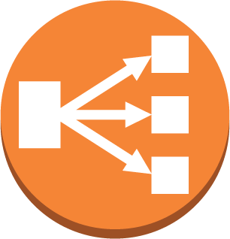
How to connect to public AWS Services? VPC Endpoints
API Gateway
Private IP: 10.0.0.6
VPC Endpoint
Endpoint Service
3rd Party Service
Public Subnet
VPC – Virtual Private Cloud
Private IP: 10.0.0.6
VPC Endpoint
Amazon S3
Private Subnet
VPC Endpoint
DynamoDB
VPC – Virtual Private Cloud
AWS Cloud
Notes:
You can use a network address translation (NAT) gateway to enable instances in a private subnet to connect to the internet or other AWS services, but prevent the internet from initiating a connection with those instances. For more information about NAT, see NAT.
A NAT gateway has the following characteristics:
A NAT gateway supports bursts of up to 10 Gbps of bandwidth. If you require more than 10 Gbps bursts, you can distribute the workload by splitting your resources into multiple subnets, and creating a NAT gateway in each subnet.
You can associate exactly one Elastic IP address with a NAT gateway. You cannot disassociate an Elastic IP address from a NAT gateway after it's created. To use a different Elastic IP address for your NAT gateway, you must create a new NAT gateway with the required address, update your route tables, and then delete the existing NAT gateway if it's no longer required.
A NAT gateway supports the following protocols: TCP, UDP, and ICMP.
You cannot associate a security group with a NAT gateway. You can use security groups for your instances in the private subnets to control the traffic to and from those instances.
You can use a network ACL to control the traffic to and from the subnet in which the NAT gateway is located. The network ACL applies to the NAT gateway's traffic. A NAT gateway uses ports 1024–65535. For more information, see Network ACLs.
When a NAT gateway is created, it receives a network interface that's automatically assigned a private IP address from the IP address range of your subnet. You can view the NAT gateway's network interface in the Amazon EC2 console. For more information, see Viewing Details about a Network Interface. You cannot modify the attributes of this network interface.
A NAT gateway cannot be accessed by a ClassicLink connection associated with your VPC.
https://docs.aws.amazon.com/AmazonVPC/latest/UserGuide/vpc-nat-gateway.html

Slide 18
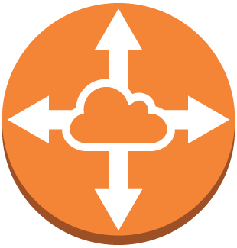
How to connect to another VPC? VPC Peering
Private IP: 10.0.10.0
Private IP: 192.168.10.0
Public Subnet
Public Subnet
VPC Peering
Private IP: 10.0.20.0
Private IP: 192.168.20.0
Private Subnet
Private Subnet
VPC – Virtual Private Cloud
VPC – Virtual Private Cloud
AWS Cloud

Slide 19
Recap
Create VPC
Create Subnets – Across Multiple AZ’s
Configure Route Tables
Create Gateways – IGW and VGW (VPN and DX)
Configure Security – Security Groups and NACLs
Create VPC Endpoints
Create NAT Gateway
Configure VPC Peering
Create Instances

Slide 20
2
Direct Connect

Slide 21
How to connect to my Datacenter to AWS? Dedicated Connection - AWS Direct Connect
API Gateway
Amazon S3
Public VIF
DynamoDB
Other AWS Services
Private IP: 172.16.0.0/24
DirectConnect
Private VIF
Customer Gateway
VPC – Virtual Private Cloud
WAN
AWS Cloud
DirectConnect Location
Corporate Datacenter
Notes:
You can use a network address translation (NAT) gateway to enable instances in a private subnet to connect to the internet or other AWS services, but prevent the internet from initiating a connection with those instances. For more information about NAT, see NAT.
A NAT gateway has the following characteristics:
A NAT gateway supports bursts of up to 10 Gbps of bandwidth. If you require more than 10 Gbps bursts, you can distribute the workload by splitting your resources into multiple subnets, and creating a NAT gateway in each subnet.
You can associate exactly one Elastic IP address with a NAT gateway. You cannot disassociate an Elastic IP address from a NAT gateway after it's created. To use a different Elastic IP address for your NAT gateway, you must create a new NAT gateway with the required address, update your route tables, and then delete the existing NAT gateway if it's no longer required.
A NAT gateway supports the following protocols: TCP, UDP, and ICMP.
You cannot associate a security group with a NAT gateway. You can use security groups for your instances in the private subnets to control the traffic to and from those instances.
You can use a network ACL to control the traffic to and from the subnet in which the NAT gateway is located. The network ACL applies to the NAT gateway's traffic. A NAT gateway uses ports 1024–65535. For more information, see Network ACLs.
When a NAT gateway is created, it receives a network interface that's automatically assigned a private IP address from the IP address range of your subnet. You can view the NAT gateway's network interface in the Amazon EC2 console. For more information, see Viewing Details about a Network Interface. You cannot modify the attributes of this network interface.
A NAT gateway cannot be accessed by a ClassicLink connection associated with your VPC.
https://docs.aws.amazon.com/AmazonVPC/latest/UserGuide/vpc-nat-gateway.html

Slide 22
How to connect to my Datacenter to AWS? Direct Connect, aka DX (1/2)
1 Gbps or 10 Gbps fiber cross connect
50M - 500M available through APN Partners
Single VIF per connection through APN Partners
Consistent Network Performance
Lower latency compared to a VPN connection

Slide 23
How to connect to my Datacenter to AWS? Direct Connect, aka DX (1/2)
Reduced Bandwidth Charges
Public and Private VIF options
Multiple Private VIFs on the 1G or 10G links
BGP Supported

Slide 24
How to connect to my Datacenter to AWS? Dedicated connection + Redundancy
API Gateway
WAN
Customer Gateway
WAN
Amazon S3
Public VIF
DirectConnect
DynamoDB
DirectConnect Location
Other AWS Services
DirectConnect
Private VIF
WAN
Customer Gateway
VPC – Virtual Private Cloud
WAN
AWS Cloud
DirectConnect Location
Corporate Datacenter
Notes:
A NAT gateway has the following characteristics:
A NAT gateway supports bursts of up to 10 Gbps of bandwidth. If you require more than 10 Gbps bursts, you can distribute the workload by splitting your resources into multiple subnets, and creating a NAT gateway in each subnet.
You can associate exactly one Elastic IP address with a NAT gateway. You cannot disassociate an Elastic IP address from a NAT gateway after it's created. To use a different Elastic IP address for your NAT gateway, you must create a new NAT gateway with the required address, update your route tables, and then delete the existing NAT gateway if it's no longer required.
A NAT gateway supports the following protocols: TCP, UDP, and ICMP.
You cannot associate a security group with a NAT gateway. You can use security groups for your instances in the private subnets to control the traffic to and from those instances.
You can use a network ACL to control the traffic to and from the subnet in which the NAT gateway is located. The network ACL applies to the NAT gateway's traffic. A NAT gateway uses ports 1024–65535. For more information, see Network ACLs.
When a NAT gateway is created, it receives a network interface that's automatically assigned a private IP address from the IP address range of your subnet. You can view the NAT gateway's network interface in the Amazon EC2 console. For more information, see Viewing Details about a Network Interface. You cannot modify the attributes of this network interface.
A NAT gateway cannot be accessed by a ClassicLink connection associated with your VPC.
https://docs.aws.amazon.com/AmazonVPC/latest/UserGuide/vpc-nat-gateway.html

Slide 25

How to connect to my Datacenter to AWS? Connect multiple AWS Regions – DX Gateway
Private VIF
VPC – Virtual Private Cloud
AWS Region #1
Direct Connect Gateway
Private VIF
Direct Connect
VPC – Virtual Private Cloud
Customer Gateway
AWS Region #2
WAN
AWS Cloud
DirectConnect Location
Corporate Datacenter
Notes:
You can use a Direct Connect Gateway to establish connectivity that spans Virtual Private Clouds (VPCs) spread across multiple AWS Regions. You no longer need to establish multiple BGP sessions for each VPC; this reduces your administrative workload as well as the load on your network devices.

Slide 26
3
ELB

Slide 27
How to distribute traffic across Instances? Elastic Load Balancing
Elastic Load Balancer
Public Subnet
Public Subnet
Elastic Load Balancer
Private Subnet
Private Subnet
Availability Zone A
Availability Zone B
VPC – Virtual Private Cloud

Slide 28
How to distribute traffic across Instances? Elastic Load Balancer (ELB) – Classic Load Balancer
Layer 4 & Layer 7 Load Balancing
Region level service
Cross AZ
Built-in Health Check
Auto Scaling Integration
SSL Supported
Client SSL Termination
Backend ELB-to-Server mutual SSL
Sticky Sessions

Slide 29
How to distribute traffic across Instances? ELB - Application Load Balancer
Layer 7 Load Balancing
Content-Based Routing (host and path based)
Containerized Application Support (ECS, EKS)
HTTP/2 Support
WebSockets Support
Deletion Protection
Request Tracing
Web Application Firewall (WAF) integration

Slide 30
How to distribute traffic across Instances? ELB - Network Load Balancer
Layer 4 Load Balancing
Connection-based Load Balancing
High Throughput
Low Latency
Preserve source IP address
Static IP and Elastic IP
Long-lived TCP Connections
Ideal for WebSockets
IP addresses as Targets

Slide 31
Elastic Load Balancing Features Comparison
Feature | Application Load Balancer | Network Load Balancer
Protocols | HTTP, HTTPS | TCP
Platforms | VPC | VPC
Health checks | Yes | Yes
CloudWatch metrics | Yes | Yes
Logging | Yes | Yes
Path-Based Routing | Yes
Host-Based Routing | Yes
Native HTTP/2 | Yes
Configurable idle connection timeout | Yes
SSL offloading | Yes
Server Name Indication (SNI) | Yes
Sticky sessions | Yes
Back-end server encryption | Yes
Static IP |  | Yes
Elastic IP address |  | Yes
Preserve Source IP address |  | Yes
Notes:
https://aws.amazon.com/elasticloadbalancing/details/ - has more complete comparison chart

Slide 32
4
Route53

Slide 33

How to direct traffic to my domain? Route 53
Route 53
Main Site healthy?
Yes
No
A/B Testing
95%
5%
App Version A
App Version B
App DR
AWS Region
AWS Region
AWS Cloud

Slide 34
How to direct traffic to my domain? Route 53
AWS DNS service
100% availability SLA
Domain Registration
Domain name resolution
Health Checks
DNS Failover
Latency Based Routing
Geo Based Routing
Weighted Round Robin
Private DNS for VPC
Notes:
Currently 7 Routing Policies:
1) Simple
2) Failover
3) GeoLocation
4) GeoProximity
5) Latency
6) Multi-value answer
7) Weighted Round Robin
See https://docs.aws.amazon.com/Route53/latest/DeveloperGuide/routing-policy.html for complete list of routing policies

Slide 35
Route53
Zone Apex integration
ELB, S3, CloudFront
Private DNS within VPC
Internal DNS names not exposed to Internet
Supports split-horizon DNS
Notes:
Route 53 zone apex (example.com) can be mapped to ELB, S3, and CloudFront
Split-horizon DNS allows different sets of DNS information, depending upon the source address of the DNS request (e.g. external IPs get different answer than internal IPs)

Slide 36

Any Questions?

